Slide 1
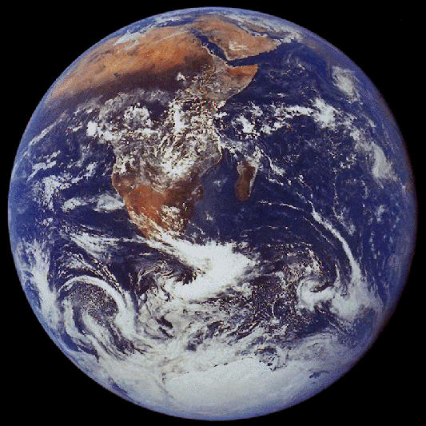
World Disasters
What’s coming next?
Robert C. Newman

Slide 2
Only a century ago…
Many Bible commentators thought the disasters of Biblical prophecy were unrealistic.
So they saw:
Jesus’ descriptions of disaster in Matthew 24 as just the fall of Jerusalem in AD 70;
the strange locusts in Revelation 9 as Turks;
the world as getting better.

Slide 3
Since then…
The 20th century has brought us:
two world wars;
nuclear weapons;
some of the worst totalitarian states in history.
We now have a more sober view of the world situation, and are not so sure the world is getting better!

Slide 4
A Choice of Catastrophes
The title of Isaac Asimov’s non-fiction book published in 1979
He listed some 15 possible disasters
some certainly far in the future
some possibly rather soon
He sorted them into 5 classes:
1: universe becomes uninhabitable
2: solar system becomes uninhabitable
3: earth becomes uninhabitable
4: human life is destroyed
5: civilization is destroyed

Slide 5
Our Talk
Here we want to look at some disasters:
which are impending today, not far in the future;
which are being taken seriously by scientists and politicians.
Our statistics are taken from The World Almanac, Science News, and www.avert.org.

Slide 6
Some Potential Disasters
Nuclear War
Ozone Depletion
Global Warming
AIDS or other epidemics
Earthquakes
Pollution, toxins

Slide 7
Nuclear War
A serious threat from the mid-1950s to 1990, now somewhat reduced.
There are still more than enough armaments around to have a good one.
Don’t know what all the effects would be:
Many killed by blast
Many more by fallout of radiation
Possibility of nuclear winter

Slide 8
Nuclear War
Since the 1990s, the biggest threat has been nuclear proliferation:
Over 30 countries are using nuclear power
A number are seeking to develop weapons
A real possibility of terrorist groups getting weapons or building them
Delivery systems are more of a hurdle, but what about trailer trucks or shipping containers?

Slide 9
Ozone Depletion
Life on earth is protected from deadly UV radiation by a layer of ozone (O₃) in the upper atmosphere.
This is being depleted by several chemicals produced by mankind (various oxides of nitrogen and refrigerants called CFCs).

Slide 10
Ozone Depletion
Already we are now getting a “hole” in the ozone layer in polar regions during part of the year.
The occurrence of skin cancers has risen by nearly 100% since 1980; this may be due to increased UV radiation reaching earth’s surface.

Slide 11
Global Warming
The earth’s climate has long been warmed by a greenhouse effect, so that our surface temperature is about 35º F or 20º C warmer than it would be without this.
But now carbon dioxide and some other gases are accumulating from modern technology, increasing this effect.

Slide 12
Global Warming
CO₂ is up over 10% in 30 years, nitrous oxide is rising 2-3% per decade.
Not sure how much effect this has had on temperatures yet, but hottest years since regular temperature records kept have been in past decade.
If temperature trend of past 20 years continues for next 20, will have warmest weather in past 100,000 years!

Slide 13
Global Warming
Not sure exactly what effects would be, but:
Will probably warm the poles most;
Produce very dry weather in continental interiors, probably messing up agriculture there;
Raise sea level (melting of all glacial ice would raise it about 600 ft).

Slide 14
AIDS, etc.
AIDS (acquired immune deficiency syndrome) is a viral infection that crashes the human immune machinery.
It first spread among homosexuals, then in the IV drug community, and now into the heterosexual population.
Though initially most of the victims were men, now about 48% are women.

Slide 15
AIDS, etc.
Since the disease was first diagnosed in 1981, more than 25 million people have died from AIDS (end of 2006).
The situation has become disastrous in sub-Saharan Africa, where nearly 25 million people have HIV/AIDS, nearly 6% of the population.
It is estimated that about 40 million people have the disease worldwide, and that about 3 million died in 2006.

Slide 16
Earthquakes
The biblical predictions of the end-times mention earthquakes prominently.
Several Christian writers and speakers have claimed the number of earthquakes has increased recently.
There is currently no evidence for more or larger earthquakes, but the damage done by them has increased due to population growth.

Slide 17
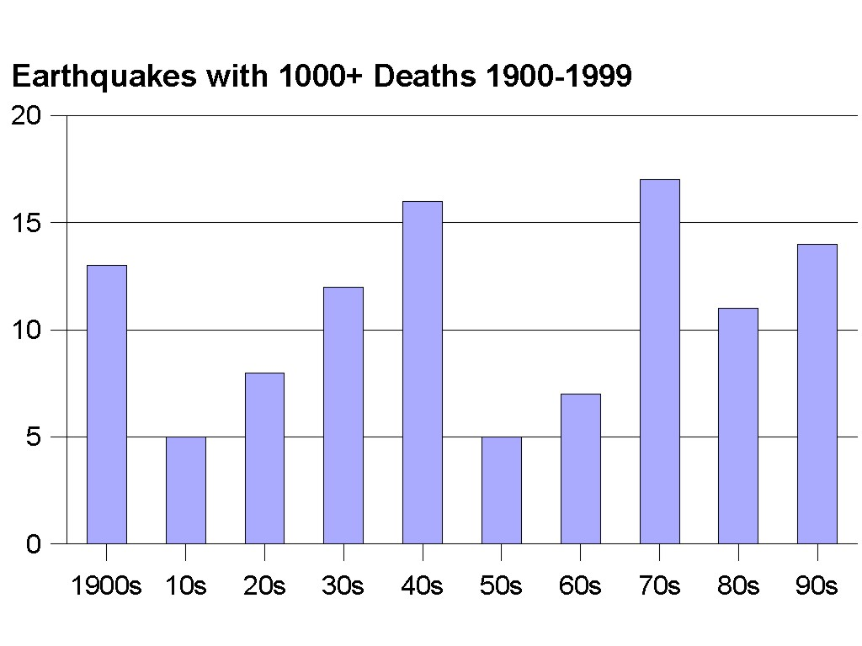
Earthquakes 1900-1999

Slide 18
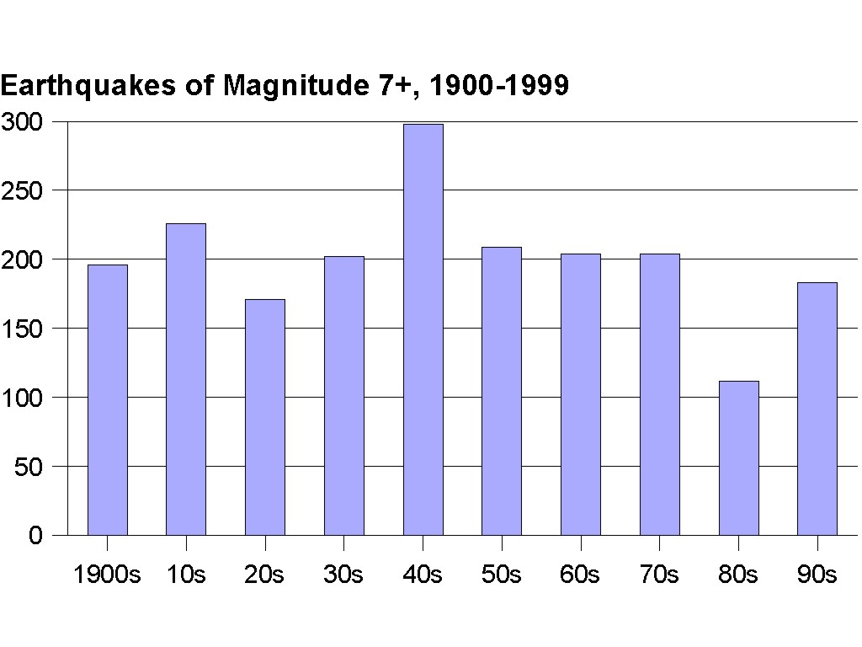
Earthquakes 1900-1999

Slide 19
Pollution, Toxins
Both growing technology and increased terrorist activity could produce disaster here.
Some items:
Modern Americans and Britons have 500-1000 times more lead in their bones than American Indians of 1000 years ago;
Long-term heavy alcohol use damages heart muscles in 1/3, skeletal muscles in almost ½.

Slide 20
Pollution, Toxins
Dioxins (some of the most powerful carcinogens known) have been spread by the paper used in milk cartons and coffee filters.
The poisoned grape scare some years ago was definitely linked to terrorism.
The earlier poisoned medicine scare was surely closely observed by terrorists.

Slide 21
Some Potential Disasters
Nuclear War
Ozone Depletion
Global Warming
AIDS or other epidemics
Earthquakes
Pollution, toxins

Slide 22
How should we respond?
These disasters have some real similarity to those pictured in Matthew 24 and Revelation:
Wars
Famines
Plagues
Earthquakes
Darkness
Sun scorching people
This might be the way God will bring disaster.

Slide 23
How should we respond?
But the Bible pictures even worse disaster ahead for those who continue to live as though God doesn’t exist.
Consider Jesus’ parable of the fruitless fig tree in Luke 13.

Slide 24
Jesus’ Parable
Luke 13:6-9 (NIV) Then he told this parable: “A man had a fig tree, planted in his vineyard, and he went to look for fruit on it, but did not find any. 7 So he said to the man who took care of the vineyard, ‘For three years now I've been coming to look for fruit on this fig tree and haven't found any. Cut it down! Why should it use up the soil?’ 8 ‘Sir,’ the man replied, ‘leave it alone for one more year, and I'll dig around it and fertilize it. 9 If it bears fruit next year, fine! If not, then cut it down.’ ”

Slide 25
Ecological Disaster
A warning of the wrath to come?

