Slide 1
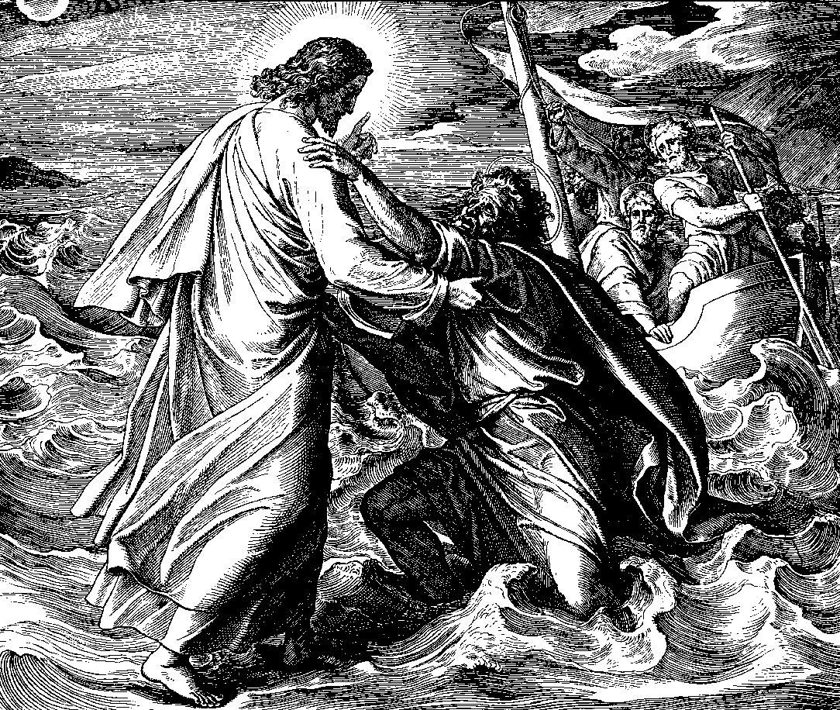
Walking on Water
Robert C. Newman

Slide 2
Matthew 14:22-33
22 (NIV) Immediately Jesus made the disciples get into the boat and go on ahead of him to the other side, while he dismissed the crowd. 23 After he had dismissed them, he went up on a mountainside by himself to pray. When evening came, he was there alone, 24 but the boat was already a considerable distance from land, buffeted by the waves because the wind was against it. 25 During the fourth watch of the night Jesus went out to them, walking on the lake. 26 When the disciples saw him walking on the lake, they were terrified. "It's a ghost," they said, and cried out in fear. 27 But Jesus immediately said to them: "Take courage! It is I. Don't be afraid."
28 "Lord, if it's you," Peter replied, "tell me to come to you on the water." 29 "Come," he said. Then Peter got down out of the boat, walked on the water and came toward Jesus. 30 But when he saw the wind, he was afraid and, beginning to sink, cried out, "Lord, save me!" 31 Immediately Jesus reached out his hand and caught him. "You of little faith," he said, "why did you doubt?" 32 And when they climbed into the boat, the wind died down.
33 Then those who were in the boat worshiped him, saying, "Truly you are the Son of God."

Slide 3
A Nature Miracle
Like several others:
Calming the sea
Water to wine
Multiplying loaves and fish
Tells us something about Jesus:
His power over nature matches the greatest prophets of the Old Testament.
His directness of miracle-working surpasses theirs.

Slide 4
Unusual re/ Peter
Disciples sometimes shared in Jesus' miracles:
Loaves & fish
Casting out demons
This is the most direct one:
Peter doing miracle in Jesus' presence
Almost seems like grandstanding, but Jesus doesn't rebuke Peter for this

Slide 5
What Does It Mean?
Peter is able to accomplish something humanly impossible thru Jesus' empowering him.
Jesus does not rebuke Peter's desire to do this.
Peter begins to waver when he realizes he is out of his depth!
When Peter withdraws his trust from Jesus & begins to fear circumstances, he fails.
Jesus comes to the rescue.

Slide 6
Is This an Acted Parable?
A fairly common feature of OT prophets:
Ahijah rips his cloak (1 Kings 11:29)
Isaiah goes 'naked' (Isa 20:2-6)
Jeremiah smashes clay pot (Jer 19:1-13)
Hosea's marriage (Hosea chs 1-3)
Jonah's gourd (Jon 4:6-11)

Slide 7
Is This an Acted Parable?
Some of Jesus' actions are parabolic:
Foot washing (John 13)
Cleansing temple (John 2, Mark 11)
Some of his miracles are parabolic:
Cursing the fig tree (Mark 11)
Healing the blind man (John 9)
How if we see this miracle as an acted parable also?

Slide 8
Understood as Parable
Not necessarily that Jesus will do miracles thru us (He might!), but …
The Christian life, rightly lived, is like walking on water.
If we really trust Jesus in living our lives, we will come into circumstances and opportunities that are way over our heads.

Slide 9
Understood as Parable
If we quit trusting in Jesus and begin to fear our circumstances, God will let us fail.
If we cling to Him, He will uphold us.
The Christian life is a life of constant trust:
Let us make God our security rather than security our god…
… and God will make our enemies flee before us (even Satan) rather than us flee our enemies (even the weakest ones).

Slide 10
Lesson
Jesus wants us to get out of the boat and join him in a grand adventure that will make our lives exciting and worthwhile in a way that we have hardly even dared to imagine.

