Slide 1
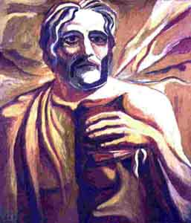
They Saw Jesus … Centuries in Advance!
Dr. Robert C. Newman
Biblical Seminary

Slide 2
Road to Emmaus – Luke 24
After Jesus left them, the two said:
"Were not our hearts burning within us while he talked with us on the road and opened the Scriptures to us?"
What did Jesus say to those two disciples?
We want to make some suggestions based on hints in the NT and important passages in the OT.

Slide 3
Abraham Saw My Day
When Jesus' opponents charged that he was demon-possessed, he responded:
"Your father Abraham rejoiced at the thought of seeing my day; he saw it and was glad." (John 8:56)
What did Abraham see, and when did he see it?
We suggest he saw it during his lifetime and it was recorded in the Bible.

Slide 4
The Covenant Confirmed
In Genesis 15, we have an unusual event.
Abraham asks God how he may know that God's promise of his inheriting the land will come true.
God has him bring three sacrificial animals and cut them in half.
That evening, a smoking firepot & blazing torch pass between the pieces and God repeats the promise.

Slide 5
The Covenant Confirmed
This peculiar event is in fact a covenant confirming ceremony, common in the ancient Near East.
We see a sample in Jeremiah 34:18:
"The men who have violated my covenant and have not fulfilled the terms of the covenant they made before me, I will treat like the calf they cut in two and walked between its pieces."

Slide 6
The Covenant Confirmed
But here in Genesis 15, it is God that passes between the pieces, not Abraham.
God is saying, "I will die rather than let this covenant fail."
That is just what God did!
Jesus died on the cross so that God could be just and still keep his promises to us sinful humans.

Slide 7
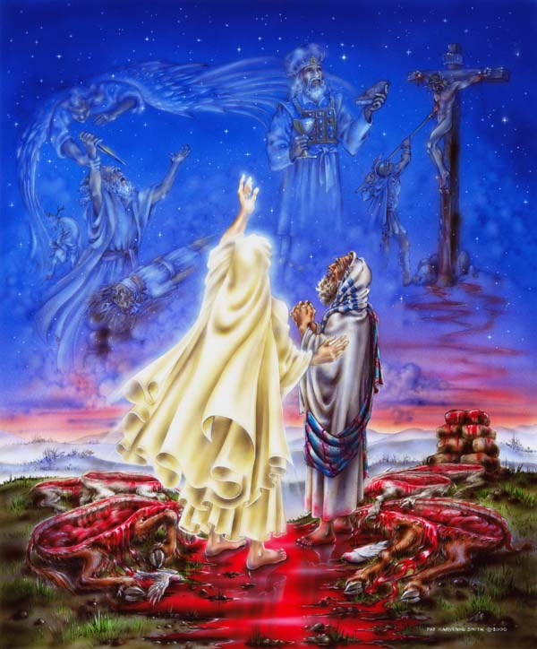

Slide 8
The Sacrifice of Isaac Stopped
In Genesis 22, Abraham is commanded by God to sacrifice his son:
His only son
The son whom he loves
He is just about to do so when an angel stops him.
A substitute is sacrificed instead.

Slide 9
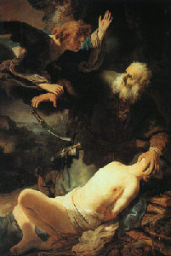

Slide 10
The Sacrifice of Isaac Stopped
This incident ends with an unusual statement in Genesis 22:14:
"So Abraham called that place 'The LORD will provide.' And to this day it is said, 'On the mountain of the LORD it will be provided.'"
Jesus was crucified as a substitute on that very mountain!

Slide 11
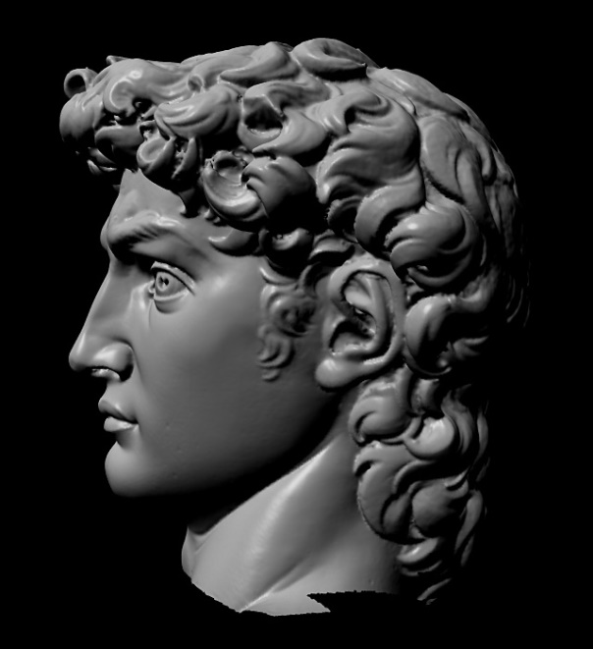
David Saw His Crucifixion
Why did Jesus cry out from the cross:
"My God, my God, why have you abandoned me?"
He was quoting Psalm 22; it tells of one who is:
Abandoned by God
Surrounded by enemies
Hands and feet pierced
Clothes gambled away
Thirsty
Bones out of joint
Laid in the dust of death

Slide 12
Why Have You Abandoned Me?
The psalm goes on to note that God does answer him and rescue him.
These events will be remembered all over the world and down through the generations.
This is just what happened in the crucifixion and resurrection of Jesus!

Slide 13
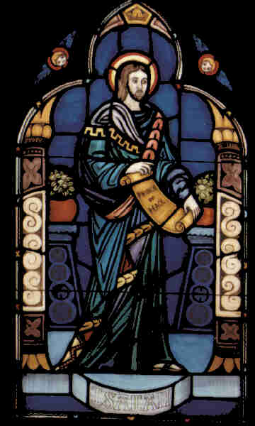
Isaiah Saw His Glory
In John 12:41, the evangelist tells us:
"Isaiah said this because he saw Jesus' glory and spoke about him."
Where does Isaiah do this?
We have time here for two passages only.

Slide 14
A Light to the Gentiles
Isa 49:1-5 (NIV) Listen to me, you islands; hear this, you distant nations: Before I was born the LORD called me;
from my birth he has made mention of my name. 2 He made my mouth like a sharpened sword, in the shadow of his hand he hid me; he made me into a polished arrow and concealed me in his quiver. 3 He said to me, "You are my servant, Israel, in whom I will display my splendor." 4 But I said, "I have labored to no purpose; I have spent my strength in vain and for nothing. Yet what is due me is in the LORD's hand,
and my reward is with my God." 5 And now the LORD says—
he who formed me in the womb to be his servant to bring Jacob back to him and gather Israel to himself, for I am honored in the eyes of the LORD and my God has been my strength—

Slide 15
A Light to the Gentiles
Isa 49:6-7 (NIV) he says: "It is too small a thing for you to be my servant to restore the tribes of Jacob and bring back those of Israel I have kept. I will also make you a light for the Gentiles, that you may bring my salvation to the ends of the earth." 7 This is what the LORD says— the Redeemer and Holy One of Israel— to him who was despised and abhorred by the nation, to the servant of rulers: "Kings will see you and rise up, princes will see and bow down, because of the LORD, who is faithful, the Holy One of Israel, who has chosen you."

Slide 16
A Light to the Gentiles
In Isaiah 49, the prophet gives us the speech of God's servant:
Called before his birth
God's secret weapon, his special arrow
Though called Israel, he will rescue Israel.
He will be a light to the Gentiles, to bring God's salvation to the ends of the earth.
Though despised by the nation, even rulers will bow to him.

Slide 17
A Light to the Gentiles
This perfectly fits Jesus!
He is the only person claiming to be Israel's Messiah who has founded a world religion of Gentiles!
He has been despised by his own nation!
Even rulers have bowed down to him.

Slide 18
The Suffering Servant
In Isaiah 53, we have the most famous prophecy of Jesus' death and resurrection.
God's servant:
Rejected by humans
Despised by Israel
Dies for their sins
Is raised to life again
Is exalted by God

Slide 19
Putting It All Together
Abraham saw his day
God's promise to die rather than let the covenant fail
God's substitute, the lamb provided
David saw him
Forsaken by God, mocked by men
Yet later delivered, good news for the world
Isaiah saw his glory:
A Light to the Gentiles
The Suffering Servant

Slide 20
Our Response
Should not our hearts, too, burn with joy when we realize:
Jesus really is the fulfillment of OT prophecy.
He really is who he claimed to be.
He really has died for our sins …
… if we are trusting in him
He really did rise from the dead!
May God be praised!

