Slide 1
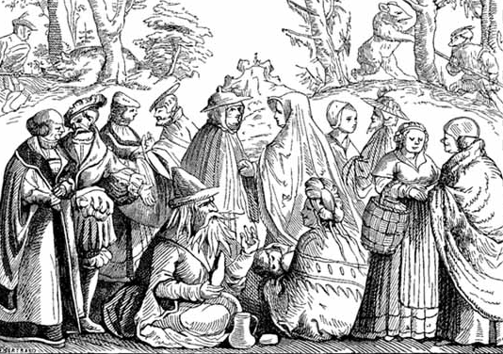
The Miraculous: 2. Miracle Accounts thru Medieval Times
Robert C. Newman

Slide 2
Introduction
We turn now from inspired biblical accounts of miracles to those in non-inspired (but nominally Christian) literature.
We begin with the so-called New Testament Apocrypha, as found in J. K. Elliott (1993) and E. Hennecke and W. Schneemelcher (1963).

Slide 3
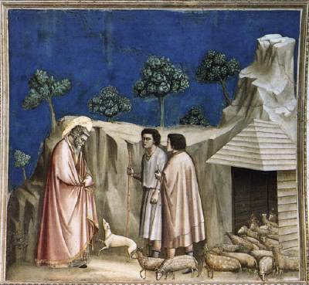
Miracle Accounts in the NT Apocrypha

Slide 4
The Protoevangelium of James
A narration of the events supposed to have taken place up to the birth of Jesus; probably written in the mid to late 2nd cen AD; very influential in the development of devotion to Mary.
Chapter 1: Joachim, a rich and pious Jew, has his offerings rejected because he is childless; he goes into the wilderness to fast for 40 days.

Slide 5
Protoevangelium James
Chs 2-3: His wife, Anna, also reproached, prays to God for a child.
4-5: Angel sent to Anna and Joachim, announcing answer to their prayers; their offspring shall be spoken of in whole world; Mary born.
6: Mary walks at six months; kept at home in special sanctuary to avoid all defilement.

Slide 6
Protoevangelium James
7: Mary dedicated to temple at age three, dances on steps of altar.
8: At age 12, to avoid [menstrual] defilement of temple, high priest Zecharias instructed by angel to give Mary as wife to widower whom God shall designate.
9: Joseph chosen by dove coming out of his staff; takes Mary home. Goes off on building project.

Slide 7
Protoevangelium James
10-12: Mary one of virgins chosen to make veil of temple. Mary receives message from angel re/ Jesus. She turns in veil work, visits Elizabeth.
13-16: Mary, age 16, now six months pregnant when Joseph returns; he won't believe her story until angel appears to him. Her pregnancy becomes known to priests, who call both in. They won't believe their stories until they are successful in bitter water test.

Slide 8
Protoevangelium James
17-18: Decree of Augustus. Mary and Joseph and his kids go to Bethlehem, but she is about to give birth in wilderness, so put in cave. As Joseph goes to look for midwife, whole world halts at Jesus' birth.
19-20: Joseph and midwife see cloud overshadow cave, then great light; baby climbs up on Mary's breast. Midwife tells friend Salome, who won't believe in virgin birth until she tests Mary's virginity. Salome's hand is consumed as punishment, but healed by touching baby Jesus.

Slide 9
Protoevangelium James
21: Visit of wise men.
22-24: Herod tries to kill young children. Mary hides baby in ox-manger. Elizabeth and John hidden by being swallowed up inside mountain. Herod finds Zecharias in temple, has him killed. His blood turns to stone, the temple walls wail. Symeon appointed high priest in Z's place.
25: I, James [Jesus' older step-brother] wrote this, hid in wilderness.

Slide 10
The Infancy Story of Thomas (formerly called Gospel of Thomas)
A narration of the marvels which supposedly took place in Jesus' childhood up to age 12; parts date back to late 2nd cen AD.
ch 1: Written by Thomas the Israelite
though Cullmann says "his book betrays no knowledge of Judaism."
2: Boy Jesus, age 5, makes 12 clay sparrows on the Sabbath. When confronted, he claps his hands and the sparrows fly away.

Slide 11
Infancy Story of Thomas
3: Another boy messes up pools Jesus is playing in. He curses the boy, who immediately withers up. Parents of boy complain to Joseph, "What kind of child do you have?“
4-5: Another boy runs into Jesus in village. Jesus curses him and he falls dead. Parents and others complain to Joseph, he rebukes child. Jesus strikes accusers blind. Joseph pulls Jesus' ear. Jesus warns Joseph not to cross him.

Slide 12
Infancy Story of Thomas
6-8: Teacher Zacchaeus offers to teach Jesus alphabet, but Jesus rebukes him for not really understanding even Alpha. Zacchaeus, shamed, says this child not earth-born, perhaps begotten before creation of world. Returns child to father. Jesus laughs, cancels curse on all those previously struck. They are afraid to provoke him again.
9: Jesus and children playing on roof of house. One falls off and dies. Parents accuse Jesus; he calls boy back to life, who clears him of responsibility.

Slide 13
Infancy Story of Thomas
10: Young man cutting wood chops his own foot. Jesus heals foot. "Arise now, cleave the wood, and remember me.“
11: Going to fetch water for his mother, Jesus stumbles and pitcher is broken. Brings back water in his garment.
12: Jesus, age 8, planting with his father, sows one grain of wheat. It yields one hundred measures of wheat which he gives to the poor.

Slide 14
Infancy Story of Thomas
13: Jesus and father making a wooden bed for a rich man. One of the beams is too short. Jesus stretches it to right length.
14-15: Another teacher strikes Jesus. Jesus curses him and he falls into faint. Later another teacher takes Jesus as pupil. Jesus takes up book, but without reading it, begins to expound law by the Holy Spirit and a large crowd gathers. Teacher praises Jesus; Jesus heals previous teacher.

Slide 15
Infancy Story of Thomas
16: Jesus and brother James gathering sticks. James bitten by snake, about to die. Jesus breathes on bite, wound healed, snake bursts.
17: Jesus raises little child who had died.
18: Jesus raises workman who died.
19: Jesus, 12, remains behind in temple. Parents find him expounding Scripture, putting elders and teachers to silence.

Slide 16
Historicity of These Two?
Did Luke really pass up all this for the temple incident at age 12?
Does this really fit Luke 2:52?
"...in favor with God and man"
Does this really fit Luke 4:22-23?
"...wondering at gracious words.... Isn't this Joseph's son.... do here in home town as well"
Does this really fit Matt 13:53-58; Mark 6:16?
"...where... this wisdom and these miraculous powers? Is not this the carpenter's son?... "
Does this fit John 2:11?
"...beginning of his signs..."

Slide 17
Other NT Apocrypha
A number of Apocryphal Acts survive, the earliest from the 2nd and 3rd centuries:
Acts of John
Acts of Paul & Thecla
Acts of Peter
Acts of Andrew
Acts of Thomas

Slide 18
Other NT Apocrypha
These apparently seek to supplement the canonical Acts, entertain the reader, and propagandize for their own particular theological approach (Acts John, Andrew, Thomas are strongly encratite, breaking up marriages and advocating eating nothing but bread & water; contrast 1 Tim 4:3)
In the apocryphal Acts, "miraculous stories are not only much exaggerated, producing fantastic and bizarre effects, but they often follow one another as isolated units and are retailed for their own sake. The intention of this is clearly not that of demonstrating the wonderful advance of the Word of God but... to glorify the apostles as miracle-workers." (Hennecke, 2:174)

Slide 19
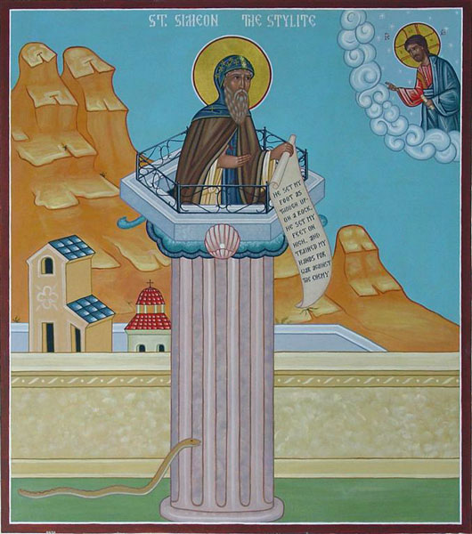
Some Post-Apostolic & Medieval Miracle Accounts

Slide 20
Introduction
These are found in E. Cobham Brewer, A Dictionary of Miracles (1884), which is accessible for free on the Internet.
This compilation includes hundreds of ancient, medieval and modern miracle accounts, categorized alphabetically under three major headings:
(1) those imitating biblical miracles
(2) those illustrating biblical texts
(3) those "proving" Roman Catholic dogma.
These accounts are taken from standard Roman Catholic sources: Acta Sanctorum; Guérin, Les Petits Bollandistes; Kinesman, Lives of the Saints.

Slide 21
Miracle Accounts Imitating Biblical Miracles
236 headings covering 346 double-column pages
St. Barnabas says where his dead body is to be found. Barnabas the apostle, after being stoned to death, was thrown into a fierce fire, that his body might be consumed; but the fire had no effect upon it, and St. Mark, carrying the dead body beyond the gates of the city wall of Cyprus, buried it. There it remained till AD 485, when, Nicephorus Callistus assures us, the ghost appeared to Antemius, bishop of Cyprus, and told him where his body was to be found. The bishop went to the spot indicated, and found the body, with the original MS of St. Matthew's Gospel, the very MS written by the hand of the evangelist himself. Both relics were taken to Constantinople... (17)

Slide 22
Imitating Biblical Miracles
Dead elm blooms. The bier of St. Zanobi (AD 407) happened, in passing, to touch an elm tree, dead and withered to the roots from old age. The moment it did so the whole tree burst into leaf, and was covered with flowers. This tree was looked on by the people with such reverence that everyone coveted a piece as a charmed relic, and the tree ere long was wholly cut away. A marble pillar was then erected on the spot, with an inscription stating what has been said above. When the bier reached the doorway of St. Savior's Cathedral, it became immovable, and no power of man could force it further on, till bishop Andrew promised to found twelve chaplains to chant the praises of God in the chapel designed for the dead saint. (54)

Slide 23
Imitating Biblical Miracles
Relics join in singing. One night a deacon watched St. Gregory of Langres (AD 541), and saw him rise from his bed, and leave his dormitory at midnight. The deacon followed him unobserved, and saw him enter the baptistery, the door of which opened to him of its own accord. For a time dead silence prevailed, and then St. Gregory began to chant. Presently a host of voices joined in, and the singing continued for three hours. "I think," says St. Gregory of Tours, naively, "the voices proceeded from the holy relics there preserved; no doubt they revealed themselves to the saint, and joined him in singing praises to God." (76-77)

Slide 24
Imitating Biblical Miracles
Some items from a list of relics given by John Brady (1839), but no information supplied on location of each: (1) one of the coals that broiled St. Lawrence; (2) a finger of St. Andrew, another of John the Baptist, and one of the Holy Ghost; (3) two heads of John the Baptist; (4) the hem of our Lord's garment touched by the woman healed of her bloody issue; (5) a vial of the sweat of St. Michael, when he contended with Satan; (6) some of the rays of the star that guided the Wise Men; (7) a rib of the Word made flesh; (8) a pair of slippers worn by Enoch before the Flood; (9) a tear shed by Jesus over the grave of Lazarus.

Slide 25
Miracle Accounts Illustrating Biblical Texts
146 headings covering 128 double-column pages
Out of the mouth of babes (Ps 8:2, etc.) (355-357):
When St. Agnes died (April 20, 1317), we are told by her biographer she received the most perfect praise this earth could afford, that of infants at the breast. The tongue of little infants was unloosed, and they announced the death of St. Agnes and her virtues, and their parents woke on hearing their voices. (356)

Slide 26
Illustrating Biblical Texts
God will provide (Mt 6:25-33) (398-99)
St. Franchy (7th cen) was employed in making bread for the monastery of St. Martin de la Bretonniere, but some of the brothers, out of envy, wishing to bring him into disgrace, hid the materials used in bread making. St. Franchy was not in the least disconcerted, but making the sign of the cross, began to knead nothing with nothing, and at the time required produced his batch of bread in perfect condition. (398)

Slide 27
Illustrating Biblical Texts
Holiness better than rubies (Prov 3:15, etc.)
The body of Simeon Stylites (AD 459) was full of sores covered with maggots. One day a maggot fell from the pillar-saint at the foot of Basilicus, king of the Saracens, and the king, picking it up, laid it on his eye, whereupon it was instantly converted into a magnificent pearl, so large, so beautiful, and of such fine water, that Basilicus valued it more than his whole empire. (415)

Slide 28
Some Miracle Accounts "Proving" Catholic Dogma
20 headings covering 52 double-column pages
Body and Blood of Christ (489-95)
St. Antony of Padua had a disputation one day with Boniville on the sacrament of the mass. Boniville denied transubstantiation, and Antony maintained its truth. To convince him, St. Antony had Boniville shut up his mule and give it no food for three days. At the end of this fast, St. Antony held out to the mule a consecrated wafer, and Boniville threw it some oats. The mule took no notice of the oats, but fell on its knees before the holy wafer, adoring it as its Creator and Lord. (490)

Slide 29
"Proving" Catholic Dogma
Purgatory (513-16)
Emilia Bicchieri (13th cen) was the superior of the convent of St. Margaret, and compelled the sisters on fast-days to abstain even from drinking water, in remembrance of Christ's thirst. One of the sisters, Cecily Margaret, died. Three days afterwards she showed herself to Emilia, and said she had been in purgatory for three days to efface the taint of birth, and on the third day her guardian angel appeared to her and said, "With this water you abstained from on earth, in memory of Christ's thirst, the flames of purgatory are extinguished. Enter, therefore, now into the joys of paradise." (514)

Slide 30
"Proving" Catholic Dogma
Virgin Mary (516-30)
St. John Damascene and Juvenal, archbishop of Jerusalem, assert that Adam and Eve, the prophets, all the apostles except Thomas, and many angels, were present at the death of the Virgin Mary, and attended the funeral procession to Gethsemane. On the third day after her interment came St. Thomas, and entreated that he might be allowed to look upon the deceased lady; so the grave was opened, when lo! the body was gone. It had been taken to heaven. The odor of sanctity remained in the place where the body had lain, and the linen clothes, in which it had been wrapped, had been carefully folded together. The apostles were amazed, but they knew that the body had been taken up to heaven to be united to its living soul. (518)

Slide 31
Some Implications of the Miracles Recorded in Brewer
Selected and reorganized from his pp xix-xxiii
These miracles (if they truly occurred and were done by God) attest to the truth of distinctive Roman Catholic doctrines:
The world is divided into two kingdoms: God's kingdom, the Catholic Church, which one enters on baptism by renouncing Satan; and Satan's kingdom, which includes not only pagans and Muslims, but also Jews and Protestants. It is meritorious for saints to injure heretics such as Lutherans and Calvinists, but a sin if the opposite occurs. There is no salvation outside the church of Rome. Its priests can actually absolve you from your sins. Its baptism regenerates. The elements of the eucharist really are changed into the body and blood of Jesus Christ, and can function as miraculous food.

Slide 32
Some Implications
Salvation is the reward of merit, hence the common end to saintly biographies: "He was called to heaven to receive the reward of his merits."
The lives of saints are considered the romantic ideals of perfection, including withdrawal from society, mortification of the flesh, self-torment, suffering and martyrdom. One of the most meritorious acts of piety is to remain single. It is possible to be meritorious, to accumulate merit, to transfer merit to others, so that the demerits of a sinner may be balanced off by transfer from a saint. [doctrine of supererogation]

Slide 33
Some Implications
Blind obedience to superiors is the first law of piety, no matter how absurd the order, how revolting, how difficult. The perfection of a saint comes when he has crushed out every natural affection. Nothing on earth must remain (its hopes, ambitions, loves) not even love to father and mother. A saint should read no secular book, think no secular thought, and hope no secular good.
It is a proof of merit to be able to work miracles. It is meritorious to see miracles and believe in them, or at least a demerit to doubt them. Miracles can be performed by dead bodies, relics, and medals, as well as by living saints.

Slide 34
Some Implications
Relics can by authenticated by any Church dignitary, such as pope, abbot or bishop. They can even be multiplied. They possess miraculous virtues no matter how small they are, which can be transferred, so that a relic can make a relic. Saints, after death, have the power of interceding for their votaries before the throne of grace, of curing diseases, and of visiting earth. The Virgin Mary is the highest of all saints, the most powerful, and the most merciful. The saints in heaven take an interest in those on earth. They like to be invoked, patronized, honored, flattered, and even be dressed up and decked with jewels.

Slide 35
Conclusions
Not having time-machines, we have no way to be sure that none of these miracles happened.
Their inconsistency with the miracles and teachings of Scripture makes it apparent that if they did, God was not their author.
The function of many of these alleged miracles, as Brewer points out, was to move the medieval church away from the teachings of Scripture.
As we will suggest in the next talk, they also seem to have moved many in the Renaissance and later away from Christianity altogether.

Slide 36
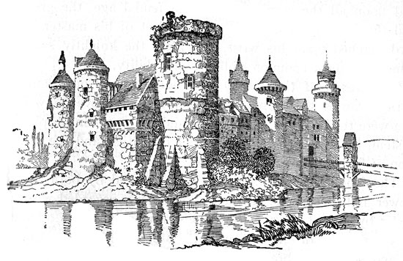
The End

