Slide 1
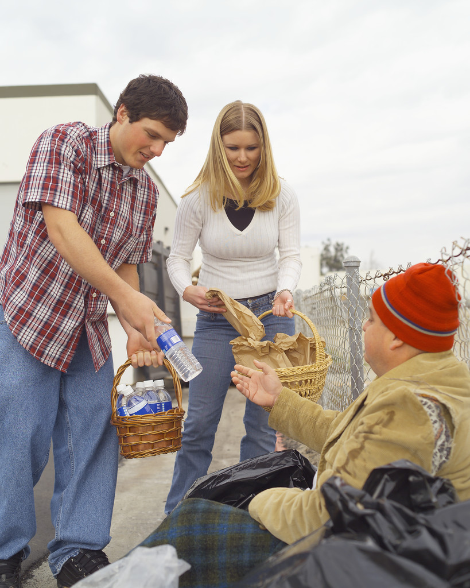

The Church & the Poor
Robert C. Newman

Slide 2
The Problem
Many have dismissed the problem of poverty with Jesus’ quotation, “The poor you have with you always,” (Mt 26:11; Mk 14:7; Jn 12:8) as though believers have no responsibilities here.
But Jesus added (in Mark): “Whenever you wish, you can do them good.”
Here we want to look at the whole problem of poverty and what Christians can & should do about it.

Slide 3
The Problem
Let us divide up our discussion into two major areas:
  Causes of Poverty & Prosperity
  Responsibilities of Christians
Under the first of these headings, we will look at causes in the form of pairs of opposites.

Slide 4
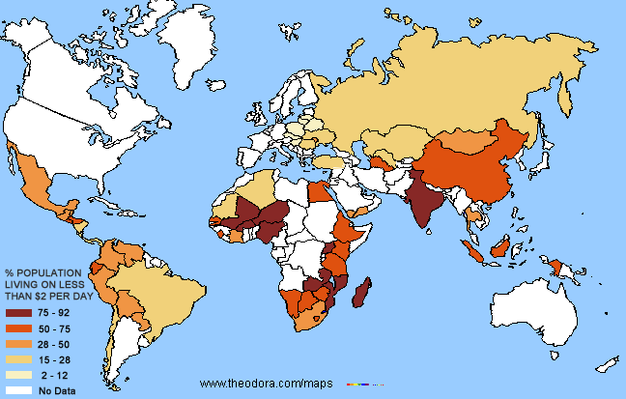
Causes of
Poverty & Prosperity

Slide 5

Laziness & Diligence

Slide 6
Proverbs 6:6-11
6 (NIV) Go to the ant, you sluggard;
consider its ways and be wise!
7 It has no commander,
no overseer or ruler,
8 yet it stores its provisions in summer
and gathers its food at harvest.
9 How long will you lie there, you sluggard?
When will you get up from your sleep?
10 A little sleep, a little slumber,
a little folding of the hands to rest n
11 and poverty will come on you like a bandit
and scarcity like an armed man.

Slide 7
Proverbs 10:4-5
4 (NIV) Lazy hands make a man poor,
but diligent hands bring wealth.
5 He who gathers crops in summer is a wise son,
but he who sleeps during harvest is a disgraceful son.

Slide 8
Proverbs 14:23, 21:5
14:23 (NIV) All hard work brings a profit,
but mere talk leads only to poverty.
21:5 (NIV) The plans of the diligent lead to profit
as surely as haste leads to poverty.

Slide 9
Ecclesiastes 4:5, 9:10
4:5 (NIV) The fool folds his hands
and ruins himself.
9:10 (NIV) Whatever your hand finds to do, do it with all your might, for in the grave, where you are going, there is neither working nor planning nor knowledge nor wisdom.

Slide 10
Extravagance & Thrift

Slide 11
Proverbs 12:27, 21:17
12:27 (NIV) The lazy man does not roast his game,
but the diligent man prizes his possessions.
21:17 (NIV) He who loves pleasure will become poor;
whoever loves wine and oil will never be rich.

Slide 12
Proverbs 21:20, 23:20-21
21:20 (NIV) In the house of the wise are stores of choice food and oil,
but a foolish man devours all he has.
23:20 (NIV) Do not join those who drink too much wine
or gorge themselves on meat,
21 for drunkards and gluttons become poor,
and drowsiness clothes them in rags.

Slide 13
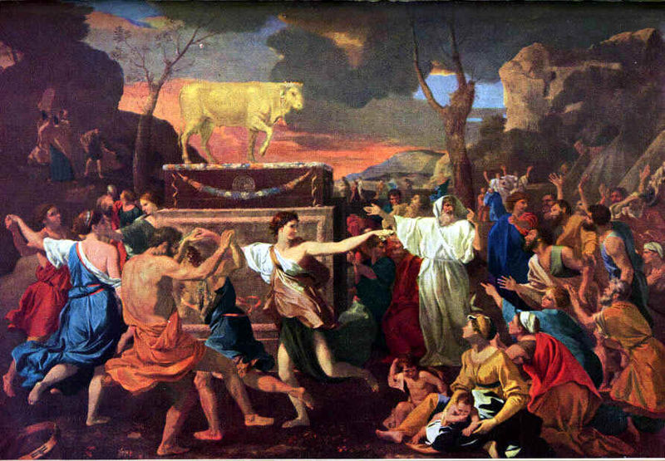
Disobedience & Obedience

Slide 14
Disobedience & Obedience
See the blessing & curse passages of God’s covenant with Israel:
Leviticus 26:
  3-13: blessings
  14-33: curses
Deuteronomy 28:
  1-14: blessings
  15-68: curses
Some samples:

Slide 15
Leviticus 26:3-5
26:3 (NIV) If you follow my decrees and are careful to obey my commands, 4 I will send you rain in its season, and the ground will yield its crops and the trees of the field their fruit. 5 Your threshing will continue until grape harvest and the grape harvest will continue until planting, and you will eat all the food you want and live in safety in your land.

Slide 16
Leviticus 26:19-20, 26
26:19 (NIV) I will break down your stubborn pride and make the sky above you like iron and the ground beneath you like bronze.
20 Your strength will be spent in vain, because your soil will not yield its crops, nor will the trees of the land yield their fruit.
26:26 (NIV) When I cut off your supply of bread, ten women will be able to bake your bread in one oven, and they will dole out the bread by weight. You will eat, but you will not be satisfied.

Slide 17
Deuteronomy 28:4-5, 8
28:4 (NIV) The fruit of your womb will be blessed, and the crops of your land and the young of your livestock n the calves of your herds and the lambs of your flocks.
5 Your basket and your kneading trough will be blessed.
28:8 (NIV) The LORD will send a blessing on your barns and on everything you put your hand to. The LORD your God will bless you in the land he is giving you.

Slide 18
Deuteronomy 28:17-18, 20
17 (NIV) Your basket and your kneading trough will be cursed.
18 The fruit of your womb will be cursed, and the crops of your land, and the calves of your herds and the lambs of your flocks.
20 (NIV) The LORD will send on you curses, confusion and rebuke in everything you put your hand to, until you are destroyed and come to sudden ruin because of the evil you have done in forsaking him.

Slide 19
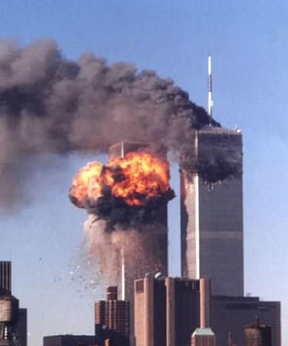
Disaster & Blessing

Slide 20
Disaster & Blessing
Disaster & blessing are not necessarily related to one’s wickedness or goodness.
Job 1-2: Job is impoverished by overwhelming disaster, yet he is the most righteous man of his generation.
Psalm 73:3-14: The wicked sometimes prosper.

Slide 21
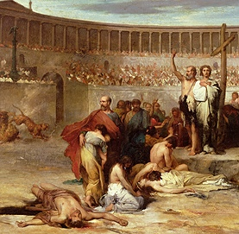
Persecuted & Persecuting

Slide 22
Persecuted, etc.
Many of these passages deal with imprisonment or death.
Some others:
  Job 1-2: Job is devastated by an unseen persecution (from Satan).
  Romans 8:35: hardship, famine, nakedness in a persecution context
  1 Cor 4:9-13: The apostles are hungry, thirsty, in rags.

Slide 23
Job 1:9-11
9 (NIV) “Does Job fear God for nothing?” Satan replied. 10 “Have you not put a hedge around him and his household and everything he has? You have blessed the work of his hands, so that his flocks and herds are spread throughout the land.
11 But stretch out your hand and strike everything he has, and he will surely curse you to your face.”

Slide 24
Romans 8:35
8:35 (NIV) Who shall separate us from the love of Christ? Shall trouble or hardship or persecution or famine or nakedness or danger or sword? 36 As it is written:
"For your sake we face death all day long;
we are considered as sheep to be slaughtered." (Psalm 44:22)

Slide 25
1 Corinthians 4:9-13
9 (NIV) For it seems to me that God has put us apostles on display at the end of the procession, like men condemned to die in the arena. We have been made a spectacle to the whole universe, to angels as well as to men. 10 We are fools for Christ, but you are so wise in Christ! We are weak, but you are strong! You are honored, we are dishonored! 11 To this very hour we go hungry and thirsty, we are in rags, we are brutally treated, we are homeless. 12 We work hard with our own hands. When we are cursed, we bless; when we are persecuted, we endure it; 13 when we are slandered, we answer kindly. Up to this moment we have become the scum of the earth, the refuse of the world.

Slide 26
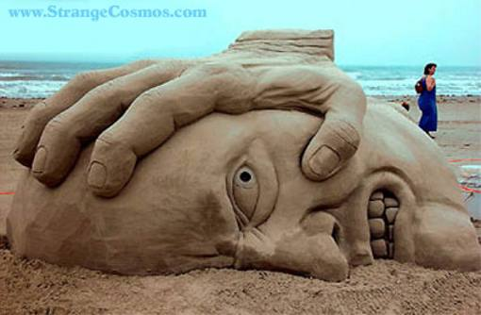
Oppressed & Oppressing

Slide 27
Oppressed & Oppressing
We looked at some of these under the category of Persecuted & Persecuting.
But many become poor just because they are weak and the strong oppress them.
Others become rich because they are powerful & unscrupulous, and they oppress the weak.

Slide 28
Proverbs 28:3-6
Prov 28:3 (NIV) A ruler who oppresses the poor
is like a driving rain that leaves no crops.
4 Those who forsake the law praise the wicked,
but those who keep the law resist them.
5 Evil men do not understand justice, but those who seek the LORD understand it fully.
6 Better a poor man whose walk is blameless
than a rich man whose ways are perverse.

Slide 29
Ecclesiastes 5:8-9
5:8 (NIV) If you see the poor oppressed in a district, and justice and rights denied, do not be surprised at such things; for one official is eyed by a higher one, and over them both are others higher still.
9 The increase from the land is taken by all; the king himself profits from the fields.

Slide 30
Ezekiel 22:29-30
29 (NIV) The people of the land practice extortion and commit robbery; they oppress the poor and needy and mistreat the alien, denying them justice.
30 I looked for a man among them who would build up the wall and stand before me in the gap on behalf of the land so I would not have to destroy it, but I found none.
31 So I will pour out my wrath on them and consume them with my fiery anger, bringing down on their own heads all they have done, declares the Sovereign LORD.

Slide 31
Amos 5:11-12
11 (NIV) You trample on the poor
and force him to give you grain.
Therefore, though you have built stone mansions,
you will not live in them;
though you have planted lush vineyards,
you will not drink their wine.
12 For I know how many are your offenses
and how great your sins.
You oppress the righteous and take bribes
and you deprive the poor of justice in the courts.

Slide 32
James 2:6-7
6 (NIV) But you have insulted the poor. Is it not the rich who are exploiting you? Are they not the ones who are dragging you into court?
7 Are they not the ones who are slandering the noble name of him to whom you belong?

Slide 33
Summary on Causes
Poverty can be caused by:
  Laziness
  Extravagance
  Disobedience
  Disaster
  Persecution
  Oppression
So not all poverty is due to the sin of the poor, but clearly some is.
How are Christians to respond?

Slide 34
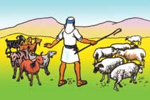
Responsibilities of Christians

Slide 35
How Should We Respond?
Don’t do any of the things that make for poverty in yourself or others.
Be a redemptive force to work against poverty.

Slide 36
Don’t Do What Makes for Poverty.
Encourage diligence.
  Be diligent in your own work.
  Encourage diligence in others by word & example.
  Don’t give to others in such a way as to discourage diligence.
Be thrifty.
  Be thrifty with your wealth.
  Fight waste & extravagance in home, church, job, & government.
  Be thrifty even in your benevolence.

Slide 37
2 Thessalonians 3:10
10 (NIV) For even when we were with you, we gave you this rule: "If a man will not work, he shall not eat."

Slide 38
Luke 10:33-35
33 (NIV) But a Samaritan, as he traveled, came where the man was; and when he saw him, he took pity on him.
34 He went to him and bandaged his wounds, pouring on oil and wine. Then he put the man on his own donkey, took him to an inn and took care of him.
35 The next day he took out two silver coins {[35] Greek two denarii}and gave them to the innkeeper. `Look after him,' he said, `and when I return, I will reimburse you for any extra expense you may have.'

Slide 39
Don’t Do What Makes for Poverty.
Be obedient.
  Be obedient to God’s Word.
  Encourage others to be obedient also.
  Work for government obedience to God’s Word.
Don’t oppress.
  Don’t oppress others.
  Oppose those who do so, whether privately or through business or government activities.

Slide 40
Be a Redemptive Force.
Use your surplus to help others in emergencies. (See Eph 4:28, Acts 4:32-5:4, 2 Cor 8:1-15; Lk 10:30-37)
Try to do without in order to have more surplus to help others. (Mt 25:34-40, 6:19-21, Lk 3:11)
Encourage your church to devote a Scriptural level of attention to benevolence. (Acts 6, 2 Tim 5)

Slide 41
Be a Redemptive Force.
Encourage those works which are helping the poor to get on their feet and reform their own lifestyle.
Work against societal practices which lead to poverty:
  Advertising → covetousness & consumption
  Credit → indebtedness
  Insurance → false security & waste

Slide 42
A Bibliography
Ronald Sider, Rich Christians in an Age of Hunger.
David Chilton, Productive Christians in an Age of Guilt Manipulators.
John Jefferson Davis, Your Wealth in God’s World.
Carl Kreider, The Christian Entrepreneur.

Slide 43
The End
Don’t forget Matthew 25:40 & 45

