Slide 1
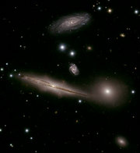
Stars & Galaxies
Robert C. Newman

Slide 2
Stars & Galaxies
Here we want to start with stars, looked at from two different perspectives:
What they look like from earth
What we know about them from astronomy and astrophysics
We will then look at clusters of stars
And finally at the particular types of star clusters we call galaxies.

Slide 3
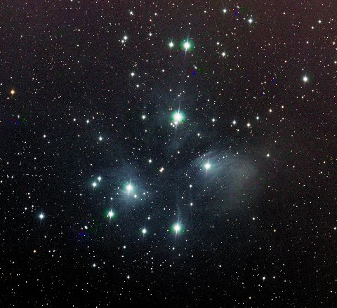
Stars

Slide 4
What are Stars?
From earth, without telescopes, stars are just points of light in the sky.
The ancients called any bright light in the sky a star, distinguishing various types:
Fixed stars
Wandering stars (planets, sun, moon)
Hairy stars (comets)
Shooting stars (meteors)

Slide 5
What are Stars?
With the 20th century, we have come to realize that stars are:
large balls of gas
held together by their own gravity
illuminated by heat produced within, usually by internal nuclear reactions.
Our sun is the nearest star.
Stars are distinguished from:
Planets – no nuclear reaction
Brown dwarfs – only deuterium or lithium fusion

Slide 6
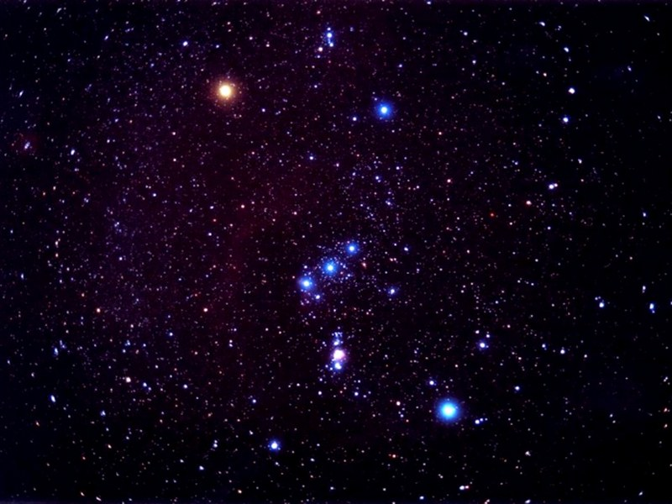
Constellations

Slide 7
Constellations
'Constellation' is the term we use for apparent star groups in the sky. Most of these are not actually gravitationally-bound groups.
There is a standard set of 88 of these used in the West, 48/50 of which come down to us from the Greeks & even the Babylonians centuries before the time of Christ.
12 of these mark off the Zodiac, thru which the sun, moon, and planets pass.

Slide 8
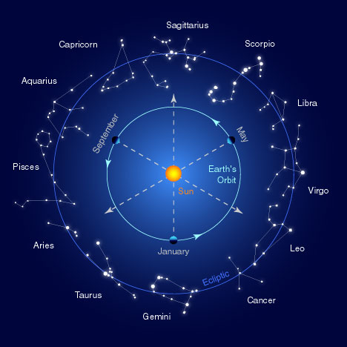
Zodiac

Slide 9
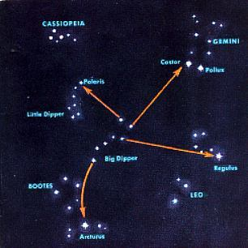
Some Northern Constellations with the Big Dipper as pointer

Slide 10
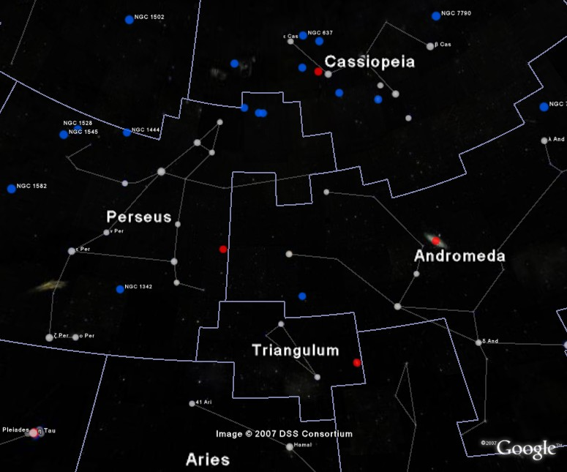
IAU Boundaries

Slide 11
Use of the Constellations
The constellations are used today in astronomy to help observers find their way around in the night sky.
They have been used by travellers for direction and by farmers for when to plant crops.
The constellations have been & are still being used by astrologers for fortune-telling.
Some Christians believe they portray a 'Gospel in the Stars' that goes back to God or to the patriarchs.

Slide 12
Back to Stars

Slide 13
Different Kinds of Stars
Even a brief glance at the stars shows us that they differ in brightness.
As one looks at the stars more carefully, it becomes apparent that they are not all the same color.
Look at the constellation of Orion shown in the next panel.

Slide 14
Orion

Slide 15
Different Kinds of Stars
Astronomers classify the apparent brightness of stars by magnitude.
The lower the number, the brighter the star
They use a similar system for the actual brightness of the star, called absolute magnitude.
They use a letter system to designate the star color: O, B, A, F, G, K, and M.

Slide 16
Brightness
The ancients called the brightest stars 'first magnitude,' the next brightest 'second magnitude,' and so on thru 6th.
Modern astronomy has regularized this, using zero and negative numbers for the very brightest objects, and higher numbers for objects invisible w/o optical help.
For instance, see some examples in the next panel:

Slide 17
Apparent Magnitude
Sun
Venus
Sirius
Vega
Betelguese
Limit w/ naked eye
-26.7
-4.4
-1.4
0.0
0.4
5
Absolute magnitude is what the apparent magnitude of a star would be if it were 10 parsecs (32.6 light years) away.

Slide 18
Star Color (Temperature)
O
B
A
F
G
K
M
~ 35,000 K
~20,000 K
~10,000 K
~7000 K
~6000 K
~4700 K
~3500 K

Slide 19
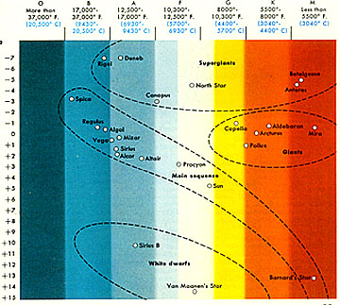

Slide 20
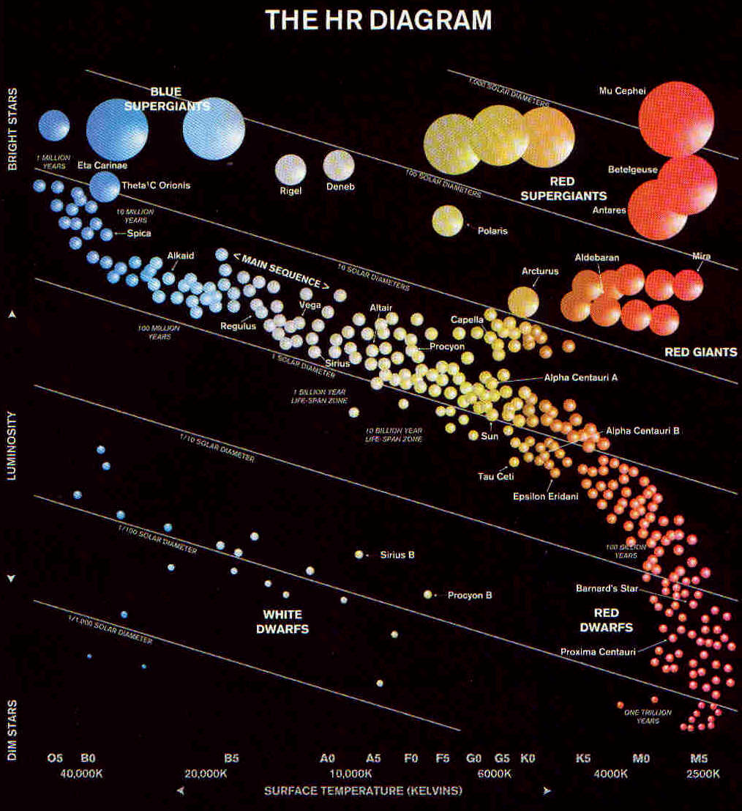

Slide 21
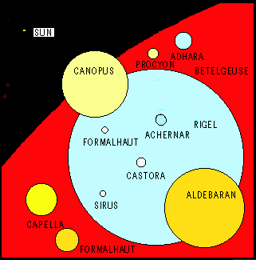
Star Sizes

Slide 22
The Hertzsprung-Russell Diagram
The curve thru the center is the Main Sequence, stars burning hydrogen in their cores.
The stars at upper right are red giants.
The stars at lower left are white dwarfs.

Slide 23
Lifespan of a G Star
This spiral shows (schematically) the life of a G-type star (like our sun).
It begins in the upper right as a gas cloud collapsing into a proto-star.
It spends most of its active life on the Main Sequence.

Slide 24
Lifespan of a G Star
When it uses up the H in its core, it expands to form a red giant, burning H in an outer shell & He in the core.
When the He is gone, the star collapses to form a white dwarf.
The dwarf gradually cools till it ceases to shine, becoming a black dwarf.

Slide 25
How Larger Stars End
Stars that are large enough explode rather than becoming white dwarfs.
We call these exploding stars supernovas.
The smaller exploding stars collapse to become neutron stars afterward.
The larger exploding stars collapse to become black holes.

Slide 26
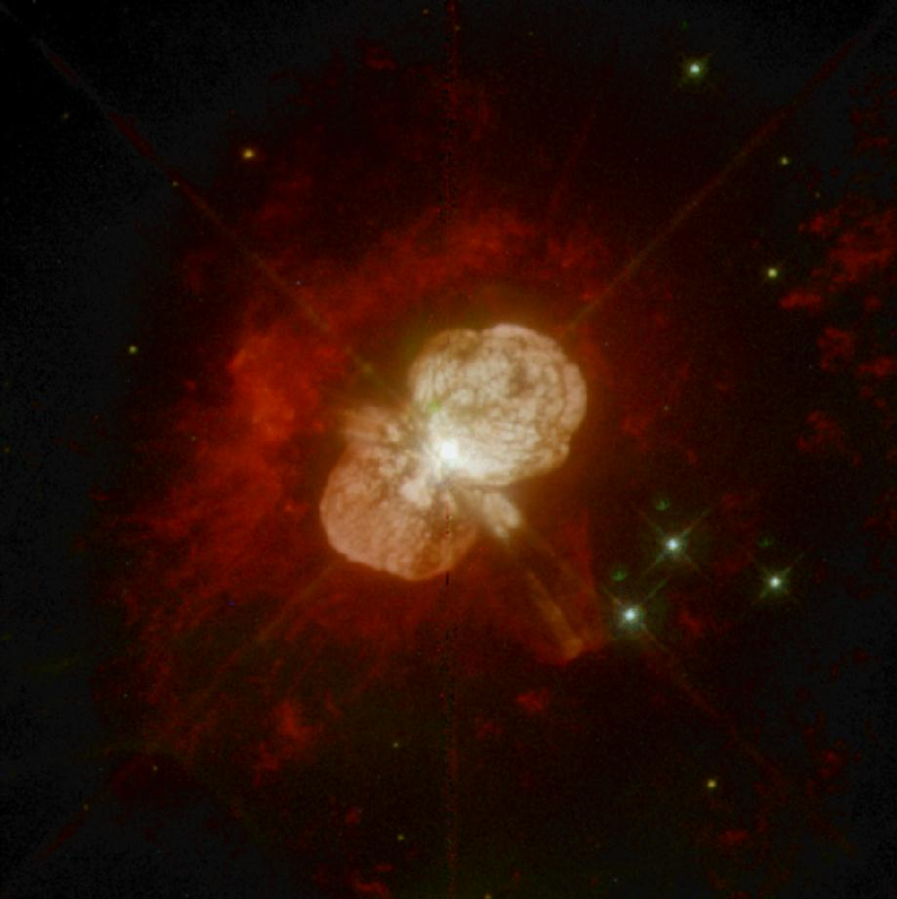
Supernova

Slide 27
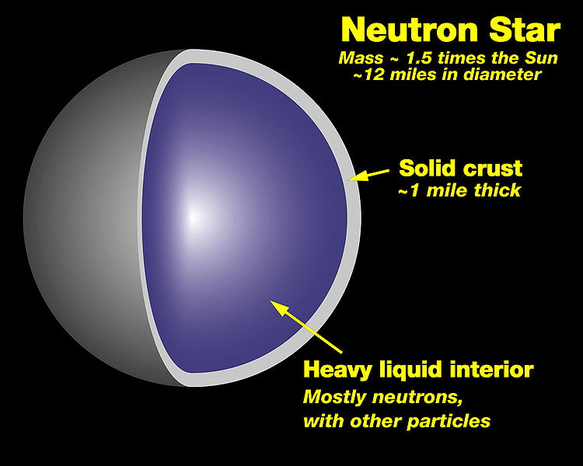

Slide 28
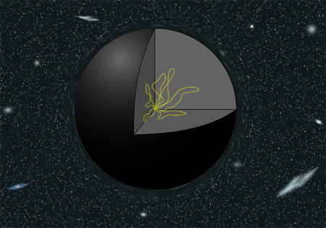
Black Hole

Slide 29
Star Clusters

Slide 30
Star Clusters
Star clusters are groups of stars that are really associated, rather than just being in the same direction from us, as many constellations are.
Star clusters are of two kinds:
Galactic, or open, clusters
Globular clusters.

Slide 31
Galactic Clusters
These are called galactic because they lie near the plane of our galaxy.
They are called open because they are not as tightly packed as globular clusters.
There are about 500 of these in our part of the galaxy.
They have typically 20-300 stars.

Slide 32
Pleiades Cluster in Taurus

Slide 33
Globular Clusters
Globular clusters are so named because they tend to have a rather spherical shape.
They are much larger and more tightly packed than galactic clusters,typically having tens of thousands of stars.
They move in a halo around the galaxy rather than in the galactic plane.

Slide 34
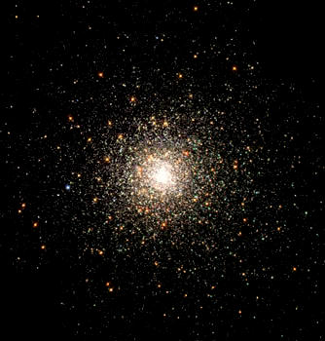
M80 – Globular Cluster in Scorpio

Slide 35
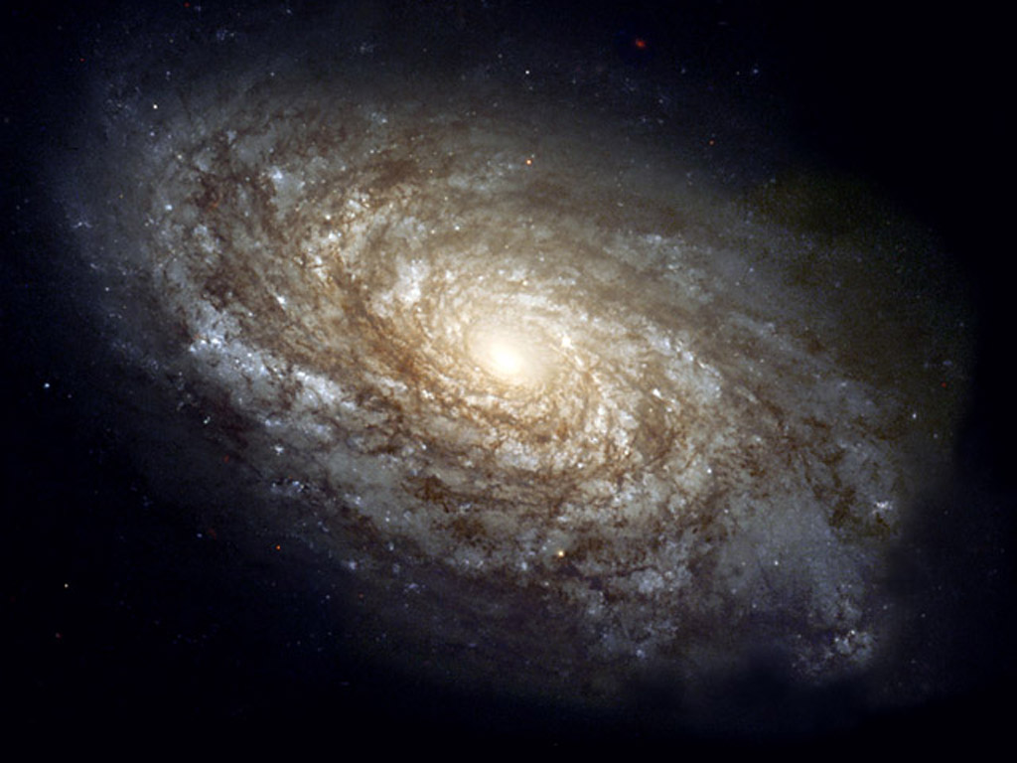
Galaxies

Slide 36
Galaxies
'Galaxies' are what we call the huge star clusters that inhabit our universe.
These clusters range in size from ten million stars to about a trillion.
The galaxy in which we live is popularly called the 'Milky Way,' because that is what it looked like to the ancients.

Slide 37
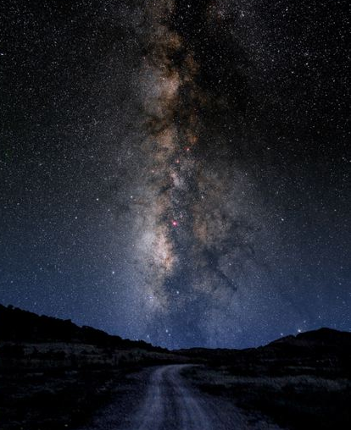
The Milky Way

Slide 38
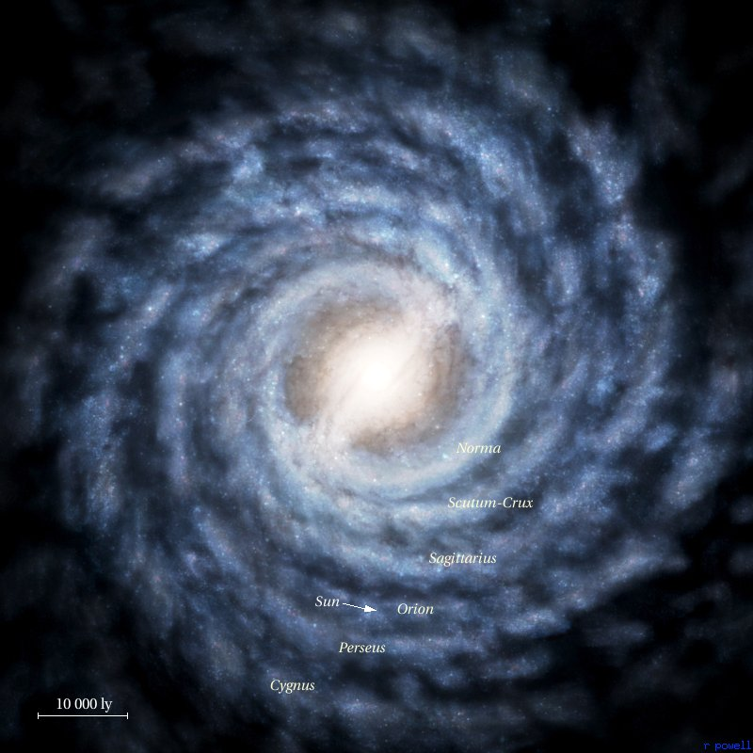
Milky Way as imagined from outside

Slide 39
Galaxy Types
Galaxies are usually categorized by shape into three types:
Elliptical
Spiral
Irregular
They are usually categorized by size into:
Dwarf
Regular
Giant

Slide 40
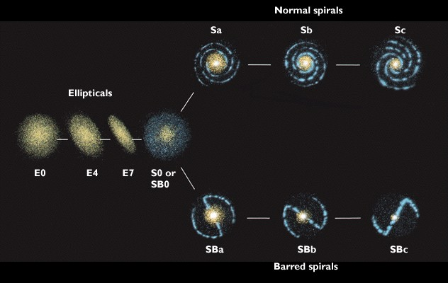
Galaxy Classes

Slide 41
Our Milky Way
Our galaxy is now known to be a barred spiral, something like SBa.
Our galaxy contains about 200-400 billion stars, so is a rather large spiral.
Its mass has recently been estimated to be about 3 trillion solar masses, but most of this is dark matter.
Its size is about 100 thousand light years across and about 10 thousand ly thick.

Slide 42
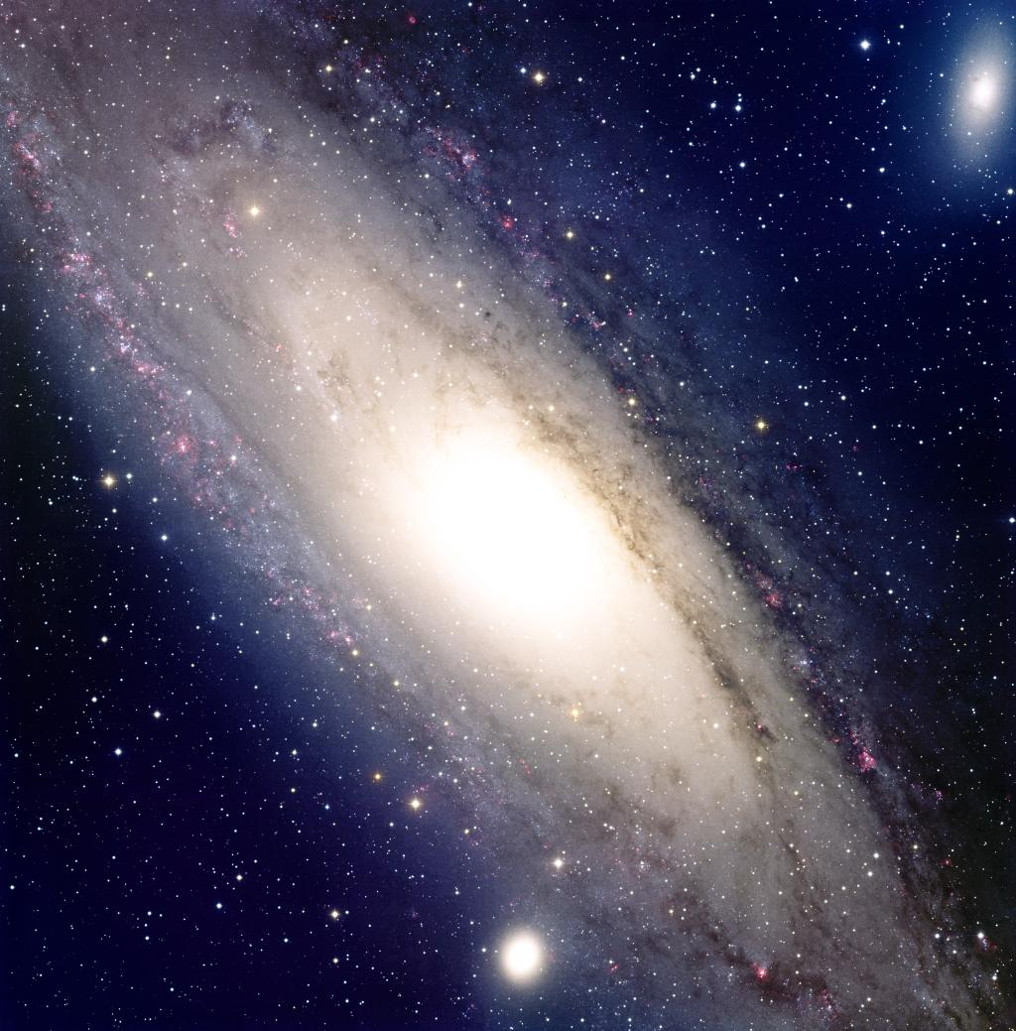
The End

