Slide 1
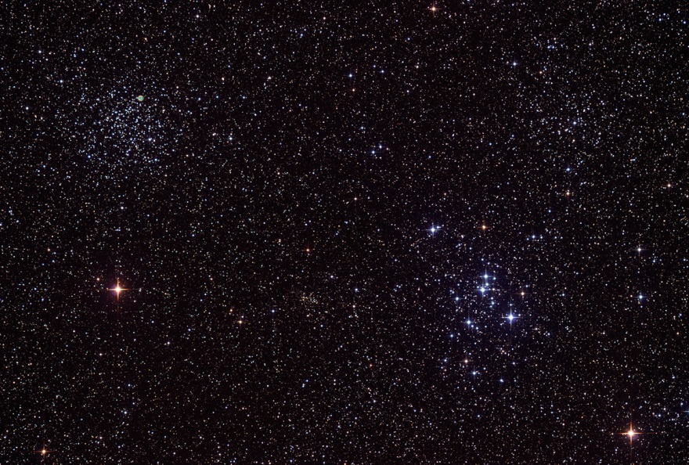
Stars in the Bible
Robert C. Newman

Slide 2
‘Star’ in Hebrew & Related Languages
The Hebrew word for star is kokav.
Similar words are the standard words for star in other Semitic languages:
Ugaritic
Akkadian
Aramaic
Syriac
Arabic

Slide 3
Derivation
These words may have been derived from kbb, ‘burn’ (Akk., Aram. and Arab.) or from kabba, ‘roll, revolve’ (Arab.).
Unlike modern English usage but parallel to ancient Greek, the Semitic word for star probably includes planets, comets, meteors, or any bright object in the night sky.

Slide 4
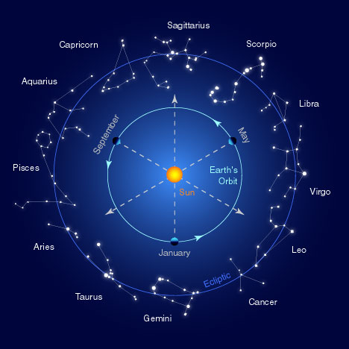
Stars in the Ancient Near East

Slide 5
Stars in the Ancient Near East
Three features of stars were especially important in the ANE and relevant to OT background:
(1) the worship of stars as gods;
(2) divination by stars, or astrology; and
(3) stars as timekeepers.

Slide 6
Worship of Stars
The worship of astronomical objects as gods is quite old and widespread.
Babylonian worship of the sun god Shamash, the moon god Sin, Ishtar as the planet Venus, and Marduk as the planet Jupiter was influential throughout the ANE.
This system was later borrowed by the Greeks (and from them by the Romans), so that our modern planet names are those of Roman deities.

Slide 7
Divination by Stars (Astrology)
The belief that the heavenly bodies are divine would encourage the thought that stellar phenomena might be messages for earth, particularly in a society already disposed to divination.
Old Babylonian texts (c1800 BC) list omens to be inferred from lunar eclipses and other heavenly phenomena.
These were later compiled (by 1000 BC) into the 70-tablet reference work Enūma Anu Enlil, influential through­out the ANE to Hellenistic times, connecting specific phenomena of sun, moon, planets, stars and weather with events on earth.
Unlike Hellenistic (and modern) astrology, such predictions involved public events, kings, and nations rather than private individu­als.

Slide 8
Stars as Timekeepers
The worship of stars and the belief they predict earthly events may have arisen from the fact that the stars certainly predict the seasons and sunrise, function­ing as calendars and clocks.
As the earth makes its yearly orbit around the sun, the stars move westward, rising four minutes earlier each night, thus providing a conve­nient set of markers for the seasons.

Slide 9
Stars as Timekeepers
Already by 3000 BC, the Egyptians had noticed that each year the star Sothis (Sirius) rose just before sunrise at the time of the annual Nile flooding.
By the Middle Kingdom (c2100-1800 BC) the Egyptians had devel­oped a list of 36 "decans" (single stars or constellations) spanning the whole year, with each successively rising with the sun at 10-day intervals.

Slide 10
Stars as Timekeepers
In Mesopotamia a similar system was devel­oped during the Old Babylonian period (c1800-1500 BC).
The positions of such stars could also be used to tell time at night (when sundials are useless), as tables had been constructed to calibrate the hours of the night with the current day and month.

Slide 11
Babylonian Constellations
These have been identified using an astronomical text ^{mul}APIN, from c700 BC.
Sufficient detail is given that nearly all the major Babylonian constella­tions have been identified with reasonable certainty.
Many of these are the same as the ancient Greek constella­tions we use today:
Our Gemini was also for the Babylonians a pair of twins;
Leo was a lion (possibly a dog);
Corvus, a raven;
Libra, a pair of scales;
Taurus, a bull;
Scorpio, a scorpion;
Capricorn, a goat-fish; and
Orion, the "true shepherd of the sky."

Slide 12
Babylonian Constellations
On the other hand, others are different:
Ursa Major was a wagon (but cp. Eng. Charles' Wain);
Cygnus and part of Cepheus, a panther;
Pisces and parts of Pegasus and Androme­da, a large swallow;
Canis Major, a bow and arrow;
Lyra, a goat;
Hercules, a dog; and
Aries, a hired laborer.

Slide 13
Babylonian Constellations
These differences undermine the attractive theory that a "gospel in the stars" comes down to us from patriarchal times,
as proposed by Frances Rolleston, Mazzaroth (1863),
and popular­ized by J. A. Seiss, The Gospel in the Stars (1882) and E. W. Bullinger, The Witness of the Stars (1893).

Slide 14
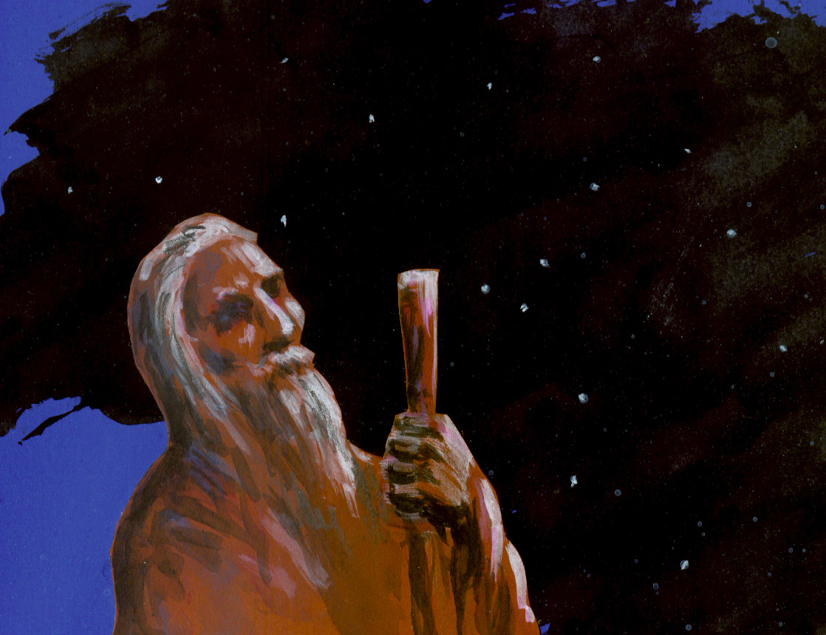
Stars in the Old Testament

Slide 15
Range of Kokav
kokav is used 37x with two areas of meaning:
(1) commonly as our word "star" (e.g., Gen 1:16; Exod 32:13) and
(2) rarely (1-3x) as an alternative term for "angel" (Job 38:7; Isa 14:12-13?).
Both stars and angels are called the "hosts of heaven" (e.g., Deut 4:19 vs. 1 Kgs 22:19).
Some see this as an indication that the stars were thought to be angels, though the connection may be no more than that angels, too, are bright objects in the sky.
Others, with later rabbin­ic theol­ogy, ex­plain this usage by seeing angels in charge of each star, just as angels are over various nations (Dan 10:20).

Slide 16
Created by God
The stars are created by God (Gen 1:16; Ps 8:3) and under his providential control (Isa 40:26; Jer 31:35).
They were "to separate the day from the night" and "serve as signs to mark seasons and days and years" (Gen 1:14).
The sun, of course, marks off the days,
the moon indicates the months, and
the stars (by their positions relative to the sun) the seasons and the years.
They were also created to praise God (Ps 148:3-6), perhaps by their
brightness (Dan 12:3; Ps 136:9),
purity (Job 25:5),
height (Job 22:12) and
number (e.g., Gen 15:5).

Slide 17
Created by God
They form a significant element in what the psalmist meant by saying, "The heavens declare the glory of God, the skies proclaim the work of his hands" (Ps 19:1).
Thus stars are a part of God's self-revelation in nature, his handiwork pointing beyond them­selves to God's bright­ness, purity, greatness and power.
The stars being merely created, God's people are not to worship them (Deut 4:19) as the pagans do. They are not gods, nor are they eternal, but rather (with the heavens) they are wearing out like clothing and will one day be discarded (Ps 102:25-26).

Slide 18
Number of Stars
The number of stars is uncountably vast (e.g., Gen 15:5), yet apparently finite (Ps 147:4).
They are often used (occasionally with the sand of the sea­shore) to illus­trate the promise to Abraham of a multitude of descen­dants (Gen 15:5; 22:17; 26:4; Exod 32:13; Deut 1:10; 10:22; 28:62).
Provisional fulfillment of this promise had already occurred when Israel entered Canaan (Deut 1:10; 10:22) but might be lost again by disobedience if Israel brought itself under the covenant curses (Deut 28:62).
In his military census, David feared to count all of Israel (1 Chr 27:23), perhaps thinking such a count would be tempting God who had promised an uncountable multi­tude.

Slide 19
Stars in Prophetic Contexts
In prophetic contexts, stars are used symbolically to represent prominent individuals
Joseph's brothers in one of his dreams (Gen 37:9-10),
the coming ruler in Balaam's vision (Num 24:17),
the king of Babylon in Isaiah's taunt (Isa 14:12-13).
In the last of these, the symbol seems to represent the king's exaltation, and his subse­quent abasement is pictured by being cast down to the earth.
In Daniel's eschato­logical promise to the wise (Dan 12:3), they are to "shine like the brightness of the heavens . . . like the stars for ever and ever."

Slide 20
Stars in Curse Contexts
The darkening of the stars, sun, and moon is a motif in curse contexts, including
Job's lament regarding the day of his birth (Job 3:9),
his character­ization of God's power in judgment (Job 9:7),
Qoheleth's picture of old age (Eccl 12:2),
Isaiah's oracle against Babylon (Isa 13:10),
the locust plague of Joel (2:10), and
the eschato­logical darkness which it foreshadows (Joel 3:15).

Slide 21
Particular Stars
The meaning of terms apparently used for particular stars, planets, and star-groups are rather uncertain due to
the infrequency of their occurrence in the OT,
the lack of specifying detail in such contexts,
the rarity of identifiable cognate expres­sions in the Sem. languages, and
the diversity of renderings in the ancient versions.
These are discussed in some detail in the article mentioned at the end of this talk.

Slide 22
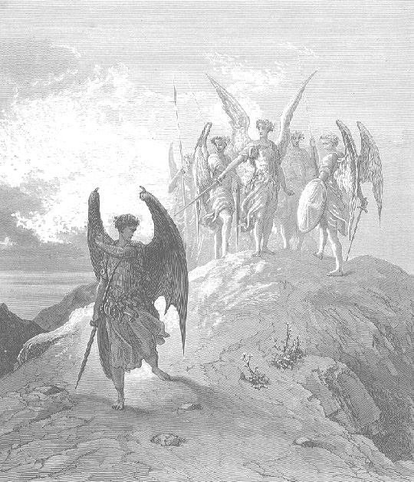
Stars in the Intertestament Period

Slide 23
Astronomy & Astrology
Babylonian astronomy and astrology continued to develop, spreading into the Greek world where the more sophisticated Greek geometry was applied to these studies.
An emphasis on individual astrology develops, based on the heavens at the time of one's birth, reaching its zenith in the Hellenistic city of Alexan­dria.
Numer­ous astrolog­ical papyri survive from this period in Egypt.

Slide 24
In the Greek Old Testament
The Hebrew kokav is rendered about equally often by the Greek words astēr and astron, the latter usually in the plural.
There appears to be no strong distinction between these terms.

Slide 25
In the Pseudepigrapha
1 Enoch and Jubilees indicate that astrology was taught to humans by the angels who sinned in Gen 6:1-4 (1 Enoch 8:1-4; Jub 8:3).
Serug and Nahor practiced astrology, but Abraham was turned away from it by "a word which comes to his heart" one night while watching the stars to make predictions (Jub 12:16-21).
Stars are moun­tains of fire (1 Enoch 18:13-15), driven through the heavens by winds (1 En 18:4).
A large section of 1 Enoch (chs 72-82) is devoted to a description of the detailed movements and nature of sun, moon and stars allegedly given to Enoch by the angel Uriel.

Slide 26
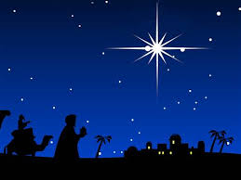
Stars in the New Testament

Slide 27
The Star of Bethlehem
The most famous star in the NT is the star of Bethlehem, which brought the Magi from the east to worship Jesus (Matt 2:1-12).
The star has been variously identified as a supernova, a comet, a conjunction of planets, an object like the pillar of fire which guided Israel, an angel, or as purely fictional.
The behavior of the star after the Magi had consulted Herod (it "went ahead of them until it stopped over the place where the child was") best fits some localized supernatural phenomenon, though some have suggested ways of interpreting this as an object at astronomical distances.
Probably the star is to be under­stood as a fulfillment of Balaam's prophecy (Num 24:17) and as symbolic of Jesus.

Slide 28
NT Use of OT Symbolism
The NT follows the OT in
connecting the vast number of stars with the promise to Abraham of uncountable descendants (Heb 11:12);
in associating stars with angels (Rev 1:20; 9:1; 12:4?);
and in seeing eschatological signs in the sun, moon and stars (e.g., Luke 21:25), though here the emphasis is on the stars falling (Matt 24:29; Mark 13:25; Rev 6:13) more than upon their being darkened (Rev 16:10).
One of the trumpet plagues of Rev (8:10-11) consists of a star falling on the rivers and poisoning their waters, an effect paralleled in the disastrous meteor fall that ended the Creta­ceous period.

Slide 29
Other Symbolism
“Wandering stars" are used as a vivid picture of the heretics denounced in Jude 13, probably in the sense of comets moving away from the sun into the darkness beyond, rather than as planets which ─ though erratic in their move­ments ─ always keep coming back.
The "morning star" is explicitly a symbol for Jesus in Rev 22:16 and probably also in Rev 2:28 and 2 Pet 1:19.
In the first two of these, the reference is apparently to the planet Venus as the morning star, a symbol perhaps of Jesus' first advent as the bright light shining in the darkness before the coming of day.
In 2 Pet 1:19, by contrast, the reference seems to be to the sun as "morning star," with Jesus' second advent in view, when darkness will be entirely banished.
The sun, moon and stars of Joseph's dream (Gen 37) appear again in the heavenly sign of the pregnant woman in Rev 12:1, variously identified as Mary, Israel, or the people of God. Perhaps she and the dragon in this passage are also to be associated with the constellations Virgo and Draco.

Slide 30
For Further Reading
See the article “kokav” from which this is condensed in the New International Dictionary of Old Testament Theology & Exegesis.
That article gives more detail and references to other literature.

Slide 31
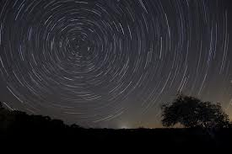
The End

