Slide 1
Scientific Problems for "Scientific Creationism"
How Old is the Earth?
Robert C. Newman

Slide 2
What is 'Scientific Creationism'?
Belief that earth & universe are very young compared to usual secular dates
Only thousands of years instead of billions
Claims the geologic record was laid quickly
Nearly all in one year of Noah's flood
But there are creationists who are scientific who do not subscribe to this view, so a better name would be "young-earth creationism."

Slide 3
Some Problems with a Young Earth
These problems can be categorized under two headings:
Problems with a young earth in general
Problems with flood geology in particular
We will consider these in reverse order.

Slide 4
What is 'Flood Geology'?
Claims geologic record is not a history of earth.
Rather geologic record is a history of Noah's flood.
Nearly all geologic strata laid down in one year.
Thus all geologic phenomena formed very quickly.
Flood geology is a major (indispensable?) feature of young-earth creationism.

Slide 5
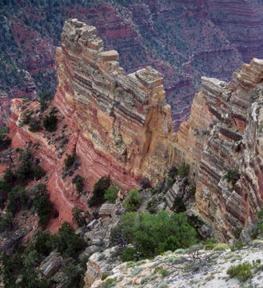
Scientific Problems for 'Flood Geology'

Slide 6
Too Many Fossils
There are thousands of feet of marine fossils.
Was the earth really covered many feet deep with marine life just before the flood?
This is no problem if these sediments are millions of years of deposits.

Slide 7
Too Many Species
An enormous variety of plants and animals are found in the fossil record.
Were there really hundreds of times as many species living at the flood as there are now?
This problem is solved if these varieties of plants and animals lived at various times in a much longer history of the earth.

Slide 8
Too Few Land Animals
There are far fewer fossils of land animals than of marine animals.
This is surprising if all these creatures perished in the same sudden catastrophe that buried them all in water or soil.
This makes better sense if most land animals died on land (not in a flood), where scavengers & decay destroyed their carcasses before they could become fossils.

Slide 9
Sediment Distribution
If the geologic record is largely that of a one-year flood, then the sediments should have settled into the lowest places – sea bottoms.
But there is too much sediment on land, not enough in the oceans, to fit this scheme.
This fits an old earth, in which sediments washed into the oceans are recycled by continental drift dragging them down into the mantle.

Slide 10
Strata Deposited Quickly?
This claim ignores the evidence of slow deposition & slow formation in much (but not all) of the geologic column:
Erosion surfaces
Potholes
Types of cementation
Metamorphosed sediments
Conglomerate rocks

Slide 11
Erosion Surfaces
Throughout the geologic column we find hills, valleys, stream beds.
A number of these have embedded pebbles or shells which are eroded flat to match the surface.
This shows the material holding these objects was already solid when the erosion occurred.

Slide 12
Potholes
Potholes are roundish, vertical-sided holes found in river bottom bedrock.
They are also found in buried strata, implying they were formed by rivers long ago.
These structures need to be solid rock to form vertical or undercut sides.
They show these layers were exposed at the surface as solid rock.

Slide 13
Cementation
Sedimentary rock consists of small particles cemented together. Some kinds are:
Sandstone – particles are sand
Siltstone – particles are silt
Limestone – particles are coral or shells
The cement is typically the same material as forms the particles.
This is surprising if all material was laid down quickly as mud by the flood, rather than gradually in water containing dissolved minerals.

Slide 14
Metamorphosed Sediments
Metamorphic rock has been chemically & physically altered by high heat & pressure.
Some metamorphic rocks were clearly water-laid sediments before they were altered.
Some of these have since been eroded and reburied, pointing to a long history of formation, not a one-year flood.

Slide 15
Conglomerate Rocks
Conglomerate rocks often consist of pieces of one sort of rock in a matrix of another type rock.
Some of these have rounded pebbles for the pieces.
Some of these rounded pebbles are sedimentary rocks.
Some of the sedimentary pebbles even contain fossils.

Slide 16
Summary on Quick Deposit
Not claiming that no sediments have ever been laid down quickly, e.g., Mt. St. Helens.
But clearly not all sediments were.
Like the processes of:
Breadmaking,
Decoupage,
Lacquering,
The time taken for the whole process is controlled by the slowest steps in the process.

Slide 17
Other Phenomena in the Geologic Record
The flood won't produce much of the detailed phenomena we actually find in the rock record:
Salt layers
Clay-silt layers
Carbonate reefs
Chemical separations
Footprints
Wind-laid sediments

Slide 18
Salt Layers
Sea water is about 3% salts, mostly NaCl, with a little CaCO₃ and CaSO₄.
As sea water evaporates, the salts precipitate when different fractions have evaporated:
CaSO₄ when 50% evaporated
CaCO₃ when 80% evaporated
NaCl when 90% evaporated
If sea water has evaporated to:
Below 10%, get a triplet layer of salts
10-20%, get a doublet layer
20-50%, get only a singlet layer

Slide 19
Salt Layers in West Texas
200,000 doublet layers of CaCO₃ and CaSO₄.
Correlated up to 40 miles apart
Average total thickness is 1300 feet
Each layer < 0.1" thick.
Looks like a summer-winter phenomenon, implying at least 200,000 years.
Need to evaporate a million feet of seawater for this!

Slide 20
Clay-Silt Layers
Paired paper-thin layers deposited in lakes or seas:
Clean clay layer
Coarser layer with organic material (pollen, spores)
Looks like a seasonal phenomenon:
Pollen, spores washed in during growing season.
Fine material settles out when lake is ice-covered.

Slide 21
Examples of Clay-Silt Layers
Green River Shales (WY, UT, CO)
Several million pairs (up to 20 million)
Covers over 10,000 square miles
Thickness varies with frequency of sunspot cycle and procession of equinoxes.
Haymond Formation (TX)
15,000 sandstone/shale pairs
Large area, almost a mile thick
How does one get silt to settle quickly?

Slide 22
Carbonate Reefs
A reef is a mound of limestone consisting of the skeletons of corals.
Coral animals can live only below water in the top 100 feet of the sea (to get enough light).
Corals have to process much seawater to get the CaCO₃ they use to make the reef.
The fastest known growth rates are ½ inch per year.

Slide 23
Examples of Carbonate Reefs
Eniwetok Atoll
4600 feet thick
100,000 years to form at fastest known rates
Erosion and land-plant pollen at some levels
Buried Reefs (TX, Alberta)
Underlaid by 1000s ft of sediments
Reefs up to 1000 ft thick, many miles long
Evidence that reefs have grown in place

Slide 24
Chemical Separations
A number of geologic strata are nearly pure salt, limestone, shale or sandstone.
If the flood was characterized by huge tidal waves (to form layers), how do we get these nice separations rather than everything mixed up?
In an old-earth view, these represent long-term environments, for example:
Tropical tidal flat with strong evaporation
Temperate lake or bay with sedimentation

Slide 25
Example of Chemical Separation
Redwall Limestone in Grand Canyon
500-700 feet thick, nearly pure limestone
175 mi NS, 275 mi EW
Enormous number of marine fossils, vs layers above
Many fossils delicate & unbroken, so apparently was rock before 2000 feet of sediment above added

Slide 26
Fossil Footprints
Young-Earth Interpretation
Claimed both human and dinosaur prints in same strata, so both lived at same time, so evolutionists wrong.
Problems with Young-Earth Interpretation
Paluxy strata underlaid by 8500 feet of sediment.
Though at surface here, overlaid E and S by much sediment.
Thus in young-earth view, tracks were made during the flood!

Slide 27
Paluxy Footprints
Recent evidence indicates that most of the claimed human tracks are parts of sequences that are clearly dinosaur tracks further on.
Other "human" tracks:
Some clearly fraudulent
Some irregular erosion patterns
A few might be genuine; more work needed to establish this.
About 60% of underlying strata is limestone, with fossils indicating this was rock before other sediment laid down

Slide 28
Wind-Laid Sediments
In many places wind-laid sediments (desert dunes) are interspersed with large thicknesses of water-laid sediments above & below.
Are we to assume that parts of the earth were bone-dry during the one-year flood, and that large dunes had time to form?
This better fits an old earth.

Slide 29
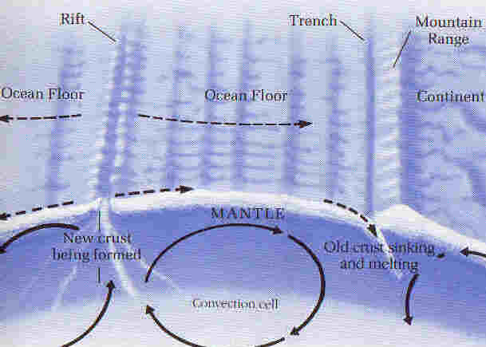
Other Problems with Young Earth

Slide 30
Other Scientific Problems
There are other scientific problems with a young-earth view of origins besides those related to flood geology:
Changes from current rates
Astronomical problems

Slide 31
Current Rates
To have a young earth, one must assume that many things happened much more quickly in the past than they do today:
Speed of light
Radioactive decay
Cooling of rock
Movement of continents
Growth of corals
Magnetic field reversals

Slide 32
Movement of Continents
We can measure the current rate at which continents move, ~ one inch per year.
This is consistent with geologic dating for their separation & collision.
It also fits the increasing depth of sediments as one moves away from the spreading centers.
It also fits the pattern of magnetic reversals.

Slide 33
Astronomical Phenomena
A young earth is not the natural reading of:
Light travel-time
Stellar life cycles as calculated & observed
Planetary cratering
Tidal slowdown

Slide 34
The Young-Earth Track Record
… Is not impressive!
Dinosaur-human tracks
Decaying magnetic field of earth
Changing speed of light
Shrinking sun
Moon dust
No old meteor craters

Slide 35
Similar to Geocentrism
The arguments for a young earth have a similar structure to those for geocentrism.
According to geocentrism, the sun goes around the earth instead of the earth around the sun.
Emphasis is placed on the alleged meaning of various Bible passages as ruling out other views.
Proponents refuse to let scientific data count in deciding what the Bible might mean.

Slide 36
A Caution
As Augustine teaches, there are two things to be observed in questions of this kind. First, that the truth of Scripture be inviolably maintained. Second, since Divine Scripture may be explained in many ways, that no one cling to any particular exposition with such pertinacity that, if what he supposed to be the teaching of Scripture should turn out to be plainly false, he would nevertheless presume to put it forward; lest thereby Sacred Scripture should be exposed to the derision of unbelievers, and the way of salvation should be closed to them.
Aquinas, On the Work of the Second Day

Slide 37
The End
"Test all things;
hold fast to that which is good."

Slide 38
For Further Study
Alan Hayward, Creation & Evolution
Moreland & Reynolds, Three Views on Creation and Evolution
Newman & Eckelmann, Genesis One & the Origin of the Earth
David Snoke, A Biblical Case for an Old Earth
John Wiester, The Genesis Connection
Dan Wonderly, Neglect of Geologic Data
See our website at www.ibri.org.

