Slide 1
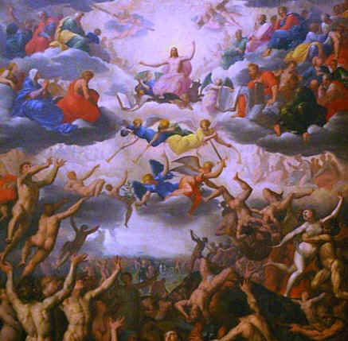
Psalm 50: The Coming Judgment
Robert C. Newman

Slide 2
Psalm 50
Psalm 50 is one of the major passages in the Bible describing what is traditionally called “the Last Judgment.”
Two others are Matthew chapter 25 and Revelation chapter 20.
Each of these has a different perspective and a different emphasis.
We will occasionally refer to these also.

Slide 3
Call to Judgment (1-6)
1 (NIV) The Mighty One, God, the LORD,
speaks and summons the earth
From the rising of the sun to the place where it sets.
2 From Zion, perfect in beauty,
God shines forth.
3 Our God comes and will not be silent;
a fire devours before him,
and around him a tempest rages.
4 He summons the heavens above,
and the earth, that he may judge his people:
5 "Gather to me my consecrated ones,
who made a covenant with me by sacrifice."
6 And the heavens proclaim his righteousness,
for God himself is judge. Selah

Slide 4
Call to Judgment (1-6)
God comes:
In majesty (1-3)
Mighty One, shines forth, fire, tempest
To summon all the earth (1, 4)
Earth, from east to west, heaven & earth
To speak & not remain silent (1, 3)
To judge those who claim to be His (4-5)
Whether they are (7-15) or not (16-21)
To vindicate His own actions (6)

Slide 5
Judgment of the True People of God (7-15)
7 (NIV) "Hear, O my people, and I will speak,
O Israel, and I will testify against you:
I am God, your God.
8 I do not rebuke you for your sacrifices
or your burnt offerings, which are ever before me.
9 I have no need of a bull from your stall
or of goats from your pens,
10 for every animal of the forest is mine,
and the cattle on a thousand hills.

Slide 6
Judgment of the True People of God (7-15)
11 (NIV) I know every bird in the mountains,
and the creatures of the field are mine.
12 If I were hungry I would not tell you,
for the world is mine, and all that is in it.
13 Do I eat the flesh of bulls
or drink the blood of goats?
14 Sacrifice thank offerings to God,
fulfill your vows to the Most High,
15 and call upon me in the day of trouble;
I will deliver you, and you will honor me."

Slide 7
Judgment of the True People of God (7-15)
First God speaks to those who are really His.
Compare Matthew 25, where Jesus speaks first to the sheep.
The emphasis here is on their shortcomings (7).
In Matthew 25, on their faithfulness
In Revelation 20, on their redemption

Slide 8
Judgment of the True People of God (7-15)
They have a poor view of God and an inflated view of their own faithfulness (8-13).
They have been faithful in sacrifices.
But they apparently think they are doing God a favor in serving Him.
God doesn’t need our sacrifices.
He created & owns everything.
If He needed anything, He wouldn’t ask us.
He doesn’t need meat or drink anyway.

Slide 9
Judgment of the True People of God (7-15)
The Purpose of Sacrifice (14-15):
Intended to remind us of our need for Him & His faithfulness to us.
Note the particular offerings mentioned:
Thank-offerings
Vow-offerings
God wants us to keep on calling for His help.
He will keep on rescuing us.

Slide 10
Judgment of the False People of God (16-23)
16 (NIV) But to the wicked, God says:
"What right have you to recite my laws
or take my covenant on your lips?
17 You hate my instruction
and cast my words behind you.
18 When you see a thief, you join with him;
you throw in your lot with adulterers.
19 You use your mouth for evil
and harness your tongue to deceit.

Slide 11
Judgment of the False People of God (16-23)
20 (NIV) You speak continually against your brother
and slander your own mother's son.
21 These things you have done and I kept silent;
you thought I was altogether like you.
But I will rebuke you
and accuse you to your face.
22 "Consider this, you who forget God,
or I will tear you to pieces, with none to rescue:
23 He who sacrifices thank offerings honors me,
and he prepares the way
so that I may show him the salvation of God."

Slide 12
Judgment of the False People of God (16-23)
Now God turns to those wicked people who claim to be His.
This is a somewhat narrower perspective than Matthew 25 & Revelation 20, which include those who don’t claim to be His.
The emphasis here is on the incongruity of their claiming to be God’s people.
In Matthew 25 on their unfaithfulness
In Revelation 20 on their not being redeemed

Slide 13
Judgment of the False People of God (16-23)
They too have a poor view of God & an inflated view of their own faithfulness (16-22).
What right have they to recite God’s laws & apply His covenant to themselves?
Their actions show where their heart really is:
Hate God’s Law.
Sympathize with sinners.
Their mouths reveal their hearts.

Slide 14
Judgment of the False People of God (16-23)
They too have a poor view of God & an inflated view of their own faithfulness (16-22).
They misread the silence of God (21-22).
Think God’s silence means His approval.
Will be surprised by God’s judgment.
God is telling you this ahead of time so that you can do something about it now.

Slide 15
Judgment of the False People of God (16-23)
The Purpose of Sacrifice (23):
Thank-offerings honor God.
They remind us of who He is.
They open the way for people to experience God’s salvation.

Slide 16
The End
Are you ready for the judgment?

