Slide 1
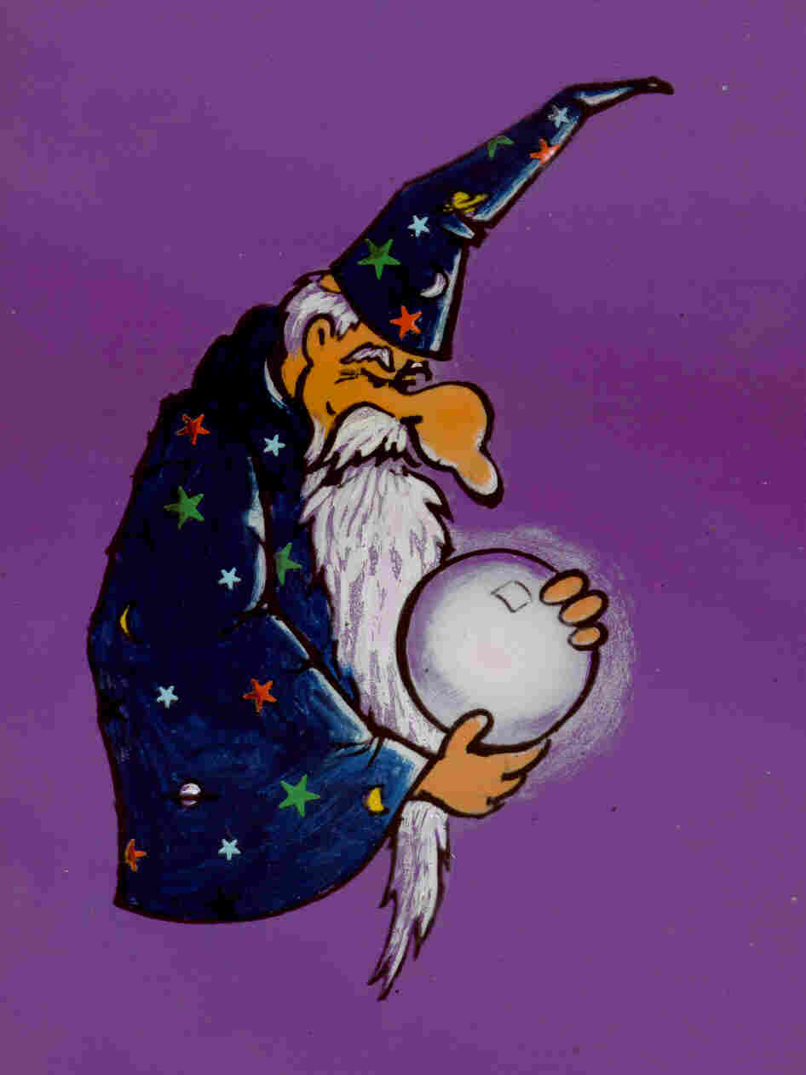
Prophecy: Ancient & Modern
Robert C. Newman

Slide 2
Successful Prophecy!
A juicy profit by modern prophets!
Weather forecasters at Accu-Weather see a hard freeze in Florida before U.S. weathermen do.
They cash in on orange juice futures.

Slide 3
How can we test for successful prediction?
Clear enough to recognize when it happens
Known to have been made before the fulfillment
Not brought about by the prophecy
Sufficiently remote and/or detailed to preclude merely good luck

Slide 4
Some Examples which Fail
Qur'an
Book of Mormon
Nostradamus
Ancient Oracle at Delphi

Slide 5
The Qur'an
The Bible of Islam
Allegedly revealed to Muhammad by an angel from Allah
Makes no predictions except for the last judgment
By then, too late to change religions!

Slide 6
Book of Mormon
Alleged to be records from an ancient civilization on the American continents, written before 400 AD
Revealed to Joseph Smith by an angel
Claims a number of predictions

Slide 7
Claimed Mormon Predictions
America's history foretold 2500 years ago, 1 Nephi 13:
Columbus, verse 12
Fate of the Indians, verse 14
The Puritans, verse 16
The Revolution, verses 17-19
The Bible, verses 23-29

Slide 8
Columbus
And I looked and beheld a man among the Gentiles, who was separated from the seed of my brethren by many waters; and I beheld the Spirit of God, that it came down and wrought upon the man; and he went forth upon the many waters, even unto the seed of my brethren, who were in the promised land. (1 Nephi 13:12)

Slide 9
Fate of the Indians
And it came to pass that I beheld many multitudes of the Gentiles upon the land of promise; and I beheld the wrath of God, that it was upon the seed of my brethren; and they were scattered before the Gentiles and were smitten. (1 Nephi 13:14)

Slide 10
The Puritans
And it came to pass that I, Nephi, beheld that the Gentiles who had gone forth out of captivity did humble themselves before the Lord; and the power of the Lord was with them. (1 Nephi 13:16)

Slide 11
The Revolution
And I beheld that their mother Gentiles were gathered together upon the waters, and upon the land also, to battle against them. And I beheld that the power of God was with them, and also that the wrath of God was upon all those that were gathered together against them to battle. And I, Nephi, beheld that the Gentiles that had gone out of captivity were delivered by the power of God out of the hands of all other nations. (1 Nephi 13:17-19)

Slide 12
Mormon Prophecies
These would be impressive if we could show that the Book of Mormon existed before the 1820s, but we cannot.
In fact, the detailed verbal dependence of the Book of Mormon on the King James version of the Bible suggests it was written after 1611 rather than before 400.
Several lines of evidence suggest the book was written by Joseph Smith in the 1820s.

Slide 13
Nostradamus
The French physician Michael de Notre Dame (1503-66) is highly regarded in New Age circles as a true prophet.
A few of his predictions have been impressively fulfilled.
A few have bombed.
Most are too ambiguous to be sure one way or the other.

Slide 14
The Fire of London (1666)
The blood of the just will make complaint to London,
Burnt by fireballs in twenty-three the sixes;
The antique dame will fall from the high place,
Of the same sect many will be destroyed.
Centuries 2.51

Slide 15
Depopulation of the World (1732)
From the time I am writing this (1 March 1555), before 177 years, 3 months and 11 days, by pestilence, long famine, and wars, and more still by inundations, the world between this day and that, before and after, shall be diminished, and its population so reduced that there will hardly be hands enough to attend to agriculture, and the lands will be left as long without culture as they have been under tillage. (Preface to Centuries, §26)

Slide 16
America?
Of the aquatic triplicity there will be born
One who will make Thursday his holiday:
His fame, praise, rule and power will grow,
By land and sea a tempest to the East.
Centuries 1.50

Slide 17
The Oracle at Delphi
The Temple of Apollo at Delphi was famed in the ancient world as a center for prophetic advice.
A prophetess would go into a trance and give a raving answer to the client's question.
The priests would take notes and come back later with a poetic response.

Slide 18
The Oracle's Advice to Croesus
According to Herodotus, Croesus, the fabulously wealthy king of Lydia in the 6th cen BC, asked the oracle for advice re/ war with the Persians.
The oracle replied: "Attack the Persians and you will destroy a mighty empire."
Croesus attacked and destroyed his own kingdom!

Slide 19
The Bible's Challenge
The prophets of the Bible challenge the other religions to match their fulfillments.
See, for example, Isaiah 45.

Slide 20
The Bible's Challenge
Gather together and come; assemble, you fugitives from the nations. Ignorant are those who carry about idols of wood, who pray to gods that cannot save. Declare what is to be, present it – let them take counsel together. Who foretold this long ago, who declared it from the distant past? Was it not I, the LORD? And there is no God apart from me, a righteous God and a Savior; there is none but me. Turn to me and be saved, all you ends of the earth; for I am God, and there is no other. (Isaiah 45:20-22)

Slide 21
The Bible's Mechanism
I make known the end from the beginning, from ancient times, what is still to come. I say: My purpose will stand, and I will do all I please. (Isaiah 46:10)

Slide 22
Prophecies about Edom & Petra
Edom, a neighbor nation to Israel & Petra, one of its major cities
The biblical prophets make predictions on them in:
Ezekiel 25 (c570 BC)
Malachi 1 (c420 BC)
Obadiah (c830 BC)
Edom

Slide 23
Edom Desolated
This is what the Sovereign LORD says: "Because Edom took revenge on the house of Judah and became very guilty by doing so, therefore this is what the Sovereign LORD says: I will stretch out my hand against Edom and kill its men and their animals. I will lay it waste, and from Teman to Dedan they will fall by the sword. I will take vengeance on Edom by the hand of my people Israel, and they will deal with Edom in accordance with my anger and my wrath." (Ezekiel 25:12-14)

Slide 24
Continual Desolation
"I have loved you," says the LORD. But you ask, "How have you loved us?" "Was not Esau Jacob's brother?" the LORD says. "Yet I have loved Jacob, but Esau I have hated, and I have turned his mountains into a wasteland and left his inheritance to the desert jackals." Edom may say, "Though we have been crushed, we will rebuild the ruins." But this is what the LORD Almighty says, "They may build, but I will demolish. They will be called the Wicked Land, a people always under the wrath of the LORD." (Malachi 1:2-4)

Slide 25
Lowly Nation
This is what the Sovereign LORD says about Edom – We have heard a message from the LORD: An envoy was sent to the nations to say, "Rise, and let us go against her for battle" – See I will make you small among the nations; you will be utterly despised. The pride of your heart has deceived you, you who dwell in the clefts of the rocks and make your home on the heights, you who say to yourself, "Who can bring me down to the ground?" Though you soar like the eagle and make your nest among the stars, from there I will bring you down, declares the LORD. (Obadiah 1-4)

Slide 26
Summary of Predictions
Edom is to be desolated.
Israel is going to take vengeance on Edom.
The desolation will be continual; Edomite attempts to rebuild will not last.
Even though their dwellings seem secure, this is what will happen.

Slide 27
Edom & Petra/Sela
Located Southeast of the Dead Sea
Most of the area is not good for agriculture, though there is some grazing.
But had copper mining, and an important N-S trade route.

Slide 28
Petra – the Siq
Entrance to the city:
Gorge a mile long
Narrows to 12 feet wide
Cliffs up to 300 ft high
The city is naturally fortified and almost impregnable.

Slide 29
Inside Petra
An enclosed valley
Most of the ruins are tombs & buildings carved in the cliffs.
About 300 BC, the Nabatean Arabs drive out the Edomites and make Petra the capital of their commercial empire.

Slide 30
Edomites Subjugated to Jews
The Edomites, forced out of Edom by the Nabateans, go into southern Palestine.
About 125 BC, they are conquered and subjugated by the Jews under the Maccabean ruler John Hyrcanus.
Idumea

Slide 31
Nabatean Petra
Back in Petra, the Nabatean Arabs are prospering.
They go on to build very elaborate structures there.

Slide 32
Roman Conquest
But in 105 AD the city of Petra is conquered by the Romans.

Slide 33
Roman Petra
Under Roman control, the city's prosperity continues, as seen in this 3,000-seat theatre.
But this is followed by a gradual decline of the city as trade routes shift.

Slide 34
Muslim Petra
About 630 AD, the city is conquered again, this time by the Muslim Arabs.
It is then gradually deserted, and not rediscovered until the 19th century.
Now the 1000+ cliff buildings are only a tourist attraction.

Slide 35
Fulfillment for Edom & Petra
The land of Edom was desolated several times, but rather permanently since about 650 AD.
Israel took vengeance on the Edomites about 125 BC by conquering them and forcing them to adopt Judaism or die.
Several attempts to rebuild Edom have been thrown down.
Even with a fortified city like Petra, the territory has been conquered and desolated.

Slide 36
Jeane Dixon
But what about those modern seers we read about so often in the newspapers?
We will consider one of the most popular, Jeane Dixon.

Slide 37
Jeane Dixon
She first became nationally known with the publication of a book about her, A Gift of Prophecy.
This book recounts several striking fulfillments.

Slide 38
Death of John Foster Dulles
One of the most uncanny forecasts Jeane Dixon has ever personally made to me came in December 1958…. "John Foster Dulles," she said, "will not be in the Cabinet after the middle of the year." Amused by her lack of political perspicacity, I replied, "I'm not going to put that in the column. President Eisenhower relies on Mr. Dulles more than any other member of his Cabinet. He would not dream of letting him go." "No," she said imperturbably, "he won’t discharge him." "Well, Mr. Dulles certainly won’t quit," I argued…. Jeane responded, "No, he will not want to quit, but he won't be living by midyear." (Gift of Prophecy, 98-9)

Slide 39
Successor to Nehru
Few could hope, for instance, to duplicate the feat she performed late in 1956. During the course of a newspaper interview a reporter asked for a forecast about Jawaharlal Nehru, who had then been Prime Minister of India since 1947. Jeane consulted her crystal ball and replied that he would be succeeded within approximately seven years by a man whose name would begin with the letter s. On May 27, 1964, death claimed the great Indian leader, and Parliament chose as his successor Lal Bahadur Shastri. Shastri's name, as foreseen slightly more than seven years before, did indeed begin with an s. (Gift of Prophecy, 28)

Slide 40
Assassination of Kennedy
Four years later, while two reporters from Parade magazine were interviewing her about predictions, she abruptly skipped over the intervening years and declared, "A blue-eyed Democratic president elected in 1960 will be assassinated." Startled by the bluntness of her words, the reporters suggested that they simply say he would "die in office." "Say it as you like, but he will be assassinated," she replied. Her prediction appeared in the Parade issue of May 13, 1956… (Gift of Prophecy, 6)

Slide 41
Some Misses
Even in A Gift of Prophecy, the author admits that Jeane Dixon has had some misses:
Red China would start a world war in October 1958.
Walter Reuther would seek the presidency in 1964.
Others have found many more.

Slide 42
Satanic Vision?
In A Gift of Prophecy, chap 19, Jeane recounts an early morning vision of a snake winding around her body & pointing her to the East, where a great world leader will arise.
In her later book My Life and Prophecies, chap 9, she admits this may have been Satanic.

Slide 43
Summary on Jeane Dixon
Some real fulfillments
Some real misses
Some of her predictions seem to look at the rise of the Antichrist from his side. Do we really want to follow a seer of this sort?

Slide 44
Some Biblical Tests of Prophecy
Those who are satisfied that the Bible comes from God will want to apply its tests to prophets, both ancient and modern.
Let's look at several of these.

Slide 45
Not all miracles are from God
And then the lawless one will be revealed, whom the Lord Jesus will overthrow with the breath of his mouth and destroy by the splendor of his coming. The coming of the lawless one will be in accordance with the work of Satan displayed in all kinds of counterfeit miracles, signs and wonders… (2 Thessalonians 2:8-9)

Slide 46
Test to see whether from God
Dear friends, do not believe every spirit, but test the spirits to see whether they are from God, because many false prophets have gone out into the world. This is how you can recognize the Spirit of God: Every spirit that acknowledges that Jesus Christ has come in the flesh is from God, but every spirit that does not acknowledge Jesus is not from God. This is the spirit of the antichrist… (1 John 4:1-3)

Slide 47
Biblical prophets don't miss
You may say to yourselves, "How can we know when a message has not been spoken by the LORD?" If what a prophet proclaims in the name of the LORD does not take place or come true, that is a message the LORD had not spoken. That prophet has spoken presumptuously. Do not be afraid of him. (Deuteronomy 18:21-22)

Slide 48
Failed Prophecies of Christian "Prophets"
This is an area where Charismatic Christians are often sloppy.
They claim to have a supernatural gift of prophecy from God, yet are reluctant to apply biblical tests.
Consider, for instance, David Wilkerson, of Cross and Switchblade fame.

Slide 49
Wilkerson's Vision
In his book, The Vision, Wilkerson claims to have direct revelation from God about the future.
However, he makes a number of predictions which have failed.

Slide 50
A few good years left
In spite of all the danger signs around us of impending economic disaster, the next few years (from 1973) will be among the most prosperous in the history of mankind. They will be fat and flourishing years. In spite of tight money policies, people will continue to spend freely. Sales will continue to break records and people will spend more than ever in modern history. Credit debt will become nearly uncontrollable. I see, very clearly, just a few years of tremendous affluence and continuing economic prosperity. (The Vision, 16)

Slide 51
What happened?
Though the prediction sounds pretty good at a distance of 30 years, in fact it bombed.
That very year, the Dow-Jones experienced its biggest fall since the Great Depression, from over 1000 to under 600 in 20 months.
Since then we have had 30 years of unusual prosperity in the US.

Slide 52
Test their message.
But even if we or an angel from heaven should preach a gospel other than the one we preached to you, let him be eternally condemned! (Galatians 1:8)

Slide 53
The "Golden Gate" Prophecy
As a last example of fulfilled predictions in the Bible, consider the prophecy relating to the so-called "Golden Gate" on the East side of Jerusalem.

Slide 54
The "Golden Gate" Prophecy
This particular gate comes directly out of the temple complex and simultaneously out of the city, just out of the picture to the left in this model of Jerusalem.

Slide 55
The "Golden Gate" Prophecy
Then the man [angel] brought me [Ezekiel] back to the outer gate of the sanctuary, the one facing east, and it was shut. The LORD said to me, "This gate is to remain shut, it must not be opened; no one may enter through it. It is to remain shut because the LORD, the God of Israel, has entered through it." (Ezekiel 44:1-2)

Slide 56
The East Gate at Jesus' Time
At Jesus' time, this gate led to a bridge across the Kidron Valley, and was the direct entry to the Temple from the east.
It looks like this was the route Jesus took at his triumphal entry.

Slide 57
Jesus' Triumphal Entry
Jesus comes from the East, from Bethany on the Mount of Olives (Mark 11:1).
Literally (Mark 11:11), "he enters into Jerusalem into the Temple…"

Slide 58
Jerusalem Destroyed
In AD 66, the Jews rebel against Roman tyranny & misrule.
After a terrible siege & famine, the Romans take Jerusalem in August, AD 70, burning & leveling the city.

Slide 59
Jerusalem Rebuilt
The city is rebuilt in AD 135 and remains under Roman control till 640, when it is taken by the Muslims.
It is under Muslim rule till 1948, with the present "Old City" walls the work of Suleiman the Magnificent in 1543.

Slide 60
Jerusalem Today
In the latest rebuilding (1543), the East Gate was rebuilt.
The gate was shortly thereafter closed up, apparently because Christians were using it for their Easter processions.

Slide 61
Jerusalem Today
Legend has it that a great conqueror will reopen the gate.
Kaiser Wilhelm's dream to open the gate was foiled because he did not take the city.
British General Allenby did, but he would not open the gate because he felt only Jesus should do so.

Slide 62
The Golden Gate Today
Thus the Eastern Gate still stands shut today.
It is a mute witness to God's Word through the prophet Ezekiel.

Slide 63
Summary on Prophecy
Whether large or small, the prophecies of the Bible have come true because God controls the future:
Edom & Petra
The Golden Gate
Other prophets, though occasionally successful, often miss because God causes them to do so.

Slide 64
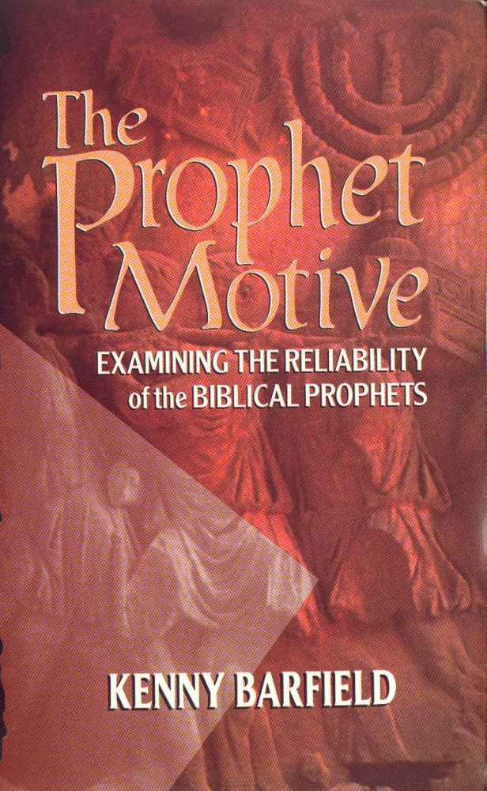
For Further Reading
There are many more biblical prophecies that have already been fulfilled besides these two.
See my book The Evidence of Prophecy and Kenny Barfield’s The Prophet Motive.

