Slide 1
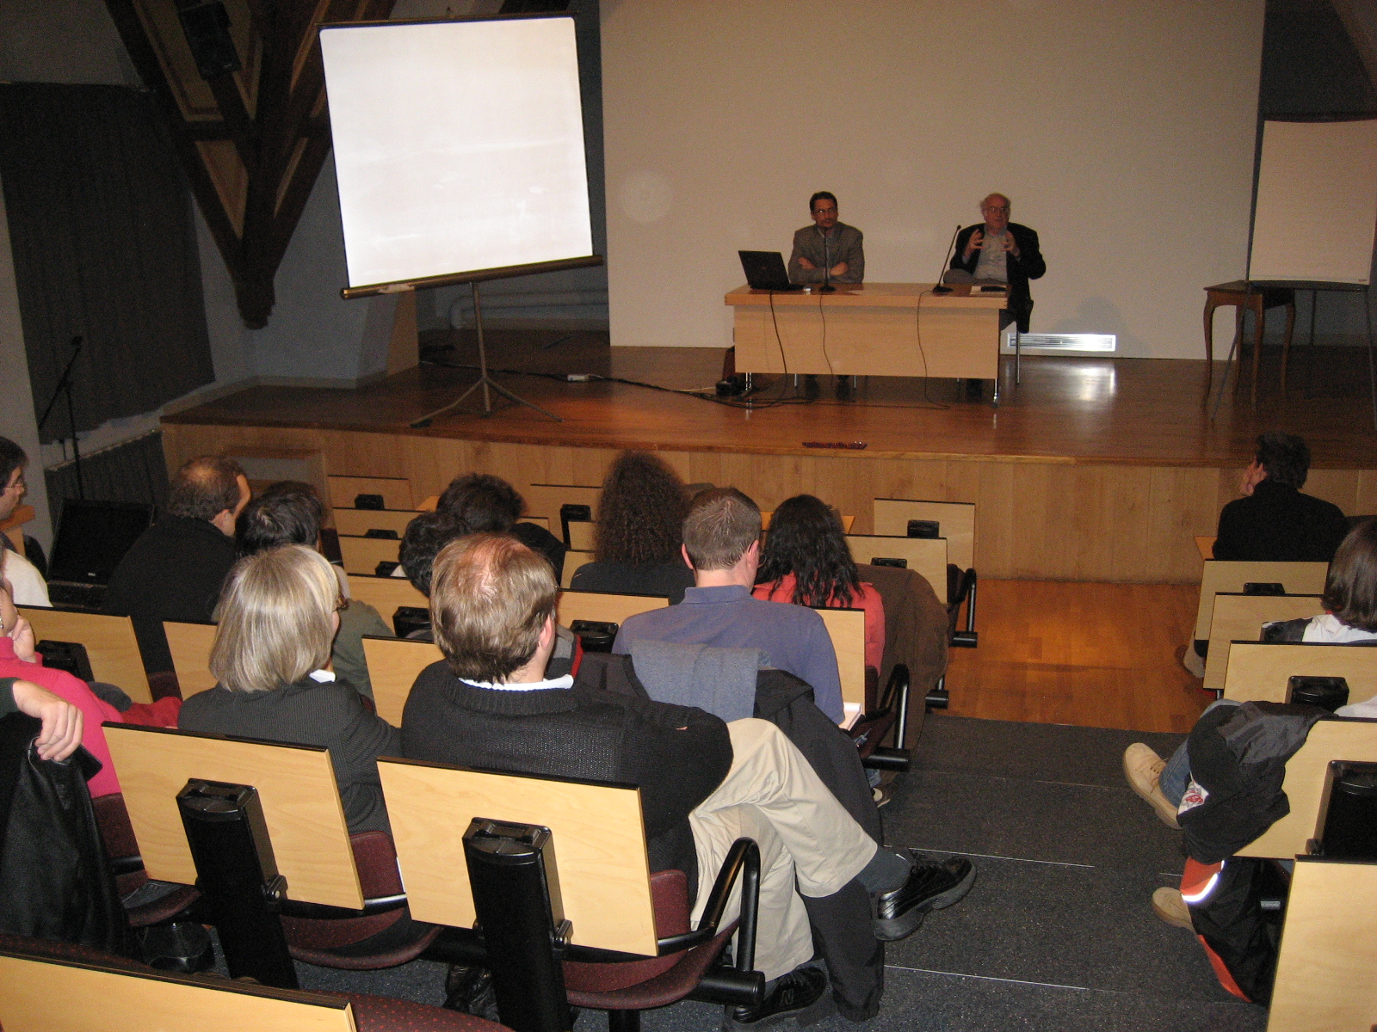


Presenting the Gospel to Those who Reject Scripture
Robert C. Newman

Slide 2
The Problem
Presenting the Gospel is fairly straight-forward when your audience is people who know & accept Scripture, as often in the US.
But even in the United States many do not fall into this category.
Gallup Poll (1984), Religion in America

Slide 3
The Problem
While 42% in the US believe the Bible is God’s inerrant word, 30% think it is sometimes mistaken, and the rest think it is not God’s word, or have no opinion.
The situation is generally far less favorable in Europe, where atheism and theological liberalism have had much more influence.

Slide 4
Religion in the Netherlands
I could not locate views on the Bible for the Netherlands, but the religious situation looks like this:
Catholic 30%
Reformed 21%
Muslim 4%
Non-Religious 40%
Other 5%
www.EveryCulture.com/Netherlands

Slide 5
Lack of Bible Knowledge
Even among those who have a high view of the Bible, many don’t know what it says.
For instance, a 1982 poll in the US showed:
70% knew where Jesus was born (seen in every Christmas pageant).
Only 46% could name all four Gospels.
Only 42% knew who gave the Sermon on the Mount.

Slide 6
Among Bible-Believers
Some, when they hear God’s offer of free pardon, will accept it immediately.
Others may later turn to Christ when they learn for themselves what the Bible says, often thru longer-term Bible studies.
Unfortunately, others will later reject it when they learn what the Bible really says. They don’t like it!

Slide 7
Responses of Bible Non-Believers
But what about those who don’t accept the Bible?
Do we just tell them what it says, and have them take it or leave it?
No.
The apostle Paul has set us an example of how to present the Gospel to quite diverse audiences.

Slide 8
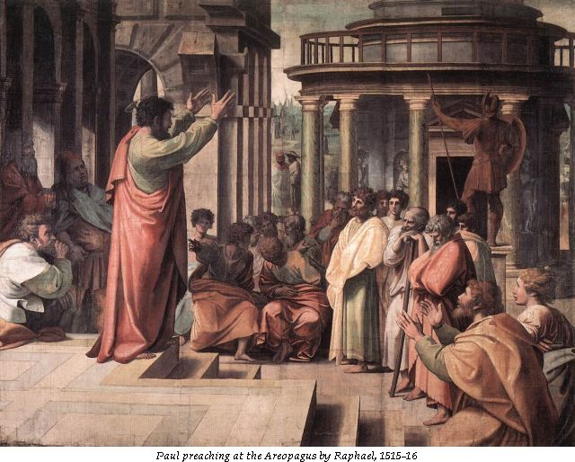
Paul’s Example

Slide 9
To Those Knowing Scripture
Paul made use of their Bible knowledge in presenting the claims of Christ.
In the synagogue at Pisidian Antioch (Acts 13), Paul spoke to Jews, proselytes, Godfearers, and interested Gentiles:
  He sketched the history of Israel.
  He used Messianic prophecy.

Slide 10
To Those Not Knowing Scripture
Paul does not assume any Bible knowledge.
To pagan Gentiles in the market-place at Lystra (Acts 14), Paul notes:
  Besides the spectacular healing…
  Evidence of the creator God in nature thru his gifts of rain, crops, food, and joy.
In the more sophisticated setting in Athens (Acts 17):
  Paul rebukes their idolatry.
  God needs nothing, but gives us everything.
  He made us to seek him, and he is not far away.
  Paul cites the pagan authors Epimenides & Aratus.

Slide 11
To All These
Paul gives a Gospel presentation:
  Telling who Jesus is…
  Calling on his hearers to repent & turn to God…
  Giving evidence of Jesus’ resurrection, of which Paul was an eyewitness.
Besides these examples, Paul gives us his guiding principles in evangelization.
To be more effective, he urges the believers at Corinth (1 Cor 9):
  To give up their selfish attitudes,
  To stop being stumbling blocks,
  To reach out to others.

Slide 12
Paul’s Strategy
1 Cor 9:19-23 (NIV) Though I am free and belong to no man, I make myself a slave to everyone, to win as many as possible. 20 To the Jews I became like a Jew, to win the Jews. To those under the law I became like one under the law (though I myself am not under the law), so as to win those under the law. 21 To those not having the law I became like one not having the law (though I am not free from God's law but am under Christ's law), so as to win those not having the law. 22 To the weak I became weak, to win the weak. I have become all things to all men so that by all possible means I might save some. 23 I do all this for the sake of the gospel, that I may share in its blessings.

Slide 13
Lessons from Paul
We should not expect the unsaved to come looking for us…
  though perhaps they ought to (and some will).
We should not expect them to accept Scripture already or to hold orthodox doctrines.
We must go where they are:
  Geographically, linguistically, culturally, methodologically, emotionally
Yet we must not compromise the Gospel itself.

Slide 14

Some Approaches to those who reject Scripture

Slide 15
Various Approaches
There are many:
These are audience-dependent (as Paul notes).
So we use different approaches for:
  Muslims
  Buddhists
  Secularists
But also different approaches for:
  Liberal, sophisticated Muslims
  Conservative, less-educated Muslims

Slide 16
Approaching Atheists/Agnostics
We present evidence for the existence of God:
Philosophical arguments for those with interest or education in philosophy
  But there aren’t many with philosophical education.
As science is highly regarded today, the scientific evidence for God will probably have a greater impact on larger numbers.
  But even here the number of people who are scientifically literate is rather small.
Most people get their knowledge of science, philosophy & theology from the media, which is a very poor source for this.

Slide 17
Approaching Theists
There are many around the world who believe a god (or gods) exists, but who don’t identify him with the God of the Bible.
For these it may be most effective to:
  Present the claims of Christianity in contrast to other religions.
  Give evidence for the truth of Scripture.

Slide 18
Approaching Bible-Believers who Pick and Choose
Some accept the truth of parts of the Bible, but not the parts that seem unreasonable to them.
These may be helped by:
  Responding to the things which trouble them,
  Presenting the claims of Jesus,
  Giving evidence for his resurrection.

Slide 19
Summary on Approaches
All these can be helpful to remove stumbling blocks that keep people from coming to Christ.
They can also be helpful to Christians:
  Giving them confidence in God’s Word
  Defending them from oppression by skeptics
They can help to stop the mouths of opponents, who often teach that Christians are ignorant, gullible & afraid to face the truth.

Slide 20

Getting People to Listen

Slide 21
Will They Listen?
If they won’t, these methods will be fruitless.
  Example of a former atheist friend
Problem of competition:
  Christianity is just one of many religions.
  The media has a powerful influence.
Problem of assumed familiarity:
  Christianity is just the same old thing.
  I’ve tried it & it didn’t work.

Slide 22
How Can We Get Them to Listen?
Ultimately, we can’t.
Only God can cause them to listen.
  Sometimes he uses disasters.
  Sometimes he uses non-Christians.
But God will often let us share in his work.
  Thru our friendships with unsaved people
  Thru others observing us when we don’t even know it.
We need to pray that God will move them to listen.
We need to have regular contacts with unbelievers.

Slide 23

Some Materials

Slide 24
Websites
There are lots of websites that provide materials and arguments to help people see that Christianity is true.
Do a Google search on “Evidence for Christianity.”
Two that emphasize evidence from science are:
  RTB: www.reasons.org
  IBRI: www.ibri.org

Slide 25
Some of My PowerPoints
These are narrated PowerPoint talks I have designed & used in various contexts, usually aimed at the level of college students.
First, a series of talks I gave to secular audiences in Russia in 1992 has recently been assembled into a single PowerPoint entitled “Russia Seminar Talks.”

Slide 26
Russia Seminar Talks
Given October 1992
in Novgorod & Vologda
by Robert C Newman

Slide 27
Russia Seminar Talks
This particular PowerPoint begins with the question “Does God exist?
Then it asks “What kind of God exists?”
Then “Why believe the Bible?”
Next “What’s wrong with mankind?”
Then “Who is Jesus?”
Next “Did Jesus really rise from the dead?”
Then “Is there life after death?”
Finally, “How can I know God?”

Slide 28
PowerPoints on Science
Christianity & Science
Computer Viruses, Artificial Life & the Origin of Life
The Cosmos & the Bible
Creation-Evolution Debate
Genesis One & the Origin of the Earth
Intelligent Design
Scientific Problems for Scientism

Slide 29
PowerPoints on Fulfilled Prophecy
Fulfilled Prophecy: Nostradamus & the Bible
Israel: Evidence of God in History
Jesus: Testimony of Prophecy & History
New Testament Prophecy
Prophecy: Ancient & Modern
Prophecy, Probability & God
They Saw Jesus … Centuries in Advance

Slide 30
PowerPoints Responding to Objections
Biblical Firmament: Vault or Vapor?
Several PPs on DaVinci Code
Did Moses Write the Torah?
The God of the Bible on Trial
Jesus and the New Age
Mormonism
Responding to Jehovah’s Witnesses
The Tomb of Jesus?

Slide 31
PowerPoints on History
Another Jesus?
Authorship & Date of the Synoptic Gospels
The Bible: Its Transmission & Value
The Canon of the New Testament
Evidence for the Resurrection
Search for the Historical Jesus
The Star of Bethlehem: What Was It?
Synoptic Problem
What is History All About?

Slide 32
Viewing These PowerPoints
All of these talks may be viewed, with audio narration, on the website www.ibri.org under “The Robert C. Newman Library” under “Power-Point Lectures.”
You are welcome to download and use any of these for outreach and education.

Slide 33
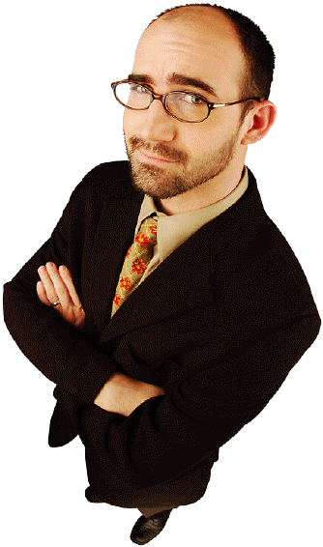
Presenting Sin to Those Who Don’t Believe in It

Slide 34
Presenting Sin
Used effectively in past centuries
Not getting much attention today
  Partly because Christians want to be more positive
  Partly the “I’m OK, you’re OK” emphasis
GK Chesterton once said that original sin is the only doctrine of Christianity which can really be proved.
Without endorsing Chesterton’s “only,” we can make use of the evidence he had in mind.

Slide 35
Evidence of Sin from Psychology
In spite of the popularity of the “self-esteem” movement and its claim that the main human problem is too low an opinion of ourselves…
David G. Myers of Hope College notes that research psychologists have amassed a “powerful river of evidence” that exactly the opposite is true.

Slide 36
Myers’ Evidence
1. We tend to accept much more responsibility for our successes than for our failures, which are typically seen as bad luck or someone else’s fault.
2. Most of us view ourselves as above average in any particular good trait, and a large percentage of us put ourselves in the very highest percentiles.

Slide 37
Myers’ Evidence
3. When we cannot deny that we did a particularly nasty thing, we are usually quite good at justifying it.
4. We commonly overestimate the accuracy of our judgments and the truth of our beliefs.
5. Most of us are unrealistically optimistic in remembering and reporting information about ourselves, and in predicting how well we will do in life.

Slide 38
Myers’ Evidence
6. We consistently overestimate how virtuously we would act in hypothetical situations compared with how we actually act in real ones.
7. Depressed people are typically more accurate in their self-appraisal and more likely to see themselves as others see them.

Slide 39
Myers’ Evidence
Myers’ paper may be located on the Internet by Googling on his name “David G. Myers” or the paper’s title “The Inflated Self.”
He has also written a book with this title.
There you will find references to all these points in the literature of research psychology.

Slide 40
Peter’s Advice
1 Pet 3:15 (NIV) But in your hearts set apart Christ as Lord. Always be prepared to give an answer to everyone who asks you to give the reason for the hope that you have. But do this with gentleness and respect,
16 keeping a clear conscience, so that those who speak maliciously against your good behavior in Christ may be ashamed of their slander.

Slide 41
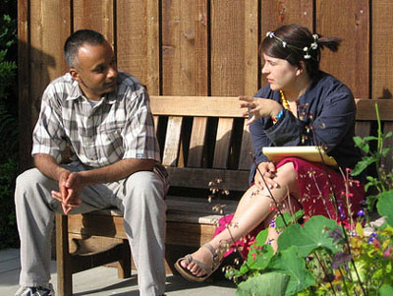
The End
May the Lord strengthen us in outreach to unbelievers

