Slide 1
New Testament Prophecy
Robert C. Newman

Slide 2
The Bible's Message
There is a God.
He has told us things we need to know:
What he is like
Who we are
Where we came from
How we have turned away from God
What he has done to bring us back

Slide 3
Our Response
Many of us do not like the Bible's message.
We would prefer a god of our own design, or no god at all.
Why should we believe the Bible is anything more than wishful thinking or guesses by ancient people?

Slide 4
The God of the Bible
Controls history.
Knows the end from the beginning.
Sometimes reveals things to prophets:
Secrets about himself
Secrets about the future

Slide 5
New Testament Prophecy
Let's look at some prophecies made in the Bible.
Made before the events happened
We will look just at New Testament examples.
These provide strong evidence the Bible is not just guesswork.

Slide 6
Cities of Galilee
At the time of Jesus, Galilee was a prosperous and densely populated part of Israel.
We want to look at three cities there:
Bethsaida
Chorazin
Capernaum
•Bethsaida
•Capernaum
•Chorazin

Slide 7
Jesus' Predictions
Jesus often taught in & around these towns.
Capernaum was his home base in Galilee.
Because many in these towns rejected his message even after seeing his miracles, Jesus warned them of disaster to come.

Slide 8
Woes to Galilean Cities
Woe to you, Chorazin! Woe to you, Bethsaida! For if the miracles had occurred in Tyre and Sidon which occurred in you, they would have repented long ago in sackcloth and ashes. Nevertheless, I say to you, it shall be more tolerable for Tyre and Sidon in the day of judgment than for you. And you, Capernaum, will not be exalted to heaven, will you? You shall descend to Hades, for if the miracles had occurred in Sodom which occurred in you, it would have remained to this day. (Matthew 11:20-24)

Slide 9
Woes to Galilean Cities
Jesus names three specific cities:
Chorazin
Bethsaida
Capernaum
The remark "it would have remained to this day" indicates Jesus is talking not only about the destiny of individuals but also the survival of the cities themselves.

Slide 10
Their Subsequent History
Each of these cities survived difficult times in the wars between Rome & Israel in the century following.
Each was later destroyed in the Arab period.
Today, none of these survive, and even their locations were lost for centuries.

Slide 11
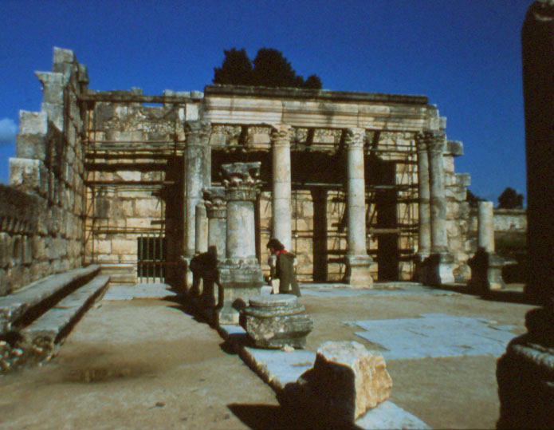
Capernaum
The location of Capernaum was rediscovered in the 19th century.
Its most prominent ruin is the synagogue.
It has been partly restored using the stone not taken earlier.
Otherwise the town is merely rubble.

Slide 12
Chorazin
Located a few miles up in the hills above Capernaum
It, too, is just a ruin today.
Perhaps Jesus spoke in its synagogue.
Its people were unwilling to admit their sin before a holy God & turn back to Him.

Slide 13
Bethsaida
Bethsaida, too, is gone.
Its site has only recently been located, buried under the silt deposited by the Jordan River.

Slide 14
Galilean Cities
There were many cities in Galilee at Jesus’ time; there are many today.
A number survive from antiquity:
Tiberias
Nazareth
Cana
But our 3 cities are gone, the only Galilean cities Jesus condemned.
•Capernaum
•Tiberias

Slide 15
Jerusalem
Jerusalem was the religious center of Israel in Jesus' time.
Jews from all over the Roman Empire came to worship here.
It was a large city, with massive walls & strong towers to defend the gates.

Slide 16
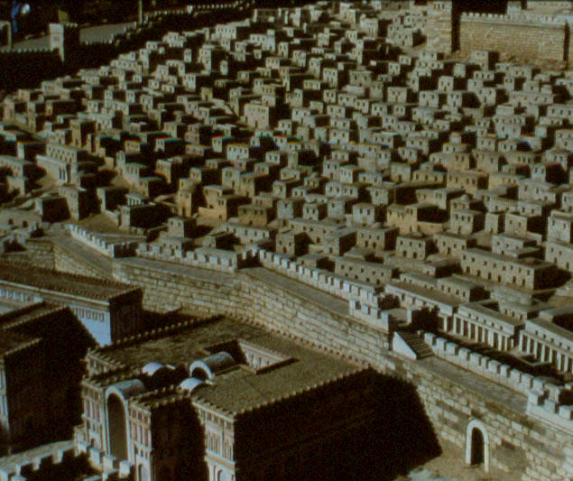
Jerusalem
The upper city was the wealthy section, home of the upper priesthood & successful merchants.
The lower city was more modest, but still rather prosperous. There was much trade because of the crowds of pilgrims, especially at the major festivals.

Slide 17
Jesus' Predictions
As with the cities of Galilee, Jesus warned of disaster to come.
But his prophecy takes a different turn for Jerusalem.
He said, "When you see Jerusalem surrounded by armies… let those who are in the city depart."
He also predicted what would happen to the city for centuries to come.

Slide 18
Jesus on Jerusalem
But when you see Jerusalem surrounded by armies, then recognize that her desolation is at hand. Then let those who are in the midst of the city depart, and let not those who are in the country enter the city… there will be great distress upon the land, and wrath to this people, and they will fall by the edge of the sword, and will be led captive into all the nations, and Jerusalem will be trampled under foot by the Gentiles until the times of the Gentiles be fulfilled. (Luke 21:20-24)

Slide 19
The Fall of Jerusalem
The Romans surrounded Jerusalem in AD 64, but then (unaccountably) withdrew.
Those who believed Jesus' words got out of the city and did not return.
Those who ignored his words flocked to the city as the best-fortified in the land, and were destroyed in the siege and capture which followed.

Slide 20
How Do We Explain This?
The events of 66-70 AD fit Jesus' predictions so well that some resort to claiming they were invented after that time & dishonestly put in Jesus' mouth.
This ignores the historical evidence that Luke was written in the late 50s or early 60s, before these events happened.

Slide 21
Jerusalem Trodden Down
It also ignores the fact that Jesus predicted the status of Jerusalem for centuries to come.
"Jerusalem will be trampled under foot by the Gentiles until the times of the Gentiles be fulfilled."

Slide 22
Aelia Capitolina
This is just what happened.
The Romans left Jerusalem a ruin for over 50 years.
Then about 135 they built a pagan city on the site, with pagan temples to desecrate the Jewish & Christian holy places.
Jerusalem was "trampled down" by pagan Romans from AD 70 to about 325.

Slide 23
Christian Jerusalem
When Constantine, a Roman emperor in the 4th century, adopted Christianity, he removed the pagan temples from Christian sites.
The Jewish temple site was left empty.
Jerusalem continued to be trampled down by Gentiles, now the Christian Romans, from 325 to 637.

Slide 24
Muslim Jerusalem
Muhammad, founder of Islam, led his followers on a holy war which burst out of the Arabian peninsula about 630.
The Muslims took Jerusalem in 637.
The Gentile Muslims controlled Jerusalem until the Crusaders took it away in 1099.

Slide 25
Crusader Jerusalem
The European Crusades to win back the Holy Land from the infidel Muslims succeeded briefly.
Jerusalem was taken with the slaughter of all its inhabitants in 1099.
The Gentile crusaders controlled Jerusalem until it was taken back by the Gentile Muslims, now Turks, in 1187.

Slide 26
Turkish Jerusalem
The Turks held Jerusalem (except for a brief time under the Egyptian Muslims) until the end of World War 1.
Here we see a sketch of Jerusalem as it looked in 1839.

Slide 27
British Mandate Jerusalem
At the end of World War 1, the League of Nations gave control of Palestine to the British.
The Gentile British continued their mandate until 1948, when the United Nations divided Palestine into two nations, one Arab and one Jewish.

Slide 28
Jerusalem Today
The war which followed British withdrawal left the control of the old city in Arab hands.
But in the Six-Day War of 1967, Israel regained the old city, and Jerusalem ceased to be trampled under foot by the Gentiles for the first time in 1900 years.

Slide 29
Summary on Jerusalem
Just as Jesus said, Jerusalem (unlike the 3 Galilean cities) continued to exist as a city.
Yet for centuries it remained under Gentile control, though it was the most holy site in Judaism.
Finally, as Jesus said, it has come once more under Jewish control.

Slide 30
Summary on Jerusalem
Though Jesus (with other prophets of the Bible) predicts still future troubles for Jerusalem, his predictions in Luke 21:20-24 have been fulfilled in detail.
A number of these details came long after the latest possible date at which Luke could have been written.

Slide 31
The Temple
Jesus not only predicted the future of Jerusalem but also that of the Temple there.
The so-called "2nd Temple" was built in 515 BC to replace Solomon’s temple, destroyed 70 years earlier by the Babylonians.
Just before the time of Jesus, Herod the Great completely rebuilt it, producing the magnificent structure modeled here.

Slide 32
Herod's Temple
Herod's Temple, which stood from 20 BC to 70 AD, was one of the marvels of the ancient world:
Large marble building, trimmed with real gold
Huge stone terrace 700 x 1500 feet
Collonades with roofs over 75 feet high

Slide 33
Jesus' Predictions
As he left the temple for the last time in his earthly career, Jesus mentioned what would happen to it.
The disciples were pointing out all the impressive buildings on the terrace.
Jesus said not one stone of them would be left upon another.

Slide 34
Jesus on the Temple
And Jesus came out from the temple and was going away when His disciples came up to point out the temple buildings to Him. And He answered and said to them, "Do you not see all these things? Truly I say to you, not one stone here shall be left upon another which will not be torn down." (Matthew 24:1-2)

Slide 35
The Fall of Jerusalem
This is exactly what happened.
When the Romans finally managed to break through the city walls in the summer of AD 70, they captured and burned the city.
Although it was claimed that the Roman general Titus did not want to destroy the Temple, somehow a fire broke out and consumed it.

Slide 36
The Temple Dismantled
The Jewish historian Josephus was an eyewitness of these events.
In book 7 of his Jewish War, he describes the destruction in these words: "The army now having no victims either for slaughter or plunder … Caesar ordered the whole city and the temple to be razed to the ground."

Slide 37
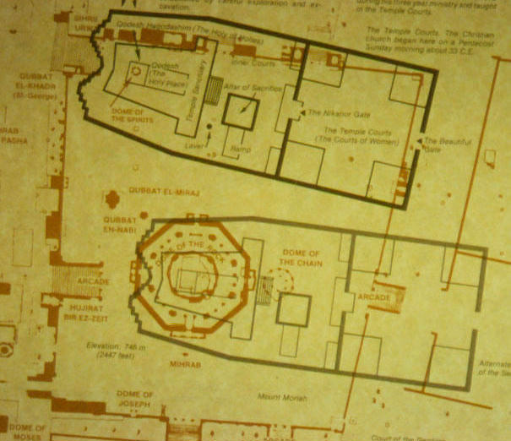
The Temple Site Today
Now not a single building on the temple terrace survives from before AD 70.
Archeologists are not even agreed where the Temple was located on the platform:
Some think it stood where the Dome of the Rock now stands.
Others put it about 100 meters to the north.

Slide 38
The Western (Wailing) Wall
Only the retaining wall of the temple terrace remains to indicate something of the Temple's magnificence.
Jesus' words were fulfilled exactly.

Slide 39
Attempts to Thwart Prophecy
We have evidence of two attempts to thwart Jesus' prophecy by the most powerful humans alive.
Titus, the general who took Jerusalem in AD 70, tried to preserve the Temple.
In spite of this, the temple was destroyed.

Slide 40
Attempts to Thwart Prophecy
Several centuries later, the emperor Julian tried to rebuild it.
He did this to spite the Christians, since they believed it would not be rebuilt until just before Jesus returns.
Julian ordered the work, provided materials, and encouraged Jewish participation.

Slide 41
Attempts to Thwart Prophecy
The night before the rebuilding was to begin, there was a disastrous earthquake.
Thereafter strange phenomena interfered with the work until it was finally abandoned.
Several accounts survive, including one from the very year of the event.
We quote from an early pagan account by a friend of the emperor.

Slide 42
Rebuilding Stopped
Eager to extend the memory of his reign by great works, [Julian] planned at vast cost to restore the once splendid temple at Jerusalem, which after many mortal combats during the siege by Vespasian and later by Titus had barely been stormed. He had entrusted the speedy performance of this work to Alypius of Antioch… But though this Alypius pushed the work on with vigor, aided by the governor of the province, terrifying balls of flame kept bursting forth near the foundations of the temple and made the place inaccessible to the workmen, some of whom were burned to death; and since in this way the element persistently repelled them, the enterprise halted. (Ammianus Marcellinus)

Slide 43
Summary on the Temple
Not only were Jesus' words fulfilled, but strong attempts to thwart the prediction were turned aside.
Was this just luck, or is the Bible really a revelation from the God who controls history?

Slide 44
Jesus' Second Coming
Another type of prophecy which occurs frequently in the NT regards Jesus’ return.
One day Jesus will return to earth to rescue his followers & bring judgment to all who are in rebellion against God.
Jesus himself made such predictions; so did his disciples Peter, Paul & John.
But Jesus has not yet returned, so how can we know he will?

Slide 45
Rejection of the 2nd Coming
Many, such as the late Bishop Pike, claim Jesus was mistaken.
"There will be no 2nd coming," they say, "because Jesus & the apostles believed it would happen in the 1st century, in their own generation."
Various Bible passages have been used in seeking to prove this.

Slide 46
This Rejection Predicted!
Yet the Bible predicts just such a reaction on the part of unbelievers.
In 2 Peter 3:4, they are predicted as saying, "Where is this promise of His coming? For ever since the fathers fell asleep, all continues just as it was from the beginning of creation."
Thus those who deny the 2nd coming fulfill a prediction by their very denial.

Slide 47
The Last Days
Not only does the NT predict the return of Jesus and denials thereof,
It also makes further predictions about conditions in the last days before his return.
Paul, writing to his associate Timothy, characterizes the days that immediately precede Jesus' return.

Slide 48
The Last Days
Paul says that at that time, things will be dangerous because "men will be lovers of self, lovers of money, boastful, arrogant, revilers, disobedient to parents, ungrateful, unholy, unloving, irreconcilable, malicious gossips, without self-control, brutal, haters of good, treacherous, reckless, conceited, lovers of pleasure rather than lovers of God; holding to a form of godliness, although they have denied its power." (2 Timothy 3:1-7)

Slide 49
Being Fulfilled Today?
It looks like our generation is characterized by this list of sins.
We live in a time of great self-indulgence.
We are "lovers of self" and "lovers of pleasure" to an unusual degree.

Slide 50
Being Fulfilled Today?
The 20th century saw:
Some of the worst wars in history
Some of the most brutal governments
A general collapse of morals that may be unprecedented in scope
Truly these are "dangerous times"!

Slide 51
Being Fulfilled Today?
There have always been criminals, but today crime is rampant in our cities.
Because men are "disobedient to parents, ungrateful, unholy, unloving,… brutal, haters of good, treacherous," the very fabric of society is threatened.

Slide 52
Being Fulfilled Today?
Sexual immorality has been common in many societies, though Christian influence has tended to drive it underground.
But the recent collapse of moral standards, plus the technology of birth control, has led to an explosion of extramarital sex and venereal diseases, most recently AIDS.
Truly our age is one in which people are "unholy, unloving … lovers of pleasure rather than lovers of God."

Slide 53
Being Fulfilled Today?
Many criminal acts of a century ago are now legal.
Fewer crimes are being solved.
A smaller fraction of convictions are being obtained.
Yet we face a serious problem of overcrowding in our prisons.
Crime must really be rampant if this is so.

Slide 54
Being Fulfilled Today?
With all our problems convicting criminals, it is not surprising that civil lawsuits have increased.
We cannot find honest behavior or get satisfaction from the law, so we pay a lawyer to sue for us.
Or we use lawsuits or threats to browbeat others.
Truly men today are "arrogant, revilers, … irreconcilable, malicious gossips."

Slide 55
Being Fulfilled Today?
Police are increasingly unable to protect the law-abiding citizens.
Individuals are having to form neighborhood surveillance teams.
Sales of watchdogs, burglar alarms, locks and firearms are rising dramatically as crime spreads to neighborhoods once thought safe.

Slide 56
Being Fulfilled Today?
Other symptoms are:
Broken families
Child-neglect
Child-abuse
Abortion
People no longer seem to be able to sacrifice their own freedom & pleasure to the welfare of their marriage & family.
They have become "lovers of self, lovers of money,… lovers of pleasure rather than lovers of God."

Slide 57
Being Fulfilled Today?
Perhaps corporations have always had better reputations than they deserve.
Yet the collapse of absolute moral standards has encouraged far more unethical activity by businesses just as it has for individuals.

Slide 58
The Point?
There have always been people who fit the categories of 2 Timothy 3.
What makes this generation notable is the rejection of absolute moral standards.
This is a spin-off from the view that evolution has shown religion is man-made & moral standards are arbitrary.
Here again the NT has predicted a phenomenon of considerable importance.

Slide 59
Summary on NT Prophecy
We have looked at a number of passages in the NT where it speaks of things still future when it was written but which have now come to pass.
It gives a list of cities to be destroyed.
It sketches the future of Jerusalem:
Its destruction
Its control by the Gentiles
Its return to Jewish control

Slide 60
Summary on NT Prophecy
The desolation of Jerusalem’s Temple occurred & continued in spite of powerful attempts to thwart it.
The scoffing of unbelievers regarding Jesus' 2nd coming itself fulfils a prediction.
Terrible conditions due to widespread moral decay seem now to be in the process of fulfillment.

Slide 61
What Should We Do?
Some claim these examples are merely a string of lucky guesses by ancient writers.
Others that these were contrived by me to make the Bible look good.
Either reaction is rather foolish.

Slide 62
What Should We Do?
At the least, we owe it to ourselves to get a Bible & see whether these things are really there.
It would be foolish to go thru life hoping there is no such God as pictured in the Bible & then find out too late that there is!

Slide 63
What Should We Do?
Right now, there is still time to do something about it.
We can follow the example of the people who first heard the apostle Peter proclaim the resurrection of Jesus.
When they suddenly realized they were under God's condemnation, they asked Peter what they should do.

Slide 64
What Should We Do?
He told them to hate their sins and turn back to God.
Like them, we must trust in Jesus, who by dying on the cross provides forgiveness in such a way that God can release us from our deserved punishment and still remain just.

Slide 65
What Should We Do?
None of us knows how much time we have to make such a decision.
We might die any moment.
We might live another 50 years.
All we know is that we have this moment, and that time is running out.

Slide 66
The End…
…May Be Nearer Than You Think!

