Slide 1
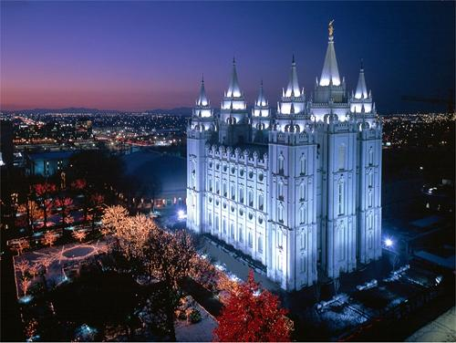

Mormonism
A Sketch & Evaluation of the LDS Church
Robert C. Newman

Slide 2
What is Mormonism?
Many people view Mormonism as just another denomination of Christians.
The leadership of the LDS Church tends to encourage this, seeking acceptance and converts.
Yet the theology of Mormonism is drastically different than that of Biblical Christianity, as we shall seek to show.

Slide 3
Overview
In this talk, we will consider:
A history of Mormonism, as told by the Mormons (with some response)
Mormon doctrine tested by the Bible
Mormon evidences examined
Conclusions on Mormonism

Slide 4
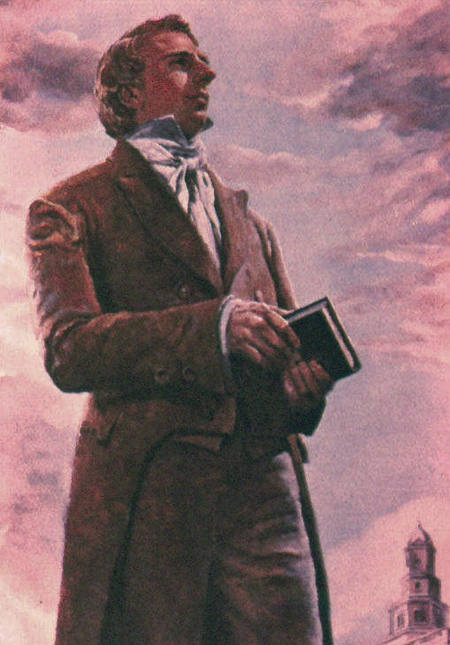
A History of
Mormonism
As told by Mormons

Slide 5

Joseph Smith, the Founder
Born 1805 in Sharon, Vermont
Moved with his parents to Palmyra, NY
Claimed to have received a vision during the NY revival of 1820:
  Saw the Father and Son
  Asked them which church he should join
  Answer: None! They are all corrupt!

Slide 6
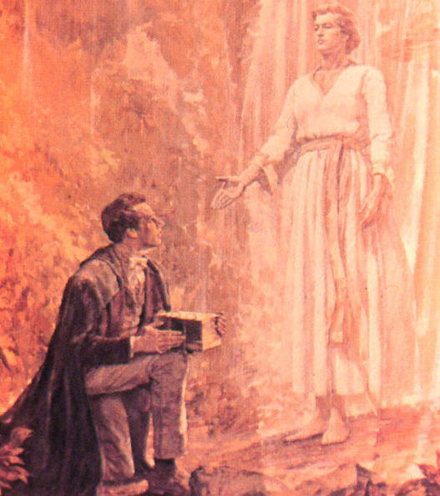
The Book of Mormon
Smith was told he had been chosen to restore the church to its original purity.
He is shown a set of golden plates containing God's revelation for the Western world.
Smith begins to translate these using the Urim and Thummim.
The translation is published in 1830.

Slide 7
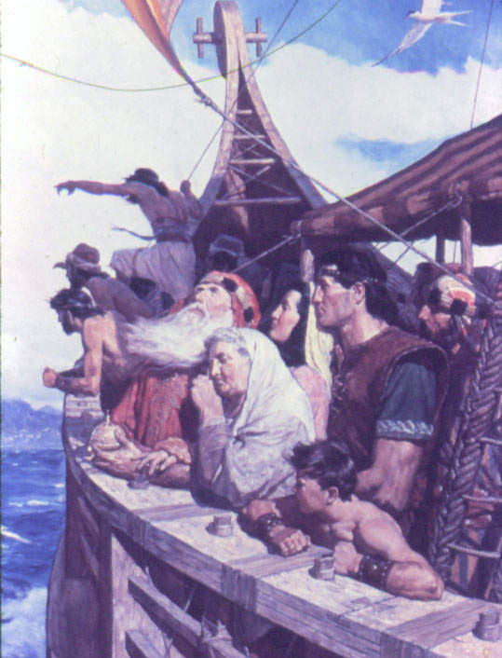
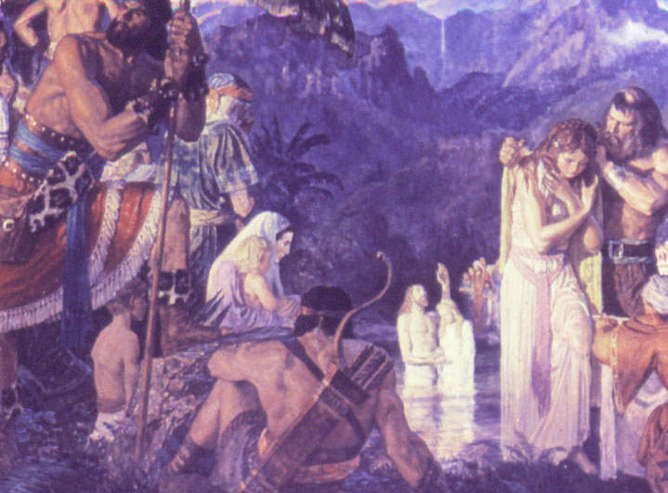
Contents of Book of Mormon
600 BC - Lehi is told by God to leave Jerusalem before it is destroyed.
He and family build a ship and sail across the Pacific to Mexico.
Their descendants develop into two nations, the Nephites (good) and Lamanites (bad). A long history of warfare, apostasy and revival follows.

Slide 8
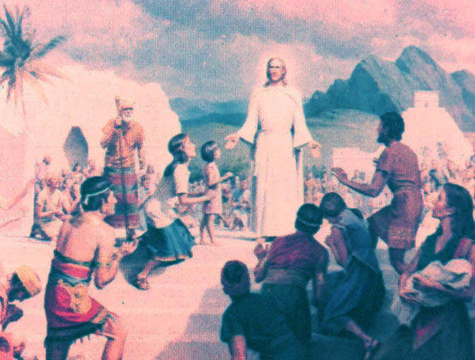
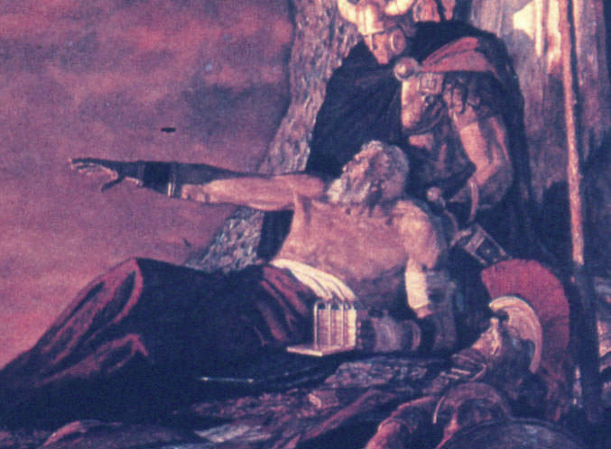
Contents of Book of Mormon
Later, Jesus comes to the W hemisphere & preaches after his ministry in Judea.
The Lamanites defeat & wipe out the Nephites.
Mormon entrusts the history on golden plates to son Moroni, who buries them in upstate NY and dies about AD 400.

Slide 9
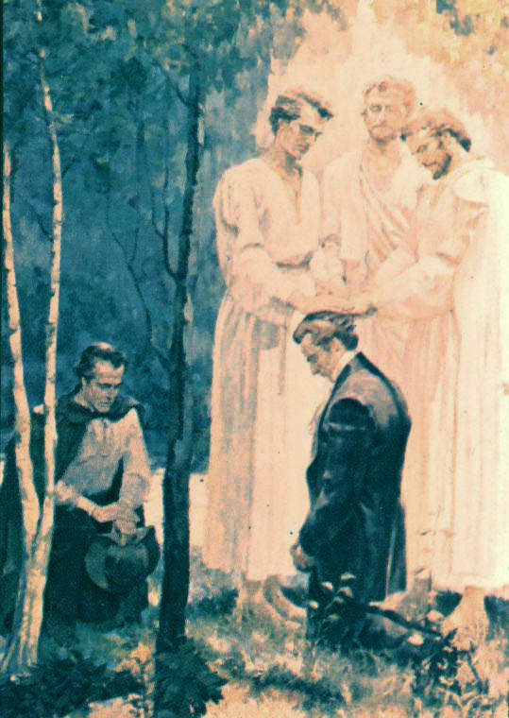
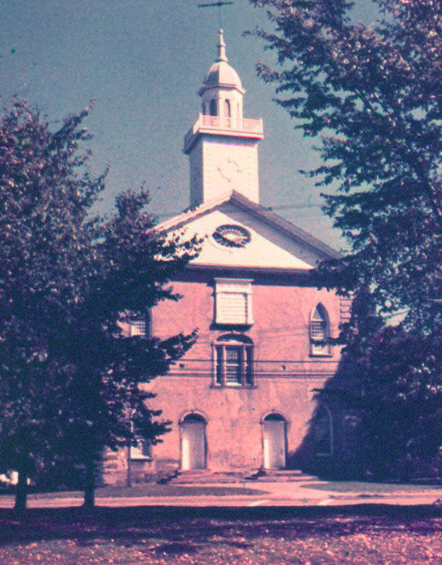
Back to Joseph Smith's Career
In June 1829 Peter, James and John appear to Smith and Oliver Cowdery, restoring the Melchizedek priesthood.
B of M is printed, 1830. Smith & followers begin to distribute "the Golden Bible."
The group moves to Kirtland, OH. Smith becomes head over 12 apostles. 1st temple is completed 1836.

Slide 10
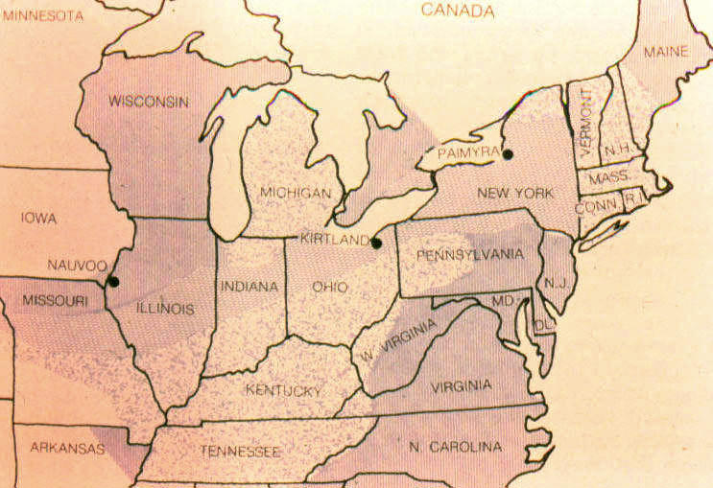
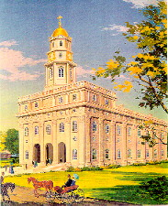
Smith's Career
The Mormons are opposed by "Gentiles" in NY, OH, MO.
In 1839, the MO settlement fails, they move to Nauvoo, IL.
Illinois, in sympathy, gives Nauvoo a broad charter; competition between Whigs & Democrats for votes.
The Nauvoo temple is begun in 1841.

Slide 11
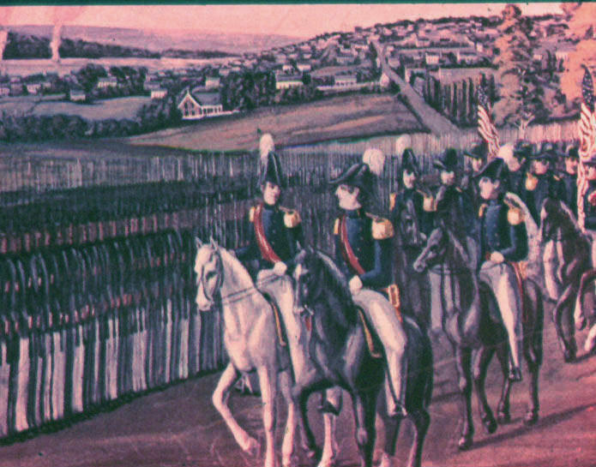
Smith's Career
Nauvoo is allowed to have its own independent militia. Smith becomes mayor of Nauvoo and commander of the Nauvoo Legion – spiritual, political & military leader.
In 1844, Mormon missionaries campaign for Smith in the US presidential election.
Smith has an opposition newspaper destroyed. His opponents charge him with treason.
The governor of IL calls up the state militia, fearing a civil war.

Slide 12
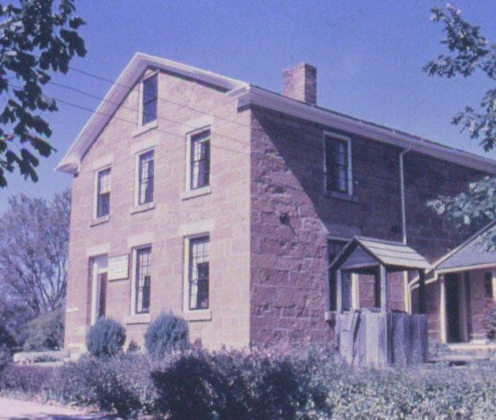
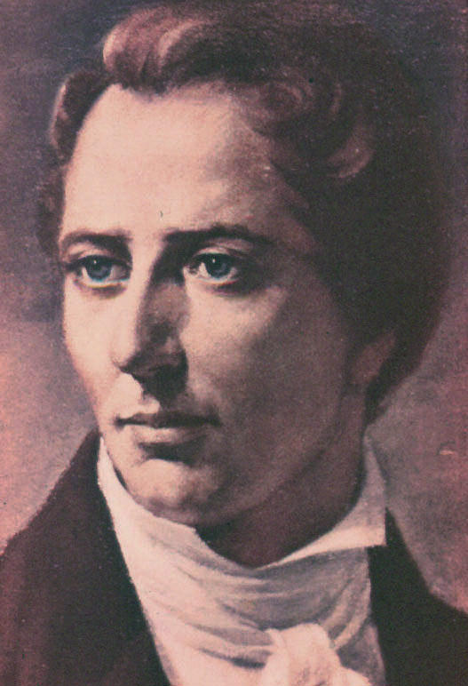
Smith's Career
Smith eventually gives himself up, and is imprisoned in the county jail.
The governor sends the militia home, but a group of them return, storm the jail, and kill Joseph Smith.
As a result, Smith comes to be seen as a martyr by the Mormons.

Slide 13
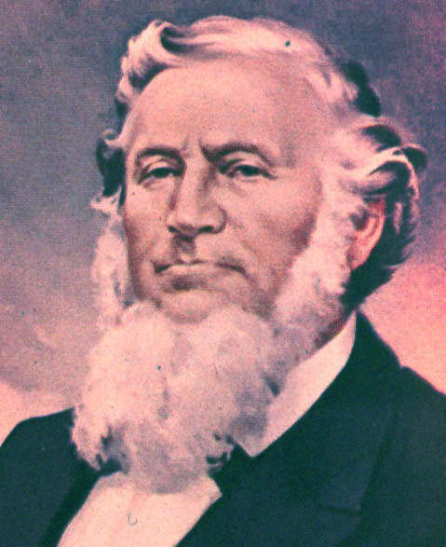
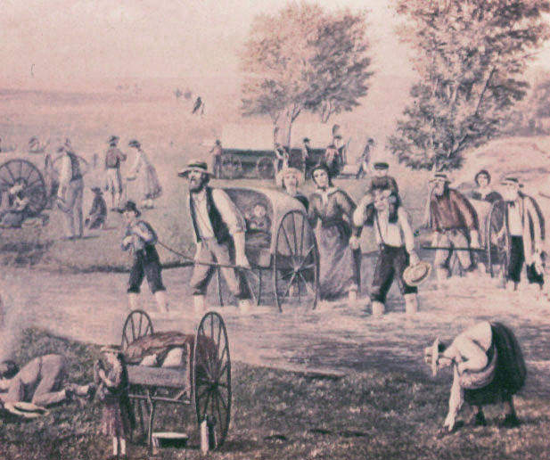
Mormons after Smith
Brigham Young becomes Smith's successor.
After 2 more years opposition, Young leads his followers to Utah, where they build their new society in the wilderness.
The Mormons continue to evangelize in the US and Europe, encourag-ing converts to come to Utah.

Slide 14
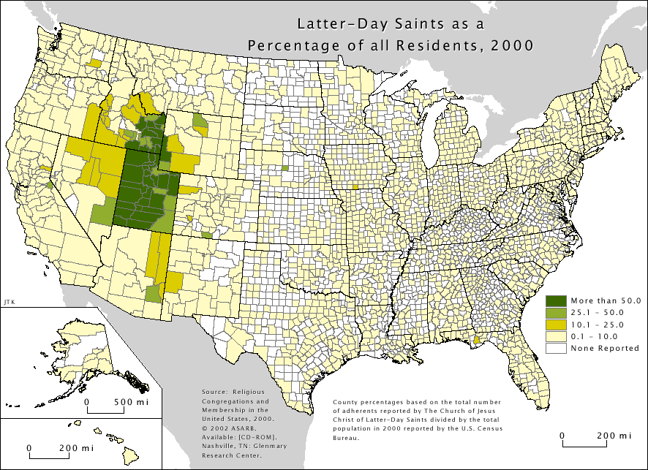
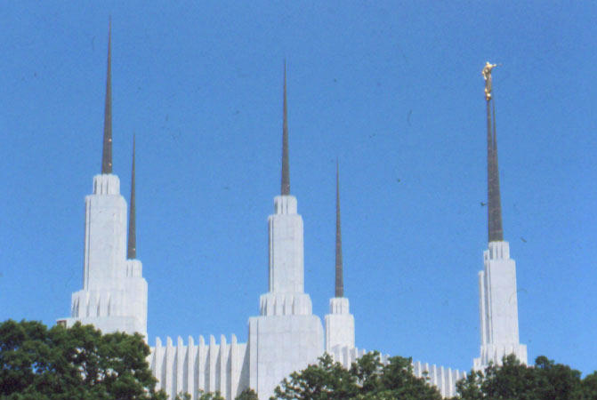
Mormons after Smith
By the 1880s, there are 80,000 Mormons, mostly in Utah.
The Mormons renounce polygamy so UT can become a state.
In 20th cen, Mormons multiply to over 5 million worldwide.
They have over 20 temples, performing eternal marriages and baptisms for the dead.

Slide 15
Some Comments on History
Not as nice as Mormons portray it.
Joseph Smith & family were involved in the occult and something like crystal gazing before he founded the church.
There are serious historical problems with Smith’s vision story.
Though the Mormons were mistreated by their neighbors, their own words and deeds contributed to this.

Slide 16
Some Comments on History
The newspaper Smith destroyed was threatening to expose his teaching of polygamy, which was then only rumored among the Mormons.
Smith had in fact been practicing polygamy on the sly for some years, and some of his "wives" were already married to others.
There is evidence that Smith had sexual relations with about forty women.
Not a good sign for an alleged prophet of God!

Slide 17
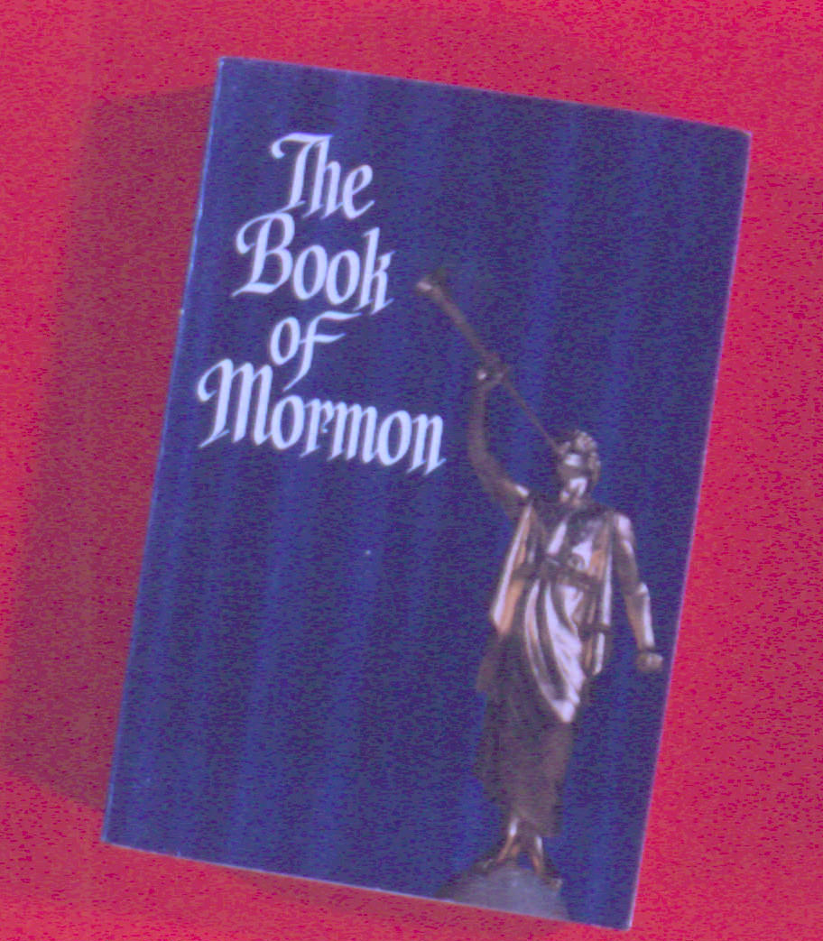
Mormon Doctrine
…tested by the Bible

Slide 18
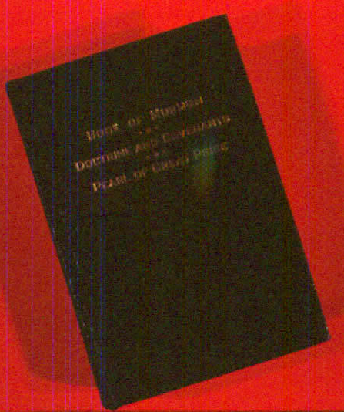
Mormon Doctrine
The official doctrinal statement of the LDS Church, adopted in 1830, shows where they started … but not where they went.
Mormonism developed a good deal during the rest of Smith's life.
The Mormon Scripture includes:
  The Bible – KJV
  The Book of Mormon
  The Doctrines & Covenants
  The Pearl of Great Price

Slide 19
The Articles of Faith – 1830
We believe in God, the Eternal Father, and in His Son, Jesus Christ, and in the Holy Ghost.
We believe that men will be punished for their own sins, and not for Adam’s transgression.
We believe that through the atonement of Christ, all mankind may be saved, by obedience to the laws and ordinances of the Gospel.
We believe that the first principles and ordinances of the Gospel are:
  (1) Faith in the Lord Jesus Christ;
  (2) Repentance;
  (3) Baptism by immersion for the remission of sins;
  (4) Laying on of hands for the gift of the Holy Spirit.

Slide 20
The Articles of Faith – 1830
We believe in the same organization that existed in the Primitive Church, viz., apostles, prophets, pastors, teachers, evangelists, etc.
We believe in the gift of tongues, prophecy, revelation, visions, healing, interpretation of tongues, etc.
We believe the Bible to be the Word of God so far as it is translated correctly; we also believe the Book of Mormon to be the Word of God.
We believe all that God has revealed, all that He does now reveal, and we believe He will yet reveal many great and important things pertaining to the Kingdom of God.

Slide 21
Applying Biblical Tests
…to Mormon Doctrine

Slide 22
Test #1 – No Other Gods
If a prophet, or one who foretells by dreams, appears among you and announces to you a miraculous sign or wonder, and if the sign or wonder of which he has spoken takes place, and he says, "Let us follow other gods" (gods you have not known) "and let us worship them," you must not listen to the words of that prophet or dreamer. The LORD your God is testing you to find out whether you love him with all your heart and with all your soul. – Deut 13:1-3

Slide 23
Other Gods
"And then the Lord said, 'Let us go down.' And they went down at the beginning, and they, that is the Gods, organized and formed the heavens and the earth.… And the Spirit of the Gods was brooding upon the face of the waters. And they (the Gods) said, 'Let there be light'; and there was light…" – Abraham 4, Pearl of Great Price.

Slide 24
Good Mormons become gods
"… if a man marry a wife by my word [with proper authorized ceremony] … ye shall come forth in the first resurrection … and shall inherit thrones, kingdoms, principalities … and they shall pass by the angels, and the gods… Then shall they be gods… then shall they be above all… because they have all power, and the angels are subject to them. Verily, verily, I say unto you, except ye abide my law, ye cannot attain to this glory." – D&C 132:19-23

Slide 25
Test #2 –
No Error in Prediction
But a prophet who presumes to speak in my name anything I have not commanded him to say, or a prophet who speaks in the name of other gods, must be put to death. You may say to yourselves, "How can we know when a message has not been spoken by the LORD?" If what a prophet proclaims in the name of the LORD does not take place or come true, that is a message the LORD has not spoken. – Deut 18:20-21

Slide 26
Smith's Civil War Prophecy
"Verily, thus saith the Lord concerning the wars that will shortly come to pass, beginning at the rebellion of South Carolina, which will eventually terminate in the death and misery of many souls; And the time will come that war will be poured out on all nations, beginning at this place. For behold the Southern States shall be divided against the Northern States, and the Southern States will call upon other nations, even the nation of Great Britain…" D&C 87:1-3a, 25 Dec 1832.

Slide 27
Smith's Civil War Prophecy
"… and the Southern States will call on other nations, even the nation of Great Britain, as it is called, and they shall also call upon other nations, in order to defend themselves against other nations, and then war shall be poured out upon all nations." – D&C 87:3

Slide 28
Salem Treasure Prophecy
"I, the Lord your God, am not displeased with your coming on this journey, notwith-standing your follies. I have much treasure in this city for you, for the benefit of Zion… And it will come to pass in due time that I will give this city into your hands, that you shall have power over it… and its wealth pertaining to gold and silver shall be yours. Concern not yourselves about your debts, for I will give you power to pay them." – D&C 111:1-5; 6 Aug 1836 at Salem, MA.

Slide 29
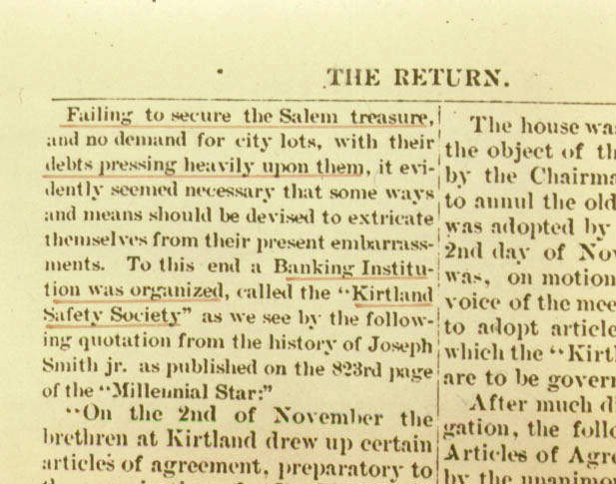
Salem Treasure Prophecy
"Failing to secure the Salem treasure, and no demand for city lots, with their debts pressing heavily upon them, it evidently seemed necessary that some ways and means should be devised to extricate themselves from their present embarassments. To this end, a Banking Institution was organized, called the 'Kirtland Safety Society.'" – The Return (July, 1889).

Slide 30
Test #3 – No Other Gospel
I am astonished that you are so quickly deserting the one who called you by the grace of Christ and are turning to a different gospel – which is really no gospel at all… But even if we or an angel from heaven should preach a gospel other than the one we preached to you, let him be eternally condemned! – Galatians 1:6-8

Slide 31
Another Gospel
"Behold, my son, this thing ought not to be; for repentance is unto them that are under condemnation and under the curse of a broken law. And the first fruits of repentance is baptism; and baptism cometh by faith unto the fulfilling the command-ments, and the fulfilling the commandments bringeth remission of sins." – Moroni 8:24-25

Slide 32
Salvation by Faith Alone
I tell you the truth, whoever hears my word and believes in him who sent me has eternal life and will not be condemned; he has crossed over from death to life. – John 5:24
For it is by grace you have been saved, through faith – and this not from yourselves, it is the gift of God – not by works, so that no one can boast. – Ephesians 2:8-9

Slide 33
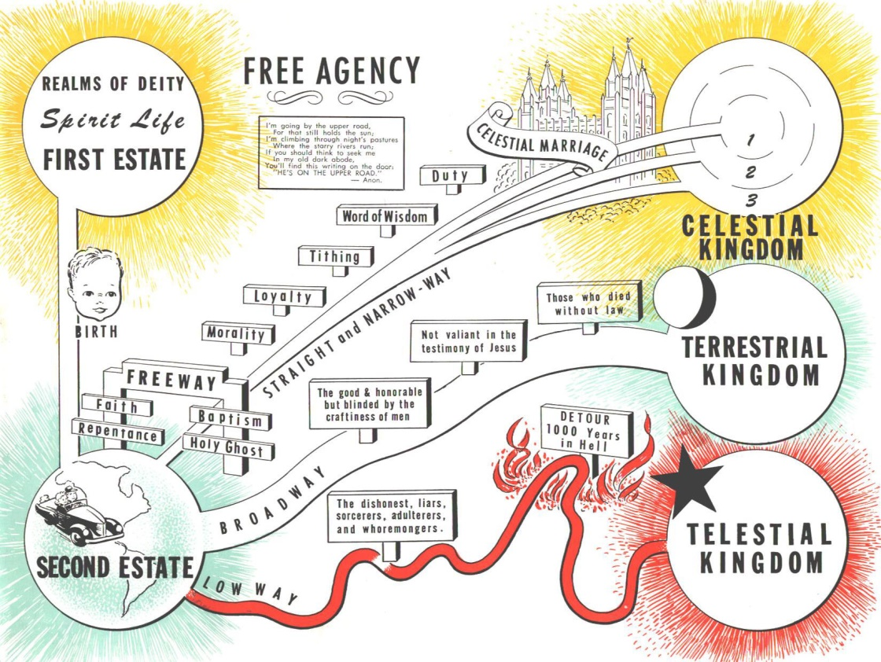
The Mormon Scheme
Celestial State (D&C 76:50-70)
  Believe, baptized, cleansed by commandments
Terrestrial State (71-80)
  Received Gospel after death
Telestial State (81-90)
  In hell till last resurrection
Hell (25-49)
  Deny Holy Spirit after having received it

Slide 34
The Biblical Scheme
Only two destinies:
  Eternal life – glory, see God face-to-face
  Second death – eternal shame & suffering
Eternal life is not earned (by us), but those whom God saves will evidence transformed lives even now:
  Care even for unlovely, least-regarded
  Love, joy, peace, patience, kindness…

Slide 35
Applying Biblical Tests
No other gods
No error in prediction
No other gospel

Slide 36
Mormon Response
Will obviously deny that they worship other Gods, though they will admit that there are other Gods, and that God the Father, whom they worship, was once a man.
Will have ways of explaining apparent disfulfillments of prophecies.
Will claim that the Bible has been corrupted by the harlot church, and many 'plain and precious promises' removed from it.

Slide 37
Mormon
Evidences
…for the truth of Mormonism

Slide 38
Mormon Evidences
As listed by Talmage, Evidence of the Book of Mormon:
The general agreement of the Book of Mormon with the Bible in all related matters
The fulfillment of ancient prophecies accomplished by the bringing forth of the Book of Mormon
The strict agreement and consistency of the Book of Mormon with itself
The evident truth of its contained prophecies
Corroborative testimony furnished by archeology and ethnology

Slide 39
Agreement: the Fall
"… behold, if Adam had not transgressed he would not have fallen… And they would have had no children; wherefore they would have remained in a state of innocence, having no joy, for they knew no misery; doing no good, for they knew no sin… Adam fell that men might be; and men are, that they might have joy." – 2 Nephi 2:22-25

Slide 40
Agreement: the Fall
God commanded humans to reproduce before Adam's fall (Gen 1:28).
Even if Eve had fallen and Adam could not have children without her, he could have returned to HQ for instructions!
God has never sinned, yet he is filled with goodness and joy beyond our imagining.

Slide 41
Agreement: New Jerusalem
"Behold, Ether saw the days of Christ, and he spake concerning a New Jerusalem upon this land [author Moroni is writing in W Hemisphere]. And he spake also concerning the house of Israel, and the Jerusalem from whence Lehi should come [Jerusalem in E Hemisphere] – after it should be destroyed it should be built up again, a holy city unto the Lord; wherefore it could not be a new Jerusalem, for it had been in a time of old…" – Ether 13:4

Slide 42
Agreement: New Jerusalem
According to Ezekiel 47-48, Zechariah 14, and Revelation 21:
The New Jerusalem pictured in Revelation is obviously drawing upon the pictures of it given in Ezekiel and Zechariah.
  Living waters having source in city
  Trees with leaves for healing
The New Jerusalem is located where the old one was.
The argument that a city can't be called "new" if it is on the site of the old city is fallacious.

Slide 43
Agreement:
Joseph's Inheritance
"Ye are my disciples and ye are a light unto this people, who are the remnant of the house of Joseph. And behold, this is the land of your inheritance; and the Father hath given it unto you. And not at any time hath the Father given me commandment that I should tell it unto your brethren at Jerusalem. Neither at any time hath the Father given me commandment that I should tell unto them concerning the other tribes of the house of Israel, whom the Father hath led away out of the land." – 3 Nephi 15:12-15

Slide 44
Agreement:
Joseph's Inheritance
Ezekiel 48 lists the tribal inheritances from north to south.
Ezekiel’s references to Damascus, Lebo Hamath, Tamar, Meribah, the Wadi of Egypt, and the Mediterranean Sea indicate that this is all in Canaan/Palestine.
The Joseph tribes (Manasseh and Ephraim) are prominently mentioned here.

Slide 45
Agree with Bible: Summary
The Book of Mormon does not appear to agree w/ the Bible in the matters of:
  Whether the fall of Adam was good or bad
  Whether the New Jerusalem will be in the Eastern or Western Hemisphere
  Whether the inheritance of Joseph will be in E or W Hemisphere
  Whether the God of the Bible has always been God
  Whether we can earn our salvation or not
Some of these are serious matters!

Slide 46
Book of Mormon
Fulfills Biblical Prophecy
Some tests for confirmed fulfillments:
Prophecy should be clear enough to recognize its fulfillment.
Prophecy should be known to have preceded fulfillment.
Fulfillment should not be unduly influenced by the prophet.
Fulfillment should be sufficiently detailed and/ or remote to preclude a reasonable guess.

Slide 47
B of M Predicted in Ps 85:11?
"Faithfulness springs forth from the earth, and righteousness looks down from heaven."
Book of Mormon "sprang forth from the earth" (gold plates were buried).
Clear enough to recognize?
Sufficiently detailed?
Give us a break!
Similar argument for Isaiah 45:8.

Slide 48
B of M Predicted in Ezekiel 37:15-20?
God instructs Ezekiel to take two sticks, write "Judah" on one, "Ephraim" on other.
Then Ezekiel is to put the two sticks together so they become one (possibly a miracle).
Mormons (stopping at verse 20) claim the Judah stick represents the Bible and the Ephraim stick the Book of Mormon.
The context (vv 1-14, and esp vv 21-22) indicates that Ezekiel’s action pictures the reuniting of the two Israelite kingdoms which had been split for centuries.

Slide 49

Prophecies in the
Book of Mormon
Inside front cover of paperback edition:
America’s History foretold 2500 years ago – 1 Nephi 13:
  Columbus – verse 12
  Fate of the Indians – verse 14
  The Revolutionary War – verses 17-19
  The Bible – verses 23-29
These would be impressive if there were clear evidence the Book of Mormon existed even in AD 1000, but there is no evidence for it before the 1820s.

Slide 50
Evidence 3 – Self-Consistency
Evidence 4 – Evident Truth
It is hard to tell whether the Book of Mormon is self-consistent without a massive, detailed study. Even if it were, that would not make it true.
Like any writing, the Book of Mormon contains many truths. We have already suggested it contains some important falsehoods if the Bible is true.

Slide 51
Archeology & the Book of Mormon
In Alma 18:9-10, King Lamoni is pictured as having horses & chariots.
The horse is now known to have been extinct in the W Hemisphere for many millennia until it was introduced again by the Spaniards.
The wheel also never made it to the W Hemisphere until introduced by Europeans.

Slide 52
Archeology & the Book of Mormon
In fact, though the Book of Mormon names many great cities in the W Hemisphere, archeologists have yet to locate any of them, in stark contrast to the Bible's references to cities.
The Smithsonian Institution has a form-letter they send out to inquirers making just this point.

Slide 53
Archeology & the Book of Abraham
One of the major parts of Mormon Scripture is the Pearl of Great Price.
This work contains several parts:
  The Book of Moses – visions revealed to Joseph Smith in December, 1830
  The Book of Abraham – an ancient Egyptian scroll translated by Smith's miraculous gifts
  Extracts from Smith's translation of the Bible and his History
  The Articles of Faith

Slide 54
History of the Book of Abraham
Joseph Smith purchased several Egyptian scrolls from a traveling showman.
Smith claimed that he could translate these by his divine powers, and that they told a story about the experiences of Abraham when he was in Egypt.
At the time, no one on earth could translate ancient Egyptian.
The scrolls disappeared after Smith's death, and were thought to have burnt in the Chicago fire.

Slide 55
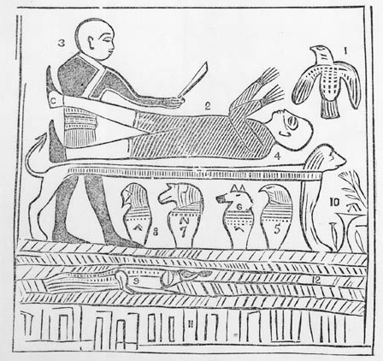
History of the Book of Abraham
Priest
Smith copied pictures from the scrolls and printed them in his Book of Abraham, with labels.
These pictures were later shown to several archeologists to get their opinion.
They said Smith was mistaken about this picture, and that it had been modified.
Naturally, Mormons disagreed with this.
Angel of Lord
Abraham
Altar
Idols
Pharaoh

Slide 56
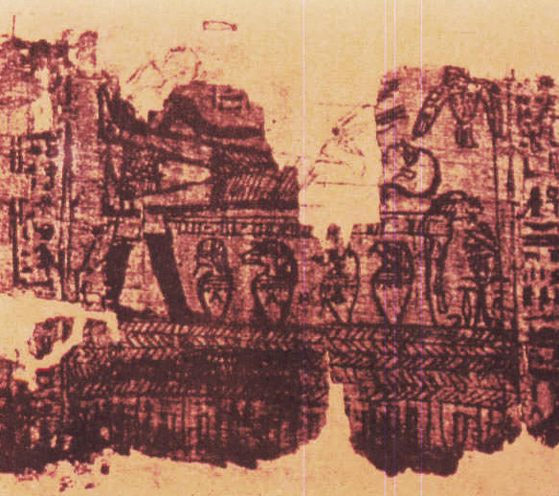
History of the Book of Abraham
Recently, the scrolls turned up in a NY museum, which gave them back to the Mormon church when this became public.
The text of the scrolls has now been translated. They have nothing to do with Abraham!
They show the picture has also been modified.

Slide 57
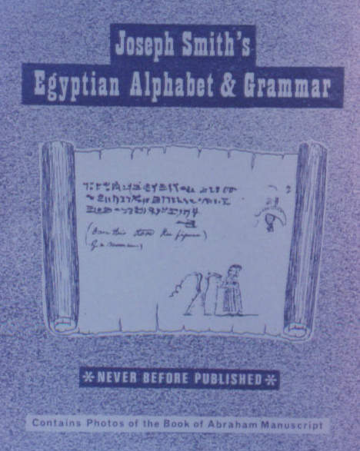
History of the Book of Abraham
Shortly before the scrolls turned up, the text of Smith's Egyptian Alphabet & Grammar was made public.
This shows that Smith did not know Egyptian!
It also contains samples of text which he had copied from the scrolls, showing how he had translated particular texts.

Slide 58
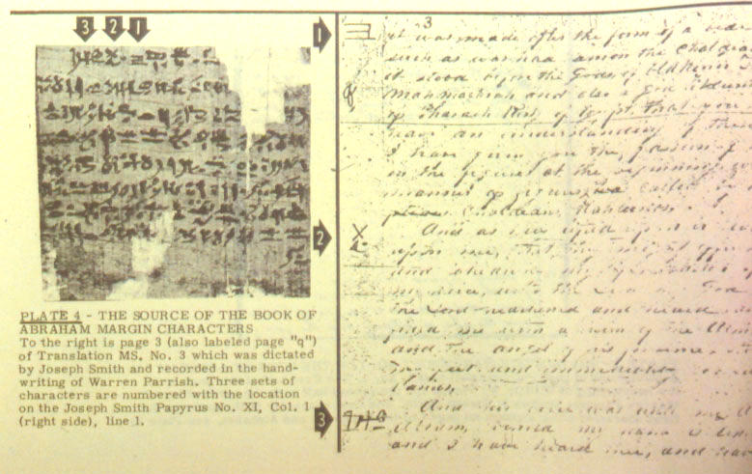
The papyrus
Smith's translation

Slide 59
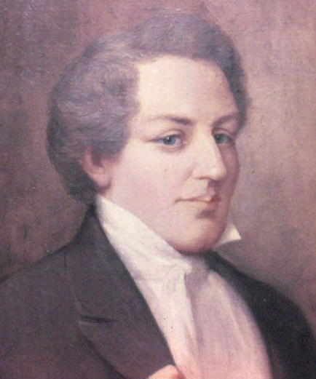
Conclusions on Mormonism
Joseph Smith is a false prophet.
The Book of Mormon, Doctrines & Covenants, and Pearl of Great Price are false revelations.
Mormonism is a false religion.

Slide 60
A Lesson for Us All
"Every word of God is flawless; he is a shield to those who take refuge in him.
Do not add to his words, or he will rebuke you and prove you a liar."
Proverbs 30:5-6

Slide 61
The End

