Slide 1
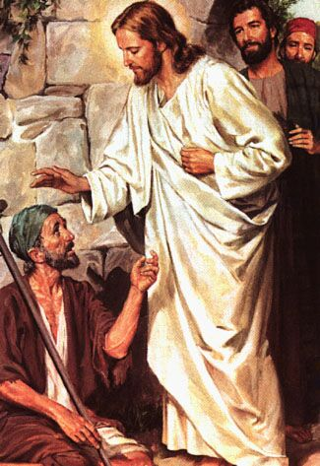
The Miracles of Jesus
Robert C. Newman

Slide 2
Miracles?
Miracles are rejected by theological liberalism and by secularism.
This explains their attitude toward the Gospels and Jesus.
If miracles don't happen, then the Gospels cannot really be reliable.
So they then feel free to make whatever changes they prefer.

Slide 3
Christianity & Miracles
But a Christianity without miracles is not really Christianity (i.e., not biblical Christianity).
This was pointed out over 80 years ago by J. Gresham Machen in his book Christianity and Liberalism.
But if miracles are not rejected a priori, then the Gospels look very good.
See Craig Blomberg, The Historical Reliability of the Gospels.

Slide 4
Purpose of Miracles?
The report of a miracle typically serves to create skepticism for many moderns today.
But the actual occurrence of a miracle can have a very powerful worldview-changing effect on those who witness it.
Miracles were used in the OT to attest a messenger from God (see Deut 13 & 18).
They also tell us something about God.

Slide 5
Purpose of Gospel Miracles?
They attest Jesus as coming from God.
They support Jesus' claims.
They tell us something about who God is and what he is doing.

Slide 6
This Series
In this series, we want to look at four (actually five) of Jesus' miracles:
The wedding at Cana (John 2:1-11)
Stilling the storm (Mark 4:35-41)
The Gerasene demoniac (Mark 5:1-20)
The woman w/ hemorrhage & Jairus' daughter (Mark 5:21-43)
These will tell us a great deal about Jesus and his mission.

Slide 7
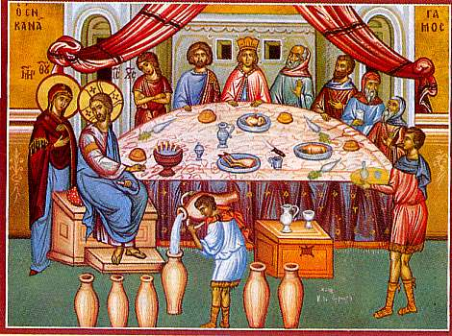
The Wedding at Cana
John 2:1-11

Slide 8
Miracles as 'Signs’
This is a distinctive emphasis in the Gospel of John.
It is one of the four common words for miracles in the NT Greek.
'Signs' are actions/events which signify something.
John selects seven (or eight) miracles for his detailed narrative, to signify who Jesus is.

Slide 9
John 2:1-6
1 (NIV) On the third day a wedding took place at Cana in Galilee. Jesus' mother was there, 2 and Jesus and his disciples had also been invited to the wedding. 3 When the wine was gone, Jesus' mother said to him, "They have no more wine." 4 "Dear woman, why do you involve me?" Jesus replied. "My time has not yet come." 5 His mother said to the servants, "Do whatever he tells you." 6 Nearby stood six stone water jars, the kind used by the Jews for ceremonial washing, each holding from twenty to thirty gallons. {[6] Greek two to three metretes (probably about 75 to 115 liters)}

Slide 10
John 2:7-11
7 (NIV) Jesus said to the servants, "Fill the jars with water"; so they filled them to the brim. 8 Then he told them, "Now draw some out and take it to the master of the banquet." They did so, 9 and the master of the banquet tasted the water that had been turned into wine. He did not realize where it had come from, though the servants who had drawn the water knew. Then he called the bridegroom aside 10 and said, "Everyone brings out the choice wine first and then the cheaper wine after the guests have had too much to drink; but you have saved the best till now." 11 This, the first of his miraculous signs, Jesus performed at Cana in Galilee. He thus revealed his glory, and his disciples put their faith in him.

Slide 11
'Sign' and 'Glory'
This is Jesus' first sign (verse 11).
Of his earthly (or incarnate) ministry.
This undercuts the claims of the apocryphal gospels that Jesus did earlier miracles.
Here Jesus displays his glory (v 11).
OT word has connotation of 'weight, status'
NT word of 'shining, brilliant'
That which distinguishes a thing from other things is its glory.

Slide 12
What Does Jesus Do?
Jesus turns water into wine in a very unspectacular way.
As CS Lewis pointed out, in turning water into wine, Jesus does quickly and miraculously what God does every year slowly and providentially by means of grapevines.
see his book Miracles

Slide 13
What Does This Mean?
Jesus' disciples will naturally see this miracle against the background of OT events.
Similar miracles:
No miracles turning water into wine or such
Hagar & Ishmael provided w/ water (Gen 21)
Water miracles in the wilderness wanderings (Exodus 15, 17, Numbers 20)
Samson provided with water (Judges 15)

Slide 14
What Does This Mean?
Similar miracles, continued:
Water at Jericho sweetened (2 Kings 2)
Judah's army rescued by water supplied in a striking way (2 Kings 3)
Bad stew repaired (2 Kings 4)
Other (non-miraculous) background:
Wine of the drink-offering
Blood of animal offerings

Slide 15
What Does This Mean?
Notice verse 4: Jesus says, "My hour has not yet come."
Elsewhere in John this refers to his crucifixion (John 12:23, 27)
So here it probably does not mean "My time to do miracles has not yet come."
John's Gospel gives considerable emphasis to the symbolism of Jesus' words and actions.

Slide 16
What Does This Mean?
In both OT and NT, the marriage/feast is used as a symbol of the age to come or the Messianic banquet (Psalm 1, 23; Isaiah 25, 54; Matthew 8:11-12, 22:1-14).
So, Jesus will somehow provide the wine/ joy for the feast which otherwise would lack it.

Slide 17
Summary
Jesus turns the water into wine:
To rescue the wedding feast from disaster
To save the hosts from embarrassment
To show something of who he is and what he has come to do.
Jesus has come:
To rescue us from embarrassment & disaster at the last judgment
To bring us joy at the messianic banquet.

Slide 18
Some Lessons for Us
Jesus is no showoff, but he really is who he claims to be.
The Father's Son who does everything the Father does (John 5:19ff).
So we can trust him fully with our lives.
If we trust him, he will one day be our chief joy.
We should seek to grow in our love for him even now.
Let him be the chief joy of your life here & now.

Slide 19
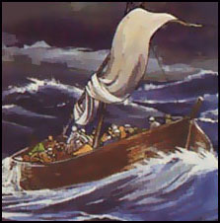
Stilling the Storm
Mark 4:35-41

Slide 20
Mark 4:35-41
35 (NIV) That day when evening came, he said to his disciples, "Let us go over to the other side." 36 Leaving the crowd behind, they took him along, just as he was, in the boat. There were also other boats with him. 37 A furious squall came up, and the waves broke over the boat, so that it was nearly swamped. 38 Jesus was in the stern, sleeping on a cushion. The disciples woke him and said to him, "Teacher, don't you care if we drown?" 39 He got up, rebuked the wind and said to the waves, "Quiet! Be still!" Then the wind died down and it was completely calm. 40 He said to his disciples, "Why are you so afraid? Do you still have no faith?" 41 They were terrified and asked each other, "Who is this? Even the wind and the waves obey him!"

Slide 21
The Story
Jesus & disciples are crossing the Sea of Galilee from NW side (near Capernaum) to either:
The NE side or
The SE side
Where the incident w/ the demons & pigs will take place in Mark 5:1-20.
Jesus is apparently worn out from the day's activities (or at least tired) and has fallen asleep in the back of the boat.

Slide 22
The Story
A storm comes up, which begins to swamp the boat.
Apparently this storm is quite fierce, since even commercial fishermen, experienced on this lake, are terrified.
The disciples finally become so distressed that they awaken Jesus, rebuking him that he doesn’t care they are about to die.

Slide 23
The Story
Jesus stops the storm with a word, and there is suddenly a great calm!
He rebukes the disciples for their fear and lack of faith.
They respond, "Who is this, that even the wind and sea obey him?"

Slide 24
Its Meaning
Similar OT miracles:
Satan calls up a storm (Job 1).
Elijah calls up a storm (1 Kings 18).
But Jesus, by contrast, stops a storm.
Compare Jesus actions w/ OT prophets:
Elijah prays & prays, sends servant 7x to see if anything is happening.
Moses announces what God is going to do; he uses his staff for his miracles.

Slide 25
Its Meaning
Nature has been a threat to humans ever since the fall of mankind.
Because of human rebellion against God, nature rebels against humans.
God's actions in the OT:
God creates by means of his word (Gen 1).
God rescues mariners from a storm (Ps 107).
Psalm 107 is strikingly parallel to Mark’s account of this miracle.

Slide 26
Psalm 107:23-31
23 (NIV) Others went out on the sea in ships; they were merchants on the mighty waters. 24 They saw the works of the LORD, his wonderful deeds in the deep. 25 For he spoke and stirred up a tempest that lifted high the waves. 26 They mounted up to the heavens and went down to the depths; in their peril their courage melted away. 27 They reeled and staggered like drunken men; they were at their wits' end. 28 Then they cried out to the LORD in their trouble, and he brought them out of their distress. 29 He stilled the storm to a whisper; the waves of the sea were hushed. 30 They were glad when it grew calm, and he guided them to their desired haven. 31 Let them give thanks to the LORD for his unfailing love and his wonderful deeds for men.

Slide 27
Its Meaning
Are the disciples protected by Jesus' presence?
Obviously, since he is Messiah, he must survive to carry out his mission.
Of course, the boat might sink and Jesus walk away on the water!
But instead, he protects his followers here (as he does also at his arrest).

Slide 28
Its Meaning
Jesus is asleep in the boat.
Is he tired? Would not be surprising given his previous activity.
From the context, it appears that the point is that Jesus is asleep because he is trusting, in contrast to his disciples.
Note this interchange: Mark 4:38 (NIV) Jesus was in the stern, sleeping on a cushion. The disciples woke him and said to him, "Teacher, don't you care if we drown?" 39 He got up, rebuked the wind and said to the waves, "Quiet! Be still!" Then the wind died down and it was completely calm. 40 He said to his disciples, "Why are you so afraid? Do you still have no faith?"

Slide 29
Some Lessons about Jesus
Jesus is human.
He gets tired.
He falls asleep.
Jesus is not merely human; he is also God.
He commands the weather, and it must obey.
Jesus as perfect human has perfect trust in his Father.

Slide 30
Some Lessons for Our Lives
We as followers of Jesus ought to live & trust like he did.
We are safe in God's arms.
Perhaps this is what Paul has in mind when he says we are the fragrance of Christ (2 Cor 2:14ff).
We are 'immortal' until we have finished the task God has for us.
Even our death need not be meaningless if we will trust him with our lives.

Slide 31
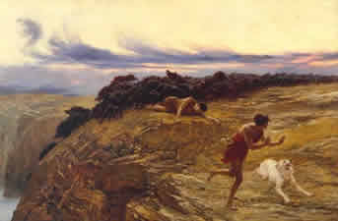
The Gerasene Demoniac
Mark 5:1-20

Slide 32
Demonism
Liberals deny (and some evangelicals downplay) demonism, tending to see it as misdiagnosed mental illness.
Given the cure rate of psychiatrists and psychologists (about the same as witch doctors), it may well be that some mental illness is misdiagnosed demonism.

Slide 33
Mark 5:1-8
1 (NIV) They went across the lake to the region of the Gerasenes. 2 When Jesus got out of the boat, a man with an evil spirit came from the tombs to meet him. 3 This man lived in the tombs, and no one could bind him any more, not even with a chain. 4 For he had often been chained hand and foot, but he tore the chains apart and broke the irons on his feet. No one was strong enough to subdue him. 5 Night and day among the tombs and in the hills he would cry out and cut himself with stones. 6 When he saw Jesus from a distance, he ran and fell on his knees in front of him. 7 He shouted at the top of his voice, "What do you want with me, Jesus, Son of the Most High God? Swear to God that you won't torture me!" 8 For Jesus had said to him, "Come out of this man, you evil spirit!"

Slide 34
Mark 5:9-15
9 (NIV) Then Jesus asked him, "What is your name?" "My name is Legion," he replied, "for we are many." 10 And he begged Jesus again and again not to send them out of the area. 11 A large herd of pigs was feeding on the nearby hillside. 12 The demons begged Jesus, "Send us among the pigs; allow us to go into them." 13 He gave them permission, and the evil spirits came out and went into the pigs. The herd, about two thousand in number, rushed down the steep bank into the lake and were drowned. 14 Those tending the pigs ran off and reported this in the town and countryside, and the people went out to see what had happened. 15 When they came to Jesus, they saw the man who had been possessed by the legion of demons, sitting there, dressed and in his right mind; and they were afraid.

Slide 35
Mark 5:16-20
16 (NIV) Those who had seen it told the people what had happened to the demon-possessed man–and told about the pigs as well. 17 Then the people began to plead with Jesus to leave their region. 18 As Jesus was getting into the boat, the man who had been demon-possessed begged to go with him. 19 Jesus did not let him, but said, "Go home to your family and tell them how much the Lord has done for you, and how he has had mercy on you." 20 So the man went away and began to tell in the Decapolis how much Jesus had done for him. And all the people were amazed.

Slide 36
OT Background
Jesus' disciples would not have much to go on here.
The OT is explicit about the existence of Satan and evil supernatural powers, and connects them with idolatry & false religion.
The OT also indicates Satan is capable of miraculous activity, as were the magicians of Pharaoh in Exodus.
Otherwise, the main OT background would be the evil spirit that comes on Saul and the lying spirit that misleads Ahab's false prophets.

Slide 37
NT Background
Demonism shows up strongly in the Gospels.
Perhaps due to demonic flocking to oppose Jesus, or to pagan influence coming into Judaism.
Some varieties of later Judaism have been heavily influenced by the occult.

Slide 38
Background in NT Period
Find demon exorcism in Josephus and in the apocryphal book of Tobit.
We have a number of magical papyri from this period, showing that the name of Yahweh was viewed as a powerful charm even among the pagans.
Recall also the account in Acts 19, where Jewish exorcists tried to use the name of Jesus as a charm.

Slide 39
Background in NT Period
Typical exorcism of this period involved a great deal of mumbo-jumbo:
Tobit: hero makes a powerful stink to chase the demon away.
Josephus: Essene exorcist uses a ring containing an herb prescribed by Solomon.
Papyri: Long strings of foreign words & names used as spells to drive out demons.

Slide 40
Jesus' Actions
He commands the demons to leave and they have to do it, though there is some negotiation for reasons not explained.
Much of this narration is somewhat obscure as we can't tell who is acting in a case of possession:
Does the man run to Jesus seeking deliverance, or the demons to harass?
Do the pigs panic and run into the lake, or do the demons drive them there?

Slide 41
Some Lessons
This world is a very dangerous place, and not just from nature & sinful humans.
We can easily be overwhelmed by evil forces far more powerful than we are.
We don't know the exact boundaries of their authority.
We have every reason to believe they are older, wiser, and more evil than humans are.

Slide 42
Some Lessons
But Jesus can overcome demons (even by the thousands).
So it makes sense to flee to Jesus for protection.
In fact, Jesus came into the world to destroy the works, kingdom & power of Satan.
This incident looks both backward & forward:
Back (to the Fall & its consequences)
Forward (to Jesus' return & destruction of evil)

Slide 43
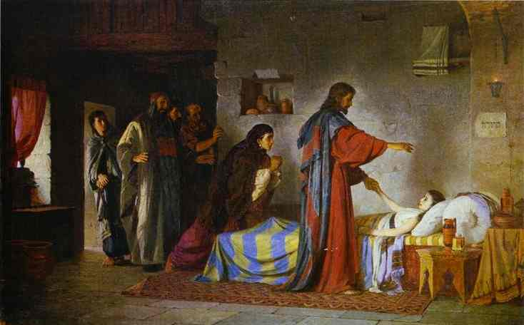
The Woman w/ Hemorrhage & Jairus’ Daughter
Mark 5:21-43

Slide 44
Introduction
Two miracles intertwined by the historical circumstances.
We have a few of these in the Gospel materials.
It fits the way we often remember events.

Slide 45
Mark 5:21-29
21 (NIV) When Jesus had again crossed over by boat to the other side of the lake… 22 one of the synagogue rulers, nam-ed Jairus… Seeing Jesus, he fell at his feet 23 and pleaded earnestly with him, "My little daughter is dying. Please come and put your hands on her so that she will be healed and live." 24 So Jesus went with him. A large crowd followed and press-ed around him. 25 And a woman was there who had been subject to bleeding for twelve years. 26 She had suffered a great deal under the care of many doctors and had spent all she had, yet instead of getting better she grew worse. 27 When she heard about Jesus, she came up behind him in the crowd and touched his cloak, 28 because she thought, "If I just touch his clothes, I will be healed." 29 Immediately her bleed-ing stopped and she felt in her body that she was freed from her suffering.

Slide 46
Mark 5:30-36
30 (NIV) At once Jesus realized that power had gone out from him. He turned around in the crowd and asked, "Who touched my clothes?" 31 "You see the people crowding against you," his disciples answered, "and yet you can ask, 'Who touched me?'" 32 But Jesus kept looking around to see who had done it. 33 Then the woman, knowing what had happened to her, came and fell at his feet and, tremb-ling with fear, told him the whole truth. 34 He said to her, "Daughter, your faith has healed you. Go in peace and be freed from your suffering." 35 While Jesus was still speak-ing, some men came from the house of Jairus, the syna-gogue ruler. "Your daughter is dead," they said. "Why bother the teacher any more?" 36 Ignoring what they said, Jesus told the synagogue ruler, "Don't be afraid; just believe."

Slide 47
Mark 5:37-43
37 He did not let anyone follow him except Peter, James and John the brother of James. 38 When they came to the home of the synagogue ruler, Jesus saw a commotion, with people crying and wailing loudly. 39 He went in and said to them, "Why all this commotion and wailing? The child is not dead but asleep." 40 But they laughed at him. After he put them all out, he took the child's father and mother and the disciples who were with him, and went in where the child was. 41 He took her by the hand and said to her, "Talitha koum!" (which means, "Little girl, I say to you, get up!"). 42 Immediately the girl stood up and walked around (she was twelve years old). At this they were completely astonished. 43 He gave strict orders not to let anyone know about this, and told them to give her something to eat.

Slide 48
Similar OT Miracles
Resurrections:
Elijah raising widow's son
Elisha raising Shunemite woman's son
Fellow thrown in Elisha's grave
Healings:
God gives Miriam leprosy, later heals her.
Elisha heals Naaman's leprosy, later gives leprosy to Gehazi.

Slide 49
Other OT Background
Uncleanness:
A ritual state which prohibited a person from taking part in the formal worship in tabernacle or temple.
It could be contracted by having certain diseases, such as leprosy or hemorrhage.
It could be contracted by touching an unclean person or object.

Slide 50
Jesus' Actions
He feels power flow out from him when touched by the woman in the crowd.
He apparently doesn't know who touched him. (Jesus' humanity; he apparently set aside his omniscience during his earthly ministry.)
He calls on the woman to explain what happened. Since he typically does not call attention to himself & his miracles, this probably has some purpose for the woman’s benefit.

Slide 51
Jesus' Actions
Jesus is not upset by this interruption, nor (in general) by relevant interruptions.
He is trusting his Father for all the circumstances of life, acting in a way to make best use of them for his Father's glory.
Jesus encourages Jairus when the news of his daughter’s death arrives.

Slide 52
Jesus' Actions
Jesus puts out the bystanders when he heals the girl.
He probably makes the remark about the girl sleeping to throw them off the track.
Some think she was not really dead, but it appears that Luke's narration (8:53) confirms that she was.
Jesus allows himself to be touched by the woman & touches the girl, so that by OT law, he would become unclean, but in each case the unclean person is cleansed!

Slide 53
Summary of the Series
Miracle
Wedding at Cana
Stilling the Storm
Gerasene Demoniac
Hemorrhaging Woman
Jairus' Daughter
Problem/Solution
Need/joy, abundance
Danger/safety
Oppression/rescue
Illness/health
Death/life

Slide 54
Lessons
Jesus is present with us in our need.
He has compassion upon us.
He has power to save us.
Jesus has come to restore what was lost in the Fall:
To rescue us from our own & others' wickedness
To give us life, health, safety, abundance, and joy.

Slide 55
The End

