Slide 1
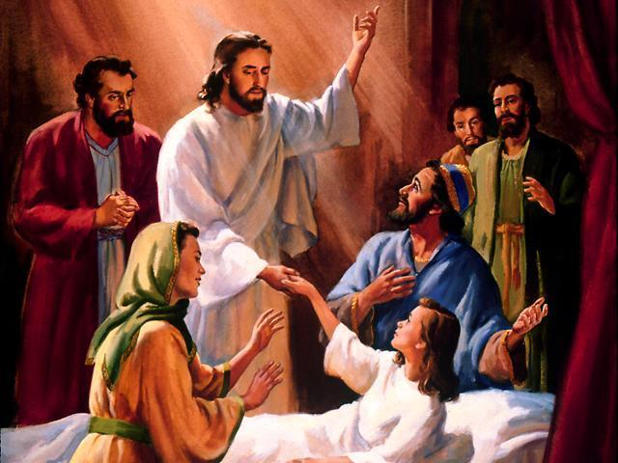
The Miracles of Jesus: 2. Over the Human Realm
Robert C. Newman

Slide 2
Introduction
In our previous talk, we looked at nature miracles. Here we look at miracles dealing with human sickness & death.
Such miracles include:
Healing Nobleman’s Son
Woman with Hemorrhage
Raising Jairus’ Daughter
Healing Paralytic
Cleansing Leper
(next panel)

Slide 3
Introduction
These include (continued):
Centurion’s Servant
Raising Widow’s Son
Healing at Pool of Bethesda
Man Born Blind
Man with Withered Hand
Ten Lepers
Deaf & Dumb Fellow
Raising Lazarus
As before, we will only do some of these that are not in our other Power-Point talks.

Slide 4
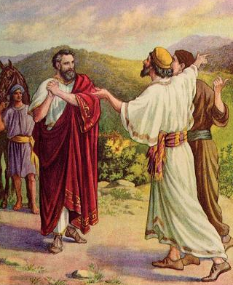
Healing Nobleman's Son
John 4

Slide 5
John 4:46-50
John 4:46 (NIV) Once more he visited Cana in Galilee, where he had turned the water into wine. And there was a certain royal official whose son lay sick at Capernaum. 47 When this man heard that Jesus had arrived in Galilee from Judea, he went to him and begged him to come and heal his son, who was close to death. 48 "Unless you people see miraculous signs and wonders," Jesus told him, "you will never believe." 49 The royal official said, "Sir, come down before my child dies." 50 Jesus replied, "You may go. Your son will live." The man took Jesus at his word and departed.

Slide 6
John 4:51-54
51 While he was still on the way, his servants met him with the news that his boy was living. 52 When he inquired as to the time when his son got better, they said to him, "The fever left him yesterday at the seventh hour." 53 Then the father realized that this was the exact time at which Jesus had said to him, "Your son will live." So he and all his household believed. 54 This was the second miraculous sign that Jesus performed, having come from Judea to Galilee.

Slide 7
Historicity of the Event
Occasion
After Jesus’ return from Judea & Samaria into Galilee
In response to pleading of father
Liberal explanation (quasi-liberal)
Jesus telepathically gave boy will to live.

Slide 8
Evidence of Historicity
Royal official or relative of royal family
was he Chuza (of Luke 8:3)?
Verb "come down" (47)
Time indications (43, 52)
Development of father's faith:
come down (47)
accepts Jesus' word (50)
began to get better (52)
believed (53)

Slide 9
Reaction of Eyewitnesses
Only father saw both sides.
… but independently checked time.
Servants & household knew of sudden end of fever.
Father & household believed.

Slide 10
Old Testament Background
Similar miracles:
Healing from serpents (Num 21)
Leprosy of Miriam (Num 12)
Leprosy of Naaman (2 Kings 5)
Healing of Hezekiah (2 Kings 20)
Request re/ Abijah (1 Kings 14)
At least one of these (Naaman) was healing at a distance.

Slide 11
Old Testament Background
Other parallels:
LORD heals all your diseases (Ps 103:3)
Psalm 103:2 (NIV) Praise the LORD, O my soul, and forget not all his benefitsn 3 who forgives all your sins and heals all your diseases…
Curses of covenant include diseases & fever (Lev 26:16)
Lev 26:15 (NIV) and if you reject my decrees and abhor my laws and fail to carry out all my commands and so violate my covenant, 16 then I will do this to you: I will bring upon you sudden terror, wasting diseases and fever that will destroy your sight and drain away your life. You will plant seed in vain, because your enemies will eat it.

Slide 12
Significance
Immediate effect
Relation of signs & wonders to faith (48)
note healing is ~20 mi away
Boy healed (52)
Father brought to faith (47-48, 50, 53)
Also household (53)
Place in salvation history
First healing? (54); probably not, see Jn 2:23
Probably means 2nd Galilean sign
1st healing in Galilee

Slide 13
Symbolic Elements
Nothing obvious
Contrast father with Abraham
Abraham ready to give son.
Contrast father with God
God gave His son.
Miracles of Jesus often look back at creation or forward to end of age.

Slide 14
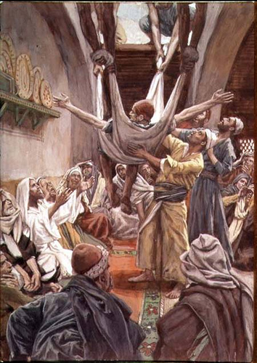
Healing Paralytic
Matthew 9, Mark 2,
Luke 5

Slide 15
Mark 2:1-7
Mark 2:1 (NIV) A few days later, when Jesus again entered Capernaum, the people heard that he had come home. 2 So many gathered that there was no room left, not even outside the door, and he preached the word to them. 3 Some men came, bringing to him a paralytic, carried by four of them. 4 Since they could not get him to Jesus because of the crowd, they made an opening in the roof above Jesus and, after digging through it, lowered the mat the paralyzed man was lying on. 5 When Jesus saw their faith, he said to the paralytic, "Son, your sins are forgiven." 6 Now some teachers of the law were sitting there, thinking to themselves, 7 "Why does this fellow talk like that? He's blaspheming! Who can forgive sins but God alone?"

Slide 16
Mark 2:8-12
Mark 2:8 (NIV) Immediately Jesus knew in his spirit that this was what they were thinking in their hearts, and he said to them, "Why are you thinking these things? 9 Which is easier: to say to the paralytic, 'Your sins are forgiven,' or to say, 'Get up, take your mat and walk'? 10 But that you may know that the Son of Man has authority on earth to forgive sins ..." He said to the paralytic, 11 "I tell you, get up, take your mat and go home." 12 He got up, took his mat and walked out in full view of them all. This amazed everyone and they praised God, saying, "We have never seen anything like this!"

Slide 17
Historicity of the Event
Occasion
Not clear from divergence of Mt & Mk when this occurred, but apparently just before Matthew's conversion.
Evidence of historicity
Occurs in 3 Gospels in such a form as to suggest not copied from one another.
Details of time are vague, but took place in Capernaum; number of men given (though natural).
Opening the roof is unusual.

Slide 18
Reaction of Eyewitnesses
Pharisees grumble at claim to forgive sin, but apparently silent when miracle worked.
Paralytic goes away glorifying God.
Others astonished, fearful, glorify God, remark on uniqueness, strangeness of event.

Slide 19
Old Testament Background
Similar miracles:
Jeroboam's hand shriveled & restored (1 Kings 13).
Lame to leap like deer at time of Israel's redemption (Isa 35:6).
Other parallels
Lameness, etc., disqualify for priesthood (Lev 21:18).
Forgiveness can be given only by God and by person sinned against.

Slide 20
Significance
Immediate effect
Fellow healed
Attestation of Jesus' claim to forgive sins
Place in salvation history
The One who forgives sin has become man.
Symbolic elements
Compare Isa 35:6, pointing to eschaton
Isa 35:6 (NIV) Then will the lame leap like a deer, and the mute tongue shout for joy. Water will gush forth in the wilderness and streams in the desert.

Slide 21
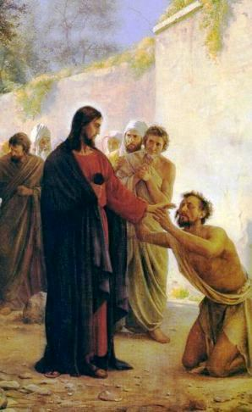
Cleansing Leper
Matthew 8, Mark 1,
Luke 5

Slide 22
Matthew 8:1-4
Matt 8:1 (NIV) When he came down from the mountainside, large crowds followed him. 2 A man with leprosy [The Greek word was used for various diseases affecting the skinnnot necessarily leprosy.] came and knelt before him and said, "Lord, if you are willing, you can make me clean." 3 Jesus reached out his hand and touched the man. "I am willing," he said. "Be clean!" Immediately he was cured [Greek made clean] of his leprosy. 4 Then Jesus said to him, "See that you don't tell anyone. But go, show yourself to the priest and offer the gift Moses commanded, as a testimony to them."

Slide 23
Historicity of the Event
Occasion
Matt seems to be most definite, putting it after Sermon on Mt (8:1).
Mark & Luke are vague, but still early in Galilean ministry.
Fellow seeks Jesus out.

Slide 24
Liberal Explanations
Some uncertainty re/ exact nature of disease.
(Heb & Gk terms broader than Hansen's disease, which itself has several types.)
Liberals tend to opt for milder forms & psychological cure.

Slide 25
Evidence of Historicity
Matt seems to locate near site of Sermon on Mount.
Mk & Lk out from Capernaum on a Galilean tour.

Slide 26
Reaction of Eyewitnesses
Not specified
Leper apparently so overwhelmed he doesn't obey Jesus' instructions not to spread the news of his cure.
Mark 1:43-45

Slide 27
Old Testament Background
Similar miracles: healings from leprosy
Moses' hand (Ex 14)
Miriam (Num 12)
Naaman (2 Kings 5)
Other parallels:
Diagnosis of leprosy (Lev 13)
Cleansing ceremony (Lev 14; cp touching dead): 8 days, including final offerings

Slide 28
Significance
Immediate effect
Man cleansed, faith rewarded
Jesus' compassion, concern for law, ceremony as testimony?
Jesus concerned to avoid wrong kind of publicity?
Place in salvation history
Like Moses & Elisha, one who heals lepers again walks the earth.
In contrast, Jesus touches leper, who is cleansed rather than rendering Jesus unclean (parallel w/ resurrections by Elijah, Elisha).

Slide 29
Symbolic Elements
Surprisingly, I could not find clear evidence of symbolic value of leprosy; Ps 51:5-7 (best candidate) is not obviously referring to leprosy.
Psalm 51:5 (NIV) Surely I was sinful at birth, sinful from the time my mother conceived me. 6 Surely you desire truth in the inner parts; you teach me wisdom in the inmost place. 7 Cleanse me with hyssop, and I will be clean; wash me, and I will be whiter than snow.

Slide 30
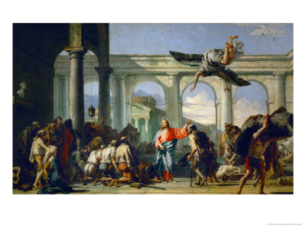
Healing at Pool of Bethesda
John 5

Slide 31
John 5:1-6
John 5:1 (NIV) Some time later, Jesus went up to Jerus-alem for a feast of the Jews. 2 Now there is in Jerusalem near the Sheep Gate a pool, which in Aramaic is called Bethesda and which is surrounded by five covered colonnades. 3 Here a great number of disabled people used to lienthe blind, the lame, the paralyzed. [Some less important mss add: and they waited for the moving of the waters. From time to time an angel of the Lord would come down and stir up the waters. The first one into the pool after each such disturbance would be cured of whatever disease he had.] 5 One who was there had been an invalid for thirty-eight years. 6 When Jesus saw him lying there and learned that he had been in this condition for a long time, he asked him, "Do you want to get well?"

Slide 32
John 5:7-12
7 "Sir," the invalid replied, "I have no one to help me into the pool when the water is stirred. While I am trying to get in, someone else goes down ahead of me." 8 Then Jesus said to him, "Get up! Pick up your mat and walk." 9 At once the man was cured; he picked up his mat and walked. The day on which this took place was a Sabbath, 10 and so the Jews said to the man who had been healed, "It is the Sabbath; the law forbids you to carry your mat." 11 But he replied, "The man who made me well said to me, 'Pick up your mat and walk.'" 12 So they asked him, "Who is this fellow who told you to pick it up and walk?"

Slide 33
John 5:13-18
13 The man who was healed had no idea who it was, for Jesus had slipped away into the crowd that was there. 14 Later Jesus found him at the temple and said to him, "See, you are well again. Stop sinning or something worse may happen to you." 15 The man went away and told the Jews that it was Jesus who had made him well. 16 So, because Jesus was doing these things on the Sabbath, the Jews persecuted him. 17 Jesus said to them, "My Father is always at his work to this very day, and I, too, am working." 18 For this reason the Jews tried all the harder to kill him; not only was he breaking the Sabbath, but he was even calling God his own Father, making himself equal with God.

Slide 34
Historicity of the Event
Occasion
During a feast of the Jews
several feasts suggested, even Purim
a few months to a year after events of John 4
Jesus sees a fellow who is lame (or some-thing of sort), & heals him on the Sabbath.
Liberal explanations
Psychosomatic healing
Didn't happen

Slide 35
Evidence of Historicity
The location is now well-established, though site unknown even in 1900.
Reaction of Jewish leaders fits rabbinic views on Sabbath.
The poorly-attested verse 4 (re/ angel) suggests place well-known in tradition from before AD 70.

Slide 36
Reaction of Eyewitnesses
Fellow himself seems grateful (11,15).
Verse 15 should not be understood that he was malicious.
Jewish leaders see only a violation of Sabbath, later compounded (17) by blasphemy.

Slide 37
Old Testament Background
Similar miracles
No references to healing on Sabbath in OT
Both Elijah and Elisha touched dead to raise them.
Other materials
Sabbath regulations (Ex 23:12; 31:14-15; 35:2-3; Num 15:32-36; Neh 13:15-22; Jer 17:21-27)
No manna on Sabbath (Ex 16:22-29)
But priests labor on Sabbath (Num 28:9-10)
Lame to walk when redemption comes (Isa 35:6)

Slide 38
Significance
Immediate effect
Man is healed.
Controversy develops between Jesus & leaders, resulting in strong opposition to Him for His actions & claims.
Place in salvation history
Jesus makes claims before official representatives of the nation.
He bases His authority over Sabbath on His unique relation to Father.

Slide 39
Symbolic elements
Sabbath as eschaton?
Healing as eschatological?
God works on the Sabbath…
… especially as regards redemption.

Slide 40
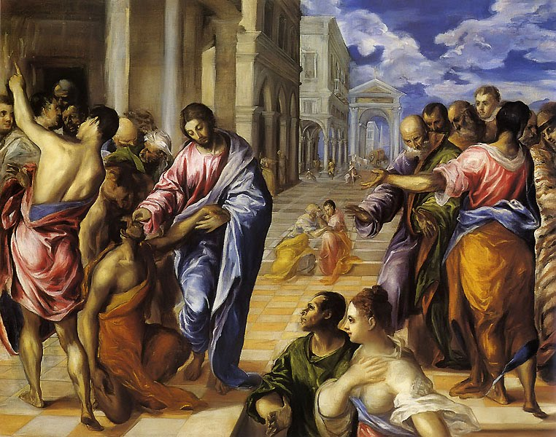
Man Born Blind
John 9

Slide 41
John 9:1-6
John 9:1 (NIV) As he went along, he saw a man blind from birth. 2 His disciples asked him, "Rabbi, who sinned, this man or his parents, that he was born blind?" 3 "Neither this man nor his parents sinned," said Jesus, "but this happened so that the work of God might be displayed in his life. 4 As long as it is day, we must do the work of him who sent me. Night is coming, when no one can work. 5 While I am in the world, I am the light of the world.“ 6 Having said this, he spit on the ground, made some mud with the saliva, and put it on the man's eyes.

Slide 42
John 9:7-12
John 9:7 (NIV) "Go," he told him, "wash in the Pool of Siloam" (this word means Sent). So the man went and washed, and came home seeing. 8 His neighbors and those who had formerly seen him begging asked, "Isn't this the same man who used to sit and beg?" 9 Some claimed that he was. Others said, "No, he only looks like him." But he himself insisted, "I am the man." 10 "How then were your eyes opened?" they demanded. 11 He replied, "The man they call Jesus made some mud and put it on my eyes. He told me to go to Siloam and wash. So I went and washed, and then I could see." 12 "Where is this man?" they asked him. "I don't know," he said.

Slide 43
John 9:13-18
John 9:13 (NIV) They brought to the Pharisees the man who had been blind. 14 Now the day on which Jesus had made the mud and opened the man's eyes was a Sabbath. 15 Therefore the Pharisees also asked him how he had received his sight. "He put mud on my eyes," the man replied, "and I washed, and now I see." 16 Some of the Pharisees said, "This man is not from God, for he does not keep the Sabbath." But others asked, "How can a sinner do such miraculous signs?" So they were divided. 17 Finally they turned again to the blind man, "What have you to say about him? It was your eyes he opened." The man replied, "He is a prophet." 18 The Jews still did not believe that he had been blind and had received his sight until they sent for the man's parents.

Slide 44
John 9:19-24
John 9:19 (NIV) "Is this your son?" they asked. "Is this the one you say was born blind? How is it that now he can see?" 20 "We know he is our son," the parents answered, "and we know he was born blind. 21 But how he can see now, or who opened his eyes, we don't know. Ask him. He is of age; he will speak for himself." 22 His parents said this because they were afraid of the Jews, for already the Jews had decided that anyone who acknow-ledged that Jesus was the Christ would be put out of the synagogue. 23 That was why his parents said, "He is of age; ask him." 24 A second time they summoned the man who had been blind. "Give glory to God,[A solemn charge to tell the truth (see Joshua 7:19)]" they said. "We know this man is a sinner."

Slide 45
John 9:25-30
John 9:25 (NIV) He replied, "Whether he is a sinner or not, I don't know. One thing I do know. I was blind but now I see!" 26 Then they asked him, "What did he do to you? How did he open your eyes?" 27 He answered, "I have told you already and you did not listen. Why do you want to hear it again? Do you want to become his disciples, too?" 28 Then they hurled insults at him and said, "You are this fellow's disciple! We are disciples of Moses! 29 We know that God spoke to Moses, but as for this fellow, we don't even know where he comes from." 30 The man answered, "Now that is remarkable! You don't know where he comes from, yet he opened my eyes."

Slide 46
John 9:31-36
John 9:31 (NIV) We know that God does not listen to sinners. He listens to the godly man who does his will. 32 Nobody has ever heard of opening the eyes of a man born blind. 33 If this man were not from God, he could do nothing." 34 To this they replied, "You were steeped in sin at birth; how dare you lecture us!" And they threw him out. 35 Jesus heard that they had thrown him out, and when he found him, he said, "Do you believe in the Son of Man?" 36 "Who is he, sir?" the man asked. "Tell me so that I may believe in him."

Slide 47
John 9:37-41
John 9:36 (NIV) "Who is he, sir?" the man asked. "Tell me so that I may believe in him." 37 Jesus said, "You have now seen him; in fact, he is the one speaking with you." 38 Then the man said, "Lord, I believe," and he worshiped him. 39 Jesus said, "For judgment I have come into this world, so that the blind will see and those who see will become blind." 40 Some Pharisees who were with him heard him say this and asked, "What? Are we blind too?" 41 Jesus said, "If you were blind, you would not be guilty of sin; but now that you claim you can see, your guilt remains."

Slide 48
Historicity of the Event
Occasion
At Jerusalem, whether Feast of Tabernacles (chs 7-8) or Feast of Dedication (Hannukah, ch 10).
Jesus & disciples see man born blind (presumably begging, v 8)
Disciples ask question about cause of ailment.
Jesus heals him.
Liberal explanations
Invented?
Psychosomatic?

Slide 49
Evidence of Historicity
Terms: rabbi, Pharisees, Siloam
Sabbath controversy, involving spittle and clay making.
Details of investigation, excommunication
Hebraism "Give God the glory" (cp Joshua 7:19)
Perceptive picture of human psychology re/ blind man, parents, neighbors,
Pharisees' behavior

Slide 50
Reaction of Eyewitnesses
Growing faith of blind man
Growing disbelief of Pharisees (but still divided)
Dispute among neighbors over his identity

Slide 51
Old Testament Background
Similar Miracles:
No cases of healing blind narrated in OT
Other:
God makes blind and heals (Ex 4:11; Ps 146:8).
Blind healed in eschaton (Isa 29:18; 35:5).
To be healed by God's servant (Isa 42:7)

Slide 52
God Makes Blind and Heals
Exod 4:11 (NIV) The LORD said to him, "Who gave man his mouth? Who makes him deaf or mute? Who gives him sight or makes him blind? Is it not I, the LORD? 12 Now go; I will help you speak and will teach you what to say."
Psalm 146:8 (NIV) the LORD gives sight to the blind, the LORD lifts up those who are bowed down,the LORD loves the righteous.

Slide 53
Blind Healed in Eschaton
Isa 29:18 (NIV) In that day the deaf will hear the words of the scroll, and out of gloom and darkness the eyes of the blind will see.
Isa 35:5 (NIV) Then will the eyes of the blind be opened and the ears of the deaf unstopped.

Slide 54
Healed by God's Servant
Isa 42:5 (NIV) This is what God the LORD saysn he who created the heavens and stretched them out, who spread out the earth and all that comes out of it, who gives breath to its people, and life to those who walk on it: 6 "I, the LORD, have called you in righteousness; I will take hold of your hand. I will keep you and will make you to be a covenant for the people and a light for the Gentiles, 7 to open eyes that are blind, to free captives from prison and to release from the dungeon those who sit in darkness."

Slide 55
Significance
Immediate effect
Fellow healed, but also faced persecution; apparently came to salvation.
Pharisees forced to deal w/ matter; refuse to accept Christ's claims, so driven further away.
Place in salvation history
Again shows uniqueness of Christ in relation to Moses, Elijah, Elisha (v 32).
Also strong theme of judgment & deliverance.

Slide 56
Symbolic Elements
Physical light & vision, darkness & blindness stand for spiritual (vv 5, 39-41; cp Isa 42:16-19; 59:10).
Jesus makes clay → God making clay to form man (Gen 2:7).

Slide 57
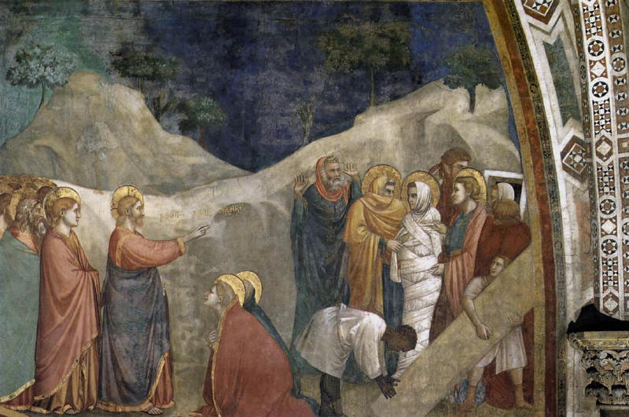
Raising Lazarus
John 11

Slide 58
John 11:1-6
John 11:1 (NIV) Now a man named Lazarus was sick. He was from Bethany, the village of Mary and her sister Martha. 2 This Mary, whose brother Lazarus now lay sick, was the same one who poured perfume on the Lord and wiped his feet with her hair. 3 So the sisters sent word to Jesus, "Lord, the one you love is sick." 4 When he heard this, Jesus said, "This sickness will not end in death. No, it is for God's glory so that God's Son may be glorified through it." 5 Jesus loved Martha and her sister and Lazarus. 6 Yet when he heard that Lazarus was sick, he stayed where he was two more days.

Slide 59
John 11:7-13
John 11:7 (NIV) Then he said to his disciples, "Let us go back to Judea." 8 "But Rabbi," they said, "a short while ago the Jews tried to stone you, and yet you are going back there?" 9 Jesus answered, "Are there not twelve hours of daylight? A man who walks by day will not stumble, for he sees by this world's light. 10 It is when he walks by night that he stumbles, for he has no light." 11 After he had said this, he went on to tell them, "Our friend Lazarus has fallen asleep; but I am going there to wake him up." 12 His disciples replied, "Lord, if he sleeps, he will get better." 13 Jesus had been speaking of his death, but his disciples thought he meant natural sleep.

Slide 60
John 11:14-20
John 11:14 (NIV) So then he told them plainly, "Lazarus is dead, 15 and for your sake I am glad I was not there, so that you may believe. But let us go to him." 16 Then Thomas (called Didymus) said to the rest of the disciples, "Let us also go, that we may die with him." 17 On his arrival, Jesus found that Lazarus had already been in the tomb for four days. 18 Bethany was less than two miles from Jerusalem, 19 and many Jews had come to Martha and Mary to comfort them in the loss of their brother. 20 When Martha heard that Jesus was coming, she went out to meet him, but Mary stayed at home.

Slide 61
John 11:21-27
John 11:21 (NIV) "Lord," Martha said to Jesus, "if you had been here, my brother would not have died. 22 But I know that even now God will give you whatever you ask." 23 Jesus said to her, "Your brother will rise again." 24 Martha answered, "I know he will rise again in the resurrection at the last day." 25 Jesus said to her, "I am the resurrection and the life. He who believes in me will live, even though he dies; 26 and whoever lives and believes in me will never die. Do you believe this?" 27 "Yes, Lord," she told him, "I believe that you are the Christ, [Messiah] the Son of God, who was to come into the world."

Slide 62
John 11:28-32
John 11:28 (NIV) And after she had said this, she went back and called her sister Mary aside. "The Teacher is here," she said, "and is asking for you." 29 When Mary heard this, she got up quickly and went to him. 30 Now Jesus had not yet entered the village, but was still at the place where Martha had met him. 31 When the Jews who had been with Mary in the house, comforting her, noticed how quickly she got up and went out, they followed her, supposing she was going to the tomb to mourn there. 32 When Mary reached the place where Jesus was and saw him, she fell at his feet and said, "Lord, if you had been here, my brother would not have died."

Slide 63
John 11:33-39
John 11:33 (NIV) When Jesus saw her weeping, and the Jews who had come along with her also weeping, he was deeply moved in spirit and troubled. 34 "Where have you laid him?" he asked. "Come and see, Lord," they replied. 35 Jesus wept. 36 Then the Jews said, "See how he loved him!" 37 But some of them said, "Could not he who opened the eyes of the blind man have kept this man from dying?" 38 Jesus, once more deeply moved, came to the tomb. It was a cave with a stone laid across the entrance. 39 "Take away the stone," he said. "But, Lord," said Martha, the sister of the dead man, "by this time there is a bad odor, for he has been there four days."

Slide 64
John 11:40-44
John 11:40 (NIV) Then Jesus said, "Did I not tell you that if you believed, you would see the glory of God?" 41 So they took away the stone. Then Jesus looked up and said, "Father, I thank you that you have heard me. 42 I knew that you always hear me, but I said this for the benefit of the people standing here, that they may believe that you sent me." 43 When he had said this, Jesus called in a loud voice, "Lazarus, come out!" 44 The dead man came out, his hands and feet wrapped with strips of linen, and a cloth around his face. Jesus said to them, "Take off the grave clothes and let him go."

Slide 65
John 11:45-50
John 11:45 (NIV) Therefore many of the Jews who had come to visit Mary, and had seen what Jesus did, put their faith in him. 46 But some of them went to the Pharisees and told them what Jesus had done. 47 Then the chief priests and the Pharisees called a meeting of the Sanhedrin. "What are we accomplishing?" they asked. "Here is this man performing many miraculous signs. 48 If we let him go on like this, everyone will believe in him, and then the Romans will come and take away both our place [Or temple] and our nation." 49 Then one of them, named Caiaphas, who was high priest that year, spoke up, "You know nothing at all! 50 You do not realize that it is better for you that one man die for the people than that the whole nation perish."

Slide 66
John 11:51-53
John 11:51 (NIV) He did not say this on his own, but as high priest that year he prophesied that Jesus would die for the Jewish nation, 52 and not only for that nation but also for the scattered children of God, to bring them together and make them one. 53 So from that day on they plotted to take his life.

Slide 67
Historicity of these Events
Occasion
Just a few months before crucifixion, at end of Jesus' Perean ministry
Jesus at Bethany beyond Jordan when message reaches Him
He waits two days before going to Bethany near Jerusalem.

Slide 68
Liberal Explanations
Lazarus not really dead:
Resuscitation
or Plot
Parable of Lazarus & Rich Man made into a narrative
Myth or allegory

Slide 69
Evidence of Historicity
Character of Mary and Martha matches that in Luke.
Location of Bethany near Jerusalem, other place names.
Details of narrative, including reaction of enemies, reference to blind man (37).

Slide 70
Reaction of Eyewitnesses
Many Jews who saw event come to believe.
Some report incident to Pharisees.

Slide 71
Old Testament Background
Similar miracles
Resurrection of widow's son (1 K 17) by Elijah
of Shunemite's son (2 K 4) by Elisha
of man by Elisha's bones (2 K 13)
All rather recently dead
Other parallels
Uncleanness conveyed by touching dead (Num 19:11-12).
Eschatological materials on resurrection (e.g., Dan 12:2; Isa 26:19)
Explicit connection of this resurrection with eschaton (23-26)

Slide 72
Significance
Immediate effect
Lazarus raised, family restored.
Sets in motion decision of Sanhedrin to kill Jesus.
Place in salvation history
Only addition to other resurrection accounts is statement of Jesus as Resurrection and Life.

Slide 73
Symbolic Elements
Here eschatological significance brought out in vv 23-26.

Slide 74
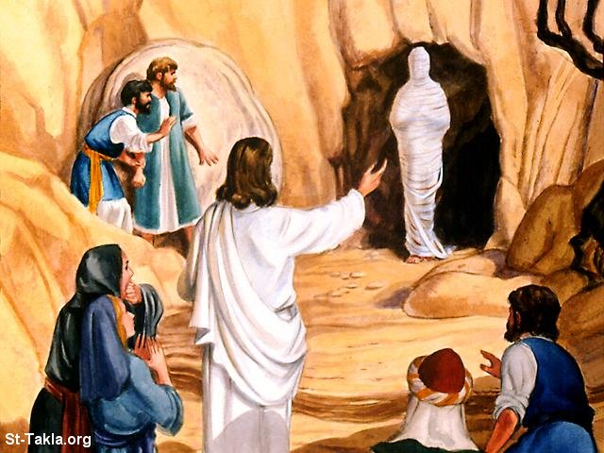
The End

