Slide 1
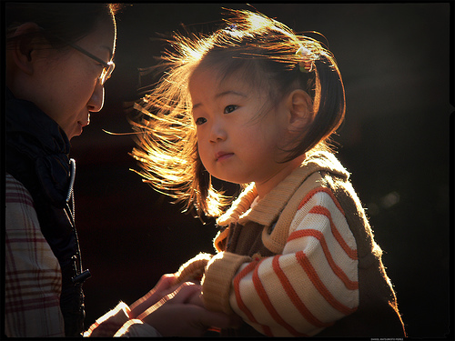
7. Walk as Children of Light
Ephesians 5
Robert C. Newman

Slide 2
Introduction
In our previous talks, we have dealt with:
First, physical light:
The Creation of Light (Genesis 1)
Light Revealing God (Psalm 19)
Then some analogies for light to divine things:
God’s Word as Light (Psalm 119)
Messiah, the Light (Isaiah 8)
God, Our Light in Bad Times (Micah 7)
God is Light (1 John 1-2)

Slide 3
Introduction
In our last two talks on light, we continue with spiritual analogies for light, but now these are applied to believers n to those on whom God’s light has shone in such a way that they too become lights:
Walk as Children of Light (Ephesians 5)
Let Your Light Shine (Matthew 5)

Slide 4
Be Imitators of God
Ephesians 5:1-7 (NIV) Be imitators of God, therefore, as dearly loved children 2 and live a life of love, just as Christ loved us and gave himself up for us as a fragrant offering and sacrifice to God. 3 But among you there must not be even a hint of sexual immorality, or of any kind of impurity, or of greed, because these are improper for God's holy people. 4 Nor should there be obscenity, foolish talk or coarse joking, which are out of place, but rather thanksgiving. 5 For of this you can be sure: No immoral, impure or greedy personnsuch a man is an idolaternhas any inheritance in the kingdom of Christ and of God. 6 Let no one deceive you with empty words, for because of such things God's wrath comes on those who are disobedient. 7 Therefore do not be partners with them.

Slide 5
Be Imitators of God
Imitate God, like children imitate their parents (1).
Walk in love, just as Christ loved you (2).
Don’t be like this (3-5):
Immoral
Impure
Greedy
Obscene
Such will have no inheritance from God.

Slide 6
Walk as Children of Light
Ephesians 5:8-14 (NIV) For you were once darkness, but now you are light in the Lord. Live as children of light 9 (for the fruit of the light consists in all goodness, righteousness and truth) 10 and find out what pleases the Lord. 11 Have nothing to do with the fruitless deeds of darkness, but rather expose them. 12 For it is shameful even to mention what the disobedient do in secret. 13 But everything exposed by the light becomes visible, 14 for it is light that makes everything visible. This is why it is said: "Wake up, O sleeper, rise from the dead, and Christ will shine on you."

Slide 7
Walk as Children of Light
You were previously darkness, now you are light (8)
What does light produce? (9)
Goodness
Righteousness
Truth
Try to learn what pleases God (10)

Slide 8
Walk as Children of Light
What does darkness produce? (11)
No fruit (or bad, shameful fruit) (12)
Don’t participate in darkness, but expose it (11).
How? (13)
By your lifestyle (13)
Think of Jesus’ example (14)

Slide 9
Live Like Sages
Ephesians 5:15-20 (NIV) Be very careful, then, how you livennot as unwise but as wise, 16 making the most of every opportunity, because the days are evil. 17 Therefore do not be foolish, but understand what the Lord's will is. 18 Do not get drunk on wine, which leads to debauchery. Instead, be filled with the Spirit. 19 Speak to one another with psalms, hymns and spiritual songs. Sing and make music in your heart to the Lord, 20 always giving thanks to God the Father for everything, in the name of our Lord Jesus Christ.

Slide 10
Live Like Sages
Pay attention to your lifestyle, like people who live by wisdom (15).
Use your time wisely (16).
Try to find out what God’s agenda is (17).
Let God, not drugs, control your mind (18).
Through Scripture
Song
Thanks

Slide 11
THE END

