Slide 1
The Letters of Peter
Robert C. Newman

Slide 2
Authenticity of the Letters

Slide 3
Authenticity of 1 Peter
Denied by many liberals
Accepted by some
Usual objection
Sounds too much like Paul
Problems (for liberals)
If Peter & Paul are so similar and have the same views about Jesus, then hard to have split between them, or between them & Gospels
If Peter, Paul & Gospels too much alike, hard to propose they are wrong!

Slide 4
Authenticity of 1 Peter
Apostolic unity is hard on liberal theories.
Conservative liberals say Peter's view is new, not going back to Jesus.
1 Peter was recognized early in church.
Evidence for its use widespread.
Authorship in antiquity not doubted within the church.

Slide 5
Authenticity of 2 Peter
Universally rejected by liberals
Their arguments:
Style is different from 1 Peter.
Refers to Paul's letters as scripture, so late.
Copied from Jude's letter.
No early references to 2 Peter.
These arguments are answerable.

Slide 6
Style of 2 Peter
Yes, it differs from style of 1 Peter.
1 Peter may have been written with help from Silas/Silvanus (see 1 Pet 5:2).
If this is Paul's Silas, he probably had better Greek language ability than Peter.
Neither letter is bad Greek, though.
No book is closer to 2 Peter than 1 Peter.

Slide 7
Reference to Paul
Only a problem if Paul & Peter enemies.
This is not the view of Acts & Paul's letters.
Peter recognized Paul's ministry to Gentiles.
Peter would surely have known of Paul's letters, as their ministries overlapped in both time and space.

Slide 8
Reference to Paul
But Peter implies Paul's letters are scripture.
Did the Apostles expect more scripture?
Jesus said the Holy Spirit would teach them.
They were given authority to "bind & loose."
Rabbinic term for rule-making & abrogating
So, if the Lord didn't return right away, they would expect to write it themselves.

Slide 9
Resemblance to Jude
2 Peter does resemble Jude in places
Possibilities:
2 Peter copied Jude, so prob late, hoax.
Jude copied 2 Peter, so 2 Peter early.
Both copied another source.
Actually looks like Jude copied 2 Peter
See our discussion under Jude

Slide 10
Lack of Early Attestation
Should not be over-emphasized.
Yes, no other book in NT canon so poorly attested.
But no other book outside NT so well-attested.
Some book in NT has to be last in attestation!

Slide 11
Lack of Early Attestation
Possible explanations:
2 Peter did not exist until late (c130 AD).
It existed but was not mentioned.
It did not have as wide circulation as 1 Peter.
It did not exist till late.
Liberals favor this, but a problem here.
How get in canon so late?
Plenty of competitors by mid-2nd century

Slide 12
Lack of Early Attestation
It existed but was not mentioned.
A statistical fluke
We know the Apostolic Fathers did not quote from every book they viewed as canonical; see under NT Canon.
It didn't have as wide circulation as 1 Peter.
Location of recipients not given in 2 Peter.
Perhaps a smaller subgroup of 1 Peter's recipients.

Slide 13
Lack of Early Attestation?
Some possible allusions to 2 Peter:
1 Clement 11 refer to 2 Peter 2:6-9?
Piety of Lot, God rescues godly, punishes others
Ps-Barnabas 15 - "day of Lord shall be as 1000 years"
Psalm 90:4 has same times, but opposite order
2 Pet 3:8 is very close in the Greek.
Jude quoting 2 Peter?
See discussion under Jude

Slide 14
Date of the Letters

Slide 15
Date of 1 and 2 Peter
If genuine, then written before Peter’s death
Martyred in Nero's reign; Nero's suicide AD 68
1 Peter before 2 Peter
"This is the 2nd letter I am writing" – 2 Pet 3:1
1 Peter sounds like persecution going on.
Written to warn of change in Roman policy?
If so, then probably not before fall AD 64
2 Peter probably close to his death, but Peter not yet in prison.
So both letters in range AD 64-68.

Slide 16
First Peter

Slide 17
Written from "Babylon"
Ancient city?
City gone, but area still called "Babylon"
Near modern Cairo?
Also called "Babylon" in NT times
Figurative for Rome?
Rev 17:9 refers to Rome as "Babylon."
Peter may have used term for OT enemies.
May be used to hide Peter’s location.

Slide 18
Recipients of 1 Peter
Written to Asia Minor (all but 2 south provinces)
Areas where Paul had ministered
Perhaps Peter had also ministered here.
Perhaps he is warning Paul's churches.
Recipients seem to be mainly Gentiles rather than Jews.

Slide 19
Main Theme
To encourage Christians in persecution:
See references to persecution:
1:6-7 – "distressed by trials… tested by fire"
4:4 – verbal abuse
4:12-13 – “fiery ordeal… testing…"
4:16 – "suffers as a Christian"
Sounds like organized persecution, probably Nero's

Slide 20
Peter's Encouragement
Look back to Christ's suffering
We share in it in some way
1:11 – predicted by prophets
2:21f – serves as our example
3:17f – suffer for doing right
4:1 – prepare to suffer as Christ did
4:13 – share sufferings of Christ

Slide 21
Peter's Encouragement
Look forward to Christ's coming:
1:3f – "a living hope… imperishable inheritance"
3:22 – Jesus has already gone to heaven
4:7 – "the end of all things is at hand…"
4:13 – will rejoice at his coming

Slide 22
A Second Theme
Peter exhorts believers to holy living
1:13ff – "gird up your minds for action…"
2:12ff – "keep your behavior excellent…"
4:1ff – "live no longer for the lusts of men…"

Slide 23
Topical Outline
Address & greeting (1:1-2)
Thanksgiving (1:3-12)
Implications of salvation (1:13-2:10)
Christian relationships (2:11-3:12)
Suffering & the will of God (3:13-22)
Holy living (4:1-11)
The fiery trial (4:12-19)
Address to elders (5:1-4)
General address & benediction (5:5-11)
Personal comments & greetings (5:12-14)

Slide 24
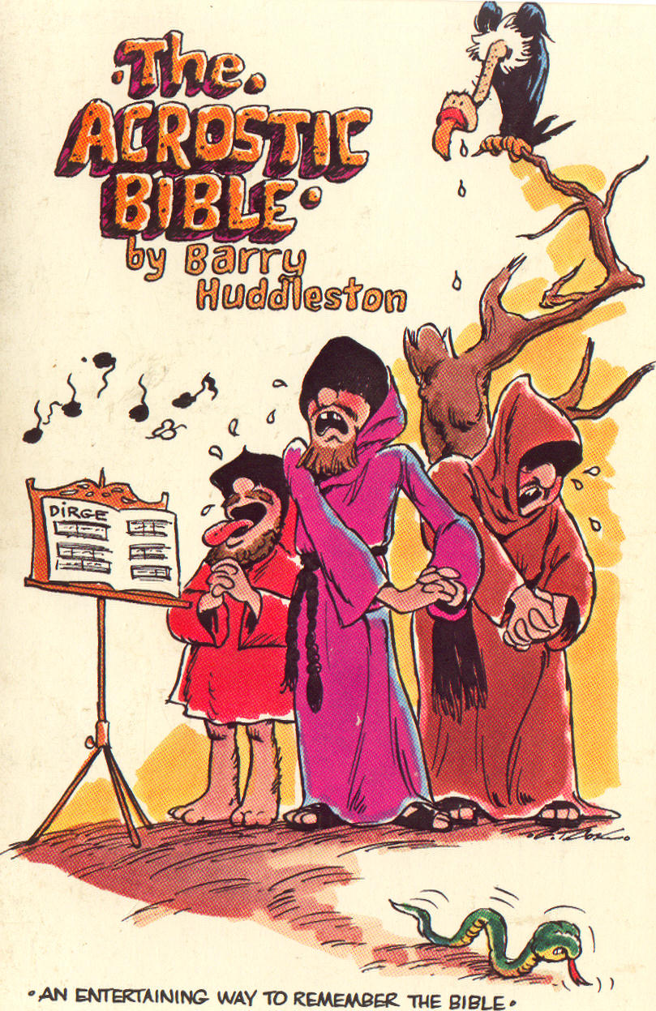
Huddleston's Acrostic
Trials prove your faith.
Respond as Christ did.
Innocent conscience quiets foes.
Attitudes pleasing to God
Leaders to serve humbly

Slide 25
Argument of 1 Peter
A condensed, explanatory paraphrase

Slide 26
Second Peter

Slide 27
Recipients of 2 Peter
Address is very general:
"Those who have received a faith of the same kind as ours"
All Christians intended, or some partial group?
Some overlap with recipients of 1 Peter, as 2 Pet 3:1 says "this is the 2nd time I’ve written you."

Slide 28
Main Themes of 2 Peter
Growth (chapter 1)
Apostasy (chapter 2)
Second coming (chapter 3)

Slide 29
Topical Outline
Salutation (1:1-2)
Truth of Christian faith attested (1:3-21)
Personal experience (3-11)
Eyewitness testimony (12-18)
Fulfilled prophecy (19-21)
Condemnation of false prophets (2:1-3:10)
Duties of believers (3:11-18)
Benediction (3:18)

Slide 30
Topical Outline
Condemnation of false prophets (2:1-3:10)
Share judgment with OT false prophets
Unrestrained sinners
Lead to slavery
Doubt 2nd coming
Pictured by flood
Delayed by God's mercy
Certain to come

Slide 31
Topical Outline
Duties of believers (3:11-18)
Be holy
Recognize God's patience
Watch out for deception
Grow in grace
Benediction (3:18)

Slide 32
Huddleston's Acrostic
Add virtues to faith
Deeds of false teachers
Diligence before Lord’s return

Slide 33
The End

