Slide 1
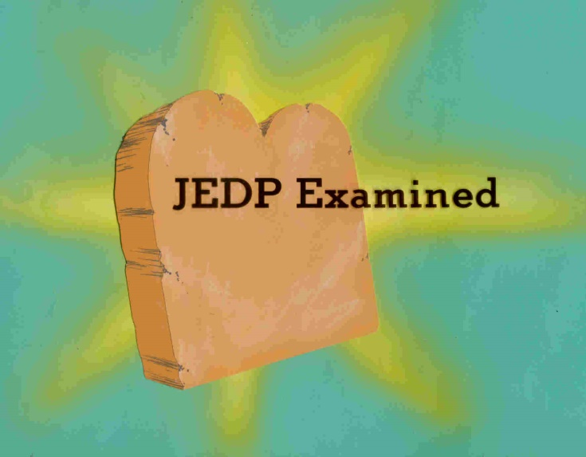
Did Moses Write the Torah?
Examining the JEDP Theory
Allan A. MacRae
Robert C. Newman

Slide 2
What is the JEDP Theory?
Proposed by Julius Wellhausen in 1878.
Has dominated liberal OT studies ever since.
The Torah (Genesis thru Deuteronomy) was not written by Moses about 1400 BC.
Instead, authors J, E, D, P wrote 850-550 BC. Their documents were assembled by editors over several centuries.

Slide 3
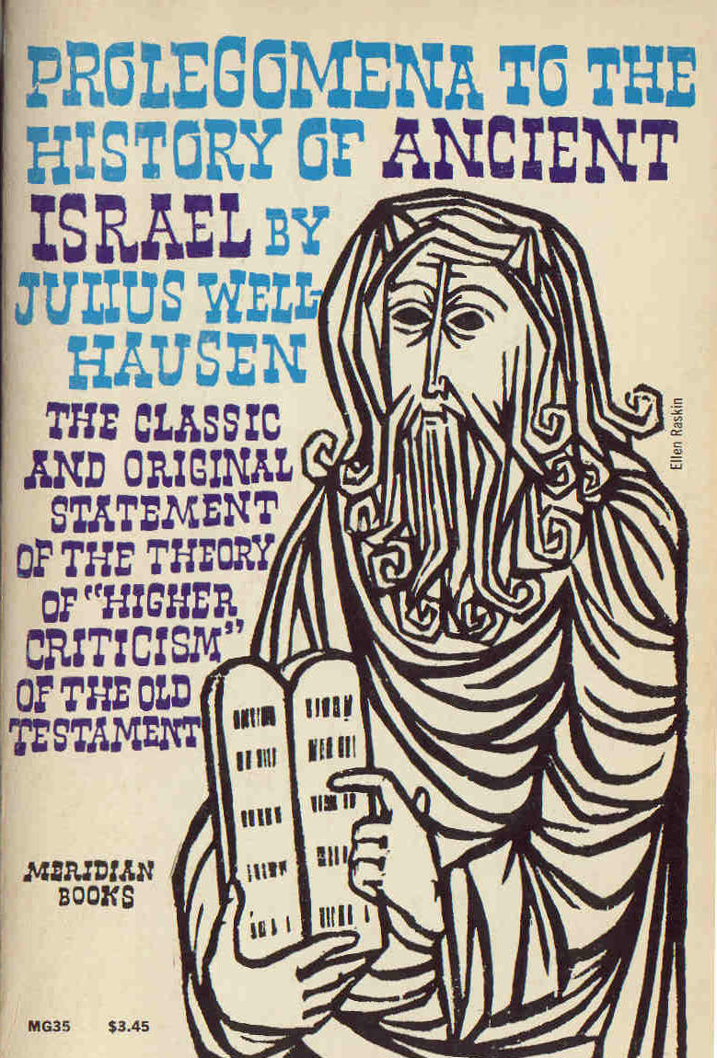
Wellhausen's Book

Slide 4
The Documents Described
J a southern work, written ~ 850 BC
Flowing narrative style, uses "Yahweh"
E a northern work, written ~ 750 BC
Flowing narrative style, used "Elohim"
D about time of Josiah, ~ 650 BC
Rhetorical style
P a priestly work, ~ 550 BC
Dry, repetitive style, many details

Slide 5
Historical Background
The Context of the JEDP Theory

Slide 6
Manuscript Evidence
We have hundreds of manuscript copies of the first five books of the Bible, all of which present them in the form in which we have them today. Not even one ancient copy of J, E, D, or P as a separate and continuous unit has ever been found.

Slide 7
Traditional Hebrew Texts
We have hundreds of manuscripts of the Hebrew Bible from the centuries before printing.
We have no manuscripts of J, E, D, or P.
This is a Hebrew Bible manuscript from the 9th century of our era.

Slide 8
Ancient Translations
The Hebrew Bible was translated into Aramaic, Greek, and Latin around the time of Jesus.
None of these contain separate texts of J, E, D or P.
This is a Greek ms from the 5th century.

Slide 9
Dead Sea Scrolls
Since the mid-20th century, we have found much earlier mss of the Bible than were previously known.
None of these contain J, E, D or P as separate works.
This is a ms from the Dead Sea community dating from the 2nd century before our era.

Slide 10
Other Historical Evidence
No record that has come down to us from ancient times contains any mention of such documents as having ever existed. There is no ancient reference to the writing of any such document, nor to such a process of combining documents as the theory assumes. There is no evidence that any such process actually occurred.

Slide 11
Rabbinic Literature
We have extensive writings from the rabbis from ~200 AD onward thru the medieval period.
None of these works refer to such documents as J, E, D or P.
This is a sample page from the Babylonian Talmud, composed about 550 AD.

Slide 12
Jewish Historians
We have several significant historical writers from the time of Jesus, and briefer materials from earlier.
None of these make reference to works such as J, E, D or P.
This is Josephus' Antiquities, the most extensive of such works, from ~ 100 AD.

Slide 13
Jewish Inscriptions
We have Hebrew inscriptions dating back as far as the 10th century BC.
None of these allude to such documents as J, E, D, P either.
This is the Gezer calendar, from the 10th century BC.

Slide 14
Summary on Historical Evidence
Thus no documents resembling nor referring to J, E, D, P have come down to us from antiquity.
Thus, the burden of proof for the existence of such documents lies with those who would propound the theory, not with its opponents.

Slide 15
Literary Method
The JEDP theory is nearly the only survivor of a 19th century literary practice that has been discarded outside the field of Biblical criticism. A century ago it was common to theorize multiple authors and sources for almost any ancient or medieval document. Most such theories have today been abandoned, and are viewed as merely curiosities. It is only in the field of Biblical study that this 19th century attitude has been retained.

Slide 16
Beowulf
An Anglo-Saxon epic poem, the oldest such in the history of English literature (~ AD 700)
Adventures of the Danish hero Beowulf fighting various monsters
Once thought to have been composed of 6 sources, now seen as a unified composition

Slide 17
The Niebelungenlied
German saga from ~1200 AD, of treasure, murder & revenge
Some of the material was used by Wagner in his Ring operas.
Karl Lachmann thought it was originally 20 independent songs.
Now seen as the work of a single author

Slide 18
Piers the Plowman
A 14th cen poem, a series of allegorical dreams, exalting simplicity & truth, satirizing the clergy
Once thought to be the work of five authors, now seen as the work of one.

Slide 19
Literary Method Today
"In field after field, theories of composite authorship, earlier versions, different strata, have been discarded. The kind of analysis which was once thought to have been the particular duty of literary criticism is now markedly out of fashion. The assumption today is more and more in favour of single authorship, unless there is clear external evidence to the contrary." – Helen Gardner, The Business of Criticism (Oxford, 1959), p 97.

Slide 20
Other Source Theories
During the 19th century various German scholars presented widely differing theories regarding the origins of the first five books of the Bible. None of these theories gained complete ascendancy until 1878, when a particular theory — strikingly different from most of the views previously held — was advanced by Julius Wellhausen. Though more than a century has passed during which no new evidence for the theory has been discovered, it is still being taught today in almost the identical form in which Wellhausen presented it.

Slide 21
Predecessors to the JEDP Theory
Two-Document Theory
Fragmentary Theory
Supplementary Theory
Crystallization Theory
Development Theories
Modified (3-Document) Theory

Slide 22
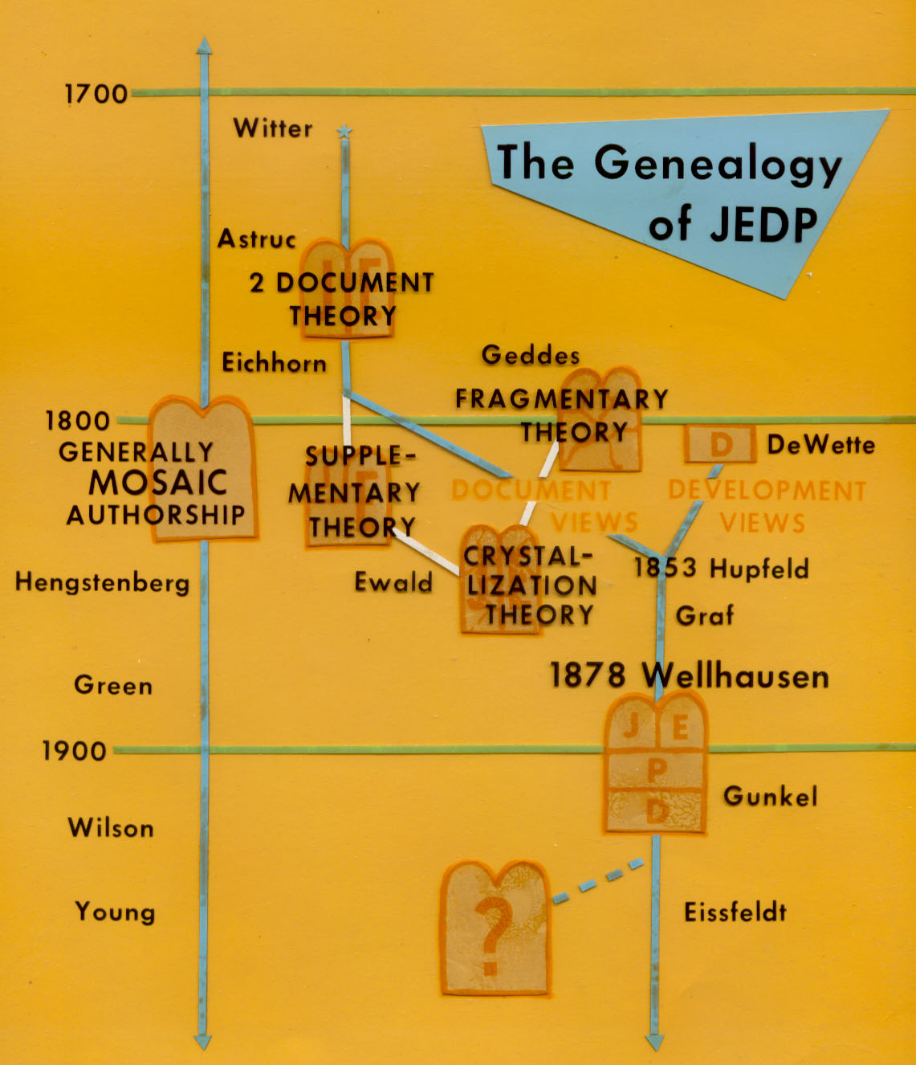
Various Views on the Origin of Genesis thru Deuteronomy

Slide 23
Two-Document Theory
Though noticed by Witter, it was Jean Astruc in 1753 who suggested that the two names for God pointed to two sources used by Moses.
Johann G. Eichhorn modified this in 1780, rejecting Moses as author & dating the sources later.
Eichhorn saw two distinct documents, J and E, with 2 names of God and 2 styles.

Slide 24
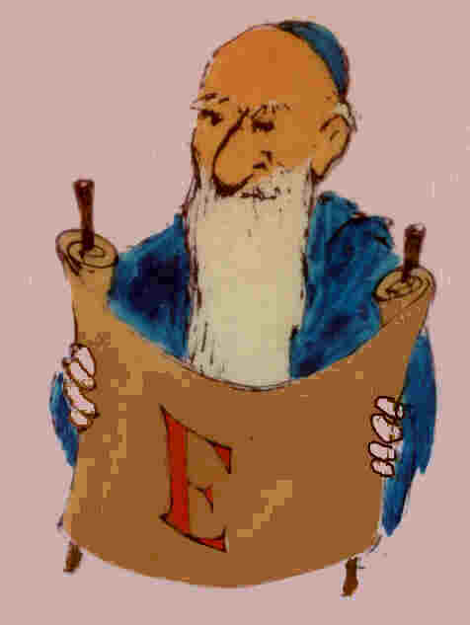
Two-Document Theory
One document, J, used "Yahweh" (Jehovah) for God’s name, and had a flowing, narrative style.
The other document, E, used “Elohim" for God, and had a very dry, statistical, detailed style.

Slide 25
Fragmentary Theory
Karl Ilgen (1798) proposed dividing the two. He came up with 17 documents and at least three authors.
Later suggestions by Alexander Geddes (1800), Johann Vater (1802) and Anton Hartmann (1831) found many more documents, mostly fragmentary, assembled by editors.

Slide 26
Supplementary Theory
Heinrich Ewald (1823) noticed an impressive unity running thru Genesis. It couldn’t very well be a mass of independent fragments.
He and DeWette proposed that E was the main document, but it was supplemented by J material.

Slide 27
Crystallization Theory
Ewald later developed this to solve problems in the Supplementary Theory, as it looked like both J and E materials assumed the existence of the other.
Ewald suggested that J and E were types of material which gradually accumulated, being composed in view of the currently existing compilation.

Slide 28
Development Theories
Meanwhile, others were suggesting the Torah showed evidence of different stages of religion in different documents.
DeWette (1805) proposed a plot theory in which Deuteronomy was written by priests shortly before Josiah's time (~650 BC) to get worship in Jerusalem.

Slide 29
Development Theories
Now scholars began to argue they had found fossils of earlier religious views in the Torah & that these could be used to date the documents.
This led to Hupfeld's (1853) attempt to combine stylistic criteria with developmental ones.

Slide 30
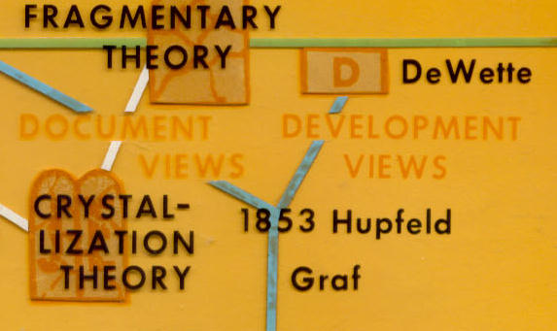
Modified 3-Document Theory
Hermann Hupfeld (1853) proposed a return to the old two-document view, but with E split into two very different documents.
One, called E, will use "Elohim" for God but have a flowing narrative style.
The other, called P, will also use "Elohim" but have a dry, statistical style.
This came to be viewed as a "Copernican Revolution."

Slide 31
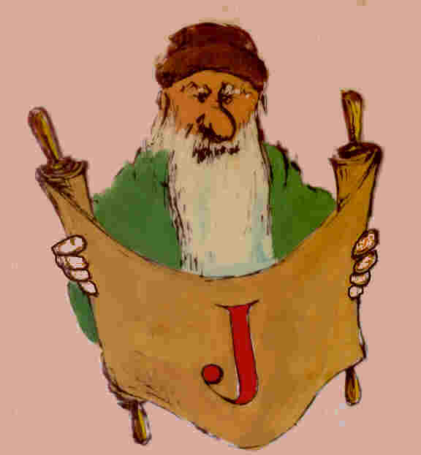
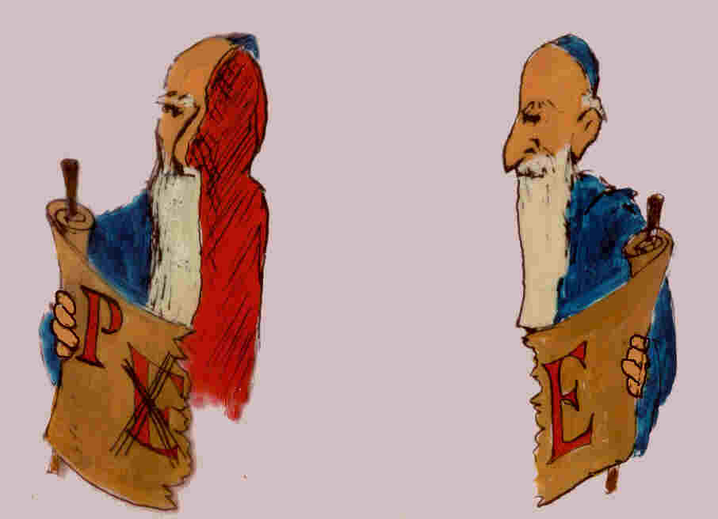
The "Copernican Revolution"
"Elohim" & dry, genealogical style
"Elohim" & flowing, narrative style
"Yahweh" & flowing, narrative style

Slide 32
The JEDP Theory
Wellhausen (1878) powerfully presented Hupfeld’s view, adding in the book of Deuteronomy as a fourth document (D) to produce his 4-document theory of the origin of the Torah.
What others had seen as the foundational document (E in the Supp Th) became for Wellhausen (as P) the very last to be written!

Slide 33
Basically Moses as Author
Other scholars feel that the evidence does not warrant dividing the text into these hypothetical documents.
These include:
E W Hengstenberg
Wm Henry Green
Robt Dick Wilson
Edward J Young
Oswald T Allis
Allan A MacRae

Slide 34
Examining the JEDP Theory
Arguments & Recent Developments

Slide 35
How Do Things Stand Today?
Will consider the evidence originally put forward for the JEDP theory.
Will make reference to recent developments
Most of our citations with be drawn from The Bible & the Ancient Near East: Essays in Honor of William F. Albright.

Slide 36
The Two Pillars
"The critical orthodoxy of the day [JEDP] rested on two pillars:
[1] an analysis of documents and
[2] a theory with regard to the development of Israel’s religion."
– John Bright in BANE, page 3

Slide 37
The Development Argument
Examining the JEDP Theory

Slide 38
The Development Argument
A great part of the reason for the acceptance of Wellhausen’s theory was his skillful presentation of a particular idea of the development of Israelite religion. This idea, however, has now been almost universally discarded. Few scholars today hold to a theory of Hebrew religious development even close to that upon which Wellhausen based his idea for the sources of the Pentateuch. Yet his method of dividing sources and his view of their dates are still being presented as established fact.

Slide 39
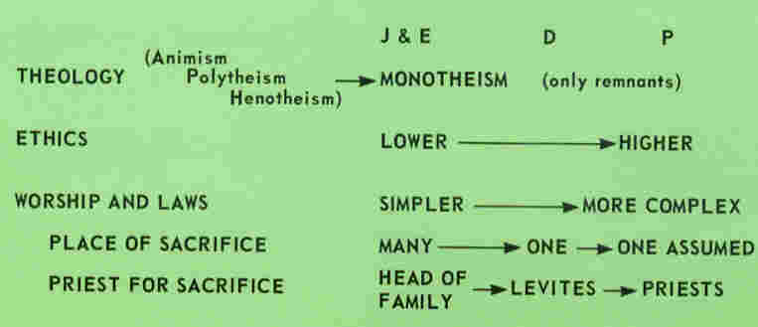
The Development Argument

Slide 40
The Place of Worship
"As we learn from the NT, the Jews and Samaritans were not agreed on the proper place of worship, but that there could only be one was taken to be as certain as the unity of God Himself…. But this oneness of the sanctuary was not originally recognized either in fact or in law; it was a slow growth of time. With the help of the OT we are still quite able to trace the process. In doing so, it is possible to distinguish several stages of development…" – Wellhausen, Prolegomena, p 17.

Slide 41
Development of Religion
"The generally accepted account of Israel’s history and religion produced by Wellhausen and popularized in the late 19th and early 20th centuries survives, to be sure, today. It is especially among non-specialists that it is accepted as indubitably valid, and especially among those who would claim the label 'liberal,' religious as well as secular. Yet [it] was largely based on a Hegelian philosophy of history, not upon his literary analysis. It was an a priori evolutionary scheme that guided him…" – Mendenhall in BANE, 32.

Slide 42
Development of Religion
"… the reconstruction of the history of Israel and its religion, which Wellhausen carried out on the foundation of his literary analysis, has almost entirely broken down…. It was assumed that a document of a particular period could be utilized by the historian only for evidence of the period in which it was written…. This 'hyperskepticism' did not result in a 'history,' for it lacked foundations, and its builders lacked yardsticks." – Mendenhall in BANE, 29.

Slide 43
Development of Religion
"The historical worth of these documents [JEDP] — centuries removed, as they were, from the events of which they purported to tell — was held to be minimal. Instead, they were valued almost exclusively for the light they cast on the beliefs and practices of the respective periods in which they were written, not as sources of information regarding the period of Israel’s origins." – Bright in BANE, 4.

Slide 44
Input from Archeology
"It has become plain that the narratives of Israel’s origins found in the Hexateuch [Genesis thru Joshua], far from reflecting the circumstances of those later ages when the documents supposedly were written, reflect precisely — whatever one may say of their historical worth — those of the second millennium BC of which they purport to tell." – Bright in BANE, 6.

Slide 45
The Stylistic Argument
The claim here is that the Pentateuch consists of four distinct documents with distinct styles:
J – flowing, narrative style, using Jahweh
E – flowing, narrative style, using Elohim
D – hortatory, preachy style
P – dry, pedantic style

Slide 46
The Stylistic Argument
"By its taste for barren names and numbers and technical descriptions, the Priestly Code [P] comes to stand on the same line with Chronicles and the other literature of Judaism which labors at an artificial revival of the old tradition. Of a piece with this tendency is an indescribable pedantry, belonging to the very being of the author of the Priestly Code. He has a very passion for classifying and drawing plans; if he has once dissected a genus into different species, we get all the species named to us one by one every time he has occasion to mention the genus." – Wellhausen, Prolegomena, 350.

Slide 47
The Stylistic Argument
"Space forbids here an examination of the styles of J and E … They have much in common; indeed, stylistic criteria alone would not generally suffice to distinguish J and E; though, when the distinction has been effected by other means, slight differences in style appear to disclose themselves." – Driver, ILOT, 126.

Slide 48
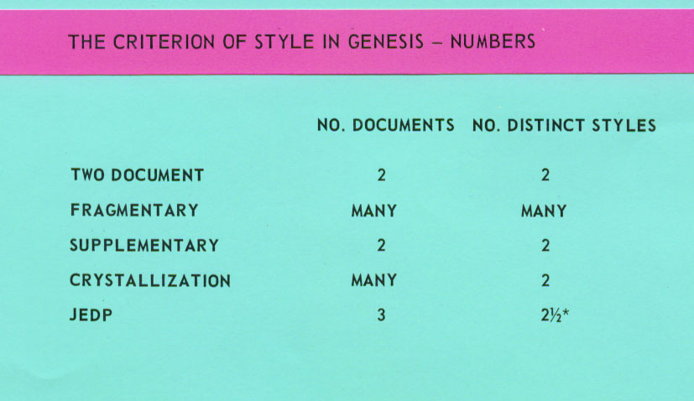

Slide 49
The Stylistic Argument
How widely can a style vary and still belong to a single person?
Consider:
The painter Pablo Picasso
The author Charles L. Dodgson

Slide 50
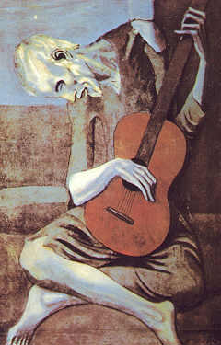
Picasso's Style

Slide 51
Dodgson/Carroll's Style
Charles Dodgson was a lecturer in math at Oxford.
He also wrote Alice in Wonderland and other stories for children.
Meeting Queen Victoria after the publication of Alice, the queen asked him to dedicate his next work to her.
He did – An Elementary Treatise on Determinants!

Slide 52
The Stylistic Argument
"The determination of authorship requires the gathering and judicious assessment of as much evidence, both internal and external, as can be found. Internal evidence is normally more abundant, but is also very slippery. The premise underlying its use is that every author’s work has unique idiosyncrasies of style…" – Richard D. Altick, The Art of Literary Research, 69.

Slide 53
The Stylistic Argument
Proponents of the JEDP theory claim its truth can be demonstrated by the stylistic differences among the documents. Yet these differences mostly settle down to the fact that certain parts of the Pentateuch are statistical or enumerative, while other parts are narrative, and most of Deuteronomy consists of exhortation. There is no reason why the same writer should not use each of these styles depending on the nature of the particular subject matter. Similar instances of the use of styles at least as different as these could be found in the works of nearly any extensive writer of recent years.

Slide 54
A Suggested Answer
J is primarily narrative using "Yahweh."
E is primarily narrative using "Elohim."
D is primarily exhortation.
P is primarly statistical and tabular material.
Thus the stylistic variation is just a reflection of differing subject matter and genre, rather than distinct authors.

Slide 55
The Divine Name Argument
This is closely related to the stylistic argument, as the latter often claims that certain words are characteristic of an author.
The divine name argument was especially important in the history of the JEDP theory.
The original division of documents was based on the use of "Yahweh" vs. “Elohim."

Slide 56
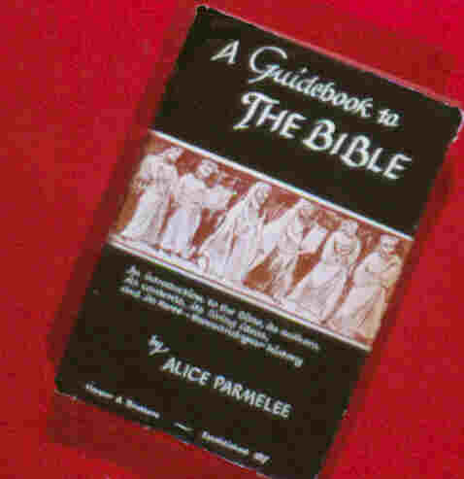
The Divine Name Argument
In simple, popular presentations of the JEDP theory, the data is presented in a way that sounds like a very strong argument:
J uses "Yahweh"
E uses "Elohim."

Slide 57
The Divine Name Argument
"We do not know who the writer was, but from hints in his book we can piece together a number of facts about him. He was a man of Judah, living, no doubt, in Jerusalem. As his name for God was Jahveh (Yahweh), we call this writer the Jahvist, or simply J" – Parmelee, 30.

Slide 58
The Divine Name Argument
"As we do not know this priest’s name, we take the initial letter of his word for God, Elohim, and of his tribe, Ephraim, and call this writer E and his Religious History of Israel the E Document." – Parmelee, 34.

Slide 59
The Divine Name Argument
In simple, popular presentations of the JEDP theory, the data is presented in a way that sounds like a very strong argument:
J uses "Yahweh"
E uses "Elohim."
In fact, "Yahweh" actually occurs in all four documents and is the commonest name in each!

Slide 60
The Divine Name Argument
Thus each writer of the four alleged documents is admitted to have known both names for God.
The real "divine name view" among liberals who are familiar with the data is that the various ancient authors had different theories as to when the name Yahweh was introduced to Israel.

Slide 61
Alleged Duplications
The claim that there is constant duplication of material in the various alleged sources is grossly exaggerated. Some of these so-called duplications are really different events that are somewhat similar, but actually no more so than is often the case in ordinary life. In other cases an alleged repetition is merely a summary given at the beginning or end of an account, a helpful recapitulation, or a literary device to make an account more vivid. Most of these, if examined without prejudice, can be shown to have a natural purpose in the narrative.

Slide 62
Alleged Contradictions
Most of the alleged contradictions between the so-called sources disappear on careful examination. For instance, it is claimed that the J and P documents picture Rebecca as influenced by different motives in sending Jacob from Canaan — to escape his brother’s anger, and to get a wife his parents liked. Actually there is no contradiction whatever in supposing that Rebecca was influenced by both motives and that, in dealing with the two men she wished to influence, she used in each case the argument she knew would appeal to rather than antagonize him.

Slide 63
Conclusions
These facts indicate there are logical reasons for the phenomena of the Pentateuch, all of them consistent with the idea of a single author. Most people who accept the JEDP theory — including most of them who teach it — do so because of their confidence in those by whom it is advanced, rather than on the basis of any thorough investigation.

Slide 64
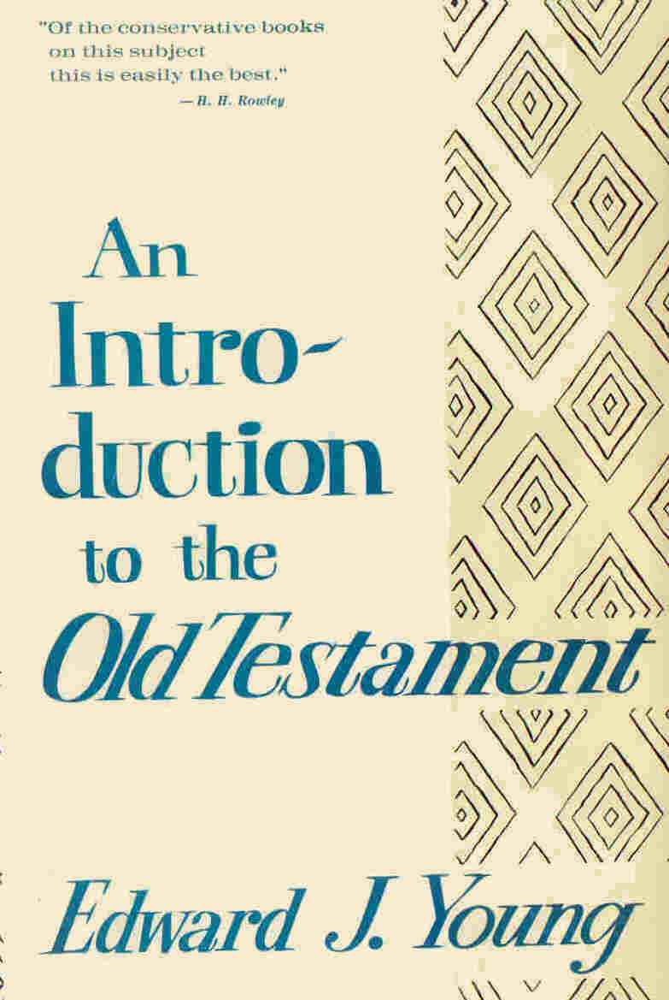
For Further Reading
Allan A MacRae, JEDP: Lectures on the Higher Criticism of the Pentateuch (1994)
Edward J Young, An Introduction to the Old Testament (1964)

