Slide 1

If God exists…
Why so many atheists?
Robert C. Newman

Slide 2
A fair question…
…deserving a fair answer.
I believe biblical Christianity to be true…
…so I am not going to answer this question from the perspective of Islam, or liberal versions of Christianity, but from that of the God presented in the Bible.

Slide 3
The argument appraised
The structure of the argument:
Consider an alternative question, which has the same structure:
  If God doesn’t exist, why so many theists?
This is usually answered by claiming that theists are engaging in wishful thinking.
Atheists, it is said, are not afraid to look at the facts, accepting reality in all its harshness.
Let's see.

Slide 4
The argument appraised
This may be true for some theists and for some views of God…
…but the God of the Bible does not look like the god a wishful thinker would invent:
  …needs nothing, so his favor cannot be earned.
  …sees even the most righteous as deserving punishment.
  …holds those who know him to a higher standard.
  …forgives the worst who repent, but condemns the most righteous who trust in themselves.

Slide 5
The argument appraised
Seems more likely the atheists are wishful thinkers, who would hardly want a god who…
  …restricts their behavior and condemns their sins.
  …judges their actions and thoughts.

Slide 6
The argument appraised
In fact, there are not many atheists in the US, where:
44% are creationists
38% are theistic evolutionists
9% are uncertain
9% believe evolution was not guided by God
Not
God
?
Creation
Theistic
Evolution
Wm Provine, The Scientist (9/5/88)

Slide 7
The argument appraised
Let us return to the main argument.
Would the Bible give us any reason to expect that atheists, whether few or many, might exist?
I suggest there are two features in the Bible that would lead us to expect atheists:
  The "silence" of God
  The sinfulness of humans

Slide 8
The "Silence" of God
Meaning: God is relatively hidden, as he does not continually intervene in the universe in an obvious way.
Result: God allows his existence & presence to be ignored or his nature to be misinterpreted.
This may be seen clearly in:
  Psalm 50:21
  Proverbs 14:12

Slide 9
The "Silence" of God
"These things you have done and I kept silent; you thought I was altogether like you."
Psalm 50:21

Slide 10
The "Silence" of God
"There is a way that seems right to a man, but in the end it leads to death."
Proverbs 14:12

Slide 11
The "Silence" of God
Why would God do this?
  To demonstrate the true character of sin
    Romans 1:21-32
  To give room for genuine moral behavior
    Ecclesiastes 8:11; Deuteronomy 13:1-3
  To lead people to repentance
    Romans 2:4
Thus, according to the Bible, God has good reasons for not making his existence as obvious as he could.

Slide 12
The Sinfulness of Mankind
Humans often suppress the truth to justify unrighteousness (Romans 1:18)
  Fred Hoyle, Galaxies, Nuclei & Quasars
    Don't waste time investigating cosmos with a beginning.
  Barrow & Tipler, Anthropic Cosm. Principle
    Avoid designer via multitude of universes.
  Julian Huxley, Ends & Means
    Meaningless universe lets us do what we want.
  Robert Jastrow, God & the Astronomers
    Einstein, et al, seeking to avoid a beginning.

Slide 13
The Sinfulness of Mankind
Humans are easily deceived by others
  2 Timothy 3:13
  Problem of specialization
    Few know what the data looks like outside their own field.
Thus, according to the Bible, humans have reasons for seeing the evidence for God as less obvious than it really is.

Slide 14
Why So Many Atheists?
If the God of the Bible exists, and if humans are as described in the Bible, we should expect many atheists.
So far, have only considered force of:
  If God exists, why so many atheists?
Is there any evidence for the existence of the God of the Bible?
Yes, let's see.

Slide 15

Evidence for the Existence of the God of the Bible

Slide 16
Design in Nature
Organization of the simplest life
  And the problem of random processes producing order.
Design in complex organisms
  And the problem of mutation + natural selection producing such
Design in inanimate nature
  "Fine-tuning" of the basic forces of the universe
  Our privileged planet in this universe (a "rare Earth")

Slide 17

Design in Nature
Some books on this:
Dembski, Mere Creation
Behe, Darwin’s Black Box
Denton, Nature’s Destiny
Ross, The Creator & the Cosmos
Ludwig, Computer Viruses, Artificial Life & Evolution

Slide 18
Cosmology
Universe gives every indication of having a beginning in the finite past.
The details of the best scientific model for the origin of the earth have a striking fit with Genesis One.

Slide 19
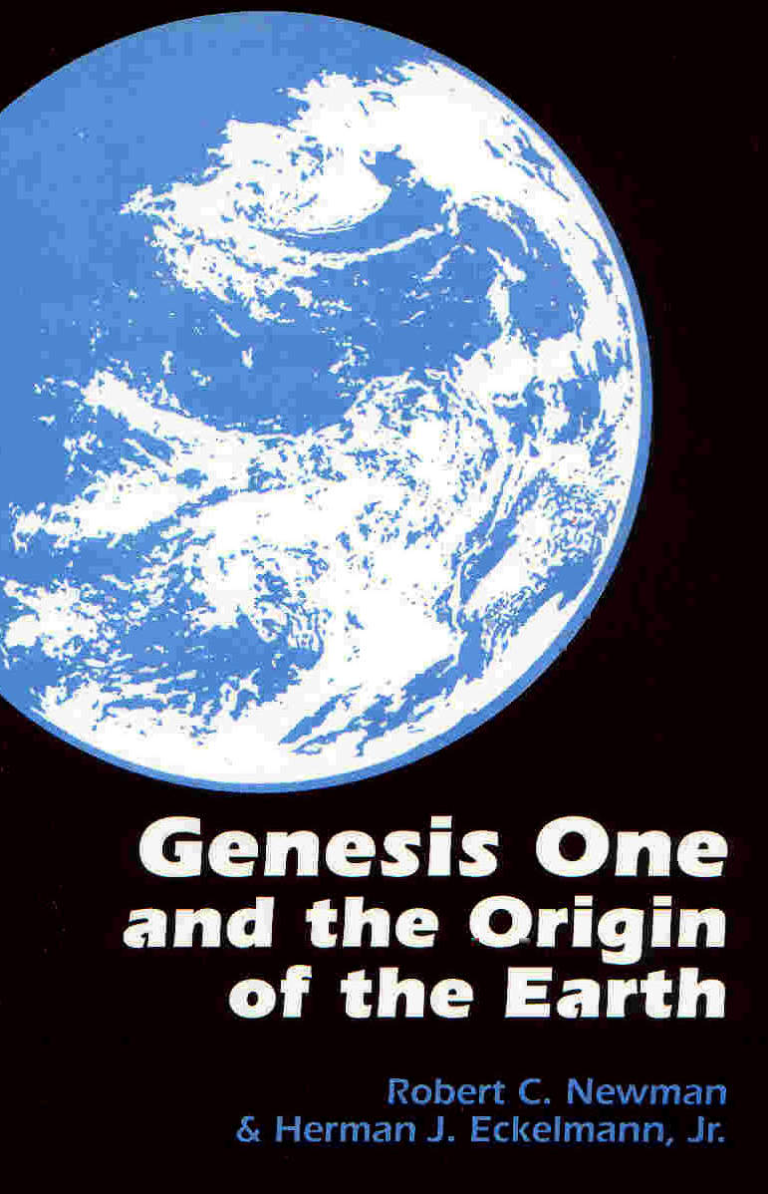
Cosmology
Some books on this:
Ross, The Fingerprint of God
Heeren, Show Me God
Newman & Eckelmann, Genesis One & the Origin of the Earth

Slide 20
Fulfillment of Biblical Prophecy
The Bible contains numerous examples of fulfilled predictions.
These are historically testable.
Many of them can be shown to have been made before the fulfillment occurred.
Many of these are beyond the power of humans to cause to happen.

Slide 21
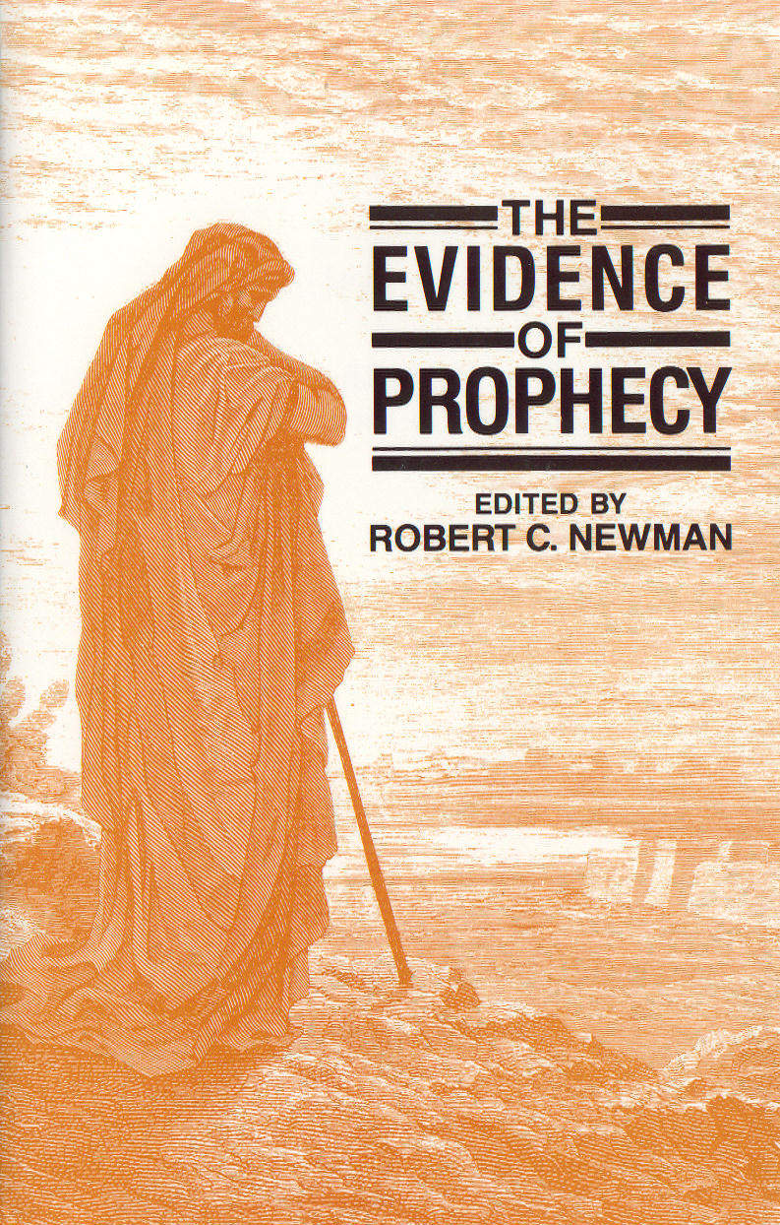
Fulfillment of Biblical Prophecy
Some books on this:
Newman, Evidence of Prophecy
Barfield, The Prophet Motive
Montgomery, Evidence for Faith

Slide 22
Conclusions
There is excellent evidence for the existence of the God of the Bible.
  This has moral force, not deductive force.
  It is not beyond quibbling.
  But remember:
    Silence of God
    Sinfulness of humans
  It is sufficient that we will have no valid excuse at the judgment.

Slide 23
Conclusions
Pascal's Wager:
  There is an infinite loss if one bets against Christianity and is wrong.
  So at least spend your time in this life investigating religions with no second chance!

Slide 24
Conclusions
The Gospel (Good News)
  All of us are in bad shape to stand before God on our own merits.
  God is just, and he will give us what we deserve.
  But God has provided a substitute, Jesus:
    To provide our righteousness
    To pay for our sins

Slide 25
The End
May it be the beginning of a new life for you!

