Slide 1
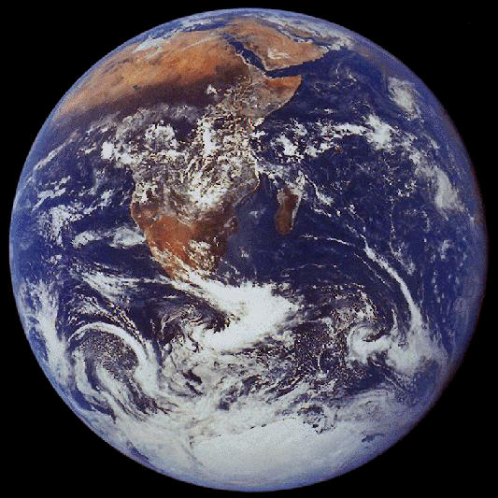
God & the Nations
Robert C. Newman

Slide 2
Independence Day
July 4th is our US national holiday, celebrating our independence from Great Britain back in 1776.
In recent years this celebration has become very secular.
The US has also become multicultural:
Not only with diverse ethnic groups
But also with diverse moral views
How should Christians respond to this?

Slide 3
Spiritual Warfare on the Level of Nations
Christians are aware that the Bible pictures the Christian life as a spiritual war:
Ephesians 6:12 (NIV) For our struggle is not against flesh and blood, but against the rulers, against the authorities, against the powers of this dark world and against the spiritual forces of evil in the heavenly realms.
We sometimes forget that this warfare is also operating at all levels of society:

Slide 4
Spiritual Warfare on the Level of Nations
Daniel 10:13 (NIV) But the prince of the Persian kingdom resisted me [Gabriel] twenty-one days. Then Michael, one of the chief princes, came to help me, because I was detained there with the king of Persia … 20 So he said, "Do you know why I have come to you? Soon I will return to fight against the prince of Persia, and when I go, the prince of Greece will come."
See also 1 Kings 22 re/ Micaiah's vision of a deceiving spirit sent out to mislead Ahab's prophets.

Slide 5
Lesson
Spiritual warfare is not just a personal thing…
… it operates on collective levels of human activity also.
We need to be aware of this:
Seeking to understand where the battle lines are,
Trying to support the right side in each struggle.

Slide 6
God's Mercy in the History of Nations
Psalm 33:12-13 (NIV) Blessed is the nation whose God is the LORD, the people he chose for his inheritance. 13 From heaven the LORD looks down and sees all mankind.
Isaiah 65:1 (NIV) I revealed myself to those who did not ask for me; I was found by those who did not seek me. To a nation that did not call on my name, I said, "Here am I, here am I."

Slide 7
Lesson
God's mercy and election has operated on the level of nations too.
God has not given up on them yet.
Neither should we!

Slide 8
Righteousness & National Prosperity
Proverbs 14:34 (NIV) Righteousness exalts a nation, but sin is a disgrace to any people.
Consider this verse from the perspective of God's actions.
Jeremiah 12:17 (NIV) "But if any nation does not listen, I will completely uproot and destroy it," declares the LORD.

Slide 9
Amos 1-2: God's Judgment for National Sins
Syria: atrocities against Gilead
Gaza: deporting people to slavery
Tyre: same
Edom: no compassion on Israel
Ammon: atrocities, imperialism
Moab: desecrated body of Edom's king
Judah: rejecting God's laws, lying
Israel: oppressing poor, sexual sins

Slide 10
Jeremiah 18: God's Judgment for National Sins
7 (NIV) If at any time I announce that a nation or kingdom is to be uprooted, torn down and destroyed, 8 and if that nation I warned repents of its evil, then I will relent and not inflict on it the disaster I had planned. 9 And if at another time I announce that a nation or kingdom is to be built up and planted, 10 and if it does evil in my sight and does not obey me, then I will reconsider the good I had intended to do for it.

Slide 11
Lesson
Spiritual principles of sowing and reaping operate on the level of nations too:
Galatians 6:7 (NIV) Do not be deceived: God cannot be mocked. A man reaps what he sows.
God's mercy does not ignore sin.

Slide 12
Obedience to God & National Testimony
Deuteronomy 4:6 (NIV) Observe them [God's laws] carefully, for this will show your wisdom and understanding to the nations, who will hear about all these decrees and say, "Surely this great nation is a wise and understanding people."
Proverbs 14:34 (NIV) Righteousness exalts a nation, but sin is a disgrace to any people.

Slide 13
Lesson
The testimony to the truth of God's existence and character manifests itself at the national level as well as at the personal level.
We should seek to live, and to help our nation live, so as to show forth God's truth and wisdom.

Slide 14
The Church is a 'Nation' Scattered among the Nations
God took 'holy nation' status away from Israel:
Matthew 21:43 (NIV) Therefore I tell you that the kingdom of God will be taken away from you and given to a people who will produce its fruit.
Romans 10:19 (NIV) Again I ask: Did Israel not understand? First, Moses says, "I will make you envious by those who are not a nation; I will make you angry by a nation that has no understanding." {Deut. 32:21}

Slide 15
The Church is a 'Nation' Scattered among the Nations
God is seeking some from every nation:
Acts 10:34-35 (NIV) Then Peter began to speak: "I now realize how true it is that God does not show favoritism 35 but accepts men from every nation who fear him and do what is right."
Acts 17:26-28 (NIV) From one man he made every nation of men, that they should inhabit the whole earth; and he determined the times set for them and the exact places where they should live. 27 God did this so that men would seek him and perhaps reach out for him and find him, though he is not far from each one of us. 28 'For in him we live and move and have our being.' As some of your own poets have said, 'We are his offspring.'

Slide 16
The Church is a 'Nation' Scattered among the Nations
The church is a 'holy nation':
1Pet 2:9-10 (NIV) But you are a chosen people, a royal priesthood, a holy nation, a people belonging to God, that you may declare the praises of him who called you out of darkness into his wonderful light. 10 Once you were not a people, but now you are the people of God; once you had not received mercy, but now you have received mercy.

Slide 17
The Church is a 'Nation' Scattered among the Nations
God will succeed in saving some from every nation:
Revelation 5:9 (NIV) And they sang a new song: "You are worthy to take the scroll and to open its seals, because you were slain, and with your blood you purchased men for God from every tribe and language and people and nation."
Revelation 7:9 (NIV) After this I looked and there before me was a great multitude that no one could count, from every nation, tribe, people and language, standing before the throne and in front of the Lamb. They were wearing white robes and were holding palm branches in their hands.

Slide 18
Lesson
God is determined to save some from every nation.
We must not think & act like our nation is especially deserving of God's favor.
We need to live like believers are a single united 'nation' whatever our ethnic background and wherever we live.

Slide 19
The End
God is still at work
among the nations

