Slide 1
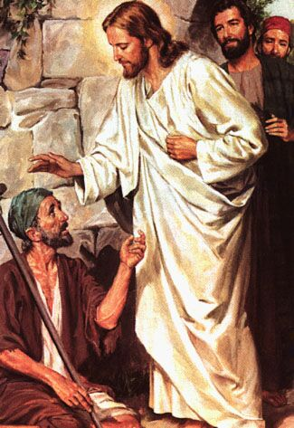
Exegeting a Miracle Account
Robert C. Newman

Slide 2
The Genre "Miracle Story"
Definition:
A narrative focusing on a miracle as its main feature
So the genre is a subgenre of narrative:
So use features of narrative analysis.
Recall Ryken's categories of narrative in the Gospels include miracle story (p 40).

Slide 3
Usual Features of This Genre
Besides the usual narrative features:
A problem is narrated.
A request for help is made.
The actions of the miracle worker are described.
The results are noted:
Healing, deliverance, etc.
Response of demon
Response of spectators, etc.

Slide 4
Function of Miracles in the Gospels
They display the person of Jesus thru his actions & power (Jn 20:30-31; Jn 5:36).
They picture God's activity in redemption.
Sometimes they point:
Forward to the end of the age
Resurrections
Backward to creation
Water into wine?

Slide 5
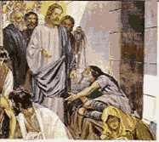
Healings in the Gospels
Man w/ leprosy
Centurion’s servant
Peter's m-in-law
Gadarene demoniacs
Paralyzed man
Woman w/ bleeding
2 blind men
Mute possessed
Shriveled hand
Blind mute poss
Canaanite's dau
Boy w/ demon

Slide 6
Healings in the Gospels
Deaf mute
Man possessed in synagogue
Blind at Bethsaida
Crippled woman
Man w/ dropsy
Ten lepers
High priest's servant
Official's son
Sick man at Bethesda
~22 narrated

Slide 7
A Healing: Gadarene Demoniac
Mark 5:1-20 and parallels
Problem (vv 2-5): man possessed by spirit; no one could subdue him; lived in tombs, shouting, hurting self
Request? (6-7): runs to Jesus
Action (8-13): resist Jesus' commands, reveals size of problem, seeks to negotiate

Slide 8
A Healing: Gadarene Demoniac
Results (13-20):
Pigs drown in lake
Keepers run to report
People astonished, fearful, ask Jesus to leave
Fellow sent to tell others

Slide 9
A Healing: Gadarene Demoniac
Person of Jesus:
Able to subdue demons by thousands
Has compassion for demoniac
Lets people turn him down
Redemption:
Saves demoniac
Drives out Satan's forces

Slide 10
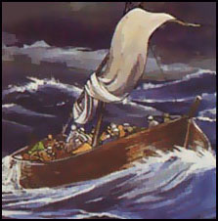
Nature Miracles in the Gospels
Calming storm
5000 fed
Walking on water
4000 fed
Coin in fish's mouth
Fig tree withered
Transfiguration
Catch of fish
Water to wine
Another catch
~10 narrated

Slide 11
Nature Miracle: Calming Storm
Mark 4:35-41 and parallels:
Problem: boat about to go under in storm
Request: Disciples: "Don’t you care?"
Action: Jesus shouts at wind & waves
Results:
Immediate calm, both wind & waves
Reaction of disciples: "Who is this?"

Slide 12
Nature Miracle: Calming Storm
Person of Jesus: cp Psalm 107
Redemption:
Rescue from danger
Pointing forward or backward?
Looking back at creation?
Looking forward to new heavens & earth?

Slide 13
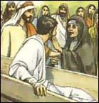
Resurrections in the Gospels
Jairus' daughter
Widow's son
Lazarus
(Jesus)
4 narrated

Slide 14
Resurrection: Widow's Son
Luke 7:11-17:
Problem: only son of widow has died
Request: no explicit request
Actions: Jesus speaks to dead man
Results:
Comes back to life
People filled with awe, praise God

Slide 15
Resurrection: Widow’s Son
Person of Jesus: able to raise dead
Contrast with OT prophets re/ method
Redemption: saved from death
Looking forward:
Resurrection at the last day

Slide 16
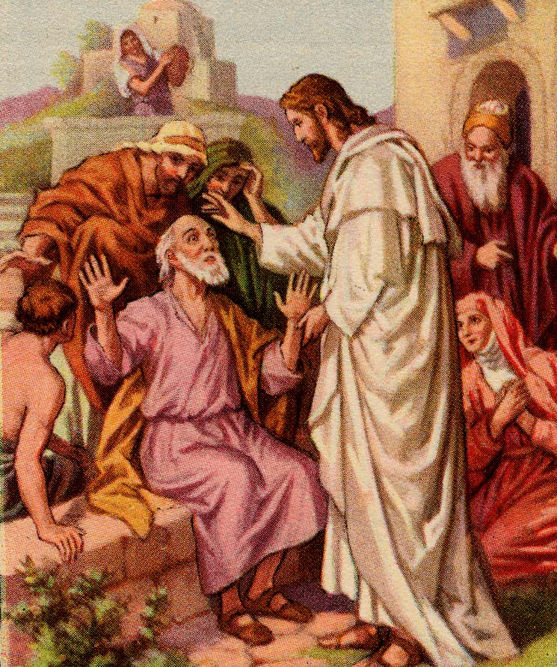
The End
Try to see what the Gospel writer is teaching as he narrates each miracle.

