Slide 1
Evidence of God
In Cosmos & Conscience
Robert C. Newman

Slide 2
The Biblical Claim
"Since the creation of the world God's invisible qualities – his eternal power and divine nature – have been clearly seen, being understood from what has been made, so that men are without excuse." – Romans 1:20

Slide 3
Evidence of God
In Cosmos

Slide 4
Evidence from Inanimate Nature
The universe provides strong evidence for the existence of a God like the One pictured in the Bible.
We examine two lines of evidence here:
Evidence the universe had a beginning
Evidence the universe is designed

Slide 5
A Beginning
Atheists must either claim that the universe has always existed or that it popped into existence without a cause.
The history of cosmology in the past century argues strongly that the universe had a beginning.

Slide 6
Cosmology in the 20th Century
Static, eternal universe model
But discovery of expanding universe
Steady-state universe model
But discovery of early high temperature
Oscillating big-bang model
Discovery of acceleration, insufficient density
Big-bang bubble models
No evidence for more than one universe

Slide 7
A Beginning?
As Hugh Ross has pointed out, the history of cosmology in the 20th century has been an ever more frantic attempt to escape a universe with a beginning in the face of mounting evidence.
As far as we can tell from the inside, the universe has not always existed, but began at a finite time in the past.

Slide 8
A Beginning!
Claims that our universe is a bubble in a larger universe are more of a leap in the dark than claims the universe was created by God.
Claims that our universe just popped into existence without a cause are truly desperate. Science itself (& personal experience) is based on the belief in causation.

Slide 9
A Designed Universe
Atheists have no mind in the universe to produce design until the universe has evolved minds.
They must therefore argue that all apparent design is not really design but a clever (& accidental!) fake.
But the universe looks designed in ways that are far from trivial.

Slide 10
The Basic Forces
There are four known basic forces that constitute the physics of our universe.
Strong nuclear force
Electromagnetism
Weak nuclear force
Gravity
These forces differ drastically in strength, yet they are very closely adjusted to allow life to exist.

Slide 11
Strong Force
The strong force holds both neutrons & protons together to form the nucleus.
It this force were 5% weaker
Deuterium would be unstable
Stars would not burn
If this force were 5% stronger
The diproton would be stable
Stars would burn explosively

Slide 12
Weak Force
The weak force holds the neutron together.
If it were a few % weaker
Neutron would be unstable
No heavy elements
If it were a few % stronger
Neutron would be too stable
No hydrogen

Slide 13
Electromagnetic Force
The e-m force holds electrons to atoms, and atoms to one another, allowing neutral atoms, molecules & solids.
This force depends on the balance of + and – charges to both attract & repel.
If this balance were off by 1 part in 10⁴⁰, this force would swamp gravity and there would be no galaxies, stars, planets or people.

Slide 14
Gravity
Gravity is the weakest of the four forces, but it dominates at astronomical distances.
Gravity & the expansion of the universe are neatly balanced to produce a life-friendly universe.
If the balance were off by 1 part in 10⁶⁰, the universe would expand too quickly or collapse too quickly to form stars, planets or people.

Slide 15
Designed Universe!
The universe is "fine-tuned" to allow life at the level of less than 1 part in 10¹⁰⁰.
In an atheistic scheme, this means we need at least 10¹⁰⁰ universes to expect this by chance.
If you wish to bet there is no God at these odds, you will have no one to blame but yourself if you are wrong.

Slide 16
Evidence of God
In Conscience

Slide 17
Evidence from Animate Nature & Humanity
High level of order in living things
"Initiative" in humans & higher animals
Level of intellect in humans
Structure of rationality in nature
Human moral standards
Human pleasure
Human futility

Slide 18
High Level of Order
"The information content of a simple cell is about 10¹² bits, equivalent to about 100 million pages of the Encyclopaedia Britannica." – Carl Sagan, article "Life" in the EB.

Slide 19
High Level of Order
Sagan's statement is just for the simple bacterium E. coli.
Multi-celled animals, especially humans, are far more complex than this.
All the evidence we have suggests that the universe is incapable of producing this level of order by natural processes.

Slide 20
Initiative
Humans & (at least) the higher animals apparently have the ability to initiate actions that are not caused by any external necessity.
One of the goals of AI (artificial intelligence) research is to show that this can be produced by purely natural causes in a mindless universe.
We should not mistake research goals for research results.

Slide 21
Level of Intellect
The level of intellect in humans appears to be far beyond what is "needed" in primitive conditions or even in most situations today.
This does not fit what one would expect from evolution:
Too much energy put into unneeded brain power takes away from what is needed to be a better competitor.
This suggests mankind was designed for some purpose that requires considerably greater intellect than we now use.

Slide 22
Structure of Rationality
"The most incomprehensible thing about the universe is its comprehensibility."
– Albert Einstein

Slide 23
Structure of Rationality
Human logic appears well-designed to explain the universe.
It can deal with all sorts of things we can never imagine it having contact with during its supposed evolution:
Mathematics
Atomic structure
Poetry

Slide 24
Structure of Rationality
Einstein was amazed that man's mind (developed by mutation) should have categories to handle all this.
But a God might very well have designed the human mind to function well in the universe he made.
Atheists have only mutation and natural selection to explain all this.

Slide 25
Moral Standards
Philosophically, we cannot derive an "ought" from an "is." Where does this realm of human activity come from?
The world’s cultures contain strangely parallel moral standards.
This argues against independent development of morality and for a common source.

Slide 26
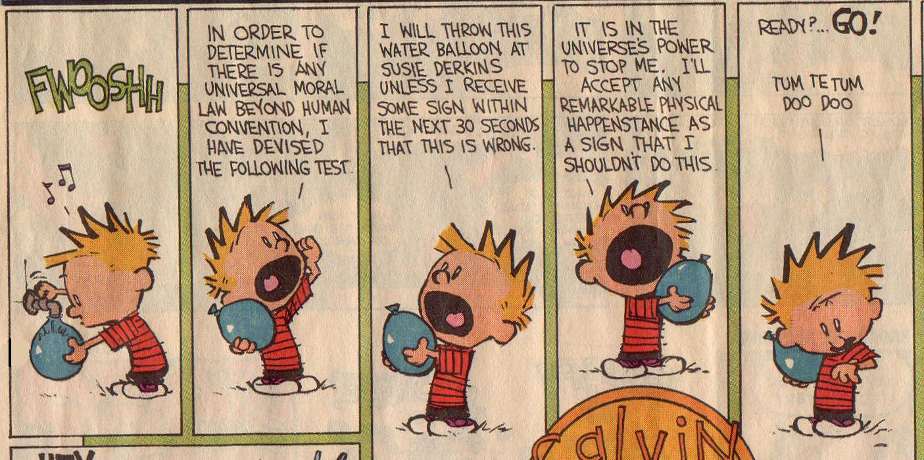
Moral Standards

Slide 27
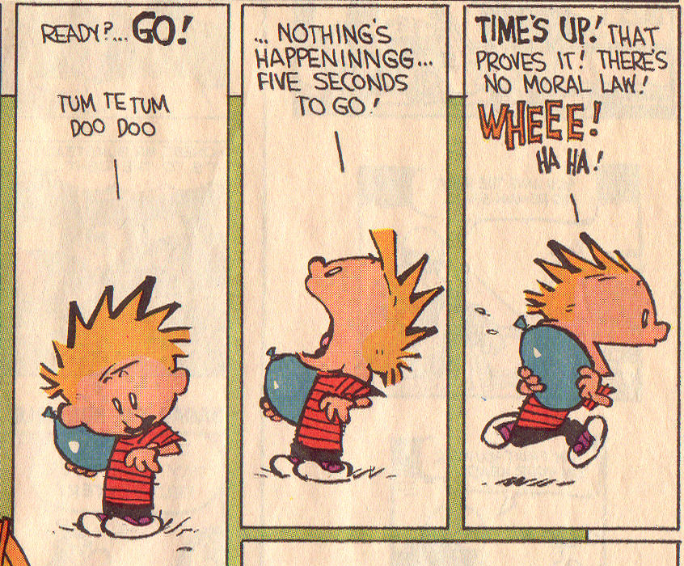
Moral Standards

Slide 28
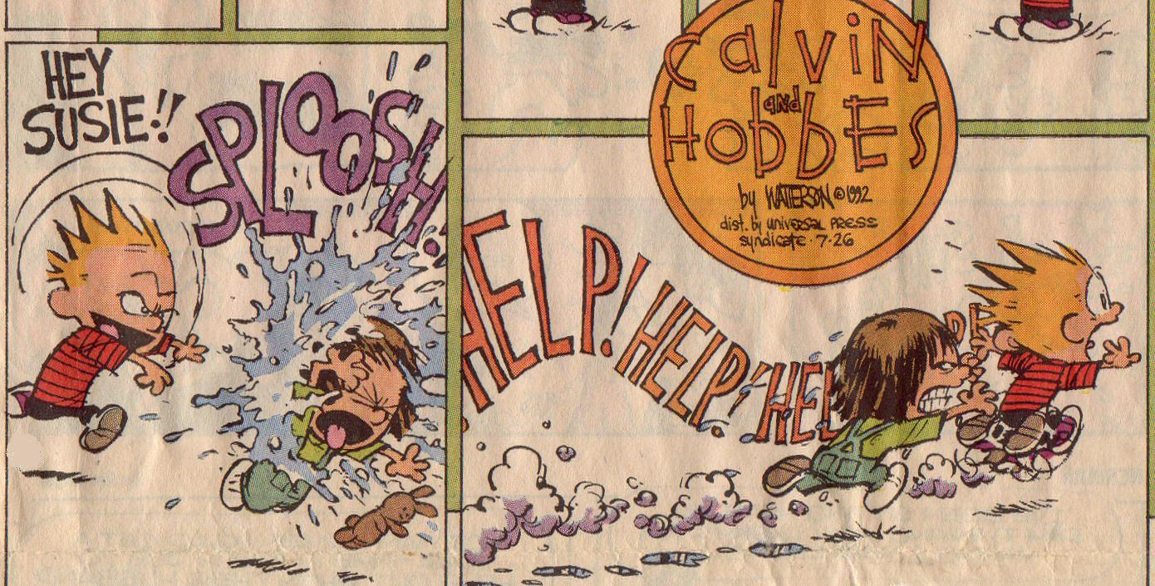
Moral Standards

Slide 29
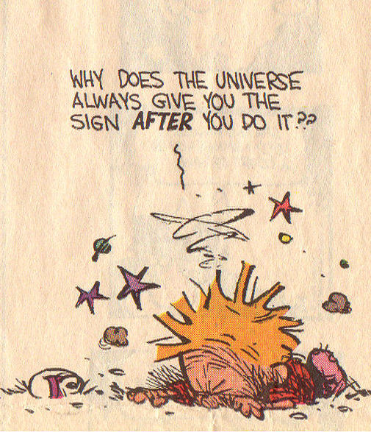

Slide 30
Pleasure
Is all pleasure really biologically useful?
Loren Wilkinson suggests that the strength and variety of human pleasures is far beyond what can be explained by biological utility.
See Wilkinson, "The Problem of Pleasure" in Montgomery, Christianity for the Tough-Minded.

Slide 31
Futility
Humans have a sense of longing and a joy that does not seem to have any object in this world.
Man appears to be a sort of ruin:
Not just junk, like unshaped stones
Not functioning as he appears to be designed to
This "frustrated design" is hard to explain by evolution, since there is no apparent reason for desires which transcend the present order.

Slide 32
Evidence of God in Conscience
These items fit well with a God behind it all, especially the God of the Bible.
High level of order in living things
"Initiative" in humans & higher animals
Level of intellect in humans
Structure of rationality in nature
Human moral standards
Human pleasure
Human futility

Slide 33
The Biblical Claim
"Since the creation of the world God’s invisible qualities – his eternal power and divine nature – have been clearly seen, being understood from what has been made, so that men are without excuse." – Romans 1:20

Slide 34
The End
Of This Talk
The Rest is Up to You

