Slide 1
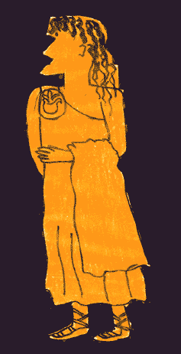
Diatribe Genre
Robert C. Newman

Slide 2
The Word "Diatribe"
Common Modern Usage
A bitter, abusive criticism or denunciation
Historical or Literary Definition
A method or mode of teaching and exhortation used in the ancient schools of philosophy
This second meaning is what we will be using here.

Slide 3
History of Diatribe
Originated among Sophists before 200 BC
Adopted by Cynics and Stoics
Used by traveling philosophers who taught on popular level
Not a literary genre, but an oral teaching method
Typically a lecture or writing on moral or philosophical topics of popular interest

Slide 4
History of Diatribe
Common topics of ancient diatribes:
Divine providence
Self-control
Self-sufficiency
Epictetus (AD 55-135) especially noted for use of this method
In New Testament, especially used by:
Paul
James

Slide 5
Characteristics of Diatribe
Not strictly a genre, having no set structure like a letter or parable
Uses features of dialogue
Uses features of rhetoric

Slide 6
Features of Dialogue
Imaginary opponents or speakers
Question and answer format
Hypothetical objections considered
False conclusions refuted or rejected

Slide 7
Features of Rhetoric
Diatribe also uses standard features of Greco-Roman rhetoric (art of public speaking):
Amplification
Adding additional matter, details
Personification
Figure of speech in which a thing, quality or idea is represented as a person.

Slide 8
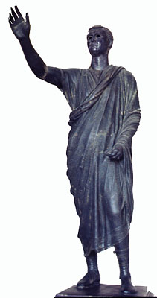
Features of Rhetoric
Maxim/Proverb
Concise statement of general truth or rule of conduct
Censure/Praise
Negative or positive evaluation
Saying/Action of Famous Person
Comparison

Slide 9
Features of Rhetoric
Historical Example
Looking to some famous event or person in history
List of Virtues or Vices
Parallelism
Successive lines have similar features
Antithesis
A parallelism contrasting opposites

Slide 10
Features of Rhetoric
Irony
Intended meaning is opposite of usual sense
Sarcasm
Taunting, sneering, cutting remark
Paradox
Statement which seems contradictory, unbelievable or absurd, but is actually true

Slide 11
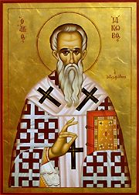
Diatribe in James

Slide 12
Highlighting in Text
Dialogue type features in yellow
Personification and lists of virtues or vices in red/pink
Maxims or proverbs in green
Historical examples or sayings of famous people in blue
Irony in orange

Slide 13
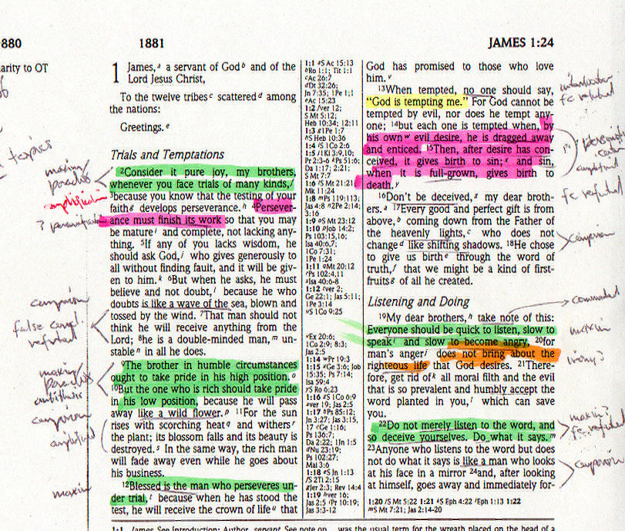

Slide 14
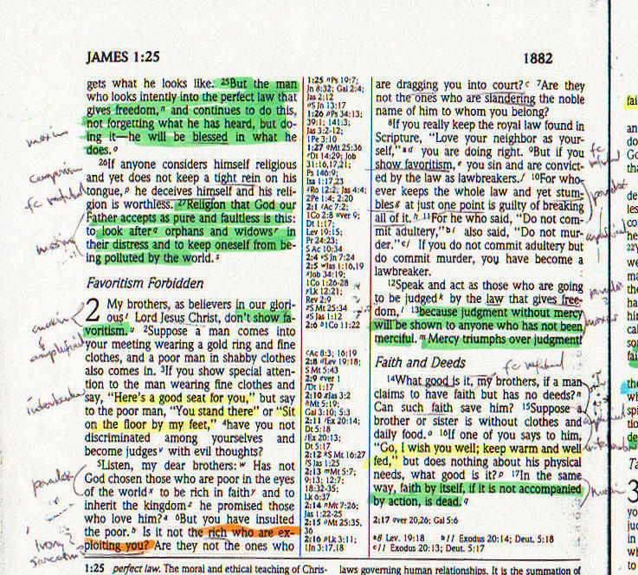

Slide 15
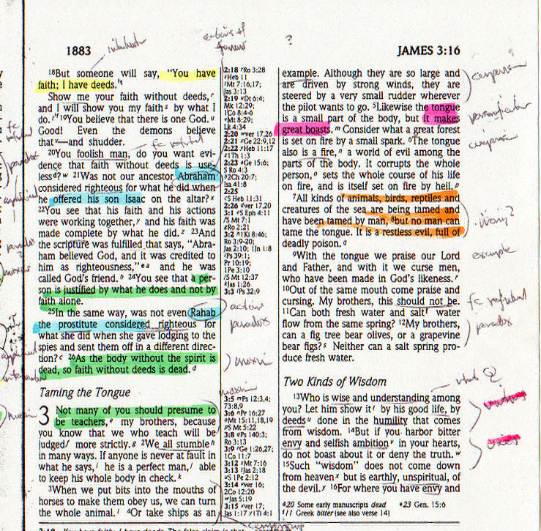

Slide 16
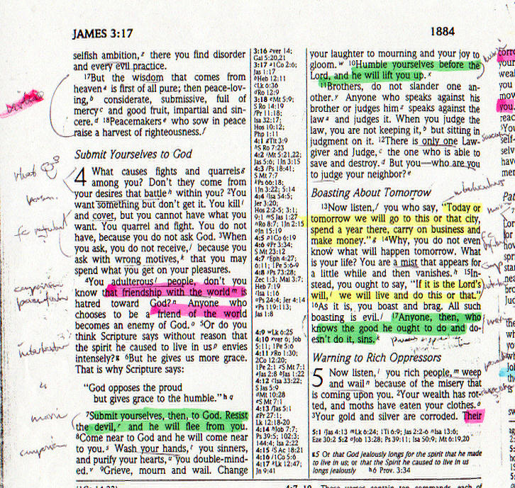

Slide 20
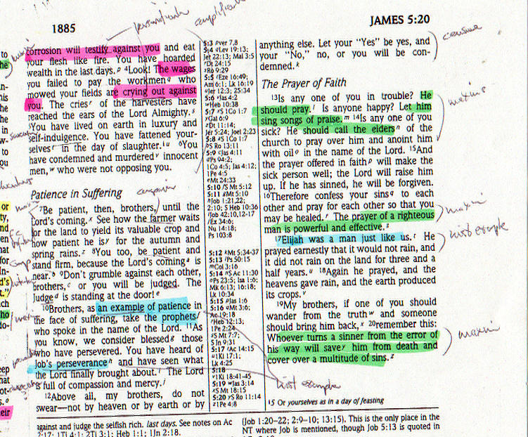

Slide 31
Be on the Lookout
For These Features

