Slide 1
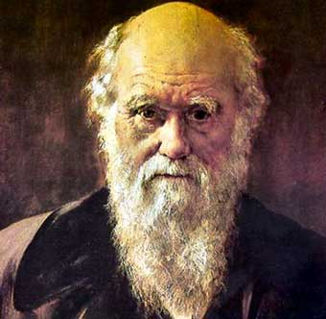
The Darwin Conversion Story
Robert C. Newman

Slide 2
Introduction
For nearly a century, a story has circulated in various tracts and books that Charles Darwin became a Christian late in his life.
According to the story, a Christian English woman, Lady Hope, visited Darwin and found him reading his Bible enthusiastically.
When asked about his theory of evolution, Darwin is reported to have said these were his unformed ideas as a young man and that people had made a religion out of them.

Slide 3
Introduction
It would be great if it turned out that Darwin found Jesus as his savior before he died.
But is the story true?
What can we find out about it?
Who is "Lady Hope"?
Did she ever have this conversation?
That's what we want to consider here.

Slide 4
Tracking Down the Story
The tracts generally mention "Lady Hope" as the narrator of the incident.
A number of them mention that the story was given at Northfield on August 15, 1915, and that it was later published in the Watchman-Examiner.
Up until 1991, none of the recent investigators had ever seen the original story.

Slide 5
Tracking Down the Story
In the summer of 1991, I found the original account in the Library of Congress.
It turns out that the Watchman-Examiner was a national Baptist newspaper issued weekly from Boston and New York since 1819, and the Library of Congress has a nearly complete run of the paper.
The account appears in the issue of August 19, 1915, as follows:

Slide 6
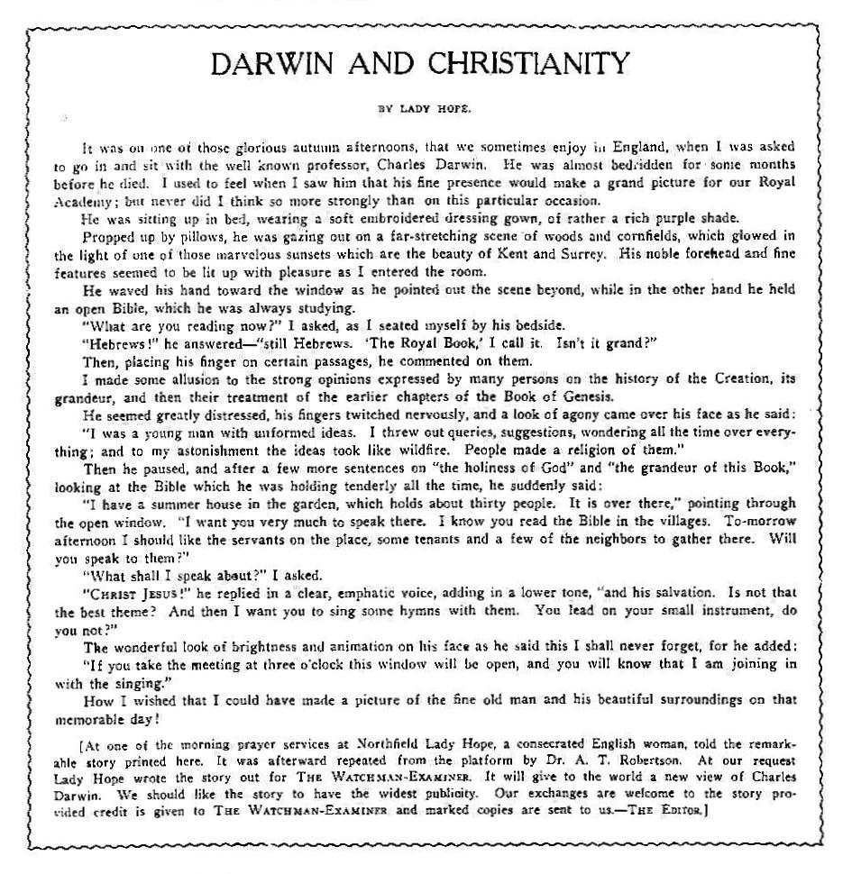

Slide 7
Darwin & Christianity by Lady Hope
It was on one of those glorious autumn afternoons, that we sometimes enjoy in England, when I was asked to go in and sit with the well known professor, Charles Darwin. He was almost bedridden for some months before he died. I used to feel when I saw him that his fine presence would make a grand picture for our Royal Academy, but never did I think so more strongly than on this particular occasion. He was sitting up in bed, wearing a soft embroidered dressing gown, of rather a rich purple shade. Propped up by pillows, he was gazing out on a far-stretching scene of woods and cornfields, which glowed in the light of one of those marvelous sunsets which are the beauty of Kent and Surrey. His noble forehead and fine features seemed to be lit up with pleasure as I entered the room.

Slide 8
He waved his hand toward the window as he pointed out the scene beyond, while in the other hand he held an open Bible, which he was always studying. "What are you reading now?" I asked as I seated myself by his bedside. "Hebrews!" he answered– "still Hebrews. 'The royal Book,' I call it. Isn't it grand?" Then, placing his finger on certain passages, he commented on them. I made some allusion to the strong opinions expressed by many persons on the history of the Creation, its grandeur, and then their treatment of the earlier chapters of the Book of Genesis. He seemed greatly distressed, his fingers twitched nervously, and a look of agony came over his face as he said: "I was a young man with unformed ideas. I threw out queries, suggestions, wondering all the time over everything; and to my astonishment the ideas took like wildfire. People made a religion of them."

Slide 9
Then he paused, and after a few more sentences on 'the holiness of God' and 'the grandeur of this Book,' looking at the Bible which he was holding tenderly all the time, he suddenly said: "I have a summer house in the garden, which holds about thirty people. It is over there," pointing through the open window. "I want you very much to speak there. I know you read the Bible in the villages. To-morrow afternoon I should like the servants on the place, some tenants and a few of the neighbors to gather there. Will you speak to them?" "What shall I speak about?" I asked. "Christ Jesus!" he replied in a clear, emphatic voice, adding in a lower tone, "and his salvation. Is not that the best theme? And then I want you to sing some hymns with them. You lead on your small instrument, do you not?"

Slide 10
The wonderful look of brightness and animation on his face as he said this I shall never forget, for he added: "If you take the meeting at three o’clock this window will be open, and you will know that I am joining in with the singing." How I wished that I could have made a picture of that fine old man and his beautiful surroundings on that memorable day!
[At one of the morning prayer services at Northfield Lady Hope, a consecrated English woman, told the remarkable story printed here. It was afterward repeated from the platform by Dr. A. T. Robertson. At our request Lady Hope wrote the story out for The Watchman-Examiner. It will give the world a new view of Charles Darwin. We should like the story to have the widest publicity. Our exchanges are welcome to the story provided credit is given to The Watchman-Examiner and marked copies are sent to us. – The Editor.]

Slide 11
Tracking Down the Story
This article was preceded by a 4-page report on the 1915 Northfield Conference, a summer conference held on the grounds of Northfield Seminary, a girls' school in Massachusetts founded by Dwight Moody.
The conference ran from July 30 to August 15 that year, and Lady Hope gave this testimony at one of the morning prayer meetings, date not specified.
The LC received its copy on August 19, so the report was in print only a few days after the conference ended.

Slide 12
The Background of the Story
So far as we know, this story was thus first circulated in the United States, some 33 years after Darwin's death in the spring of 1882.
Since this is also long after Darwin's wife Emma died in 1896, there is no merit to the suggestion Emma invented the story.
Who is this Lady Hope?

Slide 13
Lady Hope
Several researchers have now made it clear that Lady Hope was Elizabeth Reid Cotton.
She was born in 1842, married Admiral Sir James Hope in 1877, becoming Lady Hope. He died in 1881, and she would have been recently widowed when her meeting with Darwin allegedly took place.

Slide 14
Lady Hope
Lady Hope was a prolific writer, with some 30 items (dating from 1876 to 1909) listed in the British Museum General Catalogue of Printed Books and the U.S. National Union Catalog.
She and some Christian friends began a ministry to lower-class families in Sussex, beginning with Bible studies for girls, and eventually leading to coffee-houses as substitutes for the pubs, where working-men were ruining their families through drink. See her book Our Coffee-Room (1876).
I suspect it was this work that led to the reported meeting with Darwin, as the context suggests she may have been seeking a meeting place in the neighborhood.

Slide 15
Is the Story True?
Lady Hope is the only one who has reported this incident, so we have no direct corroboration.
Other information about Darwin in his last months (including some correspondence) does not suggest that he made any dramatic changes at this time.
James Moore & Paul Marston have probably done the most thorough research on this topic in Moore's book The Darwin Legend, and Marston's article "Charles Darwin and the Christian Faith."

Slide 16
Is the Story True?
It seems to me that we have four alternatives:
(1) The whole story is fiction.
(2) The event occurred, but Lady Hope exaggerated some of the features.
(3) The event occurred as reported, but Darwin was trying to put Lady Hope off.
(4) Darwin did become a Christian, but this was covered up by his family.

Slide 17
(1) The Story is Entirely Fiction
This is the claim of Henrietta, Darwin’s daughter, who was with him in his dying days.
But the story is set some months earlier, when Henrietta was not present.
Moore notes that a number of the details have the ring of truth, and Marston has shown connections between the Darwin family and Lady Hope.

Slide 18
(2) True but Exaggerated
Moore thinks that Lady Hope may have (intentionally or unintentionally) exaggerated the incident.
The incident occurred nearly 34 years before the Northfield narration (fall of 1881 versus summer of 1915).
Lady Hope would now be nearly 73 years old.
She may have elaborated what were more non-committal statements by Darwin.

Slide 19
(3) Darwin Was Putting Her On
Lady Hope was a noted evangelical.
Darwin was very averse to confrontation.
Though Darwin admired the work of Christianity among the poor, he would have no desire to be evangelized himself.
His earlier theological training would easily have equipped him to be able to use Christian jargon and expound briefly on the Letter to the Hebrews.

Slide 20
(4) Darwin Became a Christian
This is possible, but it is not supported by any of the other evidence we have of Darwin’s last years and months, in which he comes across as agnostic or at most a deist.
See his Autobiography and his correspondence.

Slide 21
Conclusions
I would guess that alternatives (2) and (3) are most likely, or even a combination of these two.
We will probably not gain certainty on this matter until the Last Judgment.
For further information, consult the bibliography in the next panel.

Slide 22
For Further Reading
David Herbert, Charles Darwin's Religious Views (1990).
Lady Hope, "Darwin and Christianity," The Watchman-Examiner, new series 3 (19 August 1915): 1071.
Paul Marston, "Charles Darwin and Christian Faith," http://scibel.gospelcom.net/content/scibelarticles.php?id=3.
James Moore, The Darwin Legend (1994).
Robert C Newman, "The Darwin Conversion Story: An Update," Creation Research Society Quarterly 29 (1992): 70-72.
W. Rusch and J. W. Klotz, Did Charles Darwin Become a Christian? (1988).

Slide 23
The End

