Slide 1
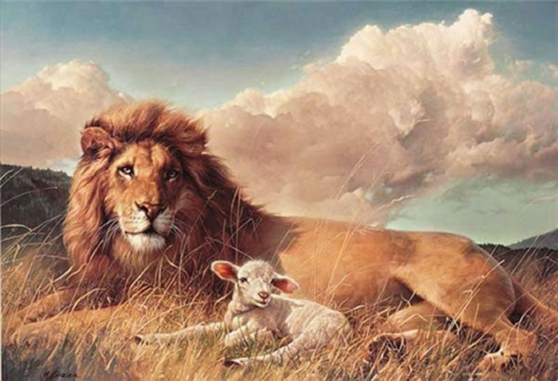
Cultivating Biblical Peace
Robert C. Newman

Slide 2
Biblical Peace
Peace is a significant theme in the Old Testament.
Isa 48:22: (NIV) "There is no peace," says the LORD, "for the wicked."
Ps 119:165: (NIV) Great peace have they who love your law, and nothing can make them stumble.
Isa 26:3: (NIV) You will keep in perfect peace him whose mind is steadfast, because he trusts in you.

Slide 3
Jesus Demonstrates Peace
Mark 4:35-41: (NIV) That day when evening came, he said to his disciples, "Let us go over to the other side." 36 Leaving the crowd behind, they took him along, just as he was, in the boat. There were also other boats with him. 37 A furious squall came up, and the waves broke over the boat, so that it was nearly swamped. 38 Jesus was in the stern, sleeping on a cushion. The disciples woke him and said to him, "Teacher, don't you care if we drown?" 39 He got up, rebuked the wind and said to the waves, "Quiet! Be still!" Then the wind died down and it was completely calm. 40 He said to his disciples, "Why are you so afraid? Do you still have no faith?" 41 They were terrified and asked each other, "Who is this? Even the wind and the waves obey him!"

Slide 4
Biblical Peace
There is peace with God: Rom 5:1 (NIV) Therefore, since we have been justified through faith, we have peace with God through our Lord Jesus Christ…
So we need not fear death or judgment
This leads to peace with others: Prov 16:7 (NIV) When a man's ways are pleasing to the LORD, he makes even his enemies live at peace with him.

Slide 5
How Do We Cultivate Peace?

Slide 6
In the Face of Circumstances
Phil 4:6 (NIV) Do not be anxious about anything, but in everything, by prayer and petition, with thanksgiving, present your requests to God. 7 And the peace of God, which transcends all understanding, will guard your hearts and your minds in Christ Jesus.

Slide 7
In Conflict with Others
Prov 20:3 (NIV) It is to a man's honor to avoid strife, but every fool is quick to quarrel.
Matt 5:9 (NIV) Blessed are the peacemakers, for they will be called sons of God.

Slide 8
We Need Heaven’s Wisdom
James 3:17 (NIV) But the wisdom that comes from heaven is first of all pure; then peace-loving, considerate, submissive, full of mercy and good fruit, impartial and sincere. 18 Peacemakers who sow in peace raise a harvest of righteousness.

Slide 9
We Need to Put Away Revenge
Romans 12:18 (NIV) If it is possible, as far as it depends on you, live at peace with everyone. 19 Do not take revenge, my friends, but leave room for God's wrath, for it is written: "It is mine to avenge; I will repay," says the Lord. 20 On the contrary: "If your enemy is hungry, feed him; if he is thirsty, give him something to drink. In doing this, you will heap burning coals on his head." 21 Do not be overcome by evil, but overcome evil with good.

Slide 10
Repay Evil with Good
1 Pet 3:8 (NIV) Finally, all of you, live in harmony with one another; be sympathetic, love as brothers, be compassionate and humble. 9 Do not repay evil with evil or insult with insult, but with blessing, because to this you were called so that you may inherit a blessing. 10 For, "Whoever would love life and see good days must keep his tongue from evil and his lips from deceitful speech. 11 He must turn from evil and do good; he must seek peace and pursue it. 12 For the eyes of the Lord are on the righteous and his ears are attentive to their prayer,
but the face of the Lord is against those who do evil."

Slide 11
Make Every Effort
Hebrews 12:14 (NIV) Make every effort to live in peace with all men and to be holy; without holiness no one will see the Lord.

Slide 12
Who Can Do This?

Slide 13
Who Can Do This?
None of us will likely do this in our own strength.
But God promises that the Holy Spirit will dwell in us if we trust in Jesus.
We can then have something of Jesus’ ability to trust His Father.

Slide 14
Who Can Do This?
If we really believe God is working all things together for good in our lives…
Then we can trust Him with circumstances as Jesus did in that boat when the wind & waves threatened to sink it.
We can have peace in disaster because we know that even in death we have a refuge in God.

Slide 15
The End
May God help us to learn to cultivate Biblical peace!

