Slide 1
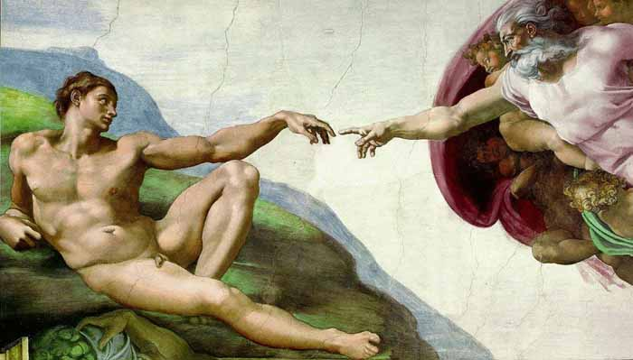

Creationism
Robert C. Newman

Slide 2
What is "Creationism"?
Broadly, the whole range of Christian attempts to reconcile nature & the Bible on origins.
More narrowly, the view that God created the world just a few thousand years ago.
Since the broader definition includes the narrower, we will discuss both here.

Slide 3
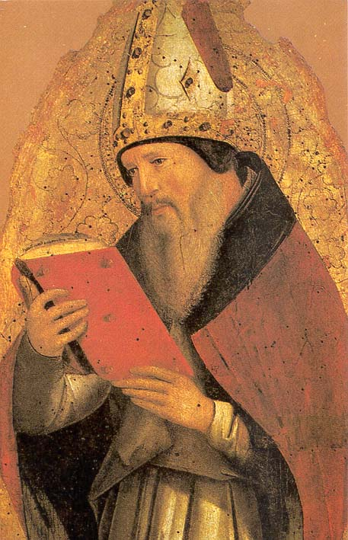
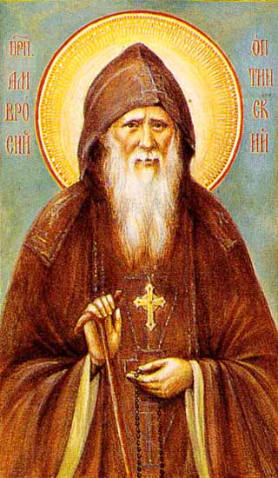
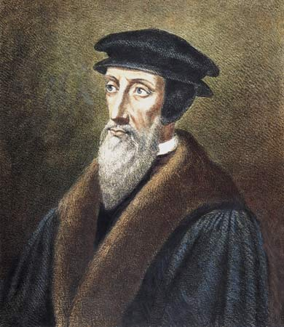
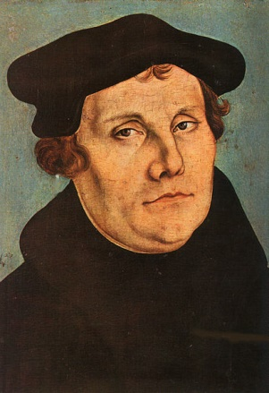
History of Creationism

Slide 4
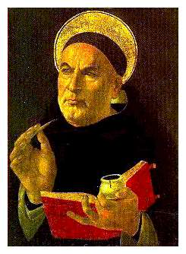
The Traditional View
The traditional Christian view of the biblical account of creation saw the world created by God in a literal week a few thousand years ago.
  Ambrose (~ 400)
  Aquinas (~ 1250)
  Luther (~ 1525)
  Calvin (~ 1550)

Slide 5
Other Views
A few had speculated with Augustine (~ 400) that creation had been instantaneous, and that the week had just been God’s way of explaining this to humans.
No one had seen a need for a more ancient creation or a longer time for God to create.

Slide 6
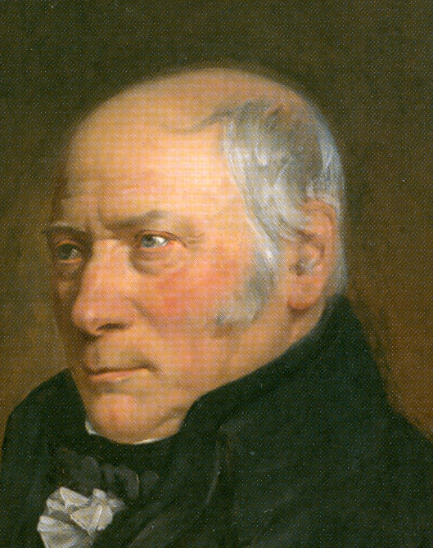
The Rise of Geology
In the late 1700s, systematic study of geology began to raise problems for the traditional view.
  Abraham Werner (1749-1817)
  William Smith (1769-1839)
  James Hutton (1726-97)
By the 1840s most geologists had concluded that the earth was far older than a few thousand years.
Some Christians proposed models to reconcile an old earth with the biblical account.

Slide 7
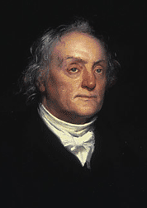
The Gap Theory
The earth and universe are very old (as evidenced by geology)…
But the biblical creation account narrates a recent restoration of the earth and the recreation of life following a great catastrophe:
  Thomas Chalmers (1780-1847)
  William Buckland (1784-1856)
This eventually became the view given in the older Scofield Reference Bible (1917).

Slide 8
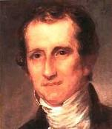
The Day-Age Theory
Here the biblical account and the geologic record refer to the same events, but the days of Genesis are long periods rather than 24 hours:
  Geologists
    James Dwight Dana (1813-95)
    Hugh Miller (1802-56)
  Theologians
    Charles Hodge (1797-1878)
    Alexander Maclaren (1826-1910)

Slide 9
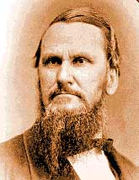
Holding to the Traditional View
Others, however, resisted these moves as unnecessary accommodations to scientific speculation and abandonment of the plain teaching of the Bible:
  Robert L. Dabney (1820-98), Presbyterian
  Francis Pieper (1852-1931), Lutheran

Slide 10
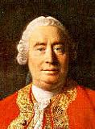
Rejection of the Miraculous
Meanwhile, David Hume (1711-76) and others had convinced many that miracles were incredible, that enlightened people should seek to understand nature and history without them.
This led to the rise of theological liberalism in Europe about 1800 and later in America, which remodeled Christianity by removing the miraculous.

Slide 11
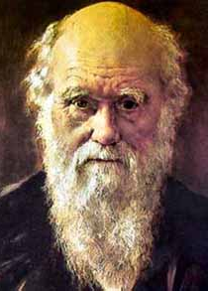
Evolution
In his Origin of Species (1859), Charles Darwin (1809-82) presented a theory to eliminate miracles from biological origins.
His proposal produced a storm of controversy which has continued to this day.
By the end of the 19th century, most biologists accepted some form of evolution, though many had reservations about Darwin’s particular mechanism.
Darwin thus added another factor to the origins debate: what parts did God, miracle, and evolution have to play in all this?

Slide 12
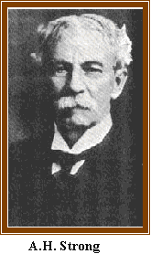
Theistic Evolution
A number of evangelical Christians sought to harmonize evolution with the Genesis account, producing models invoking both evolution and God:
  Asa Gray (1810-88)
  G. Frederick Wright (1838-1921)
  Augustus Hopkins Strong (1836-1921)

Slide 13
The Fundamentalist-Modernist Controversy
The impact of Hume and Darwin widened the rift between conservatives and liberals in Christendom.
In response to liberal teachings, conservatives issued a series of pamphlets entitled The Fundamentals (1910-15), which were sent to every pastor in the US.
One of the teachings to which this series responded was Darwinism.

Slide 14
Evolution in the Controversy
Yet the main threat seen in The Fundamentals was the atheistic form of evolution.
Thus two of the four authors responding to Darwinism were themselves theistic evolutionists:
  James Orr (1844-1913)
  G. Frederick Wright (1838-1921)
From about 1890 to 1940 the mainline denominations in the US were the battleground between Fundamentalism and Modernism.
But by the outbreak of World War 2, most of these denominations had come under the control of the Modernists.

Slide 15
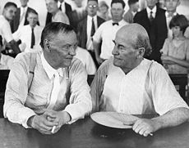
The Scopes Trial
The famous Scopes Trial in 1925 was one battle in this war, but it was fought in the public square rather than in the churches.
Though the trial resulted in a technical victory for the conservatives, its long-term effect was to establish a Darwinian monopoly on teaching biology in public education.

Slide 16
Evangelical Bible-Science Organizations
The Fundamentalists retired to lick their wounds, but proceeded to found a number of organizations concerned with science and Scripture on origins.
Two that have survived to the present are:
  The broadly evangelical American Scientific Affiliation
  The young-earth Creation Research Society

Slide 17
Evangelical Bible-Science Organizations
Some other current organizations are:
Young-Earth
  Institute for Creation Research
  Answers in Genesis
Old-Earth
  Interdisciplinary Biblical Research Institute
  Reasons to Believe
Theistic Evolution
  Biologos

Slide 18

Basic Models to Reconcile Nature with Scripture

Slide 19
Basic Models
The major views by which evangelicals and fundamentalists have sought to relate the biblical data to that of modern science can be classified in various ways, but a threefold division (with considerable variety within each) is the most common:
  (1) young-earth creation,
  (2) old-earth creation, and
  (3) theistic evolution

Slide 20
Young-Earth Creation
The universe and all its contents were created a few thousand years ago.
Everything was created in the span of six consecutive 24-hour days.
The geologic strata and the fossils found in them are not a history of millions of years, but the result of a worldwide flood at the time of Noah which destroyed all animal life not on the Ark.

Slide 21
Young-Earth Varieties
Suggestions on the date of creation range from six to twenty thousand years ago.
Proponents of this view differ on what part of the current diversity among animals was originally created vs. what has developed since the flood:
  some have all species created at the beginning
  others see only major kinds created, with species developing since then

Slide 22
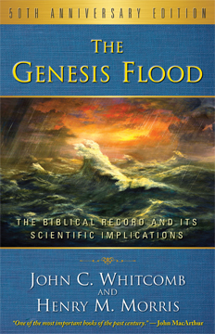
Flood Geology
An important early proponent of the idea that the flood could explain the geological strata was George McCready Price (1870-1963).
Henry M. Morris (1918-2006) and John C. Whitcomb (1924-) popularized this approach in The Genesis Flood (1961), and within a decade it had nearly replaced the Gap Restitution theory as the preferred evangelical view on origins.

Slide 23
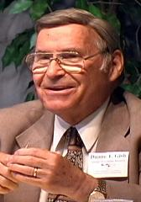

Other Young-Earth Proponents
Stephen A. Austin
Thomas Barnes
Leonard Brand
Wayne Frair
Robert Gentry
Duane Gish
Ken Ham
Russell Humphreys
Paul Nelson, and
Barry Setterfield

Slide 24
Old-Earth Creation
This view accepts the standard dating provided by geology for the earth and its strata, and by astronomy for the universe, so that:
  the cosmos is about 14 billion years old
  the earth some 4.5 billion years old
  the earliest living things appearing as soon as the earth has cooled enough to support life, perhaps 3.8 billion years ago.

Slide 25
Old-Earth Variety
Proponents disagree on how to understand the days of Genesis:
  Ages?
  Days separated by long gaps?
  Days on which the account was revealed to Moses?
  A literary device with no chronological significance?

Slide 26
Evolution?
Old-earth creationists deny that the scientific evidence favors macroevolution…
  the gradual development of all life's diversity from a single primordial creature.
Instead they feel God intervened at various times in history to provide new life forms that would otherwise never have arisen.
Small-scale evolution (microevolution) of varieties within the created kinds is typically affirmed.

Slide 27
Adam & Eve?
Adam and Eve are special creations of God rather than natural developments from the apes.
But O-E creationists disagree considerably on how far back in the past humans were created:
  Several million years?
  50 to 100 thousand years?
  5 to 10 thousand years?

Slide 28
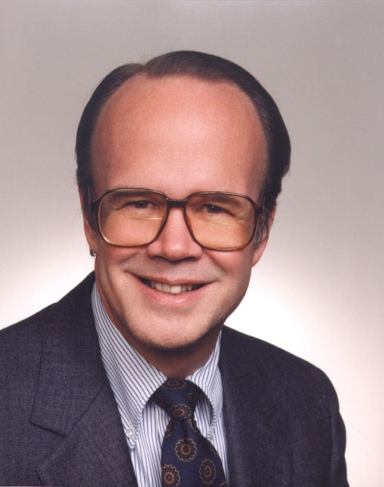

Other Old-Earth Proponents
Gleason L. Archer
James M. Boice
C. John Collins
Norman L. Geisler
Russell W. Maatman
Robert C. Newman
Pattle P. T. Pun
Hugh Ross
David Snoke
John L. Wiester

Slide 29
Theistic Evolution
Like old-earth creation, this view accepts the standard scientific dating for the universe, the earth, the various geologic strata and the fossils within them.
Unlike old-earth creation, theistic evolutionists believe:
  macroevolution (gradual, natural change to produce all the variety of living things) has actually occurred,
  but this was not a random, mindless, unguided process as many secular evolutionists (such as Stephen Jay Gould, Richard Dawkins and Daniel Dennett) believe.

Slide 30
Theistic Evolution
Instead God guided the process of evolution by means of his providential oversight of all that happens.
Theistic evolutionists disagree whether creation involved any miraculous intervention besides the origin of the universe.
  A number put such intervention at the creation of life and of humans.
  Others see the origin of life and the development of humans from the apes as divinely guided natural processes.

Slide 31

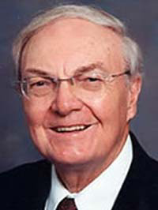
Proponents of Theistic Evolution
Henri Blocher
Richard H. Bube
Francis Collins
Michael Denton
Peter Enns
Keith B. Miller
George L. Murphy
John Polkinghorne
Howard J. Van Till
Bruce K. Waltke

Slide 32
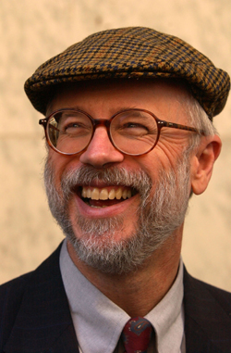
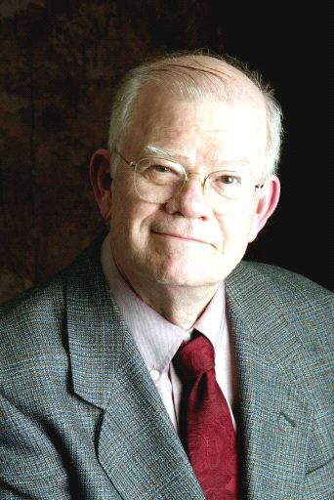
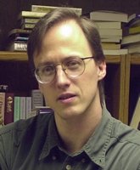
The Intelligent Design Movement

Slide 33
Background
Since the 1960s, a culture war has been heating up between materialists and theists.
Materialists believe that reality is basically matter-energy and impersonal forces, with minds being only a late development in the history of the universe.
Theists believe that behind physical reality is a Mind which has designed and produced all that we see.

Slide 34
Recent Creation-Evolution Trials
In 1982 and 1985, a pair of court decisions in Arkansas and Louisiana struck down new laws in those states which permitted teaching of creation alongside evolution in public schools. The US Supreme Court concurred in 1987.
Yet a number of observers felt that these decisions were flawed.
  (1) A narrow definition of creation was used in the decisions which made creation a religious view while evolution was not.
  (2) A narrow definition of science was used which ruled out in advance any evidence that might point to agency from beyond nature.

Slide 35
Design in Nature
Meanwhile, evidence had been accumulating that our universe and the life within it looks strangely designed:
  Lawrence J. Henderson's book The Fitness of the Environment (1913)
  Paul Davies' Accidental Universe (1982)
  Hugh Ross' The Creator and the Cosmos (1993)
  Michael Denton's Nature's Destiny (1998)

Slide 36
Design in Nature?
To many these features point to a Mind behind the universe.
To others, they merely indicate that intelligent life will only exist in those universes where everything is just right, so there must be a lot more universes where everything is not all right and consequently there is no life.

Slide 37
Design in Biology?
Darwin's theory has long been thought to have explained away apparent design.
  It is merely the result of natural selection rather than the work of a Designer.
But Michael Denton's Evolution: A Theory in Crisis (1986) and Michael Behe's Darwin's Black Box (1996) drew attention to numerous features in living things that suggest they could not have arisen by chance.
Materialists have responded that perhaps nature itself has (impersonal) forces that produce the kind of order needed.

Slide 38
Intelligent Design
Berkeley law professor Phillip E. Johnson has been a prime mover in the intelligent design movement, beginning with his book Darwin on Trial (1991), followed up with additional books and extensive speaking and writing.
Mathematician-philosopher William A. Dembski has provided a rigorous account of how to distinguish design from randomness or law-bound behavior in his book The Design Inference (1998).

Slide 39
Conclusions
We give more detail about this in our PowerPoint “Intelligent Design.”
How everything came to be is one of the most basic and debated questions we can ask.
Evangelicals and fundamentalists contend that both the Bible and nature indicate the universe is created and God is its creator.

Slide 40
Conclusions
When this occurred and how it happened are disputed.
That the universe has not always been, and that the universe and life are strikingly designed, continues to look more and more certain as scientists probe to the edges of the universe and to the depths of cells, molecules and elementary particles.

Slide 41
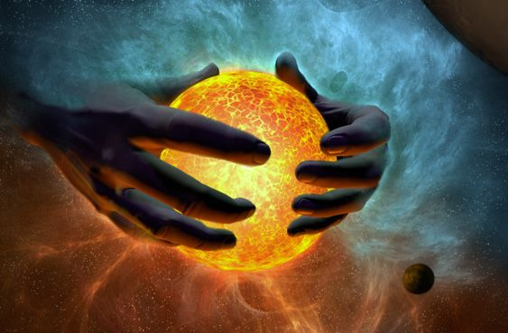
The End

