Slide 1
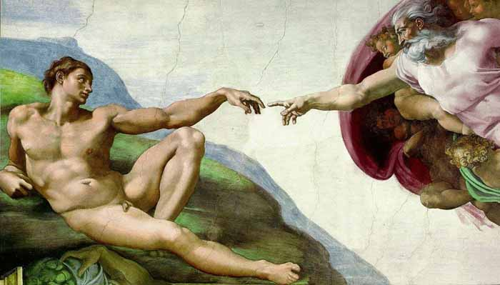

Creation, Science & the Bible
Dr. Robert C. Newman

Slide 2
The Bible's
Opening Words
In the beginning, God created the heavens and the earth. Now the earth was formless and empty, darkness was over the surface of the deep, and the Spirit of God was hovering over the waters. And God said, "Let there be light," and there was light. (Genesis 1:1-3)

Slide 3
The Problem Stated
Don't the teachings of science contradict these words from the Bible?
Isn't it impossible for a person to be a scientist and believe in God?
No, I believe there is no real contradiction.
  I am a scientist who believes in God.
  I believe there is good evidence for the existence of the God revealed in the Bible.
  I believe there is a reasonable harmonization between nature and Scripture.

Slide 4
The Problem Stated
It is true that many scientists have interpreted nature so as to contradict the Bible.
Likewise many Bible believers have interpreted the Bible to contradict nature.
To see if there is any real contradiction, we must see what the Bible and nature actually say.
That's what we want to do here.

Slide 5
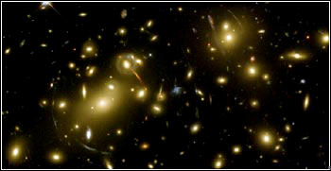
Cosmology
The Bible says there was a beginning, when God created heaven & earth.
Until recently, many scientists have claimed the universe always existed.
Evidence now indicates that the universe began (from nothing) at a finite time in the past.
Nature says there was a beginning.

Slide 6
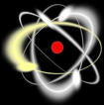
Fine-Tuning
The Bible pictures God as having made the universe by His wisdom.
Scientists who are atheists claim the universe is the way it is by chance.
It now appears that the universe is marvelously adjusted to allow life to exist.
Nature says the universe is designed.

Slide 7
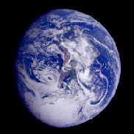
Origin of the Earth
Bible believers often claim the earth was made instantly in its finished form just a few thousand years ago.
Nature seems to teach the earth had a long history before it reached its present form.
The Biblical account of creation in Genesis One is consistent with this evidence from astronomy and geology.

Slide 8
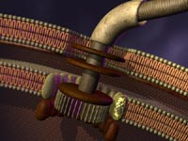
Origin of Life
The Bible says that God created life.
Some scientists claim that life arose from non-life by purely natural processes.
The complex functionality of living things seems clearly to surpass what could happen by chance in our universe.
Nature points to something beyond itself in containing the phenomenon we call 'life.'

Slide 9

The Diversity of Life
The Bible says God made the diverse living things, but does not give us much information about how He did so.
Many scientists claim that all the variety of life evolved from the simplest living things by purely mindless, random processes.
Detailed studies of the fossil record and of current life point to some sort of intelligent guidance or intervention.

Slide 10
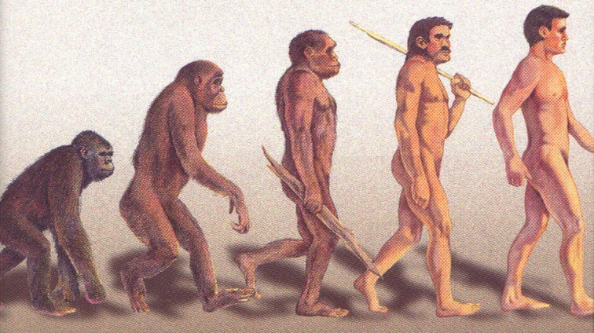
The Origin of Humans
The Bible says God made humans in His own image.
Many scientists claim humans developed naturally from the apes.
Though humans are quite similar physically to the apes, there is a great chasm between them in regard to intellect, initiative and spirituality.
This does not look like something that happened by chance.

Slide 11
A Tour of Genesis One, Comparing Nature & Scripture
In the beginning, God created heaven & earth.
  A beginning, perhaps the 'big bang'
The earth was formless & empty.
  Earth (& Sun) formed from cloud of gas & dust
Darkness over the surface of the deep.
  Gas cloud becomes dark within as it contracts

Slide 12
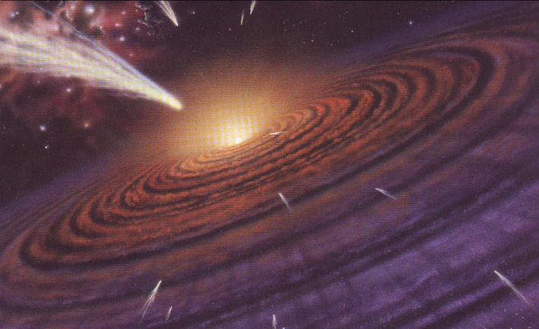
Tour of Genesis
God says, 'Let there be light.'
  With further contraction, cloud begins to glow
God separates light from darkness.
  Material to form planets pushed outside central bulge
God calls light 'day' & darkness 'night.'
  Planets form; their rotation gives night & day

Slide 13
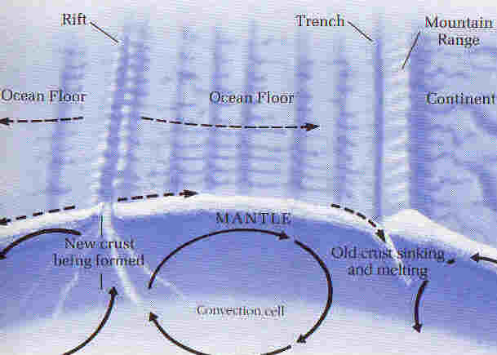
Tour of Genesis
Let the waters be gathered, land appear.
  Motion of plates produces continents, basins
Let the land produce vegetation.
  Plant life appears on land
Let sun, moon and stars appear in the sky.
  Plants oxygenate atmosphere, clearing sky so sun, moon, stars visible; provide air for animals

Slide 14
Tour of Genesis
Let waters & air fill with animals.
  Marine and air animals appear
Let the land produce various animals.
  Land animals appear
Let us make mankind in our image.
  Humans appear last in the fossil record.

Slide 15
Conclusions
A striking correlation between nature and Scripture!
Both picture:
  A universe with a beginning
  A designed universe
  An origin of life that surpasses chance
  A diversity of life that suggests intervention
The details of Genesis 1 match our best scientific model for the early earth.

Slide 16
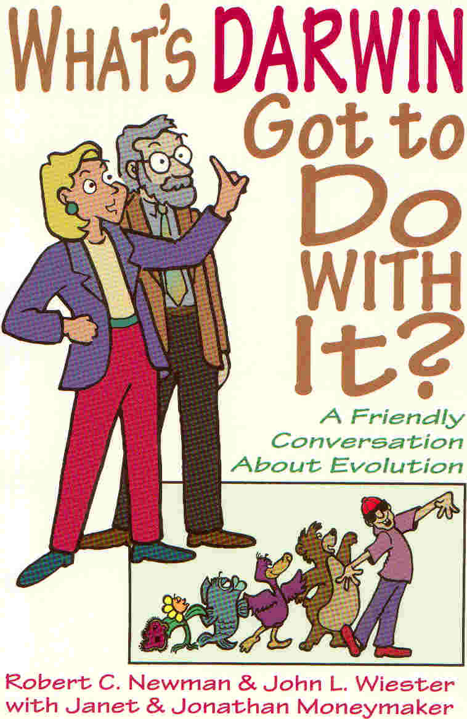
For Further Reading
Websites www.ibri.org and www.reasons.org
Hugh Ross, Creator & Cosmos
Newman, Genesis 1 & Origin Earth
Michael Denton, Nature's Destiny
Michael Behe, Darwin's Black Box
Newman & Wiester, What's Darwin Got to Do With It?

Slide 17
The End
May you continue to study both nature and Scripture!

