Slide 1
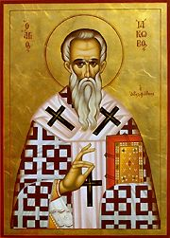
Avoiding Favoritism
James 2:1-13
Robert C. Newman

Slide 2
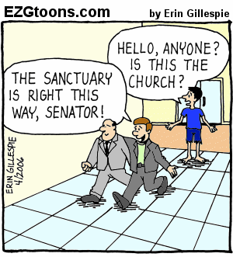

Slide 3
Favoritism or Bias
Favoritism – showing special favor; partiality
Bias – personal distortion of judgment; prejudice
This vice is very common in our society; it has probably been so throughout human history.
James gives us some insight into overcoming this problem in our own lives.
Let’s look at James 2:1-13.
We will look at it section by section.

Slide 4
James 2:1-4
1 (NIV) My brothers, as believers in our glorious Lord Jesus Christ, don't show favoritism. 2 Suppose a man comes into your meeting wearing a gold ring and fine clothes, and a poor man in shabby clothes also comes in. 3 If you show special attention to the man wearing fine clothes and say, "Here's a good seat for you," but say to the poor man, "You stand there" or "Sit on the floor by my feet," 4 have you not discriminated among yourselves and become judges with evil thoughts?

Slide 5
James 2:1-4
Favoritism is inconsistent with Christianity.
James’ example is a very common one: bias against poor people.
This bias implies rich people are more worthy of our attention; it suggests we think poor people get what they deserve.
Sometimes they do. But we are making a prejudgment, i.e., showing prejudice.
See my PP talk “The Church & the Poor.”

Slide 6
James 2:5-7
5 (NIV) Listen, my dear brothers: Has not God chosen those who are poor in the eyes of the world to be rich in faith and to inherit the kingdom he promised those who love him? 6 But you have insulted the poor. Is it not the rich who are exploiting you? Are they not the ones who are dragging you into court? 7 Are they not the ones who are slandering the noble name of him to whom you belong?

Slide 7
James 2:5-7
James reminds us of Jesus’ beatitude:
Luke 6:20 (NIV) Looking at his disciples, he said: "Blessed are you who are poor, for yours is the kingdom of God.
You have insulted the poor by your prejudice.
If anything, it is the rich who tend to exploit you, sue you, and slander the name of Jesus.

Slide 8
James 2:5-7
This (by the way) is no warrant for bias against the rich, as is common in socialism & characteristic of communism.
Exodus 23:2-3: (NIV) "Do not follow the crowd in doing wrong. When you give testimony in a lawsuit, do not pervert justice by siding with the crowd, 3 and do not show favoritism to a poor man in his lawsuit.
As Jesus points out, it is hard for the rich to enter God’s kingdom.

Slide 9
James 2:8-11
8 (NIV) If you really keep the royal law found in Scripture, "Love your neighbor as yourself," you are doing right. 9 But if you show favoritism, you sin and are convicted by the law as lawbreakers. 10 For whoever keeps the whole law and yet stumbles at just one point is guilty of breaking all of it. 11 For he who said, "Do not commit adultery," also said, "Do not murder." If you do not commit adultery but do commit murder, you have become a lawbreaker.

Slide 10
James 2:8-11
Favoritism violates the second greatest commandment, “love your neighbor as yourself.”
The law (we suggest) is like a soap-bubble: we become a law-breaker by breaking it at any point.
Favoritism may be a middle-class, white-collar sin, but it is still a sin.

Slide 11
James 2:12-13
12 (NIV) Speak and act as those who are going to be judged by the law that gives freedom, 13 because judgment without mercy will be shown to anyone who has not been merciful. Mercy triumphs over judgment!

Slide 12
James 2:12-13
These are general statements that apply to all humans and to the final judgment that we all face when Jesus returns.
But their application here to favoritism is that we are called upon to give the poor a break, and not to assume they deserve their poverty.
If we want God to show us mercy, we need to show mercy to others.

Slide 13
A Prayer
Lord, forgive us of our all-too-frequent sins of bias and favoritism. Help us to treat all people as equal in your sight, and may they be so in ours. Give us compassion for the down and out, and also for the up and out. Help us to reach out in love to all our fellow human beings, since they are all made in Your image and all need your salvation in Jesus Christ. Amen.

Slide 14
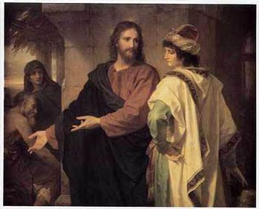
The End

