Slide 1
2009 Taiwan Trip
Robert C. Newman

Slide 2
Trip to Taiwan
Our trip lasted from May 14 to 28.
We were mostly in Taipei, with four days in Taichung.
I was accompanied by Lee Copeland, and we were led by Wright Doyle, who was already in Taiwan.
Purposes:
Survey religious situation in Taiwan
Speaking
Sightseeing

Slide 3
Companions
Dr Wright Doyle
Director of China Institute and Global China Center
Fluent in Mandarin Chinese
Taught for many years in Taiwan
Rev Lee Copeland
Member of Wright’s board
Pastor of Faith Bible Fellowship, Farmville, VA

Slide 4
Taiwan
Taiwan is an island in the Pacific Ocean some 80 mi off the SE coast of China.
It is about 250 mi long and 90 mi wide, with a population of 22.9 million.
Taipei, its capital, has a population of 2.6 million.
Taipei Taichung

Slide 5
Taiwan Ethnic Groups
The people of Taiwan are 98% Han Chinese and 2% Aborigines.
The Han Chinese can be divided into two groups which have been there for centuries, and the Mainlanders who came over with Chang-kai Shek.

Slide 6
Taiwan Religion
Most of the people on Taiwan (93%) follow a Chinese combination of Buddhism, Confucianism & Taoism.
About 4.5% are Christians, of which 2.6% are Protestant.

Slide 7
The Trip Over
Thursday, May 14:
Depart Charlottesville, VA 11:22 am
Depart Washington Dulles 1:10 pm
Cross International Date Line 8:10 pm
Friday, May 15:
Arrive Tokyo 2:55 pm
Depart Tokyo 6:36 pm
Arrive Taipei 8:30 pm
Reach China Evangelical Seminary 11:05 pm, where we stayed May 15-21

Slide 8
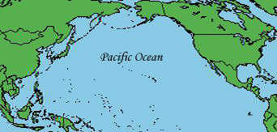
The Trip Over

Slide 9
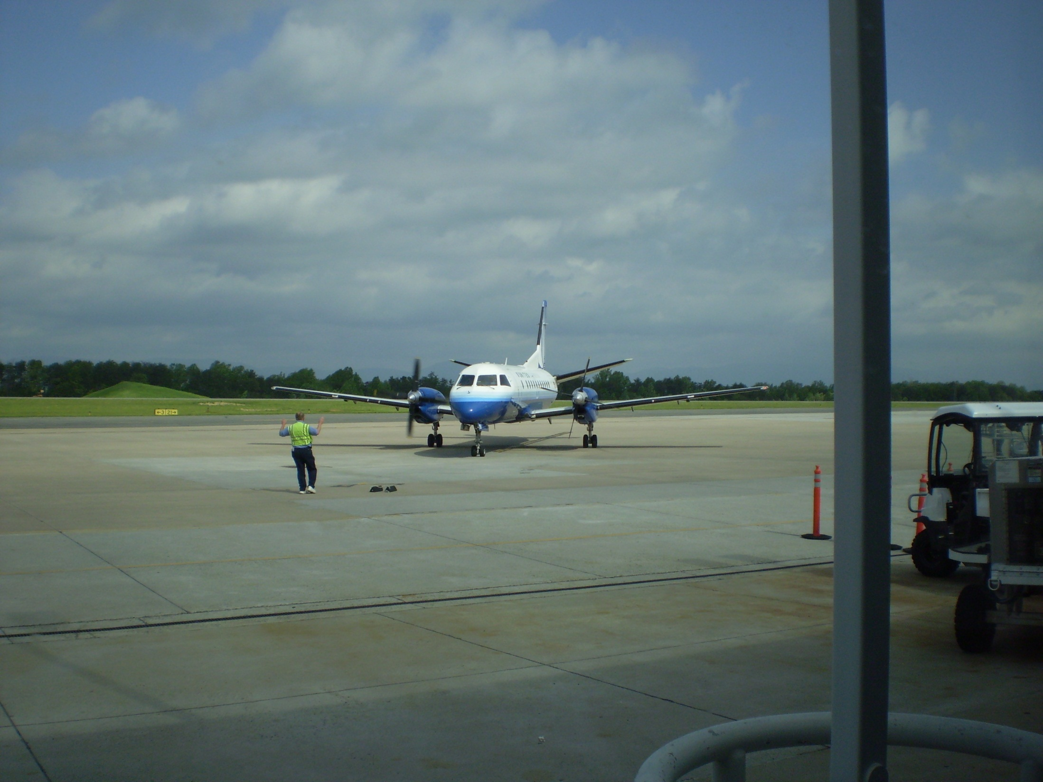
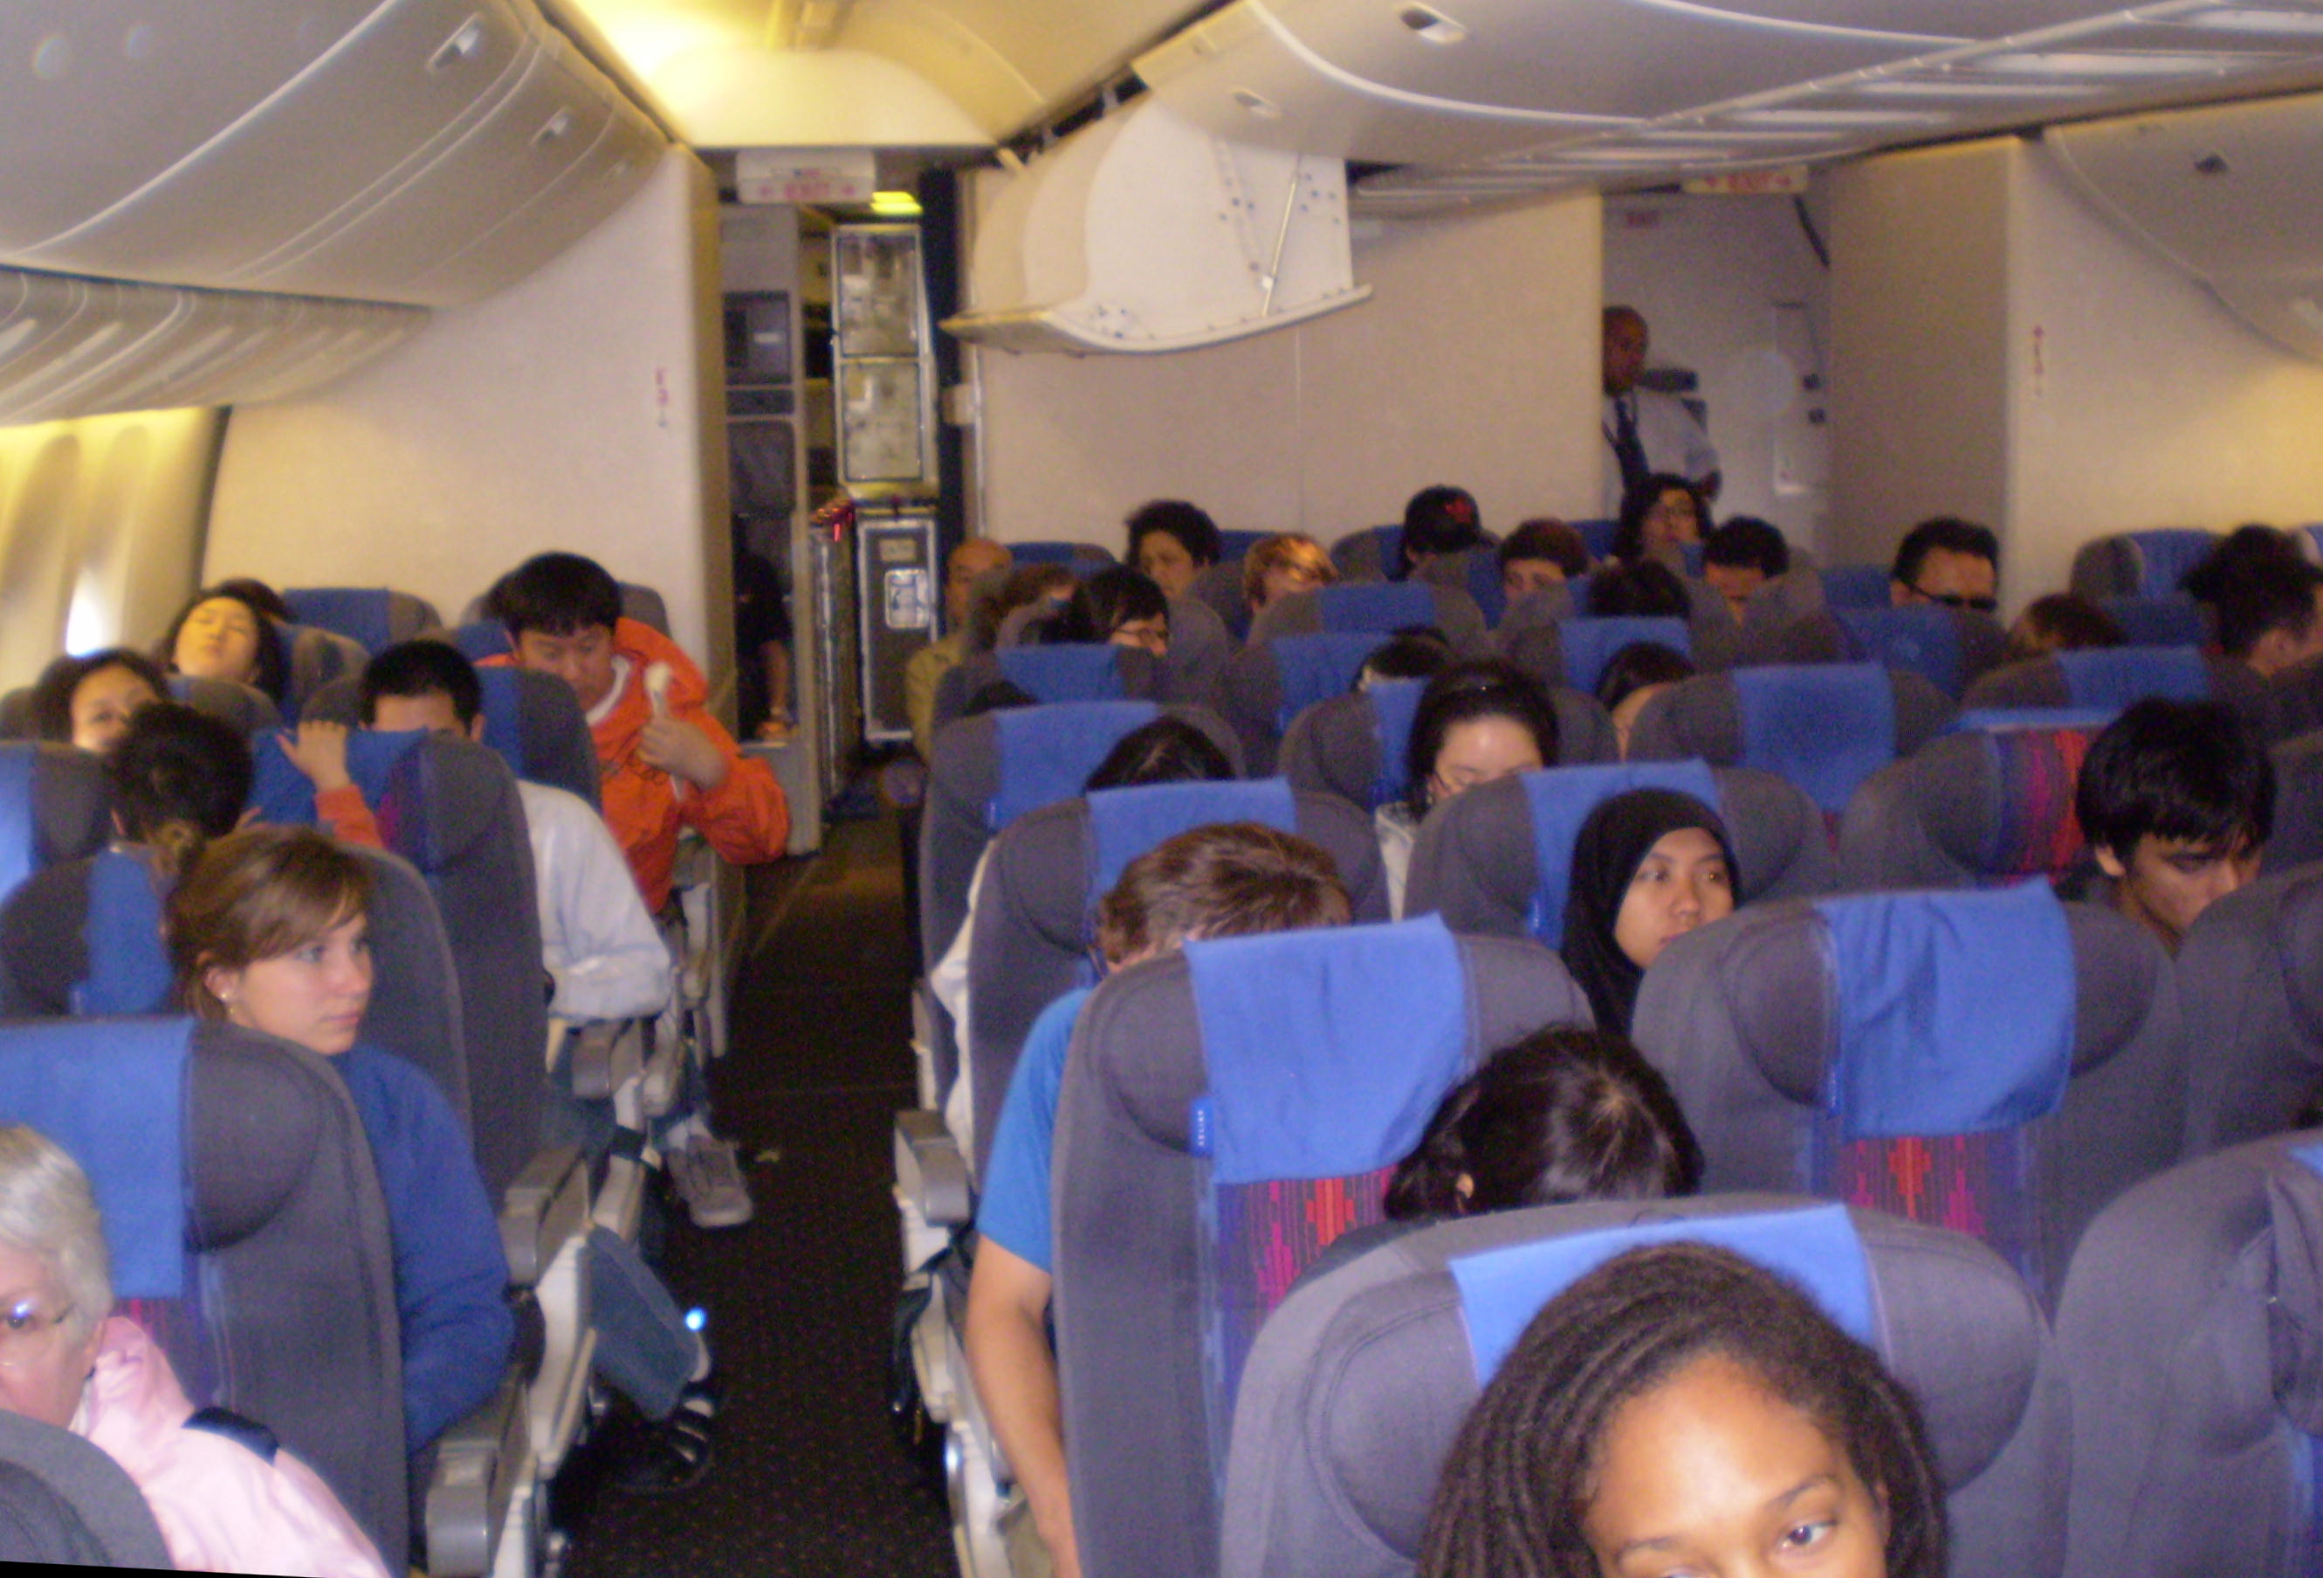

Slide 10
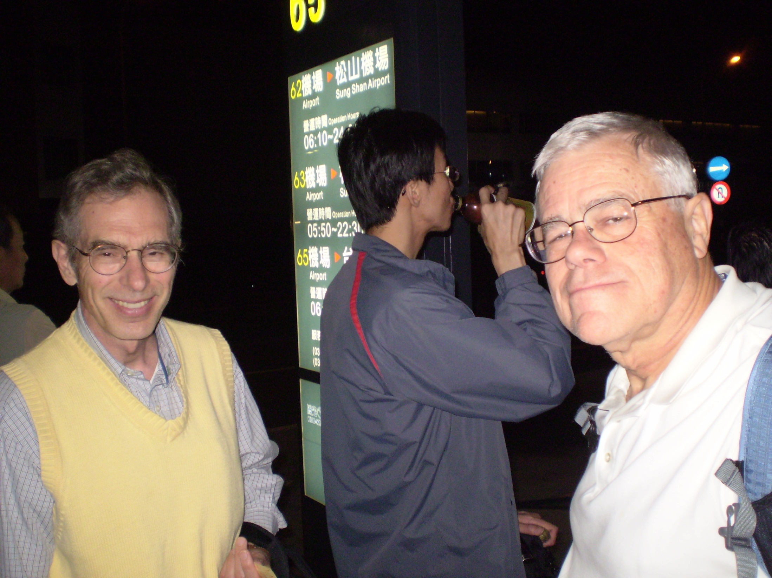
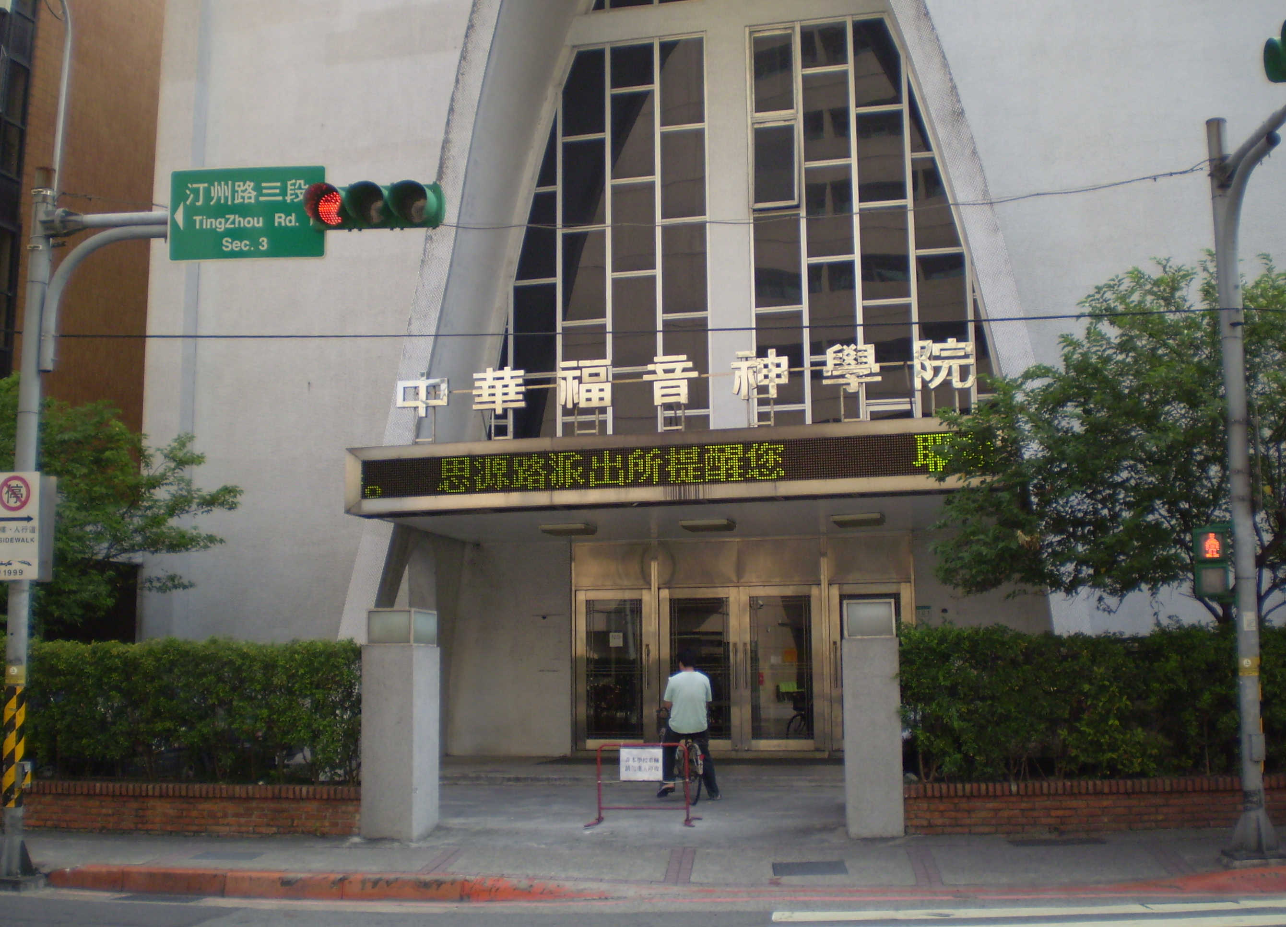

Slide 11
Saturday, May 16
Breakfast at Starbucks near Taipei 101 with Ken & Lillian Huang & kids
Up to top of Taipei 101, then the tallest building in the world
To Taipei RR station to get tickets for Taichung trip next week
Dinner at Cuckoo Café near seminary

Slide 12
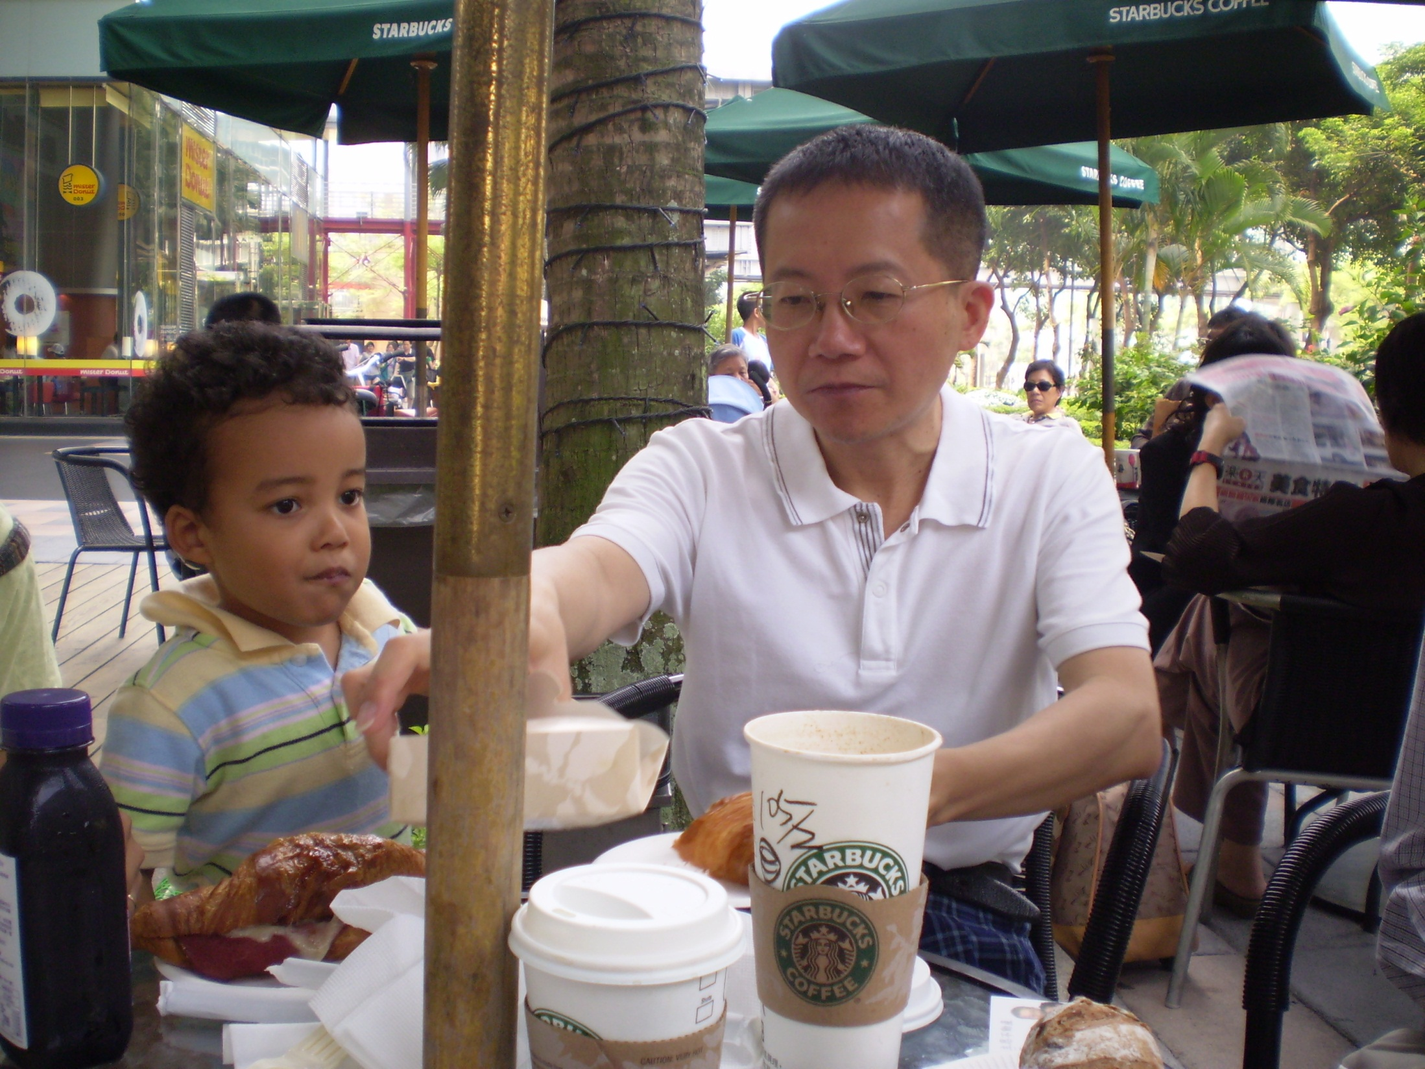
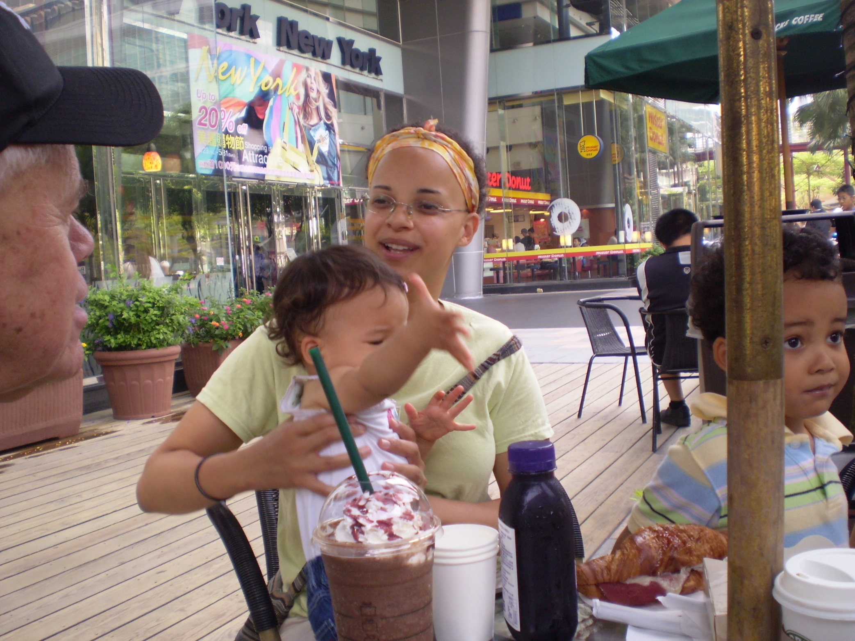

Slide 13
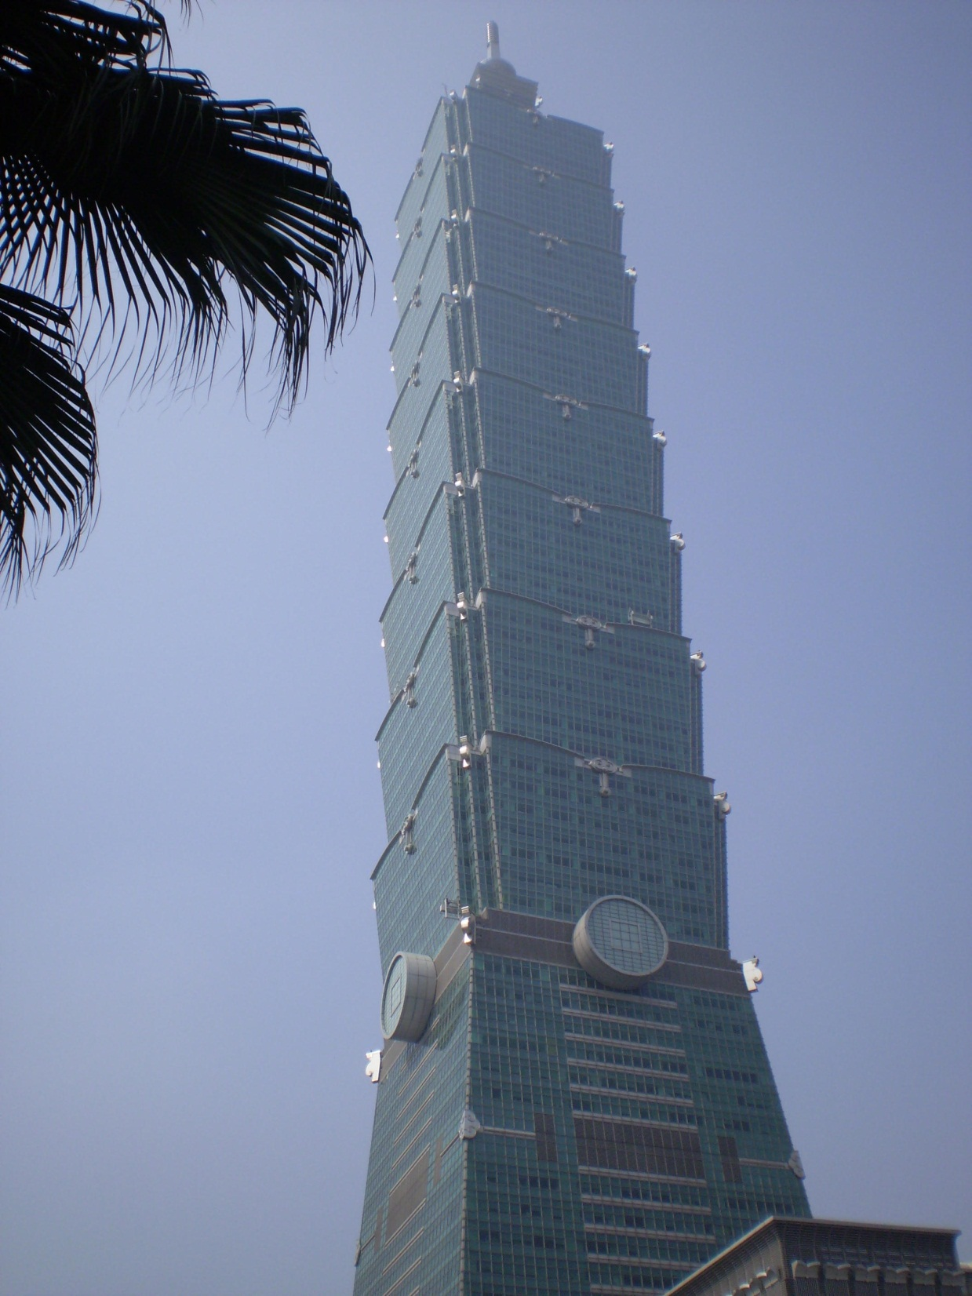
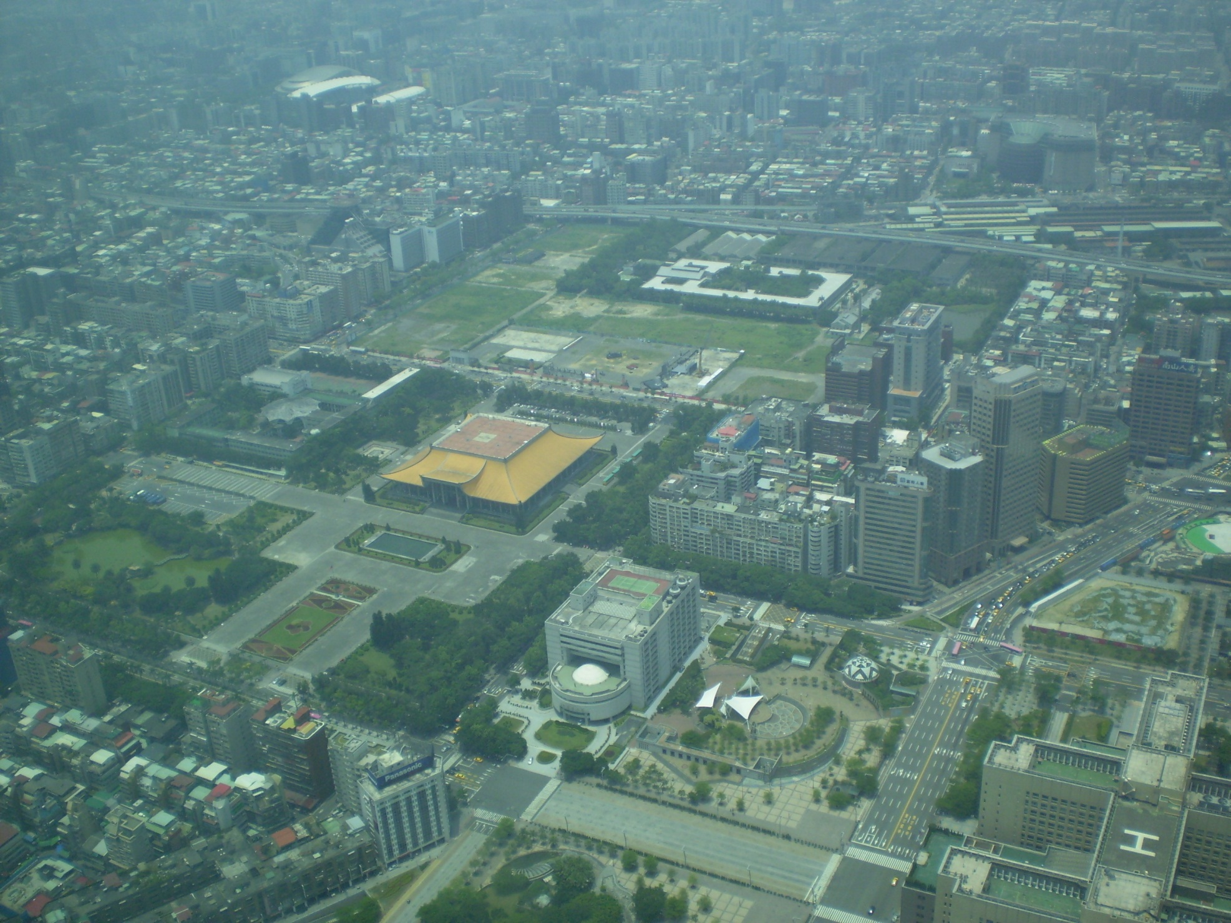
Taipei 101

Slide 14
Sunday, May 17
To Xindian by rapid transit, then by car to Hua Cheng Covenant Church
Wright preaches in Mandarin on Ephesians 5:20
Lunch at church, speaking with various members
Dinner in room at seminary with Jason & Christie Truell and children

Slide 15
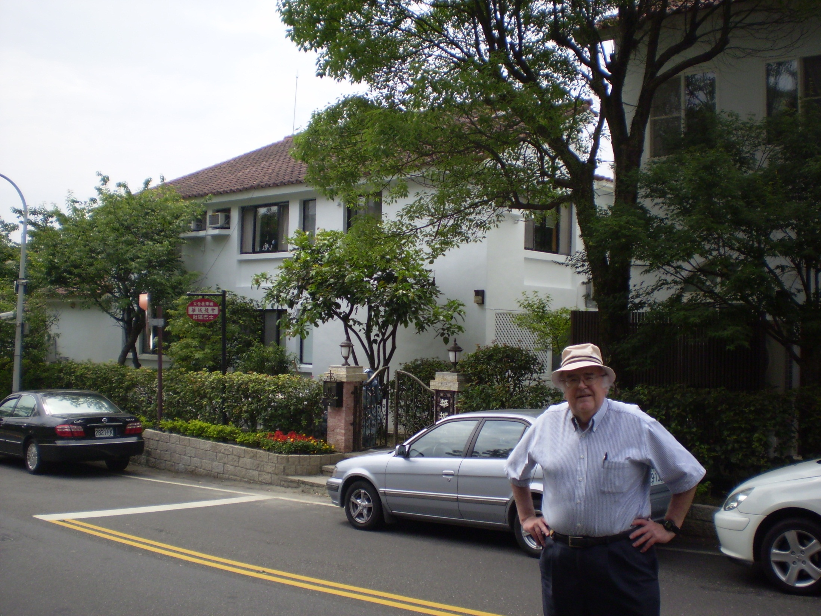

Slide 16
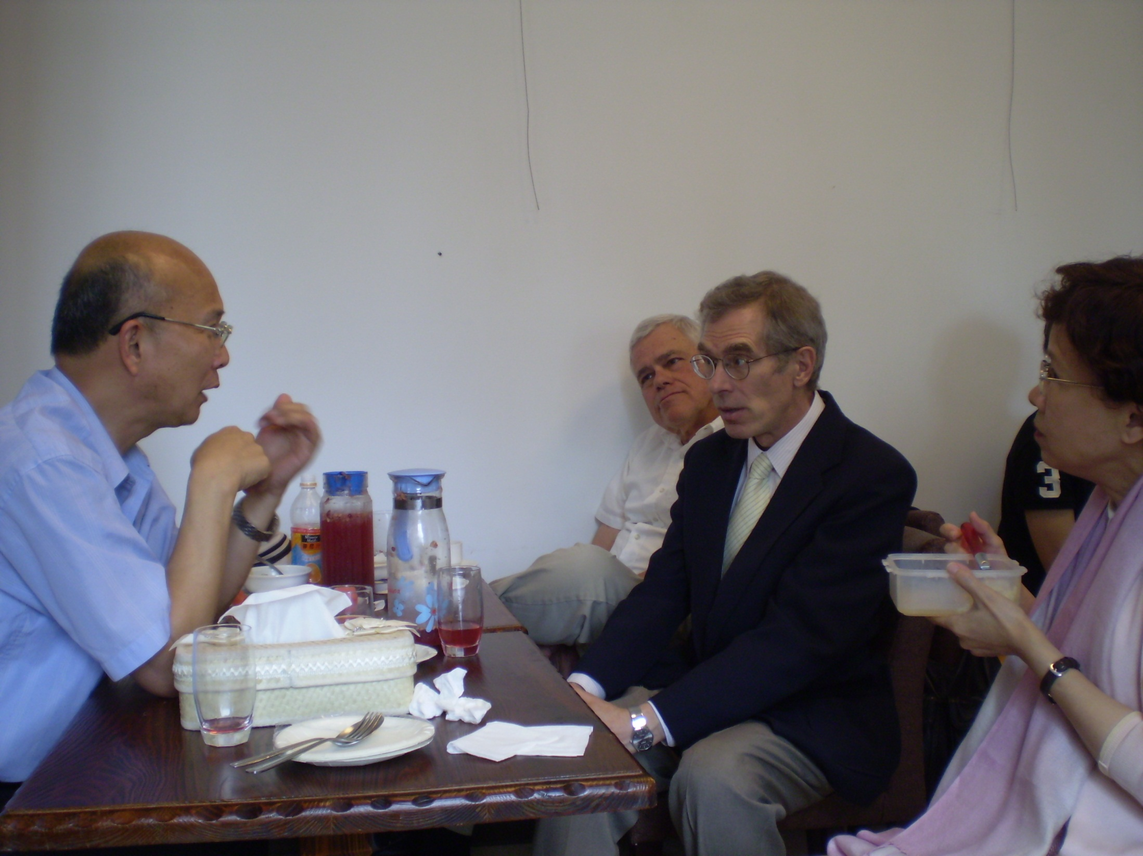
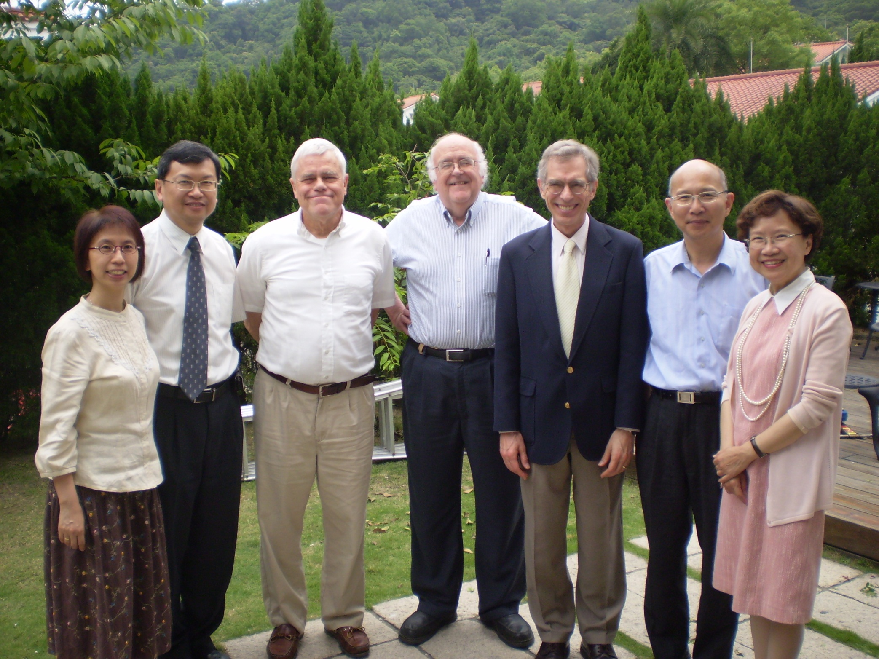

Slide 17
Monday, May 18
Tour of Far East Broadcasting Co Taiwan by Director Philip Chen
Lunch at Cottonfields Restaurant with Michael & Hong Chao, recent grad of CES and former schoolteacher, now working at New Birth Church
Time with David Wei, Prof of NT at CES
Dinner at Peking Restaurant

Slide 18
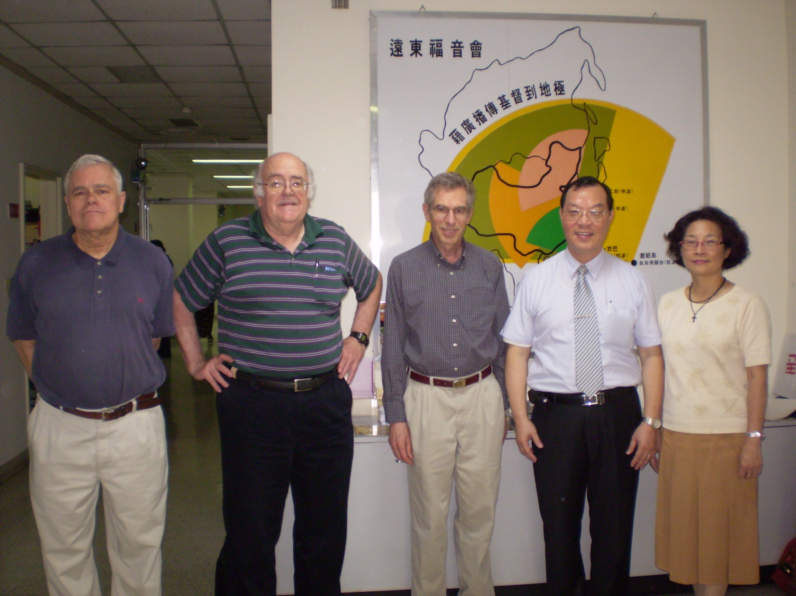
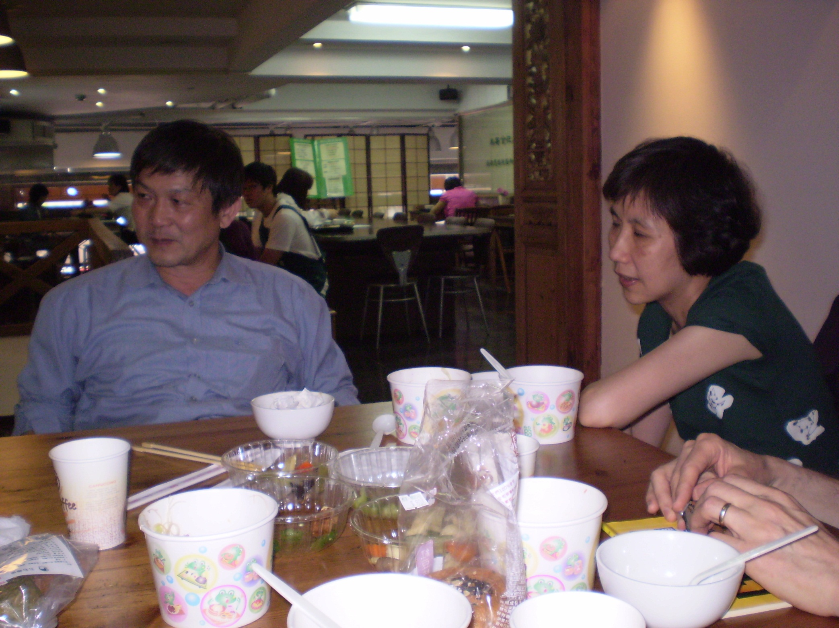

Slide 19
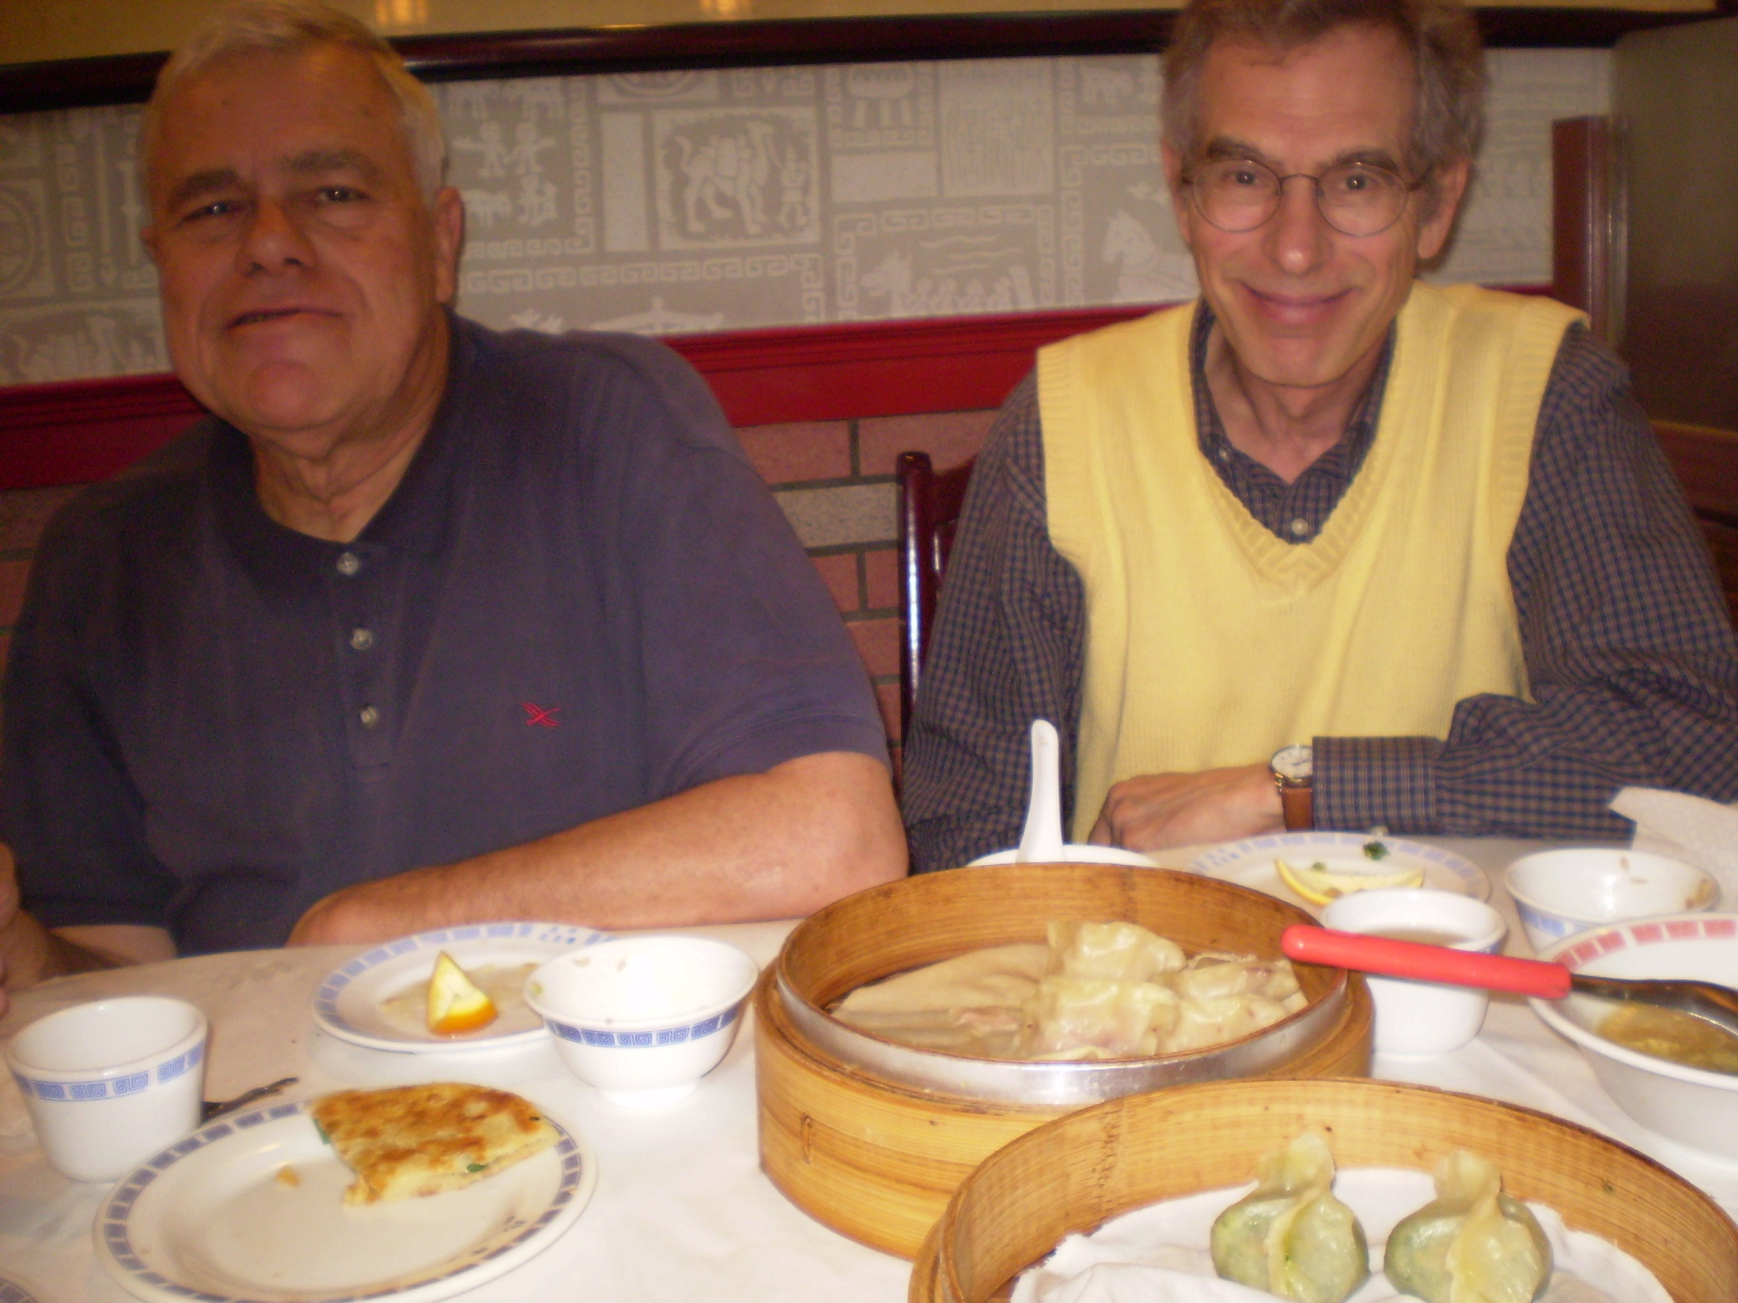

Slide 20
Tuesday, May 19
Meeting with Wesley Hu, Prof of OT and my translator for my talk on Thursday
Out for walk
Visit to Chang Kai-shek Memorial, walk thru park there
Dinner in room
Prayer time with Truells

Slide 21
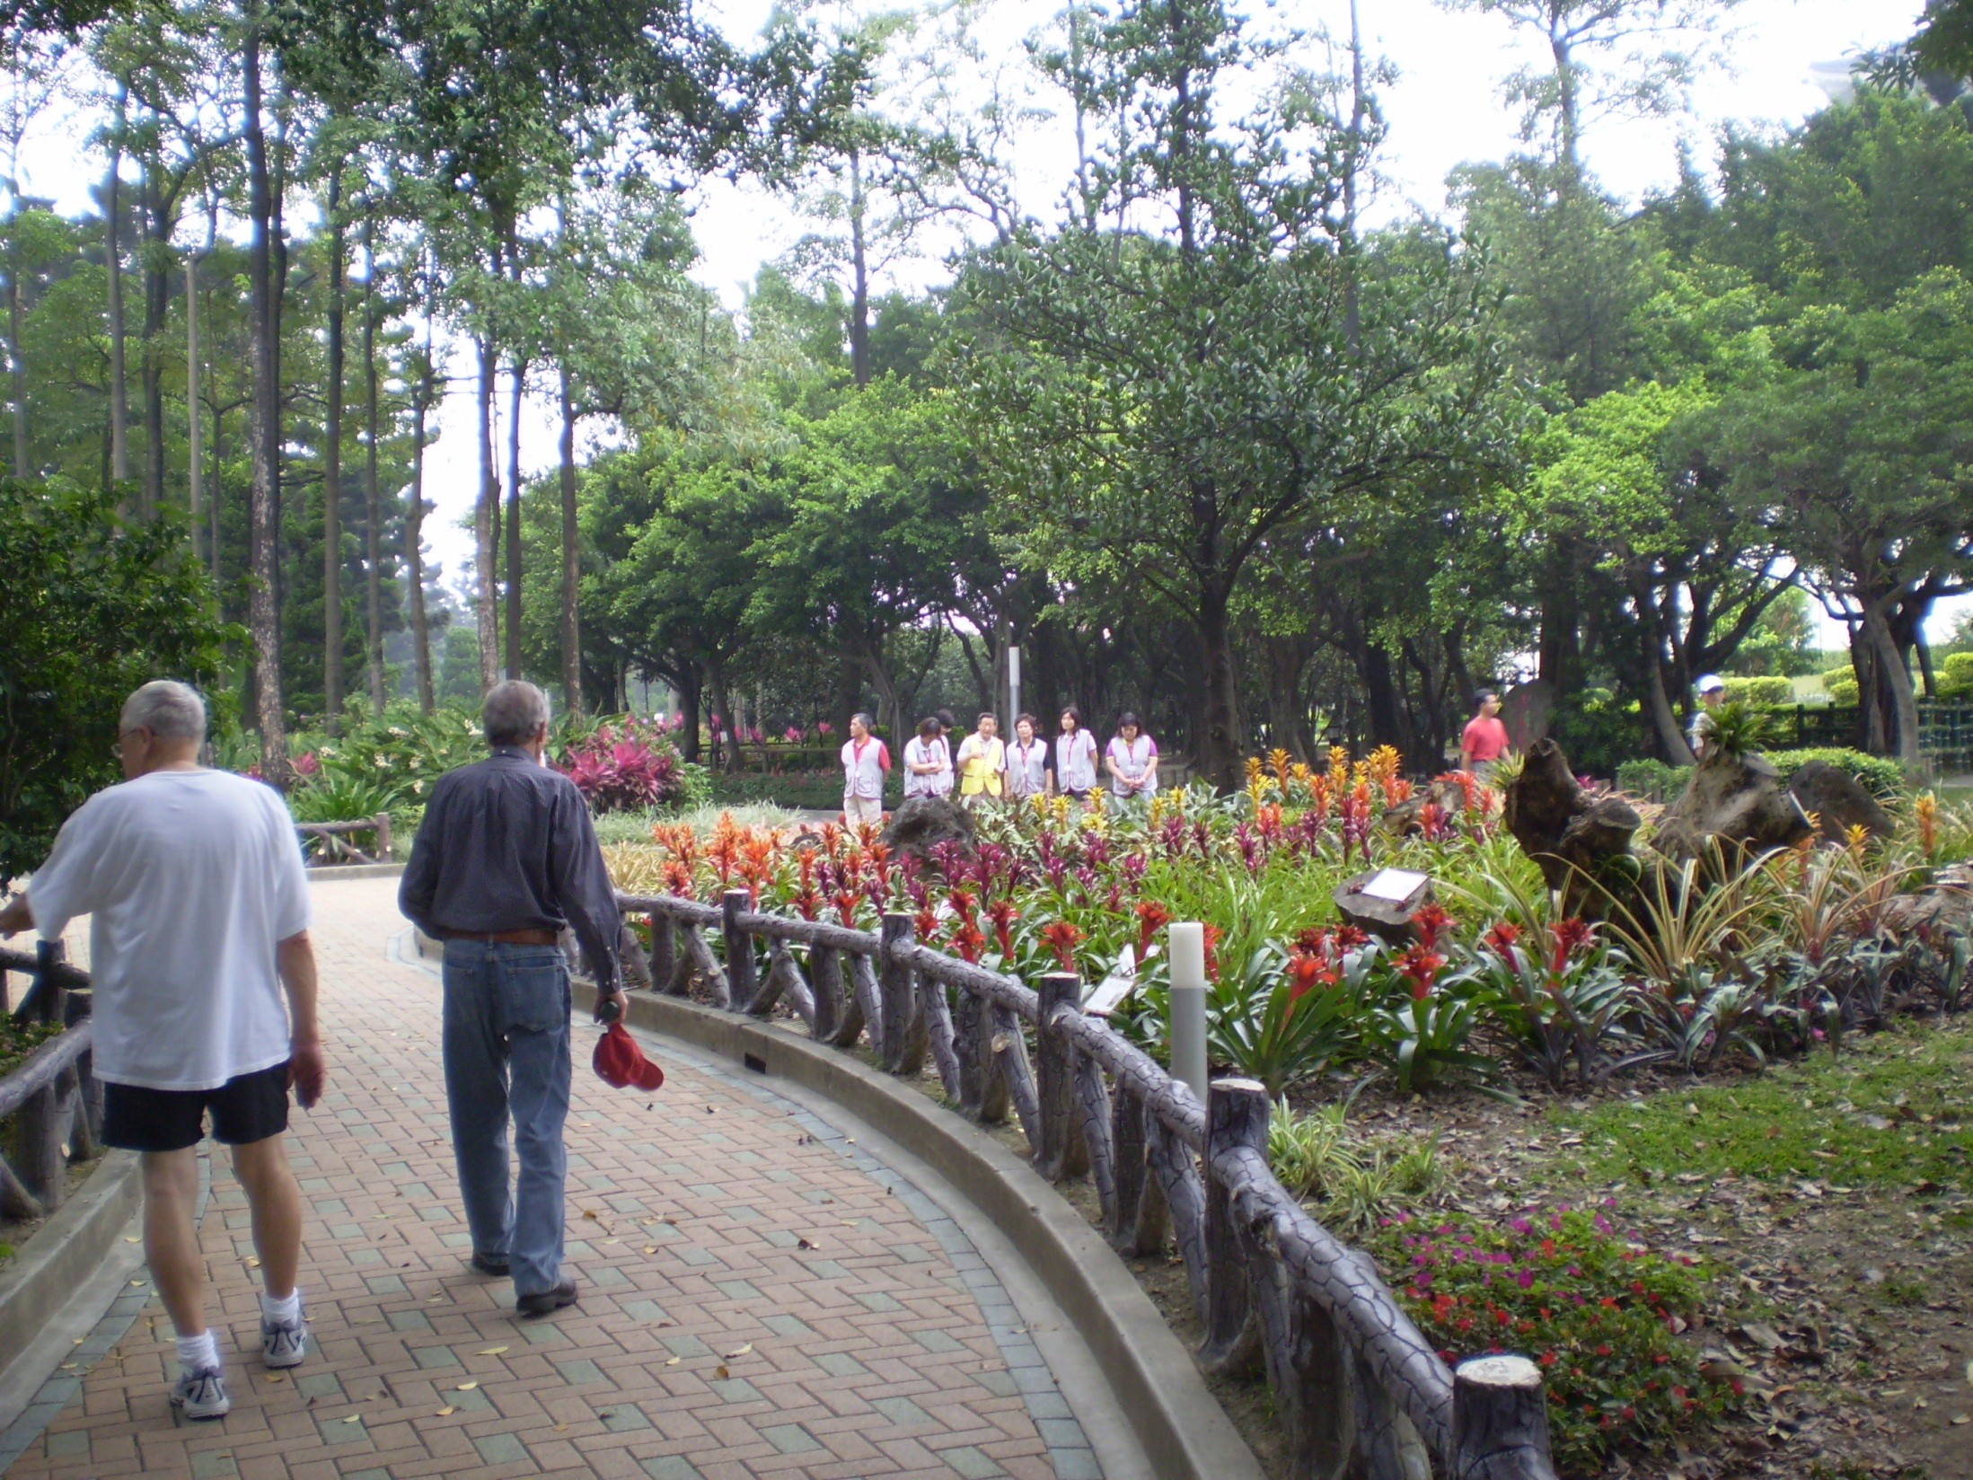
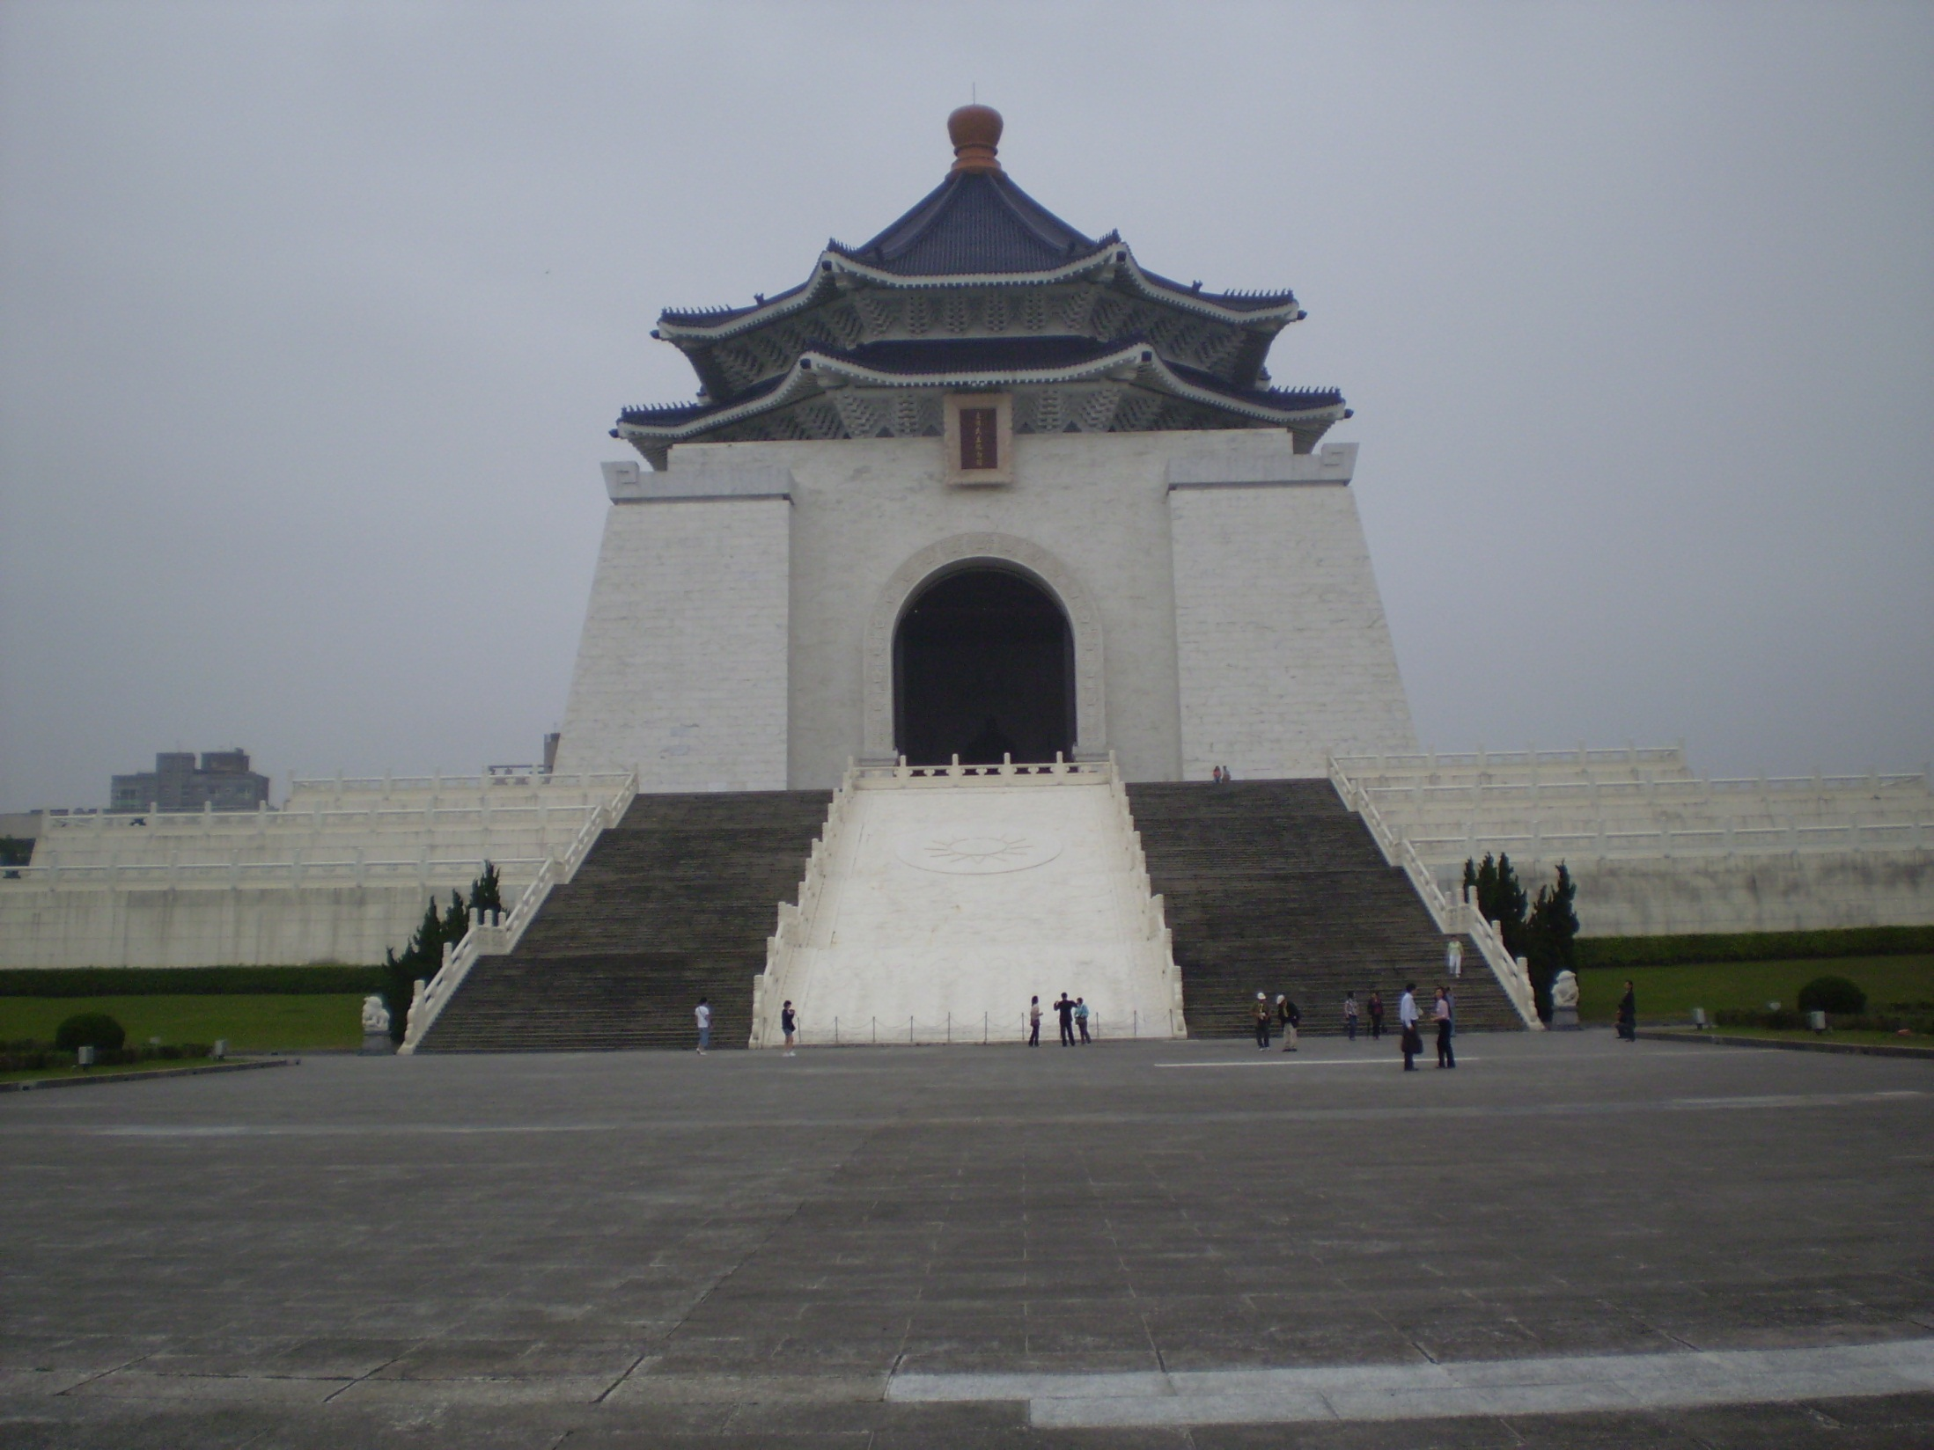

Slide 22
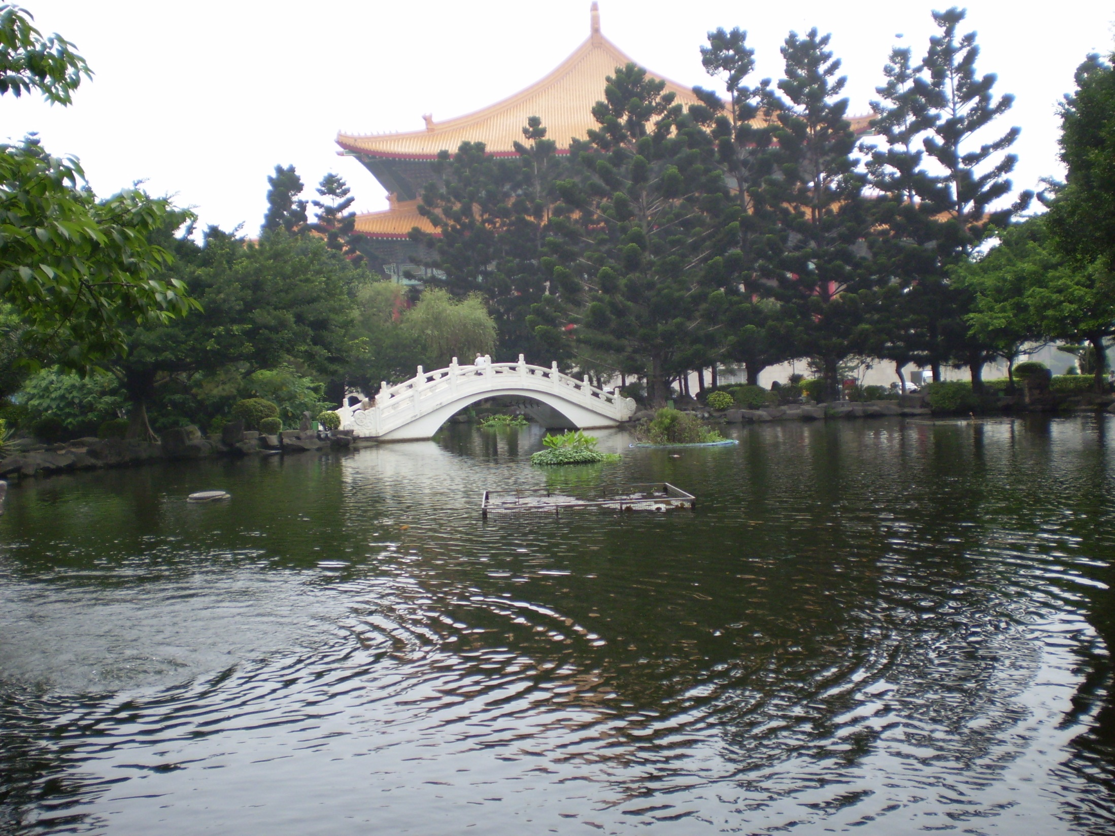
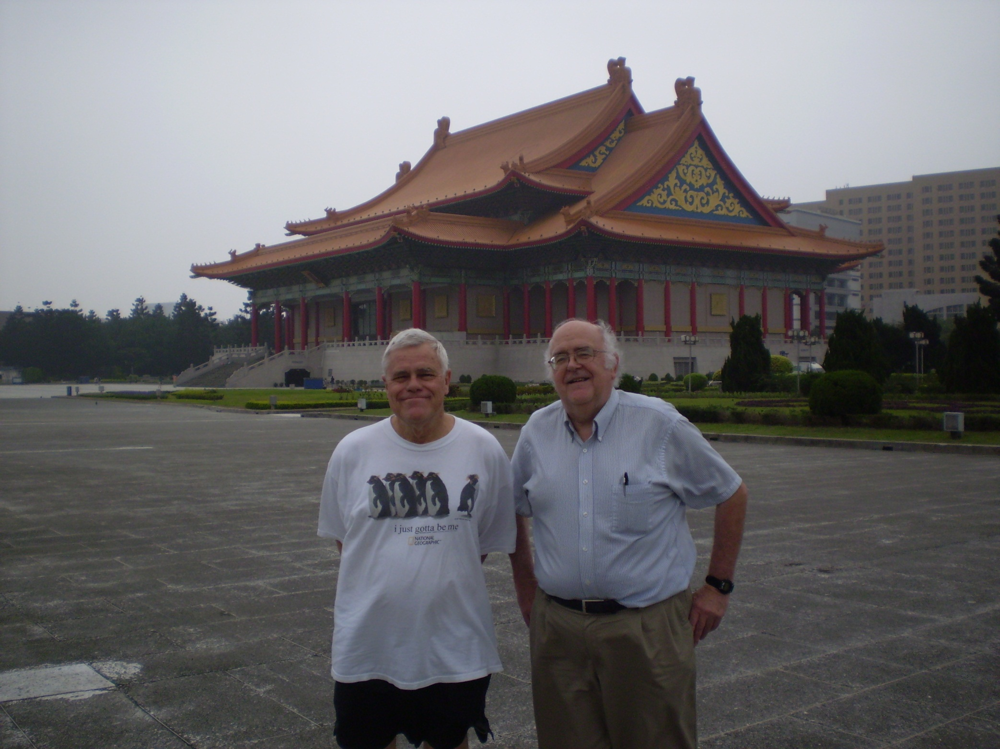

Slide 23
Wednesday, May 20
Wright preaching in Mandarin at CES chapel
Lunch at CES with faculty
Visit to Grand Hotel, fruit tea & cookies with live music
Dinner in apartment
Time of prayer with Truells

Slide 24
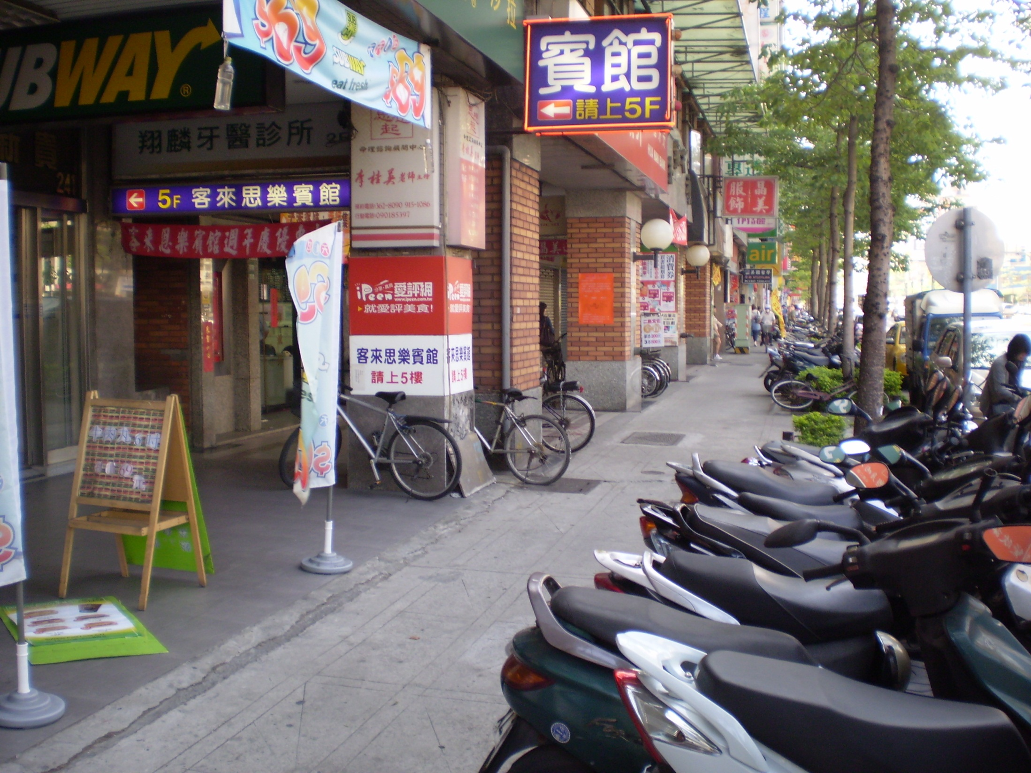

Slide 25
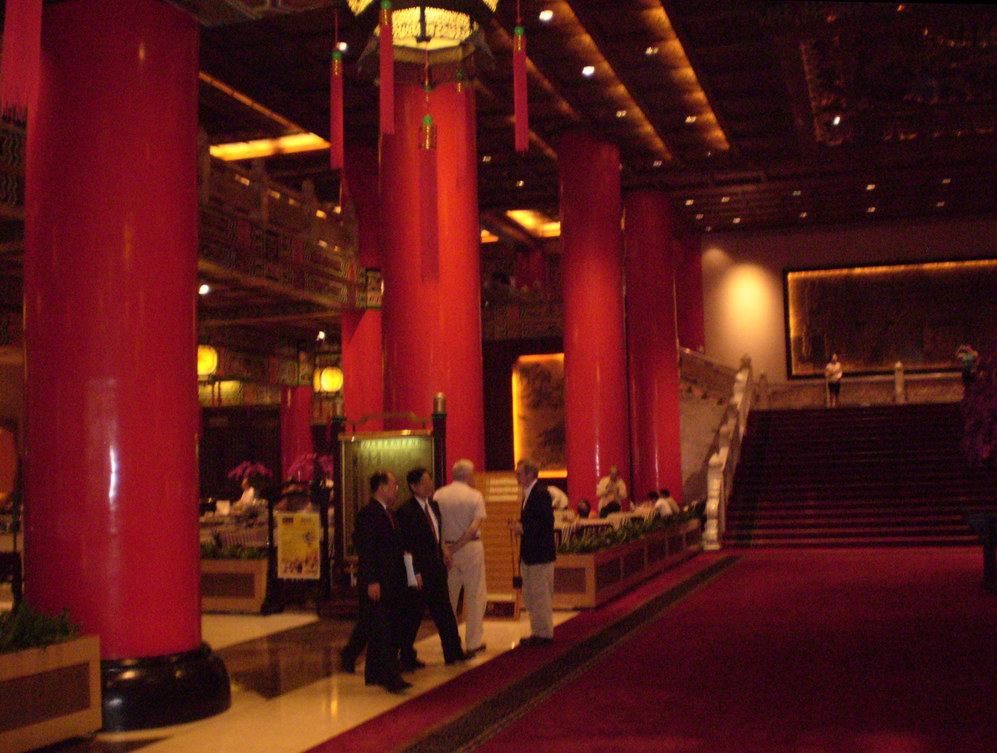
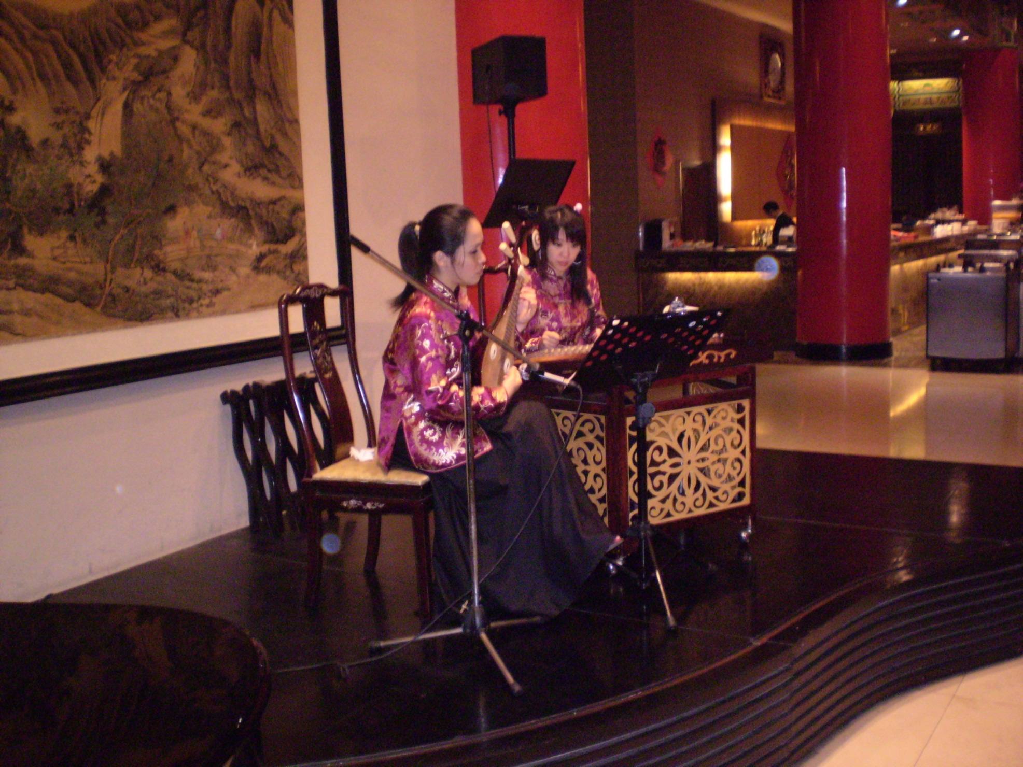

Slide 26
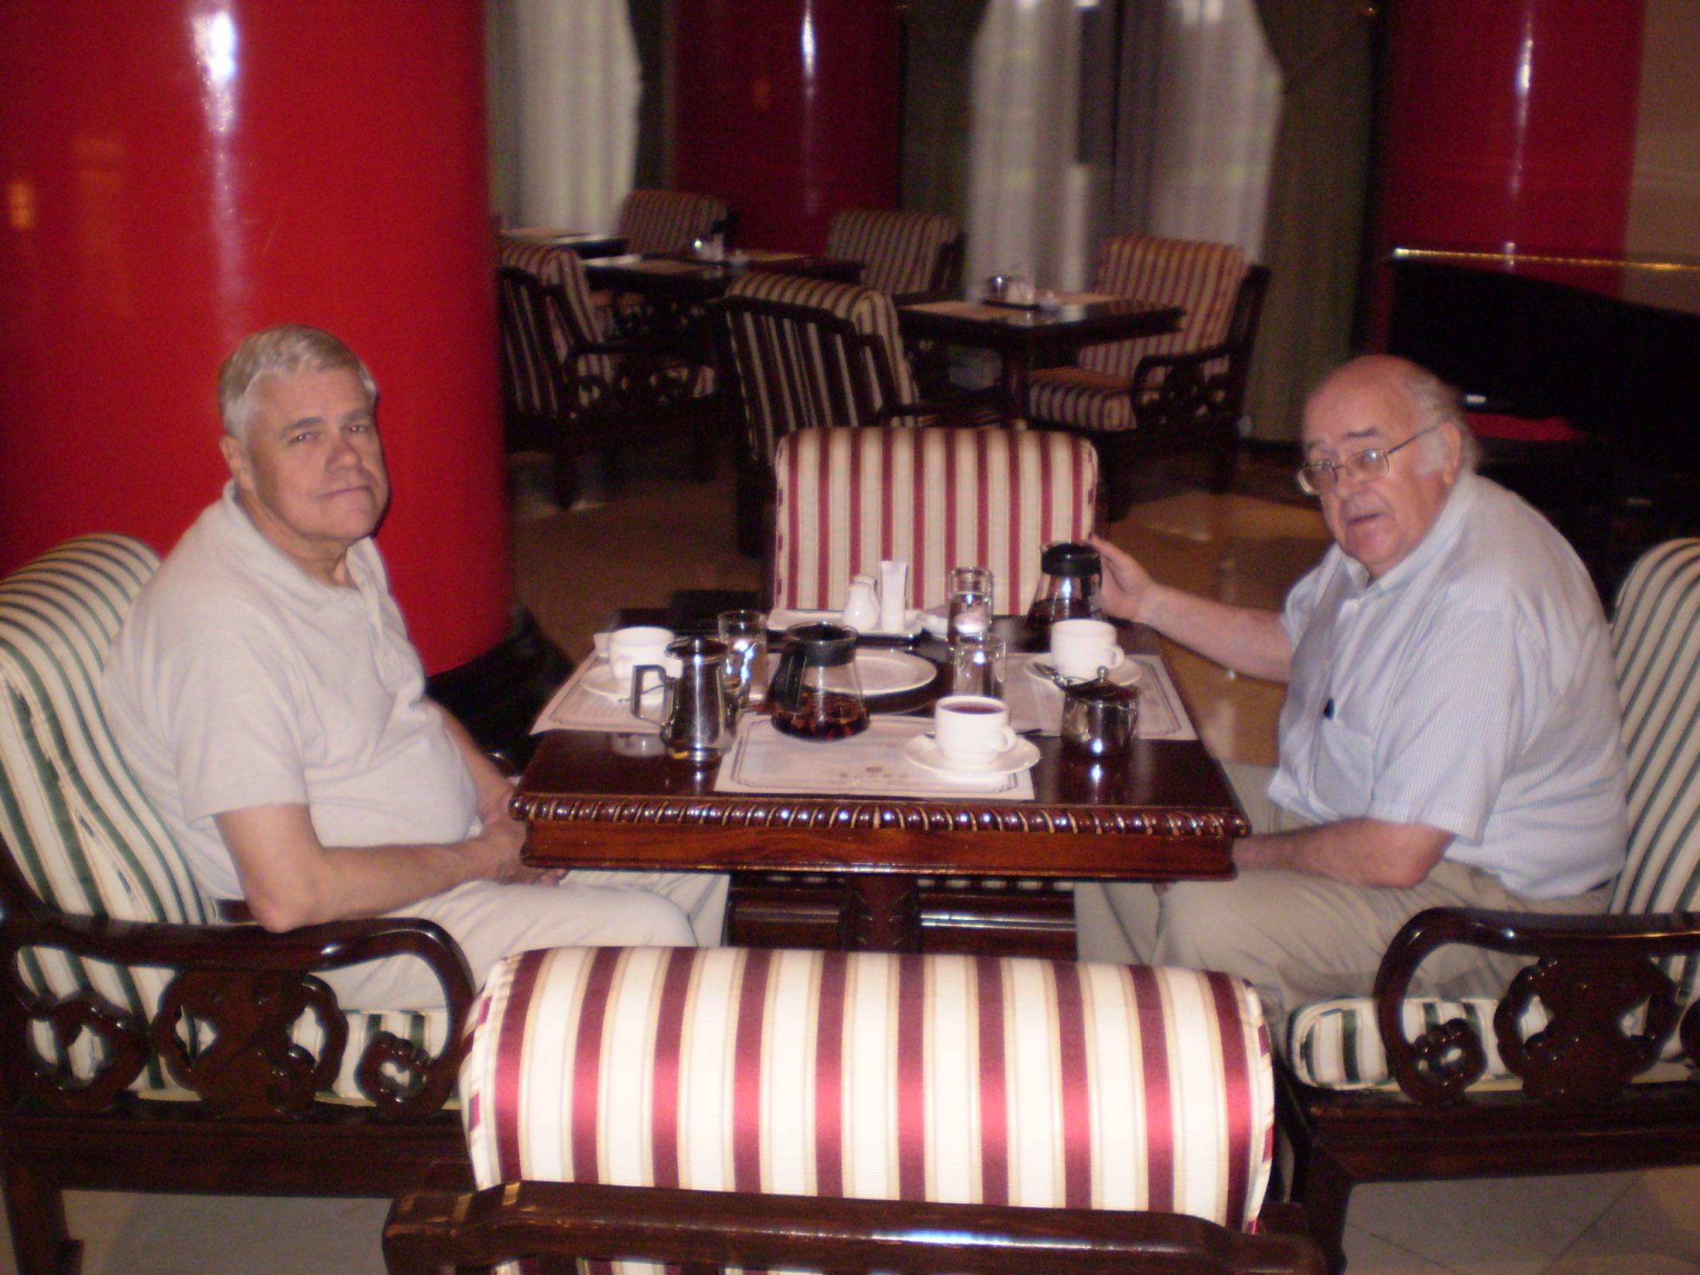
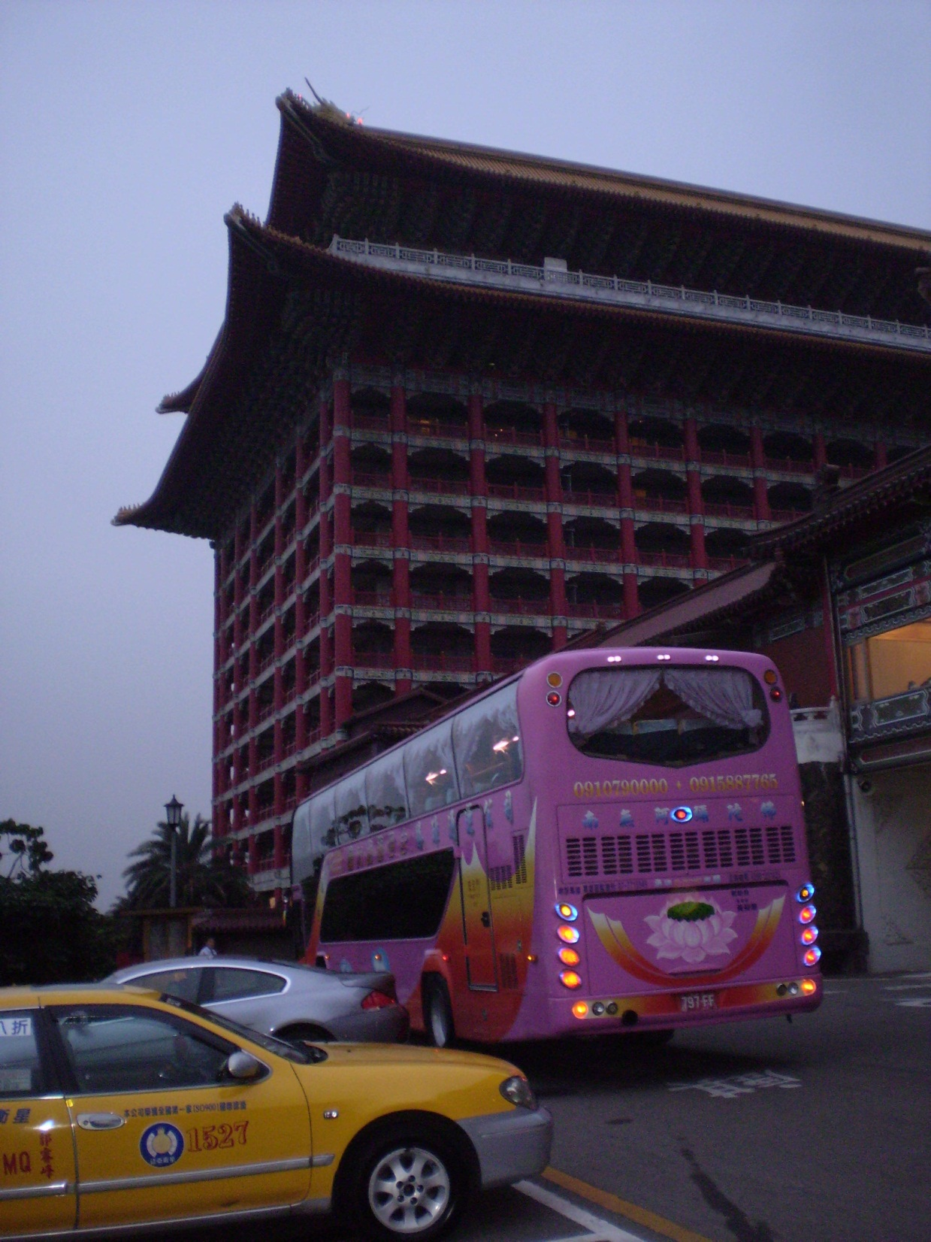

Slide 27
Thursday, May 21
Meeting with Andrew Butler, CES faculty, former director of OMF
I give my PP talk “Another Jesus” in CES chapel
Afternoon free
Depart Taipei 7:15 by rail
Arrive Taichung 9:31
Arrive Ren Meei Hotel 9:45 (for four nights)

Slide 28
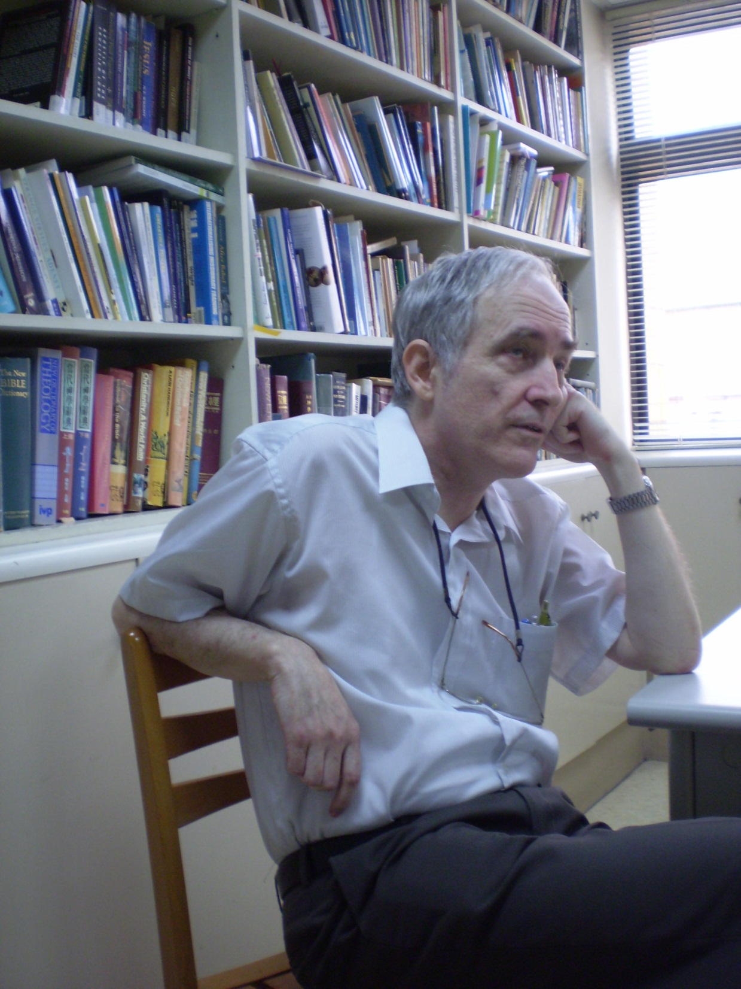
Andrew Butler, CES Faculty, former director of OMF

Slide 29
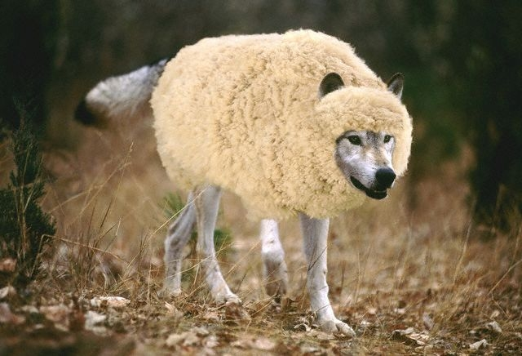
Another Jesus?
False Messiahs Then & Now
Robert C. Newman

Slide 30
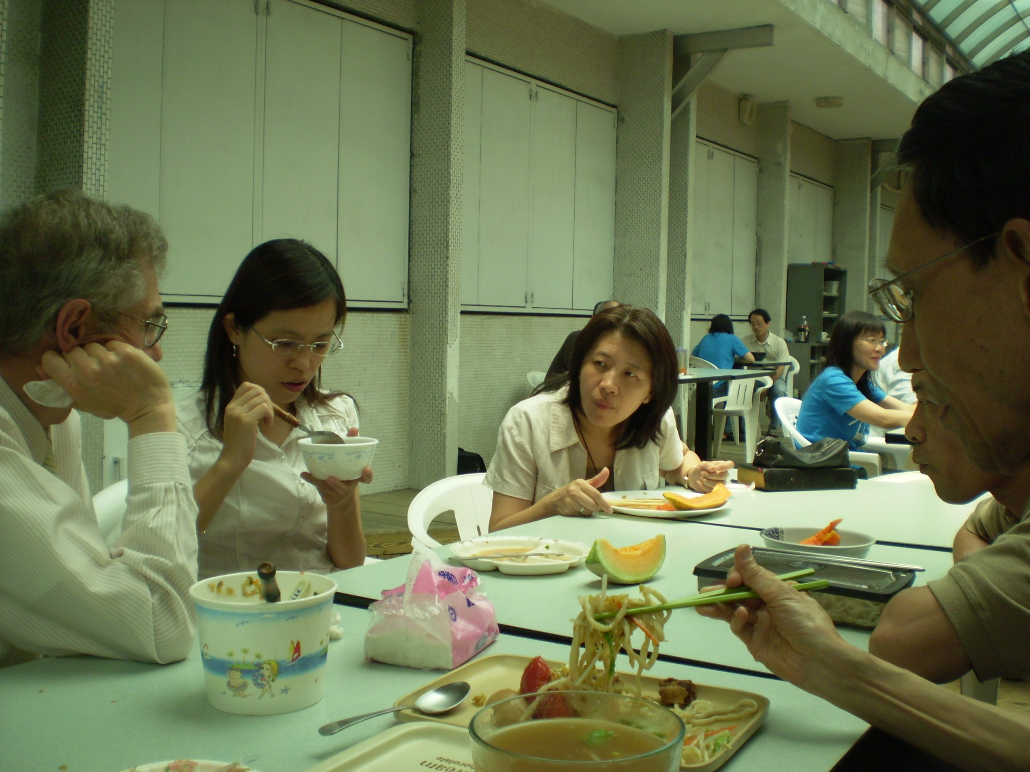
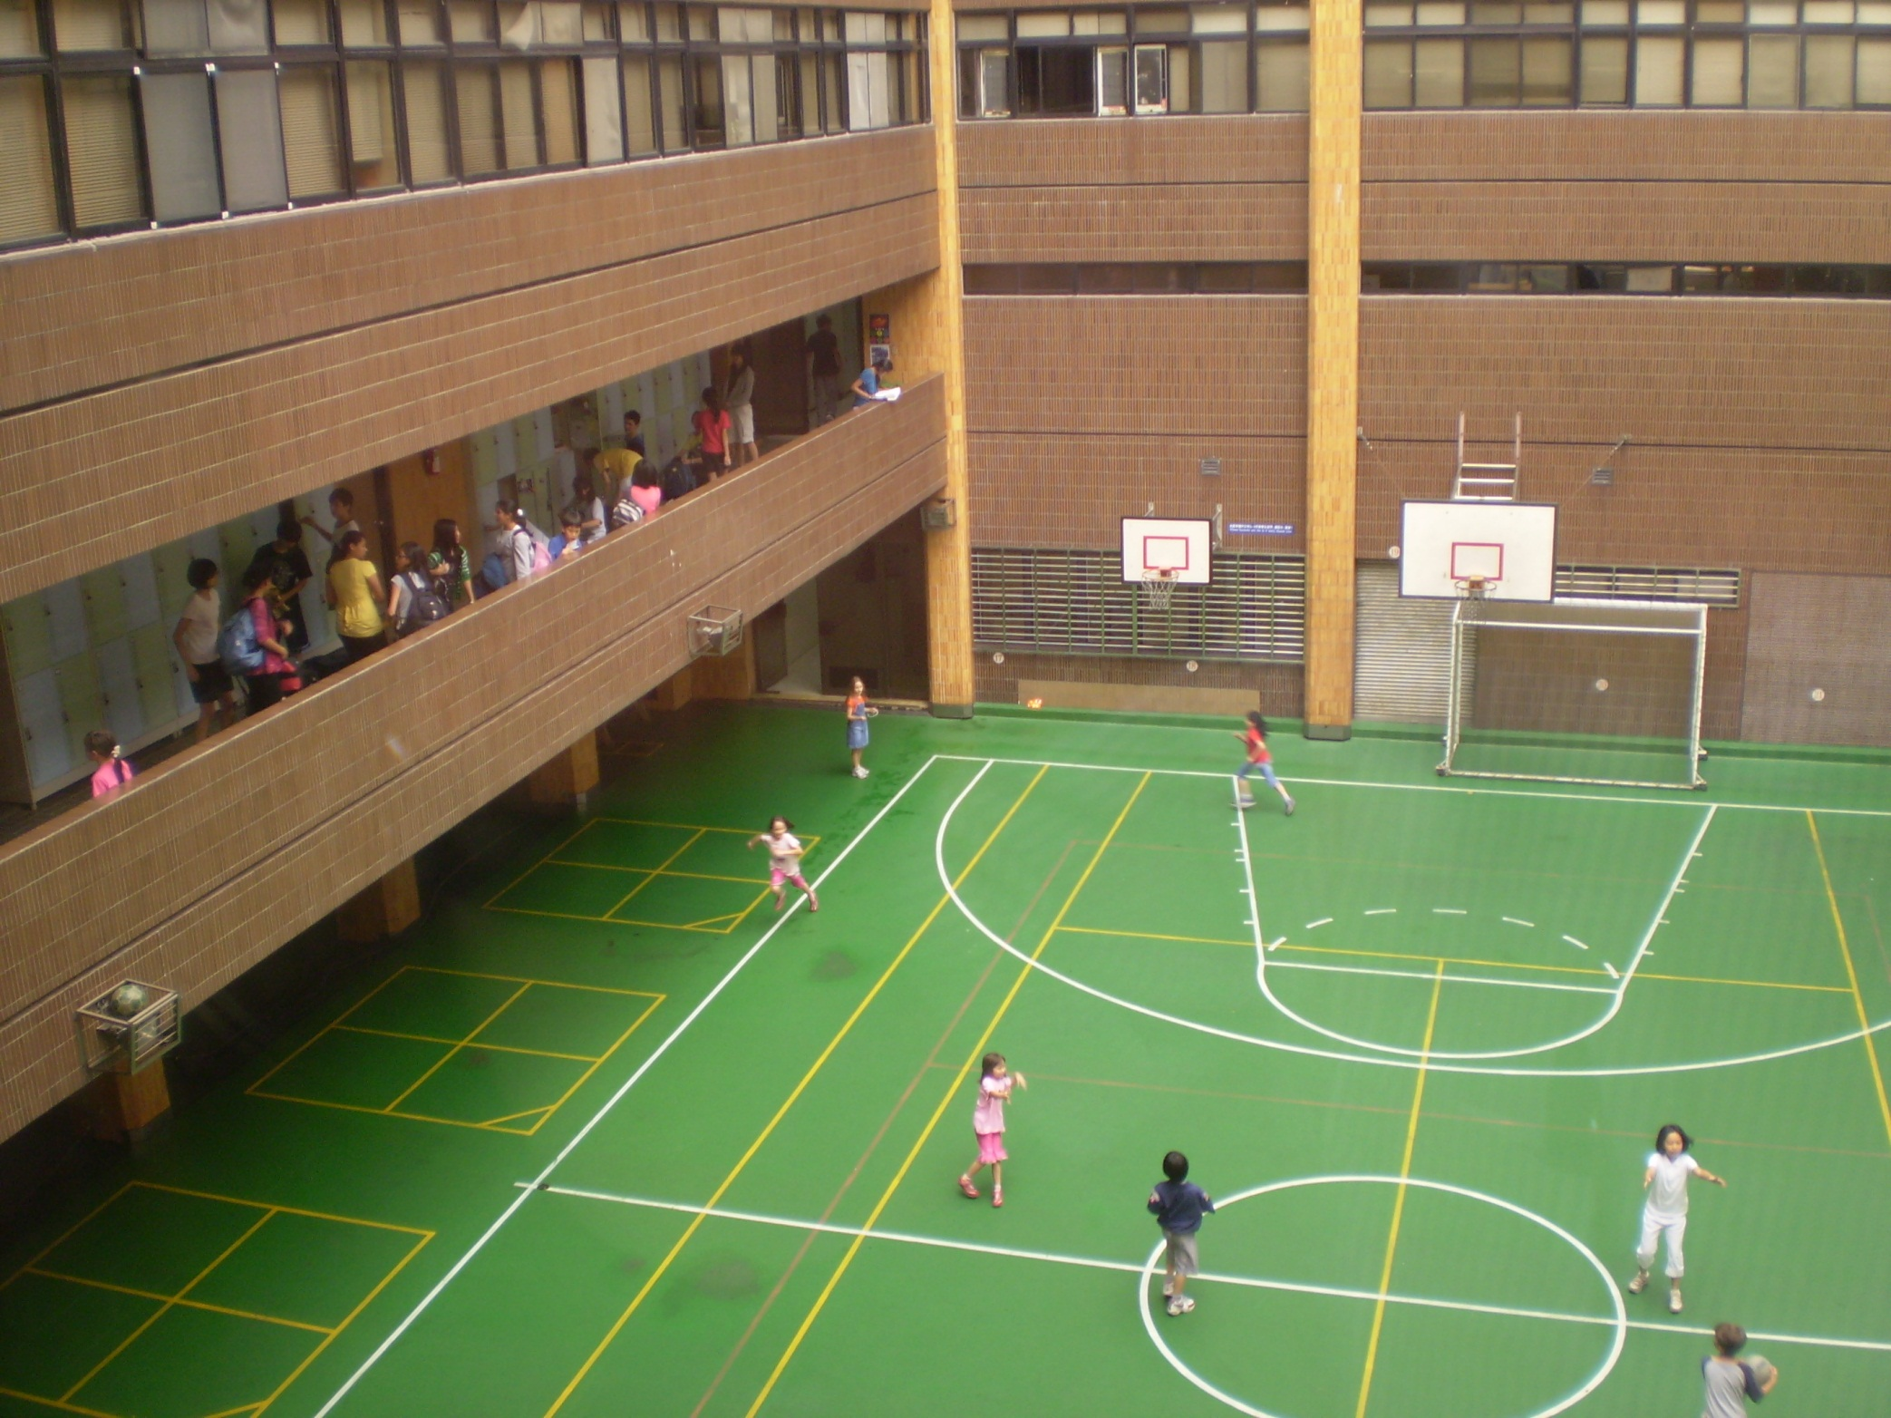

Slide 31
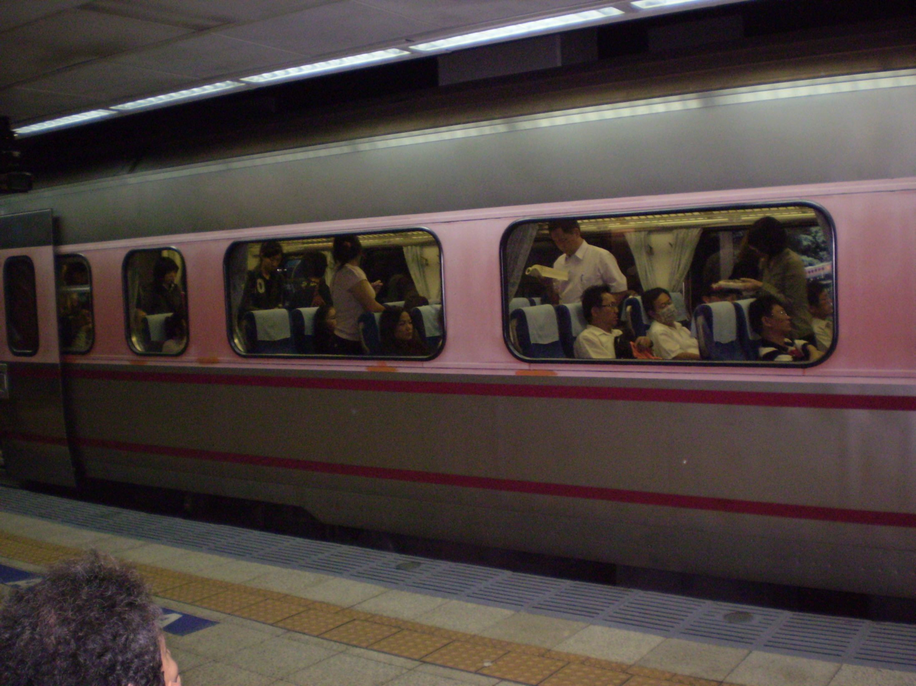
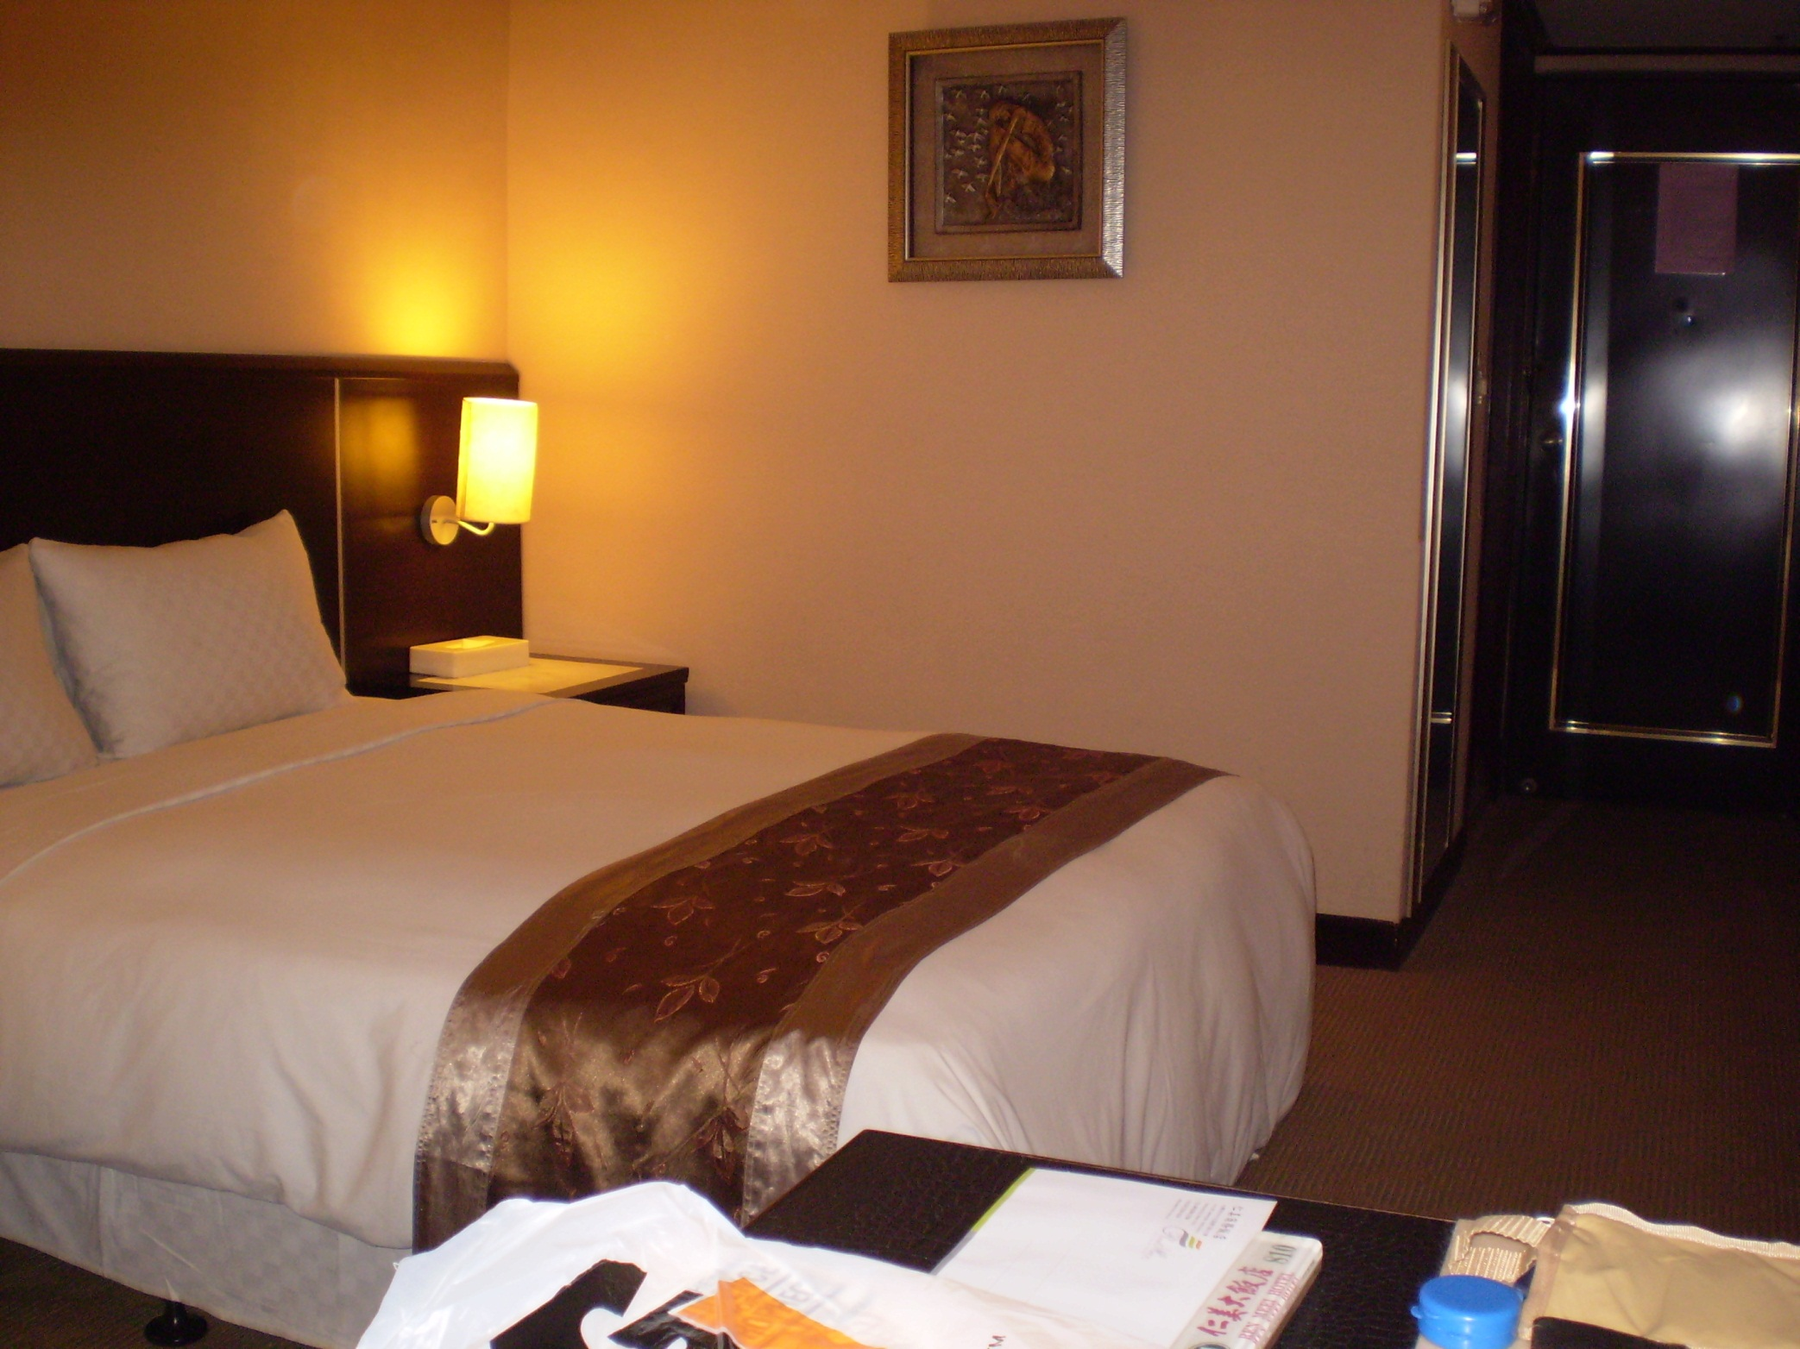

Slide 32
Friday, May 22
Met Daniel Wu, Prof of NT at CTTS, and had tea with President Chen
PP talk “Another Jesus” at CTTS chapel
Lunch (an 8-course meal) at Lian Gin Japanese Restaurant w/ two faculty and student leader
Walking in neighborhood
Dinner w/ Cole Carnesecca at Gifts Cafe

Slide 33
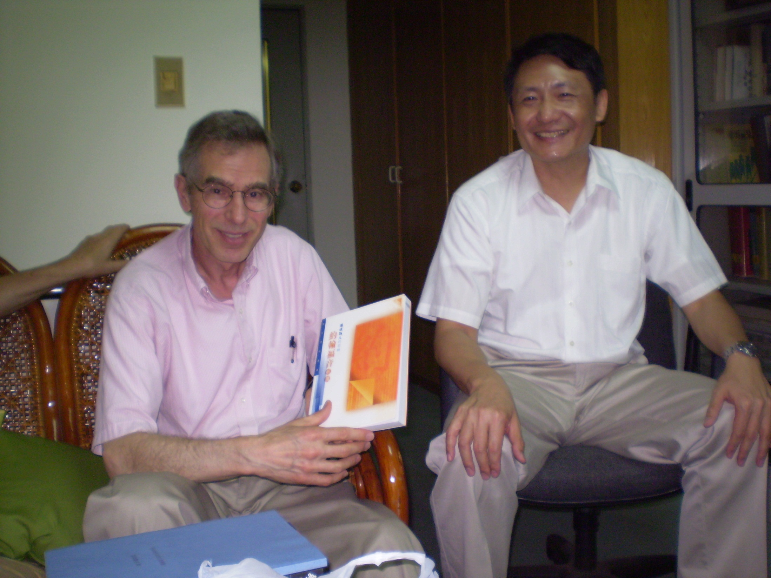
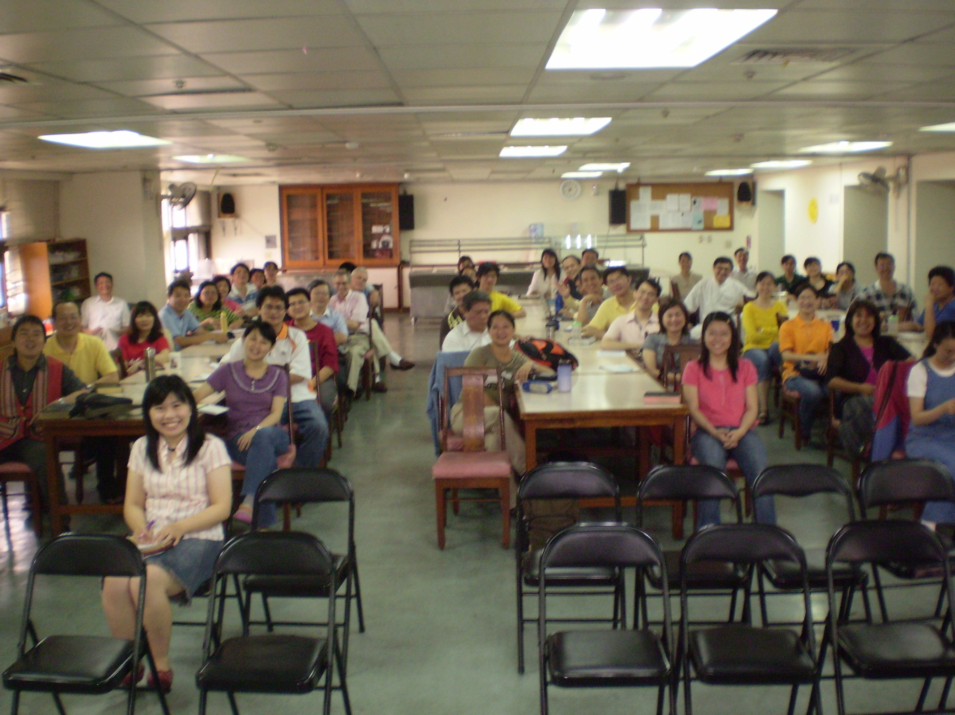

Slide 34
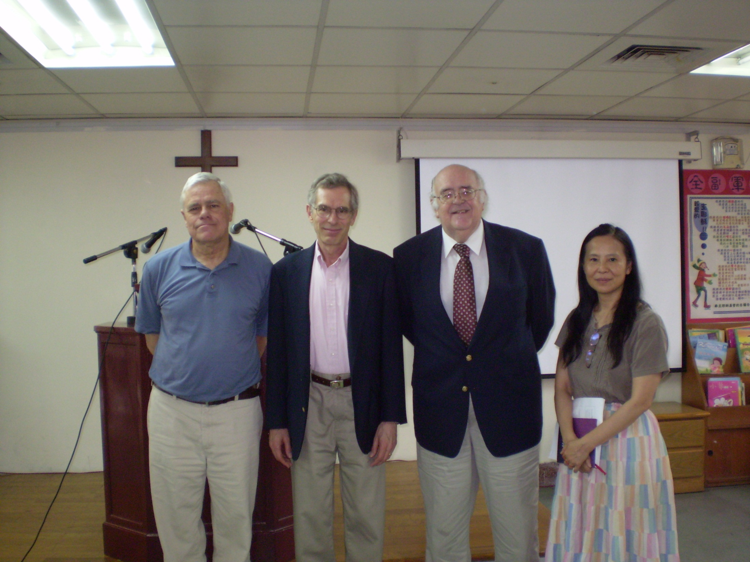
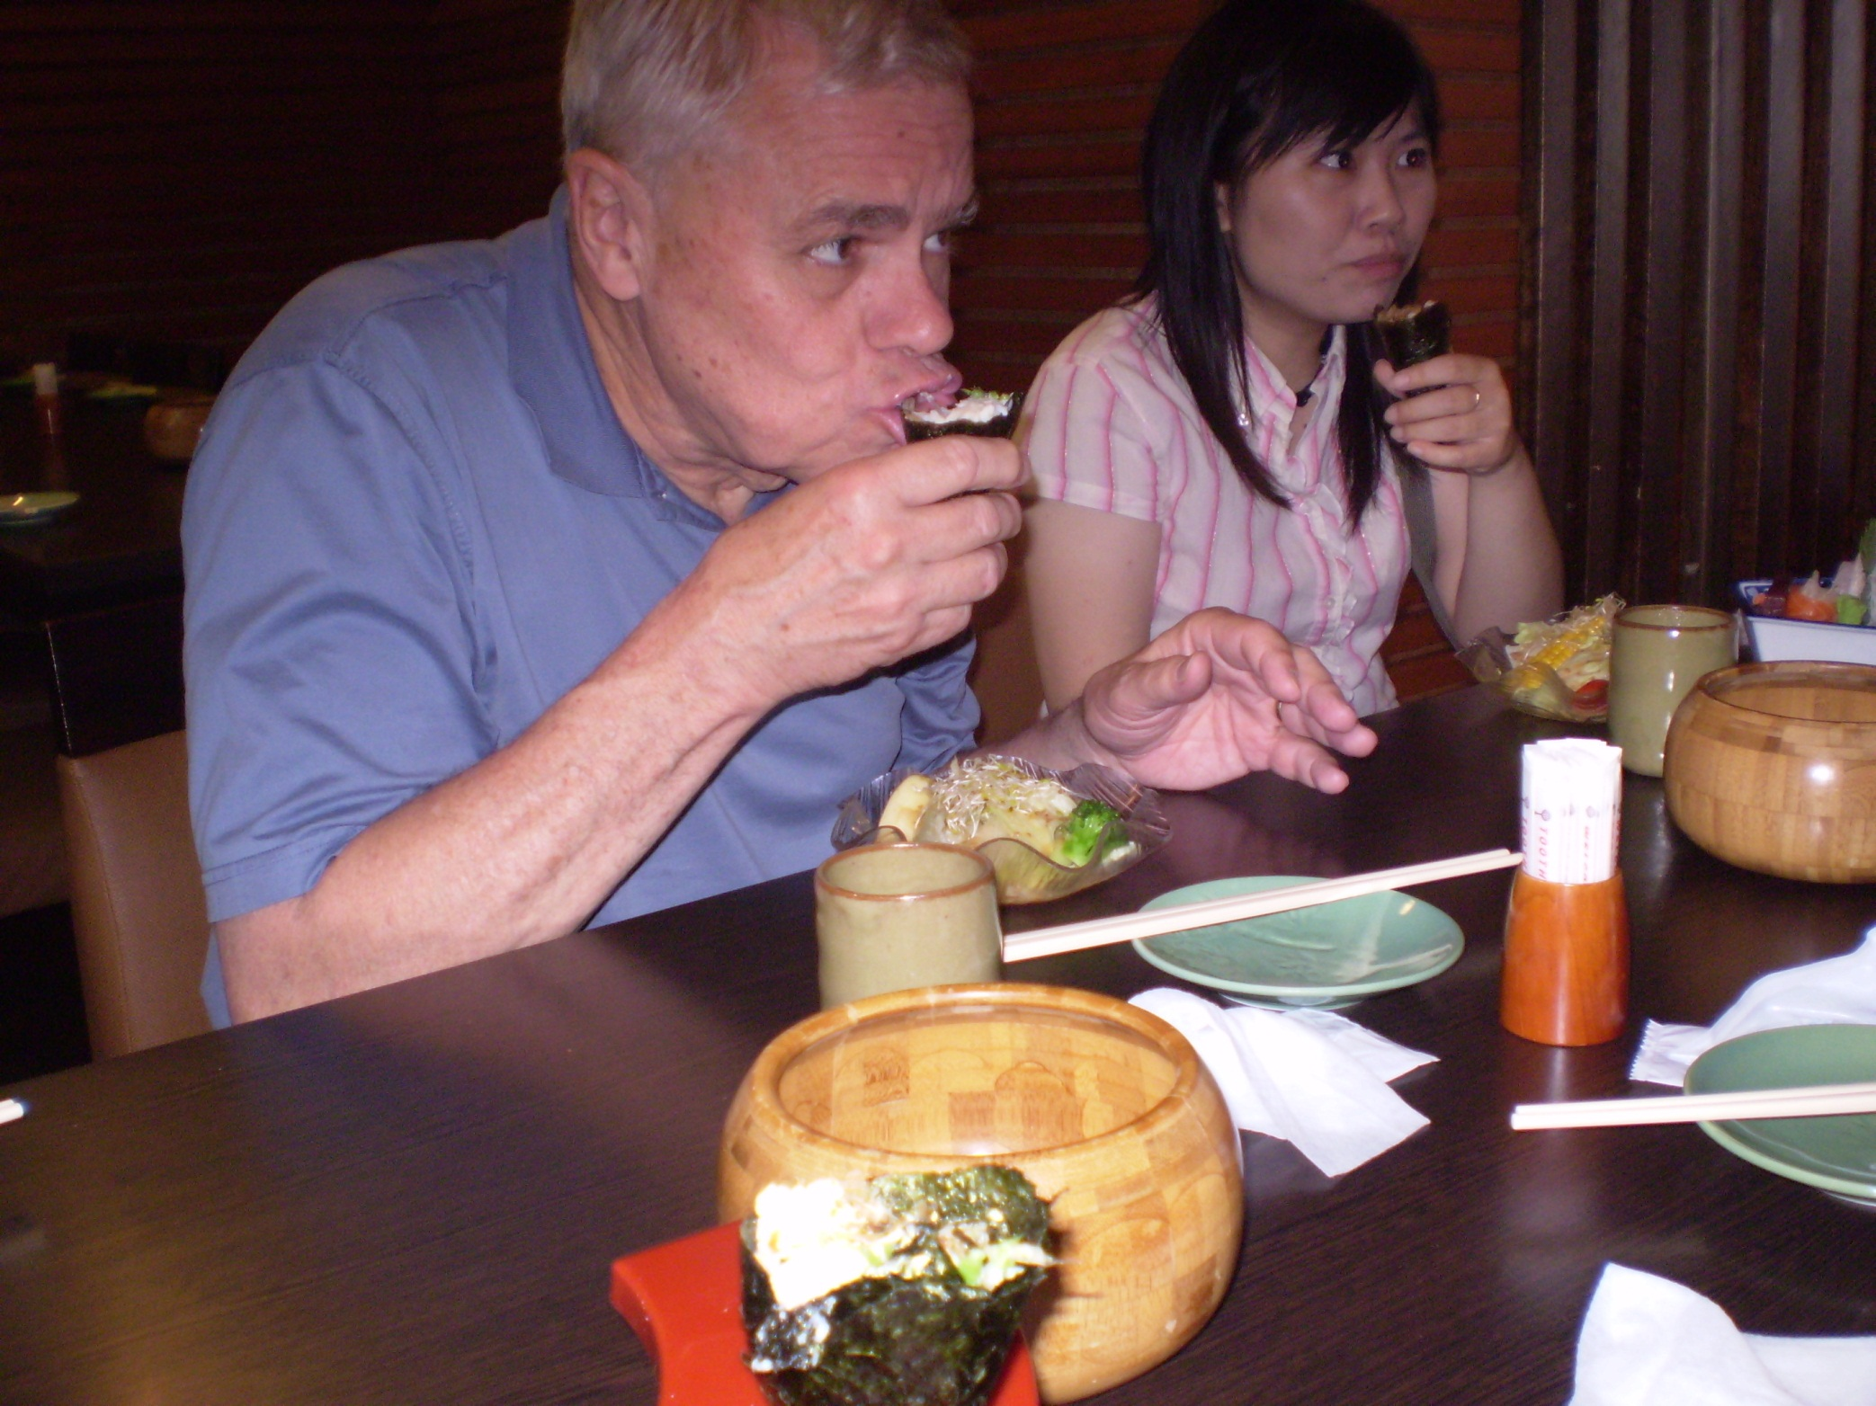

Slide 35
Saturday, May 23
Morning: meeting with Richard Chang
Out walking, shopping
Afternoon: meeting with Margaret Chen, a student at CTTS, though in her 50s
Dinner at Ours Bagel & Pasta Restaurant with Cole Carnesecca, discussing church in Taiwan

Slide 36
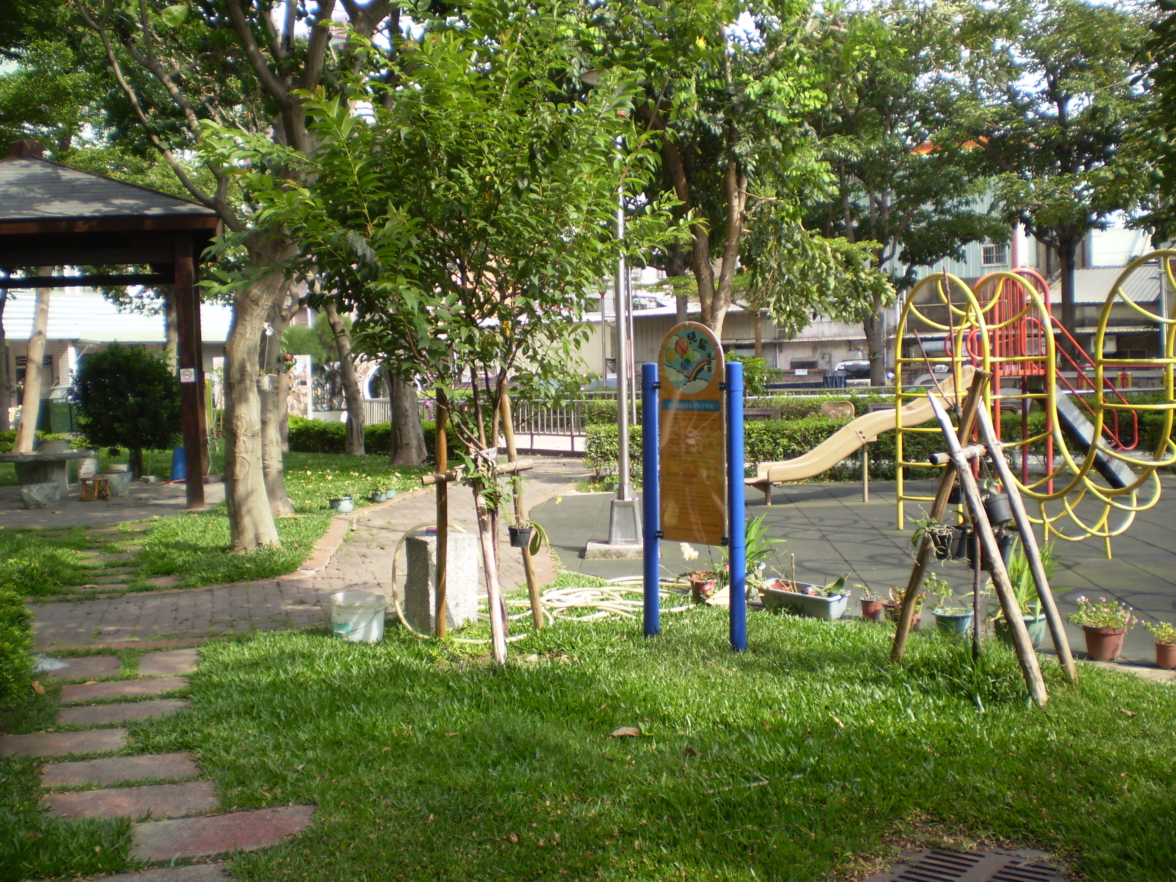
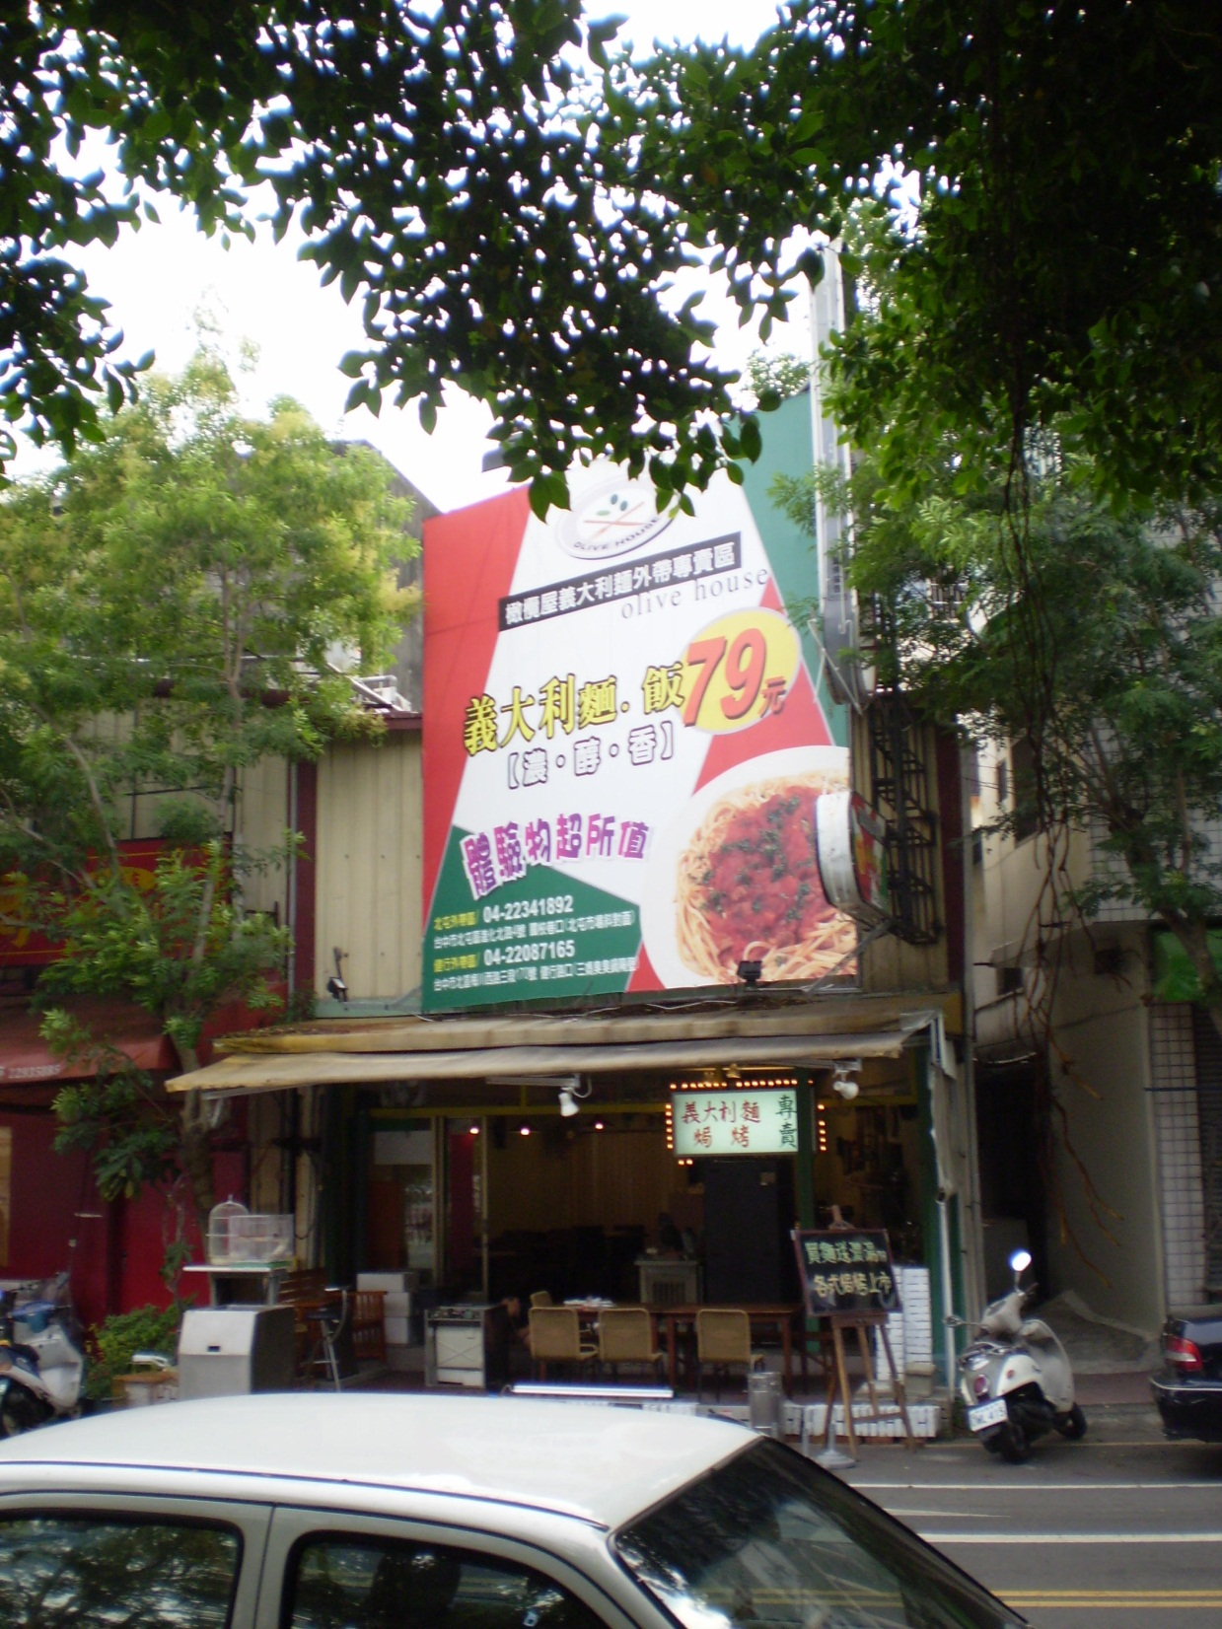

Slide 37
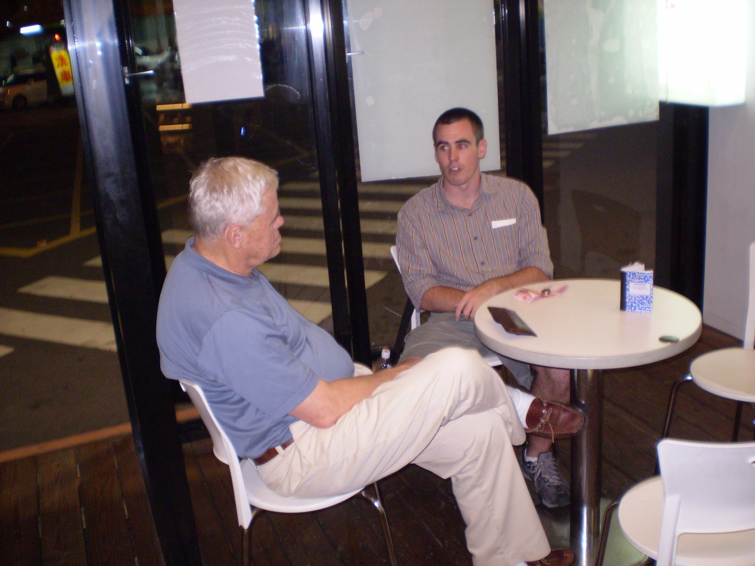
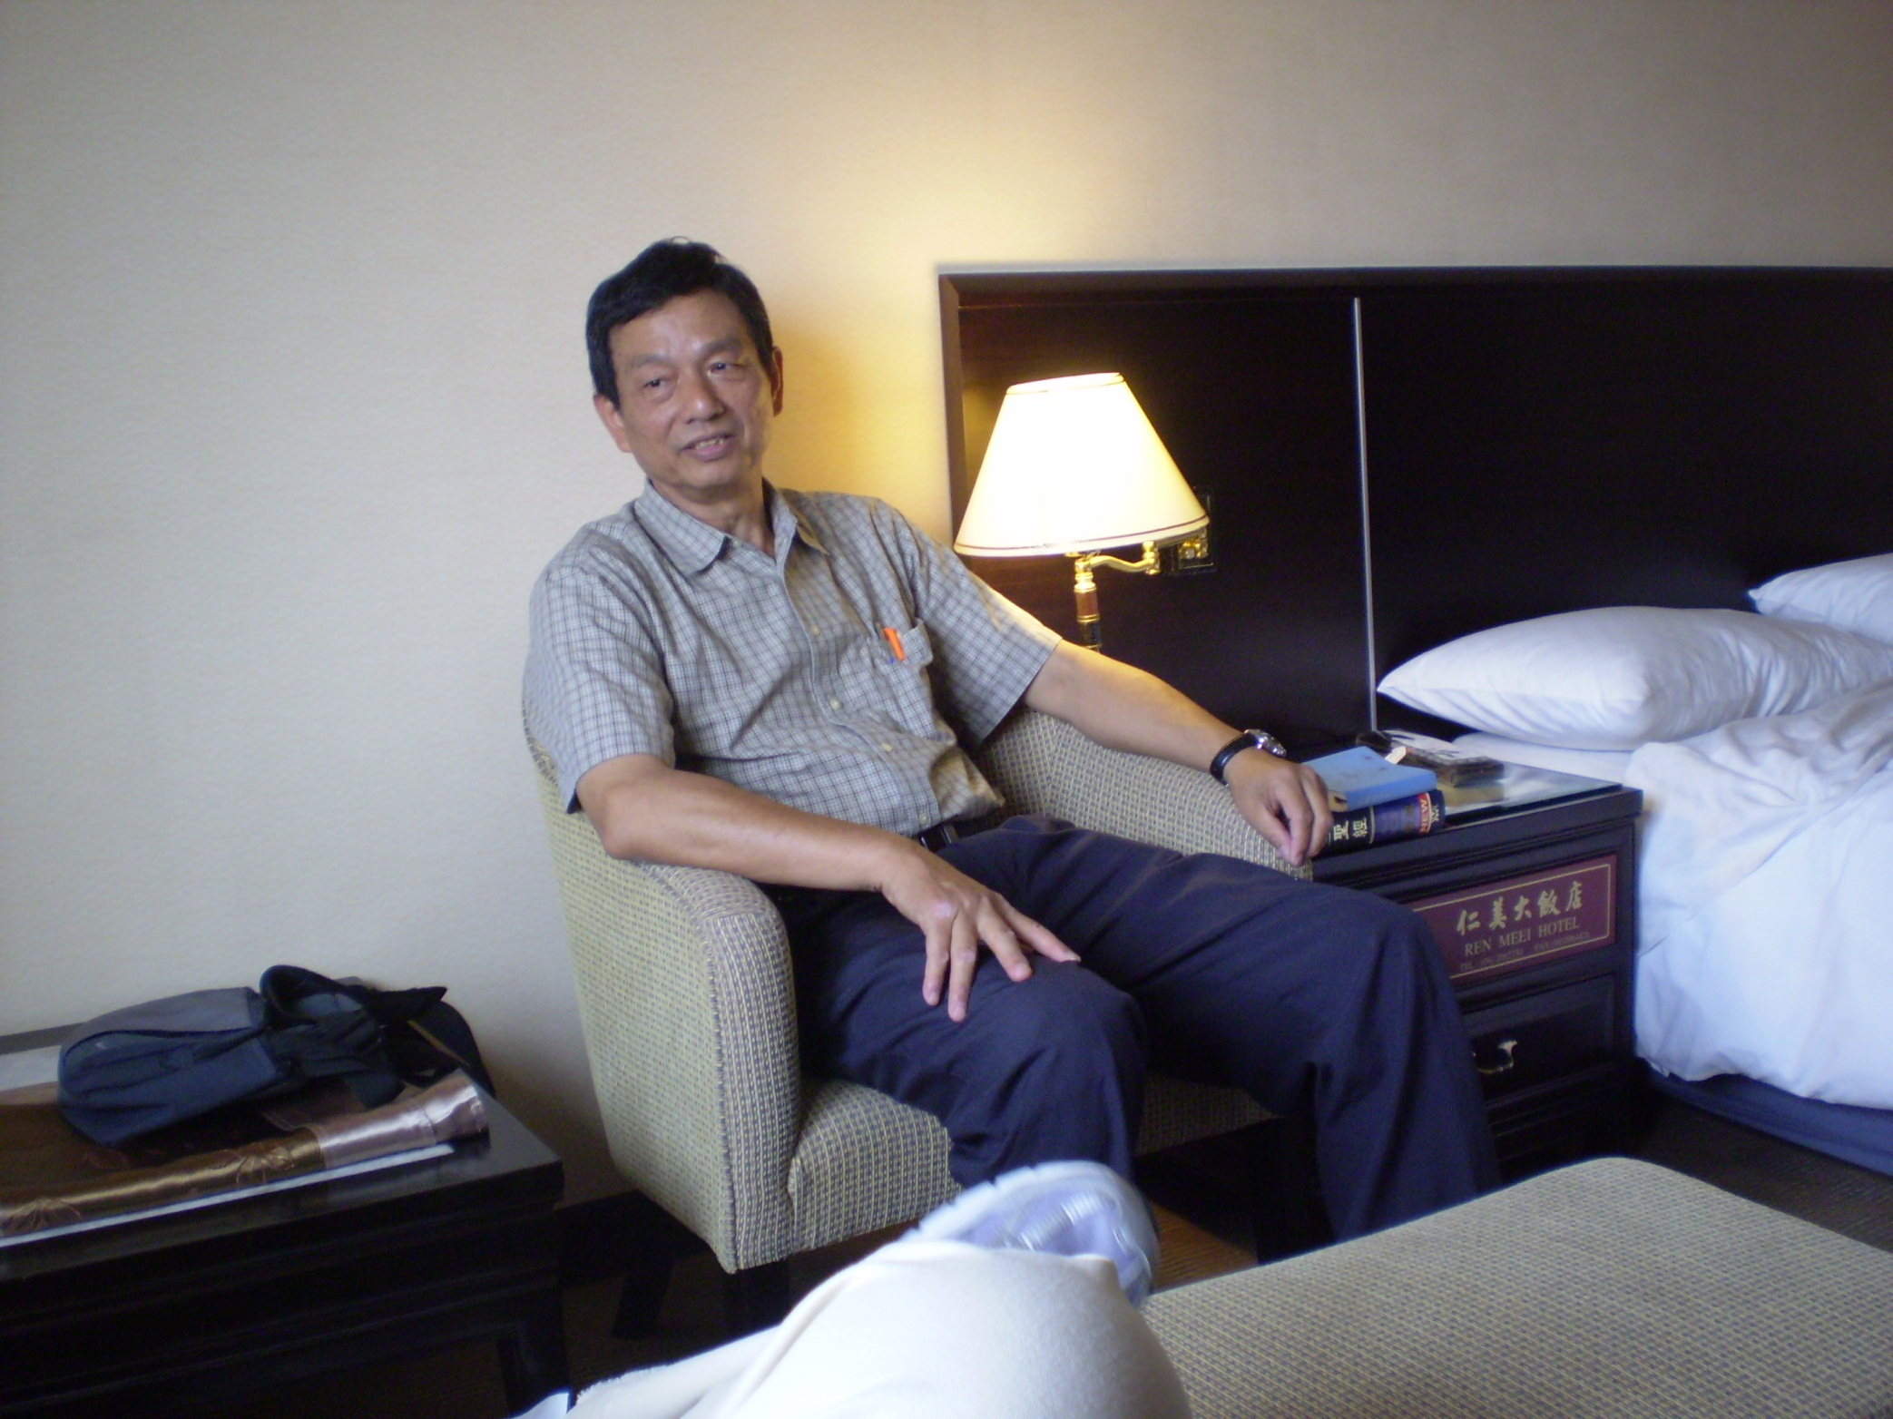

Slide 38
Sunday, May 24
To Luce Chapel at Tunghai University, for morning service
At Christian Center after service with chapel speaker & university chaplain
In office of David Newquist, prof of physics at Tunghai and IBRI member; got copies of What’s Darwin? in Chinese
Dinner at Ours Pasta & Bagel; gave them copy of WD? for their reading shelf

Slide 39
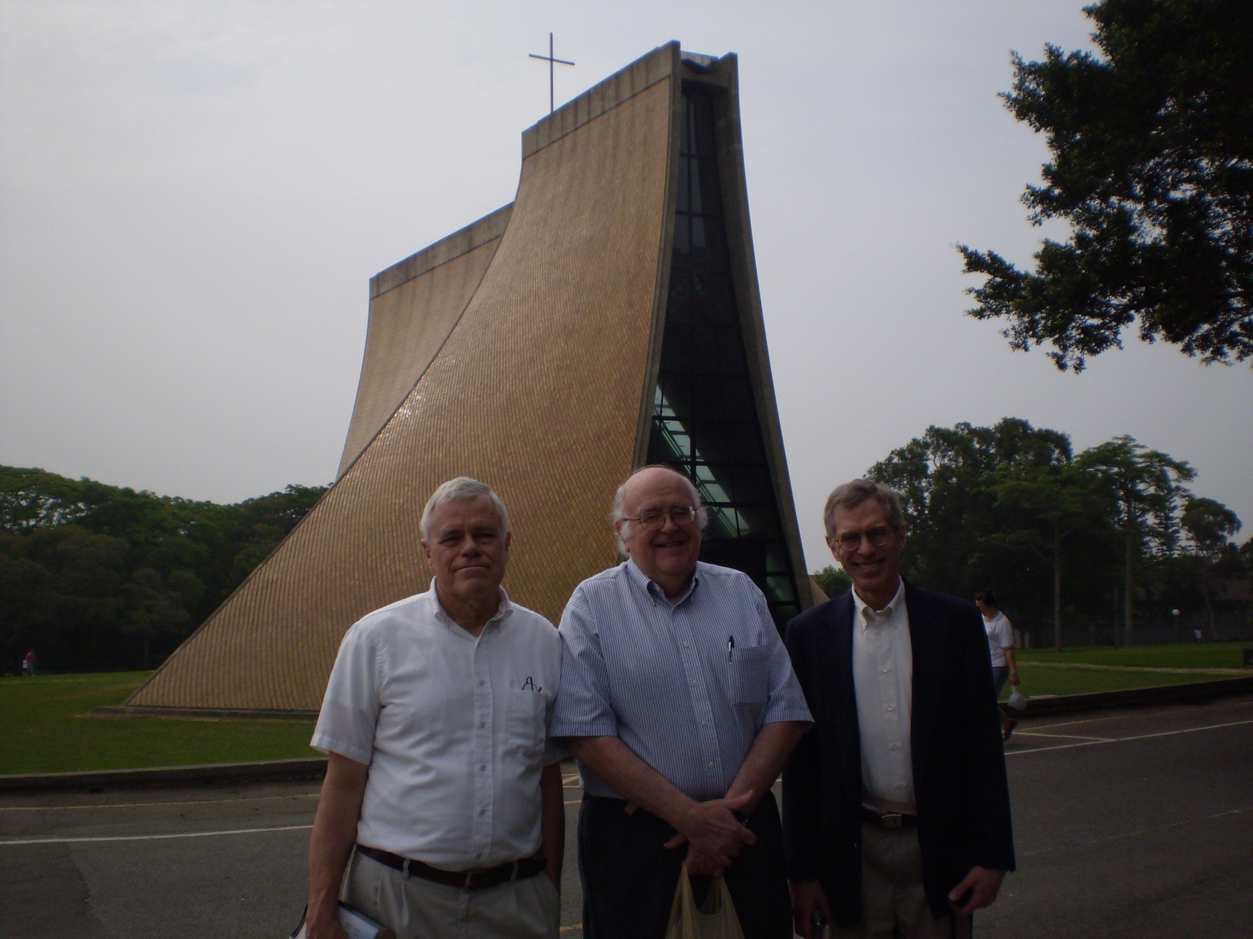
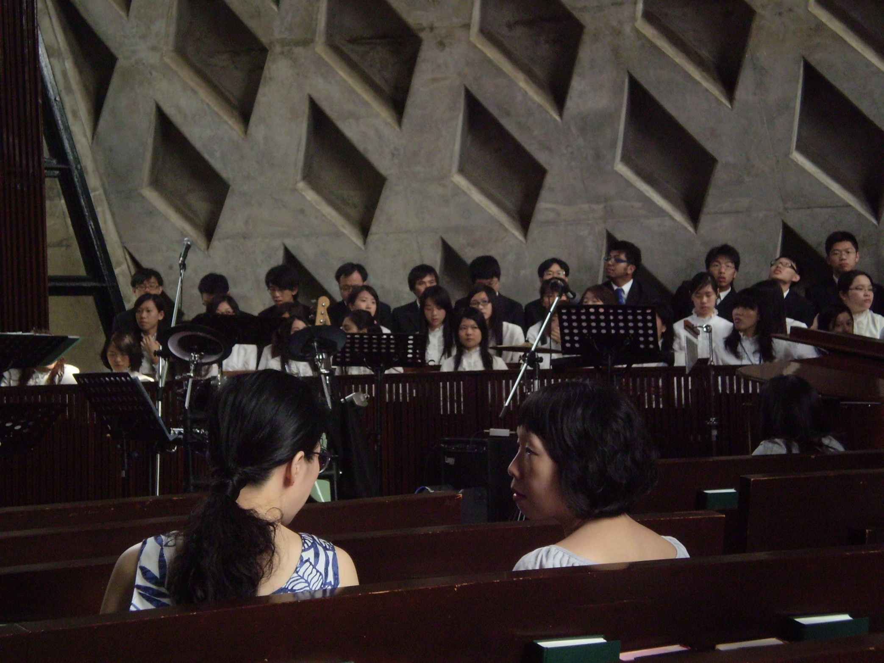

Slide 40
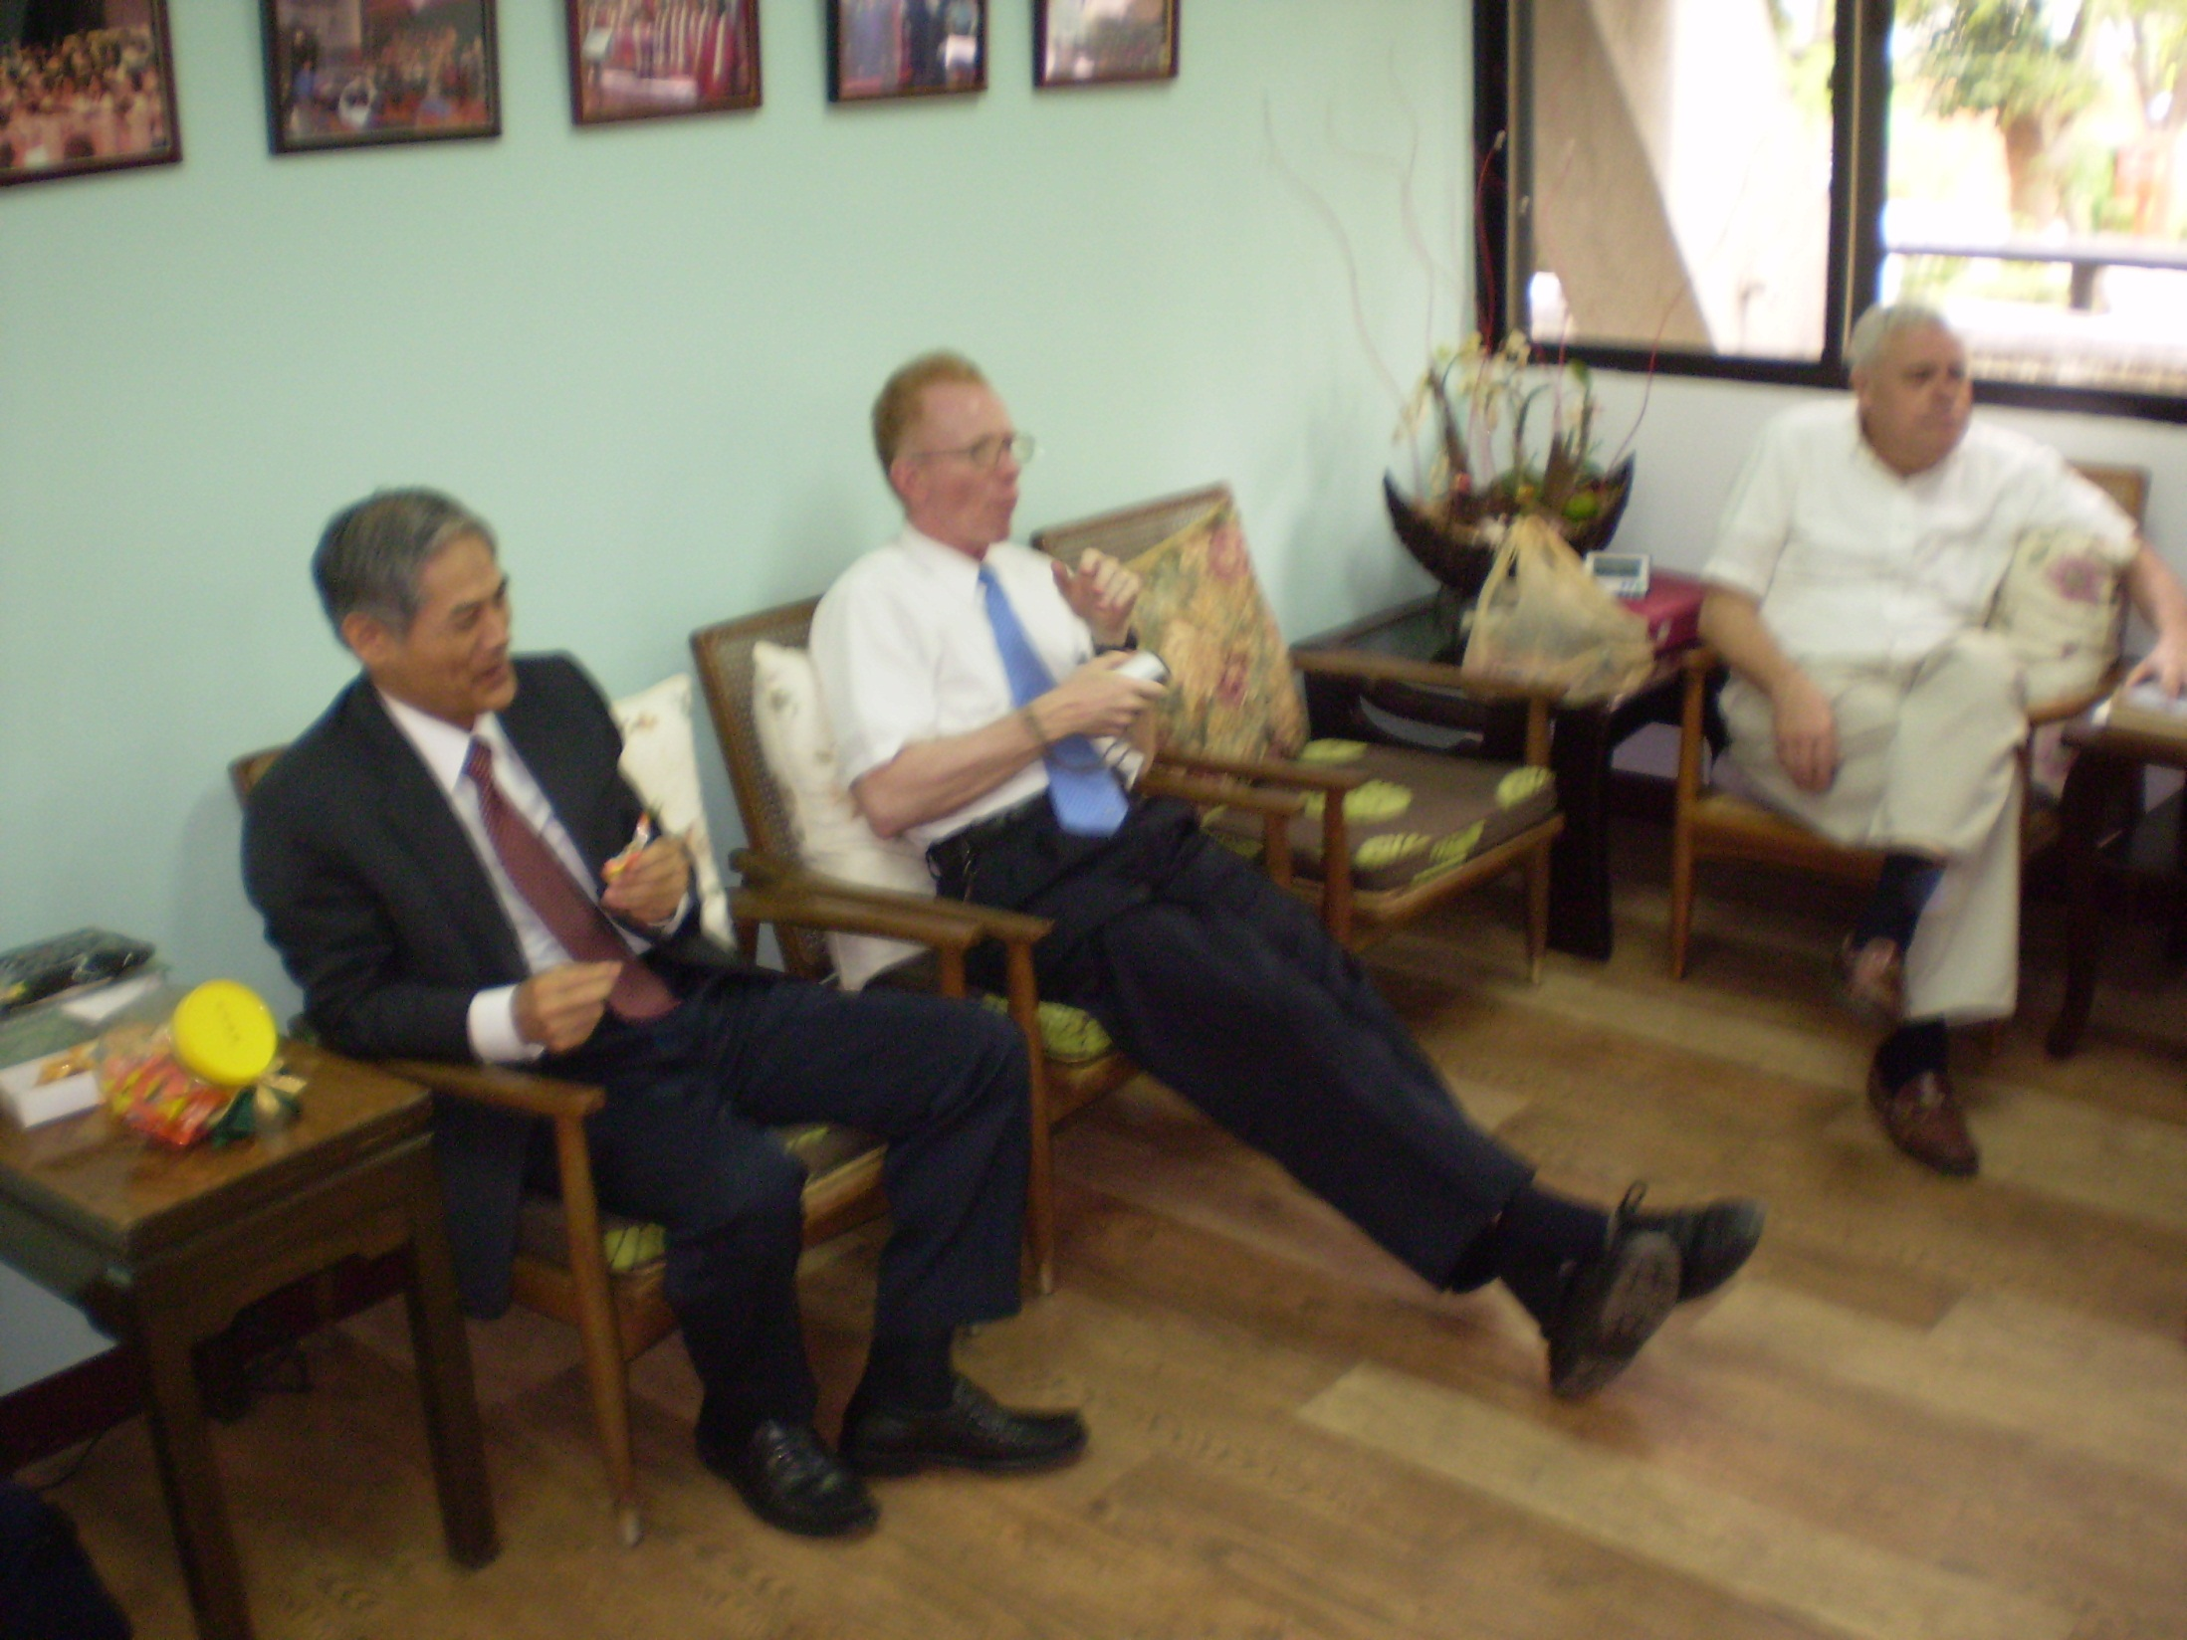
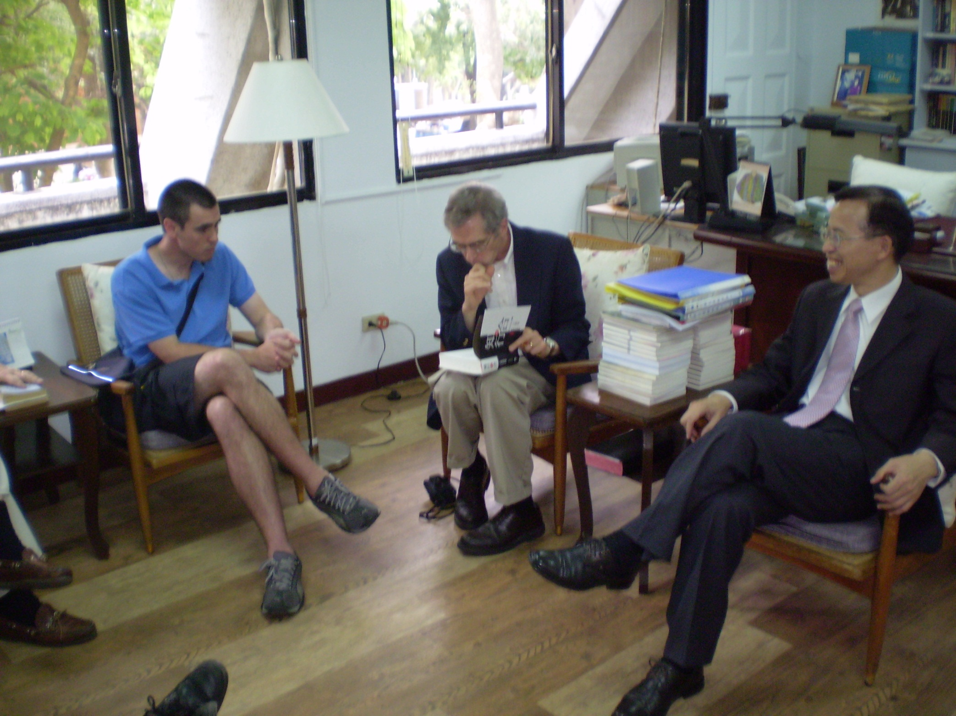

Slide 41
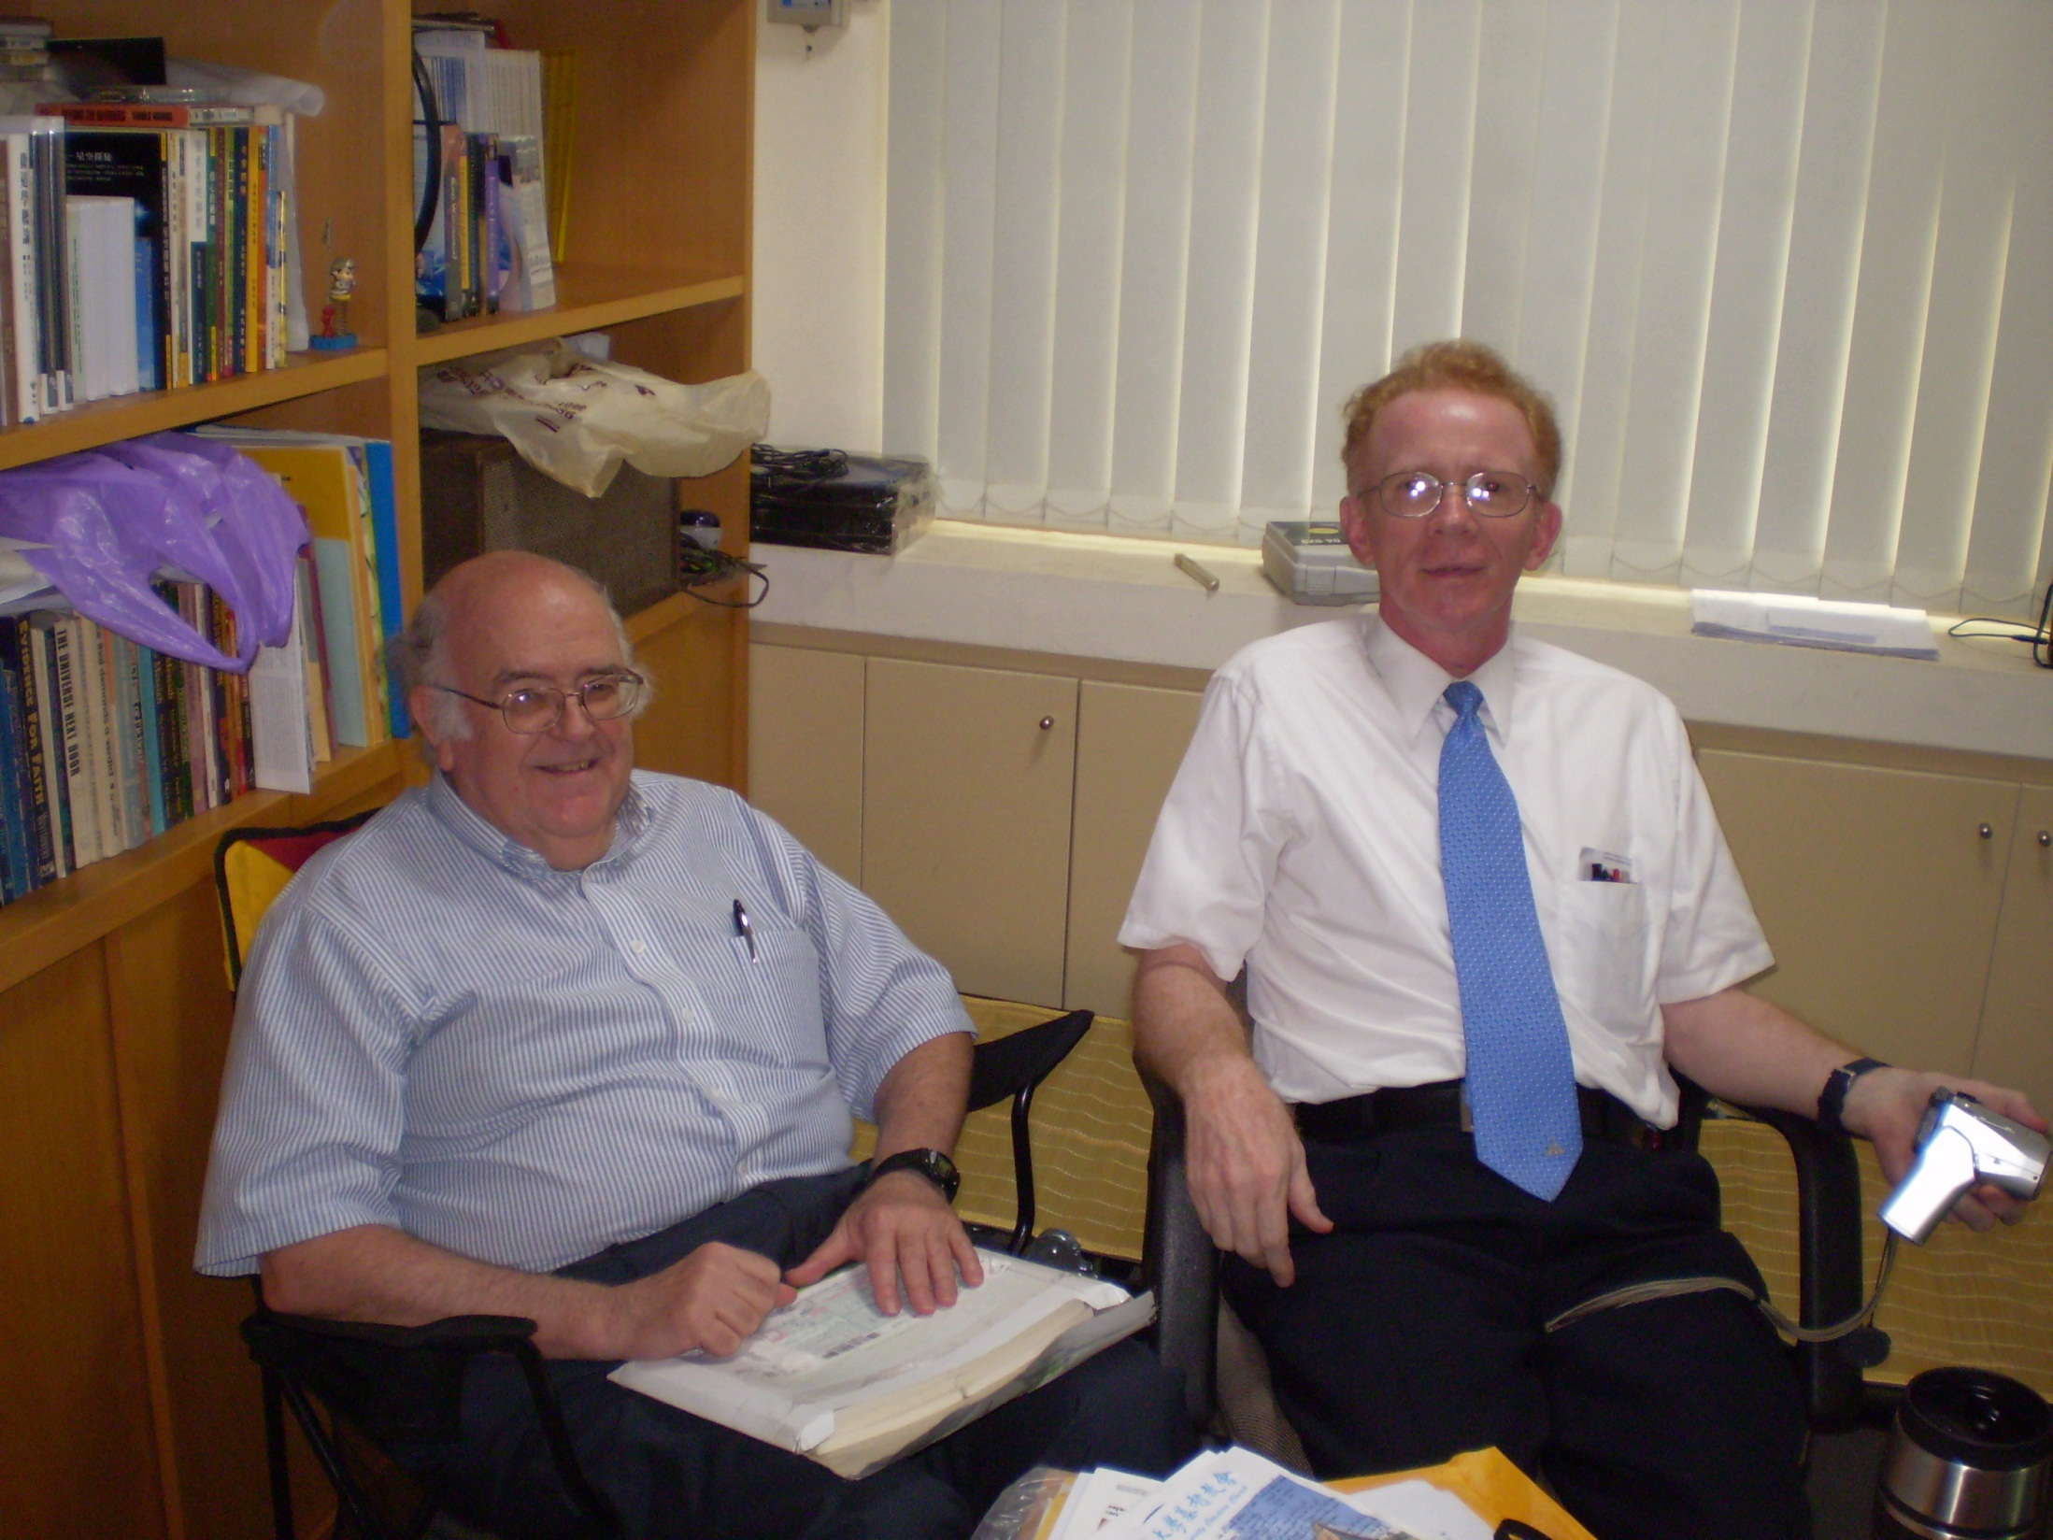
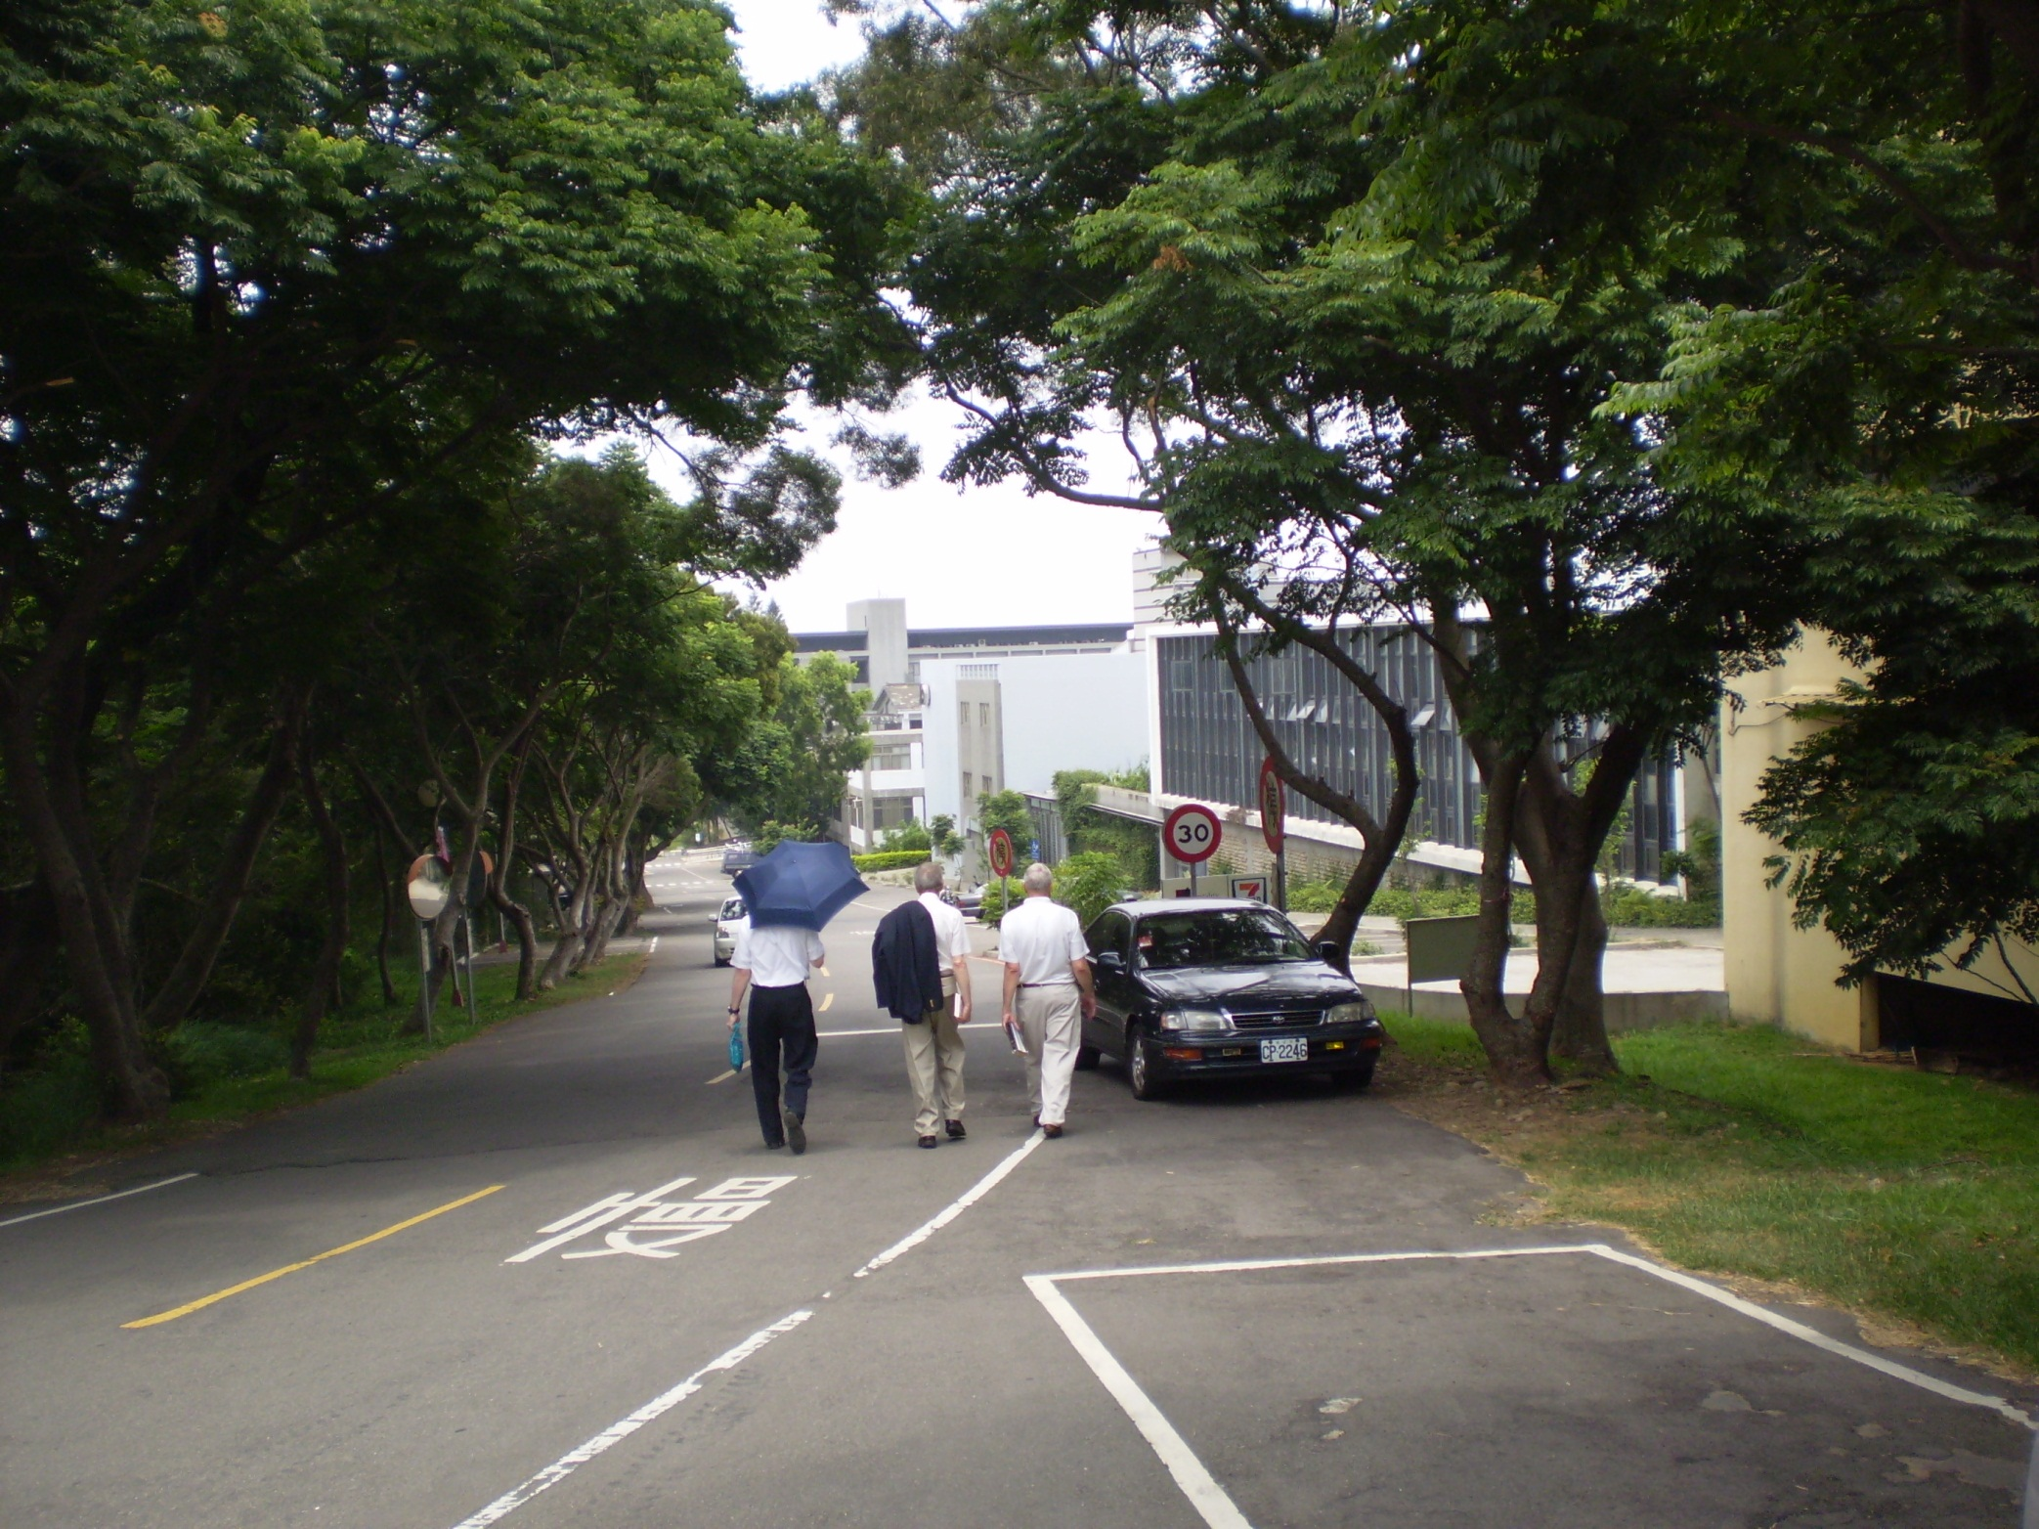

Slide 42
Monday, May 25
Morning: back to Taipei by train
Now staying at Howard Intl House Hotel
Out walking in neighborhood
Dinner at Chinese restaurant of right sort (cheap!)
At Christian bookstore near National Taiwan University

Slide 43
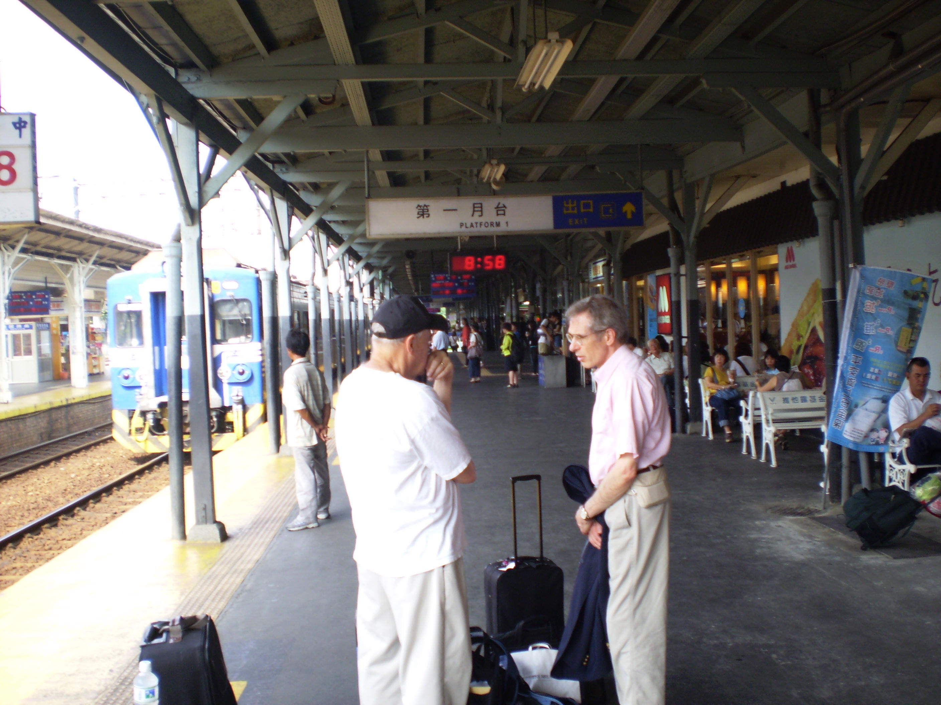
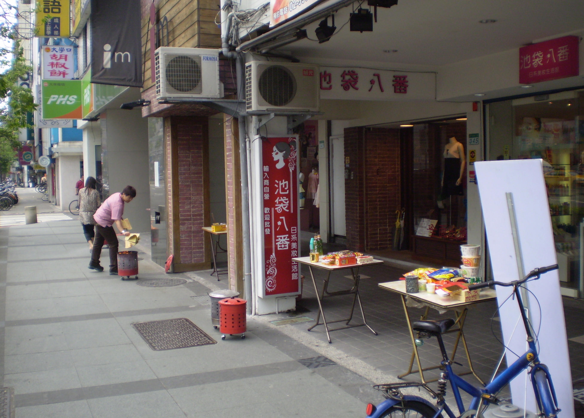

Slide 44
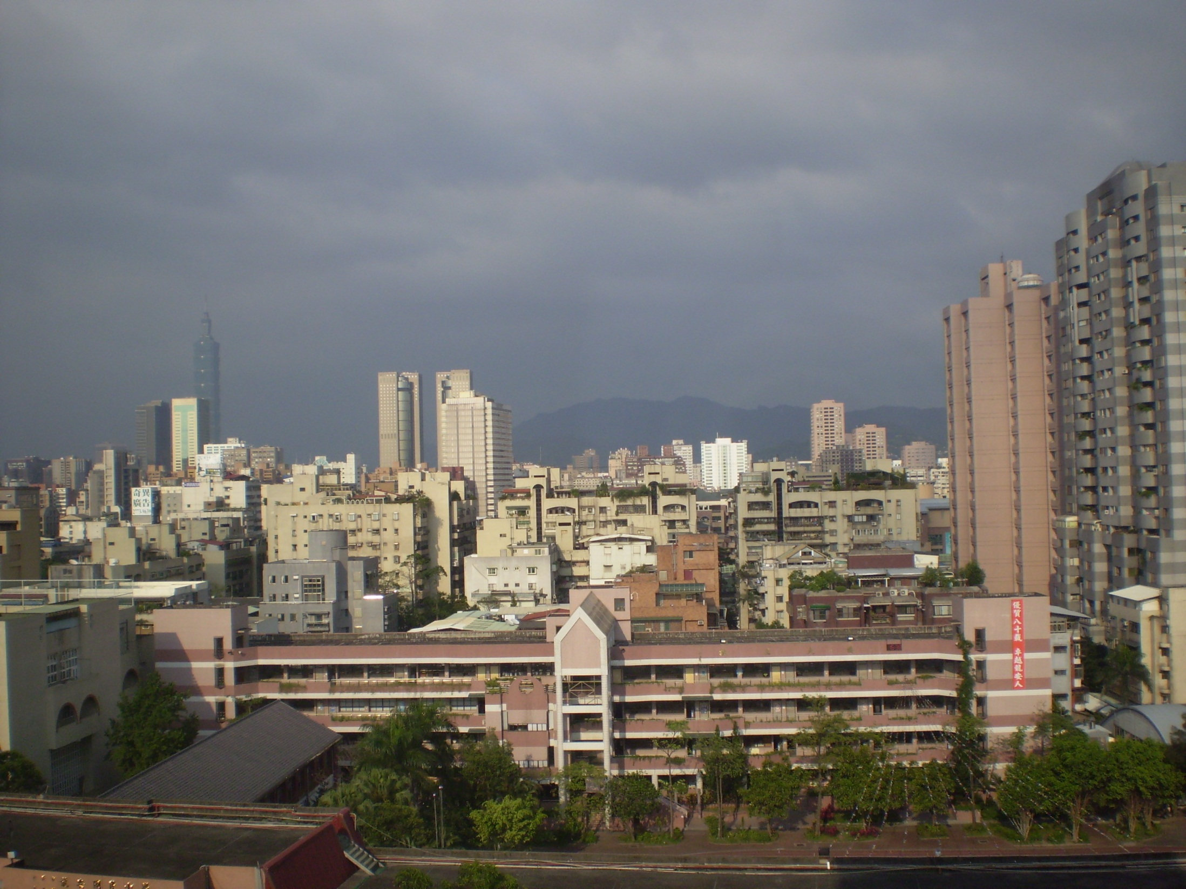
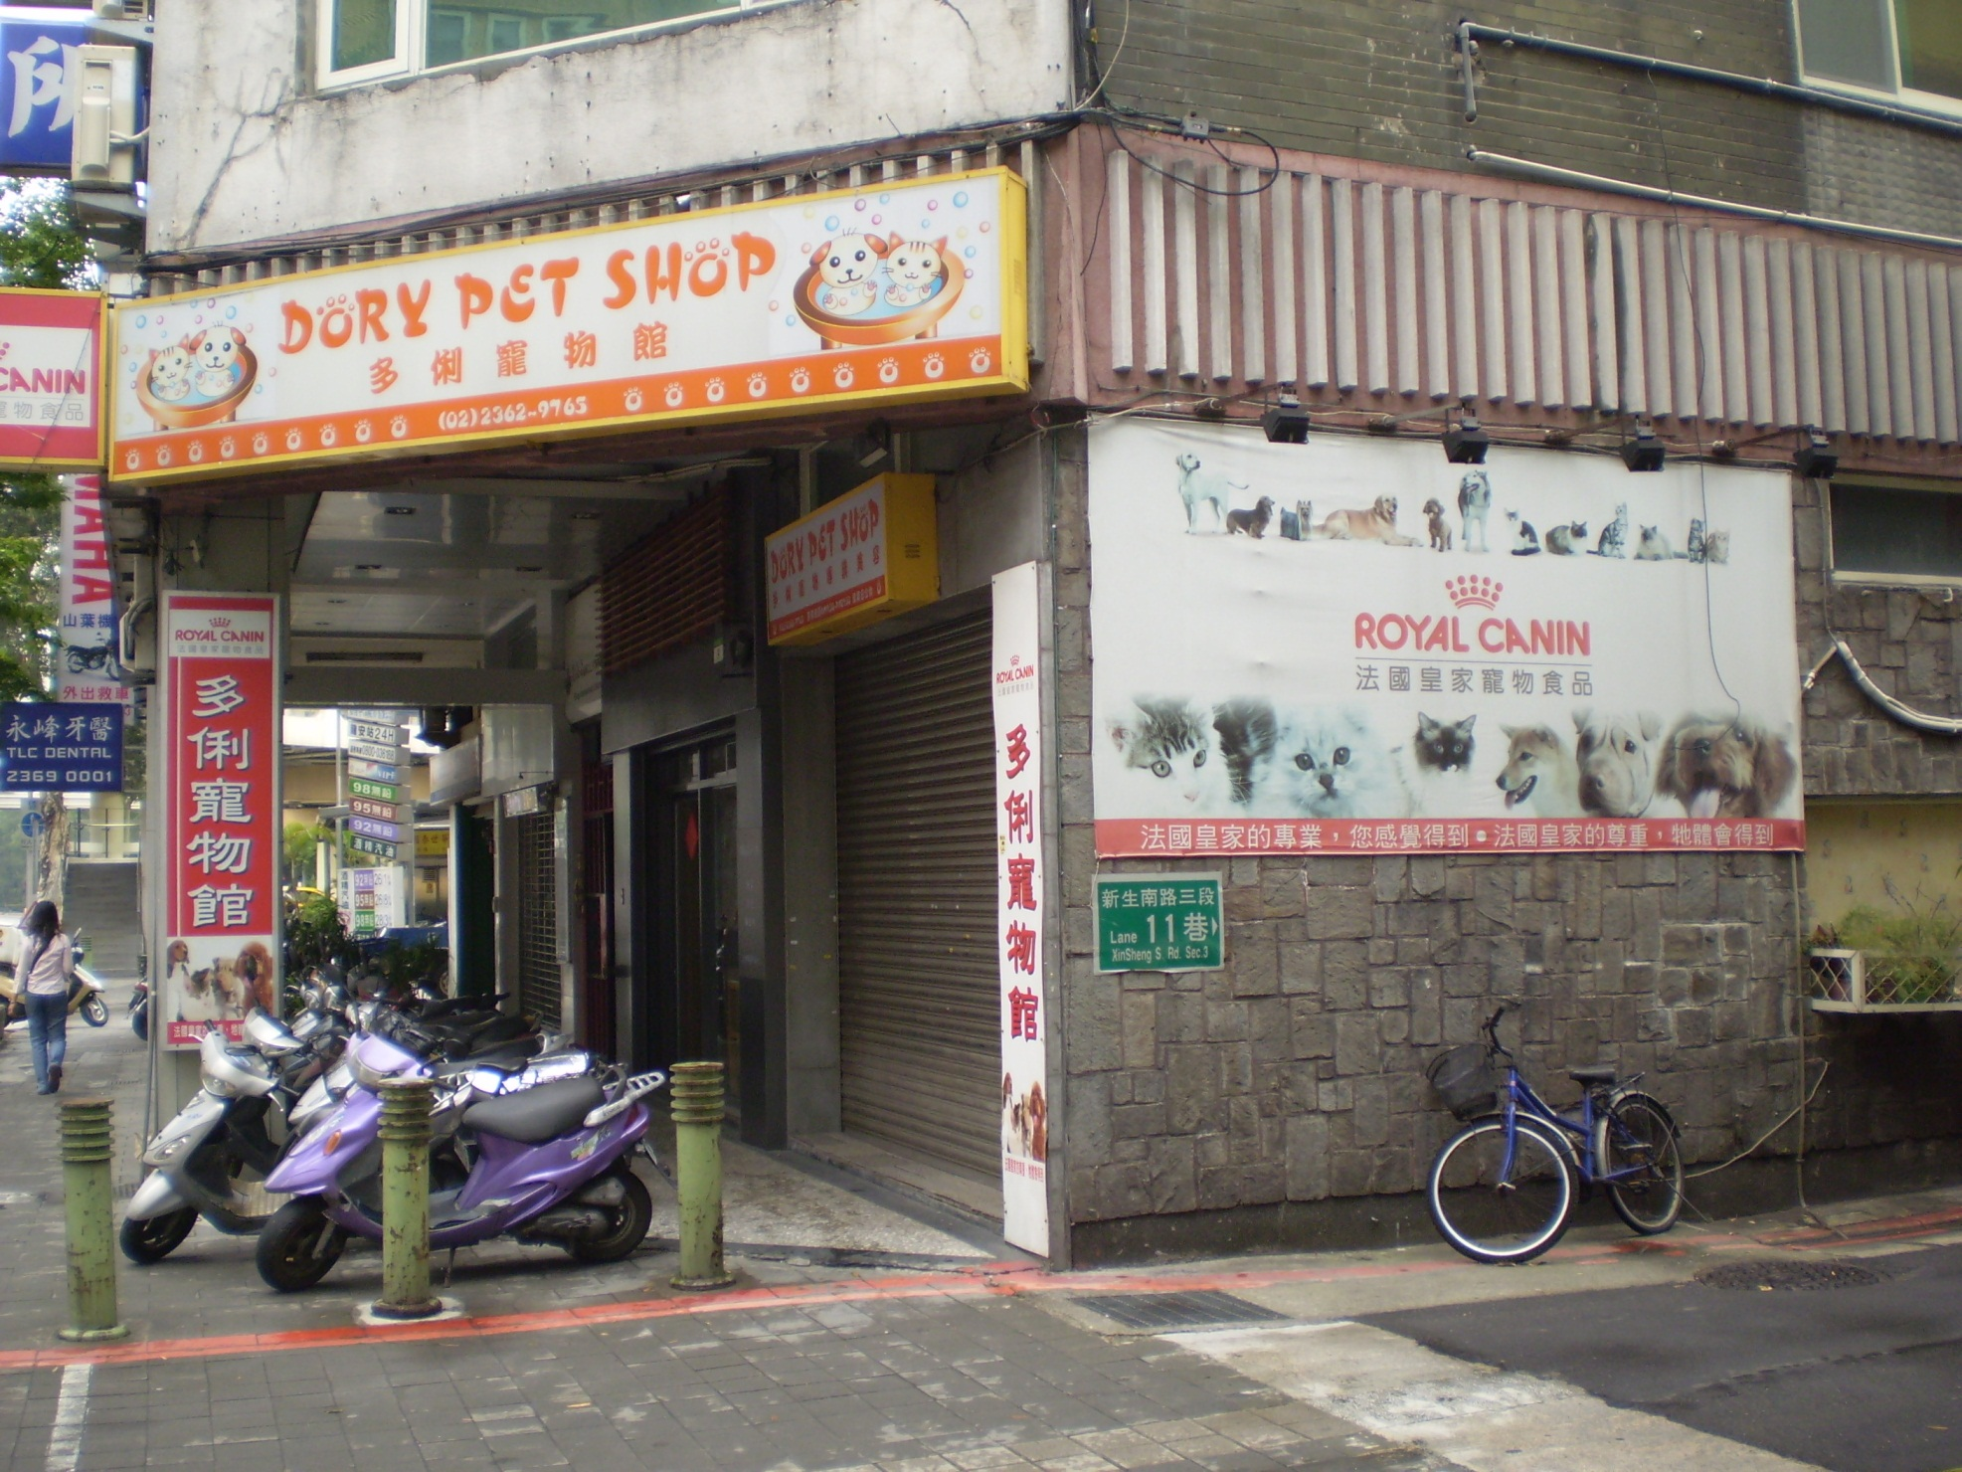

Slide 45
Tuesday, May 26
Time with Randy Adams cancelled, so out walking
At Campus Bookstore (Christian, near Taiwan Natl Univ), bought Scripture wall scroll in Chinese
Lunch at CES cafeteria w/ Dr Robert Chang, teaches counseling at CES
Rest of day free

Slide 46
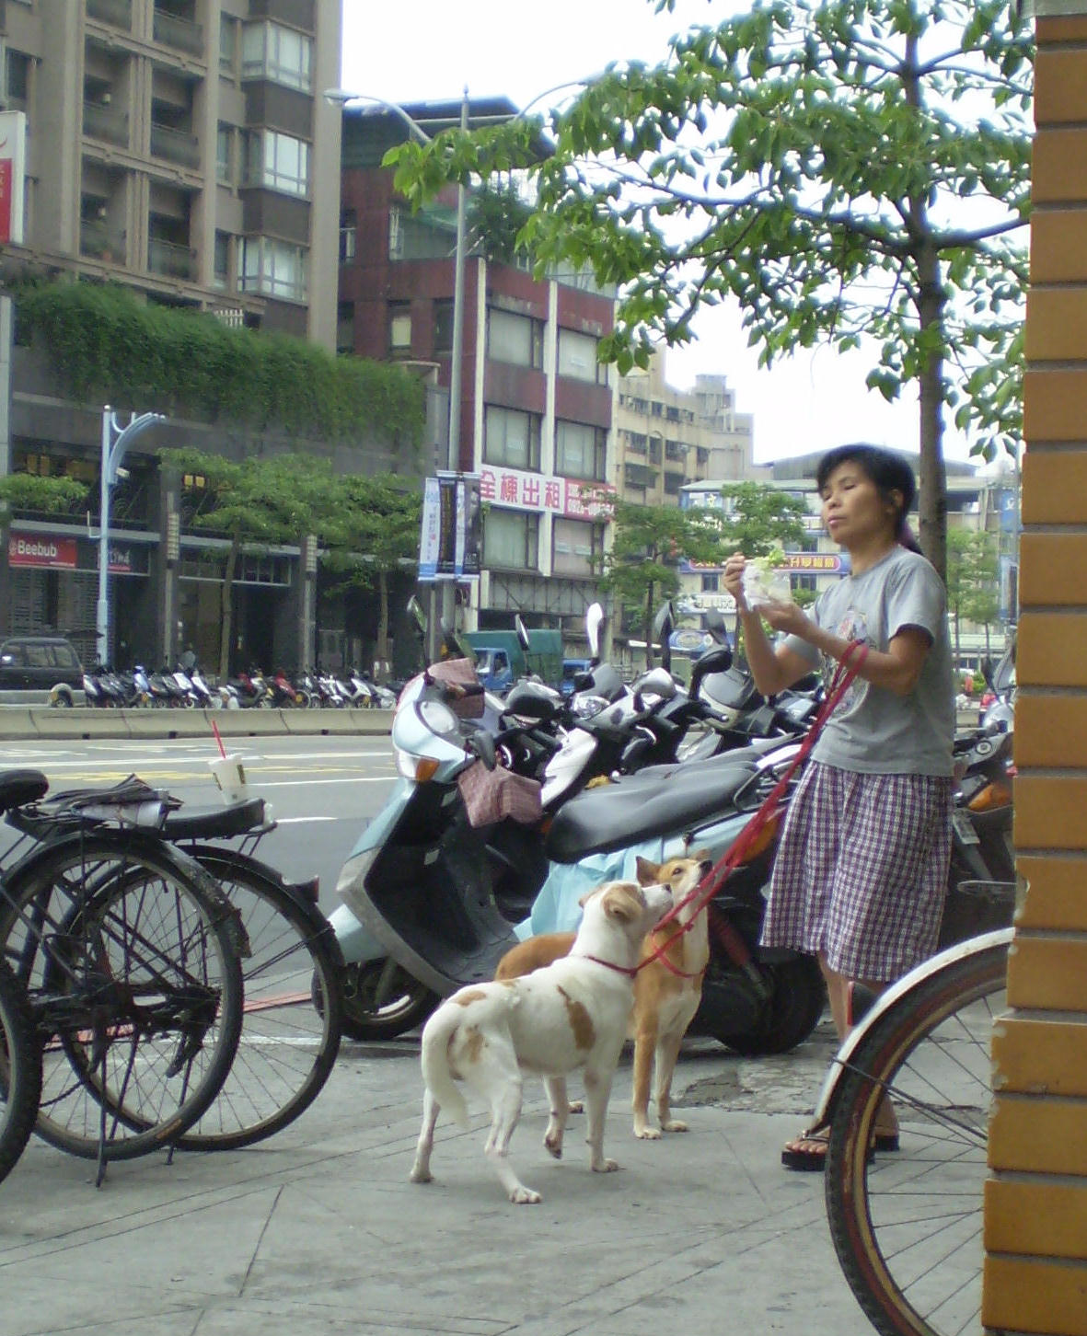
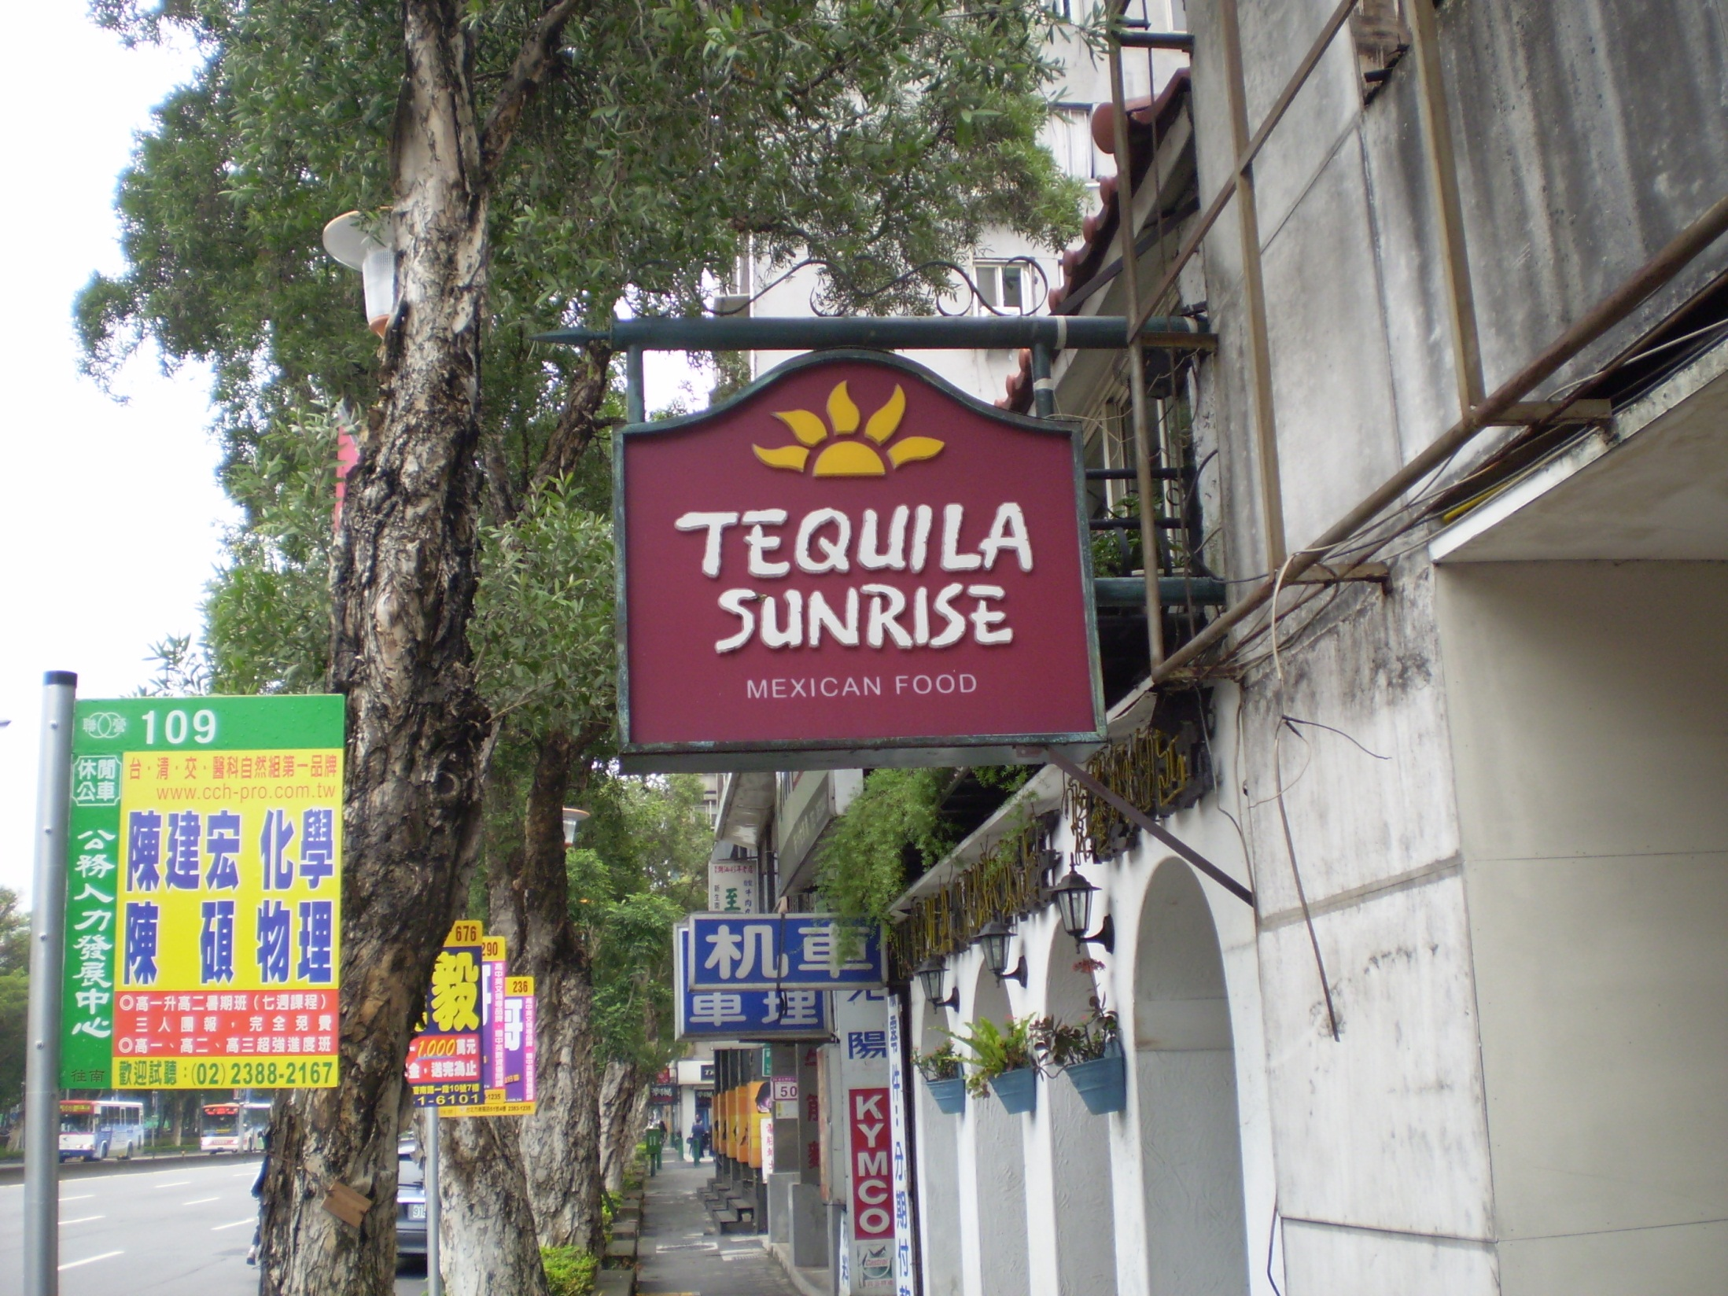

Slide 47
Wednesday, May 27
At OMF prayer meeting; talk with Andrew Butler
Lunch at CES with President Dr Paul Lai
Train to Danshuei, touring Ft San Domingo and former British Consulate
Dinner at McDonald’s in Danshuei

Slide 52
Thursday, May 28
10:20 am – Depart Taipei
1:46 pm – Arrive Tokyo
4:16 – Depart Tokyo
3:28 pm – Arrive Washington Dulles
6:43 – Depart Dulles
7:04 – Arrive Charlottesville
8:15 – Home!

Slide 54
The End
Pray for Taiwan

