Slide 1
My Summer Ministry, 2004
Robert C. Newman

Slide 2
Teaching Sunday Schools
Topic "Responding to Objections to Christianity"
A six-week series for the "People of the World" SS class at Cherrydale Baptist Church, Arlington, Virginia
A five-week series for the "Discover the Word" SS class at McLean Bible Church, Fairfax, Virginia
Both ran the same Sundays ½-hour drive apart!

Slide 3
Cherrydale Baptist Church
Founded (1913) in the house I grew up in
Has perhaps 500 members
Seeking to reach out to the unchurched community
"People of the World" is a SS class for internationals, esp. grad students at GWU

Slide 4
McLean Bible Church
A seeker-sensitive mega-church, with attendance around 9,000
"Discover the Word" is an adult SS class that my brother Jim often teaches.

Slide 5
The Series
Began with sketch of what the Lord wants us to do based on 1 Peter 3:15: "Be always ready to give an answer…"
Broke up into small groups to assemble ten common or difficult objections to Christianity.
These were tabulated to form the basis of the course.

Slide 6
Most common at POW
If God is good, why does He allow evil and suffering? (5/7)
Why does Jesus/Christianity have to be the only way? (5/7)
Does God exist? Can we prove this? (4/7)
Christians are hypocrites, and Christianity has a bad history. (4/7)

Slide 7
Most common at DTW
Christians are such hypocrites! There are too many hypocrites in the church! (6/7)
How can Christ be the only way to God? (5/7)
Why does God allow bad things to happen, especially to good people? (4/7)
Jesus was just a good man; why should I think he is God? (4/7)
I'm a good person. (4/7)
The Bible was written by mere men. (4/7)

Slide 8
Objections Categorized
Objections about God
Objections about Scripture
Objections about Jesus & Salvation
Objections about Christians
Objections about Other Religions

Slide 9
Trip to the UK
A 3 ½ week trip to England, 30 July to 23 August, which also included brief visits to Wales & Scotland
Main purpose was vacation, to see more of the country
But also wanted to engage in ministry while there
A third purpose was to see some places my ancestors allegedly came from

Slide 10
Ministry in the UK
Spoke twice at Ashford Congregational Church, in the W suburbs of London
Spoke once at L'Abri Fellowship, in Greatham, Hampshire
Spoke five times at Hartshill Bible Church, in Stoke-on-Trent, Staffordshire
Spoke once for a picnic of the Blurton Free Baptist Church in the Stoke area
Spoke once at Leeds Messianic Fellowship
Spoke once at the International Presbyterian Church of West Ealing, west of London

Slide 11
First Weekend
Flew from Washington Dulles to London Heathrow Friday July 30
Stayed at home of Dave and Sue Legg
Visited British Museum Saturday
Spoke in their church Sunday morning and evening

Slide 12
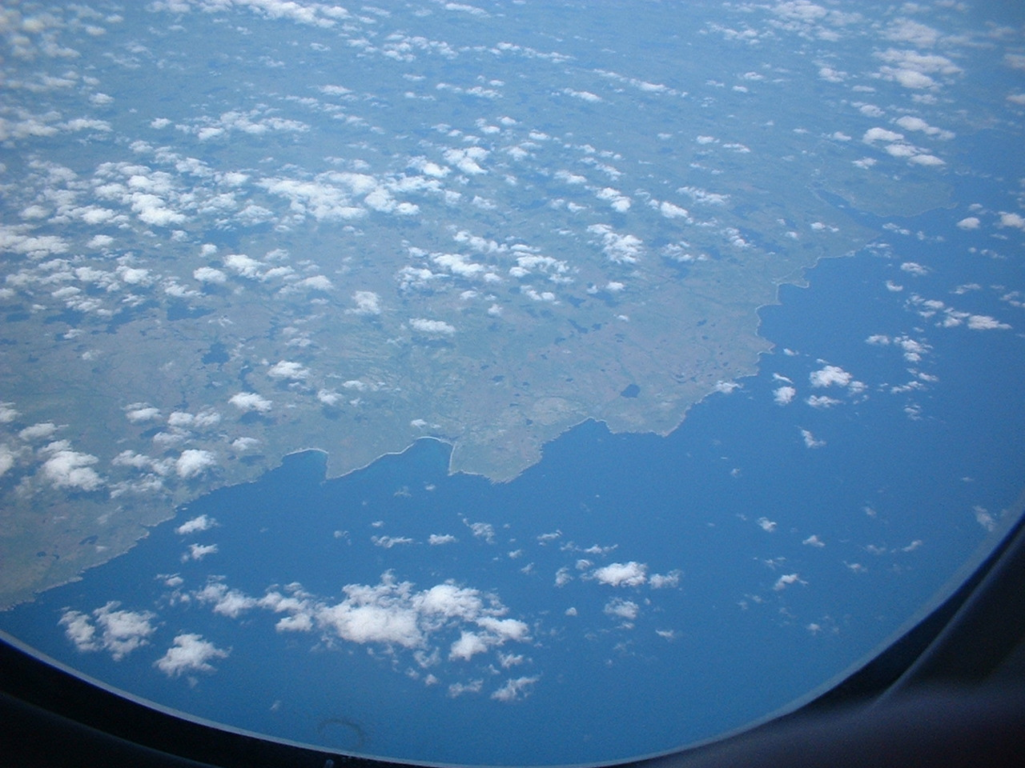
Over Nova Scotia

Slide 13
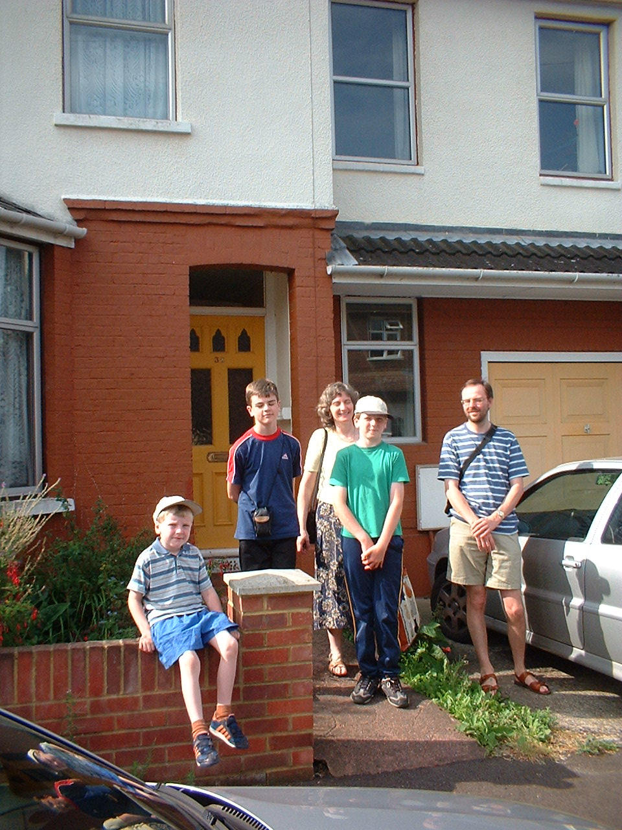
The Leggs
Dave
Sue
Stephen
Philip
Harry

Slide 14
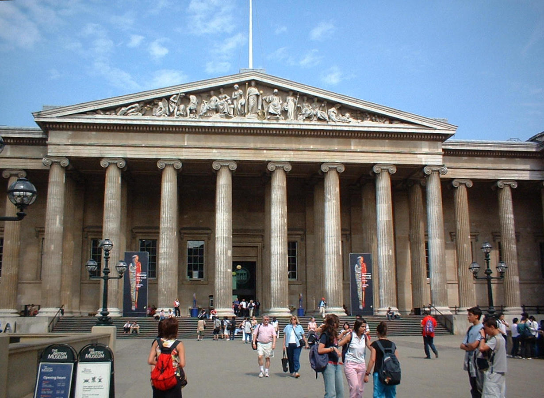
British Museum

Slide 15
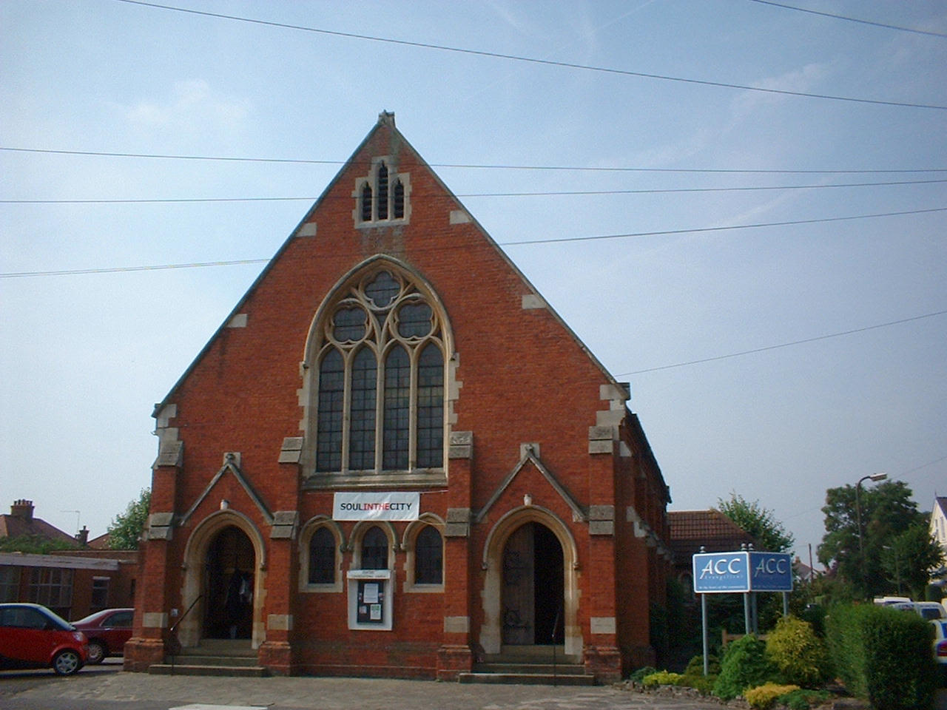
Ashford Congregational Church

Slide 16
Talks at Ashford
Morning Service: "Psalm 90"
Evening Service: "Discovering God’s Fingerprints: Why the Christian Faith Makes Sense"

Slide 17
Monday-Tuesday 2-3 Aug
Monday: Travel to British L'Abri
Gave talk "Doing Science in a Theistic Universe"
Answered questions
Tuesday: Traveled to Oxford
Met my nephew Matt, toured Oxford
On to Stoke-on-Trent

Slide 18
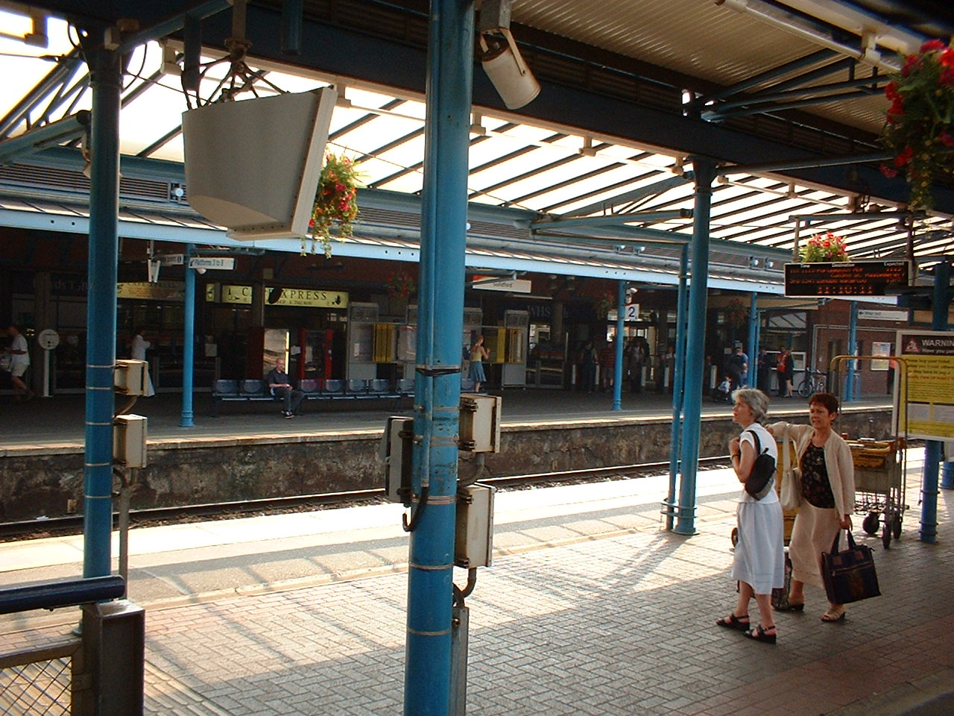
Travel by Train
Had a 22-day rail pass that allowed travel anywhere in England, Wales & Scotland
So most of my travel was by train

Slide 19
British L'Abri
L'Abri Fellowship was founded by Francis and Edith Schaeffer in 50s in Switzerland.
Now have fellowships in several countries, including the US, UK and Korea.
These are study centers for helping people see that Christianity has the answers to our modern problems, both social and personal.

Slide 20
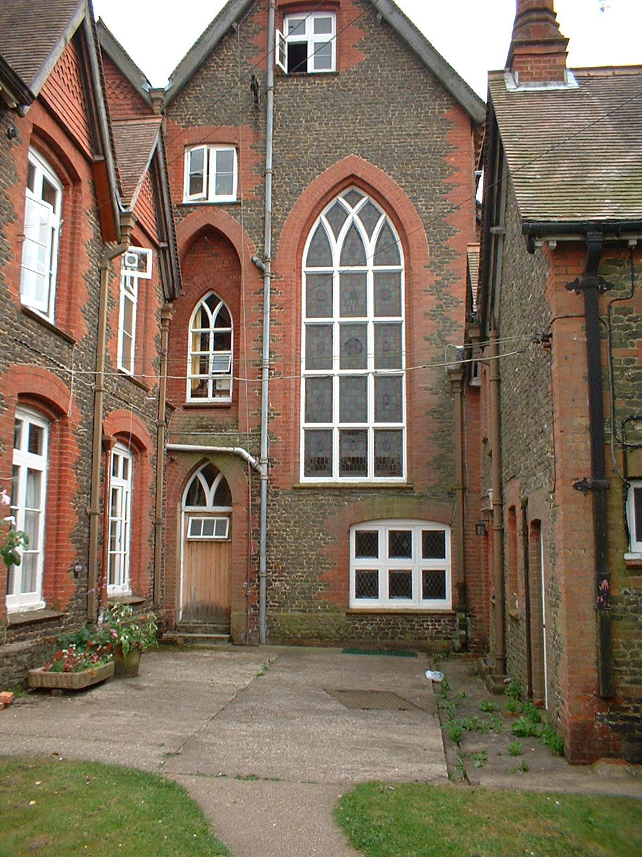
L'Abri
Located about an hour SW of London
In the village of Greatham, in Hampshire
L'Abri Fellowship was given the old Manor House

Slide 21
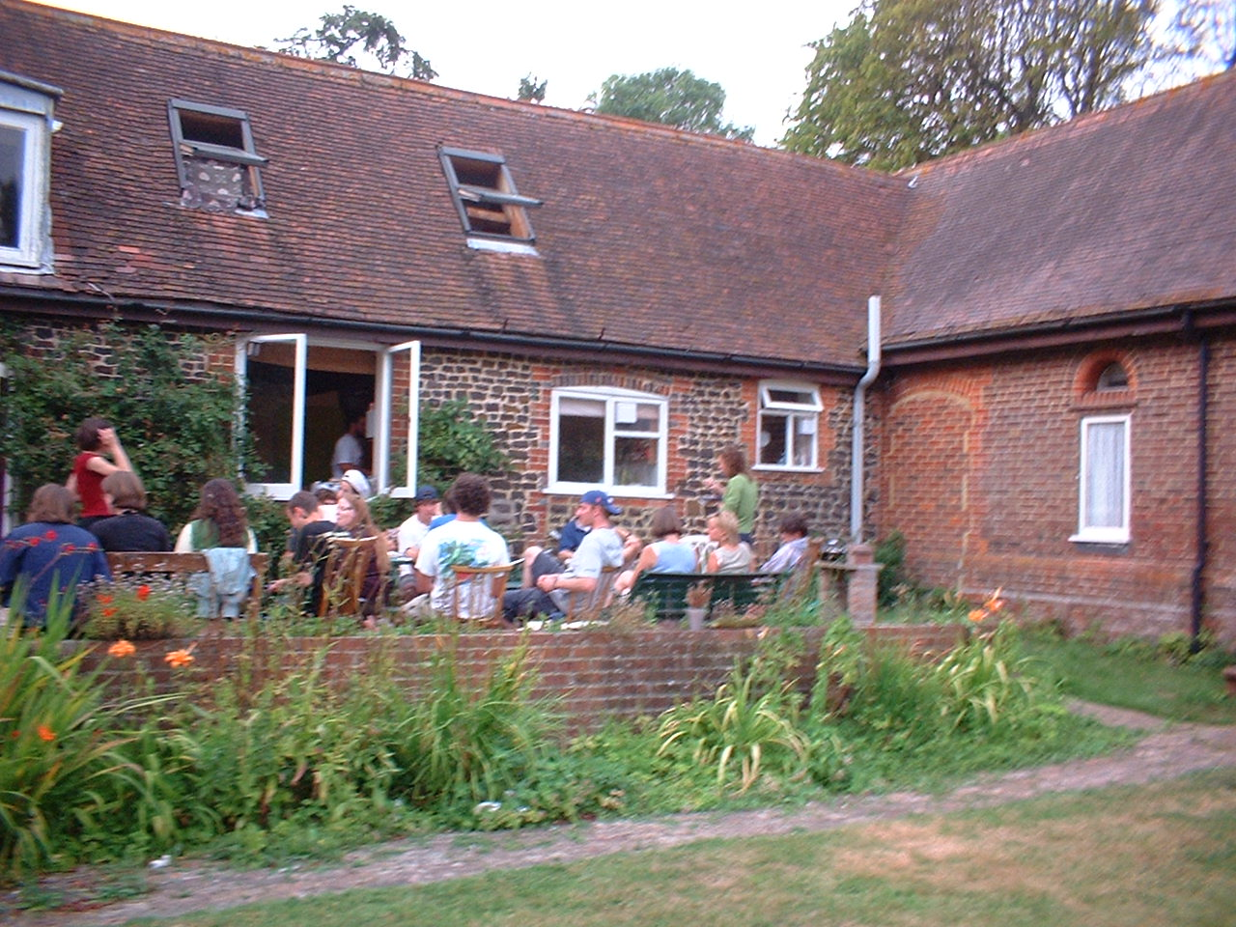
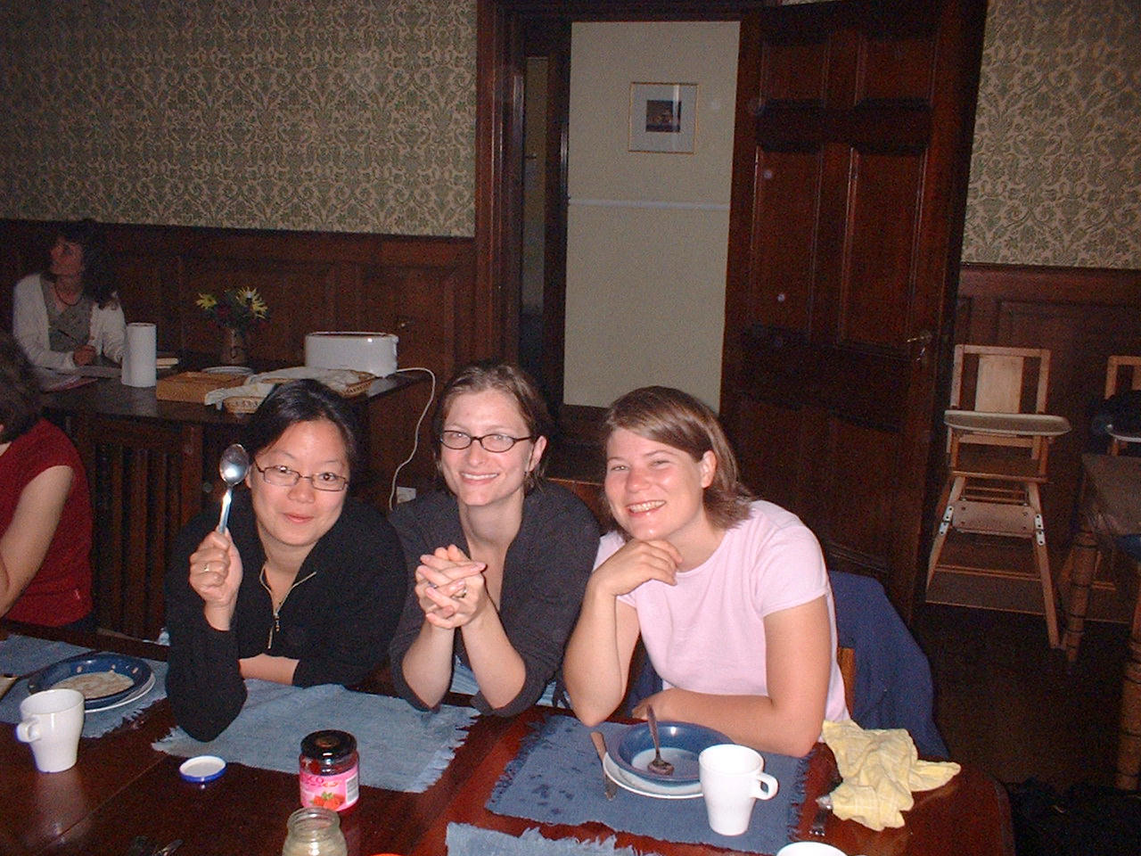
L'Abri People

Slide 22
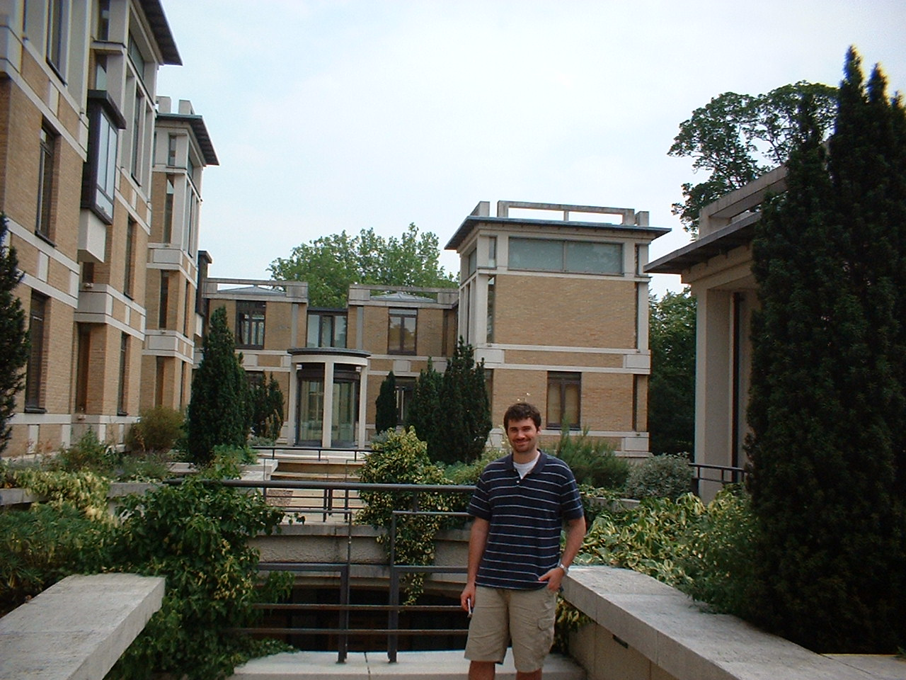
Matt Stempler at St. John’s College

Slide 23
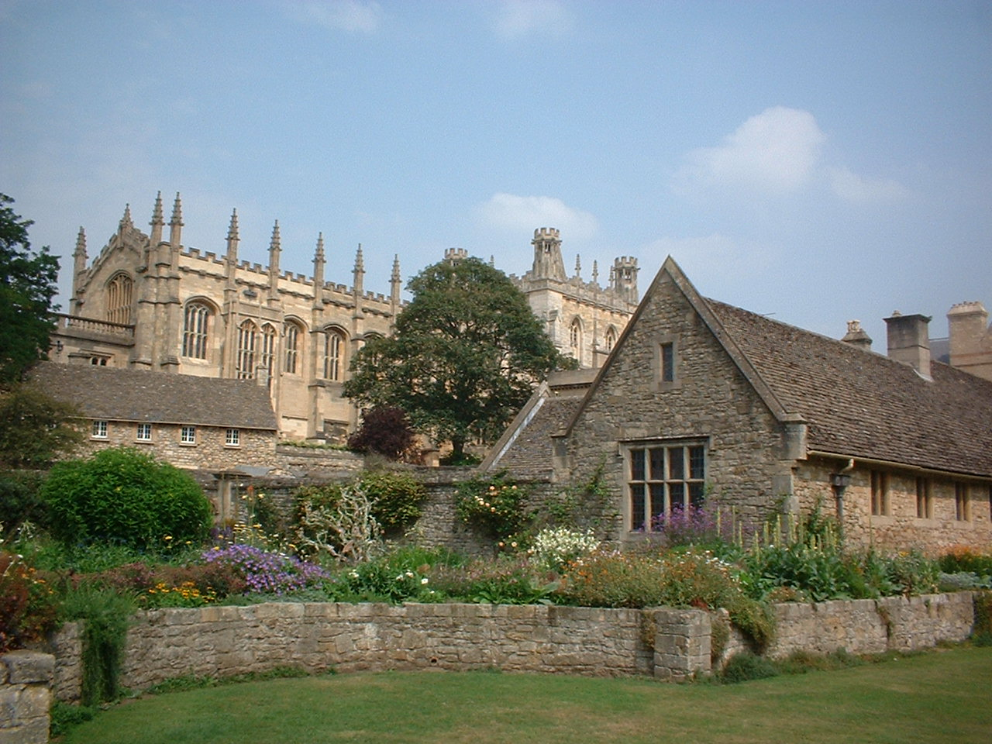
Oxford, Christ Church College

Slide 24
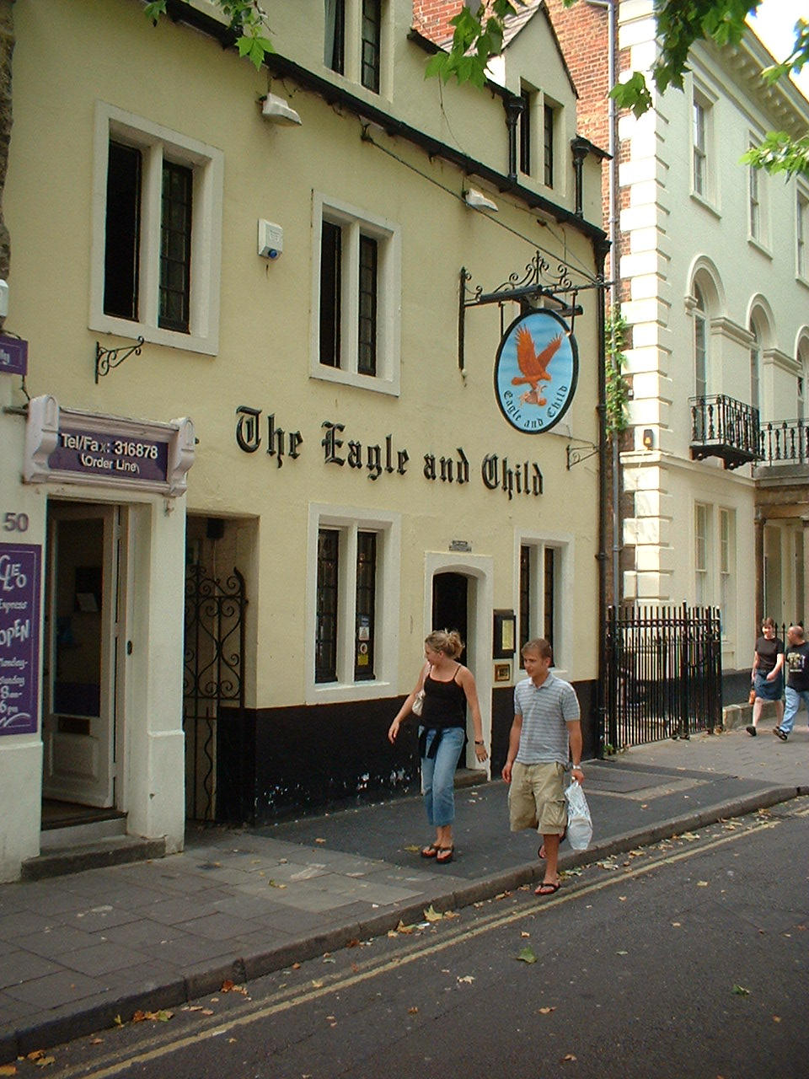
C. S. Lewis et al
CS Lewis, JRR Tolkien, and Dorothy Sayers belonged to an informal group called the Inklings.
They met regularly at this pub to discuss their writing projects.
The three have had a powerful effect on evangelicalism.

Slide 25
Mid-Week at Stoke
Arrived Tuesday evening 3 August
Stayed at home of Phil & Joy Roberts, church planters at Hartshill Bible Church
Used their place as a base for day-trips and over-night trips in the north
Spoke five times at their church in various venues over a two-week period

Slide 26
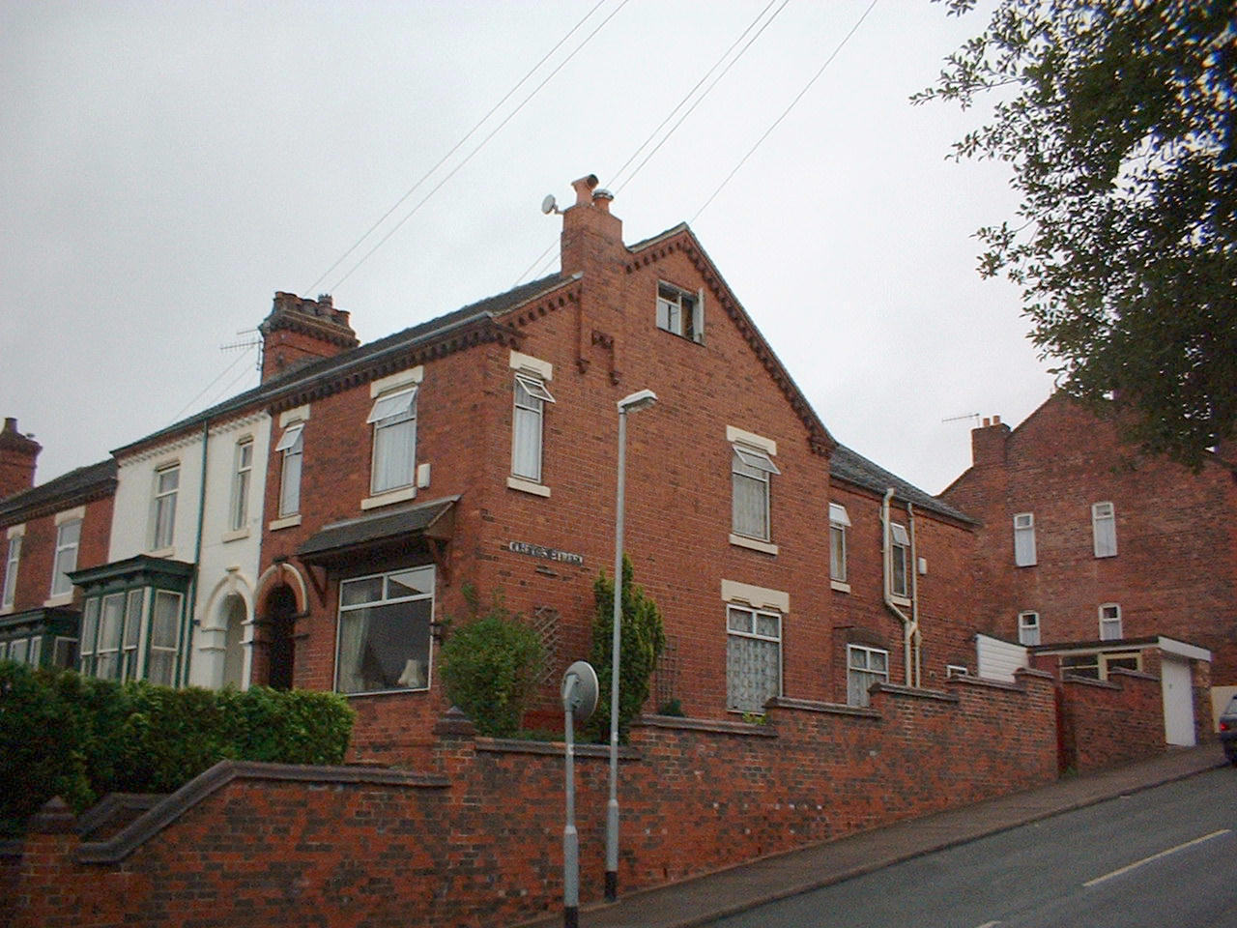
Home of Phil & Joy Roberts

Slide 27
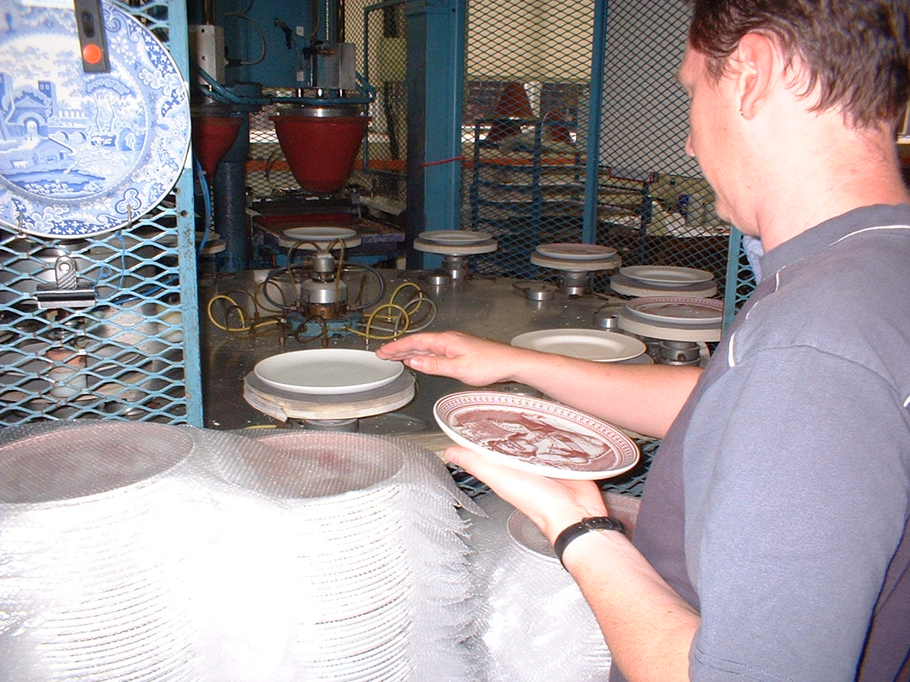
Stoke-on-Trent
The major pottery center in the UK
Home of many potteries, including Wedgewood
This scene is from the Spode Pottery Works

Slide 28
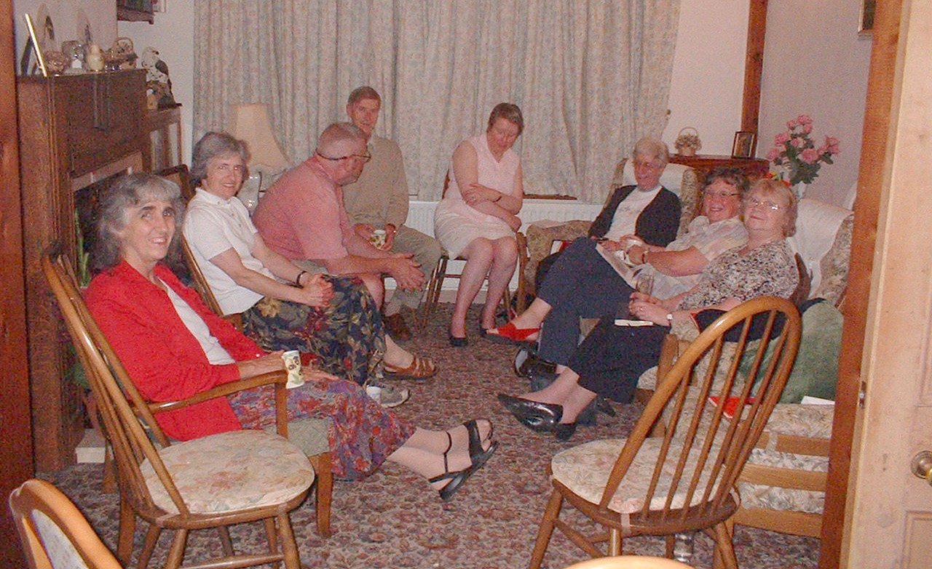
Roberts' Bible Study

Slide 29
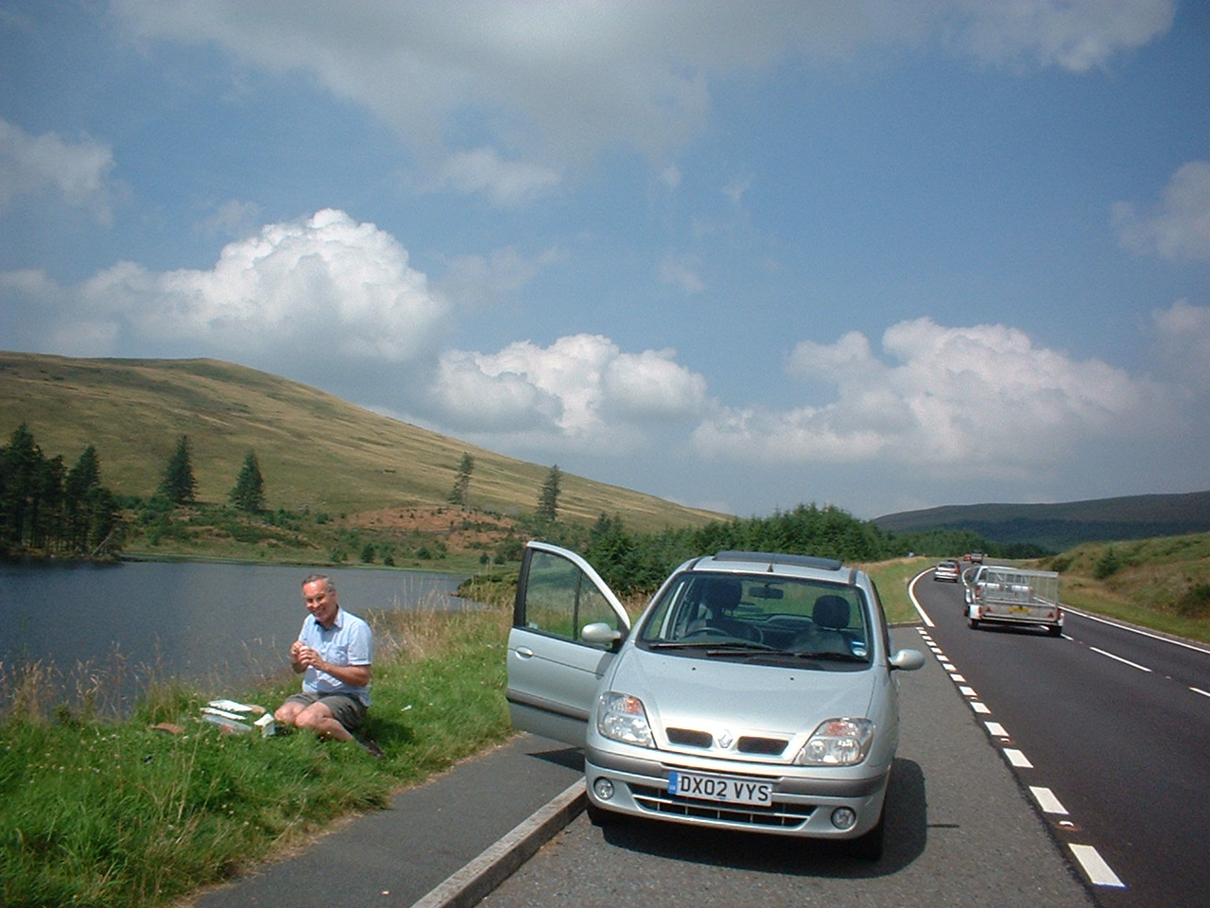
Brecon Beacons,South Wales

Slide 30
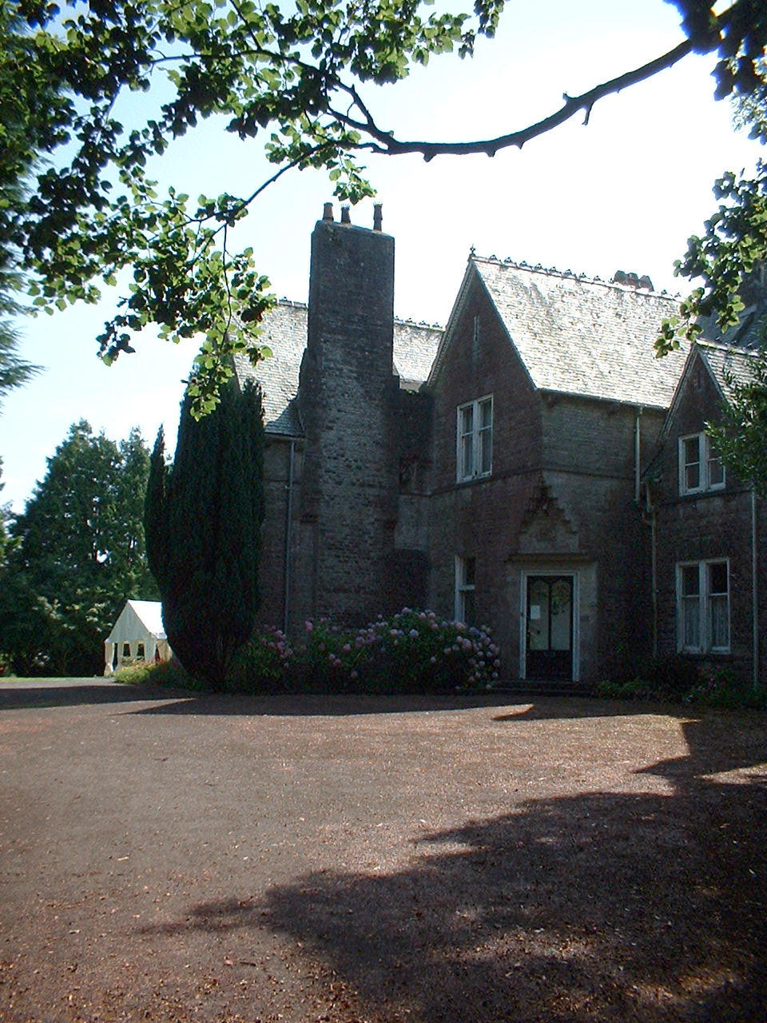
Evangelical Theological College, Wales
Equivalent of a seminary in the USA
Phil's oldest son, Alister, recently graduated from here

Slide 31
2nd Weekend, 6-8 August
Visit to Chester on Friday
Visit to North Wales on Saturday
At Hartshill Bible Church on Sunday

Slide 32
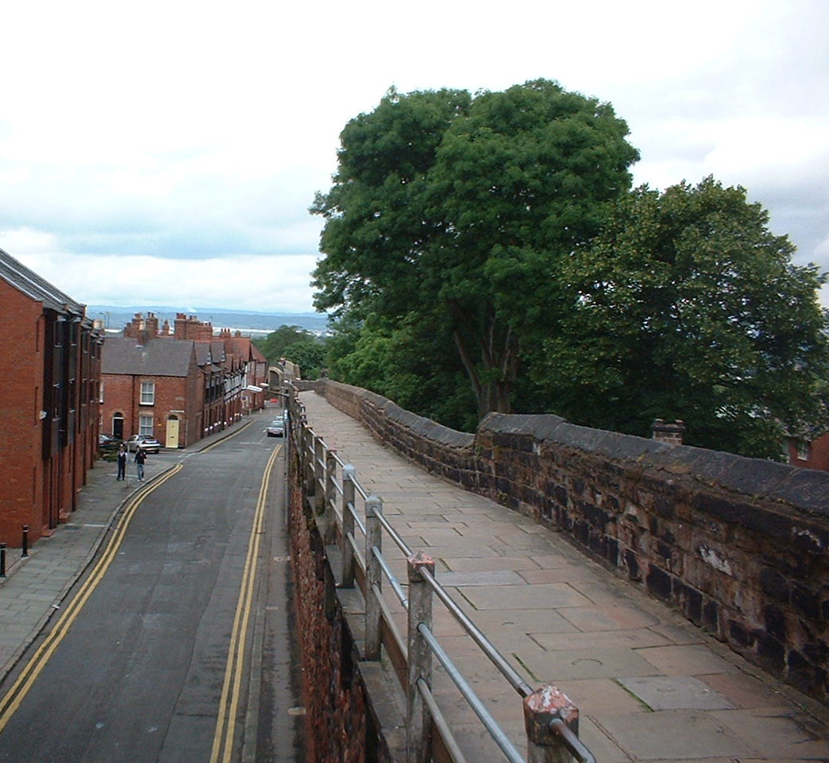
Chester
An ancient Roman city; name from Latin Castrum = fort
Only English city still having walls all the way around

Slide 33
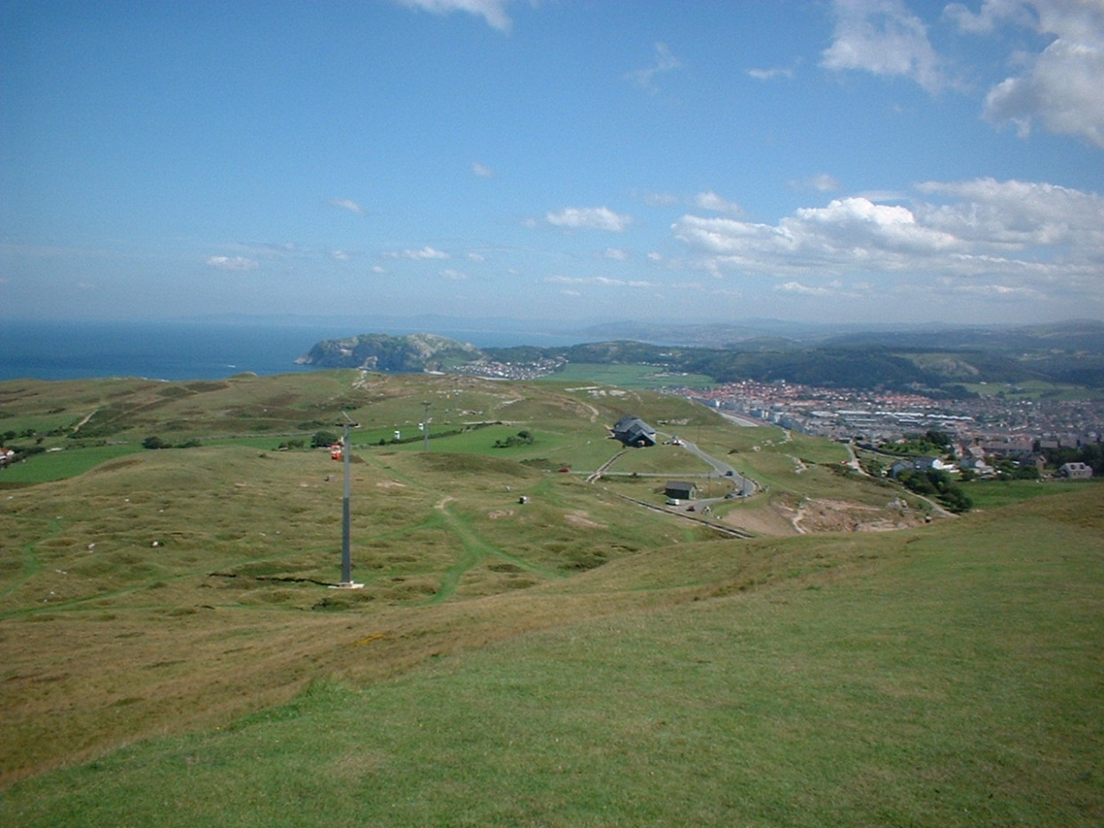
North Wales
Train trip to Llandudno, a beach resort
Dominated by high plateau, Great Orme Head
Have cable cars and tram railway to ascend from shore to top

Slide 34
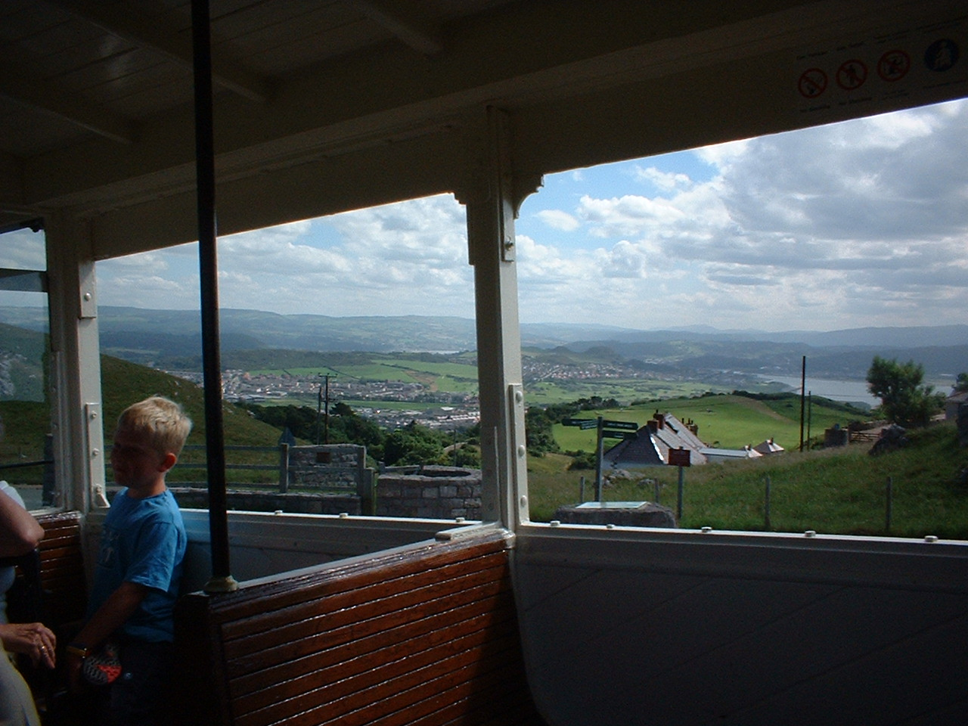
Llandudno, Wales

Slide 35
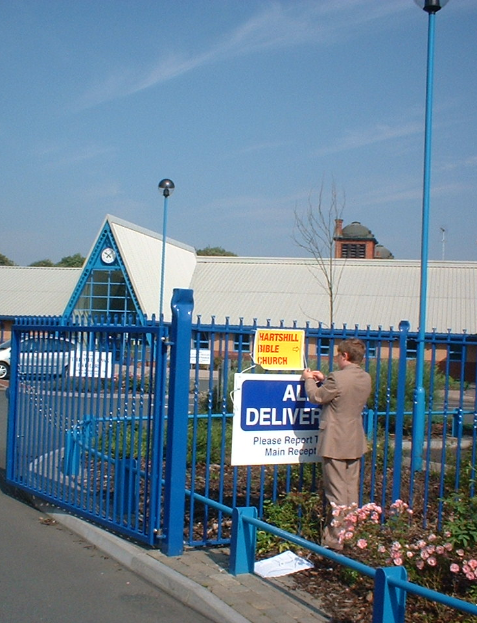
Hartshill Bible Church
Meets at The Willows School
Phil preached morning service, on Jesus as our example
I gave my Power-Point talk that evening "Discovering God’s Fingerprints"

Slide 36
Mon-Tues 9-10 August
Monday to Liverpool
Monday evening, talks to Phil’s Bible Study group
Tuesday to York
Tuesday evening to Holme-on-Spalding Moor

Slide 37
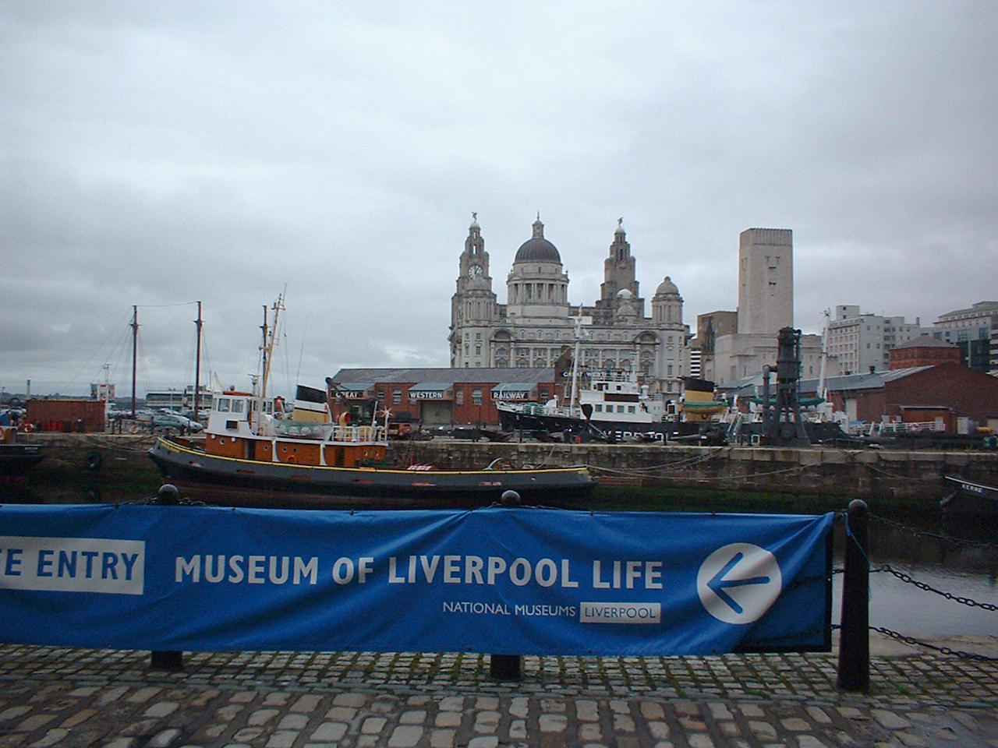
Liverpool

Slide 38
Bible Study Group
Monday evening group, meeting at Roberts’ home
Gave two talks:
"Evidence of God in Cosmos & Conscience"
"Scientific Problems for Scientific Creationism"

Slide 39
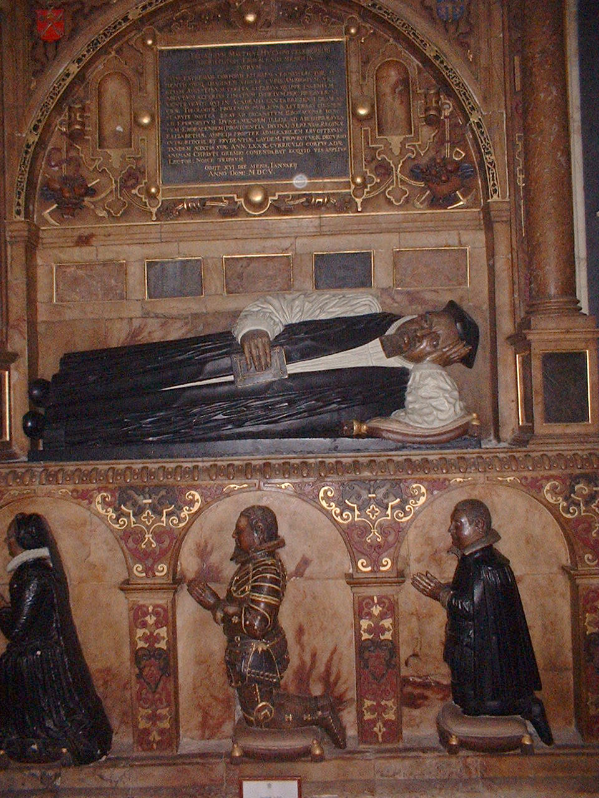
York
Inside York Minster
Tomb of one of the Archbishops of York

Slide 40
Holme-on-Spalding Moor
A village between York and Hull
Apparently the birthplace of one of my immigrant ancestors, Thomas Ellithorpe
He was born about 1600 and came to Massachusetts in the 1630s.

Slide 41
Wed-Thurs 11-12 August
Wednesday to Hadrian's Wall, which the Romans built as a barrier across England to keep out the Scots
Thursday to Glasgow, Scotland

Slide 42
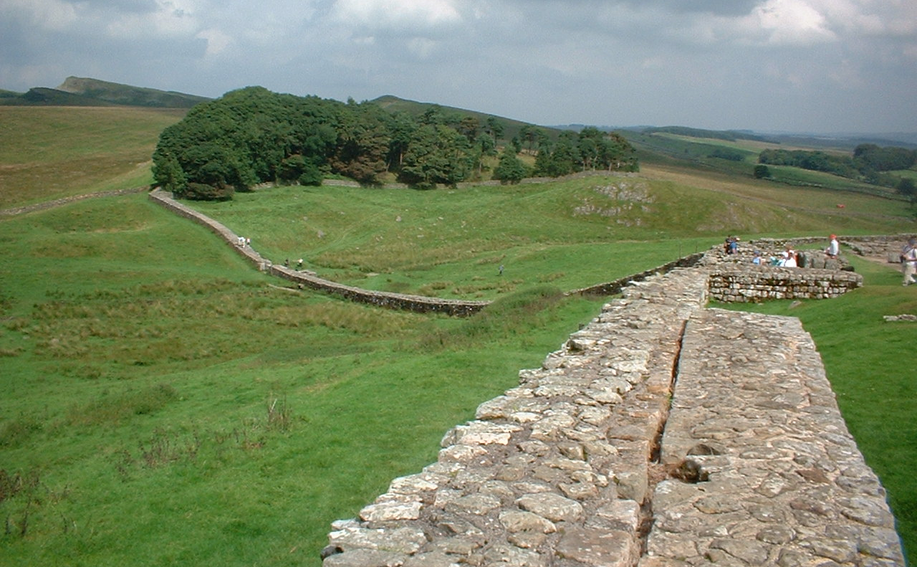
Hadrian's Wall

Slide 43
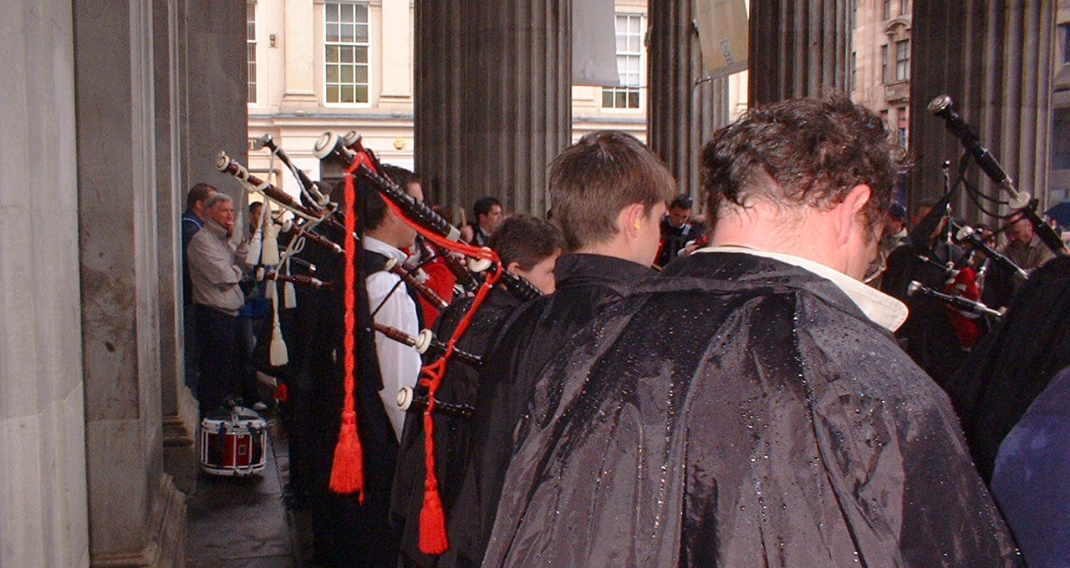
Bagpipers in Glasgow

Slide 44
3rd Weekend, 13-15 August
Friday to Leeds to speak at Leeds Messianic Fellowship
Saturday to Stoke to speak at picnic of Blurton Free Baptist Church
Sunday:
Phil preaching on Jesus as savior
Lunch at home of Tom & Christine Morrow
Evening talk, "Astrology: Is Your Destiny in the Stars?"

Slide 45
Leeds
By train to Leeds
Stayed at home of Bunmi and Bukki Ajayi from Nigeria
Spoke to Messianic Fellowship on "Jesus, the Testimony of Prophecy & History"

Slide 46
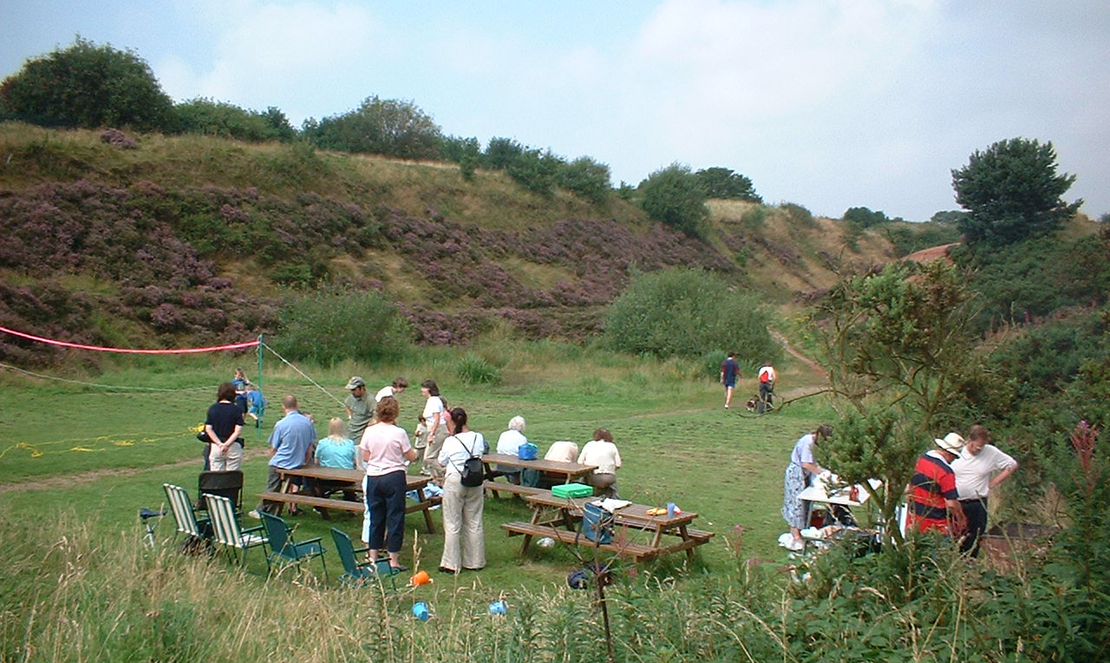
Barbeque at Park Hall

Slide 47
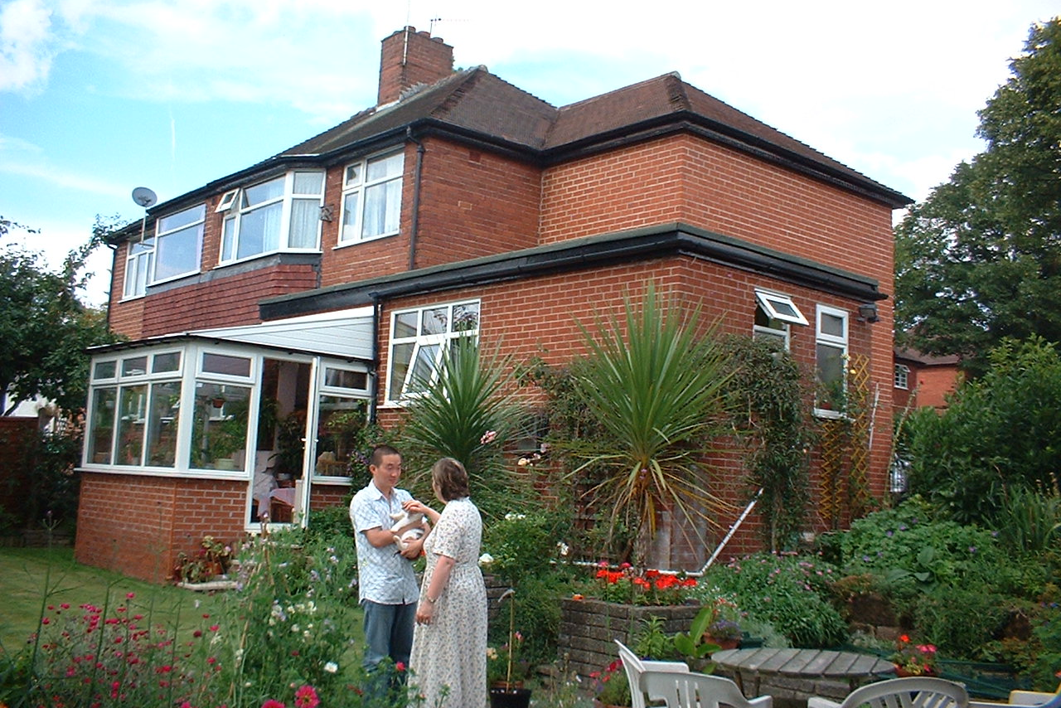
Sunday at Morrow Home

Slide 48
Talk at Hartshill Bible Church
Sunday evening at The Willow School
Power-Point talk:
"Astrology: Is Your Destiny in the Stars?"

Slide 49
Mon-Wed, 16-18 August
Monday visit to Lake District
Tuesday visit to Lancaster
Wednesday by car to Peaks District
Wednesday evening: Last talk at Hartshill Bible Church, "Prophecy: Ancient and Modern"

Slide 50
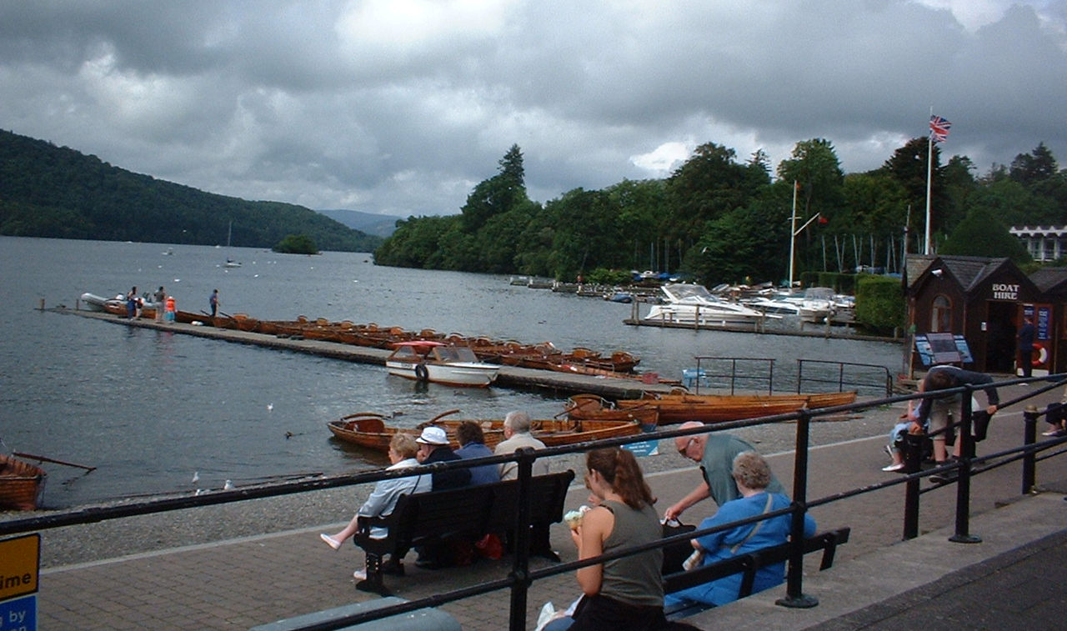
Lake Windermere

Slide 51
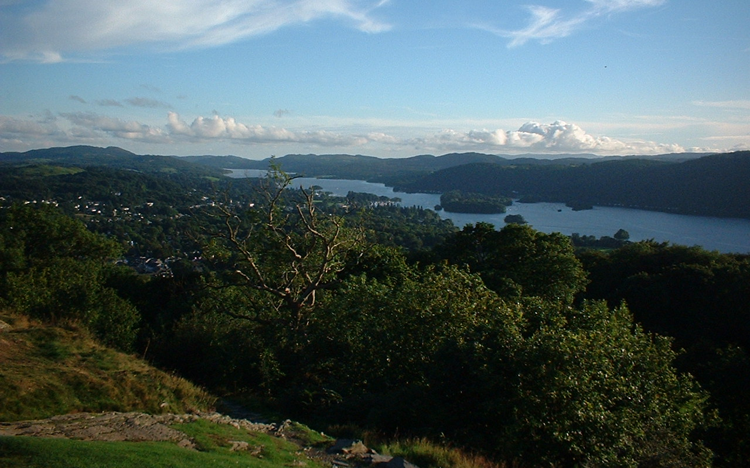
View from Orrest Head

Slide 52
Lancaster
The Castle at Lancaster
The ancestral residence of the Dukes of Lancaster
The current Duke of Lancaster is Queen Elizabeth II !

Slide 53
Lancaster
Stained glass windows in the Priory of Lancaster, founded 1094, now a parish church
Ate lunch in the Priory refectory

Slide 54
The Peaks District
One of the many picturesque valleys in the Peaks District National Park

Slide 55
Last Weekend, 19-23 August
Thursday, by train to Richmond, west of London
Friday, some ancestor hunting
Saturday, to Bath, a Roman bath and 18th century spa
Sunday, speaking at the International Presbyterian Church, West Ealing
Monday, fly home!

Slide 56
Richmond
A small city in the west suburbs of London, on the Thames River
The location of one of the royal palaces
This is a retreat center there

Slide 57
Holy Cross Church
In Greenford, NW of London, built 11th century
George Gardiner, an immigrant ancestor, was baptized here in 1600

Slide 58
Paul Levy
Met with pastor of the International Presbyterian Church for lunch Saturday
His predecessor was Nick Perrin, now on the faculty at Biblical

Slide 59
Bishop's Stortford
St Michael’s Church
The current building dates from the 1400s
But there was a church on the site in the 700s
James Howe was married here 1628

Slide 60
Hatfield Broad Oak
A small village a few miles east of Bishop’s Stortford (NE of London) in Essex
Here James Howe was born in 1598.
He died 104 years later in Ipswich, Massachusetts.

Slide 61
Bath
The only hot springs in England
Used by the Romans as a bath from 1st century AD
The same pool (with lead Roman liner) still in use today
Became a resort town in 1700s

Slide 62
International Presbyterian Church
Presbyterianism is not common in England, being largely Scots
This congregation was founded by associates of Francis Schaeffer
I spoke at the evening service, giving my talk on God's Fingerprints.

Slide 63
Back Home
Returned to the Washington, DC area on Monday, 23 Aug
Total trip was 25 days
Spoke 11 times
Returned just 2 days before my mother died

