Slide 1
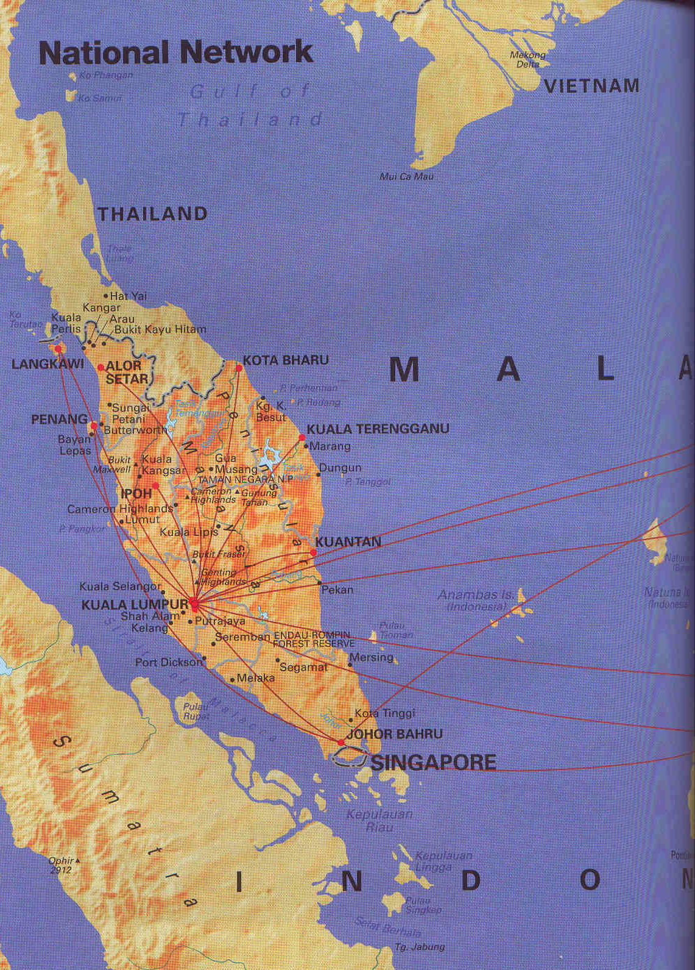

Singapore-Malaysia Trip
January 2004
Robert C. Newman

Slide 2
Flight Over
Wednesday, December 31, 2003:
Leave Baltimore-Washington International Airport 10:06 am
Leave Chicago-O'Hare 12:25 pm
Thursday, January 1, 2004:
Arrive Hong Kong 6:15 pm
Arrive Sinagpore 11:50 pm
Elapsed time: ~ 26 hours

Slide 3
The Flight Over
Hong Kong
Chicago
BWI
Singapore

Slide 4
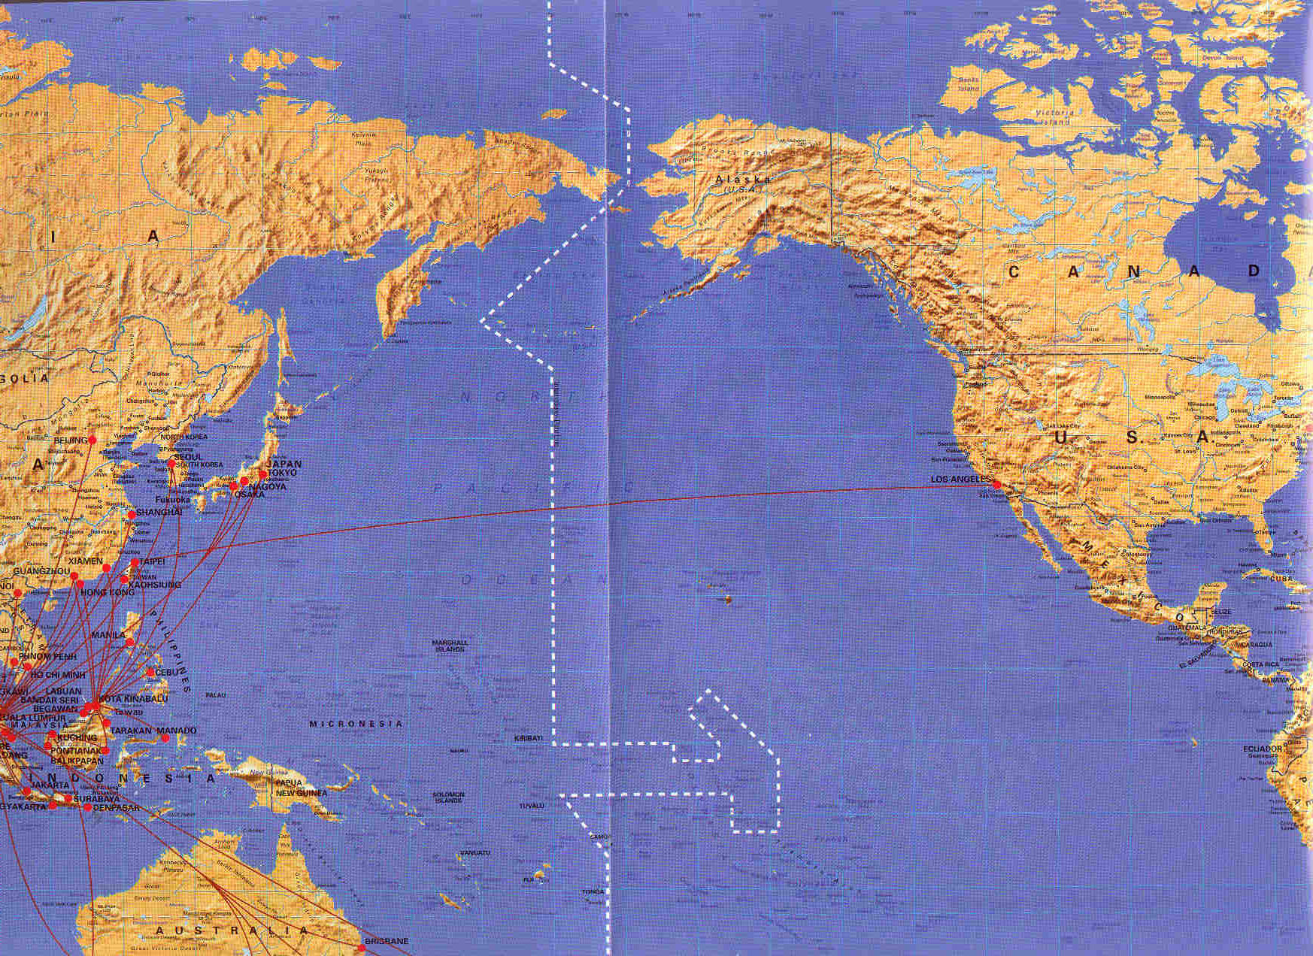
The Flight Over
Chicago
BWI
Hong Kong
Singapore

Slide 5

Singapore
Population 4 million
Peoples:
  Chinese 1.1M
  Peranakan 462K
  Anglicized Ch 239K
  Malay 509K
  Tamil 163K
  Anglicized Ind 56K
No state interference in religion

Slide 6
January 2-5: Singapore
Staying at home of Alan Wong
Friday, January 2:
  See "Return of the King" with Wongs
  Snack with Alan at Raffles Town Club
  Dinner at Fisherman's Village with Yaps and Raymond & Susan Ang

Slide 7
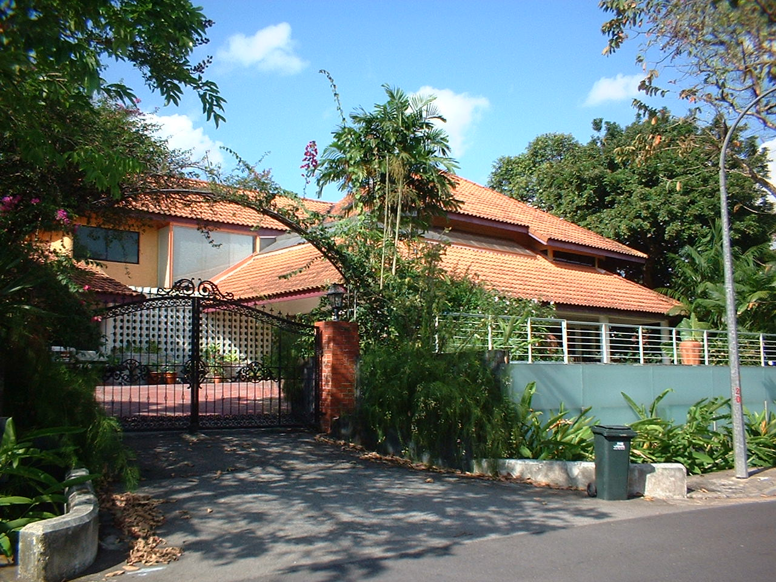
Home of Alan and Mei-Lin Wong,
Chee Hoon Ave., Singapore

Slide 8
January 2-5: Singapore
Saturday, January 3:
  Orchard Road shopping area
  Lunch at McDonalds
  Full Gospel Business Men's Banquet
Sunday, January 4:
  Lunch at Raffles Town Club
  Communion Service at Church of the Good Shepherd
  Dinner w/ Wongs and relatives

Slide 9
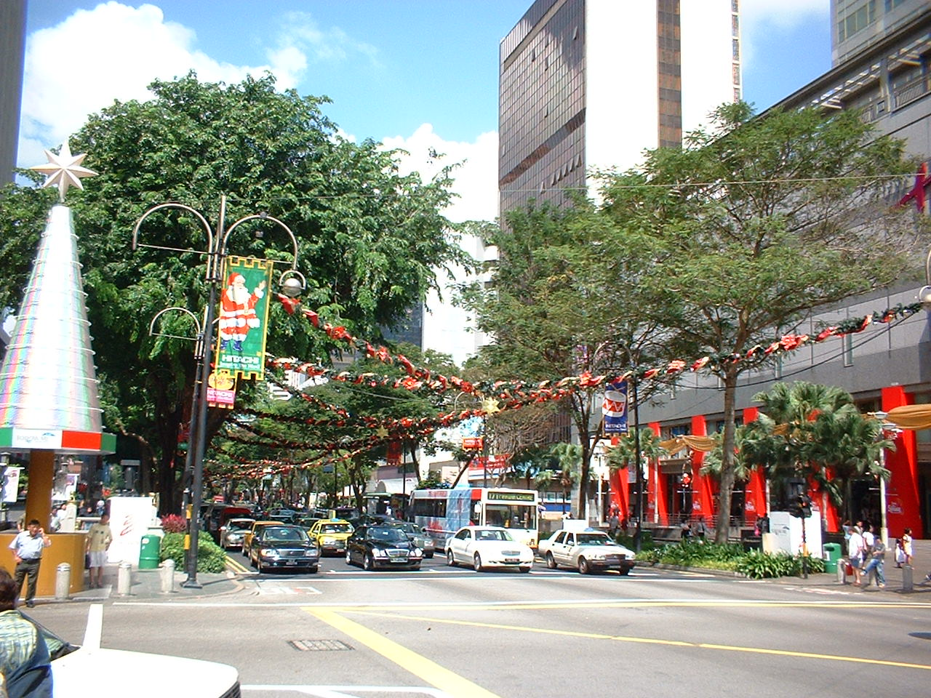
Orchard Road Shopping Area, Singapore

Slide 10
January 2-5: Singapore
Monday, January 5:
  Hike up Bukit Temah Hill with Alan Wong
  Lunch at Italian restaurant with BTS alum Colin Wong and visit to Life Bible Presbyterian Church
  Origins Interest Group of GCF at Alan Wong's:
    "Cosmos and Contact"

Slide 11
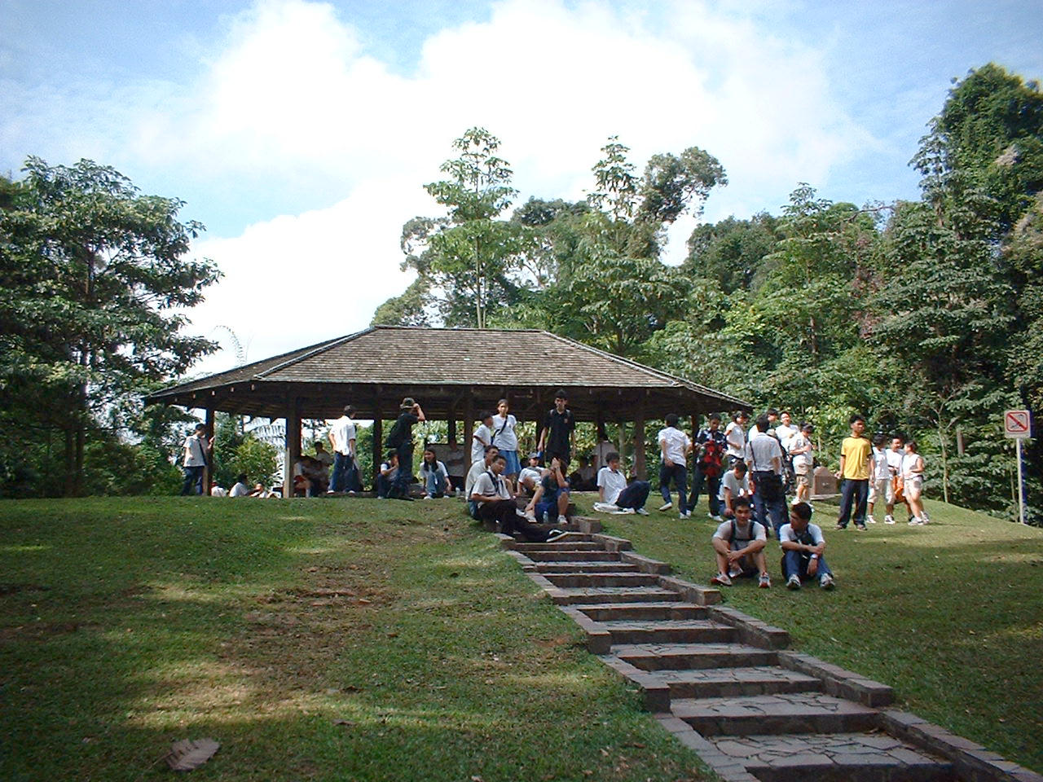
Summit of Bukit Temah Hill, Singapore

Slide 12
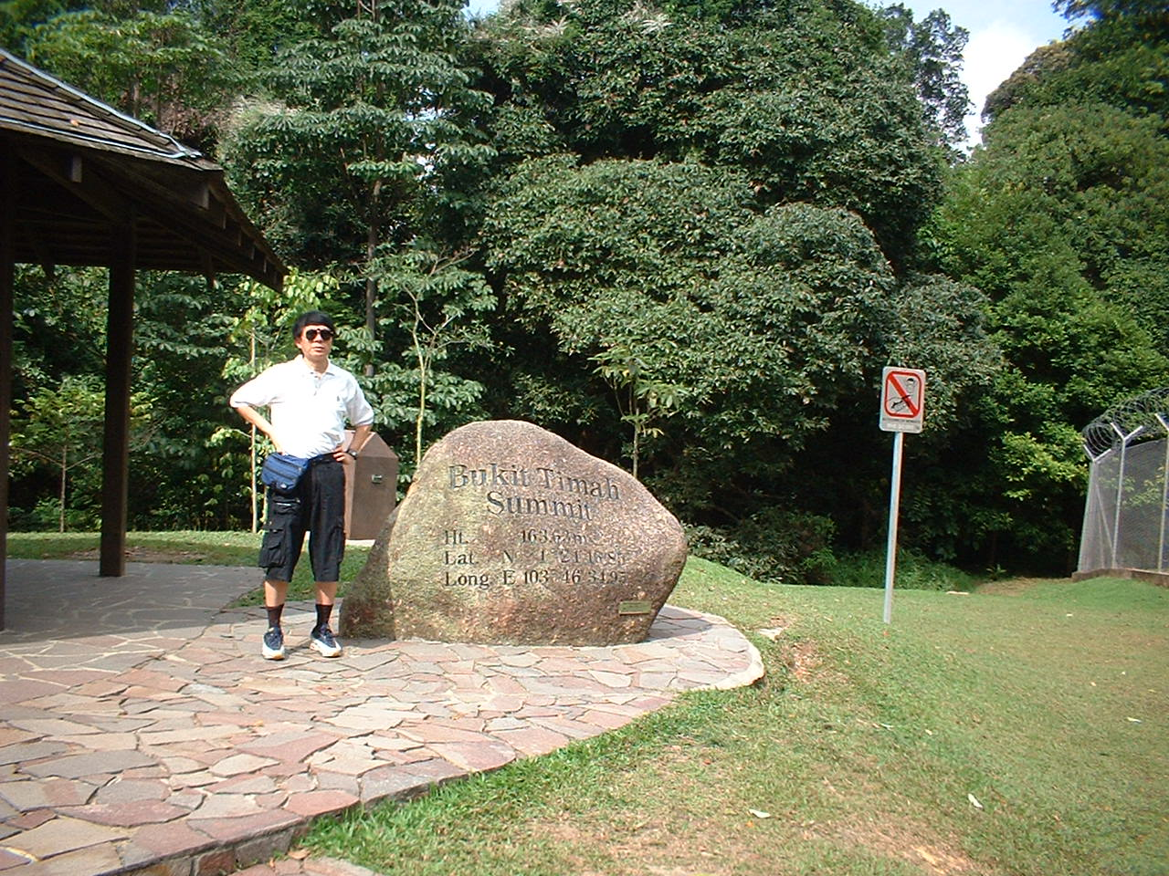
Alan Wong at Bukit Temah Summit

Slide 13
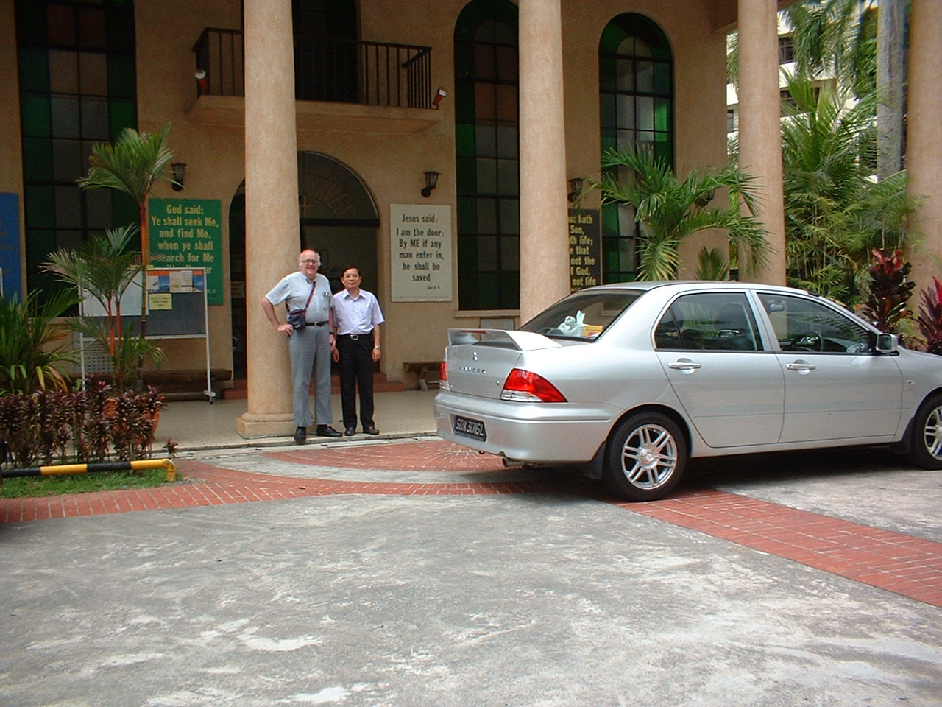
With Biblical Grad Colin Wong at Life BP Church

Slide 14
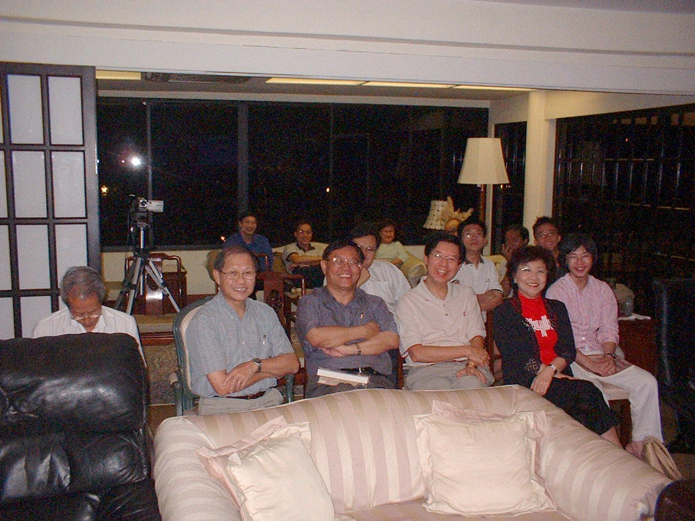
Origins Interest Group at Alan Wong's

Slide 15
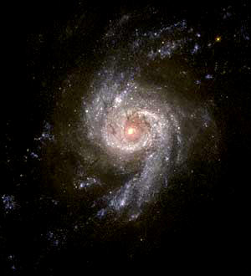
Cosmos & Contact
Evidence of Design
in the Universe
Robert C. Newman

Slide 16

Malaysia
Population 22M
People groups: 184 listed in World Xn Encyclopedia!
State religion: Islam
Religious liberty: state interference and obstruction

Slide 17
January 6: to Kuala Lumpur
8 am – Leave for KL with Kim-Sin Yap
1 pm – arrive KL
2 pm – lunch at Hot Bun Cafe with Jennifer, Stacy, Ling-Lee
3 pm – staying at home of Peter & Suzy U, Taman Tun Dr. Ismail
8 pm – dinner at Living Lee's

Slide 18
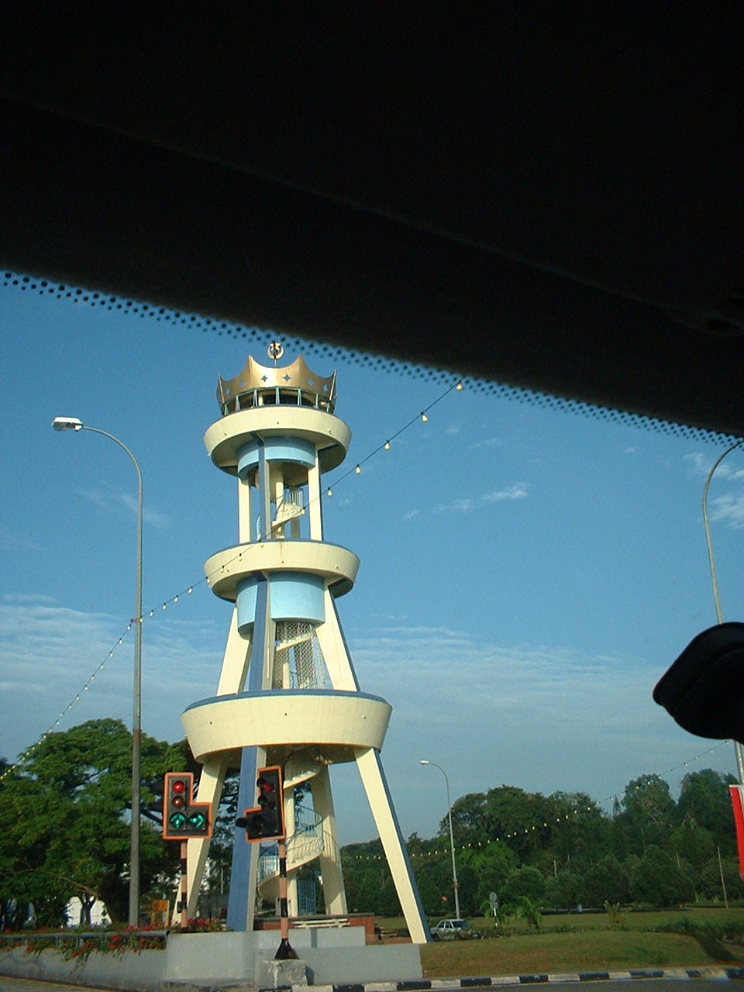
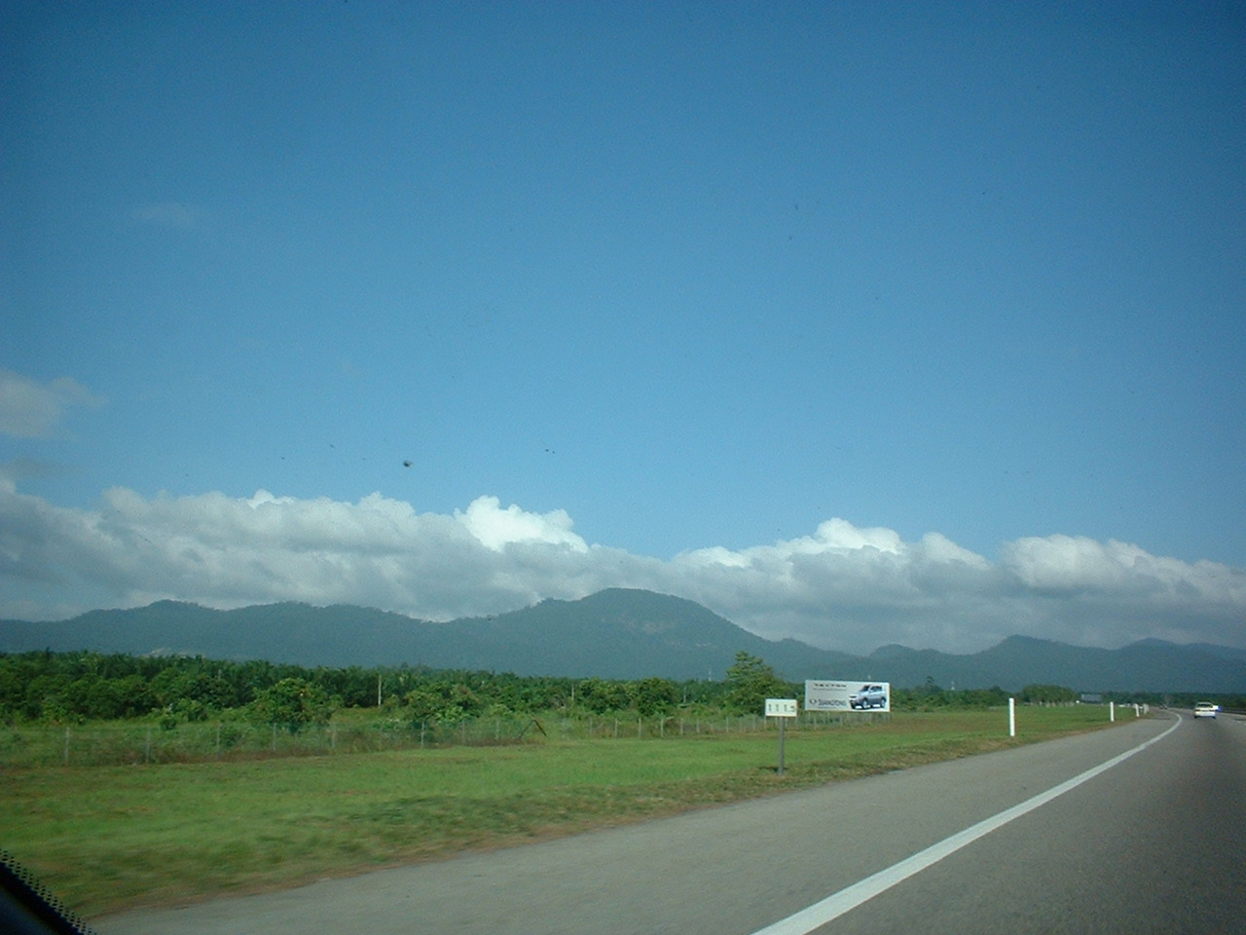
Scenes on way to Kuala Lumpur

Slide 19
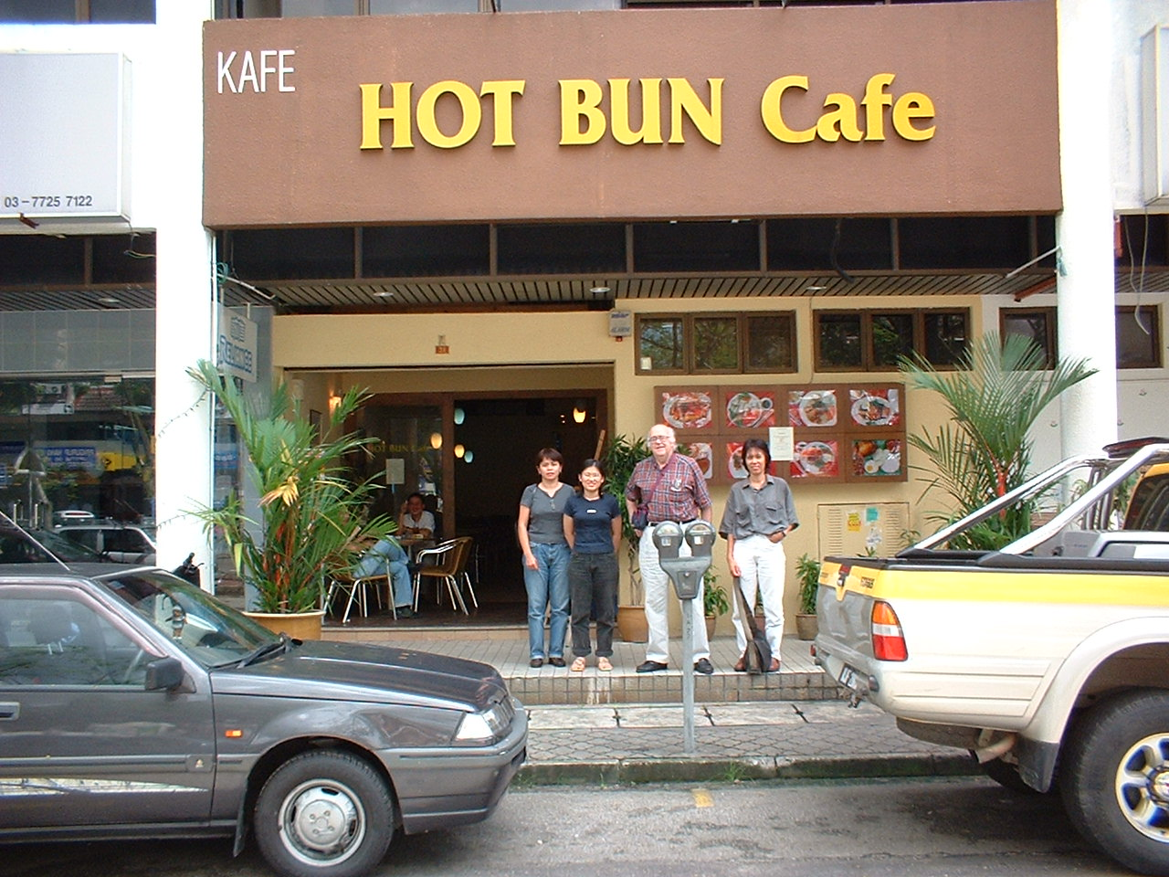
Hot Bun Café, Taman Tun Dr. Ismail, Kuala Lumpur

Slide 20
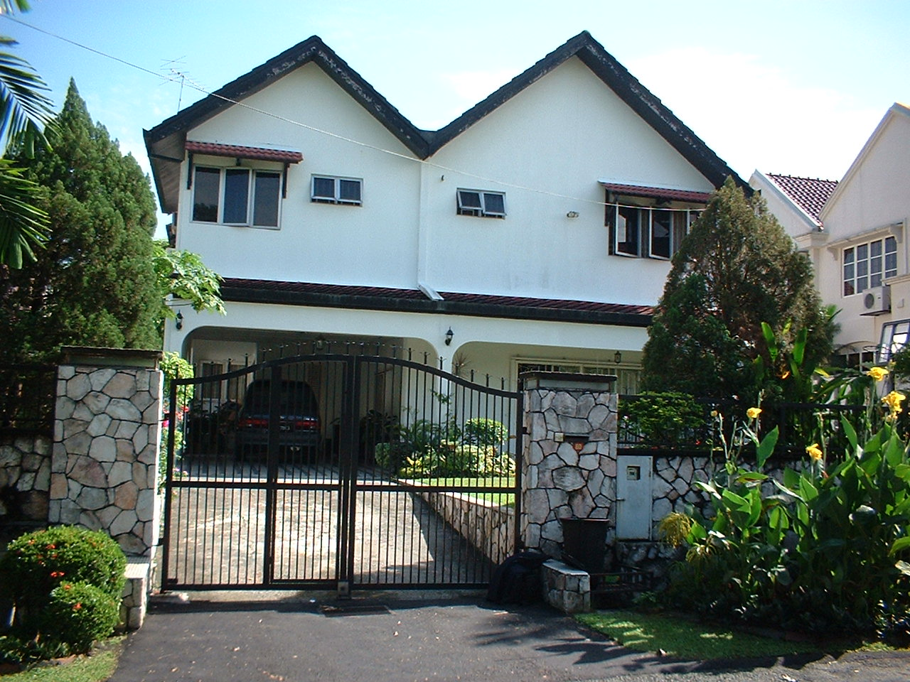
Home of Peter & Suzy U, Taman Tun Dr Ismail, KL

Slide 21
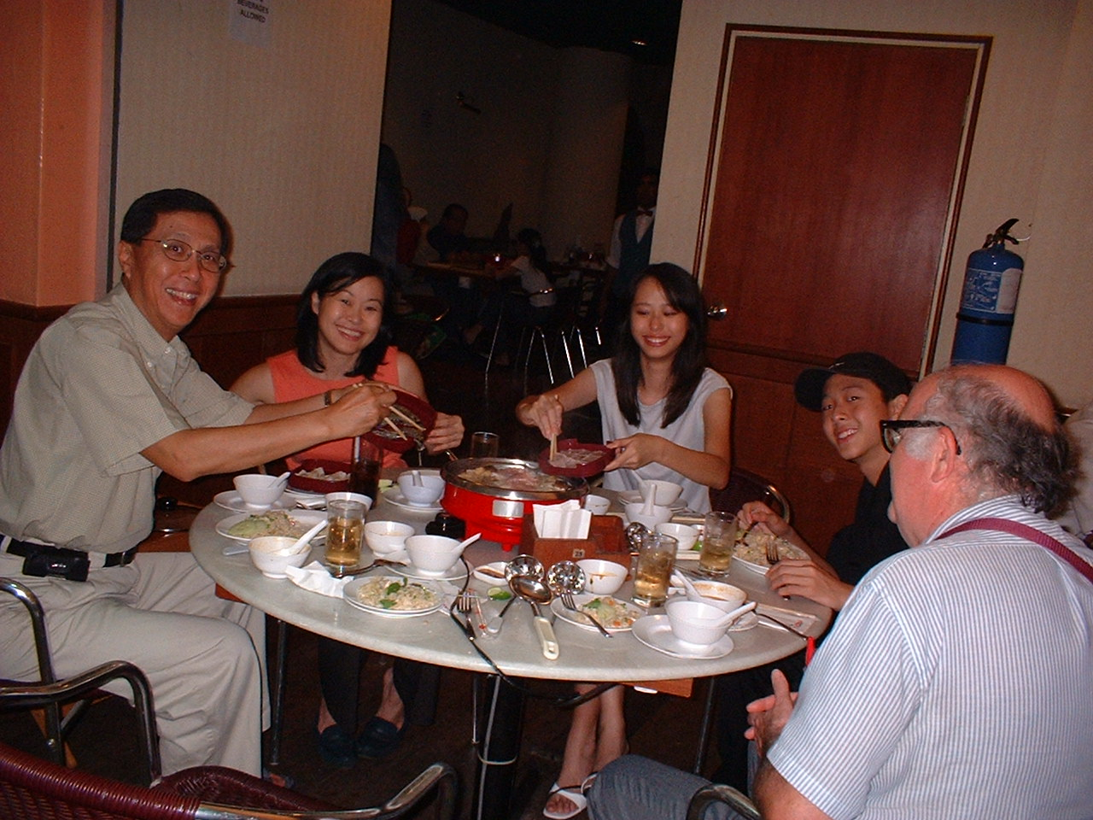
With hosts Peter & Suzy U and family

Slide 22
January 7-12: Malaysia
Wednesday, January 7:
  Talk to non-Christian students at University of Malaya: "Proof of God from Science"
  Lunch at UM faculty dining room with Prof Aziz Baharuddin et al
  Prayer meeting at Peoples Park Baptist Church, Petaling Jaya
    "Parables of Hidden Treasure & Valuable Pearl"

Slide 23
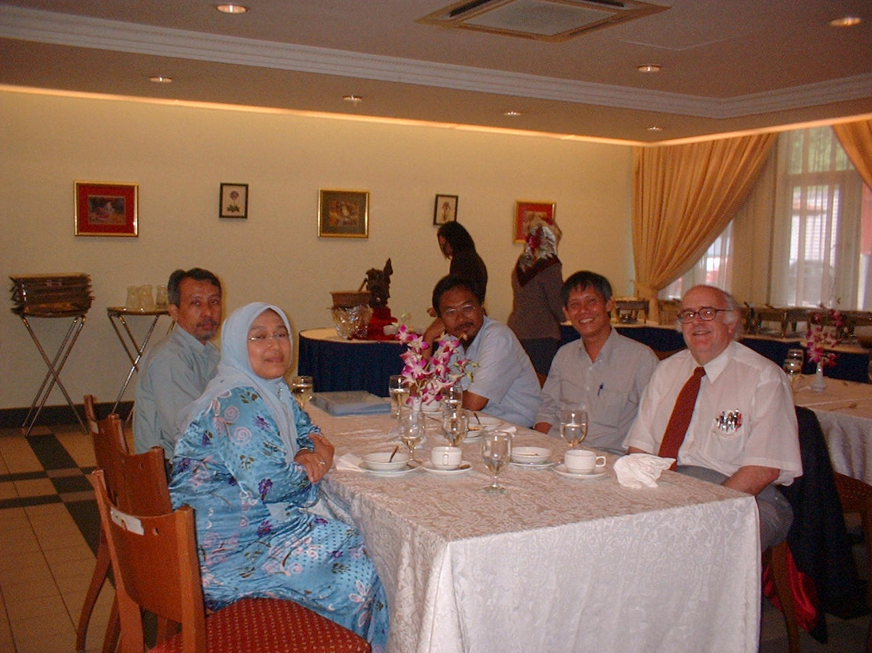
Lunch at Univ Malaya Faculty Dining Room

Slide 24
January 7-12: Malaysia
Thursday, January 8:
  Morning free
  5 pm – "Scientific Problems for Creation Science" to Geological Society and Graduate Christian Fellowship at UM
  7 pm – dinner with Living Lee and African Chemistry professor
  8 pm – Open discussion with UM Christian students (Varsity Christian Fellowship)

Slide 25
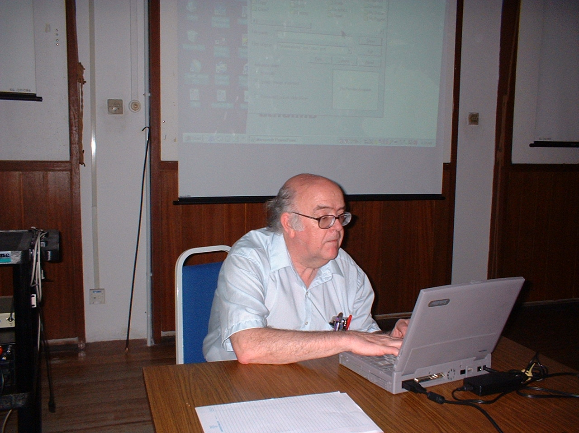
Preparing to give talk to Geological Soc and GCF

Slide 26
Scientific Problems for "Scientific Creationism"
How Old is the Earth?
Robert C. Newman

Slide 27
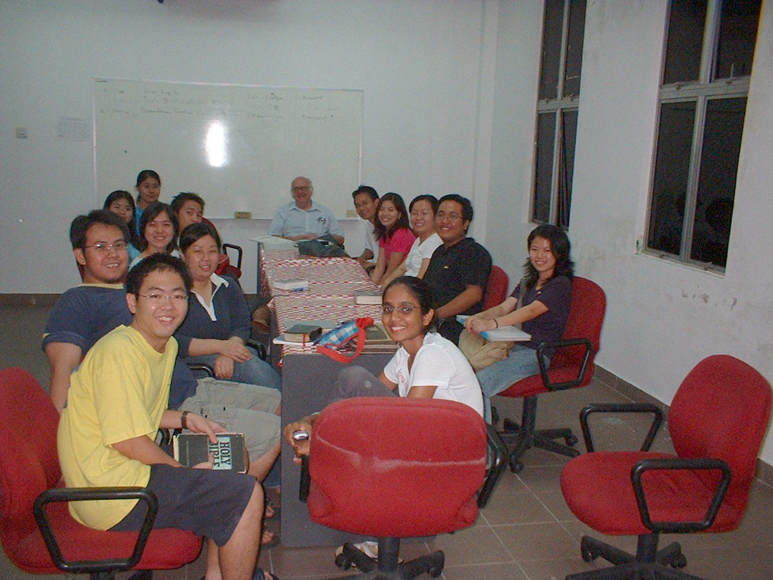
VCF students at University of Malaya

Slide 28

My cartoon book "What’s Darwin Got to Do with It?" in bilingual English-Chinese format

Slide 29
January 7-12: Malaysia
Friday, January 9
  At Bible College of Malaysia (AOG)
  1st session "Christianity and Science"
  Snack w/ President Ng Kok Lee and Lecturer Lim Yeu Chuen
  2nd session "Creation-Evolution Debate"
  Snack at McDonald's
  Housewarming for Suzy U's sister

Slide 30
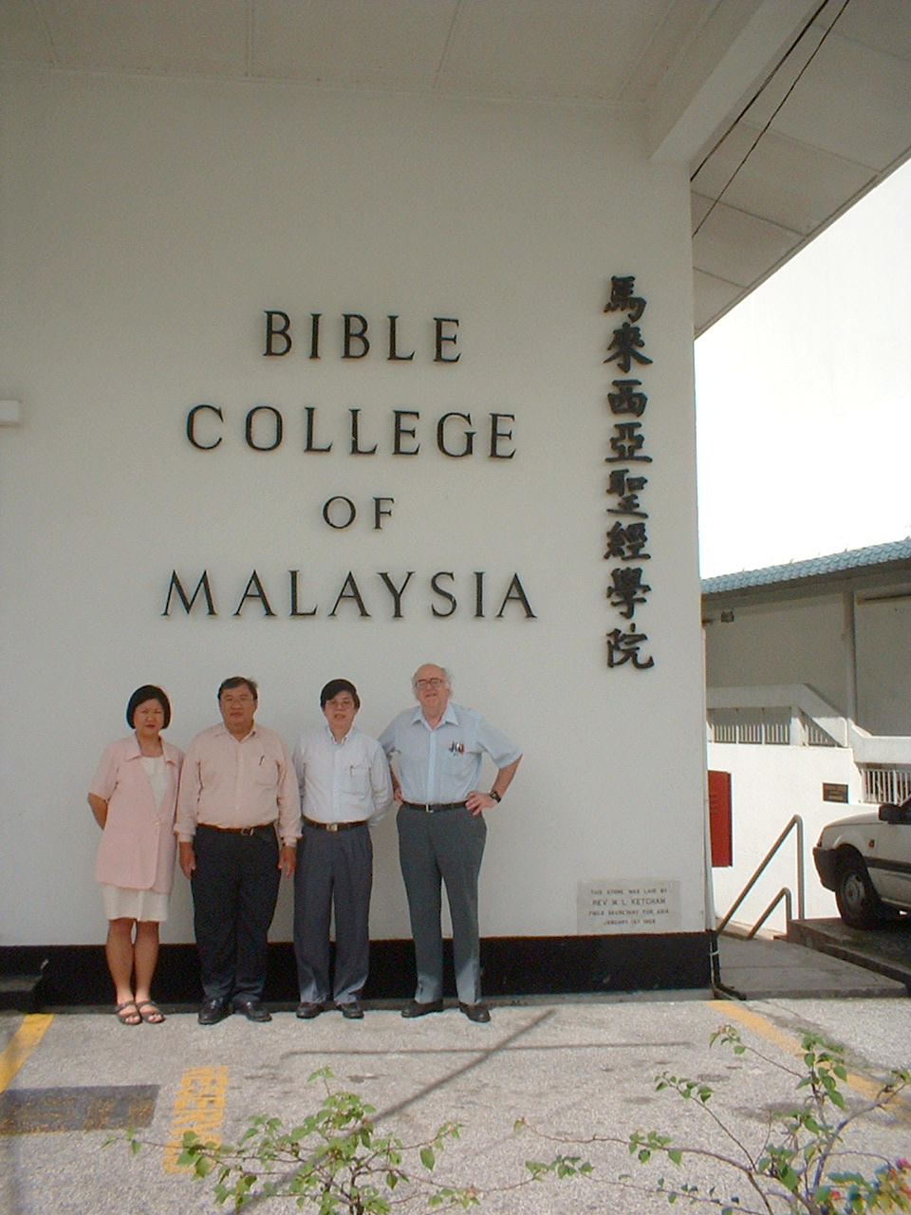
Newman with Academic Dean, Theology Lecturer, and President of BCM

Slide 31
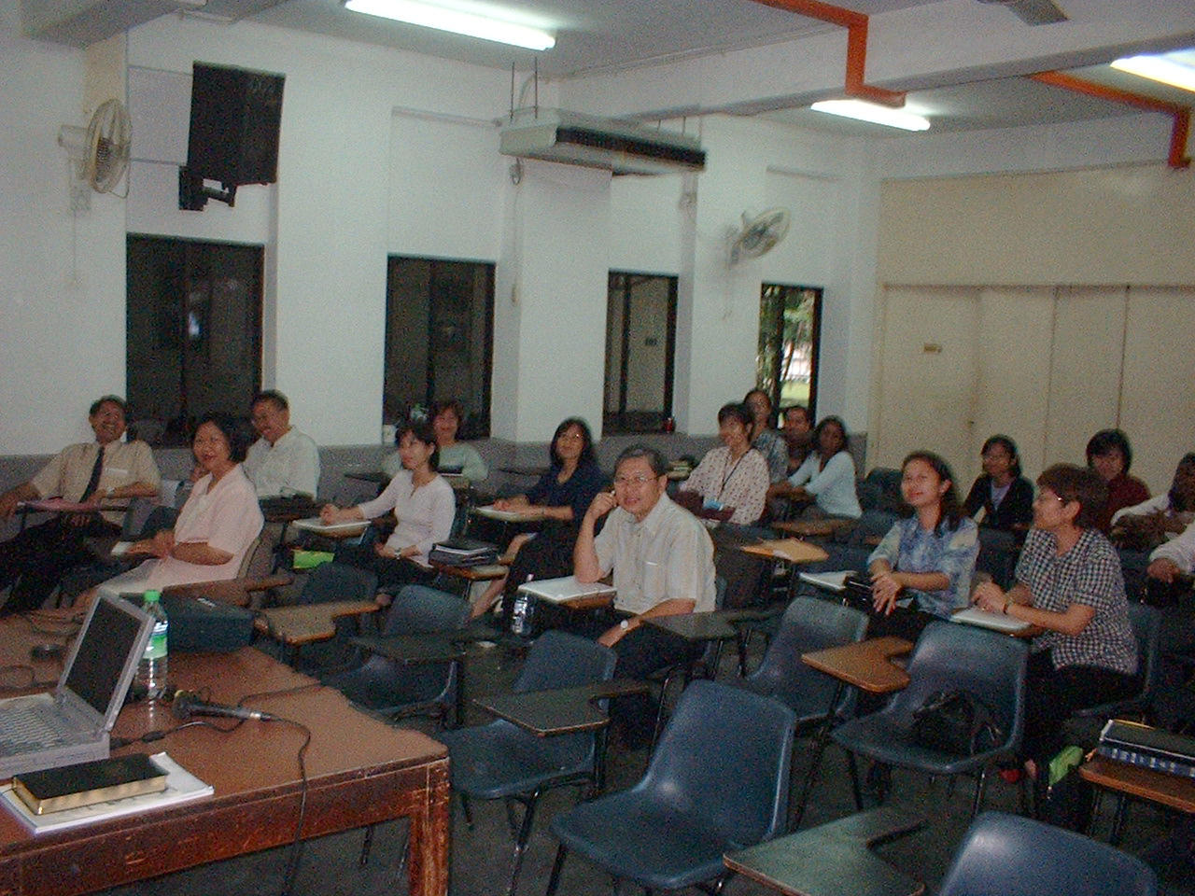
Seminary Students at Bible College of Malaysia

Slide 32
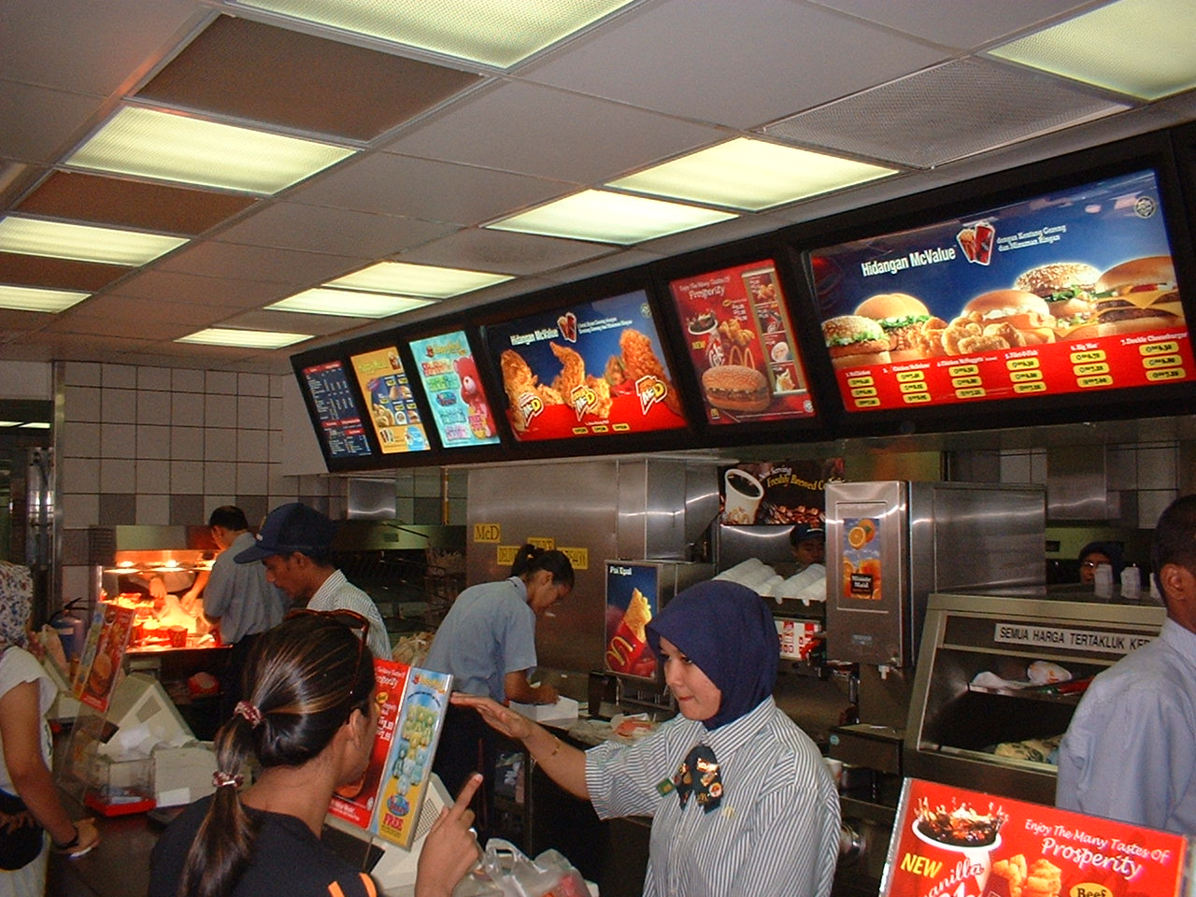
McDonald's in Kuala Lumpur, Malaysia

Slide 33
January 7-12: Malaysia
Saturday, January 10:
  Visit to 1Utama Mall
  Lunch with Living Lee at Shakey’s Pizza
  Presentation at Peoples Park Baptist Church for GCF and churches:
    "Discovering God's Fingerprints"

Slide 34
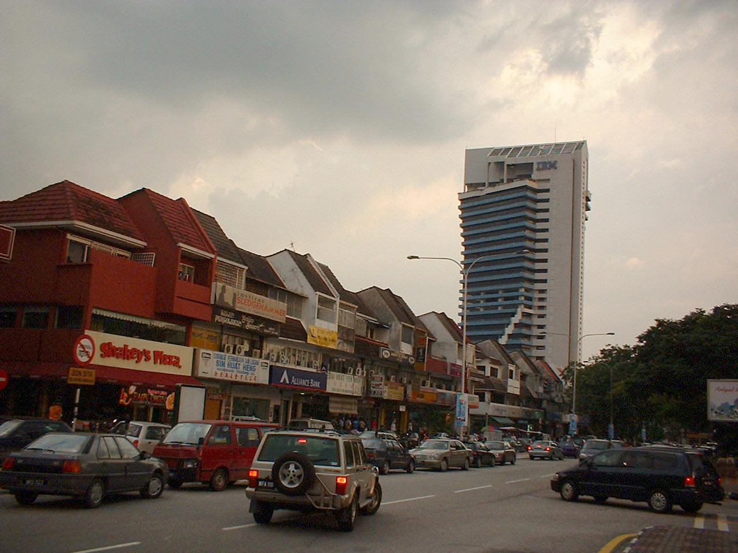
IBM, Shakey's Pizza, etc. at Taman Tun Dr. Ismail

Slide 35
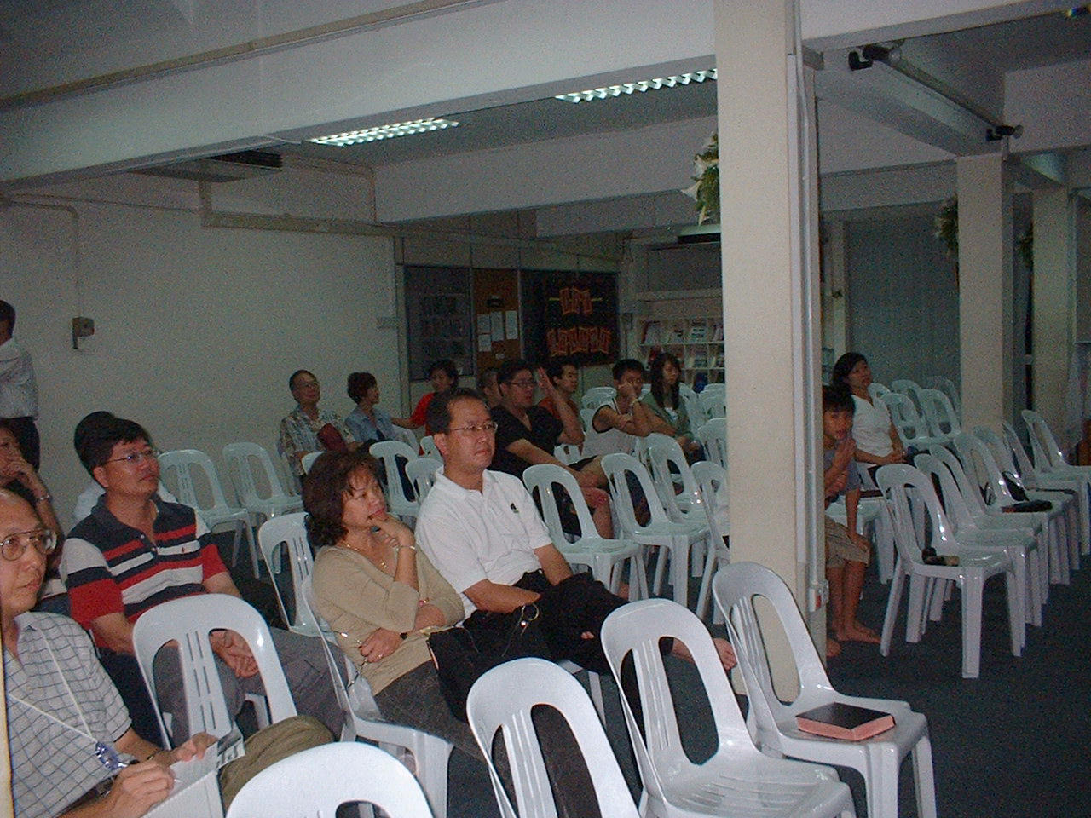
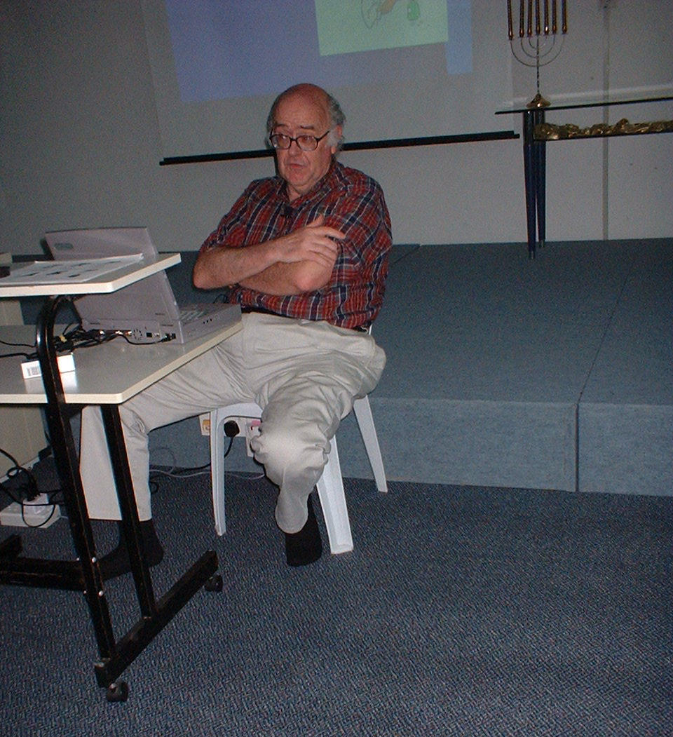
"Discovering God's Fingerprints" at Peoples Park Baptist Church

Slide 36
January 7-12: Malaysia
Sunday, January 11:
  Sunday service at Kota Damansara Agape Chapel "Parable of the Crooked Business Manager"
  Answer questions at SS hour
  Visit to KL Tower
  Visit to Chinatown
Monday, January 12:
  Free day

Slide 37
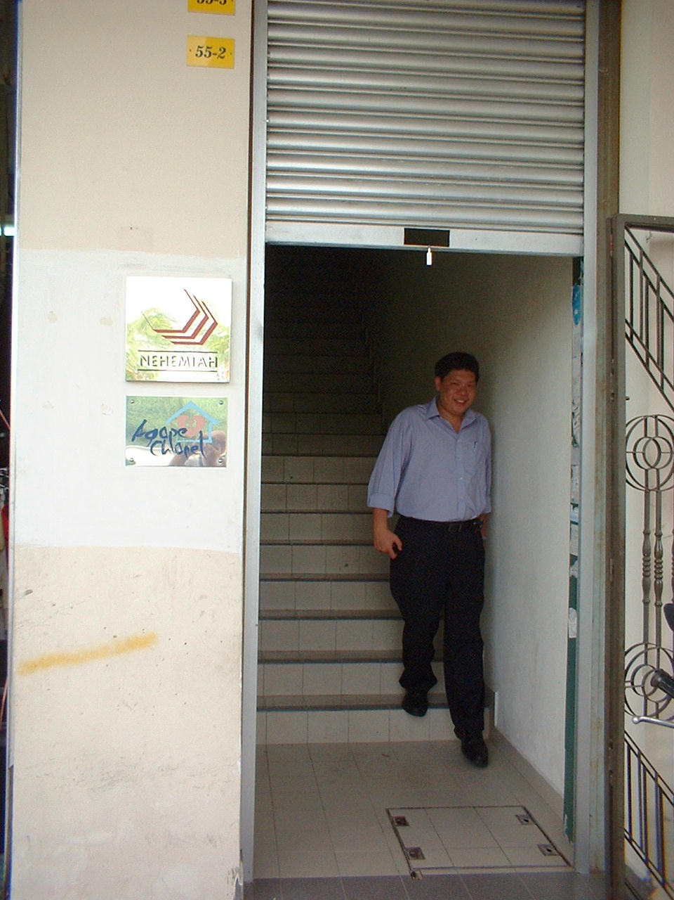
Entrance to Kota Damansara Agape Chapel (2nd floor over shops)

Slide 38
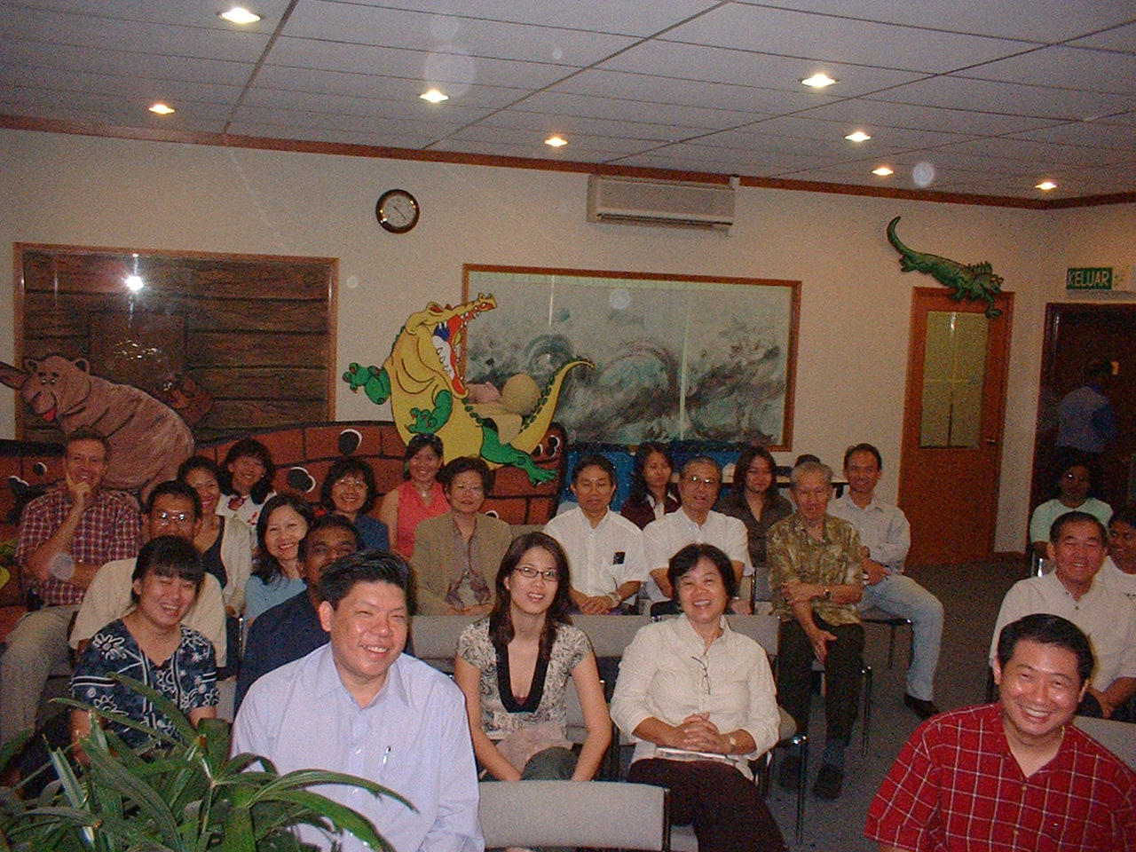
Part of congregation at Kota Damansara Agape Chapel

Slide 39
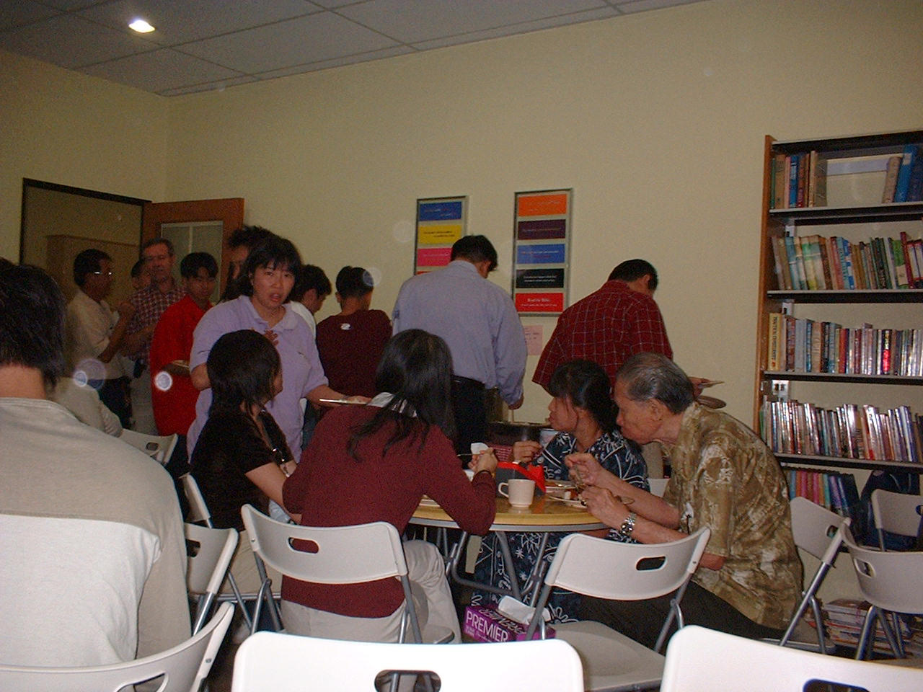
Between services snack at KD Agape Chapel

Slide 40
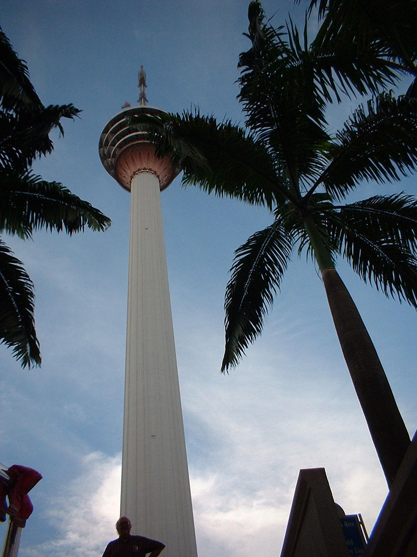
KL Tower, tallest concrete tower in the world, 4th tallest tele-communication tower. Top is 421 m (1368 ft); observation tower is 276 m (897 ft) high.

Slide 41
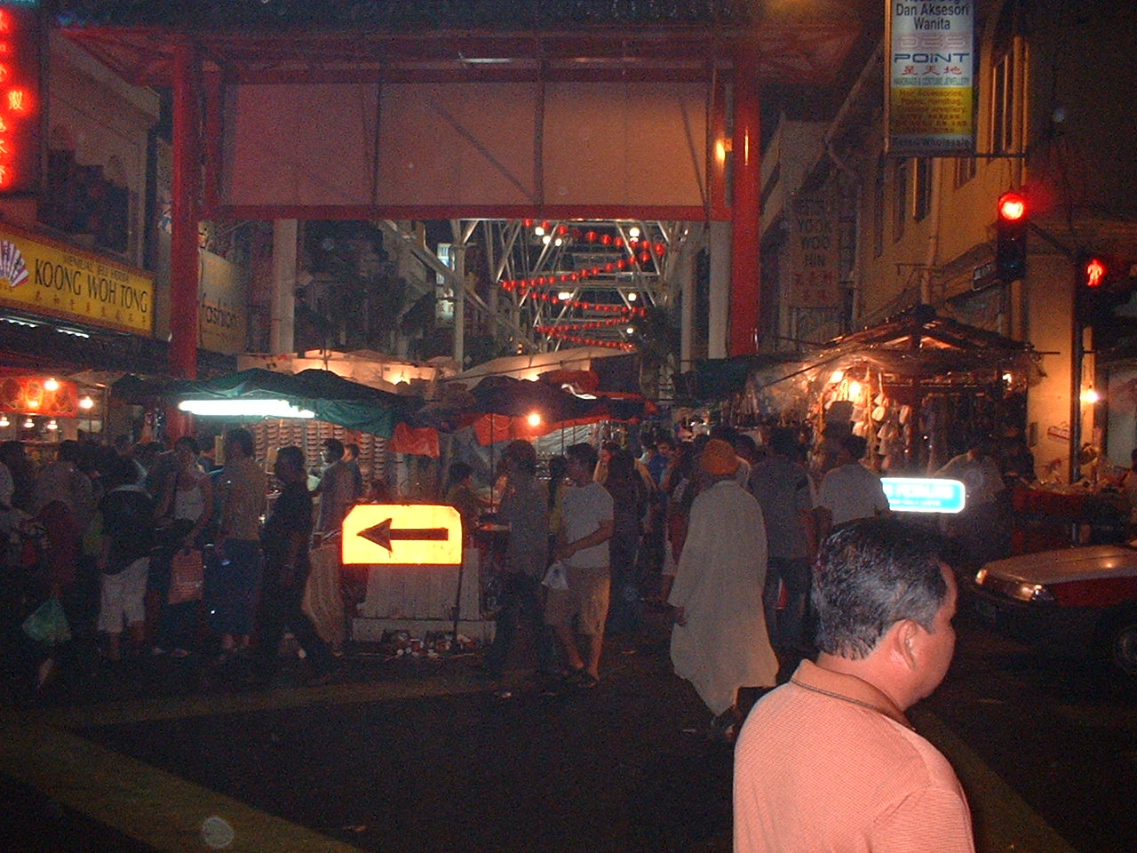
Chinatown in Kuala Lumpur, Malaysia

Slide 42
January 13: Back to Singapore
Express train from KL to KL Intl Airport
Flight to Singapore delayed ~ 2 hours
Arrive at Singapore ~ 3 pm
Staying at home of Kenneth & Helen Tan, Berwick Drive, Serangoon

Slide 43
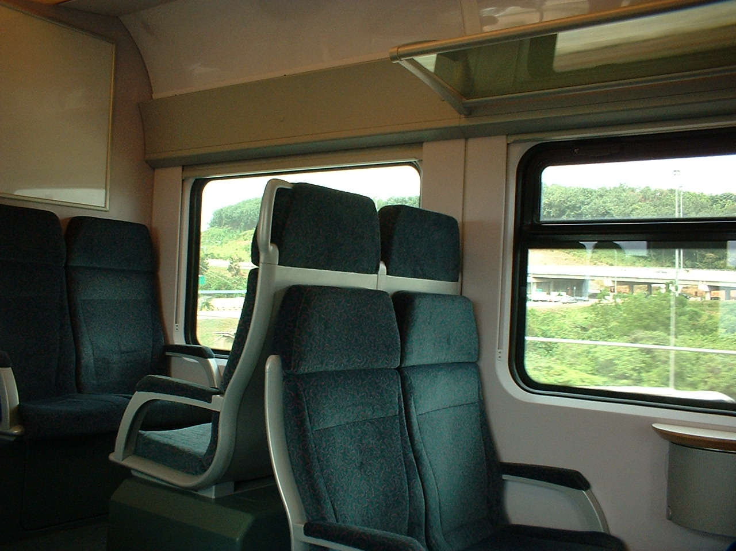
Express Train to KL International Airport

Slide 44
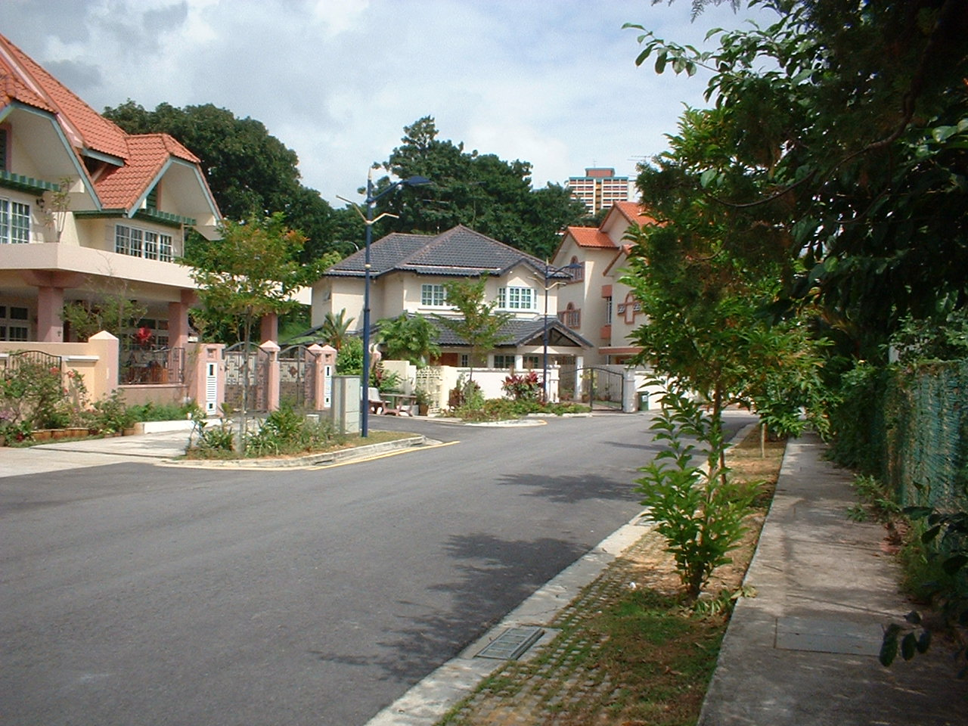
Home of Kenneth & Helen Tan, Berwick Dr, Serangoon

Slide 45
January 14-18: Singapore
Wednesday, January 14:
  AM – at Discipleship Training Center
    "Discovering God's Fingerprints"
  Lunch at Nanyang Technological Univ
    Informal discussion with Xn faculty
  Evening – at GCF Headquarters
    Islamic Study Group

Slide 46
Discovering God's Fingerprints
Why the Christian Faith Makes Sense
Robert C. Newman

Slide 47
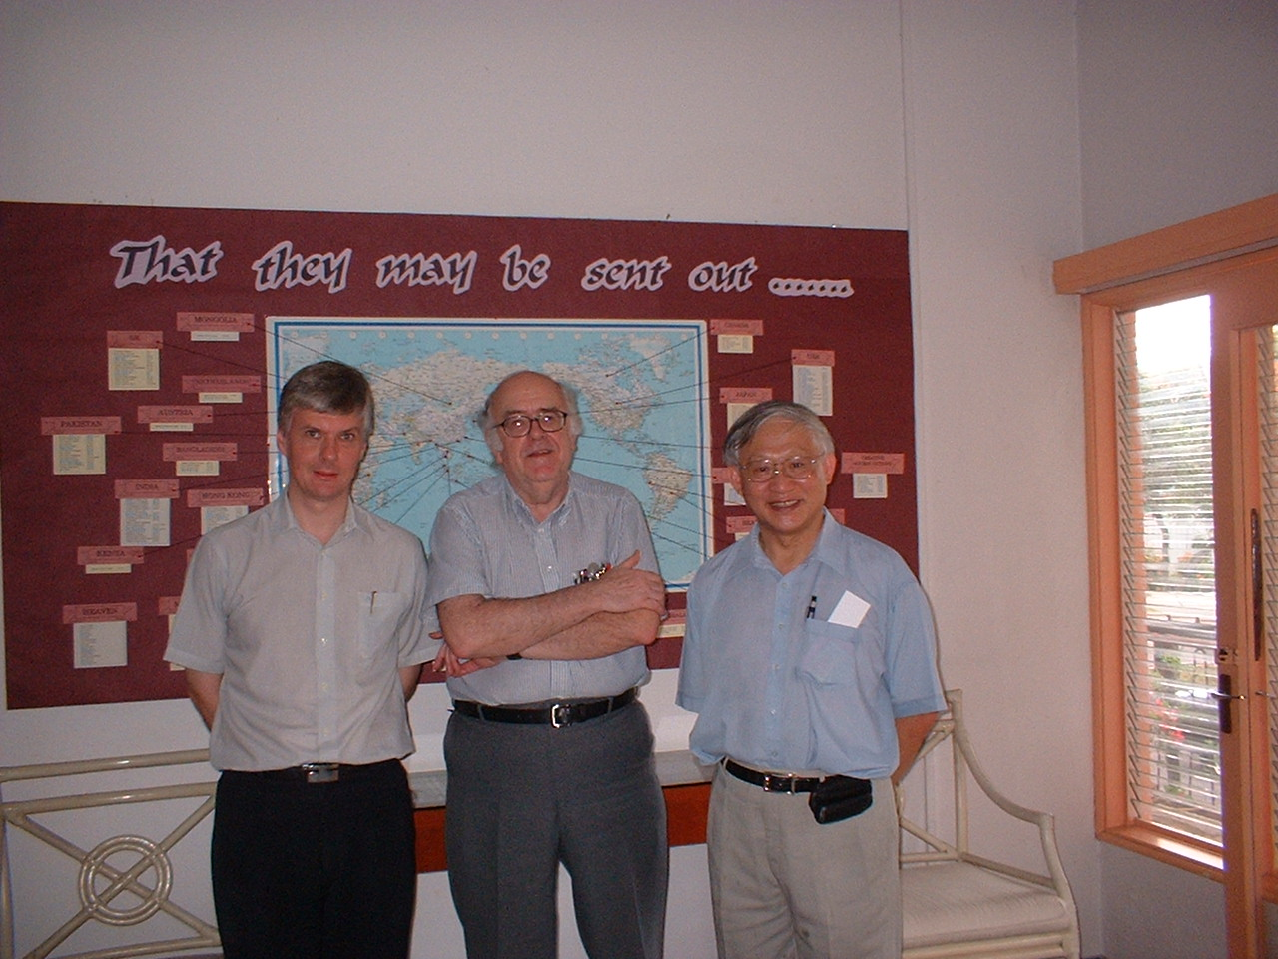
With Lecturer and Director,
Discipleship Training Centre

Slide 48
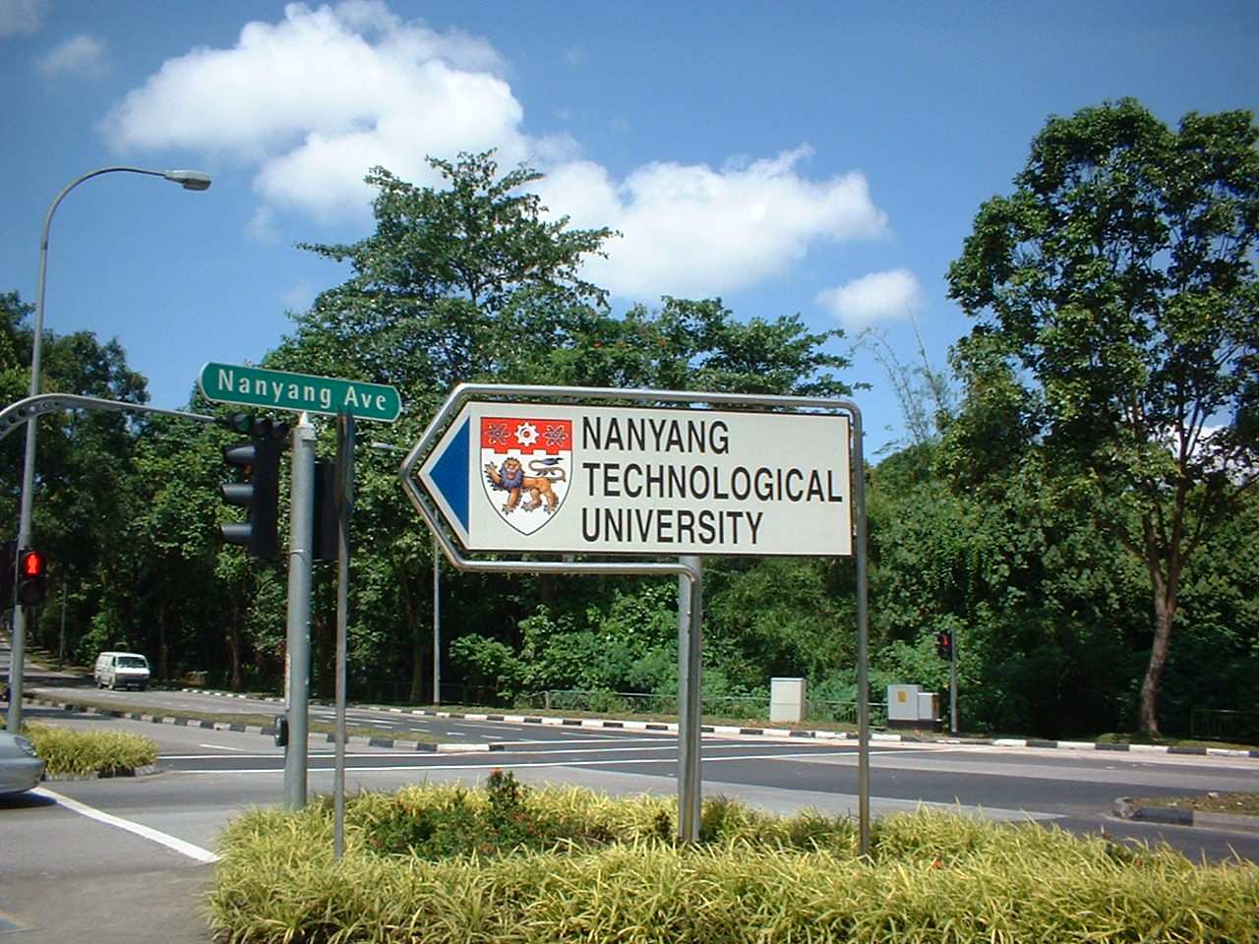

Slide 49
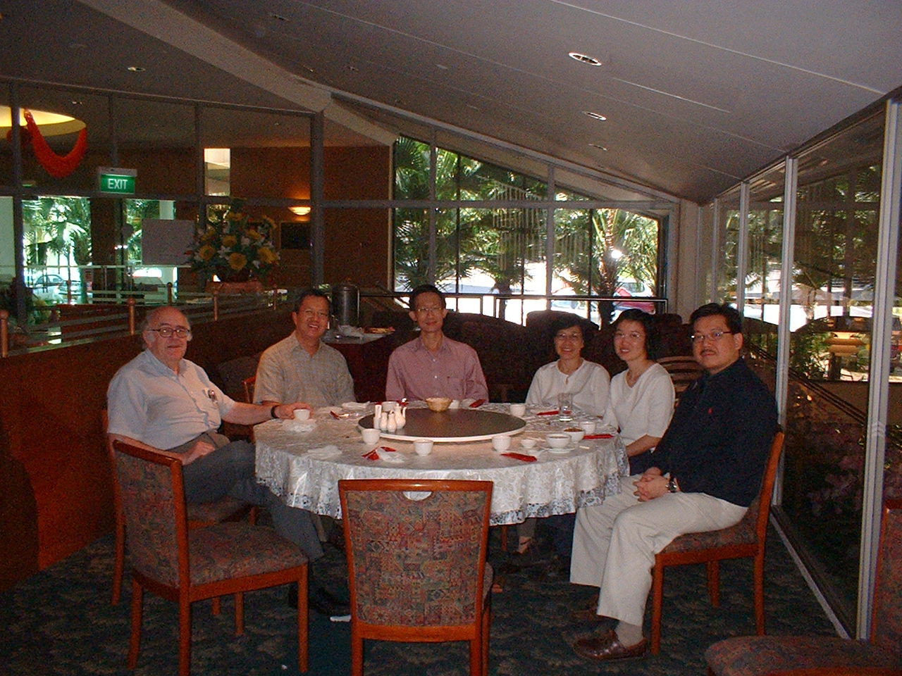
Lunch with Christian faculty at Nanyang Tech Univ

Slide 50
January 14-18: Singapore
Thursday, January 15:
  Farewell Lunch for staff member at Zion Bible Presbyterian Church
  Dinner with Kenneth Tan at Borshch Steakhouse
  Helping Hand drug rehab center
    "Evidence for the Resurrection"

Slide 51
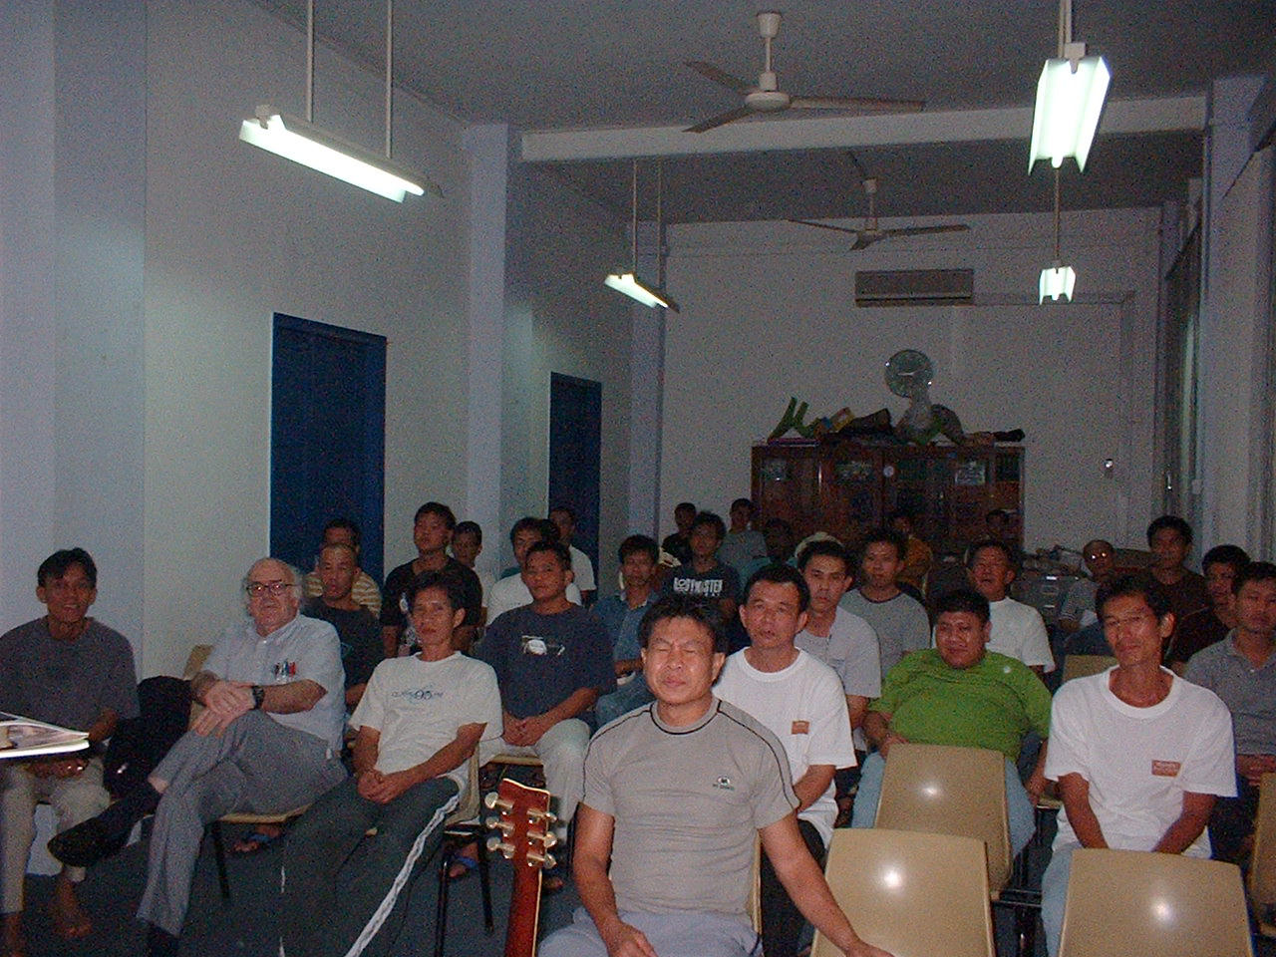
With residents at The Helping Hand

Slide 52
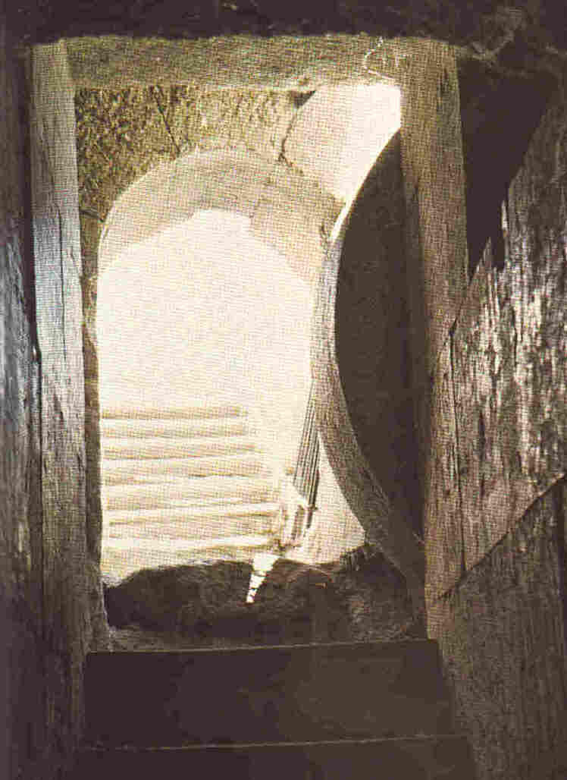
The Importance of
Jesus' Resurrection
Validates Jesus' claims vs charge for which he was executed
Indicates God accepted Jesus' sacrifice
Points to a life beyond this one
Reminds us that history is controlled by God

Slide 53
January 14-18: Singapore
Friday, January 16:
  At Singapore Polytechnic University with BTS alum Albert Ong
    Lunch in Staff dining room
    Lecture by Albert on Personal Development
  Trip to Chinatown with Kenneth Tan
    Souvenirs
    Dim-sum at Tak Po Restaurant

Slide 54
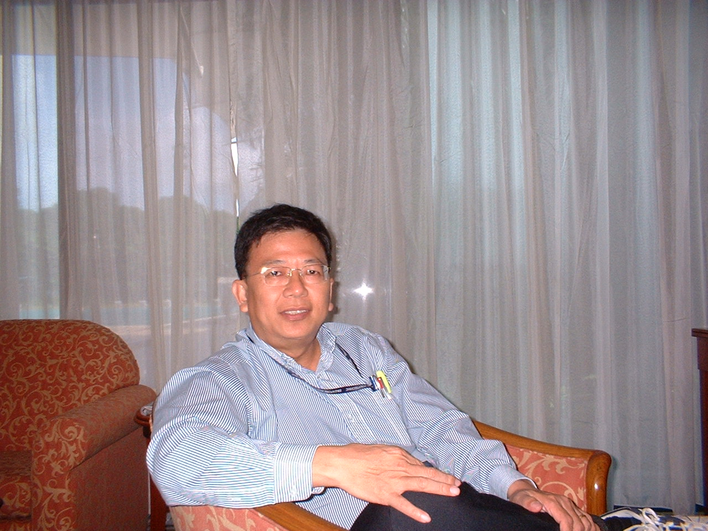
Biblical alumnus Albert Ong, teacher at Singapore Polytechnic University

Slide 55
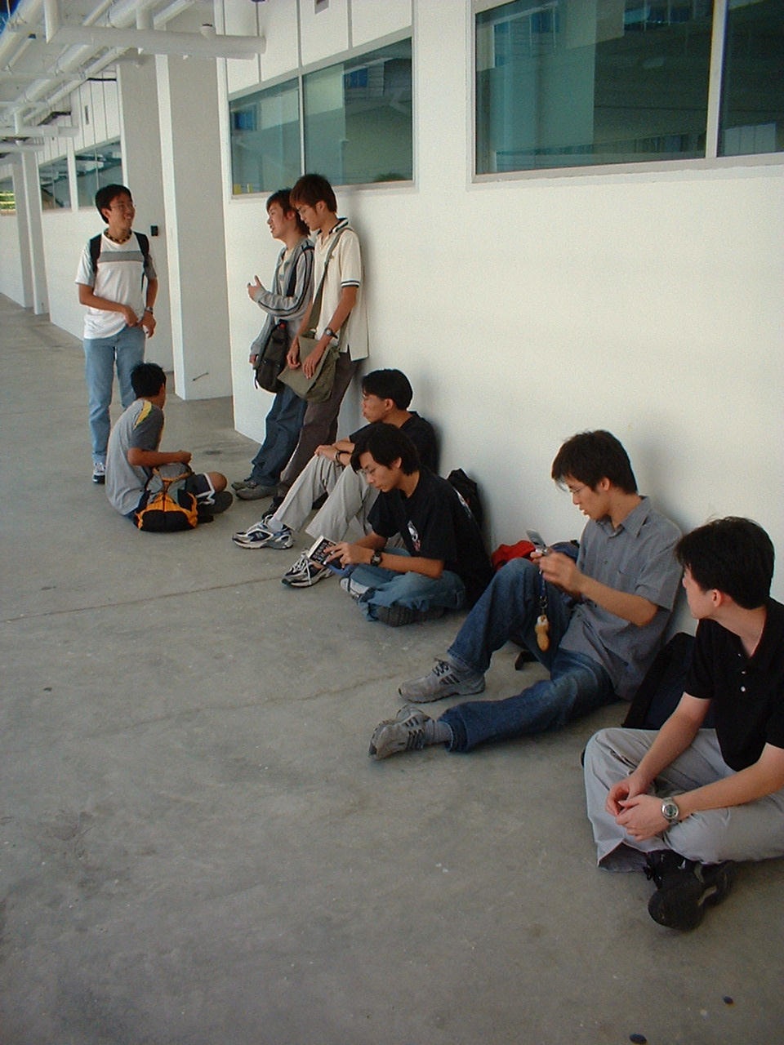
Some of Albert Ong's students waiting to get into classroom at SPU

Slide 56
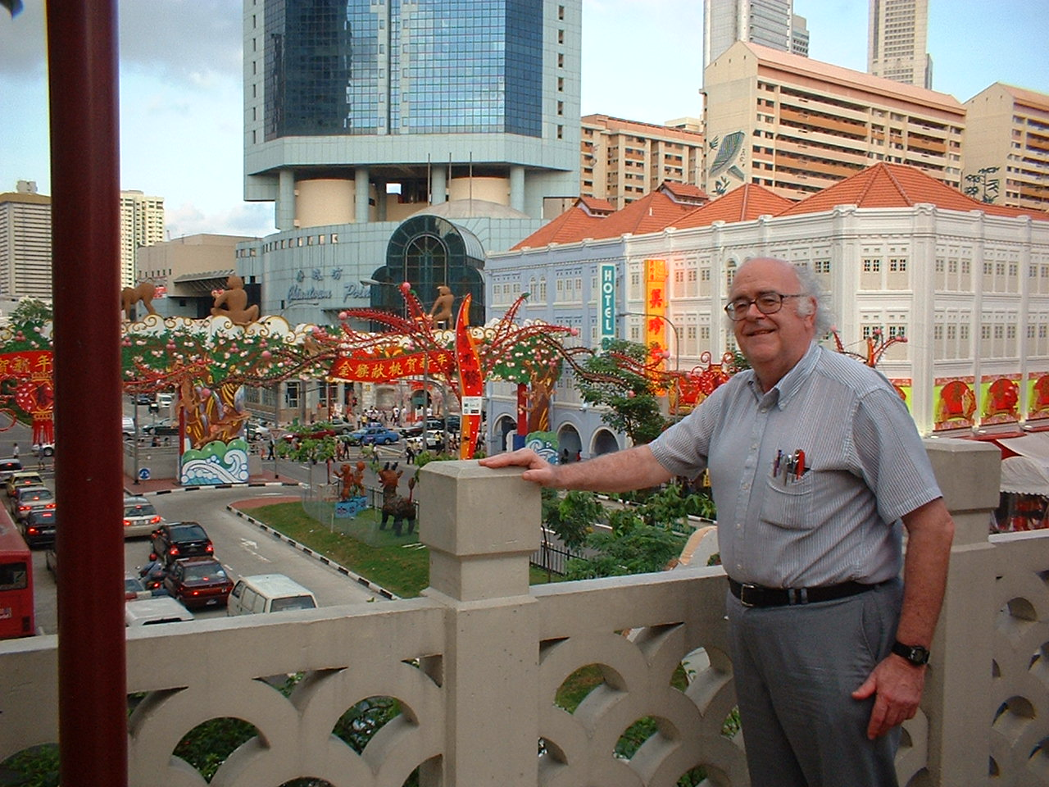
Singapore's Chinatown

Slide 57
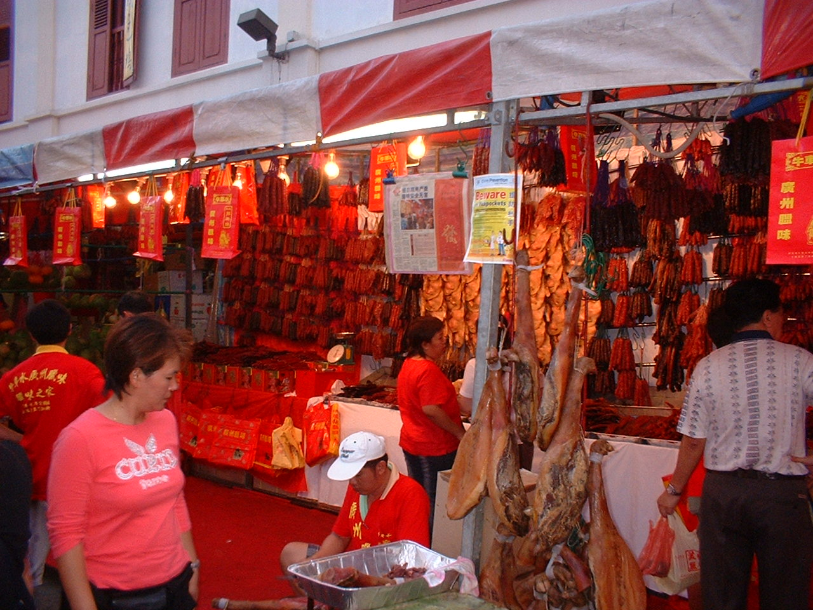
Singapore's Chinatown

Slide 58
January 14-18: Singapore
Saturday, January 17:
  Seminar at Zion BPC on Christianity and Science:
    "Evidence of God in Cosmos & Conscience"
    "Genetic Engineering & Cloning"
  Dinner at Raffles Town Club hosted by Dr. Erik Ang and his Action Group

Slide 59
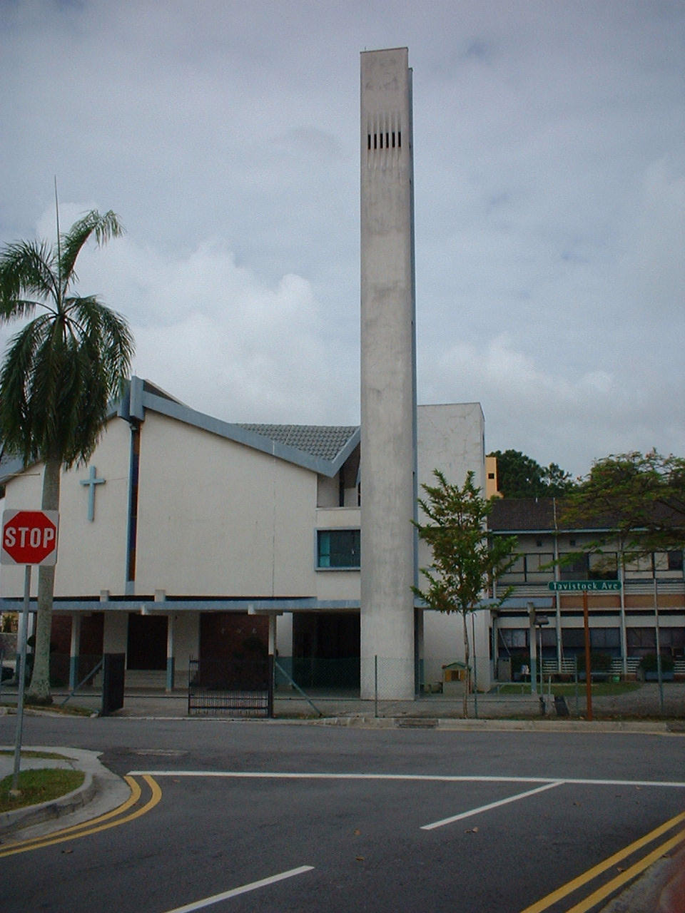
Zion Bible Presbyterian Church, Serangoon; Biblical alumnus Kim-Sin Yap, senior pastor

Slide 60
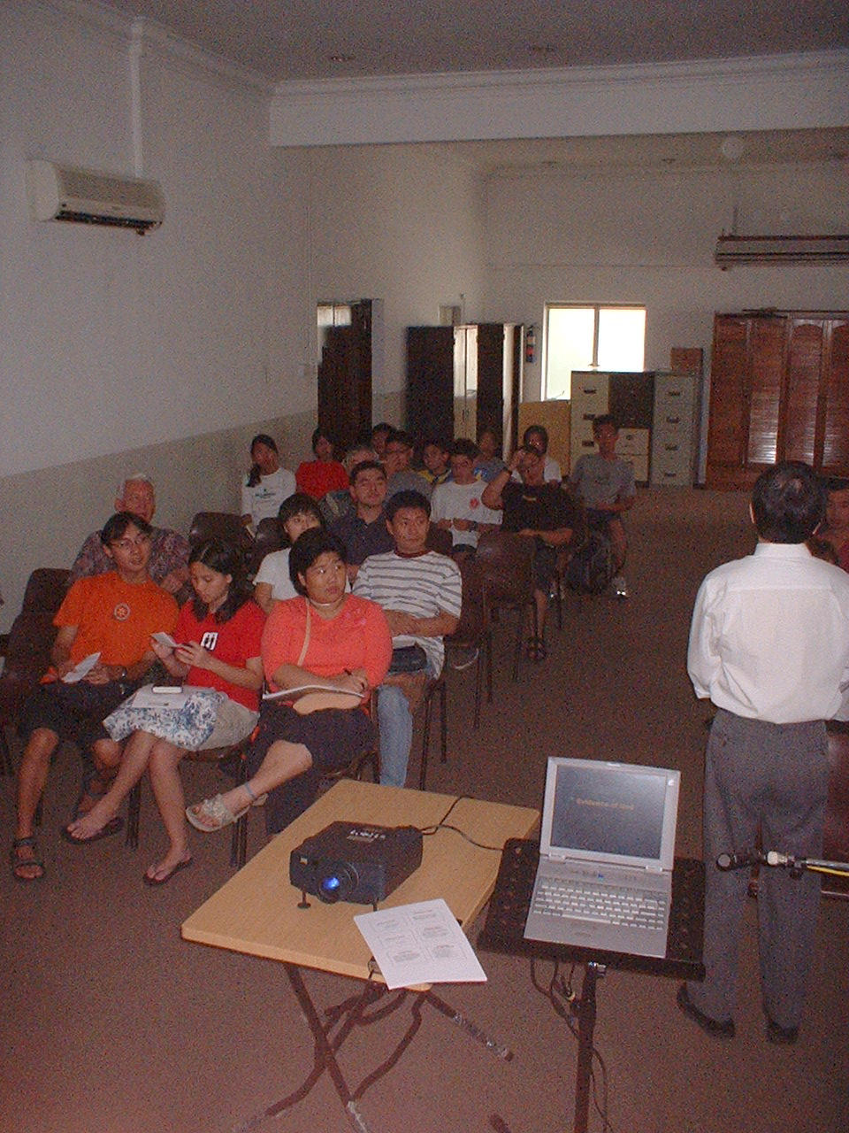
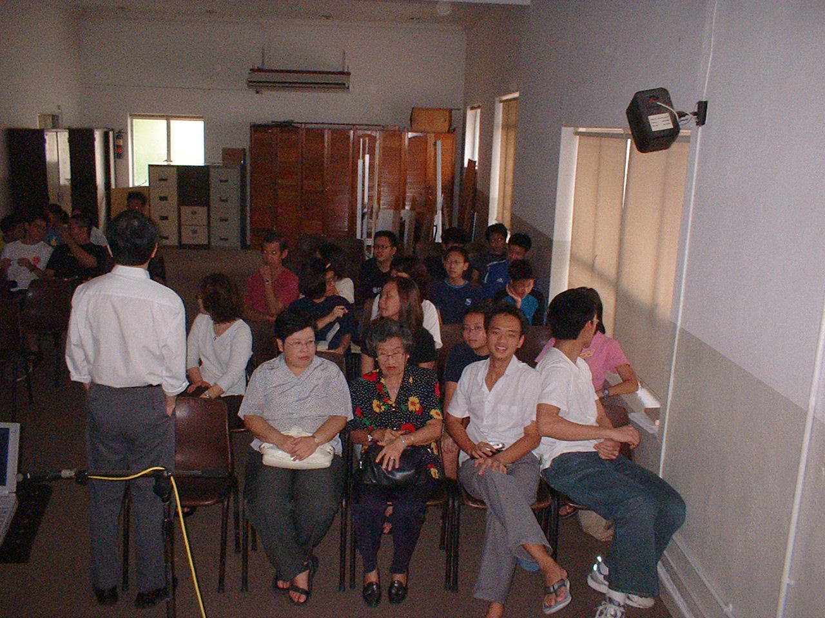
Seminar at Zion BP Church

Slide 61
A Brief History of Cloning
For centuries it has been known that simple animals – worms & starfish – can be cloned by cutting them in half.
This doesn't work for higher animals!
Part of the problem is cell specialization:
  Nerve
  Bone
  Muscle, etc.

Slide 62
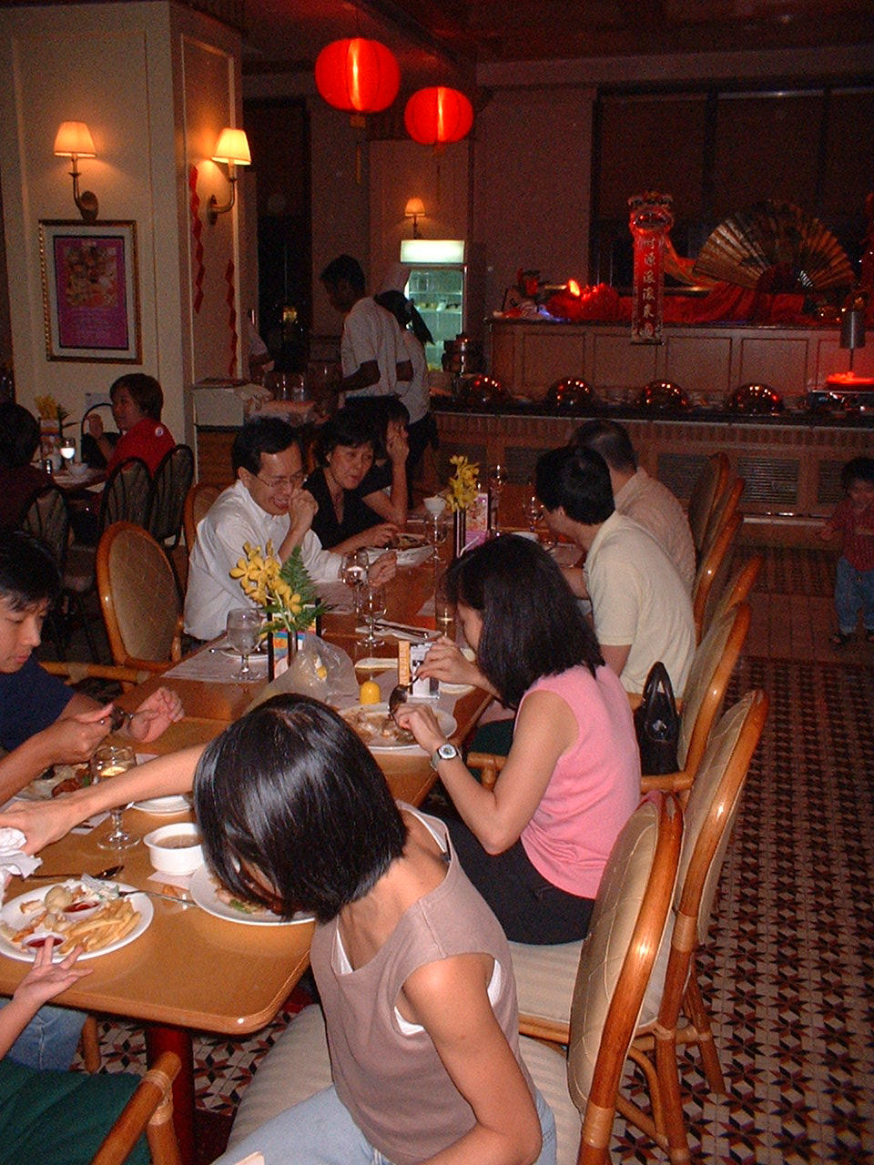
Dinner at Raffles Town Club, hosted by Dr. Erik Ang and his small group

Slide 63
January 14-18: Singapore
Sunday, January 18:
  Preach AM service at Zion BPC:
    "Apostasy & Assurance" (Heb 6:13-20)
  Teach combined Youth & Adult classes:
    "Search for the Historical Jesus"
  Lunch at Serangoon Garden CC hosted by Deacon Daniel Ang
  Preach PM service at Zion BPC:
    "Encountering Jesus" (John 1:43-51)

Slide 64
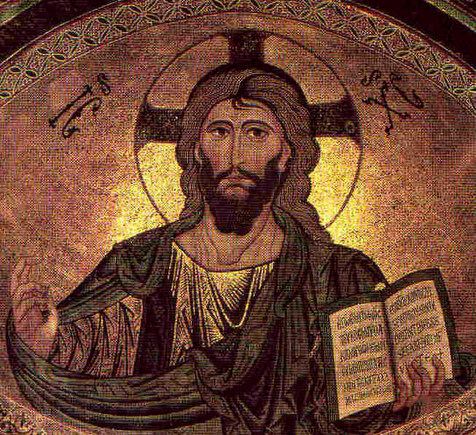
Why all this variety?
Are the Gospels really this unclear?
No, but if you haven't read them, you're a sucker for every charlatan that comes along.
But why all this variety?

Slide 65
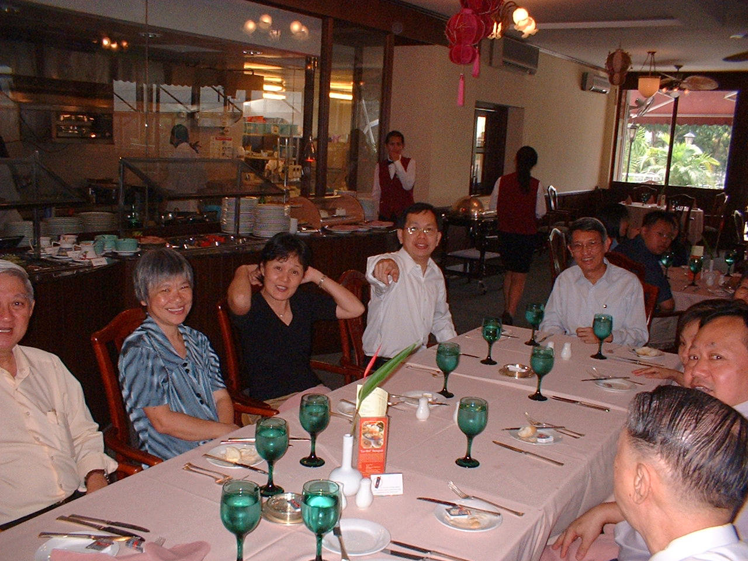
Lunch at Serangoon Garden Country Club

Slide 66
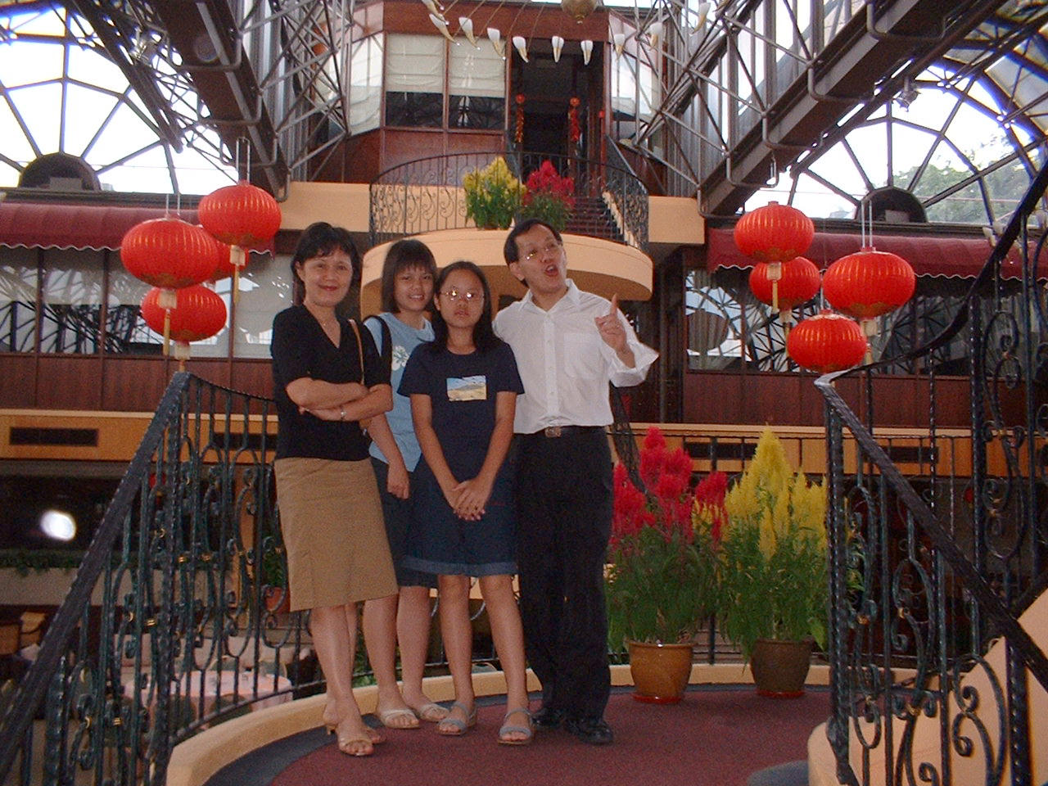
Kim-Sin and family: Swee-Toh (June), Erica, Lindsay

Slide 67
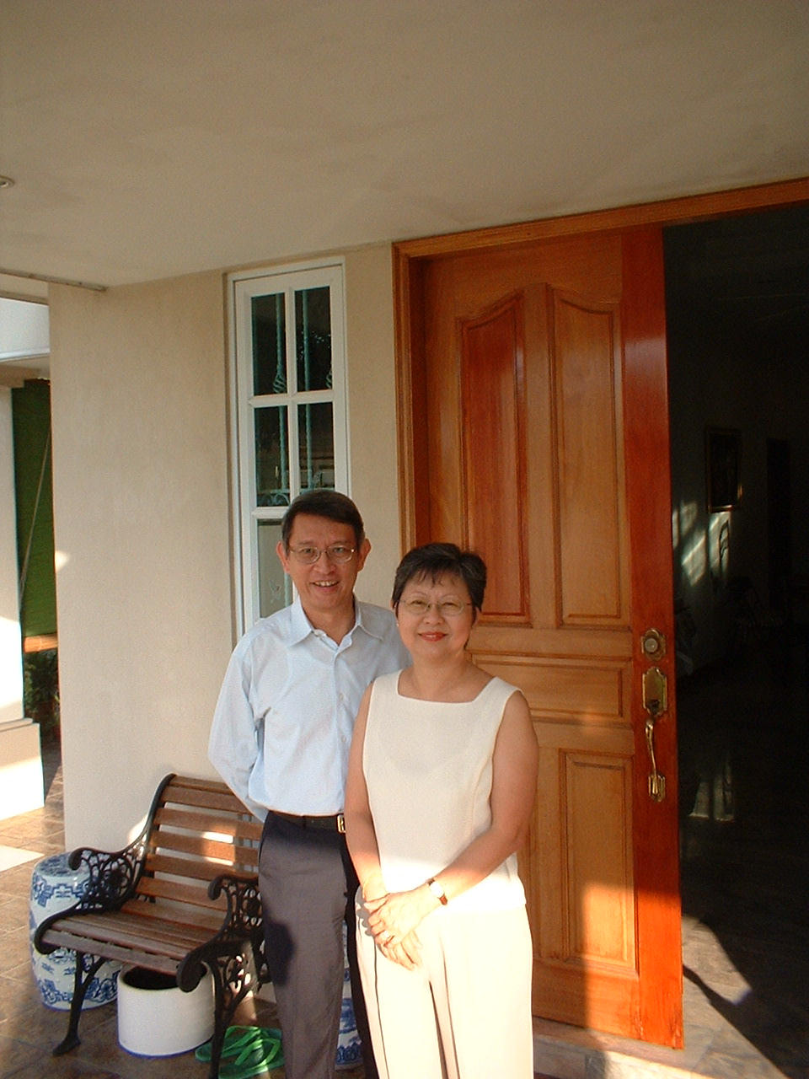
Hosts Kenneth & Helen Tan

Slide 68
January 19: Coming Back
6:50 am – leave Singapore
10:30 am – arrive Hong Kong
11:35 am – leave Hong Kong
11:45 am – arrive Chicago
1:25 pm – leave Chicago
4:19 pm – arrive Baltimore
7:30 pm – arrive home!

Slide 69
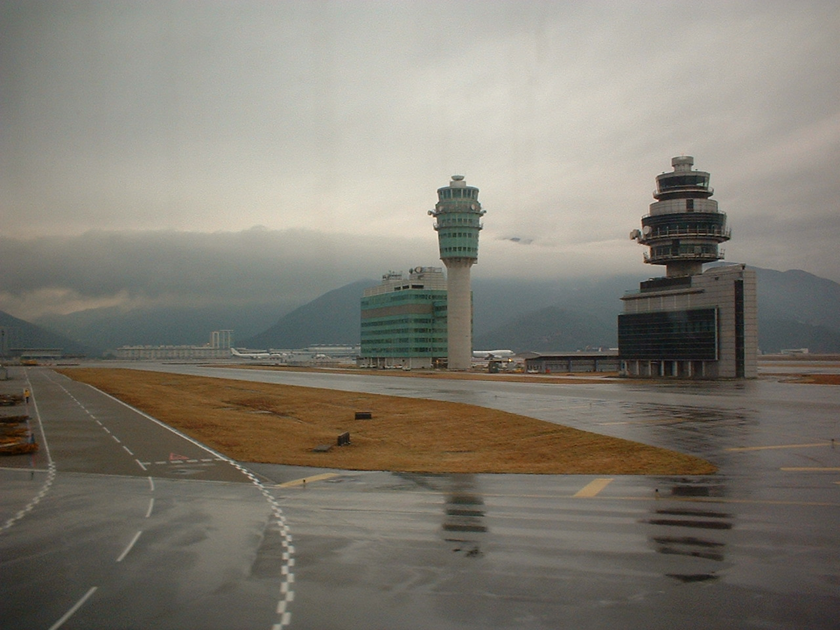
Hong Kong Airport

Slide 70
The End
Tiring but Rewarding!

