Slide 1
The Star of Bethlehem
What Was It?
Robert C. Newman
Biblical Theological Seminary

Slide 2
What was It?
Was it natural?
A comet?
A planetary conjunction?
A supernova?
Was it supernatural?
An angel?
The Shekinah glory?
Some other bright light?

Slide 3
Was It Natural?
Do we have other historical references?
Can we re-enact it with a computer?
But if it was at astronomical distances, it won't fit Matthew's account of guiding the Magi to the right location.

Slide 4
Was It Supernatural?
A localized bright light could easily lead the Magi to the right place.
It is not likely that such an object would leave extra-biblical traces in the historical record.

Slide 5
Was It a Hybrid?
Here we will propose a hybrid model:
Part natural
Part supernatural
We suggest a model that leaves us something to investigate 2000 years later …
… and also fits a straight-forward reading of Matthew's account.

Slide 6
What Sort of Hybrid?
We propose a modification of Ernest Martin's interpretation: a series of planetary & stellar conjunctions …
… to which we add a localized bright object which would have been seen by the Magi as the 'same' star, and which leads them to where the baby Jesus is.

Slide 7
The Natural Part
A series of planetary
& stellar conjunctions

Slide 8
Ancient planetary positions
… have been calculated occasionally since John Kepler (~1600).
This is very tedious when done by hand.
The development of electronic computers has made calculations much easier.
Thus, in 1962, the American Philosophical Society published Bryant Tuckerman's computer tables, Planetary, Lunar and Solar Positions 601 BC to AD 1.

Slide 9
Roger Sinnott's Research
Sinnott looked thru Tuckerman's tables to find all close planetary conjunctions occurring near the birth of Jesus.
Among these, he found one very close conjunction, of Venus and Jupiter in the constellation Leo, on the evening of 17 June 2 BC.
Such a conjunction would happen less than once every thousand years.

Slide 10
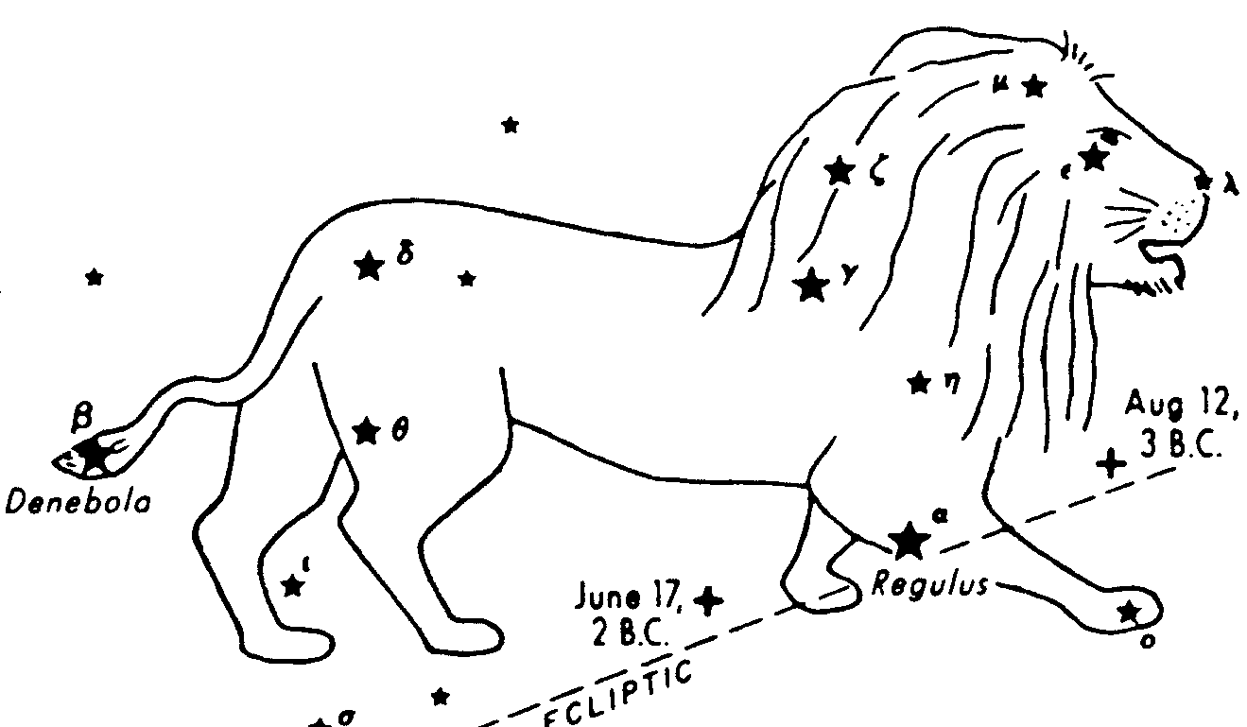
Sinnott's Research

Slide 11
Roger Sinnott's Paper
Sinnott published his results in the December 1968 issue of the magazine Sky and Telescope.
His suggestion has been adopted as the Christmas program at many planetariums all over the world.

Slide 12
Ernest Martin's Research
Martin, in his book The Star that Astonished the World (1991), noticed that within a year of Sinnott's conjunction there were several other conjunctions usually involving one or both of these planets.
He suggested that the symbolism of these conjunctions would have brought the Magi to Jerusalem to look for a newborn king of the Jews.

Slide 13
Martin's Conjunctions
12 Aug 3 BC Venus-Jupiter 4.3'
31 Aug 3 Mercury-Venus 22'
11 Sept 3 Sun-Moon-Virgo --
14 Sept 3 Jupiter-Regulus 20'
17 Feb 2 Jupiter-Regulus 51'
8 May 2 Jupiter-Regulus 43'
17 June 2 Venus-Jupiter 0.5'
26 Aug 2 Mars-Jupiter 7'

Slide 14
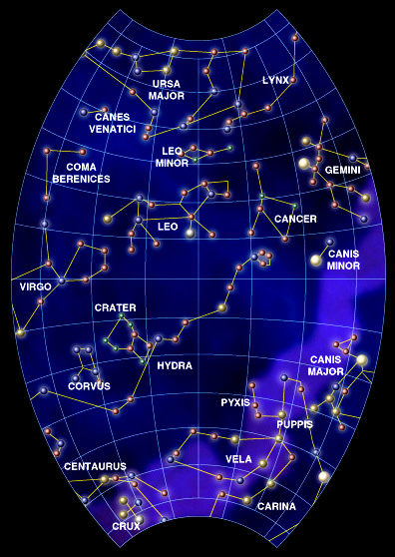
Region of the Sky
for our Conjunctions
Leo (the Lion)
Virgo (the Virgin)

Slide 15
Martin's Conjunction 1
12 August, 3 BC, Venus & Jupiter
Jupiter (the king planet), having left the Sun (the supreme Father), is now joined with Venus (the mother).
Sun, moon, Mercury (the messenger) are also with Venus & Jupiter in Leo (the lion), which represents the tribe of Judah.
Some important royal event is to happen in Judah.

Slide 16
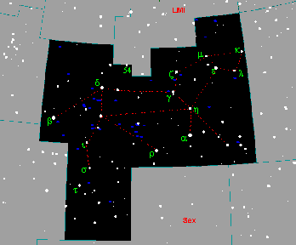
Martin's Conjunction 1
12 August, 3 BC
Jupiter & Venus

Slide 17
Martin's Conjunction 2
31 August, 3 BC, Mercury & Venus
Mercury (the heavenly messenger), having left the Sun, now arrives at Venus (the mother). The Sun is now in Virgo (the virgin).
God's message is sent to the mother.

Slide 18
Martin's Conjunction 2
31 August, 3 BC
Mercury & Venus

Slide 19
Martin's Conjunction 3
11 September, 3 BC, Sun, Moon & Virgo
The vision of the woman about to give birth in Revelation 12:1-5 can easily be understood astrologically to mark an exact date.
If the woman is taken to be the constellation Virgo (the virgin), then the Sun clothes her body about one month each year.

Slide 20
Revelation 12
12:1 (NIV) A great and wondrous sign appeared in heaven: a woman clothed with the sun, with the moon under her feet and a crown of twelve stars on her head. 2 She was pregnant and cried out in pain as she was about to give birth. 3 Then another sign appeared in heaven: an enormous red dragon with seven heads and ten horns and seven crowns on his heads. 4 His tail swept a third of the stars out of the sky and flung them to the earth. The dragon stood in front of the woman who was about to give birth, so that he might devour her child the moment it was born. 5 She gave birth to a son, a male child, who will rule all the nations with an iron scepter. And her child was snatched up to God and to his throne.

Slide 21
Martin's Conjunction 3
The sun clothes Virgo for one month each year.
The Moon will pass through Virgo each month, so that in this month, it is (just) under her feet on one particular day.
In 3 BC, that day is September 11.
Martin takes this to be the date of Jesus' birth.

Slide 22
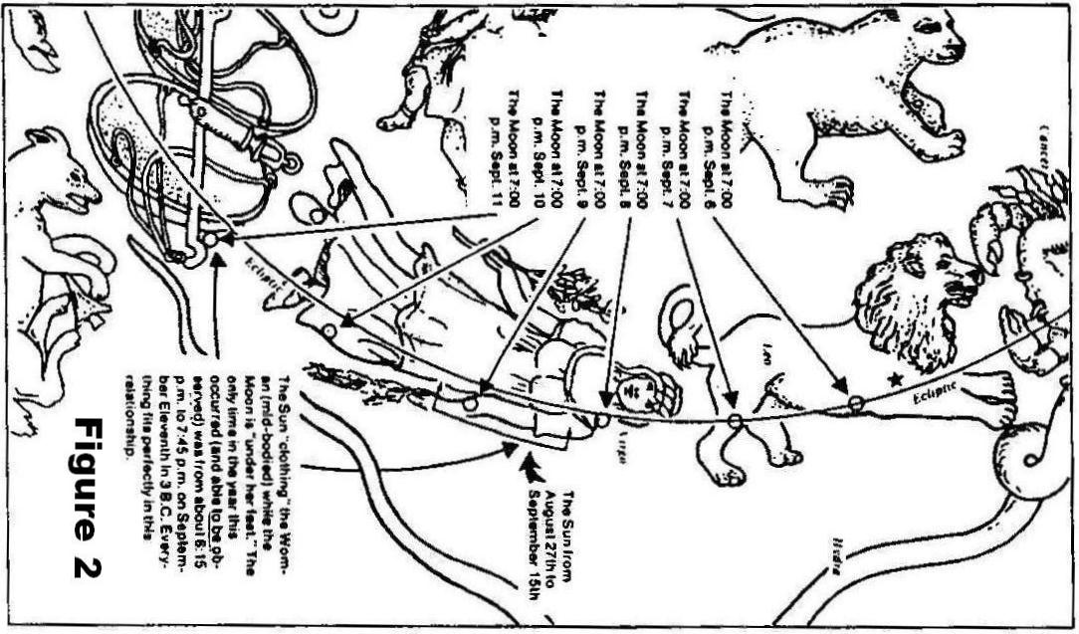
Martin's Conjunction 3

Slide 23
Martin's Conjunctions 4-6
14 September, 3 BC
17 February, 2 BC
8 May, 2 BC
Three conjunctions of Jupiter with Regulus, the brightest star in Leo, located between the lion's feet.
Martin notes the prediction in Genesis 49:10.

Slide 24
Genesis 49:9-10
9 (NIV) You are a lion's cub, O Judah; you return from the prey, my son. Like a lion he crouches and lies down, like a lioness– who dares to rouse him? 10 The scepter will not depart from Judah, nor the ruler's staff from between his feet, until he comes to whom it belongs and the obedience of the nations is his.

Slide 25
Martin's Conjunctions 4-6
Martin sees these three conjunctions as Jupiter (the king planet), circling Regulus (the king star), placing a crown on him.

Slide 26
Martin's Conjunction 7
17 June, 2 BC, Jupiter and Venus
A very rare, very close conjunction, with the minimum separation variously estimated to be 3 minutes of arc (Sinnott), ½ minute (Martin) or 1/10 minute (Carroll).
The frequency of such a close conjunction (depending on which estimate is right) would range from once in 1150 years to once in about 34 thousand years.

Slide 27
Martin's Conjunction 7
Martin sees this conjunction as having the same significance as that of 12 August, 3 BC; some important royal event to happen in Judah.
Given the 31 Aug conjunction of messenger and mother, this is presumably a birth.
He suggests this conjunction also sends the Magi on their way, and they arrive at Jerusalem about 25 December.

Slide 28
Martin's Conjunction 7
17 June, 3 BC
Jupiter & Venus

Slide 29
Martin's Conjunction 8
26 August, 2 BC
A close conjunction of Jupiter and Mars (war) in Leo, with Venus & Mercury also in Leo, and the Sun in Virgo
Martin suggests this sign may mean that these events will lead to war.

Slide 30
My Modifications
Recently I have noticed several things about these conjunctions that suggest some modifications of Martin's view.
When these changes are made, the symbolism of the conjunctions snaps into focus in a remarkable way!
Let's see.

Slide 31
My Suggestions
Martin's 11 September birth event comes only 2 weeks after the 31 August conjunction, in which God's messenger comes to the mother.
This 31 August event sounds like the angel Gabriel's annunciation to Mary, which would hardly be just two weeks before the birth!

Slide 32
My Suggestions
Suppose we take the 11 September event of the Sun in Virgo and the Moon under her feet to be the conception instead of the birth; then the really close conjunction of 17 June is just nine months later.
This 17 June date thus makes best sense as Jesus' birth, which is (after all) what Matthew 1-2 is all about!

Slide 33
My Suggestions
This arrangement gives a different flavor to the three conjunctions of Jupiter with Regulus, as the baby Jesus is in Mary's womb during this period.
Thus Jupiter can be seen as God hovering over him.
Note the star name Regulus (the Latin diminutive of Rex) means "little king"!

Slide 34
My Suggestions
The 26 August, 2 BC massing of planets (all the ancient planets but Saturn) between Leo and Venus may indeed imply war, as Martin suggests.
If we assume that the Magi set out from Babylon at the close conjunction of 17 June, they would have 70 days to get to Judea by this date. Not impossible.

Slide 35
My Scheme
(A few dates adjusted to fit my planetarium program)
12 August, 3 BC – Jupiter the king planet joins with Venus the mother in Leo. An important royal event – a birth? – is about to occur in Judah.
26 August, 3 BC – Mercury, the heavenly messenger, comes to Venus the mother. The annunciation.

Slide 36
My Scheme
11 September, 3 BC – The Sun clothes the body of the Virgin while the Moon is under her feet. The conception of the child.
14 September, 17 February, 8 May, now 2 BC – Jupiter the king planet hovers over Regulus, the little king, who is in his mother's womb.

Slide 37
My Scheme
17 June, 2 BC – the rare close conjunction of Jupiter w/ Venus in Leo, almost exactly the same distance East of Regulus that the earlier 12 August conjunction was West. The birth. Magi set out for Judea.
28 August, 2 BC – The clustering of Sun, Moon, Jupiter, Venus, Mercury & Mars. This means war. The Magi arrive, and Herod moves to kill the baby Jesus.

Slide 38
How rare is the event?
This depends on the separation of Venus & Jupiter at their closest on 17 June, 2 BC:
Sinnott (3 minutes of arc): 1 in 1154 years
Martin (.5 minute) 1 in 6923 years
Carroll (.1 minute) 1 in 34,615 years

Slide 39
How rare is the event?
This is even rarer when we take the triple conjunction of Jupiter & Regulus into account, with probability .03:
Sinnott: once in 38,000 years
Martin: once in 228,000 years
Carroll: once in 1,142,000 years
No more than once in human history!

Slide 40
How prominent is the event?
The two planets Venus and Jupiter are the brightest in the sky after Sun and Moon.
But the event takes place near the Sun, so perhaps only noticed by experts.
The conjunction is very close!

Slide 41
How close?
Imagine two dots at 20 feet:
Sinnott – they are 1/5 inch apart
Martin – they are 1/30 inch apart
Carroll – they are 1/150 inch apart!
Relative to size of planets?
Sinnott – they are a few widths apart
Martin – they are near touching or overlapping
Carroll – they are overlapping!

Slide 42
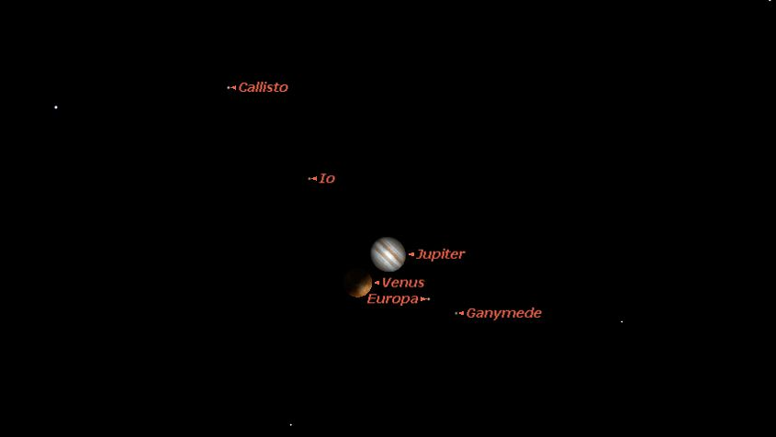
In Program Starry Night

Slide 43
Symbolism & Order
12 Aug 3 – Magi pay attention! A royal birth in Judah.
26 Aug 3 – The heavenly messenger informs the mother.
11 Sept 3 – The conception occurs.
Triple conjunction – God hovers over the little king.
17 June 2 – The birth occurs.
28 Aug 2 – This means war!

Slide 44
Apologetic Value
This sequence can easily be reconstructed two thousand years later by anyone having a home computer with a planetarium program.
Its apologetic value is enormous!
Rare close conjunction of brightest planets
In constellations of Lion and Virgin
Sequence fits events as reported in Gospels.
The 'little king'!

Slide 45
The Supernatural Part
A localized light in the sky that guides the Magi

Slide 46
Problem with purely natural view
Matt 2:9 (NASU) After hearing the king, they went their way; and the star, which they had seen in the east, went on before them until it came and stood over [the place] where the Child was.
10 When they saw the star, they rejoiced exceedingly with great joy.

Slide 47
Problem with purely natural view
Objects at astronomical distances cannot guide someone to explicit places on the earth by mere movement alone.
Guidance by movement is characteristic of objects that are only a few tens of feet above the ground, like the pillar of cloud and fire in the wilderness.

Slide 48
Martin's Solution
"Stood" is used in a technical sense, for Jupiter stopping its W movement and beginning to move E relative to the stars.
But this is nothing one would notice by watching Jupiter that night, so the Magi's extreme joy is hard to understand.

Slide 49
Maunder's Solution
See his article "Star of the Magi" in ISBE, 1939 edition.
Legend in Bethlehem that one of the Magi saw the star reflected in the bottom of the well at the inn, so straight overhead.
Clever, but does not do justice to the account in Matthew.

Slide 50
The Magi's Reaction
Matt 2:9 (NASU) After hearing the king, they went their way; and the star, which they had seen in the east, went on before them until it came and stood over [the place] where the Child was.
10 When they saw the star, they rejoiced exceedingly with great joy.

Slide 51
Supernatural Solution
Supernatural models handle this problem quite easily.
An object only some tens of feet above the ground can move and guide as pictured in Matthew.
The terminology used in the LXX for Israel's guidance by the pillar of fire and cloud in the wilderness is quite similar.

Slide 52
The Dilemma
The purely natural explanation gives a strong apologetic but doesn't handle the guidance.
The purely supernatural explanation provides the guidance but the conjunctions are just a fluke, however strange or rare.
A hybrid seems the best alternative.

Slide 53
My Proposal
Matt 2:9-10 identifies the guiding star with the star they saw in the East.
If they arrive in Jerusalem around 28 August, 2 BC, then the cluster of planets will set with the Sun (actually, just ahead of the Sun).

Slide 54
My Proposal
Suppose the Magi see a supernatural light about the size, brightness, & color of the 17 June conjunction.
It rises from the W where the Sun has just set and comes toward them till low overhead.
Then it turns S and guides them to the house where Joseph, Mary & Jesus are.

Slide 55
My Proposal

Slide 56
My Proposal
Though speculative (and not likely to be testable in this life), it handles both the biblical text and the astronomical data fairly.
It fits a theme of Matthew here, that of Jesus' birth drawing outsiders to come and worship him. Maybe it still does!

Slide 57
The Star of Bethlehem
A Testimony to the Nations
and to the Ages

