Slide 1

Intelligent Design
Robert C. Newman

Slide 2
What is 'Intelligent Design'?
Design – "an underlying scheme that governs functioning, developing, or unfolding"
Intelligent – not here intended to contrast with "stupid" but with "apparent" or "accidental"
The combination – "intelligent design" – is used as a term to describe a movement in the evolution controversy which maintains that design in nature implies a mind that produced this result rather than being a mere appearance of design produced by selection effects in a mindless universe.

Slide 3
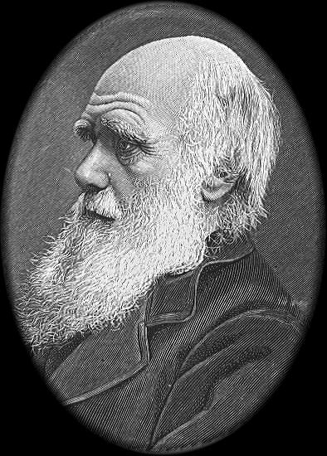
Some Historical Background
Evolution came to be seen as a replacement for a Designer in biology after 1859.
  “Darwin made it possible to be an intellectually fulfilled atheist.” (Richard Dawkins)
  Mutation and natural selection are seen to be the cause of all apparent ‘design.’
But what about apparent design in inanimate nature?

Slide 4
Design in Inanimate Nature
Design in inanimate nature had been noticed and discussed a number of times before Darwin: in William Paley's Natural Theology (1802), and especially in a series of books The Bridgewater Treatises (1833-40).
After Darwin, the problem surfaced again in the 1913 book by Lawrence J. Henderson, The Fitness of the Environment, which noticed many strange features of chemistry that are quite necessary for life to exist.

Slide 5
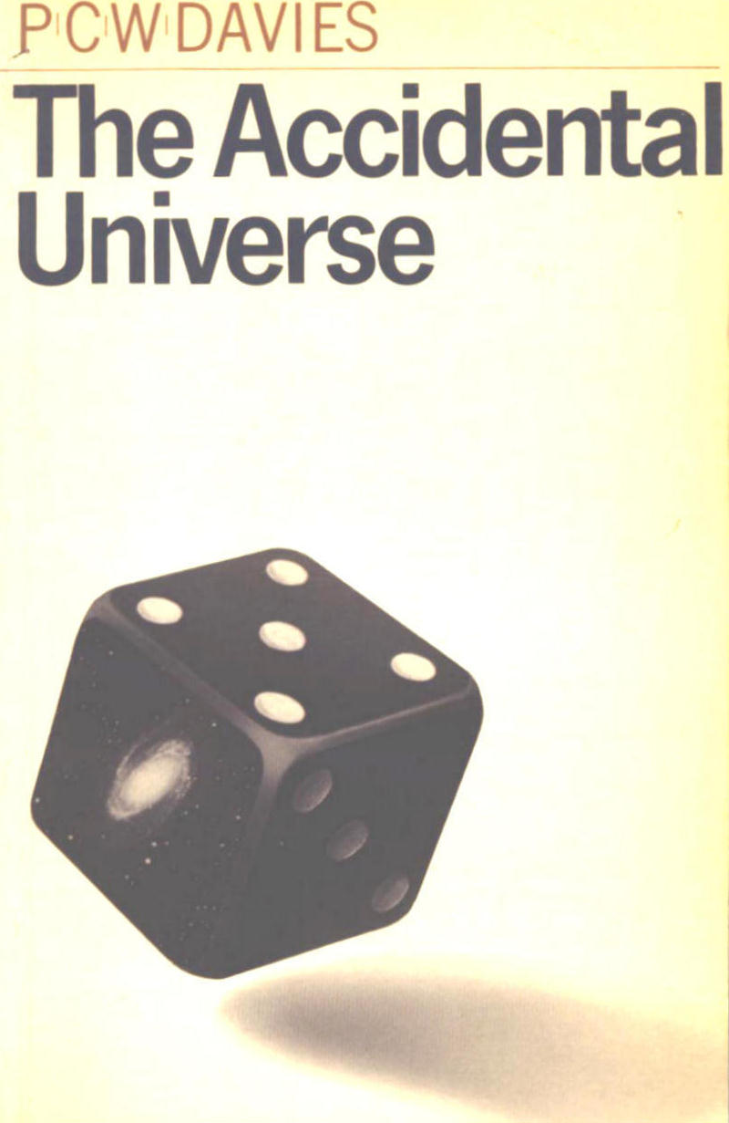
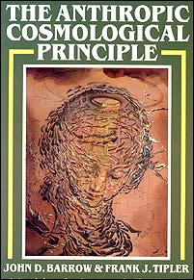
Design in Inanimate Nature
'Fine-tuning' in the laws of physics:
Paul Davies, Accidental Universe (1982)
Barrow & Tipler, The Anthropic Cosmological Principle (1986)

Slide 6
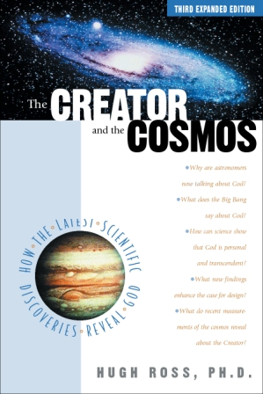
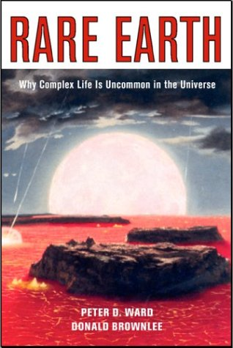
Design in Inanimate Nature
'Fine-tuning' in Earth's cosmic environment:
Hugh Ross, The Creator and the Cosmos (1995)
Ward & Brownlee, Rare Earth (2000)

Slide 7
Historical Background, cont.
Meanwhile, in the US, a pair of court decisions (1982, 1985) had struck down state laws which required teaching of creation alongside evolution. The US Supreme Court upheld these decisions in 1987.
But a number of observers felt these decisions were flawed because they used:
  A very narrow definition of creation
  A narrow definition of science

Slide 8
Historical Background, cont.
Narrow definition of creation:
  Creation is religious, but evolution is not.
Narrow definition of science:
  Only naturalistic explanations are allowed.
The really crucial problem is this second one, as it rules out all versions of creation without considering the evidence.
This led rather quickly to the intelligent design movement.

Slide 9

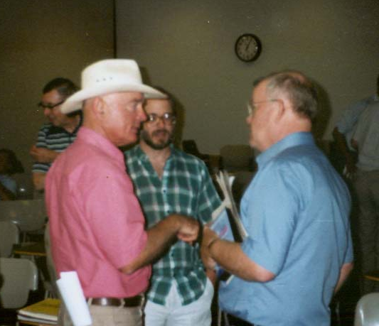
The Rise of the ID Movement
Usually marked as beginning with the publication of Darwin on Trial (1991) by Phillip Johnson, Professor of Law at the University of California at Berkeley, who was aroused by the problematic nature of the legal argumentation.

Slide 10
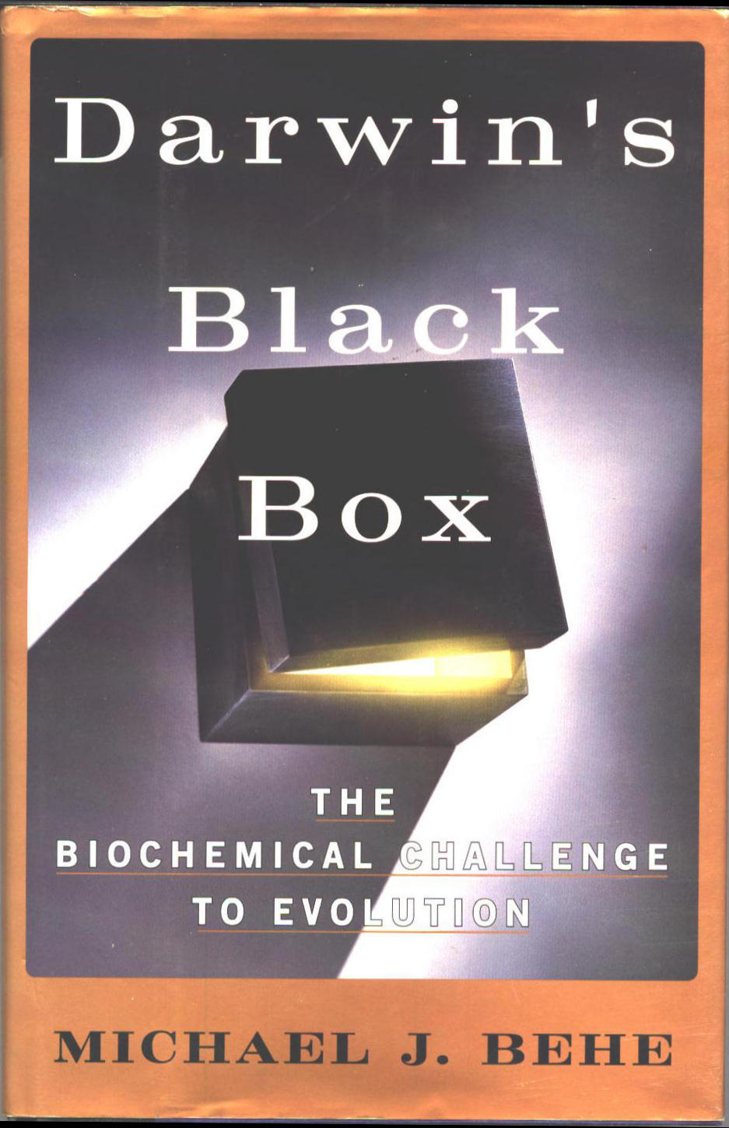
The Rise of the ID Movement
This was followed in 1996 by the publication of Darwin’s Black Box, authored by Michael J. Behe, Associate Professor in the Department of Biological Sciences at Lehigh University, who raised the problem of irreducible complexity.

Slide 11

Darwin’s Black Box
Behe gave a number of examples of a common feature in living things, one that does not look like it can be produced by mutation & natural selection.
He called this feature "irreducible complexity."

Slide 12
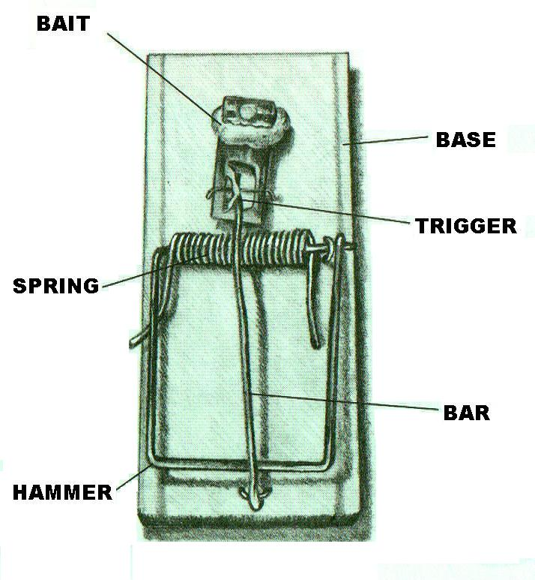
Irreducible Complexity
A feature is "irreducibly complex" when:
It consists of a number of parts…
…none of which can be removed without destroying the function of the feature.
A common example is the mousetrap.

Slide 13
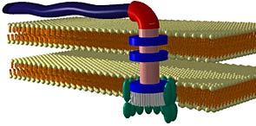
Irreducible Complexity
Behe finds many such in living things.
His examples are:
The rotary flagellium of the E coli bacterium
Blood clotting
Intra-cell transport
The immune system
Vision

Slide 14
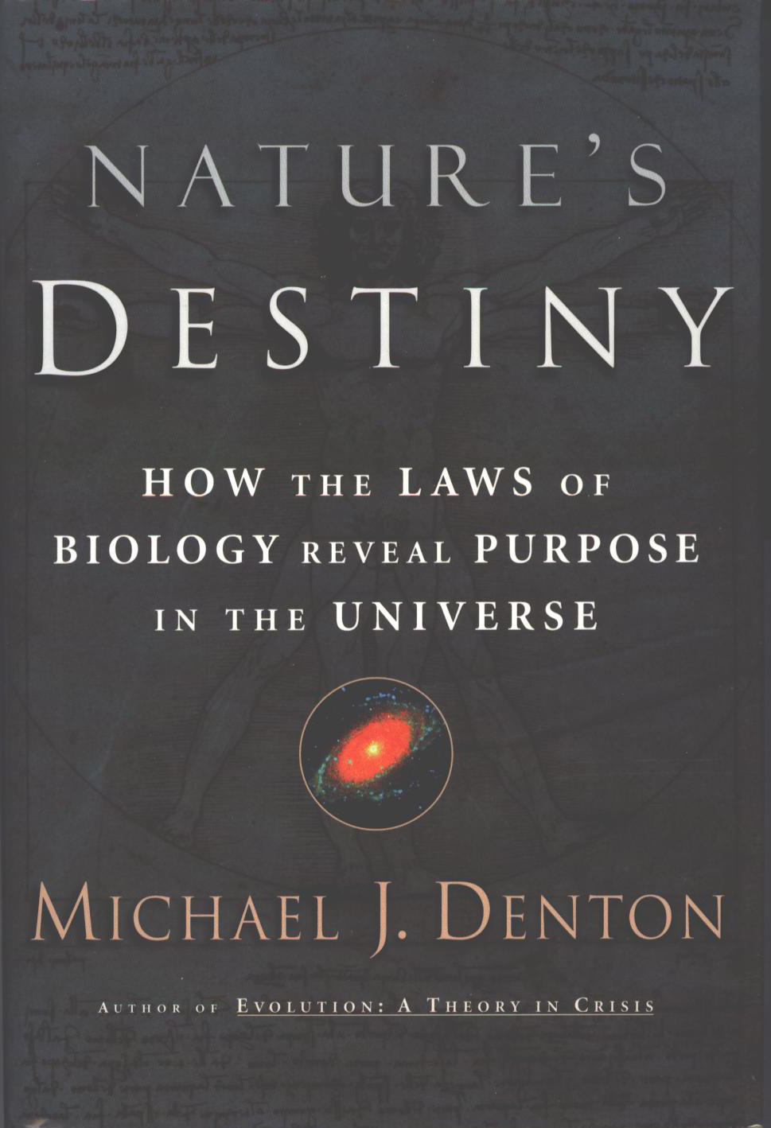
Nature's Destiny
A striking example of irreducible complexity that spans the universe from large to small is described in the book by microbiologist Michael Denton, Nature’s Destiny (1998).

Slide 15

Nature's Destiny
Denton discusses the fitness (relative to life) of:
Water
Light
Elements & Earth
Carbon
Nitrogen
Oxygen
DNA
Nanomolecules
Metals
The Cell
He gives even more examples in the appendix of his book.

Slide 16
Denton's Summary
We may not have final proof that the cosmos is uniquely fit for life as it exists on earth – because the possibility of alternative life forms cannot yet be entirely excluded – but there is no doubt that science has clearly shown that the cosmos is supremely fit for life as it exists on earth. For as we have seen, the existence of life on earth depends on a very large number of astonishingly precise mutual adaptations in the physical and chemical properties of many of the key constituents of the cell: the fitness of water for carbon-based life, the mutual fitness of sunlight and life, the fitness of oxygen and oxidations as a source of energy for carbon-based life, the fitness of carbon dioxide for the excretion of the products of carbon oxidation, the fitness of bicarbonate as a buffer for biological systems, the fitness of the slow hydration of carbon dioxide, the fitness of the lipid bilayer as the boundary of the cell, the mutual fitness of DNA and proteins, and the perfect topological fit of the alpha helix of the protein with the large groove of the DNA. In nearly every case these constituents are the only available candidates for the biological roles, and each appears superbly tailored to that particular end. (381)
In nearly every case these constituents are the only available candidates for the biological roles, and each appears superbly tailored to that particular end.

Slide 17
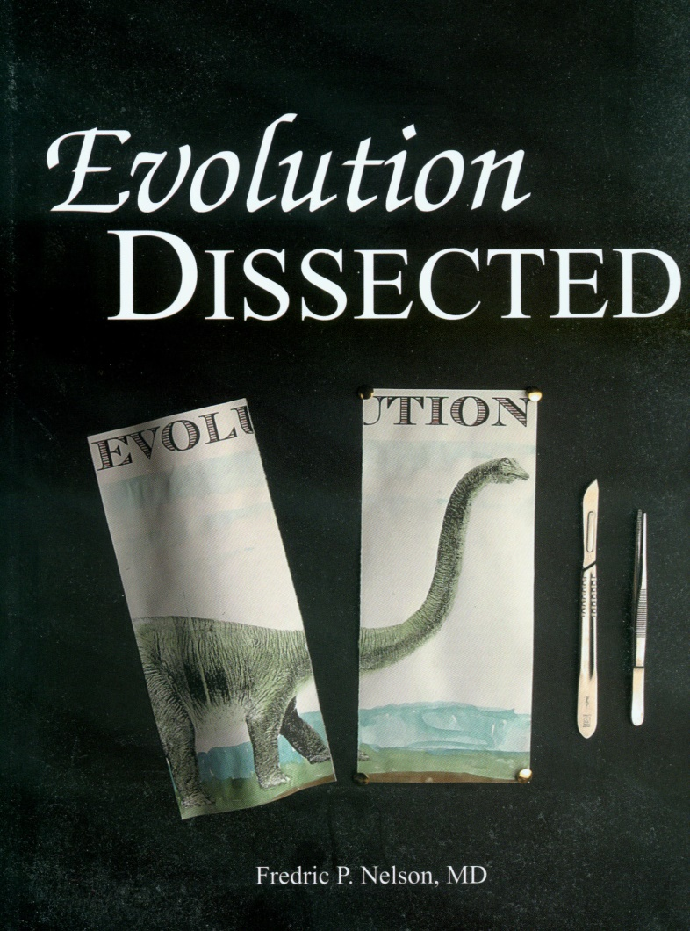
Evolution Dissected
Physician Frederic Nelson has written an excellent book (2003) which seeks to provide numbers to test the claim that life and its diversity can have arisen by purely natural processes.

Slide 18
Stubborn Physical Limits
Time – no more than 14 billion years are available, 4.42 x 10¹⁷ seconds.
Matter – no more than 10⁸⁰ baryons, i.e. 10⁸⁰ nuclei or atoms, in our universe.
Proteins – thus, no more than 3.1 x 10⁹¹ proteins can have contributed to the naturalistic formation of life, less than 10⁸¹ in any one galaxy, less than 10⁵⁰ on Earth.
Chances – no more than 10⁵⁰ tries to bring about every step of naturalistic evolution on Earth.

Slide 19
Calculating Probabilities
To assemble a functional 100-amino-acid protein with complex enzymatic activity, about 1 chance in 10⁶⁵ per try.
So, with 10⁵⁰ tries, the chance of success is one in 10¹⁵, one in a million billion.
To assemble a protein of 80-amino-acid residues with even minimal enzymatic activity, there is only about one chance in 10¹¹ per try.

Slide 20
More Probabilities
For multiple-enzyme systems, the probability would be far less than 1 in 10¹¹ per try for each enzyme.
Glycolysis (10 enzymes): < 1 in 10¹¹⁰
ADP assembly (9): < 1 in 10⁹⁹
Histidine assembly (9): < 1 in 10⁹⁹
DNA polymerase (6): < 1 in 10⁶⁶
RNase (13): < 1 in 10¹⁴³
Transcription factors (10): < 1 in 10¹¹⁰

Slide 21
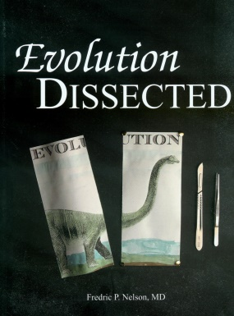
Summary
We are not taking into account the problem of left- and right-handed amino acids…
…nor the problem of the needed enzymes finding each other…
…nor of competing reactions destroying the needed components.
The naturalistic biochemical evolution of the first cell and naturalistic macroevolution are both highly irrational scientific hypotheses.

Slide 22

The Cambrian Explosion
Walter L. Starkey, retired professor of mechanical engineering at Ohio State University and a frequent expert witness in lawsuits related to causes of mechanical failure, analyzes the origin of animals from a mechanical engineering perspective (1999).

Slide 23
Evidences of a Designer
Starkey sees the following as evidence:
Ordered arrays of materials
Shapes of parts
Refined materials
Manufacturing processes
Multipart systems
Complex mechanical systems
Complex chemical systems
Complex electrical systems
Artistic patterns, colors & shapes
Clever, novel, patentable devices
All of these are present in animals from the beginning, the Cambrian Explosion

Slide 24
Some Other Books
on Intelligent Design

Slide 25
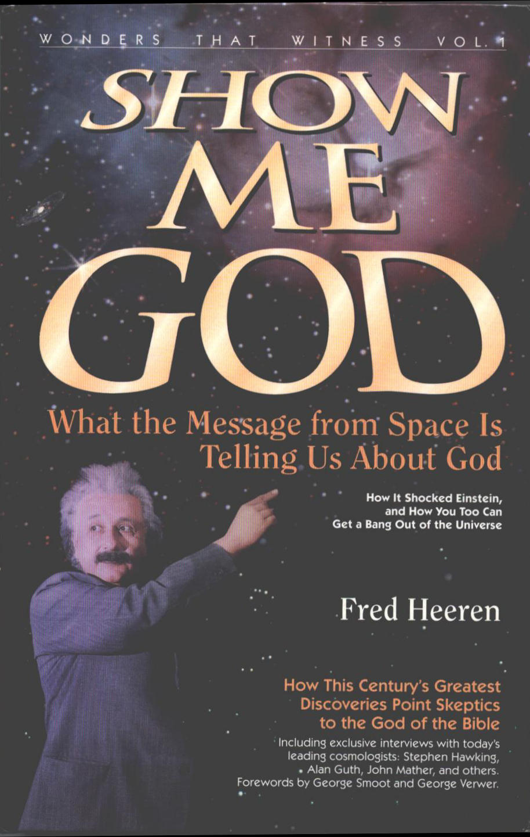
Show Me God
Science writer Fred Heeren has put together a fascinating popular-level book subtitled "What the Message from Space is Telling Us About God" (1995).

Slide 26

Contents
Part III – God & the Origin of Everything
  Chap 4 – Is the Bible's God the Best Explanation?
  Chap 5 – The Non-God Explanations
  Chap 6 – Scientific Pointers to Creation
  Chap 7 – the Big Bang Theory
  Chap 8 – The Bible & the Big Bang
Part IV – Evidence of Divine Design
  Chap 9 – Evidence of Design
  Chap 10 – Alternative Explanations to Design
  Chap 11 – Implications of Design

Slide 27
Contents
Includes interviews with:
Alan Guth (father of inflationary theory)
Stephen Hawking
Robert Jastrow
John Mather (chief scientist for COBE), Nobel 2006
Jeremiah Ostriker (co-discoverer of dark matter)
Arno Penzias (co-discoverer of cosmic black body radiation)
George Smoot (leader of COBE team), Nobel 2006
James Truran (early galaxy formation)
Robert Wilson (co-discoverer of cosmic black body radiation

Slide 28
Introduction
This cutting-edge book explores creation where science and religion ask the same questions and think the same thoughts …. an engaging and stimulating book that probes the frontier of science and faith, showing how they reconcile. This ground-breaking book shows that Bible believers and scientists can have a healthy and – for both – uplifting dialogue, a thing I have long felt crucial for humanity.
George F. Smoot, Lawrence Berkeley Laboratory

Slide 29
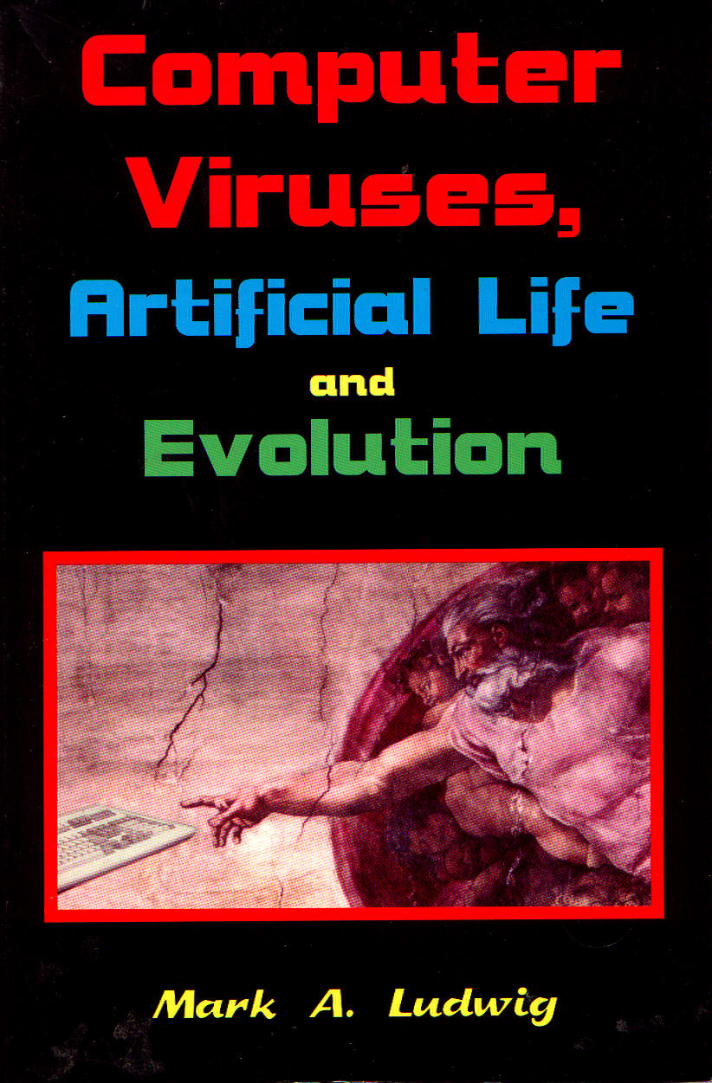
Computer Viruses, Artificial Life and Evolution
Computer scientist Mark Ludwig, author of The Little Black Book of Computer Viruses, suggests that computer viruses are more like life than anything else humans have ever made (1993).

Slide 30
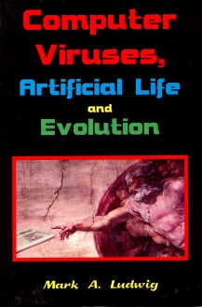
Formation of
Computer Viruses
Ludwig sponsored the 1st International Virus Writing Contest in 1993.
The purpose was to design the smallest possible virus having a certain minimal functionality.
The winning entry was 101 bytes in length.
If every elementary particle in the universe were a PC generating a 101-byte file every 10⁻²⁶ sec from the big bang until now, the chance they would have produced this one is less than one chance in 10¹⁰⁹.

Slide 31
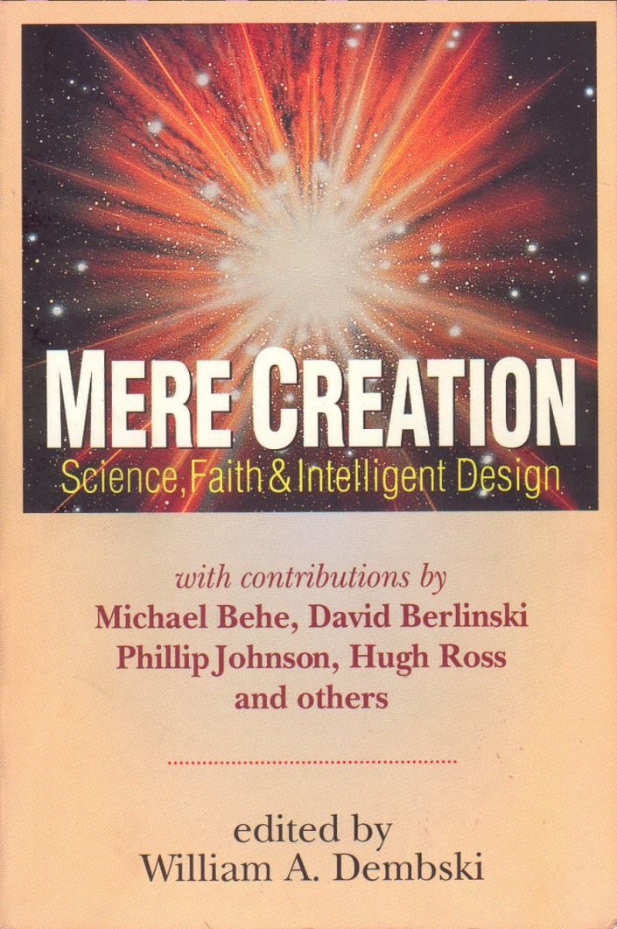
Mere Creation
These collected papers, edited by philosopher-mathematician William Dembski, were presented at a conference held at Biola University in 1996. Authors are scholars and scientists who reject naturalism as an adequate framework for doing science and identify with an intelligent design paradigm.

Slide 32

Contents
Sections on:
Unseating Naturalism
Design Theory
Biological Design
Philosophy and Design
Design in the Universe

Slide 33
Chapter Titles
Mere Creation – William Dembski
Nature: Designed or Designoid – Walter Bradley
Unseating Naturalism – Jonathan Wells
"You Guys Lost" – Nancy Pearcy
Redesigning Science – William Dembski
The Explanatory Power of Design – Stephen Meyer
Applying Design Within Biology – Paul Nelson

Slide 34
Chapter Titles
ID Theory as a Tool for Analyzing Biochemical Systems – Michael Behe
Basic Types of Life – Siegfried Scherer
Apes or Ancestors? – Sigrid Hartwig-Scherer
Evolutionary Accounts of Altruism & the Problem of Goodness by Design – Jeffrey Schloss
The Explanatory Relevance of Libertarian Agency as a Model of Theistic Design – JP Moreland
Design, Chance & Theistic Evolution – Del Ratzsch
God of the Gaps – John Mark Reynolds

Slide 35
Chapter Titles
Design & the Cosmological Argument – William Lane Craig
Big Bang Model Refined by Fire – Hugh Ross
Design in Physics & Biology – Robert Kaita
Gödel’s Question – David Berlinski
Artificial Life & Cellular Automata – Robert Newman
How to Sink a Battleship – Phillip Johnson

Slide 36
Obtaining These Books
All of the books mentioned in this talk are currently available on Amazon.com

Slide 37
Intelligent Design
Something Worth Thinking About

