Slide 1
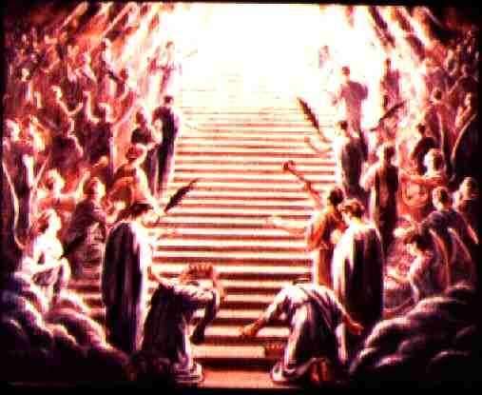
You Will Be Like God
Ephesians 3:14-21
Robert C. Newman

Slide 2
You Will Be Like God
This was Satan’s temptation to Eve in the Garden of Eden (Genesis 3:5):
(NIV) "For God knows that when you eat of it your eyes will be opened, and you will be like God, knowing good and evil."
Similarly Satan tempted Jesus in the wilderness (Matthew 4):
To use His miraculous power to feed Himself
To force God’s hand in order to win others
To worship Satan to gain power

Slide 3
What is God Like?
See Jeremiah 9:23-24:
23 (NIV) This is what the LORD says: "Let not the wise man boast of his wisdom or the strong man boast of his strength or the rich man boast of his riches, 24 but let him who boasts boast about this: that he understands and knows me, that I am the LORD, who exercises kindness, justice and righteousness on earth, for in these I delight," declares the LORD.

Slide 4
What is God Like?
Though God is:
All-wise
All-powerful
Owns all the wealth in the universe
He delights in:
Kindness
Justice
Righteousness

Slide 5
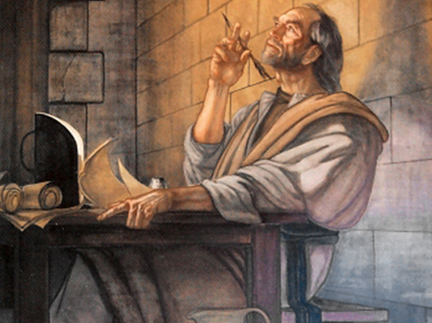
Paul’s Prayer for the Ephesians
Ephesians 3:14-19

Slide 6
Paul’s Prayer
Ephesians 3:14 (NIV) For this reason I kneel before the Father, 15 from whom his whole family in heaven and on earth derives its name. 16 I pray that out of his glorious riches he may strengthen you with power through his Spirit in your inner being, 17 so that Christ may dwell in your hearts through faith. And I pray that you, being rooted and established in love, 18 may have power, together with all the saints, to grasp how wide and long and high and deep is the love of Christ, 19 and to know this love that surpasses knowledgenthat you may be filled to the measure of all the fullness of God.

Slide 7
Request #1
Empowered with inner strength:
God’s power granted to us.
Mediated through the Holy Spirit.
Christ living in us.

Slide 8
Request #2
Able to grasp the love of God:
Rooted and established in love.
Realizing the magnitude & character of Christ’s love for us.
Even to experience this love surpassing knowledge.

Slide 9
Request #3
Filled with God’s fulness:
Not explained
But the Bible characterizes God as love

Slide 10
What Does It Mean to Be Like God?
Until we delight in:
Kindness
Justice
Righteousness
We cannot really be like God.
This is another way of saying
Until we love like God…
We cannot really be like God.

Slide 11
Being Like God
Not grasping for power & independence
Satan’s way of “being like God”
Not playing it safe, either
Seeking security first
If we always stay with what is safe, in a sense we dictate what God can do with us.
Instead, trusting God with everything we are and have

Slide 12
Paul’s Prayer
For the Ephesian Christians (and for us)
Is that we may know the power of God’s love in & thru us.
We should pray this for ourselves
And for others.

Slide 13
Paul’s Benediction
Ephesians 3:20 (NIV) Now to him who is able to do immeasurably more than all we ask or imagine, according to his power that is at work within us, 21 to him be glory in the church and in Christ Jesus throughout all generations, for ever and ever! Amen.

Slide 14
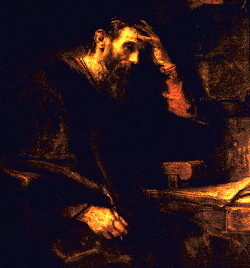
The End
May Paul’s prayer & benediction be true for us, too!

