Slide 1
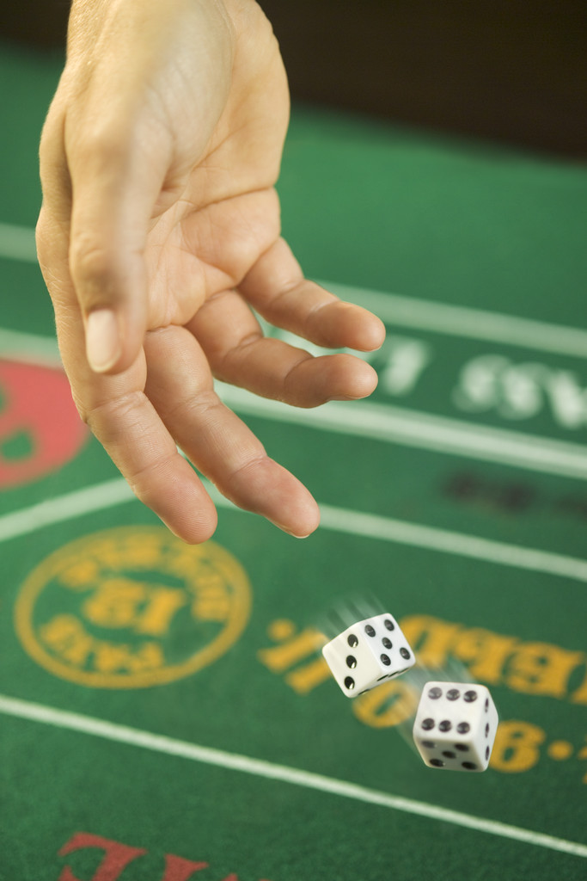

You Bet Your Life!
Pascal's Wager and
Modern Game Theory
Robert C. Newman

Slide 2
Gambling
Is now more popular in the US than any time since the 19th century:
  State lotteries
  Atlantic City
  Riverboat gambling
  Casinos on Indian Reservations
15 million people in the US have some serious gambling addiction.
2/3 of the adult population has placed some sort of a bet in the past year, totaling hundreds of billions of dollars.

Slide 3
Bet Your Life!
But actually, all of us are gambling, and for much higher stakes than just money.
We are betting our lives, even our eternal destinies!
Perhaps the first person to recognize this was Blaise Pascal (1623-1662), in his famous work, Penseés, which was not published until some years after his death.

Slide 4
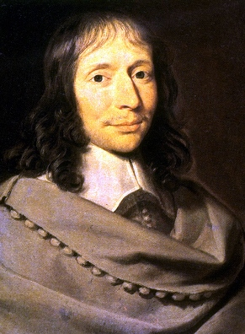
Blaise Pascal
Pascal, in poor health all his life, died before he reached 40.
He is still noted, over 300 years later, as:
  The inventor of probability theory & a mechanical calculator
  A major apologist for Christianity
  A significant figure in French literature

Slide 5
Pascal's Wager:
All of us live either like God exists, or as though He doesn't.
We can’t be 100% certain one way or the other, thus our life is a gamble.
Will we live like He exists, and take the consequences if we are right or wrong?
Or will we live like He doesn't exist, and take those consequences instead?
How will you bet your life?

Slide 6
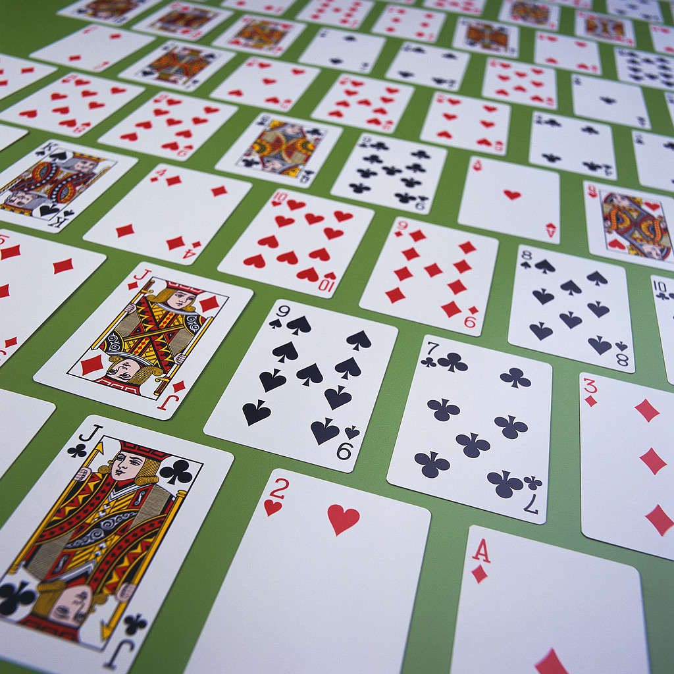
The Theory of Games

Slide 7
Theory of Games
In the 20th century, Pascal's work of applying probability theory to games of chance has been extended to more complicated situations in real life:
  Investments
  Diplomacy
  Warfare
A good introduction to game theory is given in the Dec 1962 issue of Scientific American.

Slide 8
2 x 2 Matrix Game
To help us understand Pascal's wager, let us look at one of the simplest problems in mathematical game theory, the two-by-two matrix game.
By 'matrix' here, we are not referring to the science fiction film series, or the recent Toyota automobile, but to a mathematical object called a matrix, an array of numbers in a particular order.

Slide 9
2 x 2 Matrix
A 2 x 2 matrix is a collection of four numbers (here represented by letters) arranged to form two rows & two columns.
a b
c d

Slide 10
A Matrix Game
A 2 x 2 matrix game involves two players, say Ron (rows) and Charles (columns).
Ron secretly chooses one of the two rows.
Charles covertly selects one of the two columns.
The two choices (when announced by the judge) determine a particular number in the matrix. If this number is positive, Ron wins that amount from Charles; if negative he pays that amount to Charles.

Slide 11
An Example
The character of the game depends entirely on the values of the 4 numbers.
Given the matrix at right:
If Ron chooses row 1, he will always win 1 (say, a dollar) from Charles.
Charles will not want to play, but if it is warfare he may have no choice.
1 1
-3 -4

Slide 12
Another Example
This game would be more interesting:
Here, sometimes Ron will win, sometimes Charles.
One can work out a best strategy for each.
1 -4
-3 1

Slide 13
The Strategy
Let Ron play row one a fraction p of the time. (Then he plays row two a fraction 1-p of the time.)
Let Charles play column one a fraction q of the time (and column two 1-q).
Ron's expected winnings (if positive) or losses (if negative) will be a weighted average of the four possible outcomes, multiplying each by the fraction of the time it will occur.

Slide 14
Ron's Expected Winnings
E = pqa + p(1-q)b +(1-p)qc + (1-p)(1-q)d
For the second matrix game, above, we plug in a = 1, b = -4, c = -3, and d = 1.
With a little algebra this gives:
  E = 9pq – 5p – 4q + 1
Consider the simple cases:
  p,q = 0, E = 1
  p,q = 1, E = 1

Slide 15
Ron's Expected Winnings
E = 9pq – 5p – 4q +1
  p = 0, q = 1, E = -3
  p = 1, q = 0, E = -4
Ron's best strategy is to choose p so as to make E as large as possible.
Charles' best strategy is to choose q so as to make E as small as possible.
Ron's best is p = 4/9, but E is still -11/9, so Ron loses $1.22 per play on average.

Slide 16
Application to
Pascal's Wager

Slide 17
Pascal's Wager
Set up as a 2 x 2 matrix game, Pascal's wager looks like this:
Christianity
True False
Christianity
Accepted a b
Rejected c d

Slide 18
The Play of the Game
Player Ron is any living person, who must either live as though Christianity is true or as though it were false.
Player Charles is Reality, the Grim Reaper, Chance, God, or something of the sort, which will eventually reveal to each individual the wisdom or folly of their choice.

Slide 19
The Values
The crucial question in any matrix game is the relative values of the numbers.
In the 2nd case we looked at earlier, the reason why Ron was hooked into a tough game was that the negative numbers were larger (in absolute value) than the positive ones.
What are the values of a, b, c and d for Pascal's wager?

Slide 20
Value of d: Xy false, rejected
We take the alternative to Christianity to be some sort of materialism or secular humanism, with no survival after death.
The payoff has then been collected before death.
It will vary widely from person to person.
We assign a value d = 1 to a long life of health, wealth and happiness.

Slide 21
Values of a and c: Xy true
Value of a: Xy accepted and true
  Matthew 25:34, 46: (NIV) Then the King will say to those on his right, "Come, you who are blessed by my Father; take your inheritance, the kingdom prepared for you since the creation of the world." These go with Him "into life eternal."
  a = + infinity

Slide 22
Values of a and c: Xy true
Value of c: Xy rejected but true
  Matthew 25:41, 46: (NIV) Then he will say to those on his left, "Depart from me, you who are cursed, into the eternal fire prepared for the devil and his angels." These go "into everlasting punishment."
  c = - infinity

Slide 23
Value of b: Xy false, but accepted
I think Pascal was mistaken in thinking that if Xy was false but one accepted it as true, nothing would be lost, i.e., b = 0.
The apostle Paul, with persecution in view, says, 1Cor 15:19 (NIV) "If only for this life we have hope in Christ, we are to be pitied more than all men."
But this is only a finite loss, though the Xn should do worse than others, so we put b = -1.

Slide 24
Pascal's Wager Matrix
Christianity
True False
Christianity
Accepted infinity -1
Rejected -infinity 1

Slide 25
The Strategy
So, given these values, what should be Ron's strategy?
Charles, being reality, will always play either "Xy true" or "Xy false," but (by Pascal's premise) we don't know for sure which.
Even the staunchest atheist must agree there is at least a very small possibility e, that Christianity is true.
So let q = e, where e << 1.

Slide 26
The Strategy
Ron's expected winnings are:
  E = pqa + p(1-q)b +(1-p)qc + (1-p)(1-q)d
  Since e << 1, q = e, 1-q ≈ 1
  E ≈ pea + pb + (1-p)ec + (1-p)d
Now substitute in the values of a, b, c, d, using N instead of infinity:
  E ≈ peN – p – (1-p)eN + (1-p)

Slide 27
The Strategy
E ≈ peN – p – (1-p)eN + (1-p)
  As N → infinity, the first term becomes very large (positive), the third term very large (negative), and the other terms are negligible by comparison.
So for Ron to have the maximum winnings, he should choose p = 1:
  E ≈ eN, which will become arbitrarily large as N → infinity, no matter how small e is.

Slide 28
The Result
Thus, as Pascal argues, one should always live as though Christianity is true, and advise others to do the same!
Many people, over the centuries, have been put off by the allegedly low morality of Pascal's wager.
But the argument is not a moral argument, but a prudential one.
It reminds us that is it stupid to go thru life without investigating religions in which the stakes are infinite!

Slide 29
Generalizing Pascal's Wager
What about other religions?
  There are more than two religions or philosophies in the world.
  What about Hinduism, Islam, and the various New Age religions?
  Don’t they count?
Let's see…

Slide 30
Generalizing Pascal's Wager
Pascal's wager may be generalized by expanding it into a choice among n different worldviews.
In modern game theory, this involves an n-by-n matrix rather than 2 x 2.
The diagrams & arithmetic are more complicated and were set out in an article I wrote for the Bulletin of the Evangelical Philosophical Society in 1981.

Slide 31
The Generalized Result
Ron's optimum strategy here is to select only some combination of those world views which have:
  an infinite heaven
  an infinite hell
  no additional lives in which to guess again
I believe orthodox Christianity is the only religion which satisfies these.

Slide 32
Conclusions
Remember the advice of Jesus:
Luke 12:58-59 (NIV) "As you are going with your adversary to the magistrate, try hard to be reconciled to him on the way, or he may drag you off to the judge, and the judge turn you over to the officer, and the officer throw you into prison. 59 I tell you, you will not get out until you have paid the last penny."

Slide 33
You Bet Your Life!
Don't make a foolish bet!

