Slide 1

Witnessing to Jews
Ron Elkin
AMMI Ministry
Philadelphia, USA

Slide 2
Topics to Cover
Branches of Judaism Today
Major Obstacles We Face in Sharing the Gospel with Jews.
How to Respond to Major Jewish Objections to Christianity.

Slide 3
Branches of Judaism
Orthodox Judaism
Conservative Judaism
Reform Judaism

Slide 4
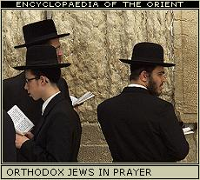
Orthodox Judaism
Revelation
  Bible is God's Word.
  So is the Oral Law.
Creed
  Nothing quite like the Westminster Confession
  The Shema (Deut 6:4-5)
God
  Derived from Bible, but reject Trinity

Slide 5
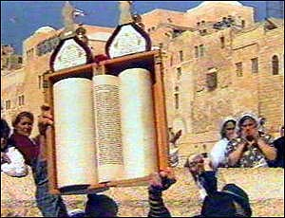
Orthodox Judaism
Emphasis on Practice
  Law (as taught by Rabbis) is to be obeyed.
Creation
  Good; to be enjoyed within limits of God’s law
Man
  Basically good; can become better by good deeds
  Eternal soul; eternal paradise for righteous
  Evil allowed to test human character

Slide 6
Orthodox Judaism
Israel
  Elect; chosen to help establish God's rule & glorify Him
  Will one day live in peace in the Promised Land
Messiah
  Still to come, will bring in world peace, establish Israel
  Not Jesus! Not God!
End Times
  There will be a resurrection of the dead.
  Humans will live eternally.

Slide 7
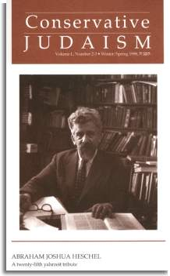
Conservative Judaism
Established as an alternative to Orthodox and Reform Judaism.
More adapted to Western and secular culture than are Orthodox Jews.
Rabbis have less authority.

Slide 8
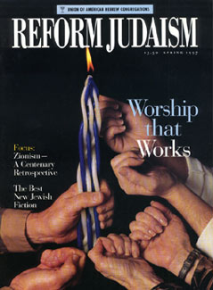
Reform Judaism
Maintains Jewish identity.
Very liberal in theology
  May or may not believe in God
  Feel no obligation to obey the Bible or Rabbinic tradition

Slide 9
Major Obstacles to Gospel
Persecution by the Church
  Many Jews killed & oppressed in name of Jesus
Theological Differences with Christianity
  God
    no Trinity
    God cannot be divided

Slide 10
Major Obstacles to Gospel
Theological Differences
  Jesus
    Not the Messiah; didn't set up Kingdom
    God cannot be man.
    The Rabbis don't accept him.
  Sin
    Man is basically good, made in God's image.
    Righteousness is increased by good deeds.

Slide 11
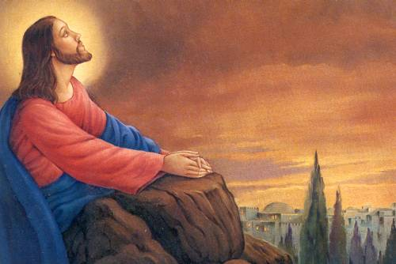
Our Responses
To the Major Objections
of Jews to the Gospel

Slide 12
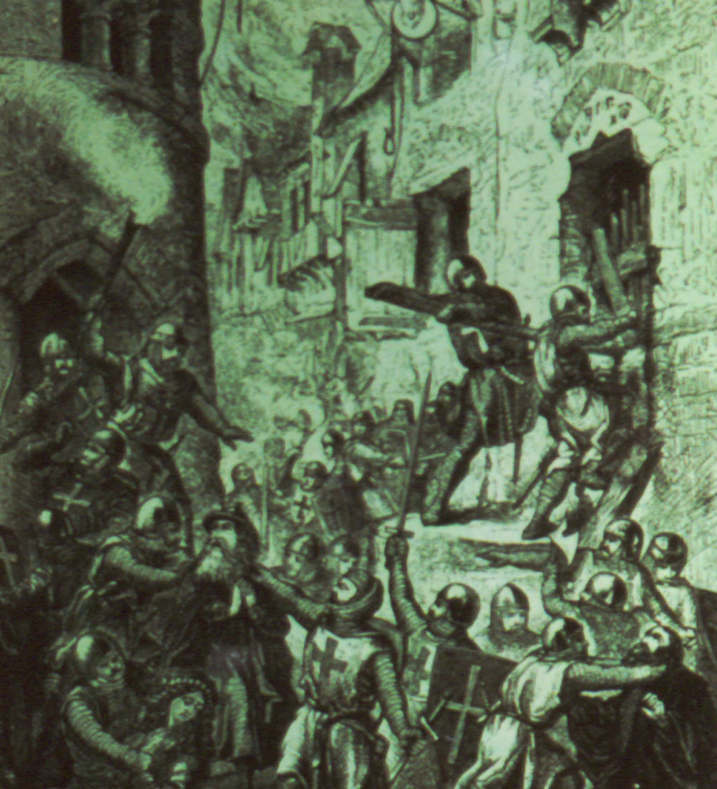
Persecution of Jews
Admit wrong done, express sorrow & regret.
Explain prejudice as having source in our sin nature.
Use this as a way to show that all are sinners (Ps 14:2; 51:5, 9)

Slide 13
Trinity
Word "one" in Deut 6:4 is achad, a plural unity (Gen 2:24; 11:6), in which two or more things are combined into one.
Another word, yachid, is used to mean "only one" (Gen 22:2).

Slide 14
Jesus
Jesus didn't being peace.
  Jesus brought inner peace to those who trust him.
  When he returns he will bring outward peace.
  The Rabbis' two Messiahs (suffering & reigning) are actually one — Jesus!
God cannot be a man.
  Is anything impossible for God?
  Isa 7:14 – Virgin will bear son, Immanuel.
The Rabbis don't accept him.
  Some have. Would you believe if I showed you?

Slide 15
Sin & Salvation
Sin nature
  Ps 14:2-3 – no one does good, not even one
  Ps 51:5, 9 – sinful at birth; blot out my iniquity
  Jer 17:9 – heart is deceitful above all things
  Isa 6:5 – woe to me… unclean lips!
Salvation by works?
  No sacrifice for willful sins – Num 15:30-31
  David cried out to God for mercy – Ps 51
  Abraham declared righteous by faith – Gen 15:6
  Isaiah saved by God's mercy – Isa 6:7

Slide 16
Forgiveness
Sins were forgiven by a blood sacrifice – Lev 17:11.
Where is our atonement today?
  Does God accept a bloodless sacrifice?
Why did God allow the temple to be destroyed?
  1st temple destroyed for 70 years
    Because of Israel's disobedience
  2nd temple now destroyed for 1930+ years
    Destroyed only some 40 years after Jesus' death

Slide 17
The Gospel in the Hebrew Bible
All are sinners.
  Ps 14:2; Jer 17:9; Isa 6:5
Sins separate us from God.
  Isa 59:2; Ex 34:33; Dan 12:2
Our good deeds are not enough.
  Isa 64:6 – all our righteousness like filthy rags.

Slide 18
The Gospel in the Hebrew Bible
God gave a blood atonement.
  Lev 17:11; Ex 12:7, 13
God promised a Messiah to bear our sins.
  Isa 52:13-53:12
How do we know Jesus is the promised one?
  Micah 5:2; Dan 9:26; Zech 12:10; Psalm 22

Slide 19
The Gospel in the Hebrew Bible
Salvation is by faith.
  Gen 15:6; Isa 26:3-4; Ps 2:12
There is a life after death; where will you spend it?
  Dan 12:2

Slide 20
Major Messianic Verses
Gen 3:12 – wounded but will crush Satan
Gen 49:10 – from tribe of Judah
2 Sam 7:16 – from line of David
Ps 2:12 – trust/believe in Messiah
Psalm 22 – will suffer; deliverance to be worldwide news
Psalm 110 – Messiah to be a priest & king

Slide 21
Major Messianic Verses
Isa 7:14 – born of a virgin
Isa 9:6-7 – boy who is God & king forever
Isaiah 11 – will bring peace to Jews & Gentiles
Jer 23:5-6 – a king who is God
Zech 9:9-10 – will enter Jerusalem on a donkey, yet rule all the earth one day

Slide 22
Major Messianic Verses
Zech 12:10-13:1 – Israel will see the one they have pierced and they will mourn.
Mic 5:2 – to be born in Bethlehem, yet active for ages past.

Slide 23
The End
May God encourage and empower you to reach out to your Jewish friends and acquaintances!

