Slide 1

Where is Heaven?
A Study of the Biblical Teaching
Dr. Robert C. Newman

Slide 2
Which Heaven?
"Boasting is necessary, though it is not profitable …. I know a man in Christ who 14 years ago, whether in the body I do not know or out of the body I do not know … was caught up to the third heaven … was caught up to Paradise and heard inexpressible words which a man is not permitted to speak."
– Paul in 2 Corinthians 12

Slide 3
Which Heaven?
The Bible does not — like some ancient texts — speak of seven heavens.
In the context of 2 Corinthians 12, it appears that Paul means by the third heaven the place where God especially manifests Himself, what we now usually call "heaven."
There are apparently two other heavens.

Slide 4
The Bible's 3 Heavens
1st – where the birds fly
  'birds of heaven'
2nd – where the stars are
  'stars of heaven'
3rd God's dwelling place
  'God of heaven'

Slide 5
Which Heaven?
We already know where the first and second heavens are.
We are here interested in the location of the third heaven, the dwelling place of God.
Where is the third heaven?

Slide 6
Heaven is "up"
This is a standard expression used for the location of heaven.
On several occasions, the Bible makes reference to travel "up" to heaven.
On other occasions, travel from heaven to earth is pictured as travel "down."

Slide 7
How Far Up?
Many Christian hymns and choruses speak of heaven as far, far up.
  'beyond the sunset'
  'way beyond the blue'
The Bible's picture does not seem to put heaven so far away.
  Jacob's ladder
  Jesus' ascension
  God at Sinai

Slide 8
Jacob's Ladder
"And he [Jacob] had a dream, and behold a ladder was set up on the earth with its top reaching to heaven. And behold, the angels of God were ascending and descending on it, and behold the Lord stood above it and said, 'I am the Lord, the God of your father Abraham, the God of Isaac. The land on which you lie I will give to you and to your descendants.'" – Genesis 28

Slide 9
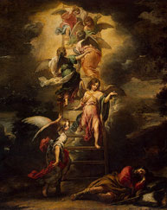
Jacob's Ladder
A dream, in which things are not always realistic.
Yet God typically appears in the Bible in human form and human size. So do the angels.
This suggests that the top of the ladder is not very far up, and heaven is not far away.

Slide 10
Jesus' Ascension
"After he [Jesus] had said these things, he was lifted up and a cloud received him out of their sight." – Acts 1:9

Slide 11
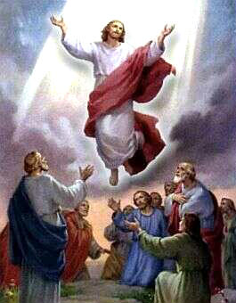
Jesus' Ascension
Does Acts 1:9 merely describe the beginning of a long journey, as we might see a spaceship disappear into the clouds at Cape Kennedy?
It looks more like Jesus disappears into a glory cloud — like that at Sinai, in the wilderness, or above the Tabernacle — the sort of cloud on which he will one day return.

Slide 12
Is heaven beyond the stars?
The king of Babylon speaks of setting his throne above the stars of God in Isaiah 14.
Is this saying that heaven begins beyond the stars?
Or is this saying that his throne will be more glorious than the stars?
Some passages on heaven suggest that "up" is not necessary.

Slide 13
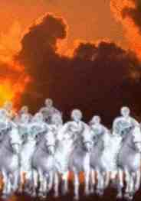
Elisha & the Armies of Heaven
Elisha & his servant are surrounded by enemy forces in 2 Kings 6.
The servant is (naturally) fearful.
Elisha prays that God would open his eyes.
The servant suddenly sees that he and Elisha are surrounded and protected by the armies of heaven.
Were these armies sent out from heaven, or is heaven all around us?

Slide 14
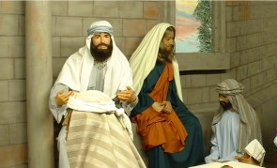
Jesus' Upper Room Appearance
Narrated in Luke 24 and John 20.
Here Jesus appears suddenly inside a closed room.
Perhaps he is coming from heaven, which is an invisible realm all around us.
Or perhaps Jesus just has this ability to become invisible.

Slide 15
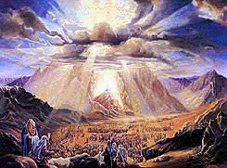
God at Sinai
"You came down on Mt Sinai and spoke with them from heaven." – Neh 9:13
Is heaven here on Mt Sinai?
Or is this like on TV?
  TV anchorman is in my TV set
  TV anchorman is speaking from New York

Slide 16
God at Sinai
"Has any people heard the voice of God speaking from the fire, as you heard it, and survived?" – Deuteronomy 4:32-33
Nehemiah – God speaking from heaven
Deuteronomy – God speaking from the fire
Same incident
Heaven is where the fire is?

Slide 17
God at Sinai
"So the people stood at a distance while Moses approached the thick cloud where God was." – Exodus 20:21
"Then the Lord said to Moses, 'Thus you shall say to the sons of Israel, you yourselves have seen that I have spoken to you from heaven.'" – Exodus 20:22
God is on the mountain speaking from heaven.

Slide 18
Various Views on
Heaven's Location
The Attic Model
The Way-Out Model
The Interaction Model
The Dimensional Model

Slide 19
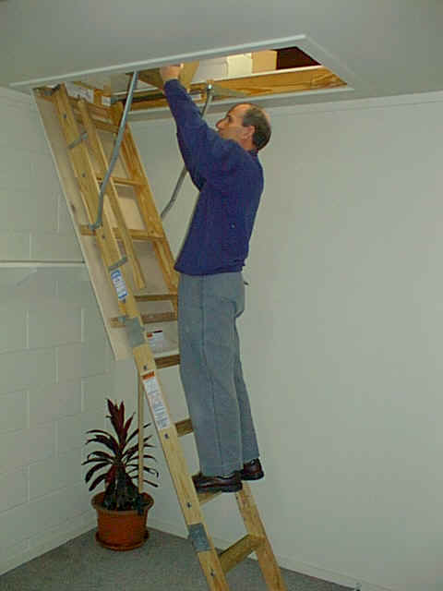
The Attic Model
The sky is some kind of ceiling.
The 3rd heaven is an attic above the ceiling.
Angels come and go thru holes in the sky:
  Using ladders
  Or flying
This was probably a common view in antiquity.
Liberals dismiss the Bible as unreliable because they claim this is what it really teaches.

Slide 20
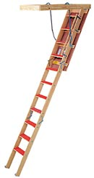
Problems w/ Attic Model
Makes use of ladder passage (Gen 28), but the ceiling must be awfully low!
Why is the Bible so vague if this is its view?
This view does not fit the Sinai narratives.
This view must add invisibility to account for the movements of the angels, the heavenly armies, and Jesus.

Slide 21

The Way-Out Model
A common evangelical view today
Heaven is beyond the stars, perhaps beyond our universe.
Needs to use the "TV anchorman" explanation for Sinai.
Needs to add idea of invisibility for angelic movement.
Movement between heaven & earth seems quite rapid, with one exception (Dan 10).

Slide 22
Two More Recent Views
These seem to solve the problems of the Attic and Way-Out views.
Not sure which (if either) of these is correct.
The Interaction Model
The Dimensional Model

Slide 23
The Interaction Model
Suggested by the late Dr. Irwin Moon, physicist and founder of the Moody Institute of Science.
Moon notes that all our senses depend on the interaction of various forces:
  Sight – light (e-m interaction)
  Hearing – sound, air pressure (e-m)
  Touch – solidity (e-m)
  Taste, smell – chemical reactions (e-m)

Slide 24
The Interaction Model
So all our senses depend on the interaction of various forces.
Suppose there were something around us that did not interact with these forces. We would not be able to detect it.
Moon suggests that the unseen spiritual world is all around us, but it has a different set of forces so we cannot normally detect it.

Slide 25

The Interaction Model
Part of the 3rd heaven is right here around us.
God at Sinai turns on an interaction so Israel can see cloud, hear sounds.
God gives Elisha’s servant the ability to interact with the heavenly army.
The model has invisibility built-in.
It naturally explains fuzzy cloudiness.
It does require a switchable interaction.

Slide 26
The Dimensional Model
The previous (interaction) model has heaven in our space, but with different interactions.
The dimensional model has heaven in a different dimension right next to our three dimensions, a fourth (or higher) spatial dimension.
This model is harder to visualize than the interaction model, but Edwin Abbott helps us with his short story Flatland written over a century ago.

Slide 27
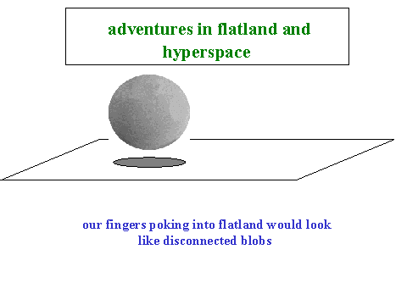
Visualizing the
Dimensional Model
Imagine a 2-D world, "Flatland."
Flatlanders cannot move, see, or hardly think in more than 2-D, just as we cannot in more than 3-D.
Imagine a 3-D visitor coming to Flatland.
He can see into any part of Flatland, and can enter any part without passing thru another part.

Slide 28
Visualizing the
Dimensional Model
Now imagine a four (or higher) dimensional being looking down into our 3-D world.
He can see inside anything.
He can enter at any point without passing thru any other point in our space.
Just so, Jesus could enter a closed room without passing thru any of its doors or windows.

Slide 29
Visualizing the
Dimensional Model
If a 3-D being were moved a little in the 4th direction, he could see things he now cannot.
So Elisha's servant (or his eyes) are moved a little in this fourth direction so he can see the armies of heaven.
When God moves us a little bit, we can see heavenly realities. Or God can move the heavenly realities into our dimension so we can see them.

Slide 30
Evaluating the Models
Attic Model
  rejects the Bible as primitive.
Way-Out Model
  puts heaven far away.
Interaction Model
  fits biblical data
  needs an interaction switch.
Dimensional Model
  also fits Bible
  doesn't need interaction switch
  is harder to visualize.

Slide 31
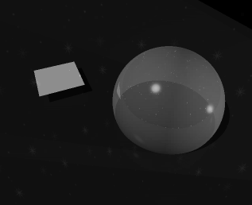
So What?
The biblical picture of heaven is more sophisticated than many people have been willing to admit.
This is another indication that the Bible is not to be dismissed as the guesses of ancient, superstitious people.

Slide 32
So What?
"Then I saw a great white throne and him who was seated on it. Earth and sky fled from his presence, and there was no place for them. And I saw the dead, great and small, standing before the throne, and books were opened … If anyone's name was not found written in the book of life, he was thrown into the lake of fire." – Revelation 20

Slide 33
So What?
"But the day of the Lord will come like a thief. The heavens will disappear with a roar; the elements will be destroyed by fire, and the earth and everything in it will be laid bare. Since everything will be destroyed in this way, what kind of people ought you to be? You ought to live holy and godly lives as you look forward to the day of God and speed its coming." – 2 Peter 3:10-12

Slide 34
For Further Reading
Edwin A. Abbott, Flatland
Rudy Rucker, The Fourth Dimension
Hugh Ross, Beyond the Cosmos
Robert C. Newman, The Biblical Firmament, Vault or Vapor?

Slide 35
The End
Are you going to be
in heaven one day?

