Slide 1
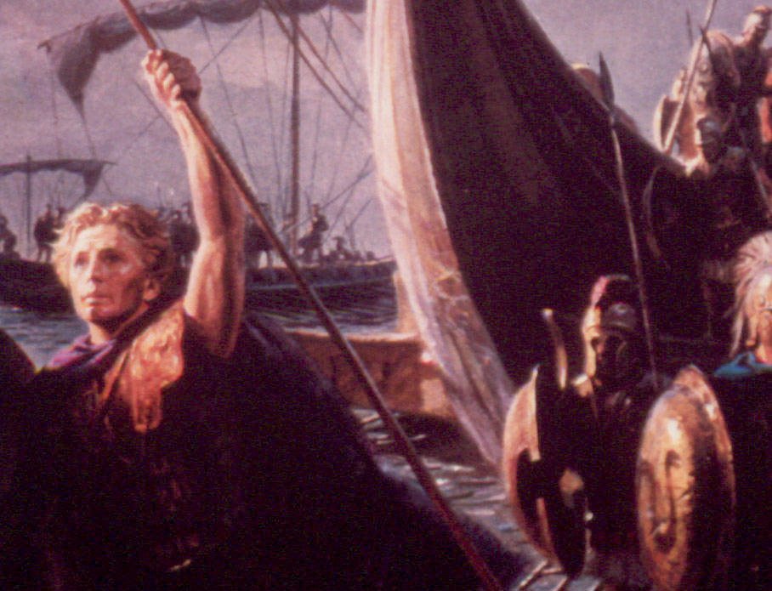

What is History All About?
Psalm Two
Robert C. Newman

Slide 2
Introduction
Psalm 2 is a:
  Dramatic reading
  Short play
  Cantata?
It has a narrator, two characters, and a chorus.
It divides nicely into four equal sections of three verses each.

Slide 3
The Psalm as a
Dramatic Reading
Dramatis personae - in order of appearance:
  The narrator
  The rebels
  God
  His Messiah

Slide 4
Strophe 1: Mankind's Attitude
Narrator: Why are the nations in turmoil?
Why do the people think futile thoughts?
The kings of the earth take their stand,
The influential ones sit in conference together
Against the LORD
And against His Messiah.
Rebels: Let us tear off their shackles
And throw away their ropes!

Slide 5
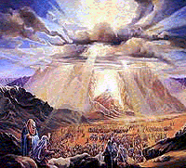
Strophe 2: God's Reaction
Narrator: The One sitting in heaven laughs
The LORD mocks them.
Then He will speak to them in His anger
He will terrify them in His wrath.
God: Even I Myself will establish my King
On Zion, my holy mountain!

Slide 6
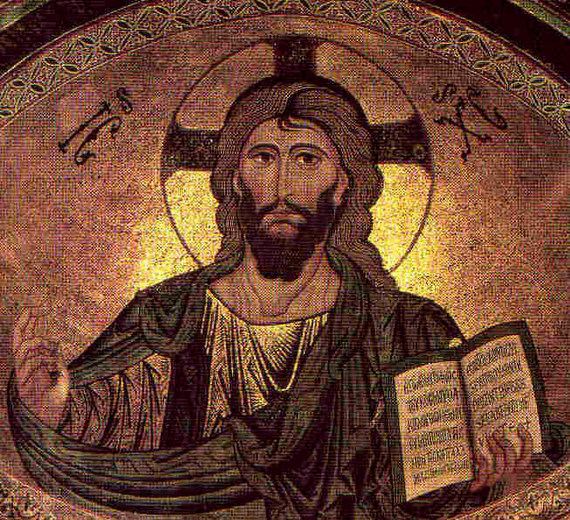
Strophe 3: Messiah's Commission
Messiah: Let me tell you about the decree of the LORD.
He said to me: "You are My Son.
I Myself have begotten you today.
Ask Me and I will give you
your inheritance – the nations
and your property – the ends of the earth
You will break them with an iron mace,
You will shatter them like a clay pot."

Slide 7
Strophe 4: Narrator's Advice
Narrator: Therefore, O kings, act wisely
Let yourselves be corrected, O judges of the earth
Serve the Lord with fear
Rejoice with trembling
Kiss the Son lest He be angry
And you perish from the way
For His wrath will soon flare up.
Oh, the happiness of all who seek safety in Him!

Slide 8
The Psalm Analyzed
Verse-by-Verse

Slide 9
Strophe 1: Mankind's Attitude
Narrator: Why are the nations in turmoil?
Why do the people think futile thoughts?
The kings of the earth take their stand,
The influential ones sit in conference together
Against the LORD
And against His Messiah.
Rebels: Let us tear off their shackles
And throw away their ropes!

Slide 10
Mankind's Attitude (1-3)
Fallen humans find God's word too restrictive.
National turmoil, empty speculation, political conferences – all to break away from the rule of God & His Messiah.

Slide 11
Mankind's Attitude (1-3)
Some Illustrations:
  OT – Eden, Babel, time of Judges, much of Israel's history
  NT – Crucifying Jesus (cp Acts 4:24-28)
  Today – "Moral Darwinism" (cp 2 Tim 3)
  Future – the rebellion will reach its climax in the Antichrist

Slide 12
Crucifying Jesus
Acts 4:24-28 (NIV) When they heard this, they raised their voices together in prayer to God. "Sovereign Lord," they said, "you made the heaven and the earth and the sea, and everything in them. 25 You spoke by the Holy Spirit through the mouth of your servant, our father David: 'Why do the nations rage and the peoples plot in vain? 26 The kings of the earth take their stand and the rulers gather together against the Lord and against his Anointed One.' 27 Indeed Herod and Pontius Pilate met together with the Gentiles and the people of Israel in this city to conspire against your holy servant Jesus, whom you anointed. 28 They did what your power and will had decided beforehand should happen."

Slide 13
Moral Darwinism
2Tim 3:1-5 (NIV) But mark this: There will be terrible times in the last days. 2 People will be lovers of themselves, lovers of money, boastful, proud, abusive, disobedient to their parents, ungrateful, unholy, 3 without love, unforgiving, slanderous, without self-control, brutal, not lovers of the good, 4 treacherous, rash, conceited, lovers of pleasure rather than lovers of God – 5 having a form of godliness but denying its power. Have nothing to do with them.

Slide 14
Strophe 2: God's Reaction
Narrator: The One sitting in heaven laughs
The LORD mocks them.
Then He will speak to them in His anger
He will terrify them in His wrath.
God: Even I Myself will establish my King
On Zion, my holy mountain!

Slide 15
God's Reaction (4-6)
Now – humor, derision
  Consider His power in a hurricane, an earthquake, the sun
Future – a response in wrath
  Probably the events leading to Jesus' return
  May be more general interventions also
Result – in this way, God will set up His own government.

Slide 16
Strophe 3: Messiah's Commission
Messiah: Let me tell you about the decree of the LORD.
He said to me: "You are My Son.
I Myself have begotten you today.
Ask Me and I will give you
your inheritance – the nations
and your property – the ends of the earth
You will break them with an iron mace,
You will shatter them like a clay pot."

Slide 17
Messiah's Commission (7-9)
From God, quoted as an official would present his own commission.
Given sonship:
  Acts 13:33 – applied by Paul to Jesus' resurrection
  Heb 5:5 – when glorified to be High Priest
His rule:
  Worldwide (cp Rev 2:26-27)
  Forcible (not yet eternal state?)

Slide 18
Strophe 4: Narrator's Advice
Narrator: Therefore, O kings, act wisely
Let yourselves be corrected, O judges of the earth
Serve the Lord with fear
Rejoice with trembling
Kiss the Son lest He be angry
And you perish from the way
For His wrath will soon flare up.
Oh, the happiness of all who seek safety in Him!

Slide 19
Narrator's Advice (10-12)
Be wise!
  Stupid to think you can resist or outwit God.
Submit to God!
  Stupid to think breaking the Creator's principles will give you a better life.
Trust Him!
  If you can't trust God, whom can you trust?

Slide 20
Conclusions
An important way of looking at history is to see it as the story of human rebellion and God's response.
This will help us to understand many things that don't otherwise make sense.
It will help us to get on the right side!
It will show us the way to true happiness.

Slide 21
The End
Oh, the happiness of all who seek safety in Him!

