Slide 1
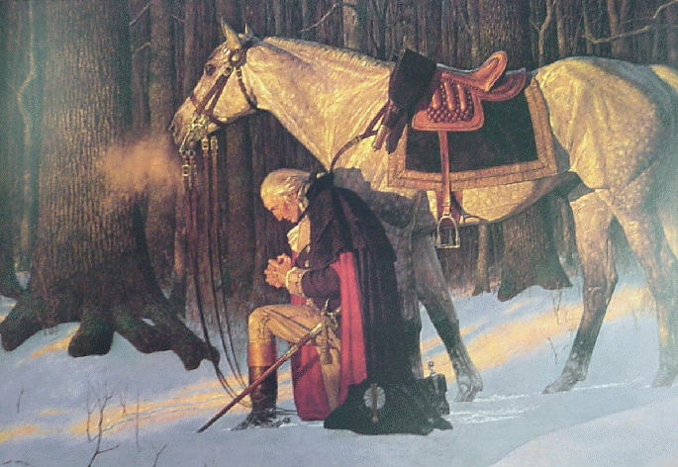

Washington's Vision at Valley Forge
Robert C. Newman

Slide 2
Washington's Vision
For nearly 150 years, a story has been circulating that George Washington had a vision of the future of America while the troops were camped at Valley Forge in 1777.
I first encountered the story when my mother showed me a tract about it published by the Russian Bible Society in the 1950s.
Since then, I have been able to trace it back to a pamphlet published in 1864.

Slide 3
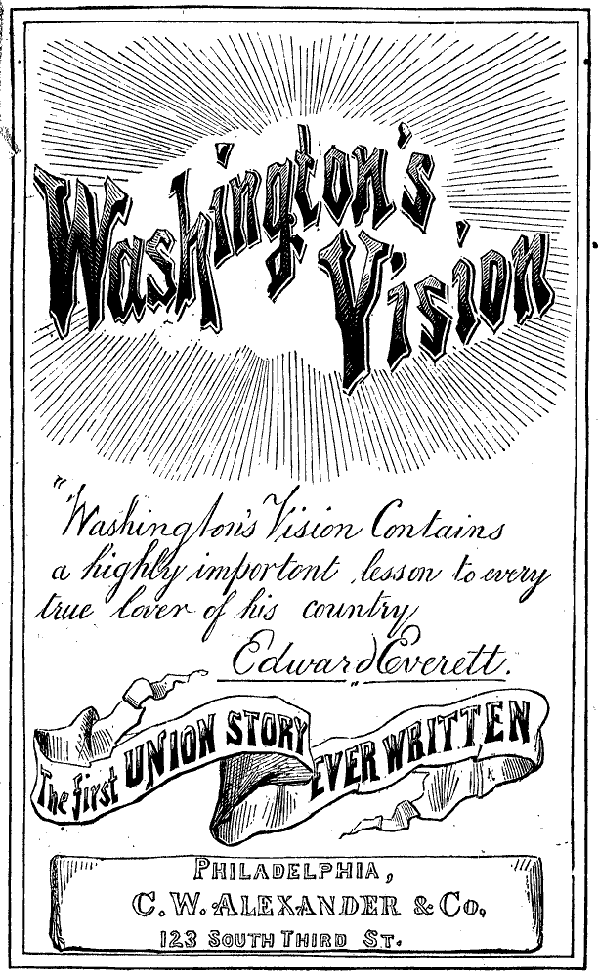
The Story
Washington is visited in his tent by a mysterious ethereal woman, who shows him a vision of three perils that sketch the future of the United States:
  Peril 1 is the American Revolution.
  Peril 2 is the Civil War.
  Peril 3 is an invasion that nearly destroys the country.
We give selections from each on the following panels.

Slide 4
Peril 1: the Revolution
At that moment I beheld a dark, shadowy being, like an angel, standing, or rather floating in mid-air between Europe and America. Dipping water out of the ocean in the hollow of each hand, he sprinkled some upon America with his right hand, while he cast upon Europe some with his left. Immediately a dark cloud arose from each of these countries, and joined in mid-ocean. For a while it remained stationary, and then moved slowly westward, until it enveloped America in its murky folds. Sharp flashes of lightning now gleamed throughout it at intervals, and I heard the smothered groans and cries of the American people. A second time the angel dipped water from the ocean, and sprinkled it as before. The dark cloud was then drawn back to the ocean, into whose heaving waves it sank from view.

Slide 5
Peril 2: the Civil War
"Son of the Republic, the end of a century cometh; look and learn." At this, the dark shadowy angel turned his face southward, and from Africa I saw an ill-omened spectre approaching our land. It flitted slowly and heavily over every village, town, and city of the latter; the inhabitants of which presently set themselves in battle array, one against the other. As I continued looking, I saw a bright angel, on whose brow rested a crown of light, on which was traced the word UNION, bearing an American flag, which he placed between the divided nation, and said: "Remember, ye are brethren." Instantly, the inhabitants, casting down their weapons, became friends once more, and united around the national standard. And again I heard the mysterious voice, saying: "Son of the Republic, the second peril has passed; look and learn."

Slide 6
Peril 3: the Invasion
"Son of the Republic, the end of a century cometh; look and learn." At this, the dark, shadowy angel placed a trumpet to his mouth, and blew three distinct blasts; and taking water from the ocean, sprinkled it out upon Europe, Asia, and Africa. Then my eyes looked upon a fearful scene. From each of these coun-tries arose thick, black clouds, that were soon joined into one. And throughout this mass gleamed a dark-red light, by which I saw hordes of armed men, who, moving with the cloud, mar-ched by land, and sailed by sea, to America, which country was presently enveloped in the volume of the cloud. And I dimly saw these vast armies devastate the whole country, and pillage and burn the villages, towns, and cities that I had beheld springing up.

Slide 7
Peril 3: the Invasion
As my ears listened to the thundering of cannon, clashing of swords, and shouts and cries of the millions in mortal combat, I again heard the mysterious voice, saying: "Son of the Republic, look and learn." When the voice had ceased, the dark, shadowy angel placed his trumpet once more to his mouth, and blew a long, fearful blast. Instantly a light, as of a thousand suns, shone down from above me, and pierced and broke into frag-ments the dark cloud which enveloped America. At the same moment, I saw the angel upon which forehead still shone the word UNION, and who bore our national flag in one hand, and a sword in the other, descend from heaven, attended by legions of bright spirits. These immediately joined the inhabitants of America, who I perceived were well-nigh overcome, but who, immediately taking courage again, closed up their broken ranks and renewed the battle.

Slide 8
Conclusion: the Lesson
"Son of the Republic, what you have seen is thus interpreted. Three perils will come upon the Republic. The most fearful is the second, passing which, the whole world united shall never be able to prevail against her. Let every child of the Republic learn to live for his God, his land, and Union." With these words the figure vanished. I started from my seat, and felt that I had seen a vision, wherein had been shown to me the birth, progress, and destiny of the Republic of the United States. In UNION she will have strength, In DISUNION her destruction.

Slide 9
Is the Story History?

Slide 10
Is the Story History?
This 1864 version can be accessed at: www.letrs.indiana.edu/cgi/t/text/pageviewer-idx?c=wright2;sid=c7b49925b8b924a08eab10d8b8a74ba3;cc=wright2;node=Wright2-0051%3A1;idno=Wright2-0051.
Did Washington ever experience such a vision?
Without time-machines, it is impossible to be sure, but there are several features which are very suspicious.

Slide 11
Suspicious Features
The author, Wesley Bradshaw, is a pseudonym for Charles Wesley Alexander, an author and publisher of many sensational stories.
His alleged informant, Anthony Sherman:
  Claims that he was the only one alive who knew of this incident in 1859.
  Is 99 when he tells the story to Bradshaw on July 4, 1859.
  Would have been only 17 in 1777, so not likely to have been the "confidential officer" to whom Washington is supposed to have told the story.
The only Anthony Sherman known to have served in the American forces during the Revolution was not present at Valley Forge and apparently died before 1840.

Slide 12
Tentative Conclusions
These features suggest that the story is merely another piece of fiction authored by Wesley Bradshaw aka C.W. Alexander.
It appears that he may have published the story as early as 1861, when it appeared in the Philadelphia Inquirer.
I have not yet been able to get a copy of this 1861 version.

Slide 13
Tentative Conclusions
The 1864 version, title page shown at right, was apparently condensed and reprinted in the GAR newspaper, the National Tribune, in 1880.
Most recent versions of the story claim to come from this 1880 version.

Slide 14
Tentative Conclusions
But a significant change has been made in all versions of the story that I am aware of circulating in the 20th century:
  The text has been modified to make the 3rd peril the worst, rather than the 2nd.
  The 1880 article and the 1864 pamphlet have the 2nd peril as the worst, as seen above in panel #8.
  This modification certainly makes the story more relevant in the 20th century, but it is also fraudulent.

Slide 15
Tentative Conclusions
Yet, with the passing of the 20th century, it looks like the major real prediction of the vision has been falsified. The vision appears to put:
  The Revolution in the 18th century
  The Civil War in the 19th century
  The Invasion in the 20th century
As is now obvious, no such invasion occurred in the 20th century.

Slide 16
Some Lessons

Slide 17
Some Lessons
As best we can tell at this point, the story of Washington's vision at Valley Forge is a fictional account, written by Wesley Bradshaw shortly after the alleged date of his meeting with Anthony Sherman.
It reminds us of Jesus' warning that the time between his ascension and return will be characterized by false prophets.

Slide 18
Some Lessons
It also reminds us that humans are notoriously bad at predicting the future!
The transmission history of this story is also interesting.
  Someone changed the main point of the story (from the importance of national unity to the prediction of an invasion) to make it more exciting for later readers.
  This provides us with yet another lesson.

Slide 19
Some Lessons
The difference between the canonical writings of the Bible and the 'Gospels' and 'Acts' of the Gnostics is that the former had a controlled transmission.
  Because the leaders of the Christian church viewed the Bible as a real revelation from God, they did not dare to tamper with its message.
  Gnosticism, a diffuse movement with many gurus, cranked out new revelations and modified old ones whenever a new group split off.

Slide 20
Some Lessons
We need to be sure that the revelations we trust in really come from the God who cannot lie.
We have assembled our various materials at www.ibri.org to help site visitors appreciate the marvelous evidence that God has provided for our faith.

Slide 21
The End

