Slide 1


Various Views of Revelation
Robert C. Newman

Slide 2
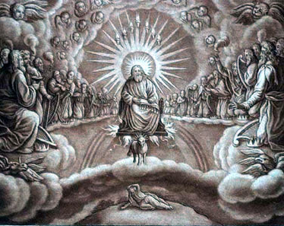
Introduction
Revelation is surely the most unusual book in the New Testament.
Many Christians seriously neglect the book.
Other Christians overemphasize the book to the neglect of equally important matters.

Slide 3
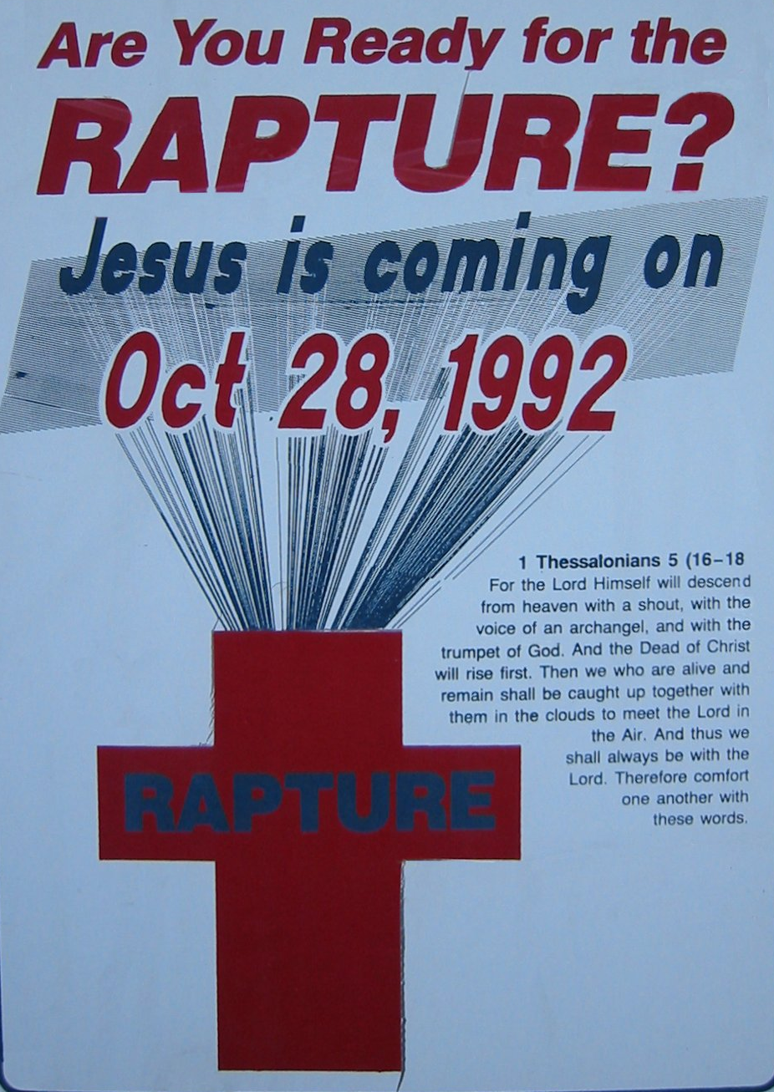
Why sometimes neglected?
Book thought to be unintelligible by some
Some repelled by its symbolism
Some turned off by its interpreters
Some don't like to think about heaven & hell

Slide 4
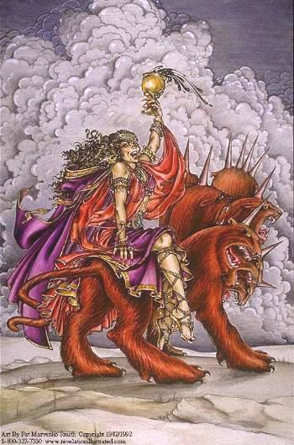
Why thought unintelligible?
More symbolism than any book in the New Testament
  Only Daniel & Zechariah come close in OT
Wide varieties of interpretation
  Only Song of Songs close in OT

Slide 5
Varieties of approaches
Contemporary (Preterite) View
Historical (Church History) View
Future (Futurist) View
Spiritual (Idealistic) View

Slide 6
Church History
Jesus
Church Age
SecondComing
Nearly all Christians (except extreme Preterists) believe that Jesus will come again in the future, and that the time between his comings is primarily the church age, in which we have a responsibility to take the Gospel to all the nations.

Slide 7
Preterist View of Revelation
Fulfillment
Jesus
Church Age
SecondComing
Preterists believe that all or nearly all of Revelation was fulfilled in the first century or the first few centuries after the time of Christ's ministry on earth.

Slide 8
Historical View of Revelation
Fulfillment
Jesus
Church Age
SecondComing
Those holding the historical view believe that Revelation is fulfilled fairly uniformly over church history.

Slide 9
Futurist View of Revelation
Fulfillment
Jesus
Church Age
SecondComing
Futurists believe that nearly all of Revelation is to be fulfilled near the end of church history, just before and around Jesus' second coming.

Slide 10
Idealist View of Revelation
General Fulfillment
Jesus
Church Age
SecondComing
Idealists believe that Revelation will be fulfilled throughout church history, but that the symbols are a general picture of the warfare between good & evil, God & Satan, not referring only to single events.

Slide 11
Some Proponents of Views

Slide 12


Preterist View
Alcasar (1614)
Jay Adams
G. B. Caird
Hugo Grotius
Leon Morris
Moses Stuart

Slide 13

Historicist View
Berengaud (9th century)
Albert Barnes
Luther
Wycliffe
Many older A-Mill
Not very popular today

Slide 14
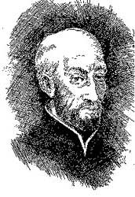
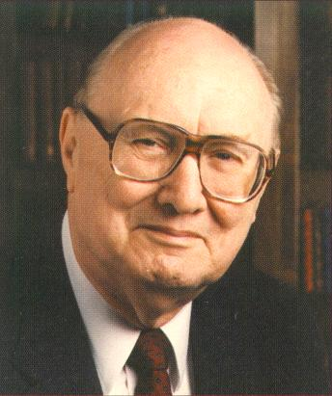
Futurist View
Ribera (1591)
George E. Ladd
Robert Mounce
John Walvoord
Usual Pre-Mill

Slide 15
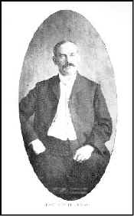
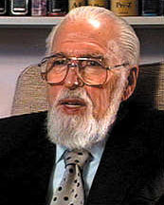
Idealist View
Auberlen (1854)
Chuck Colclasure
William Hendriksen
R. C. H. Lenski
William Milligan
Rousas Rushdoony
Michael Wilcock

Slide 16
Mixed Views
A number of commentators combine two of the approaches.
Alford – Historicist & Futurist
Beasley-Murray – Preterist & Futurist
Hoeksema – Futurist & Idealist
Swete – Preterist & Idealist

Slide 17
Some Merit to Each View
Preterite – the visions presumably made sense to John & early Christians.
Historical – the visions are valuable in each century of church history.
Futurist – the visions surely involve events at the end of church history.
Idealist – the visions picture the spiritual warfare that we all experience.

Slide 18
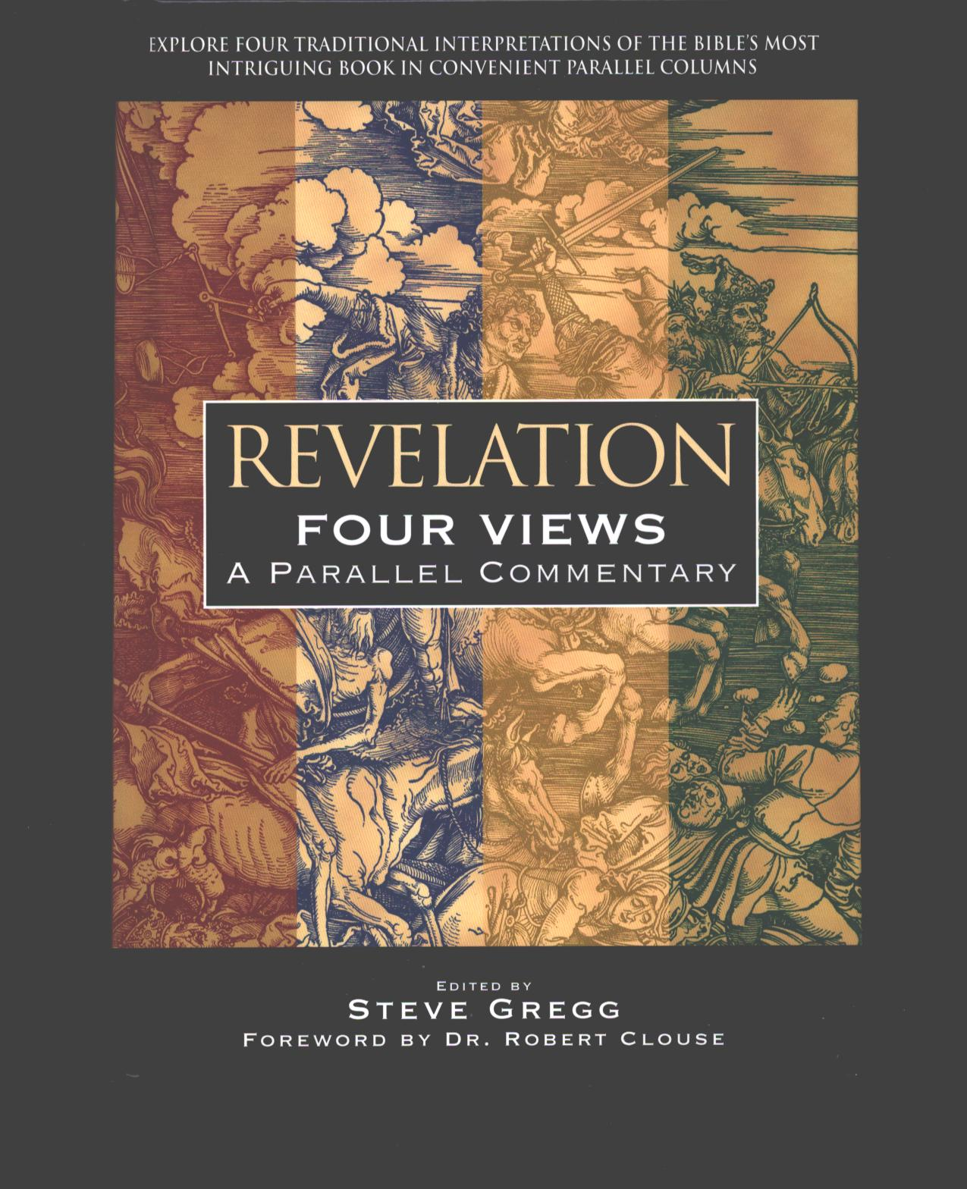
Four Views Commentary
To get a feel for how these different approaches handle various passages...
See Steve Gregg's Revelation: Four Views, A Parallel Commentary.

Slide 19
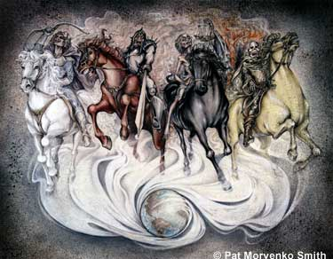
The End …
… of dispute on what Revelation means will probably not come before Jesus returns!

