Slide 1
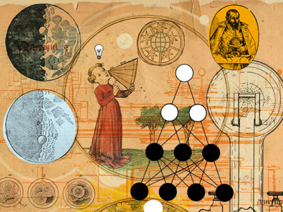

A Universal History
A narration based on the biblical revelation
Robert C. Newman

Slide 2
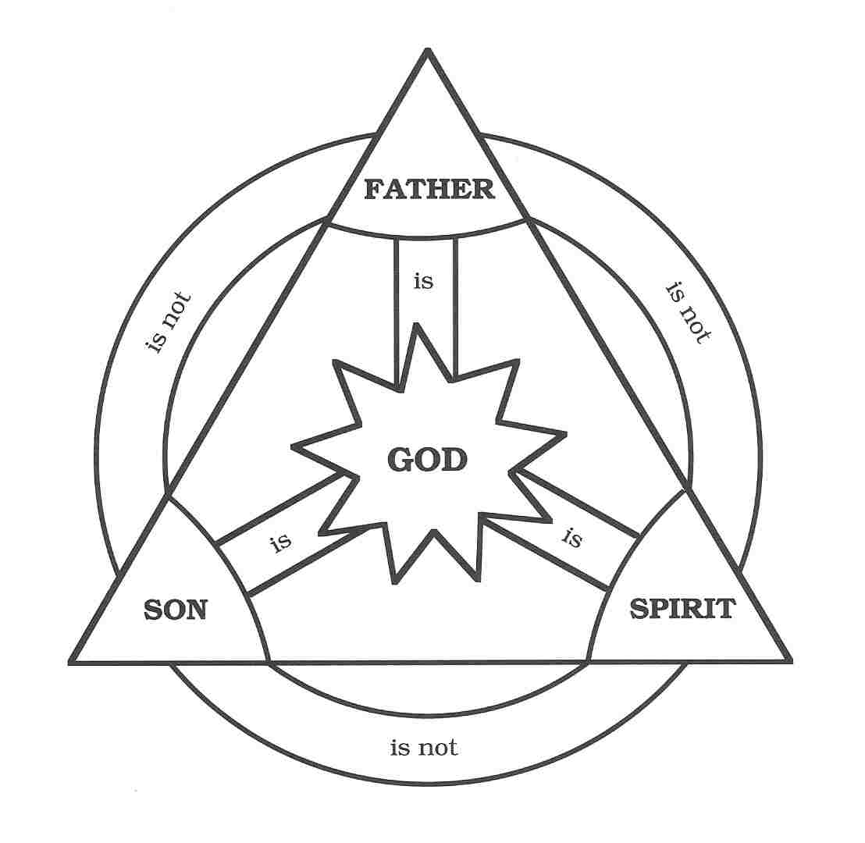
Before Our Universe (1)
God has always existed, but the universe has not.
Before anything else existed, there was God.
God was not lonely, because He exists as three persons, whose mutual interaction provide eternal love and enjoyment.
But God created other beings so they could share this love and enjoyment.

Slide 3
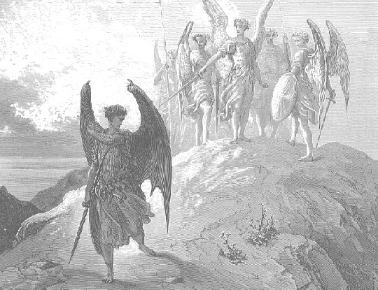
Before Our Universe (2)
Apparently He created the beings we call angels even before our universe.
We don't know much about these beings, but they were all good when they were first made.
Somewhere, somehow, some of them rebelled.
These include Satan, the fallen angels, & presumably the beings we call demons.

Slide 4
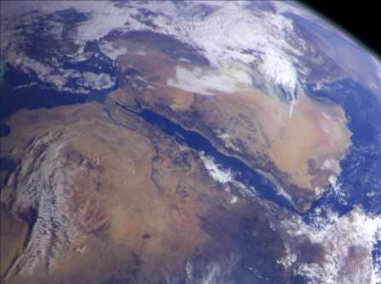
Our World
We are not sure when these angels rebelled: perhaps before, perhaps after, the creation of our world.
The angels appear to be in charge of various aspects of our world: e.g. nations, groups, individuals, weather, etc.
When Satan first appears in the biblical narrative, he has already rebelled.
Perhaps the creation of mankind, or even of our universe, was God’s first step in ending this rebellion.

Slide 5
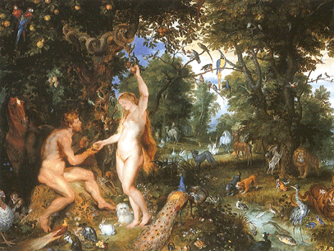
Adam & Eve
When God made Adam, and then Eve, both were good.
They were placed in a special location, with special privileges & duties.
Their duties were to:
  Multiply and fill the earth
  Subdue and rule over the earth.
This latter duty suggests they may have been intended to redeem the earth.

Slide 6
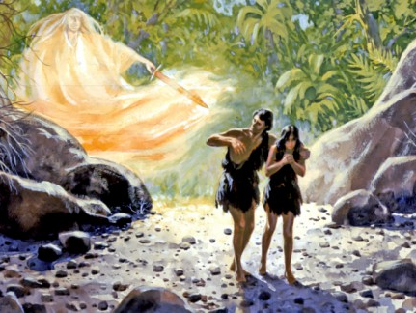
The Fall
But Satan was allowed to tempt them, to try & get them to rebel against God as he had.
Satan succeeded, so that Adam & Eve failed their test & fell into sin.
Adam & Eve lost both innocence & immortality, both for themselves & for their offspring to come.
They were excluded from that special place, Eden, into a cold, cruel world.
Instead of being redeemers, they now needed to be redeemed themselves.

Slide 7
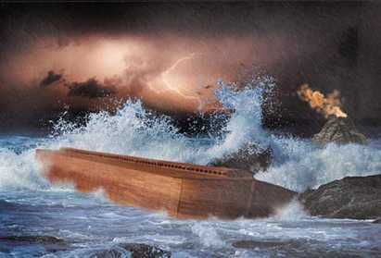
Filling the Earth
The descendants of Adam & Eve proceeded to fill the earth, but as sinners in rebellion rather than as people who love like God does.
So the earth was being filled with lying, cheating, stealing, murder, false worship, and all sorts of other terrible things.
At one point God destroyed nearly all the people in a flood; but even so, those who survived had much the same character as those who died.

Slide 8
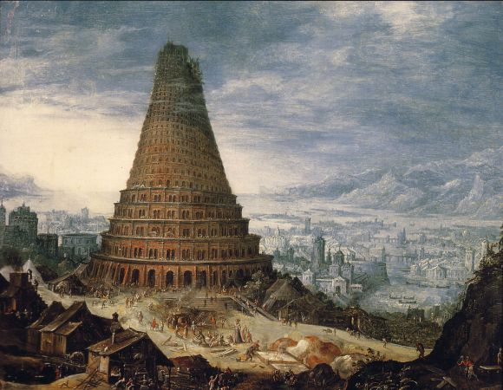
After the Flood
It appears that God shortened the human lifespan after the flood, perhaps to decrease the amount of evil an individual could do.
But this was only a bandage for the problem, not really healing it.
Later, God confused human communication by multiple languages, perhaps to limit the amount of evil a civilization could do.

Slide 9
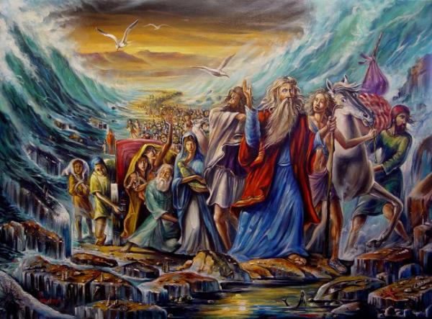
A Chosen People
Then God called Abraham to leave his homeland & people, and God began a process of forming from Abraham's descendants a people for Himself.
After some time in Canaan, these people went to Egypt, where they were eventually enslaved; there they grew into a nation, which later came to be called Israel.
They were finally rescued from slavery & led out of Egypt by Moses.
They were given God's laws in the wilderness to guide their worship & daily lives.

Slide 10
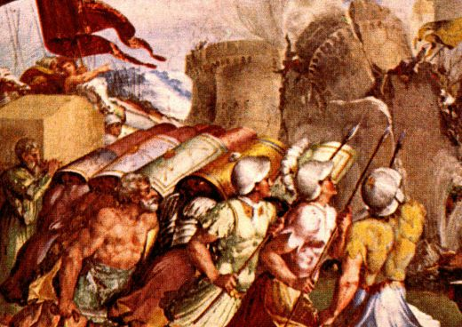
A Promised Land
After 40 years of wandering, Israel was led into the land of Canaan by Joshua, Moses' successor.
There they conquered and drove out the various Canaanite tribes, whose sins had by then ripened to the point of judgment.
But Israel's subsequent history showed that they, too, were still a wicked & rebellious people.

Slide 11
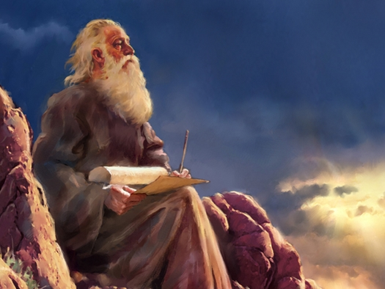
A Promised Redeemer
Throughout Israel's history in the land, prophets were sent to give God's perspective on how they were keeping His laws, to warn of coming judgment & to comfort with promised blessing.
A major aspect of these prophecies was the coming of a person who would rescue Israel from their rebellion & their enemies, and who would be a light to the other nations as well.

Slide 12
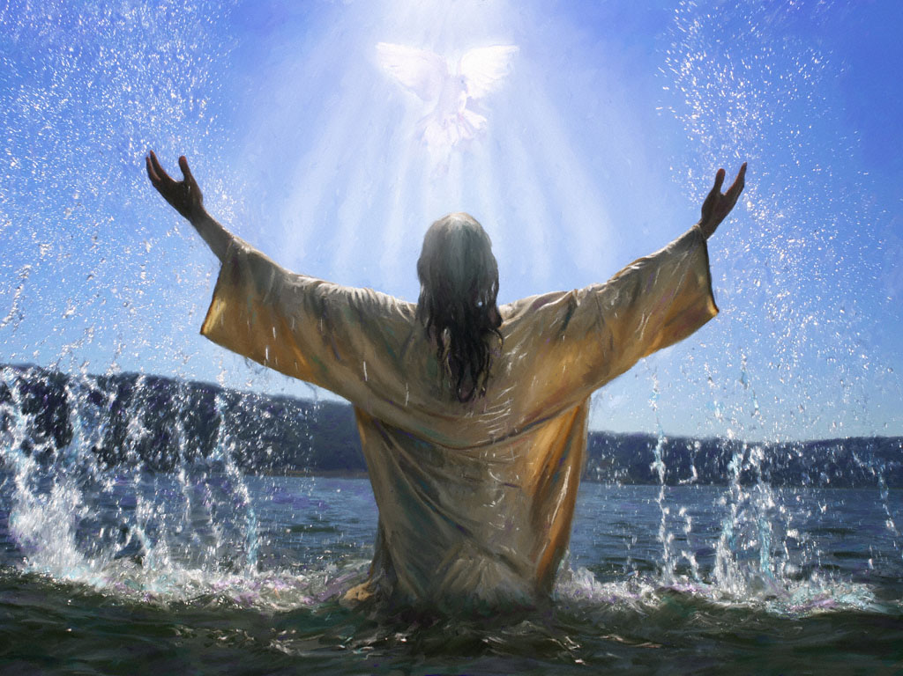
The Messiah
This person came to be called "the Messiah," one of several titles given him by the prophets.
Many striking prophecies were made about him, hinting he would be both God and man, and that he would die for our sins & then rise from the dead.
Some of these are discussed in other PowerPoints on our website www.ibri.org.
Use the website search engine to find:
  "Jesus, the Testimony of Prophecy & History"
  "They Saw Jesus… Centuries in Advance"

Slide 13
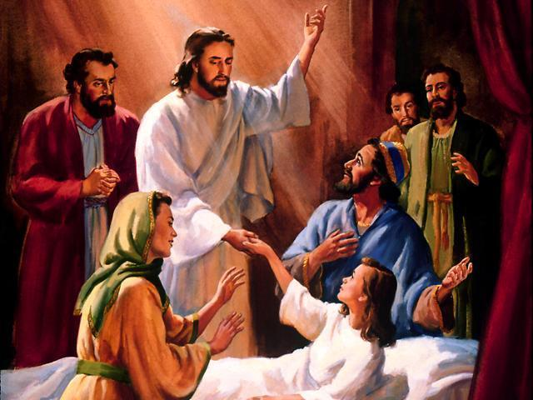
His Coming
As the time for the Messiah's coming (specified in the prophet Daniel 9:20-27) drew near, most of the Israelites had been scattered among the nations, and only a relatively small fraction remained in the land, now under Roman domination.
About AD 30, Jesus of Nazareth came on the scene, teaching about God, doing many miracles of healing, and making astonishing claims.

Slide 14
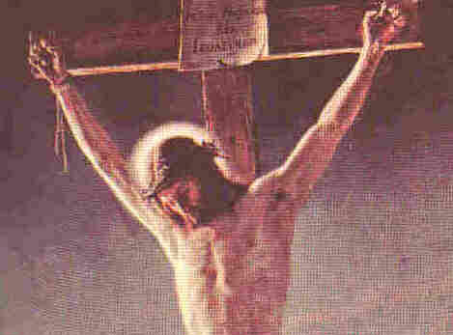
Jesus Rejected
Though many Israelites (Jews) accepted Jesus as the Messiah, the religious leadership rejected his claims, and got the Roman government to put him to death by crucifixion.
But as Jesus himself had predicted, he rose from the dead three days later, and appeared to many of his followers and even to some of his opponents.

Slide 15
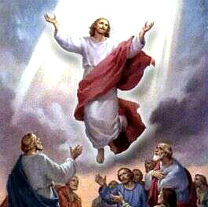
Jesus Ascends to His Father
After appearing again & again to his followers over a period of 40 days, Jesus returned to heaven.
He left his followers (the Church) with:
  A commission to spread the message of his death as a sacrifice to pay for human sin, and to call people to trust & follow him;
  A promise that he himself will return one day to make everything right.

Slide 16
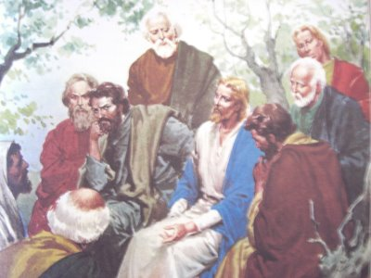
The Apostles
Jesus' followers began to spread his message among the Jews, but soon branched out to the other nations, as Jesus had commanded them.
The early leaders (called apostles) wrote up narratives of Jesus' ministry (called Gospels), a narrative of their own ministries (called Acts), and numerous letters of instruction for the local churches.

Slide 17

Since Then
It has been nearly 2000 years since Jesus' death, resurrection, and ascension.
The Church has now spread over all the world, with followers of Jesus in every nation and in most ethnic groups.
Christianity has become the largest of the world religions.

Slide 18
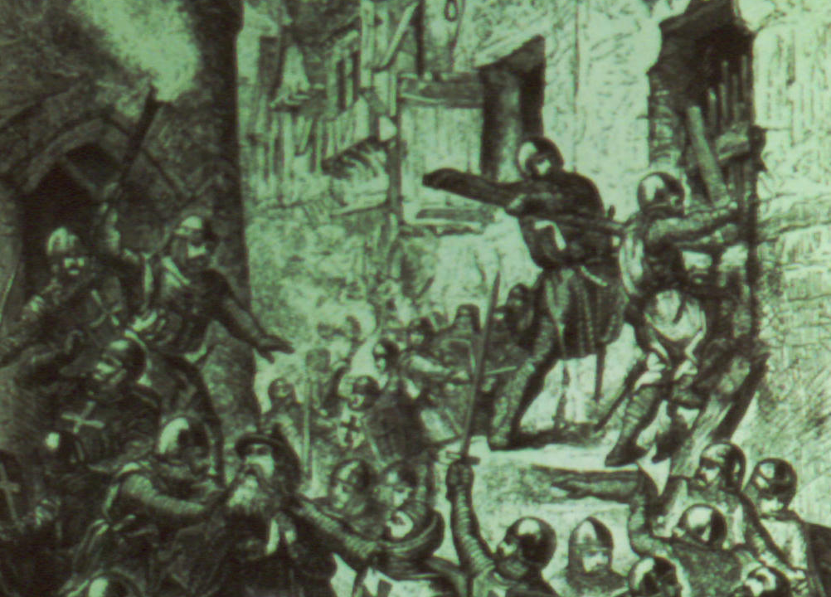
Since Then
Like all groups of humans, Christians have shown themselves to be sinners still, and they have done many things of which we are ashamed.
Yet, when Christians have followed the teachings of Jesus, their lives have been transformed, and so have the societies in which they live.

Slide 19
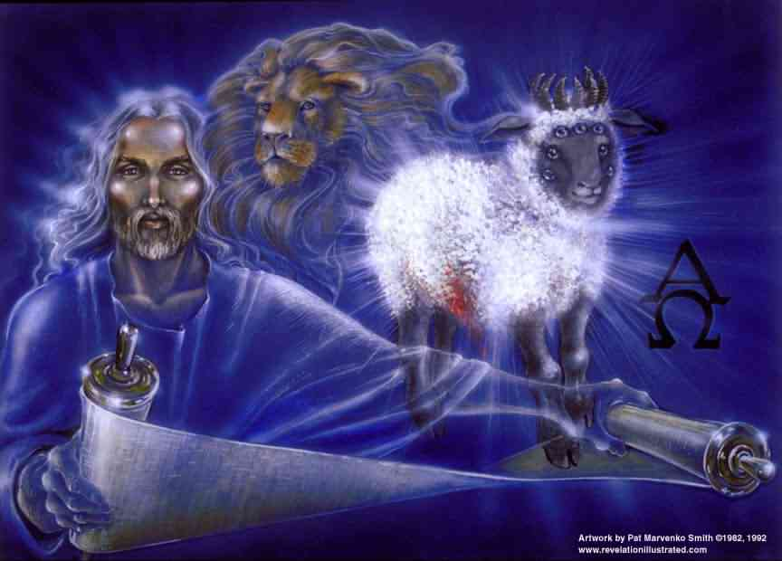
What Lies Ahead
Predictions of the End-Times

Slide 20
Where We Are
We are in that period of our universal history between the first and second comings of Jesus.
The Bible gives us a good deal of information about what is to happen as Jesus' second coming approaches.
Let us sketch a bit of that for you.

Slide 21
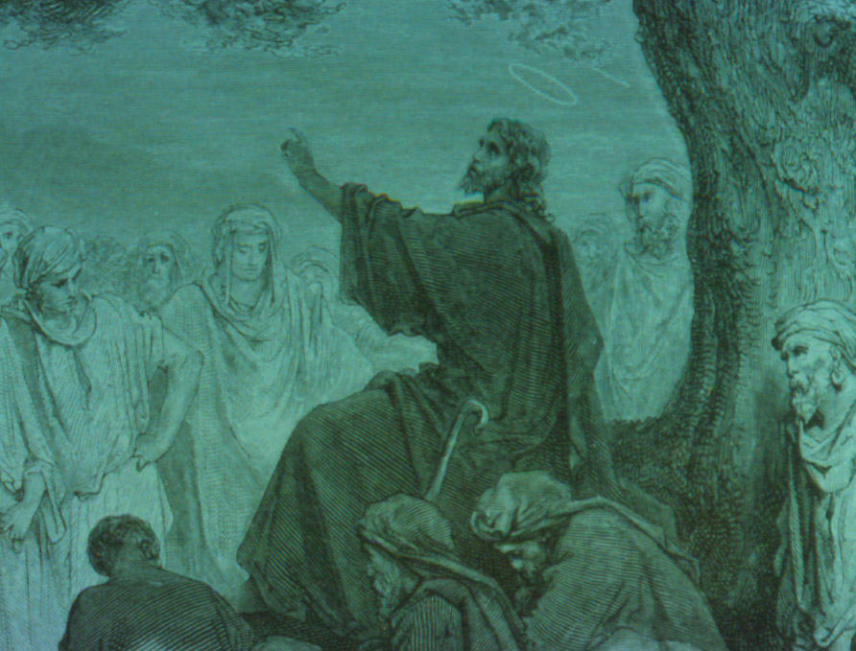
Signs of the End
The Gospel (the message Jesus left for his followers to spread) will be proclaimed all over the world; then the end will come.
Jesus gave a number of other things that would happen as the end of the age approaches.
There will be people falsely claiming to be the Messiah (or Christ).

Slide 22
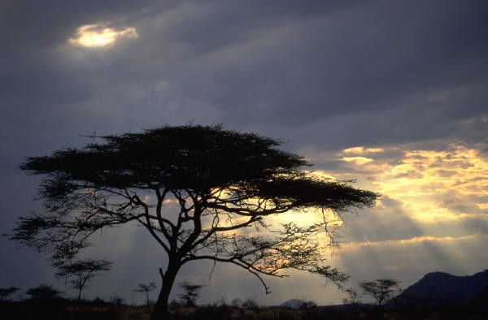
Signs of the End
There will be wars and rumors of wars.
There will be famines & earthquakes.
Christians will be persecuted & killed.
Wickedness will increase greatly.
The Antichrist will proclaim himself God in Jerusalem.
There will be great distress, unequaled in the history of the world.

Slide 23
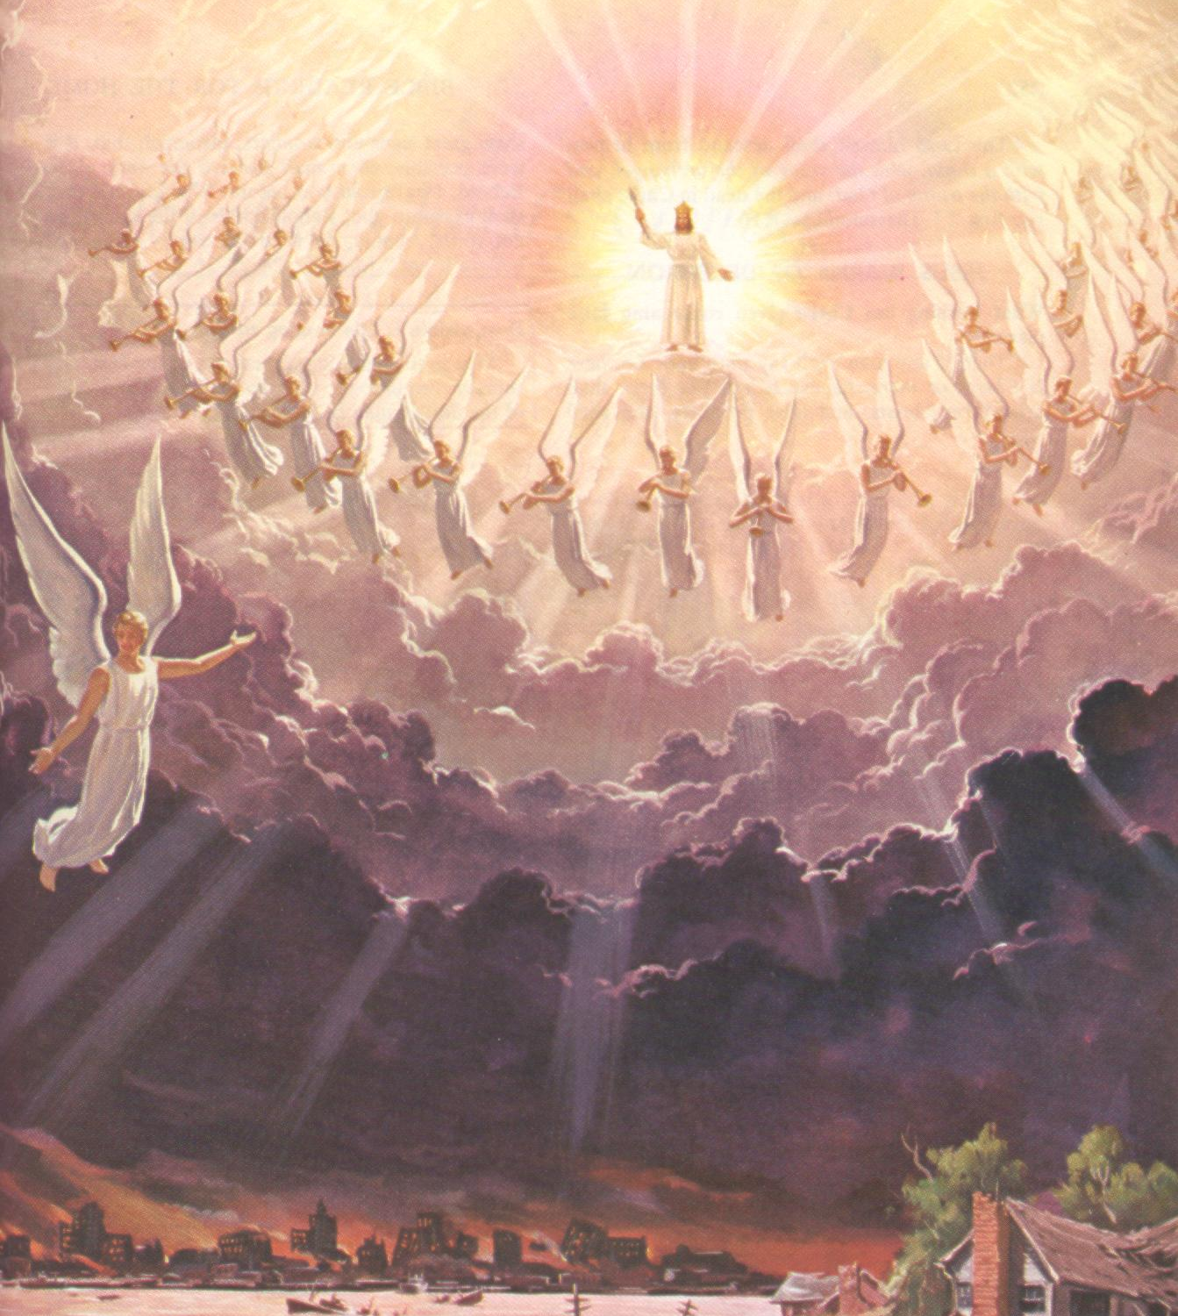
Jesus' Second Coming
Finally, Jesus will come with his army, consisting of his angels and his human followers, who have reen raised from the dead to accompany him.
The world's nations will mourn.
Jesus will defeat his enemies.
As I understand the Bible, this will be followed by a thousand years of peace.

Slide 24
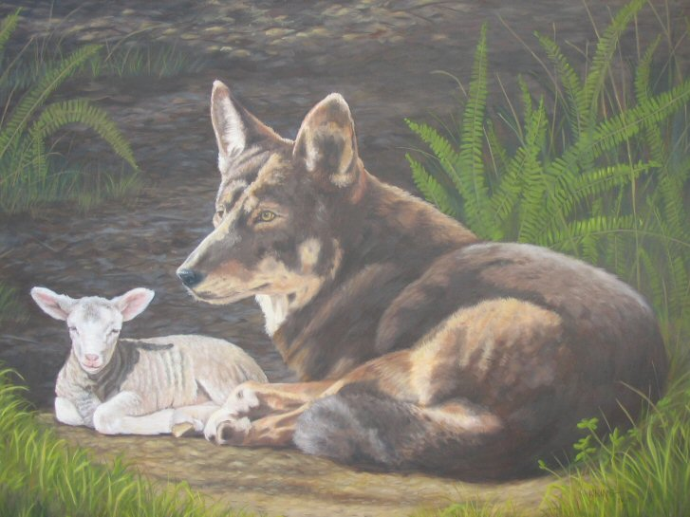
The Thousand Years
This 1000 years will be characterized by world peace and prosperity, ruled over by Jesus.
Yet it will end with a rebellion.
Perhaps this period is ordained by God to show us that even perfect circumstances will not solve human problems without a change in our sinful character.

Slide 25
The Last Judgment
When Jesus has put down the revolt, heaven & earth will vanish, and all mankind will stand before God's judgment.
Each person will be judged for what they have done with their lives, and especially for what they have done with God's offer of pardon through the death of Jesus as a sacrifice for sin.

Slide 26

The Eternal State
Our story of the universal history ends with a glimpse of what lies beyond.
We see there are only two destinies.
(1) Eternal life: complete fulfilment of all our best desires, in the presence of Jesus, on the new earth.
(2) The second death: fulfilment of our worst fears, separated from God, experiencing eternal shame.

Slide 27
What About You?
What are you depending on?
Will you take your chances that when you die you will cease to exist?
Or if not, that God will accept you whatever you have lived like?
Or will you realize that you, like all of us, are not good enough to stand in God's judgment, and cast yourself upon Jesus?

Slide 28
The End
Of this universal history …
But human existence will never end.

