Slide 1
Understanding Islam
Robert C. Newman

Slide 2
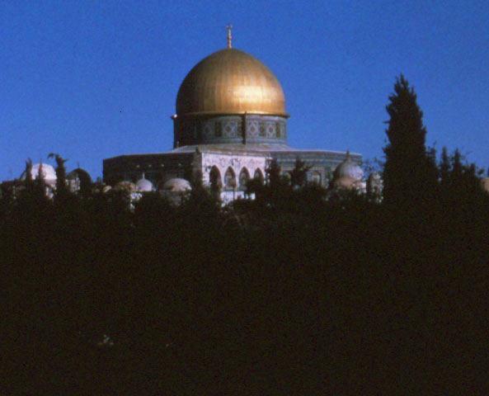
What is Islam?
"The religion of Islam is the acceptance of and obedience to the teachings of God which He revealed to His last prophet, Muhammad." BIGUI, 45
"Islam" and "Muslim" are derived from the Arabic word for "submission," not the similar word for "peace."

Slide 3
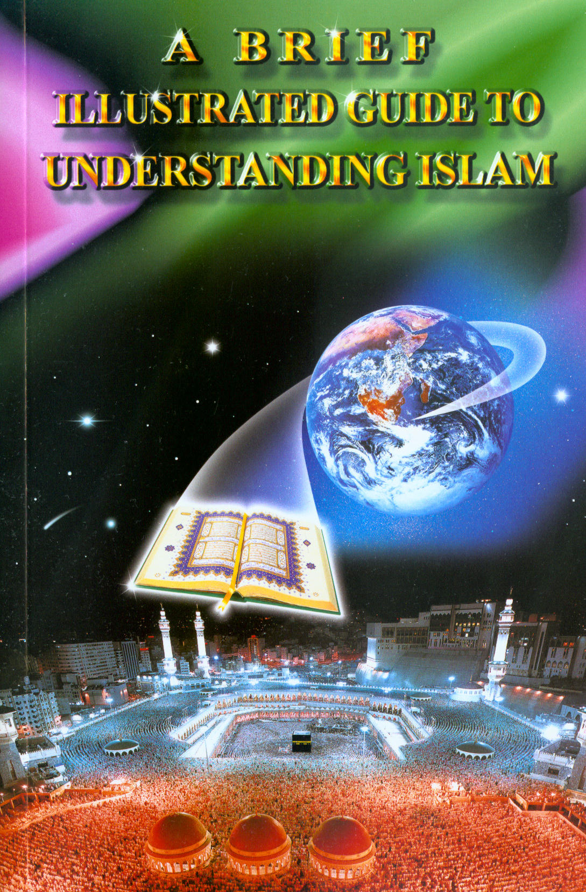
Sources
Our material from an Islamic perspective will largely be drawn from A Brief Illustrated Guide to Understanding Islam, 2nd ed., edited by I. A. Ibrahim and published by Darussalam of Houston, TX, 1997. Abbreviated here as "BIGUI."

Slide 4
Some Basic Islamic Beliefs
Belief in God
Belief in the Angels
Belief in God's Revealed Books
Belief in the Prophets & Messengers of God
Belief in the Day of Judgment
Belief in Divine Predestination

Slide 5
Belief in God
"Muslims believe in one unique, in-comparable God, Who has no son nor partner, and that none has the right to be worshipped but Him alone." BIGUI, 45
Thus the deity of Jesus is rejected. Most Muslims believe the Christian Trinity consists of God, Mary & Jesus.

Slide 6
Belief in the Angels
"Muslims believe in the existence of the angels, and that they are honored creatures. The angels worship God alone, obey Him, and act only by His command.
"Among the angels is Gabriel, who brought down the Qur'an to Muhammad." BIGUI, 47

Slide 7
Belief in God's Revealed Books
"Muslims believe that God revealed books to His messengers as proof for mankind and as guidance for them. Among these books is the Qur'an, which God revealed to the Prophet Muhammad. God has guaranteed the Qur'an's protection from any corruption or distortion." BIGUI, 48
The Bible is viewed as revealed by God but subsequently corrupted.

Slide 8
Belief in the Prophets & Messengers of God
"Muslims believe in the prophets and messengers of God, starting with Adam, including Noah, Abraham, Ishmael, Isaac, Jacob, Moses, and Jesus (peace be upon them).
"But God’s final message, a reconfirmation of the eternal message, was revealed to the Prophet Muhammad … the last prophet sent by God." BIGUI, 48

Slide 9
Belief in the Day of Judgment
"Muslims believe in the Day of Judgment (the Day of Resurrection) when all people will be resurrected for God's judgment according to their beliefs and deeds." BIGUI, 48
Muslims do not (in general) have assurance that their sins will be forgiven.

Slide 10
Belief in Divine Predestination
"Muslims believe in Divine Predestination, but this belief … does not mean that human beings do not have freewill … This means that they can choose right or wrong and that they are responsible for their choices." BIGUI, 48

Slide 11
Belief in Divine Predestination
"The belief … includes … four things:
God knows everything.
God has recorded all that has happened and will happen.
Whatever God wills to happen happens…
God is the Creator of everything."
BIGUI, 48-49

Slide 12
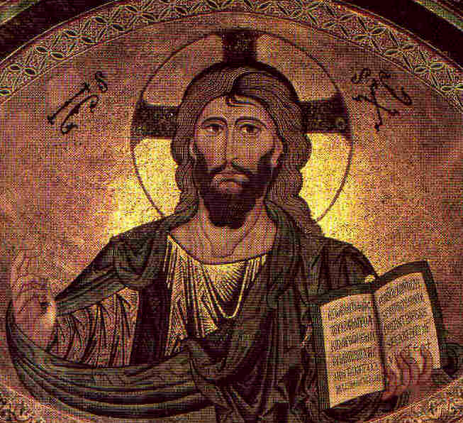
Comparing Christianity & Islam
Consider the Apostles' Creed.
We will first go through it as it stands.
Then we will mark the items rejected by Islam with red type.

Slide 13
Apostles' Creed
I believe in God the Father Almighty, Maker of Heaven and Earth;
And in Jesus Christ His only Son, our Lord,
Who was conceived by the Holy Ghost, Born of the Virgin Mary,
Suffered under Pontius Pilate, Was crucified, dead and buried…

Slide 14
Apostles' Creed
He descended into hell; the third day He arose again from the dead,
He ascended into heaven,
And sitteth at the right hand of God the Father Almighty;
From thence He shall come to judge the quick and the dead.

Slide 15
Apostles' Creed
I believe in the Holy Ghost;
The Holy Catholic Church;
The Communion of Saints;
The Forgiveness of Sins,
The Resurrection of the body,
And the life everlasting.

Slide 16
Apostles' Creed
I believe in God the Father Almighty, Maker of Heaven and Earth;
And in Jesus Christ His only Son, our Lord,
Who was conceived by the Holy Ghost, Born of the Virgin Mary,
Suffered under Pontius Pilate, Was crucified, dead and buried…

Slide 17
Apostles' Creed
He descended into hell; the third day He arose again from the dead,
He ascended into heaven,
And sitteth at the right hand of God the Father Almighty;
From thence He shall come to judge the quick and the dead.

Slide 18
Apostles' Creed
I believe in the Holy Ghost;*
The Holy Catholic Church;
The Communion of Saints;
The Forgiveness of Sins,
The Resurrection of the body,
And the life everlasting.

Slide 19
The Five Pillars of Muslim Practice
Confession of Faith (Shahada)
Ritual Prayer (Salat)
Obligatory Alms (Zakat)
The Fast of Ramadan (Saum)
Pilgrimage to Mecca (Hajj)

Slide 20
The Confession of Faith
Saying with conviction: La ilaha illa Allah, Muhammadur rasoolu Allah (There is no god but Allah, and Muhammad is the Messenger of Allah).
By saying this with conviction, one becomes a Muslim.
BIGUI, 65

Slide 21
Ritual Prayer
"Muslims perform prayer fives times a day. Each prayer does not take more than a few minutes to perform." BIGUI, 66
Prayers are performed at:
Dawn
Noon
Mid-afternoon
Sunset
Night

Slide 22
Obligatory Alms
"Giving a specified percentage on certain properties to certain classes of needy people"
The percentage on money is 2.5%
People may also give as much or little as they wish in the form of voluntary alms or charity.
BIGUI, 66

Slide 23
The Fast of Ramadan
"Every year in the month of Ramadan, Muslims fast from dawn to sunset, abstaining from food, drink, and sexual relations." BIGUI, 67
This is typically balanced by feasting during the dark hours of Ramadan.

Slide 24
The Pilgrimage
"The annual pilgrimage (Hajj) to Makkah is an obligation once in a lifetime for those who are physically and financially able to perform it.
"About two million people go to Makkah each year from every corner of the globe."
BIGUI, 67-68

Slide 25
Sharing with Muslims
Use God's Word.
Be much in prayer.
Be a genuine friend.
Ask thought-provoking questions.
Listen attentively.
Present your beliefs openly.
Reason, don't argue.
Never talk down Muhammad or the Qur'an.
Respect their customs.
Persevere.

Slide 26
Use God's Word
Muslims respect the sacred books:
Law of Moses
Psalms
Gospel
Qur'an
Let the Word speak for itself.
Start with the Gospels, Matthew & Luke.

Slide 27
Be Much in Prayer
It is God, the Holy Spirit, who changes hearts and wins people to Jesus.
Seek God's guidance, wisdom and power as you present the Word.

Slide 28
Be a Genuine Friend
Saying "hello" isn't enough.
If you really care, show it by:
Inviting them into your home,
Sharing your time,
Helping them with their problems.

Slide 29
Ask thought-provoking questions
"Do you have the assurance that God will accept you?"
"What does the Qur'an teach about forgiveness?"
"May I show you what the Bible teaches?"
Questions like these show that you have an interest in the important things in life.

Slide 30
Listen Attentively
When you ask a question, courtesy requires that you listen to the answer, no matter how long it takes.
You'll be surprised at how much you'll learn!

Slide 31
Present Your Beliefs Openly
State what you believe:
Clearly & without apology,
Showing Scripture passages that support these beliefs.
In this way, you put the responsibility for doctrine where it belongs – on the Word of God.

Slide 32
Reason, Don't Argue
Argument may win a point but lose a hearing.
On some points you can argue forever:
Achieving nothing,
Closing the person's mind against you.

Slide 33
Never Talk Down Muhammad or the Qur'an
This is very offensive to Muslims.
Think of how you feel when someone talks down Jesus or the Bible.

Slide 34
Respect Their Customs & Sensitivities
Don't put your Bible on the floor.
Don't appear to be too free with the opposite sex.
Don't refuse hospitality.
Don't make jokes about sacred topics:
Fasting
Prayer
God

Slide 35
Persevere
Muslims have a lot of rethinking to do when they are confronted with the Gospel.
We may rest in the assurance that:
God's Word will do its work,
In God's time.

Slide 36
For Further Information
On Islam from a Christian perspective:
www.answering-islam.org
On Islam from an Islamic perspective:
www.answering-islam.com

Slide 37
The End
May God help us to be kind to Muslims

