Slide 1
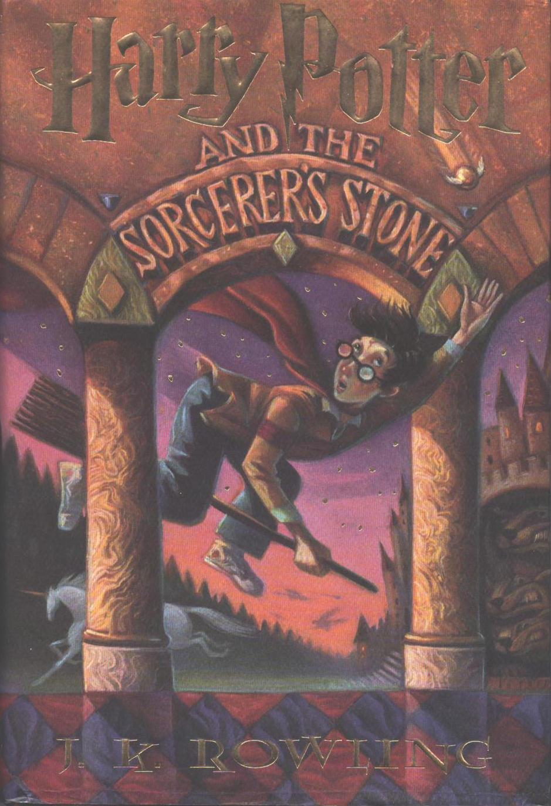
Understanding Harry Potter
Robert C. Newman

Slide 2
What's the Buzz?
This adventure series for kids (and grownups!) has sold many millions of copies in many languages.
The seven-volume book series is now complete (2007).
Five films have been made to date, with two more still to come.
The series is very controversial in Christian circles.

Slide 3
The Controversy
The series is about an orphan, Harry Potter, who learns on his eleventh birthday that he is a wizard.
He discovers that his parents were killed by the wicked wizard Lord Voldemort.
The series then follows his years of study at Hogwarts, a school for training witches and wizards, his further adventures, and his encounters with Voldemort.

Slide 4
The Controversy
Many Christian parents are concerned that the stories may influence their children to get involved in witchcraft.
Others feel this is just part of a fantasy world (like those of CS Lewis and JRR Tolkien) that helps to make the stories exciting, and that the adventures themselves can help kids experience the real-world struggle between good and evil on a level that will prepare them for adult life.
What can we say about this?

Slide 5
Our Response
Parents obviously have an awesome responsibility raising their kids.
If you feel there is a significant danger that your child might get involved in witchcraft as a result of this series, naturally you would not want to let them read the books or watch the films.
However, I do think you should view the rest of this talk before making your final decision.

Slide 6
My Experience
I am not a parent. I do have 11 nieces & nephews, plus 14 great-nieces & -nephews.
I am a life-long bachelor, a retired seminary professor, and a great fan of the writings of CS Lewis & JRR Tolkien.
When I first heard of the Harry Potter stories (about the time the second or third book came out), the news and reviews (both secular and Christian) did not sound attractive to me.

Slide 7
My Experience
One of my nephews, however, had read the books, and he said they were quite good and I should try them.
I did. They were good!
The first thing I noticed (having taught apologetics for years), is that the books were surely not written by an occultist.
The author passed up numerous opportunities to dump on Christianity, e.g., by making the Dursley family Fundamentalists, Catholics or Anglicans.

Slide 8
My Experience
I began to suspect that the author's agenda might be something like that of Lewis or Tolkien, particularly when I heard that JK Rowling was a professing Christian.
Lewis, in an essay entitled "Sometimes Fairy Stories May Say Best What’s to Be Said," remarks:

Slide 9
Those Watchful Dragons
Why did one [as a child] find it so hard to feel as one was told one ought to feel about God or about the sufferings of Christ? I thought the chief reason was that one was told one ought to. An obligation to feel can freeze feelings. And reverence itself did harm… But supposing that by casting all these things into an imaginary world, stripping them of their stained-glass and Sunday school associations, one could make them for the first time appear in their real potency? Could one not thus steal past those watchful dragons? I thought one could. Of Other Worlds, 37.

Slide 10
The Harry Potter Series
Like Lewis' Narnia Chronicles and Tolkien's Lord of the Rings, Rowling's Harry Potter series has magic, wizards & strange creatures.
Unlike the Narnia books, the Christianity in Harry Potter is not explicit.
But I would suggest that Christianity is more obvious in Potter than in Tolkien.
Let's do a quick tour of the Potter books.

Slide 11
Book 1: Sorcerer’s Stone
Harry learns he is a wizard; he begins school at Hogwarts.
He makes friends with Hermione & Ron and we learn a lot about the magical world.
Harry becomes a Quiddich star.
At the end Harry meets & defeats Voldemort.

Slide 12
Book 2: Chamber of Secrets
2nd year at Hogwarts; Ron's little sister Ginny begins school.
An unseen monster begins turning people to stone.
Finally, Harry rescues Ginny from the secret chamber, kills the monster and destroys Voldemort's diary.

Slide 13
Book 3: Prisoner of Azkaban
Year 3: An escaped murderer, Sirius Black, is apparently after Harry.
Harry rides a Hippogriff, continues as a Quiddich star, and meets Remus Lupin.
Harry & Hermione save the Hippogriff and also Sirius, who turns out to be really innocent.

Slide 14
Book 4: Goblet of Fire
Harry is secretly entered into the dangerous Triwizard Tournament.
He faces rejection, ridicule & danger as he competes in the 3 tests.
Finally he is kidnapped & nearly killed by Voldemort, escaping with help from the phantoms of his parents.

Slide 15
Book 5: Order of the Phoenix
Voldemort has now returned to his own body & is building up his sinister organization.
The Minister of Magic won't admit this, so Dumbledore forms the Order to oppose Voldemort.
Harry & his friends, seeking to rescue Sirius, face Voldemort's Death Eaters, but they escape.

Slide 16
Book 6: Half-Blood Prince
Harry is instructed by Dumbledore on the mysterious history of Voldemort.
They learn that Voldemort has divided his soul and put the pieces in various objects to become immortal.
Dumbledore is killed by Snape in an attack on Hogwarts by the Death Eaters.
Harry must now seek & destroy these objects.

Slide 17
Book 7: Deathly Hallows
Voldemort takes control of the Ministry of Magic.
Harry, Ron & Hermione must flee, while seeking the horcruxes in which V has hidden his soul.
Finally, Harry & Voldemort meet in a thrilling climax.

Slide 18
Where is God in All This?
Admittedly, there is no mention of God in Harry Potter.
As Lev Grossman says in a TIME article (July 12, 2007), "Who Dies in Harry Potter? God":

Slide 19
Where is God?
"Harry Potter lives in a world free of any religion or spirituality of any kind. He lives surrounded by ghosts but has no one to pray to, even if he were so inclined, which he isn't. Rowling has more in common with celebrity atheists like Christopher Hitchens than she has with Tolkien and Lewis."

Slide 20
Where is God?
Even after reading the last book, Grossman says:
"Her insistence on this point is a reflection of the cosmology of the Potterverse: there are no higher powers in residence there. The attic and the basement are empty. There may be an afterlife, and ghosts, but there is certainly no God, and no devil."
TIME, July 21, 2007

Slide 21
Where is God?
Is Grossman right?
Yes and no.
There is no explicit mention of God in Harry Potter…
… but neither is there in Lord of the Rings,
… nor (we should note) in the Old Testament book of Esther!
What are we to make of this?
Let's look first of all at what Harry Potter does say.

Slide 22
What does Harry Potter Teach?
It teaches that there is an objective difference between right and wrong, which gets rather little play in our secular society.
It teaches that there is some sort of afterlife, without giving us a clear picture of just what this is like.
It teaches that love is real, and all-important, which is a central feature of Christianity (remember Jesus' two greatest commandments, and 1 Corinthians 13?).

Slide 23
What does Harry Potter Teach?
It teaches that there is a difference between good and bad people, but even good people have plenty of badness.
It teaches that bad things often happen to good people, but that this is no reason to despair.
It teaches us that we are not in control of our own destiny, without giving us a clear picture of whether someone beyond is or is not in control.

Slide 24
What does Harry Potter Teach?
It teaches us that making immortality our goal can lead to disastrous evil, while being willing to give up our lives can be the greatest form of love.
It teaches us that our choices show and determine who we really are, not our abilities, our background, or our circumstances.

Slide 25
Why No Reference to God?
The author doesn't explicitly tell us, but she gives hints about God, as we shall see in a bit.
Perhaps the author wants us to think thru certain moral questions, even experience where they lead, without being put off by feeling that this is something religious & we are being preached to.
Jesus does something like this in several of his parables, as does the prophet Nathan when he seeks to confront David with his sin concerning Uriah and Bathsheba.

Slide 26
What are These Hints?
They show up in Rowling's choices of bad names:
Voldemort – will to death
Malfoy – bad faith
Draco – dragon, a biblical picture for Satan
Slytherin – "slithering" snake, ditto
Whinging – British for "whining, complaining"
See the huge list of name meanings at http://www.mugglenet.com/books/name_origins1.shtml.

Slide 27
What are These Hints?
They also show up in Rowling's choices of good names:
Lovegood
Potter – God is the potter, we are the clay
Granger – God is the farmer, we are the plants
Gryffindor – gold griffin; see our discussion of symbolism later.

Slide 28
What are These Hints?
They show up in a couple of Bible quotations that appear in the last book, neither of which is identified as such:
On the Dumbledore family tombstone: "Where your treasure is, there will your heart be also." [from Matthew 6:21] (p 325)
On the Potter family tombstone: "The last enemy that shall be destroyed is death" [from 1 Corinthians 15:26] (p 328)

Slide 29
What are These Hints?
They show up in the author’s symbolism:
Phoenix – Dumbledore's pet bird, who comes to Harry's aid in the Chamber of Secrets. The good guys are the Order of the Phoenix.
Stag – the form which Harry's (and his father's) patronus takes.
Unicorn – an animal which is studied at Hogwarts, is killed by Voldemort because its blood gives a sort of life; Harry's patronus is said to look something like one in Prisoner of Azkaban, p 385.

Slide 30
Phoenix
A mythological bird that dies in flames and comes back to life from the ashes.
In medieval bestiaries, the phoenix is an allegory of the death and resurrection of Christ.
It can also picture the resurrection of the righteous.

Slide 31
Stag
The stag is a real animal, a male deer.
According to the medieval bestiaries, it is a symbol for Christ, who tramples and destroys the Devil.
Here we see it eating a snake.

Slide 32
Unicorn
A mythological beast that looks like a horse but has a single horn.
It may be tamed by a virgin.
In the bestiaries, it symbolizes Christ.

Slide 33
What are These Hints?
They show up in the author’s symbolism:
Lion – the symbol for Gryffindor house at Hogwarts.
Griffin – Godric Gryffindor's name comes from "golden griffin."
Snake – the symbol for Slytherin house at Hogwarts.
Basilisk – the monster in the Chamber of Secrets.

Slide 34
Lion
The lion is applied to the tribe of Judah in Genesis 49, and to Jesus in Revelation 5.
In the bestiaries, the lion is regularly seen as Christ.

Slide 35
Griffin
A mythological animal that is a combination of lion and eagle.
Both the lion and the eagle have been seen as symbols of Christ.

Slide 36
Snake
The snake is an animal that has been seen as symbolic of Satan already in Bible times, see Genesis 3 and Revelation 12.

Slide 37
Basilisk
The basilisk is a mythological beast that is pictured as a crested snake, or cock with snake's tail.
The name in Greek & Latin means "king" (of the serpents).
So it, too, is connected with Satan.

Slide 38
The Deathly Hallows
A topic that first shows up explicitly in the last book is the deathly hallows.
These are three items that together are alleged to make their possessor invulnerable:
The Elder Wand, more powerful than any;
The Resurrection Stone, which will recall others from death;
The Cloak of Invisibility, which will not wear out or be overcome by spells.

Slide 39
The Deathly Hallows
At the beginning of chapter twenty-one, we are given a diagram that symbolizes the three-fold deathly hallows.
The triangle represents the cloak; the circle, the stone; and the line, the wand.

Slide 40
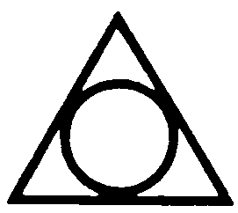
Its Symbolism
Except for the vertical line, this is a standard symbol for the Trinity:

Slide 41
Its Symbolism
On the website "Myk's Wanderings" at www.freewebs.com/mykal-laws/themeaningofshape.htm, the author explains the symbolism of straight lines:
The line is a symbol of boundary and division. A straight line represents infinity because it can continue in either direction indefinitely. A vertical line represents the spiritual world and a horizontal line the temporal world.
The horizontal line represents the path of birth to death, beginning to end, and the dual nature of man...left and right,good and evil, and male and female. The feminine principle.
A vertical line symbolizes man, the body, the spine, the tree of life, and the path from earth to heaven...the realm of the spirit. The masculine principle.

Slide 42
Its Symbolism
Using these ideas, we could say that the vertical line represents Jesus, the one who came down from heaven, but who is part of the Trinity:

Slide 43
The RR Station
Let us look at one last item in the Harry Potter series, the London railway station from which Harry, Ron & Hermione travel each year to Hogwarts.
This is the King's Cross station, one of the several railway stations in the north part of London and a natural place of departure for points north.

Slide 44
The RR Station
This is the place that Rowling chooses for Harry to wake up in when he has just been zapped by Voldemort with the Avada Kedavra curse and is presumed dead.
It turns out that Harry is not dead, or at least he can choose to go back.
This celestial version of the King's Cross station is thus some sort of way station between life and death, and it is to this place that Dumbledore comes in order to meet with Harry.

Slide 45
The King's Cross
Do you get it?
The name of this way station between this life and the life beyond is "the King's Cross," certainly a very appropriate name from a Christian perspective.
Are we to believe that JK Rowling used this name merely by accident?
I think she is telling us something.

Slide 46
Conclusions
Is the Harry Potter series a Christian work?
That depends on what you mean.
I think it was clearly written by a professing Christian and is filled with Christian symbolism.
I do not think it was written primarily for Christians, but rather for secular readers to get them thinking about ultimate questions.

Slide 47
Conclusions
I think some of these ultimate questions are:
What is life all about?
Is there anything beyond this life?
Isn't there really a powerful difference between love and hate, between sacrifice and selfishness?
Is there, perhaps, an invisible world all around us?

Slide 48
For Further Study
For more on symbolism in the Harry Potter series, see John Granger, Looking for God in Harry Potter (Salt River/Tyndale, 2004).

Slide 49
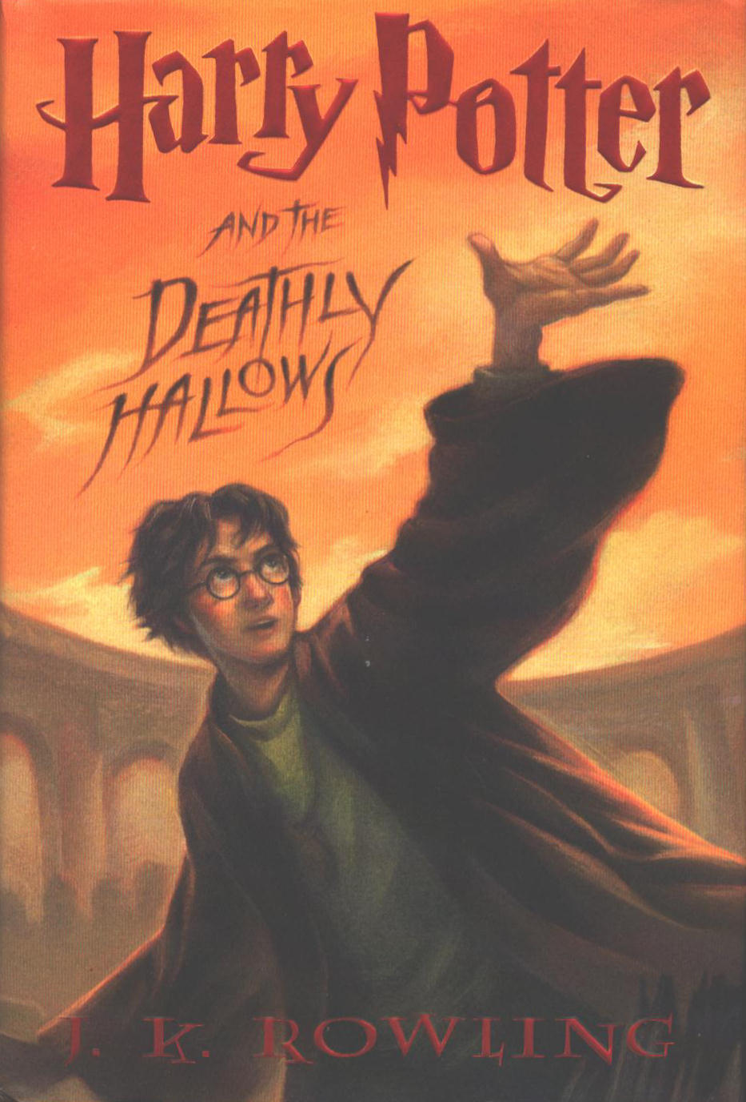
The End
Why don't you give Harry Potter another read?

