Slide 1
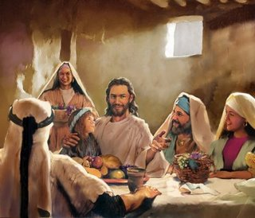
Two Parables on Selfishness
Luke 14:7-14
Robert C. Newman

Slide 2
Visualizing Sin
In trying to talk to others about Jesus, we often find that we have a hard time getting them to see sin for what it really is.
Part of the problem is that we ourselves have trouble seeing sin as God sees it.
But Jesus once attended a banquet where he provided the guests with two powerful parables that do just that.

Slide 3
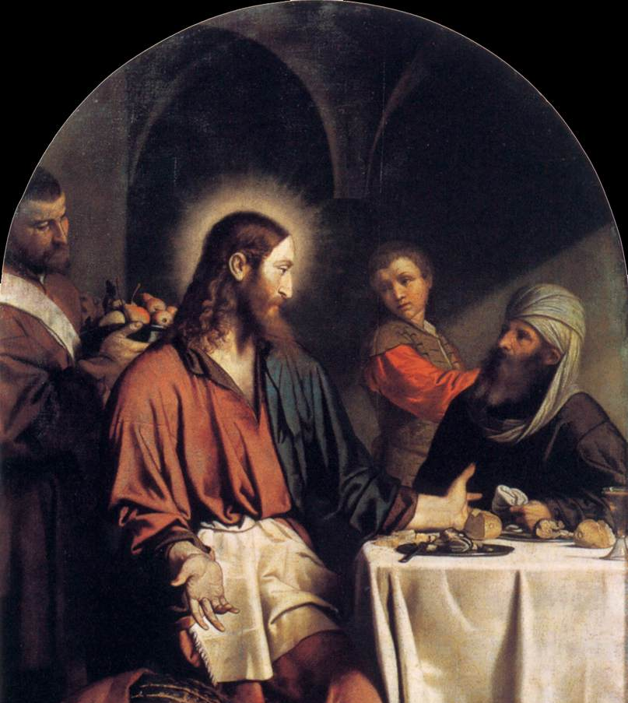
Parable of the Banquet Seats
Luke 14:7-11

Slide 4
Luke 14:7-11
7 (NIV) When he noticed how the guests picked the places of honor at the table, he told them this parable: 8 “When someone invites you to a wedding feast, do not take the place of honor, for a person more distinguished than you may have been invited. 9 If so, the host who invited both of you will come and say to you, ‘Give this man your seat.’ Then, humiliated, you will have to take the least important place. 10 But when you are invited, take the lowest place, so that when your host comes, he will say to you, ‘Friend, move up to a better place.’ Then you will be honored in the presence of all your fellow guests. 11 For everyone who exalts himself will be humbled, and he who humbles himself will be exalted.”

Slide 5
The Story
Jesus gives this parable in the form of advice to the banquet guests.
Don’t take the honored place at a banquet.
Why not?
If someone more honored was invited, you will lose your place & be shamed before all.
Instead, take the lowest place.
Why?
If you’re not the least honored person invited, the host may have you move up & you’ll be honored before all.

Slide 6
Its Meaning
Looks at first like Jesus is stooping to the level of sinners, giving scheming advice.
But (egotists that we are), even though this is good advice to avoid shame, we probably won’t take it for fear that we’ll be left to eat the meal in the lowest spot!
This is a vivid picture of human nature, not just about seats at a banquet.
We so want to be first that we are willing to take a chance on being shamed in order to get our share or more.

Slide 7
Its Meaning
As Christians, God doesn’t want us to live this way:
It denies that we love our neighbor as ourselves.
It denies that we really believe in God, who puts down the proud & raises up the humble.
In fact, it is just asking God to put us down!
If we will just ask God to change us so that we are naturally no longer selfish like this, we will be taking one of the biggest steps we possibly can to be more like Jesus.

Slide 8
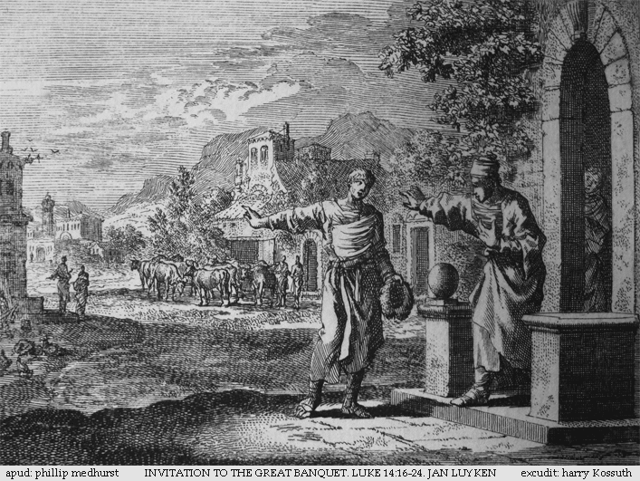
Parable of the Invitations
Luke 14:12-14

Slide 9
Luke 14:12-14
12 (NIV) Then Jesus said to his host, “When you give a luncheon or dinner, do not invite your friends, your brothers or relatives, or your rich neighbors; if you do, they may invite you back and so you will be repaid.
13 But when you give a banquet, invite the poor, the crippled, the lame, the blind,
14 and you will be blessed. Although they cannot repay you, you will be repaid at the resurrection of the righteous.”

Slide 10
The Story
Jesus now turns to the host, and gives this parable in the form of advice to him.
Don’t invite your friends, relatives, or rich neighbors.
Why not?
They will pay you back.
That’s bad?
Well, there’s something much better.

Slide 11
The Story
Instead, invite the poor, crippled, lame & blind (i.e., outcasts).
Why?
They can’t pay you back.
That’s better?
Certainly!
God will pay you back,
Though perhaps not till the resurrection.

Slide 12
Its Meaning
This also looks like Jesus is stooping to give us a scheme:
If you really want a payback, do this.
But again this is a vivid picture of human nature:
Not just about who we invite to our parties,
But about all our actions.
When we do good, we want a quick return.
We want somebody to notice.
We want to do favors to those who will make it worth our while.

Slide 13
Its Meaning
It is certainly strange & unnatural to invite outcasts like this, but:
It shows that we believe they are worth something too.
And they are!
It shows we believe this life is not all there is.
And it isn’t!
It shows that we believe in God & are willing to trust Him with our time & money.

Slide 14
Conclusions
Which side do we come down on here?
If our actions are indistinguishable from those of unbelievers, we either:
Demonstrate that we aren’t really Christians, or
That selfishness has such a strong hold on us that we can hardly expect unbelievers to take our Christianity seriously.
We as Christians can have a powerful testimony to those around us to the degree that we are different in significant & God-honoring ways.

Slide 15
Conclusions
Here we see two such ways, both related to rejecting selfishness & putting ourselves in God’s hands:
(1) Be unselfish & humble:
Don’t always be looking out for yourself.
Look out for God & others.
Let God look out for you.
(2) Be unselfish & compassionate:
Ask the Lord to help you care for those others don’t care for.

Slide 16
The End
Treat others as you would like to be treated.

