Slide 1
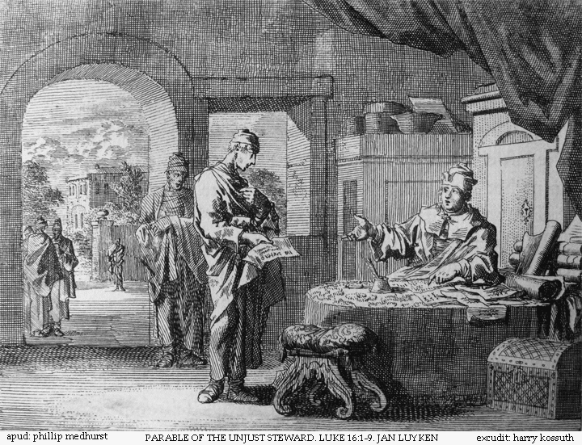
Two Debtors
Luke 7:36-50
Robert C. Newman

Slide 2
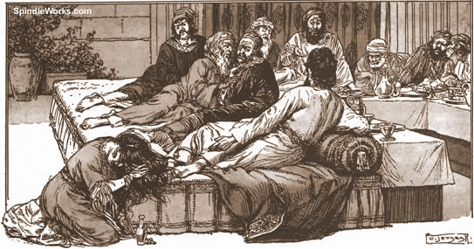
The Incident
Luke 7:36-39

Slide 3
Luke 7:36-39
36 (NIV) Now one of the Pharisees invited Jesus to have dinner with him, so he went to the Pharisee's house and reclined at the table. 37 When a woman who had lived a sinful life in that town learned that Jesus was eating at the Pharisee's house, she brought an alabaster jar of perfume, 38 and as she stood behind him at his feet weeping, she began to wet his feet with her tears. Then she wiped them with her hair, kissed them and poured perfume on them. 39 When the Pharisee who had invited him saw this, he said to himself, “If this man were a prophet, he would know who is touching him and what kind of woman she is n that she is a sinner.”

Slide 4
The Incident
Jesus is invited to dinner at the home of a Pharisee named Simon.
While dining there (reclining on couches):
A woman who is a notable sinner comes in.
She stands behind Jesus w/ a jar of perfume.
She breaks down weeping, her tears falling on Jesus’ feet.
She wipes his feet w/ her hair, begins to kiss them, anoint them w/ perfume.
Simon thinks this is clear evidence that Jesus is no prophet.

Slide 5
Jesus’ Parable
Luke 7:40-43

Slide 6
Luke 7:40-43
40 (NIV) Jesus answered him, “Simon, I have something to tell you.”
“Tell me, teacher,” he said.
41 “Two men owed money to a certain moneylender. One owed him five hundred denarii, and the other fifty. 42 Neither of them had the money to pay him back, so he canceled the debts of both. Now which of them will love him more?”
43 Simon replied, “I suppose the one who had the bigger debt canceled.”
“You have judged correctly,” Jesus said.

Slide 7
Jesus’ Parable
Jesus tells Simon the parable, without letting on that he knows what Simon is thinking.
Two fellows are in debt to a moneylender:
One owes 500 denarii
The other owes 50
Neither can pay, but lender forgives both.
Who will love creditor more?
Simon: I imagine the one forgiven more.
Jesus (giving positive reinforcement): You’re right!

Slide 8
Application to the Incident
Luke 7:44-50

Slide 9
Luke 7:44-50
44 (NIV) Then he turned toward the woman and said to Simon, “Do you see this woman? I came into your house. You did not give me any water for my feet, but she wet my feet with her tears and wiped them with her hair. 45 You did not give me a kiss, but this woman, from the time I entered, has not stopped kissing my feet. 46 You did not put oil on my head, but she has poured perfume on my feet. 47 Therefore, I tell you, her many sins have been forgiven n for she loved much. But he who has been forgiven little loves little.” 48 Then Jesus said to her, “Your sins are forgiven.” 49 The other guests began to say among themselves, “Who is this who even forgives sins?”
50 Jesus said to the woman, “Your faith has saved you; go in peace.”

Slide 10
Application to the Incident
Who loves Jesus more?
Simon?
The woman?
It is striking that a score of the evidence comes out with the same ratio as the debts in the parable, namely 1:10.
Let’s see.

Slide 11
Scorecard
Evidence Simon Woman
Invitation 1 0
Wash feet 0 4
Wash, self, tears, hair
Kiss 0 3
Kiss, feet, continually
Anointing 0 3
Anointing, feet, perfume
Totals 1 10

Slide 12
Jesus’ Warrant
Because of this evidence…
Jesus has warrant before Simon & guests to say that woman loves more.
Therefore this must be because she has been forgiven more.

Slide 13
Why Forgiven?
At first, it looks like Jesus says the woman is forgiven because she loved more, but this does not fit the parable.
In the parable, the creditor forgives the debtors because:
They cannot pay.
He is gracious
As a result, they love the creditor.

Slide 14
Why Forgiven?
True, Jesus does say, “Therefore, I tell you, her many sins have been forgiven, for she loved much,” but this does not mean she was forgiven in return for her love.
Rather the love is Jesus’ warrant for saying she has been forgiven. Compare:
“It’s late, because the clock says 10 pm.”
“It must be hot outside, since we’re selling so much ice cream.”

Slide 15
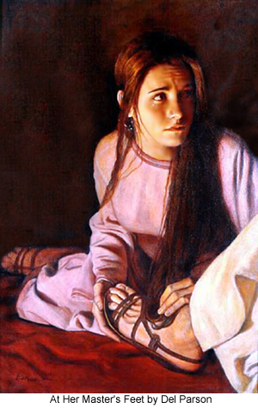
Application to Us

Slide 16
Some Lessons
Jesus is shown to be a prophet, as Simon came to learn.
But he is more than a prophet.
He can forgive sin.
And who can forgive sin but God alone?
All people are sinners…
From the most righteous (like Simon?)
To the most wicked (like the woman?)

Slide 17
Some Lessons
Though some of us are worse sinners than others, none of us can pay the debt we owe God.
God graciously forgives those who ask him by bearing the loss himself, since he (in Jesus) paid the price upon the cross.

Slide 18
Some Lessons
What about us?
Is there unmistakeable evidence in our lives that we have been forgiven?
For the woman in this incident, the evidence was sacrificial love for Jesus.
Elsewhere in the Bible (1 John), it is obedience to God, love of fellow humans.
Other evidence is a forgiving spirit (Matthew 18).
Or Galatians 5: love, joy, peace, patience, kindness…
If we lack these, we have no right to think we are really forgiven.

Slide 19
The End
May you, too, seek God’s forgiveness!

