Slide 1
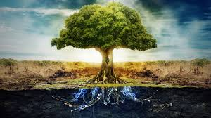
IMMORTALITY & THE TREE OF LIFE
Robert C. Newman

Slide 2
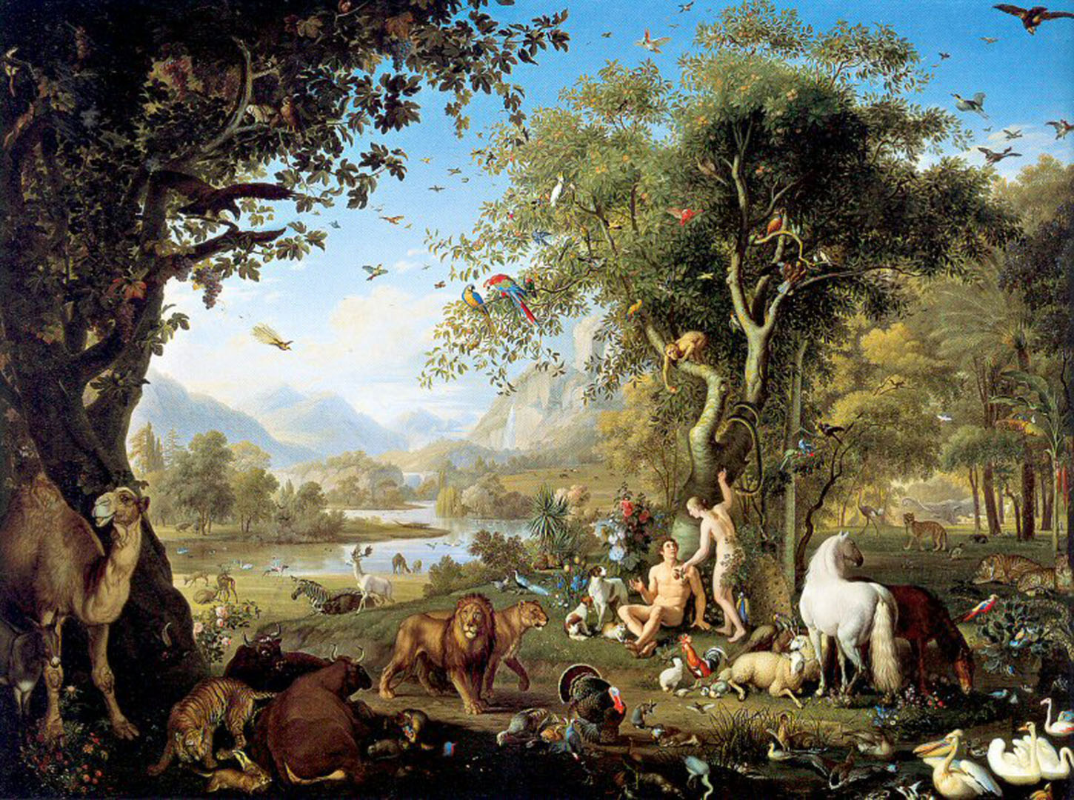
introduction

Slide 3
The Account of Creation
Genesis One gives an overview of creation in terms of six days of creation and one day of rest.
In this account, humans are created last, in the image of God.
They are to have rule over creation.

Slide 4
The Account of Creation
Genesis Two gives a close-up of the creation of humans, who are placed in a special location, the Garden of Eden, and instructed to care for it.
Two special trees are mentioned in this garden:
one is the Tree of Life, from which they are permitted to eat;
the other is the Tree of the Knowledge of Good & Evil, from which they are prohibited from eating.

Slide 5
The Rebellion of Mankind
Genesis Three tells us how humans disobeyed God’s command and ate from the Tree of the Knowledge of Good & Evil.
As a result, curses come upon the man, the woman and their tempter, the Serpent.
Also, the humans are expelled from the Garden, in order that they might not eat from the Tree of Life.

Slide 6
Tree of Life passages

Slide 7
Tree of Life Passages
There are ten passages in the Bible that speak explicitly of a "tree of life."
Two of these are in Genesis.
Four are in the book of Proverbs.
Four are in the book of Revelation.
Let us look quickly at each of these.

Slide 8
Genesis 2:8-9 (ESV)
⁸ And the Lord God planted a garden in Eden, in the east, and there he put the man whom he had formed. ⁹ And out of the ground the Lord God made to spring up every tree that is pleasant to the sight and good for food. The tree of life was in the midst of the garden, and the tree of the knowledge of good and evil.

Slide 9
Genesis 3:22-24 (ESV)
²² Then the Lord God said, "Behold, the man has become like one of us in knowing good and evil. Now, lest he reach out his hand and take also of the tree of life and eat, and live forever—" ²³ therefore the Lord God sent him out from the garden of Eden to work the ground from which he was taken. ²⁴ He drove out the man, and at the east of the garden of Eden he placed the cherubim and a flaming sword that turned every way to guard the way to the tree of life.

Slide 10
Proverbs (ESV)
3:18: She [Wisdom] is a tree of life to those who lay hold of her; those who hold her fast are called blessed.
11:30: The fruit of the righteous is a tree of life, and whoever captures souls is wise.

Slide 11
Proverbs (ESV)
13:12: Hope deferred makes the heart sick, but a desire fulfilled is a tree of life.
15:4: A gentle [or healing] tongue is a tree of life, but perverseness in it breaks the spirit.

Slide 12
Revelation 2:7 (ESV)
⁷ He who has an ear, let him hear what the Spirit says to the churches. To the one who conquers I will grant to eat of the tree of life, which is in the paradise of God.

Slide 13
Revelation 22:1-3 (ESV)
Then the angel showed me the river of the water of life, bright as crystal, flowing from the throne of God and of the Lamb ² through the middle of the street of the city; also, on either side of the river, the tree of life with its twelve kinds of fruit, yielding its fruit each month. The leaves of the tree were for the healing of the nations. ³ No longer will there be anything accursed, but the throne of God and of the Lamb will be in it, and his servants will worship him.

Slide 14
Revelation 22:14-15 (ESV)
¹⁴ Blessed are those who wash their robes, so that they may have the right to the tree of life and that they may enter the city by the gates. ¹⁵ Outside are the dogs and sorcerers and the sexually immoral and murderers and idolaters, and everyone who loves and practices falsehood.

Slide 15
Revelation 22:18-19 (ESV)
¹⁸ I warn everyone who hears the words of the prophecy of this book: if anyone adds to them, God will add to him the plagues described in this book, ¹⁹ and if anyone takes away from the words of the book of this prophecy, God will take away his share in the tree of life and in the holy city, which are described in this book.

Slide 16
Tree of life: genesis

Slide 17
The Tree of Life in Genesis
We take the Genesis account to be historical and accurate.
We take the tree to be a real tree, which in some sense confers immortality.
As a result, this suggests that humans were not immortal originally, or at least not physically immortal.

Slide 18
The Tree of Life in Genesis
How did this tree work?
We won’t attempt to give any sort of mechanism, but …
Does one taste confer immortality?
This has been the common assumption.
In that case, Adam & Eve never tasted it, even though it was not forbidden.
We suggest this is probably not correct, based on the natural reading of Rev 22:2.

Slide 19
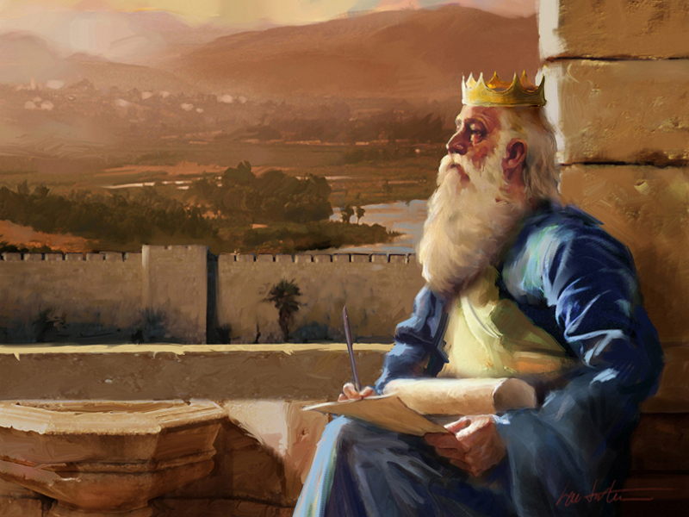
Tree of life: proverbs

Slide 20
The Tree of Life in Proverbs
We suggest that all four of these occurrences are figurative (probably of "life giving")
The Tree of Life is compared to:
Wisdom
The fruit of the righteous
A desire fulfilled
A gentle [or healing] tongue
The point of comparison seems to be that each is life-giving in some way or other.

Slide 21
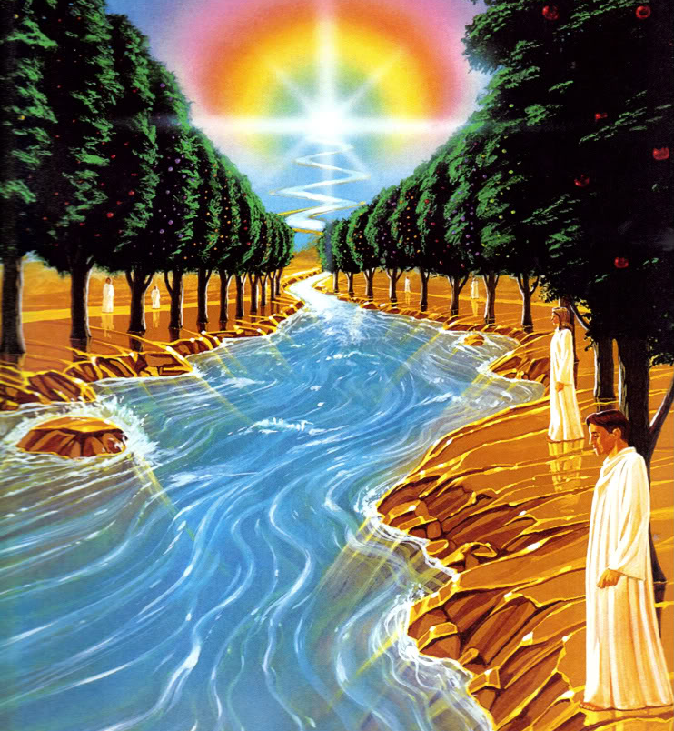
Tree of life: revelation

Slide 22
The Tree of Life in Revelation
In Genesis 3, humans were excluded from Eden and access to the Tree of Life.
In Revelation, we see that believers will be permitted to eat from the Tree in the New Jerusalem.
The Tree will bear various fruits each month, and its leaves will be used for healing.
It sounds as though people will eat of it regularly rather than just once.

Slide 23
The Tree of Life in Revelation
If we carry this idea back into Genesis, this might mean that Adam & Eve had previously eaten from it, but were denied further access.
In such a case, the Tree gives temporary life, but one must keep eating from it to live forever.
Perhaps this is why Adam & his immediate descendants lived so long as they did.

Slide 24
Summary & conclusions

Slide 25
Summary
In this proposed model, humans did not initially have eternal life before they sinned.
It is possible that their souls were immortal, but apparently they needed to eat from the Tree to keep their bodies living.
So Adam & Eve may have eaten from the Tree of Life, but were thereafter denied further access to it.

Slide 26
Conclusions
In the Age to Come, it appears that people will live forever, restoring their bodies by eating the fruit and using the leaves of the Tree of Life regularly.
This seems best to fit the remark of Rev 22:2, which speaks of the Tree of Life yielding fruit each month, while its leaves are for "the healing of the nations."

Slide 27
The End
May God grant you the right to eat of the Tree of Life, which is in the Paradise of God.

