Slide 1
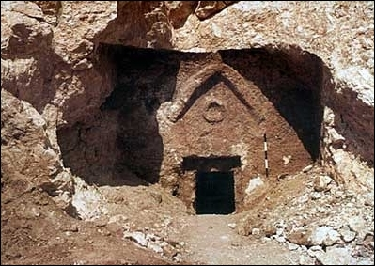

The Tomb of Jesus?
Robert C. Newman

Slide 2
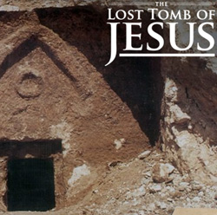
The Tomb of Jesus?
On 4 March 2007, the Discovery Channel broadcast their documentary entitled "The Lost Tomb of Jesus," in association with the publication of the book The Jesus Family Tomb, by Simcha Jacobovici & Charles Pellegrino.

Slide 3
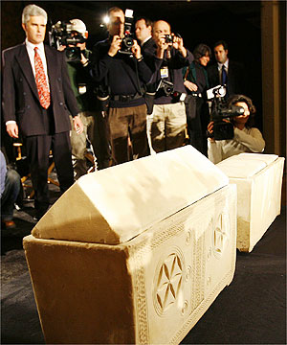
Tomb of Jesus?
They reported the 1980 discovery of a tomb in Talpiot, a SE suburb of Jerusalem, which contained 10 ossuaries (bone boxes), six of which had names inscribed on them:

Slide 4
The Inscriptions
(1) Yeshua bar Yehosef (Jesus son of Joseph)
(2) Maryah (Mary)
(3) Matiah (Matthew)
(4) Yoseh (Jose, a shortened form of Joseph)
(5) Mariamne e Mara (Mariamne or Mara; the presenters claim "Mariamne the Lord")
(6) Yehudah bar Yeshua (Judah son of Jesus)

Slide 5
The Claims
The authors Simcha Jacobovici and Charles Pelligrino claim:
  This is the family tomb of Jesus of Nazareth.
  His remains were interred in box #1.
  Box #2 contained his mother Mary.
  Box #3 was probably a relative, possibly the apostle Matthew.
  Box #4 was Jesus' father or brother.
  Box #5 was Jesus' wife Mary Magdalene.
  Box #6 was their son Judah (= apostle Thomas).

Slide 6
Implications
If the identifications of the remains interred in these boxes are correct (especially #1), then:
  The Christian teachings of the physical resurrection & ascension of Jesus are mistaken.
  Jesus married and had children (at least one).
The real question, of course, is:
  Are these identifications correct?

Slide 7
Arguments for This Being Jesus' Tomb

Slide 8
Arguments For
(1) The inscriptions are authentic, as the site was excavated by professional archaeologists.
(2) A statistical calculation of the probability that this combination of names occurred by chance was given as only 1 chance in 600, so that the chances are 600 to 1 that this is the tomb of Jesus of Nazareth!

Slide 9
Arguments For
(3) The famous "James" ossuary which was in the news a few years back is actually the 10th box found here, but it was stolen & sold on the antiquities market. Tests of the patina on these boxes match.
(4) DNA testing was done on bone fragments found in boxes #1 (Jesus) and #5 (Mariamne). The two individuals are shown to be unrelated. The book claims they were thus husband & wife.

Slide 10
Responses to These Arguments

Slide 11
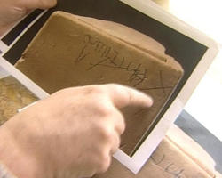
(1) Inscriptions Authentic
The inscriptions do seem to be authentic, but the crucial inscription (#1) is by far the most difficult one to decipher.

Slide 12
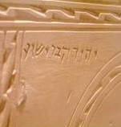
Inscriptions
This is the inscription on box #6.
For anyone who can read traditional Hebrew, this is clearly "Yehuda bar Yeshua" (Judah son of Jesus).
ישוע בר יהודה

Slide 13
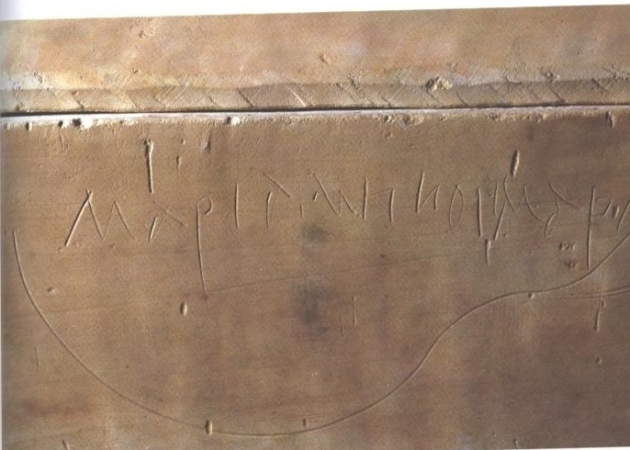
Inscriptions
This is the inscription on box #5.
It is much less deeply engraved, and some of the letters are sloppy, but is readable Greek for the most part.
It looks like ΜΑΡΙΑΜΝΗ…ΜΑΡΑ

Slide 14
Inscription #5
A closer view; there is obviously something between the end of "Mariamne" and the beginning of "Mara."

Slide 15
Inscription #5
If we take the circled portion above to be Η ΚΑΙ instead, then the inscription is exactly parallel to Acts 13:9, where a masculine form of this construction connects two names, "Saul, who is also called Paul." We would then have "Mariam, who is also called Mara," and the name "Mariamne" disappears!

Slide 16
Inscription #5
Another alternative would be to put the Η with the first name, giving ΜΑΡΙΑΜΗ as the first name, and then the ΚΑΙ would indicate there were two sets of bones in this ossuary, those of Mariame and of Mara.

Slide 17
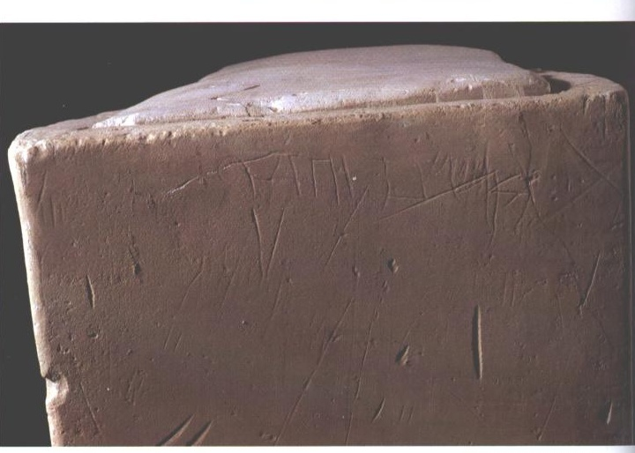
Inscription #1
This is the inscription on box #1.

Slide 18
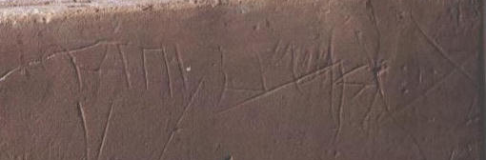
Detail of Inscription #1
This is a detail of #1, with contrast increased and picture brightened. The last word "Yehosef" is reasonably clear. The word "bar" is readable. But the first name is arguable, because of extra lines thru it. Some have suggested it be read "Hanun."

Slide 19
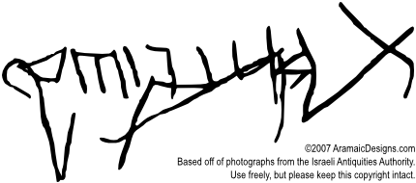
Sketch of Detail #1
Yehosef
?
bar
Yeshua
Here is an outline of the box #1 inscription, prepared by Steve Caruso of Aramaic Designs.

Slide 20
What's the X?
Jacobovici & Pellegrino claim this is a cross, tilted to represent Jesus carrying it.
Some have suggested it is a mason's mark, which is sometimes used on ossuaries to align the lid with the bottom.
Its close connection with the name suggests it may be an "alef," the first letter of the Hebrew/Aramaic alphabet. It might alternatively be a "tav."

Slide 21
What's the X?
If this is an alef or tav, then the name may be something other than "Jesus."
The name would begin "Ish…" or "Tish…"
So far, no known name has been found to match the available letters, so we will go with "Jesus" in what follows.

Slide 22
(2) Probabilities are Questionable
There are 10 bone boxes, so at least 10 individuals are represented in the tomb.
Since #4 (Jose) might be the father mentioned in #1, he shouldn't be counted twice in the probabilities.
Mary is the commonest female name among Jews at this period, occurring 21.3% of the time.
Among male names, Joseph is 2nd (8.3%), Judah 4th (6.2%), and Jesus 6th (3.8%).

Slide 23
(2) Probabilities are Questionable
In a tomb with 10 boxes (assuming 4 female and 6 male interments), given that one name is "Jesus," what are the chances he is a son of "Joseph" and that the tomb also contains a "Mary"?
  That the father is Joseph, p(J) = .083
  That one of the interred is a Mary, p(M) = 1 - (1-.213)⁴ = 1-.384 = .616
  P(both J&M) = .083 x .616 = .0511 = over 1:20
Since there have already been 22 ossuaries found with "Jesus" on them, this combination should not be too surprising.

Slide 24
(2) Probabilities are Questionable
Since we have no evidence Jesus of Nazareth had a son named Judah nor a close relative named Matthew, these do not figure in our calculation.
What about Mariamne, (or Mariam, if our suggested reading is adopted)?
She might well be (since the DNA rules out a sister) a wife of any of the males in the tomb: Jesus, Jose, Matthew, Judah, or an unnamed male in one of the other boxes.

Slide 25
What about Mary Magdalene?
Though she was a close follower of Jesus of Nazareth, there is no evidence that either was married, to each other or to anyone else.
Jacobovici & Pellegrino try to make Mary Magdalene the sister of Philip in the apocryphal Acts of Philip, but Philip is from Bethsaida, not Magdala, and Philip's sister does not die until after AD 98, which is nearly 30 years after Jerusalem is destroyed and all these secondary burials with ossuaries came to an end.

Slide 26
(3) The James Ossuary
The patina tests do show a real similarity between the James ossuary and those from the Jesus tomb. But more work is needed to see how unusual such a similarity might be.
Meanwhile, the owner of the James ossuary claims he got it before 1980, when the Jesus tomb was discovered.
Amos Kloner, who supervised the 1980 dig, says the missing 10th ossuary was unmarked, unlike the James ossuary.

Slide 27
(4) DNA Testing
DNA was only tested from boxes #1 (Jesus) and #5 (Mariamne). These show that Jesus and Mariamne do not share a common mother.
It does not show they were married, as any tomb containing members of an extended family will contain a number of spouses who are in-laws, not blood relatives.
It would be of interest to do DNA testing on bone fragments from the other ossuaries in the tomb, but since we don’t know the DNA of Jesus of Nazareth, it is hard to see how this would be of any earth-shaking interest.

Slide 28
Conclusions

Slide 29
Conclusions
We have not brought in much of the evidence from the canonical Gospels, since it was their veracity which was questioned.
Jacobovici & Pellegrino, like many today, are exceedingly skeptical about the canonical Gospels (which certainly date from the first century) and exceedingly gullible about the NT apocrypha (which date from the second century or later).

Slide 30
Conclusions
The canonical Gospels testify that the tomb of Jesus was empty by the morning of the third day, and that he personally appeared to hundreds of people in the following month or so. As Paul points out, the Christian faith rests upon Jesus' bodily resurrection.
The family of Jesus would not have been well-off enough to afford a tomb such as the one discovered in 1980, at least until Christianity had been going for a while.

Slide 31
Conclusions
The case for Jesus' Messiahship was based on his resurrection from the dead. Do you think his family (some of whom were significant figures in the early Christian movement) would have inscribed his name on a bone box so that anyone who entered their family tomb could see it?
I think it is clear that the "Jesus" of this tomb is not Jesus of Nazareth.

Slide 32
The End
But I fear we will see many more of these suggestions!

