Slide 1
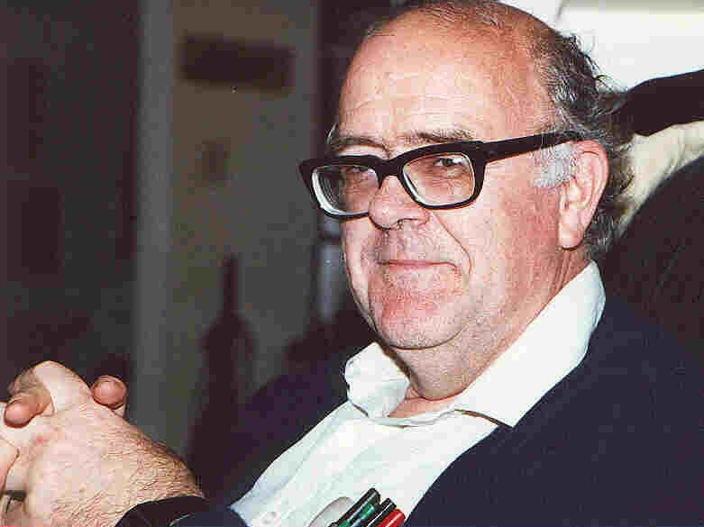

This is Your Life,
Bob Newman

Slide 2
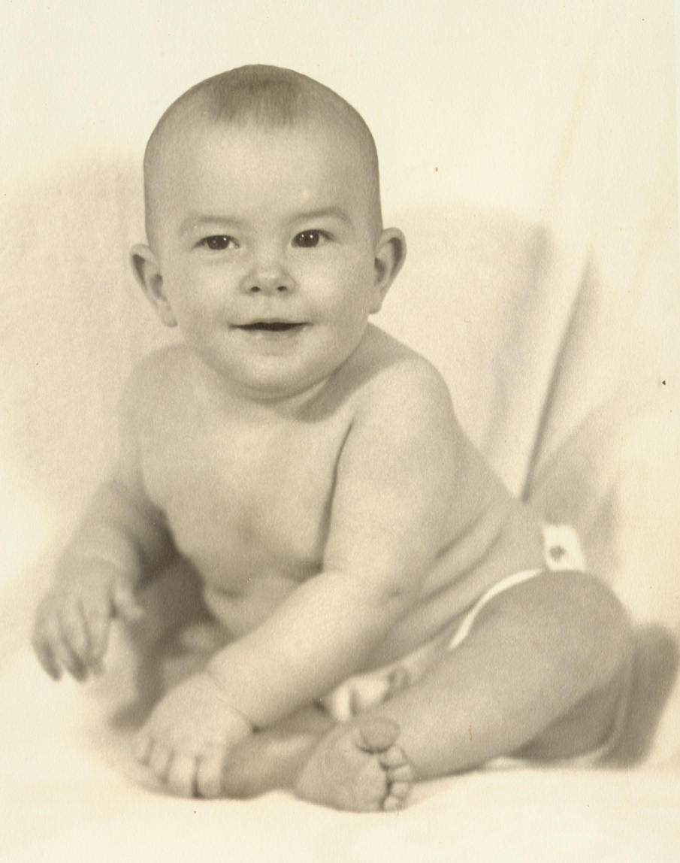
Birth & Early Life
Born 2 April 1941
  Washington, DC
Raised in Virginia suburbs 1941-59
  Arlington, VA
3rd of 5 kids
  Perry
  Beth
  Bob
  Jim
  Ellen

Slide 3
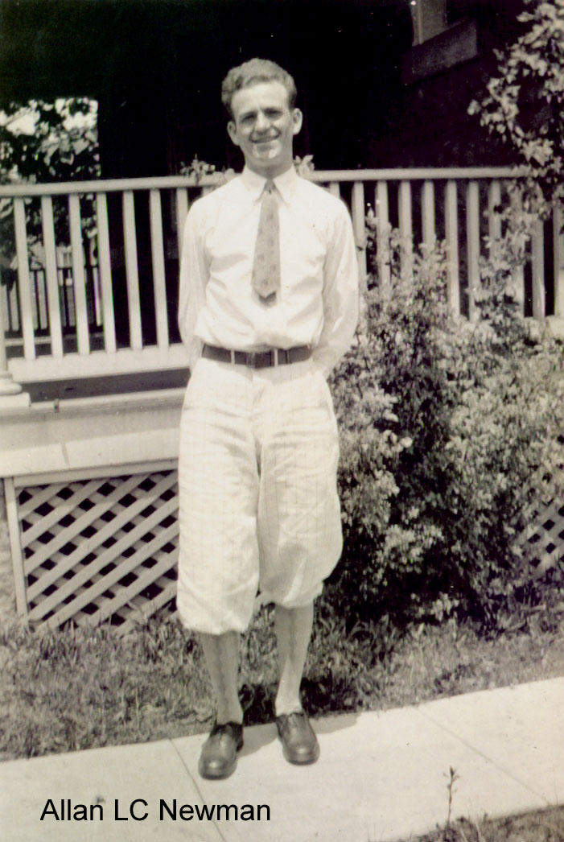
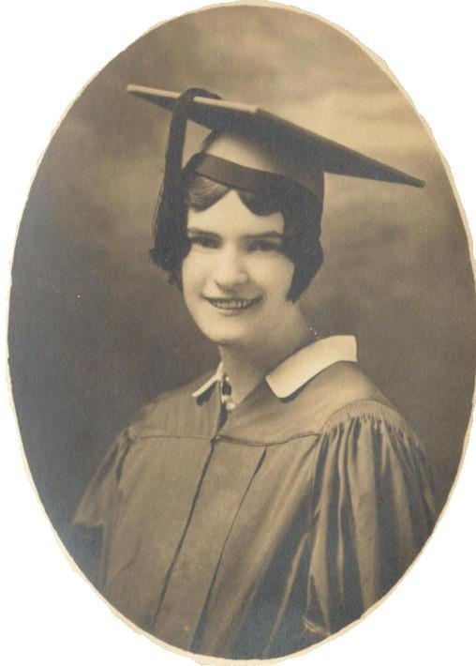
Parents
Father: Allan Lanham Carhart Newman
  Born 1900, Washington, DC
Mother: Lois May Gardner
  Born 1912, Louisburg, Kansas

Slide 4
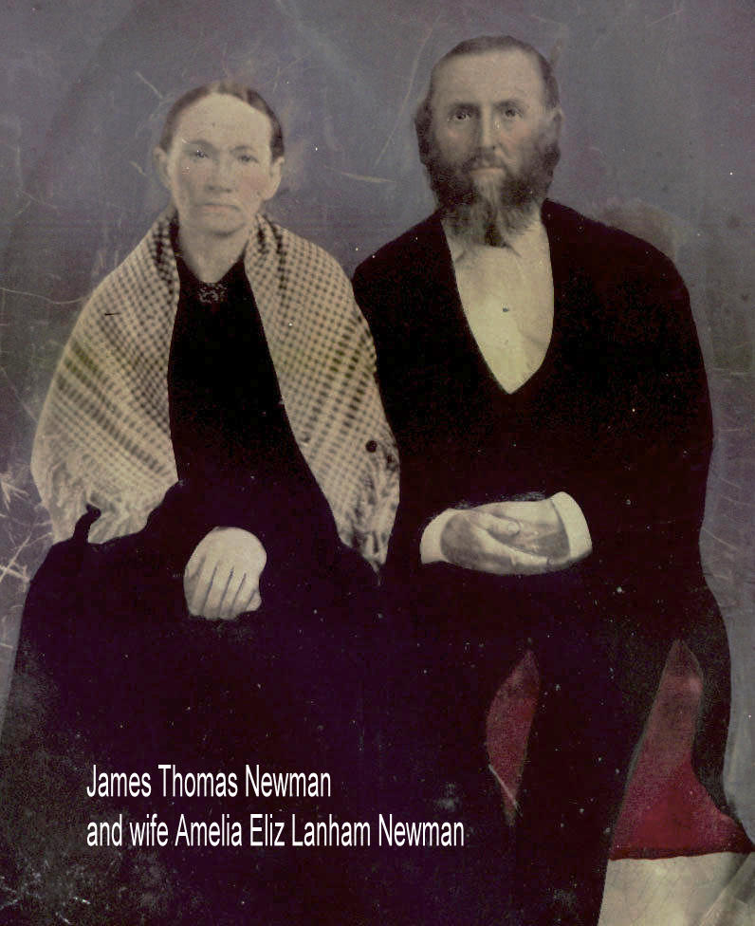
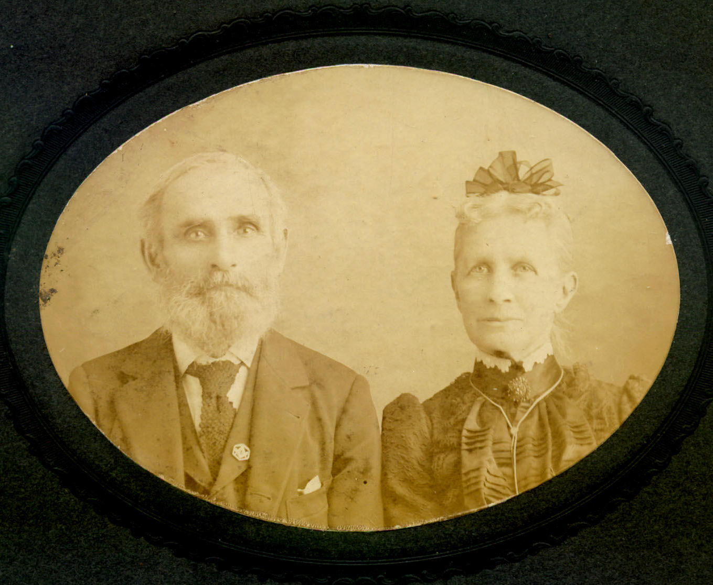
Ancestry
The Newmans (and allied families) came into Virginia & Maryland from England in 1600s.
The Gardners (and allied families) came into MA and RI from England in 1600s, later moving west into CT, NY, OH, IL, MI, KS.

Slide 5
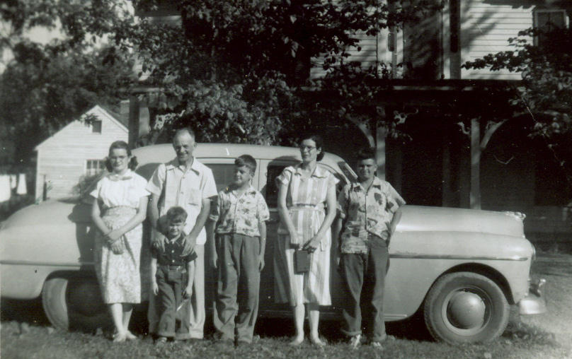
Family, 1951

Slide 6
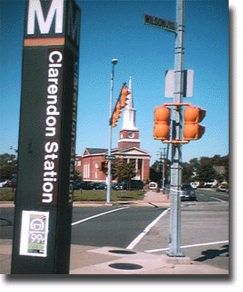
Home Church
1st Baptist Church of Clarendon, Arlington, VA
Southern Baptist
Not very conservative
But went forward to receive Christ here at age 7

Slide 7
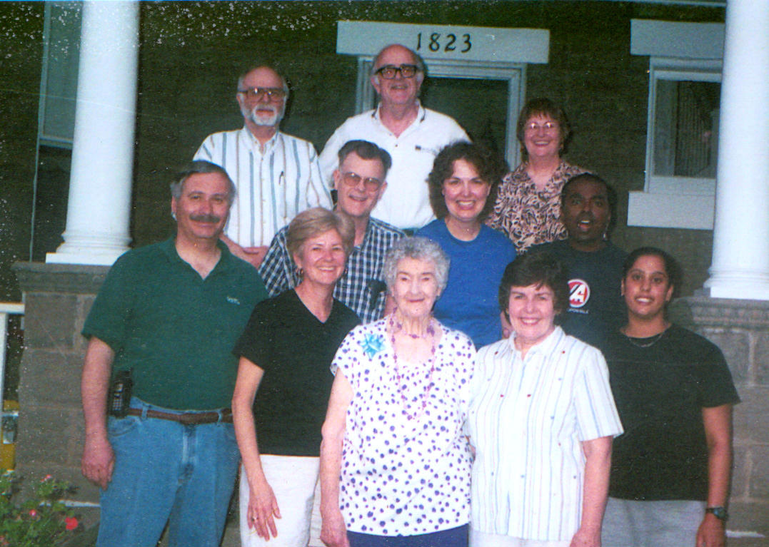
Family, 2001

Slide 8
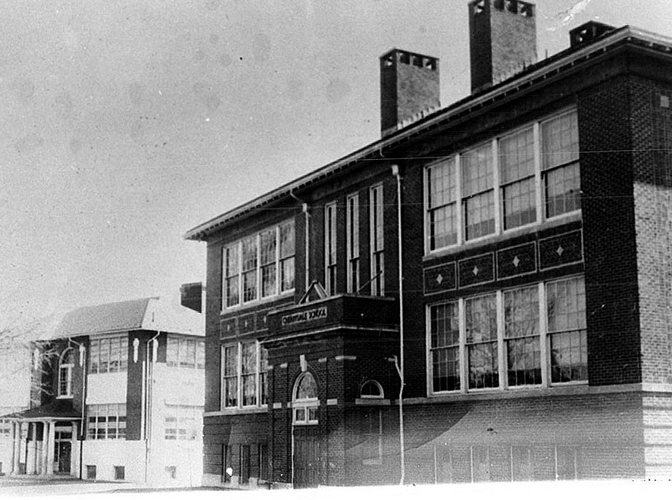
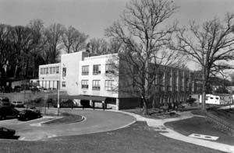
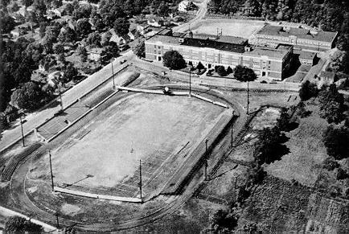
Public Education
Elementary school: Cherrydale, 1947-53
Junior High: Stratford, 1953-56
Senior High: Washington-Lee, 1956-59

Slide 9
Public Education
My first contact with evolution as an alternative to creation
My interest in science began in elementary school, later encouraged by a physics teacher in high school.
The upshot was that I went to Duke to major in physics.

Slide 10
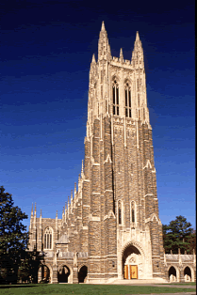
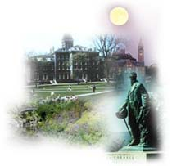
Science Education
Duke University 1959-1963
  BS, physics
Cornell University 1963-1967
  PhD, astrophysics
University of Wisconsin summer 1966
  Seminar on Cosmic Gas Dynamics

Slide 11
Science Education
Strangely, the greatest challenges to my faith at Duke were my two required religion courses.
These courses raised questions about the truth of Christianity; eventually they were significant in my going to seminary.
I was helped a great deal at that time by the writings of C.S. Lewis.
At Cornell, I came into contact with Herman Eckelmann, a pastor and a research associate in the Cornell Space Center.
The result was that I went to Faith Seminary after completing my PhD at Cornell.

Slide 12
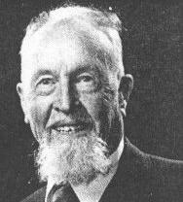
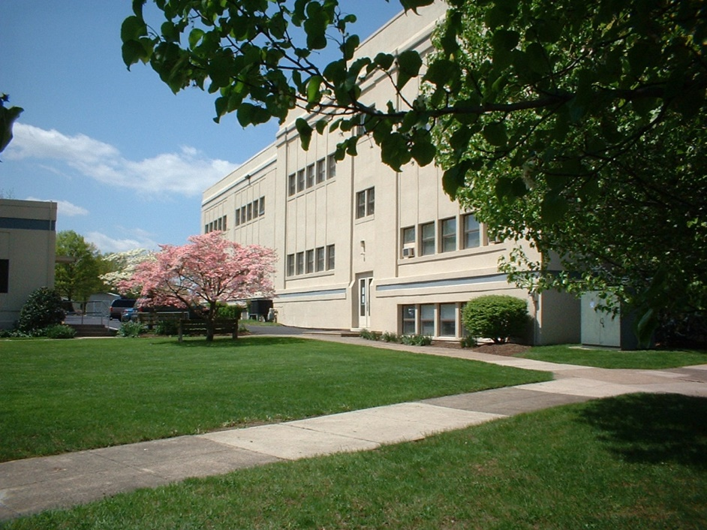
Theological Education
Faith Seminary, MDiv, 1967-70
Biblical Seminary, STM in OT, 1970-72
Univ of Pennsylvania, grad studies in religious thought, 1974-75
Institute of Holy Land Studies, January 1978
Westminster Seminary, grad studies in biblical interpretation, 1981-84

Slide 13
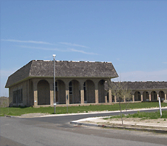
Teaching
During seminary, I began my teaching career…
…part-time at Shelton College, Cape May, NJ, 1968-71…
…teaching physical science and mathematics.

Slide 14
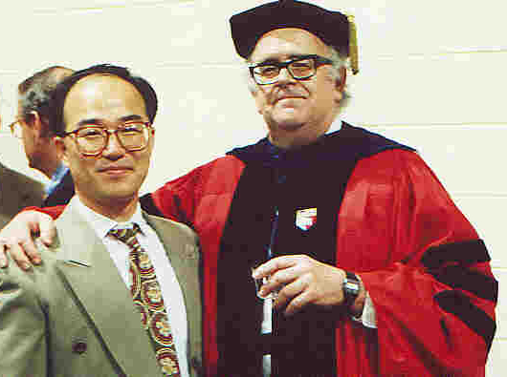
Teaching
In 1971, I began teaching at Biblical Seminary.
I became Professor of NT in 1977.
I have taught all the NT courses at Biblical, except for a few added recently.
I plan to retire in June 2006.

Slide 15
Teaching
My main teaching and research emphasis in the NT has been in the Gospels.
  Particularly in the Synoptics
  Especially in the Parables
Another interest has been the word-pictures the Bible provides to help us understand its message.
I have also taught the course Evidence for the Christian Faith a number of times.

Slide 16

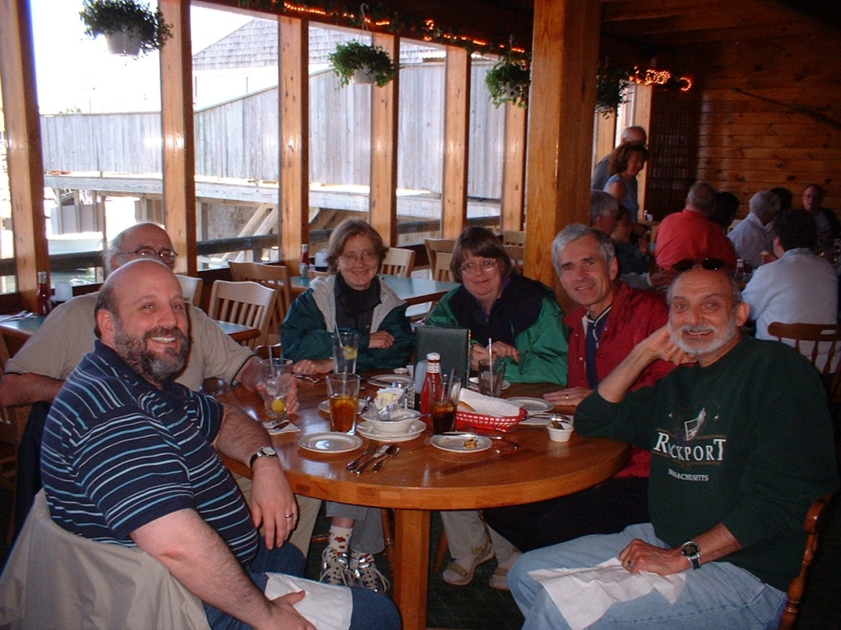
IBRI
In 1979, several of us at Biblical formed an organization we call "IBRI."
The full name is the Interdisciplinary Biblical Research Institute.
This was founded to strengthen Christians in outreach to seekers with advanced education, particularly in the sciences.

Slide 17
IBRI
IBRI over its history has published:
  54 research reports
  21 books and pamphlets
  10 tracts
We have held numerous public meetings:
  165 colloquium sessions
  16 multi-speaker seminars at various places on evidence of design in nature and for the truth of Christianity.

Slide 18

www.ibri.org
In recent years, we have put together a website to help Christians and seekers.
We now have posted for free access:
  All our Research Reports
  All our tracts
  Several books
  60 PowerPoint talks
  Over 400 audio lectures

Slide 19
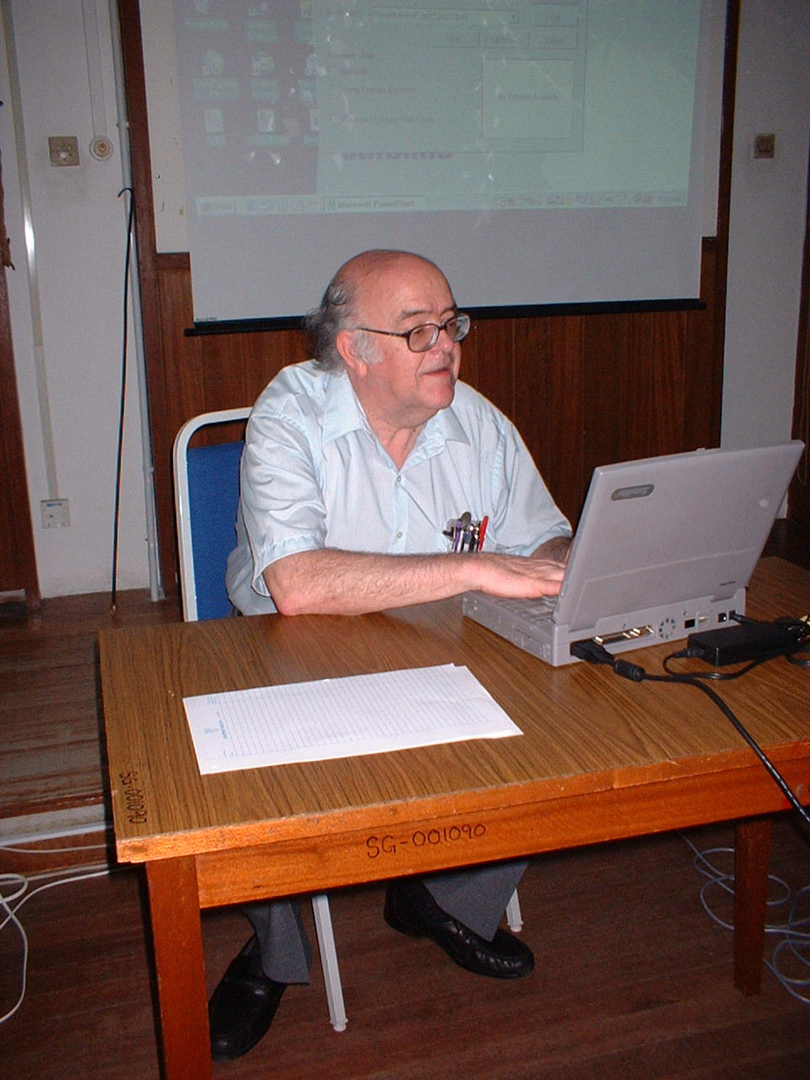
Speaking
Over the years, I have done a good deal of speaking outside the seminary.
This is usually in one of two settings:
  Churches
  Colleges

Slide 20
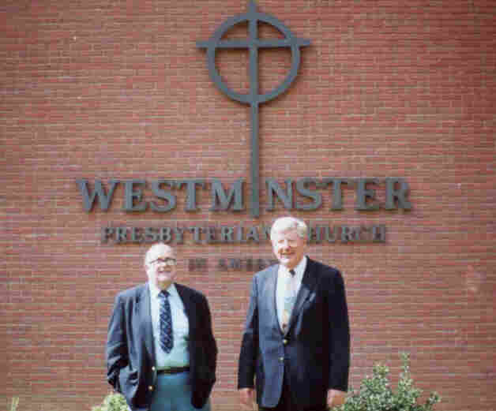
Speaking in Churches
This often involves preaching, mostly from the NT, frequently from the Gospels, often from the parables.
Also I give talks on subjects related to apologetics and Christian evidences.

Slide 21
Speaking at Colleges
These are usually at the invitation of campus Christian organizations, such as Inter-Varsity or Campus Crusade.
They are typically on Christian evidences or apologetics, though of diverse sorts:
  Science and origins
  Reliability and historicity of Bible
  Popular religious phenomena or cults

Slide 22
Speaking at Colleges
Over the years I've spoken at some fifty or sixty schools, mostly in the East.
Some of these are:
  Cornell
  Princeton
  Penn
  Colorado School of Mines
  University of California at Davis
  University of Cologne
  University of Malaya

Slide 23
Speaking at Colleges
Some more notable opportunities:
Response to von Däniken’s Chariots of the Gods at Cornell
Debate on Easter accounts at Cornell
Critique of Sagan’s Cosmos at Cornell
Evidence of design in nature at UC-Davis
Fulfilled prophecy re/ Jesus at Penn

Slide 24
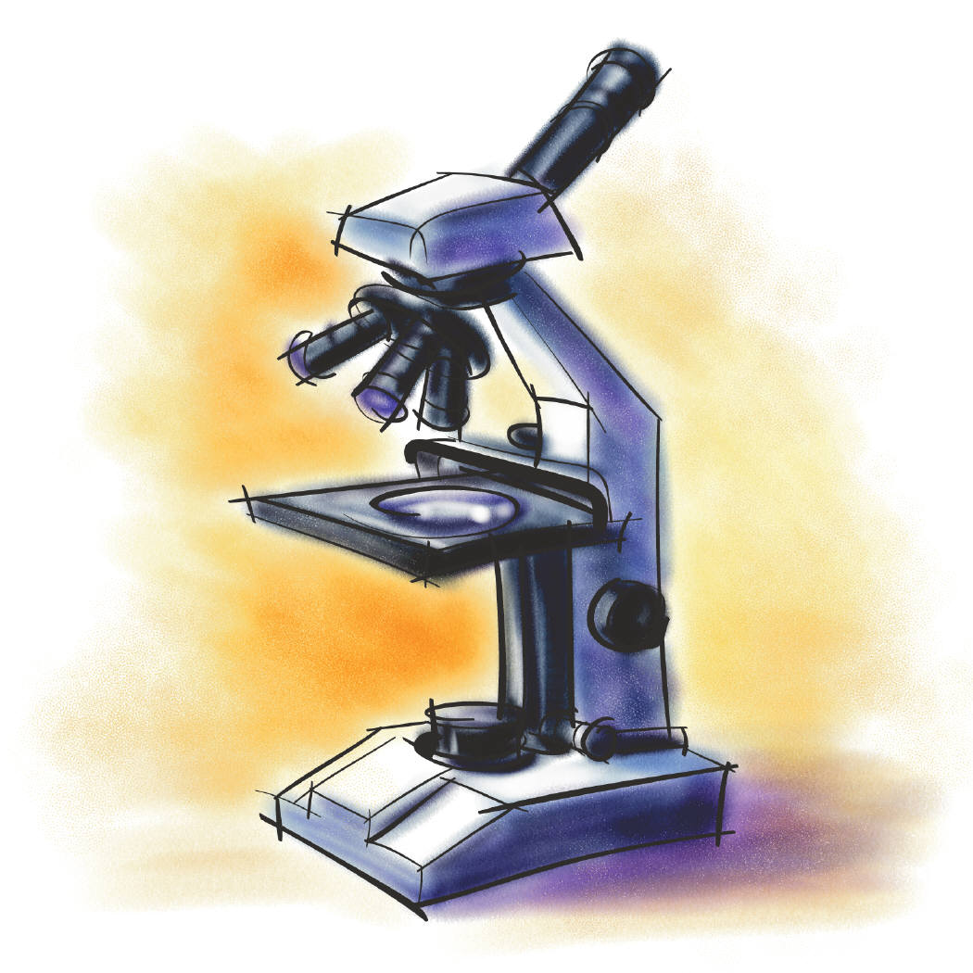
Research
My major interests are:
Biblical studies
Christian evidences
Interaction of science & Christianity

Slide 25

Research
Under biblical studies:
Parables
Other biblical figures
NT background (cultural, historical)
Scientific aspects of biblical passages
Fulfilled prophecy
Eschatology

Slide 26
Research
Under Christian evidences:
Cosmology
Intelligent design
Origin & history of life
Preknowledge of science
Fulfilled prophecy
Jesus
Transformed lives & societies

Slide 27
Research
Under interaction of science & Christianity:
History of science
Philosophy of science
Doing science in a theistic universe
Problems for naturalism
Problems for evolution
  Atheistic
  Theistic

Slide 28
Writing
35 journal articles, in:
Astrophysical Journal
Planetary & Space Science
Journal ASA/PSCF
Journal of the ETS
Westminster Theol Journal
Grace Theol Journal
Concordia Theol Journal
Presbyterion
Philosophia Christi

Slide 29
Writing
22 contributions to books, encyclopedias:
Kantzer & Henry, Evangelical Affirmations
Montgomery, Evidence for Faith
Youngblood, The Genesis Debate
Geivett & Habermas, In Defense of Miracles
Zondervan New Intl Dict of OT Theol & Exegesis
Dembski, Mere Creation
Moreland & Reynolds, 3 Views of Creation & Evolution
InterVarsity Dictionary of NT Background
Routledge Encyclopedia of Fundamentalism

Slide 30
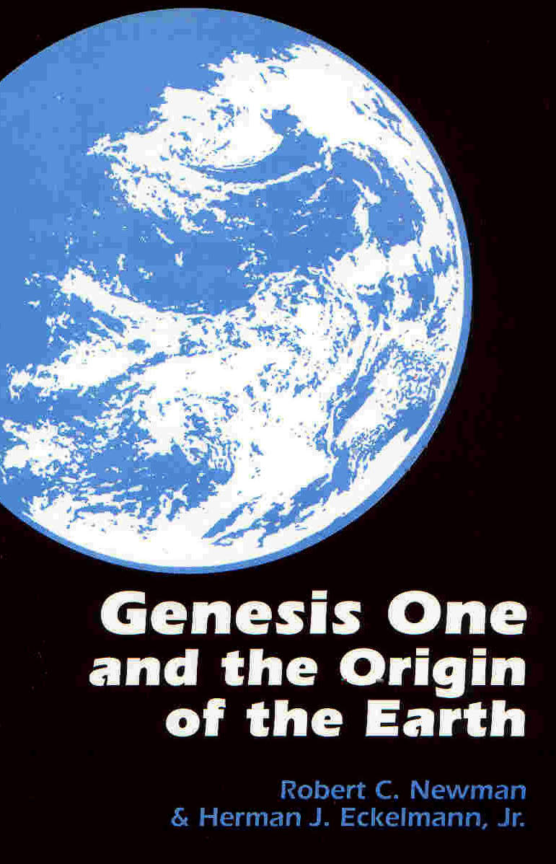

Writing
Several books:
Science Speaks
Genesis One & Origin of Earth
Evidence of Prophecy
What’s Darwin Got to Do with It?
The Biblical Firmament

Slide 31
Other Activities
Trinity House
Genealogy
Reading
Hiking
Photography
Travel

Slide 32
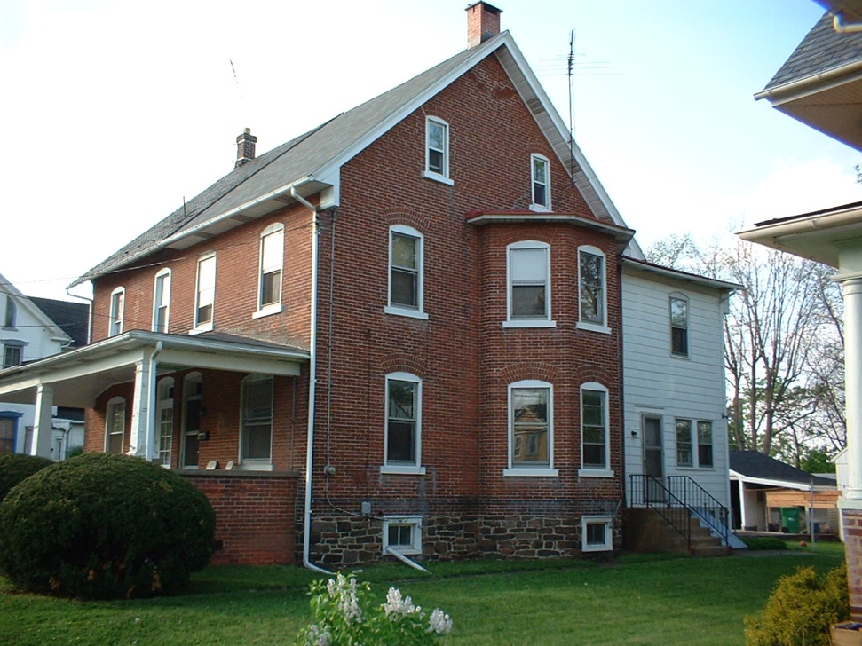
Trinity House
Purchased 1982
To house myself and a number of Biblical students
Capacity: 8
Total number of residents in 22 years: about 100

Slide 33
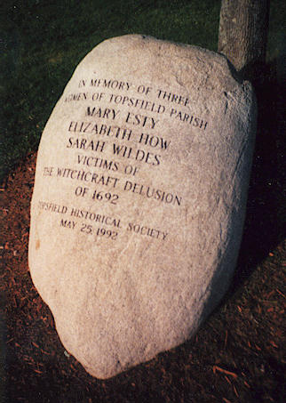
Genealogy
Have been interested in family history since junior high school
Began working in earnest in early 1970s
Real breakthroughs with the development of genealogical information on the internet

Slide 34

Reading
I like to read.
For 25 years (when I kept track) I averaged over 80 books read per year.
Some of these were books for my teaching and research, others were for pleasure.

Slide 35

Reading
My favorite topics are:
Fiction/fantasy
History
  Ancient
  British
  American
Science

Slide 36
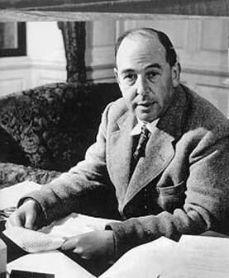
Reading
My favorite authors are:
C. S. Lewis
J. R. R. Tolkien
J. K. Rowling
Stephen Lawhead
George MacDonald

Slide 37
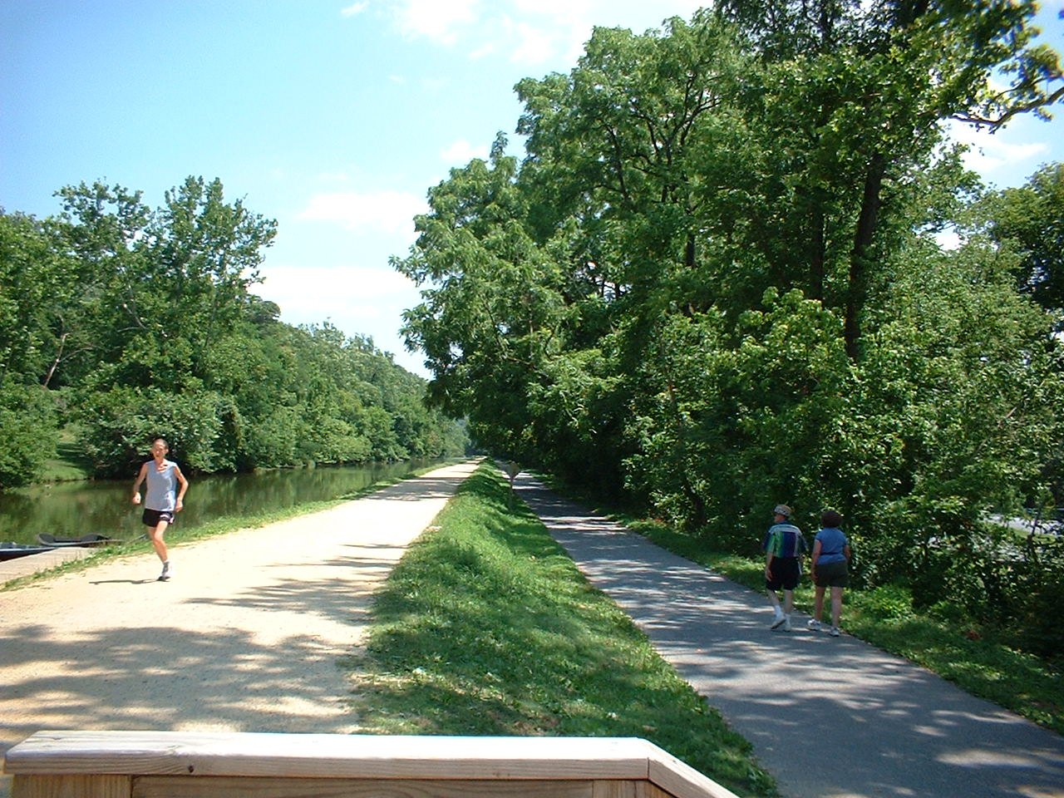
Hiking
Have enjoyed hiking since I was a Boy Scout
Have taken a number of week pack hikes, but not since I hurt my back in grad school
Have hiked all of the Appalachian Trail in MD and WV

Slide 38
Photography
My earlier photography was in slide format, much of it for my slide-illustrated lectures.
More recently, I have been using a digital camera, with computer, PowerPoint, and projector.

Slide 39
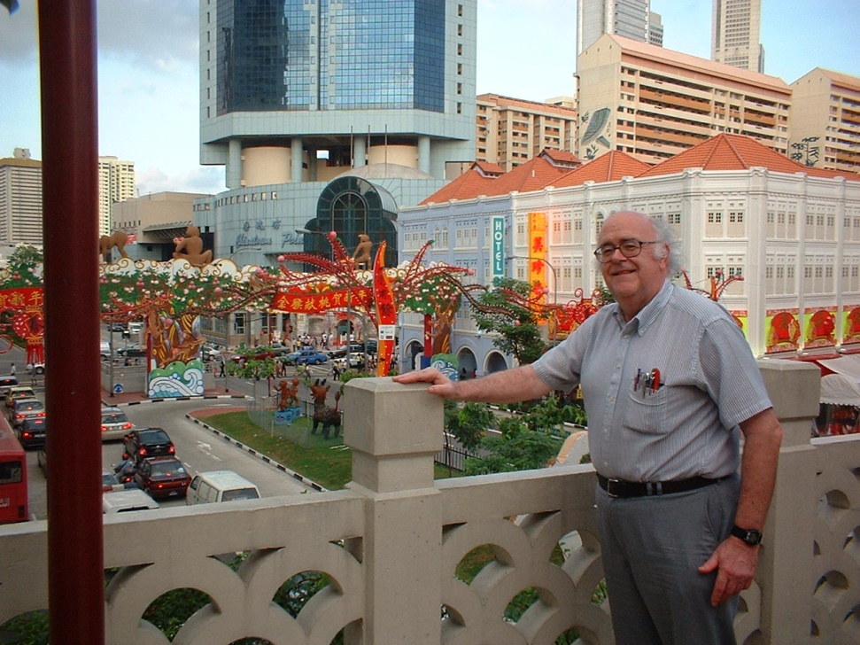
Travel
I like to travel, but I don’t like to do it just for recreation.
I have tried to make some sort of ministry a part of most of my travels.

Slide 40
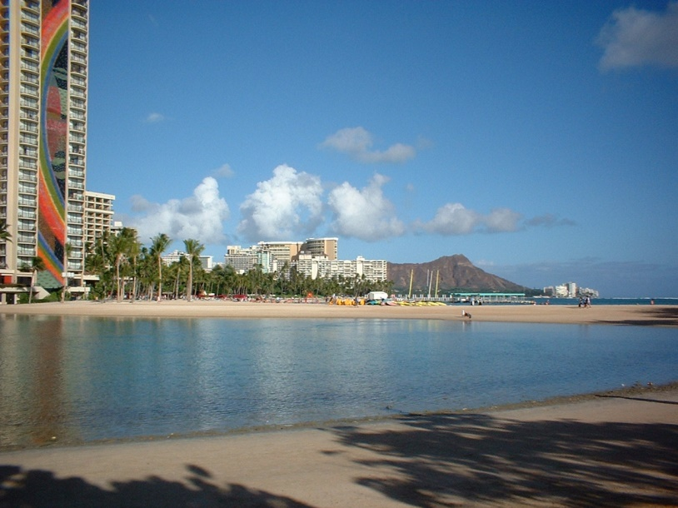
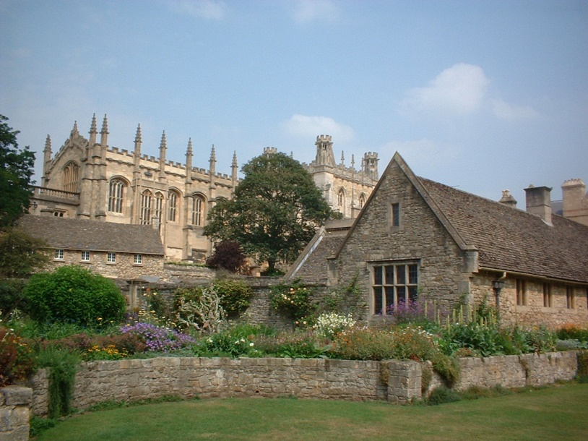
Travel
Some places I’ve visited:
Israel & Middle East
Caribbean
Ireland, UK, Germany
Russia
Singapore & Malaysia
Hawaii

Slide 41
The End
Going downhill …
… but not dead yet!

