Slide 1



The Passion of the Christ or
The Da Vinci Code?
Which is good history?
How do we know?
Robert C. Newman

Slide 2

The Passion &
Da Vinci Code
Both the film & the book have recently attracted enormous interest and controversy.
They differ greatly in their views on the reliability of the NT Gospels.
Which is more accurate?
How can we tell?
That's what we'll examine here.

Slide 3

The Da Vinci Code
By Dan Brown

Slide 4
The Da Vinci Code
A novel — fiction — of the mystery-thriller type, both exciting and well-written.
But the first page claims:
  "All descriptions of artwork, architecture, documents, and secret rituals are accurate."
Are they?
Let's see.

Slide 5
DV Code on the Bible
Leigh Teabing: "The Bible is a product of man … not God. The Bible did not fall magically from the clouds. Man created it as a historical record of tumultuous times, and it has evolved through countless translations, additions, and revisions. History has never had a definitive version of the book." (231)

Slide 6
DV Code on the Gospels
Teabing: "More than eighty gospels were considered for the New Testament and yet only a relative few were chosen for inclusion — Matthew, Mark, Luke and John among them."
Sophie: "Who chose which gospels to include?"
Teabing: " Aha! … The fundamental irony of Christianity! The Bible, as we know it today, was collected by the pagan Roman emperor Constantine the Great. " (231)

Slide 7
DV Code on Jesus
Teabing: "… until that moment in history [AD 325, the Council of Nicaea], Jesus was viewed by his followers as a mortal prophet … a great and powerful man, but a man nevertheless."
Sophie: "Not the Son of God?"
Teabing: "Right … Jesus' establishment as 'the Son of God' was officially proposed and voted on by the Council of Nicaea … a relatively close vote at that…" (233)

Slide 8
On Constantine & the NT canon
Teabing: "Because Constantine upgraded Jesus' status almost four centuries after Jesus' death, thousands of documents already existed chronicling His life as a mortal man. To rewrite the history books, Constantine knew he would need a bold stroke … [He] commissioned and financed a new Bible, which omitted those gospels which spoke of Christ’s human traits and embellished those gospels which made Him godlike. The earlier gospels were outlawed, gathered up, and burned." (234)

Slide 9
Early Evidence on the Gospels
Are these claims true?
Let's consider:
Early manuscripts of the Gospels
Early references and quotations in the writings of Christian leaders ("Church Fathers")
Early evidence re/ non-canonical gospels

Slide 10
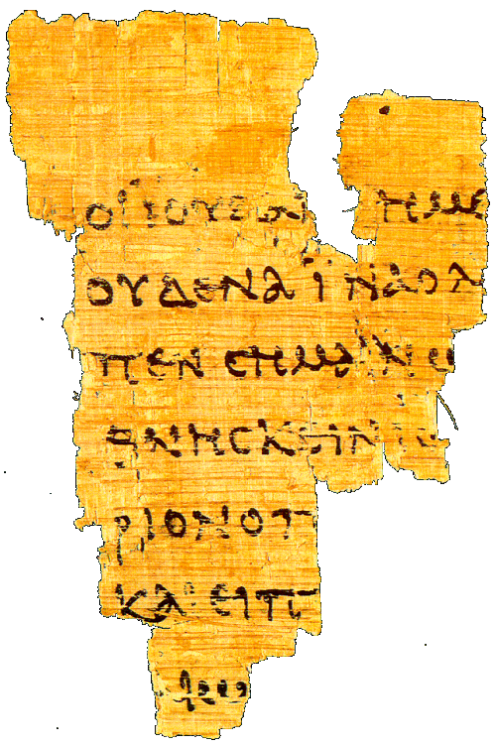
Early Manuscripts
This is papyrus p⁵², the oldest known fragment of any gospel.
The front is John 18:31-33 (shown), the back is John 18:37-38.
It is dated about AD 125, only 35 years after this Gospel was written.

Slide 11
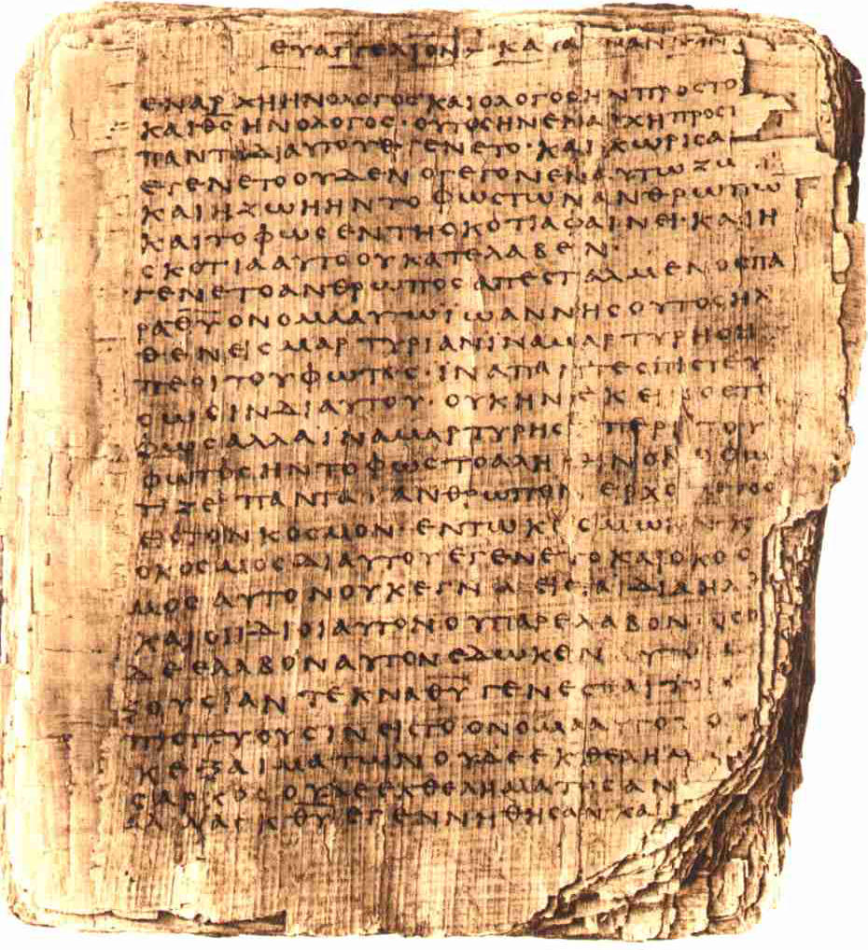
Early Manuscripts
This is papyrus p⁶⁶, a manuscript of John in which nearly all of the Gospel has survived.
It is dated about AD 200.
This picture shows the first page, with the other pages behind it.

Slide 12
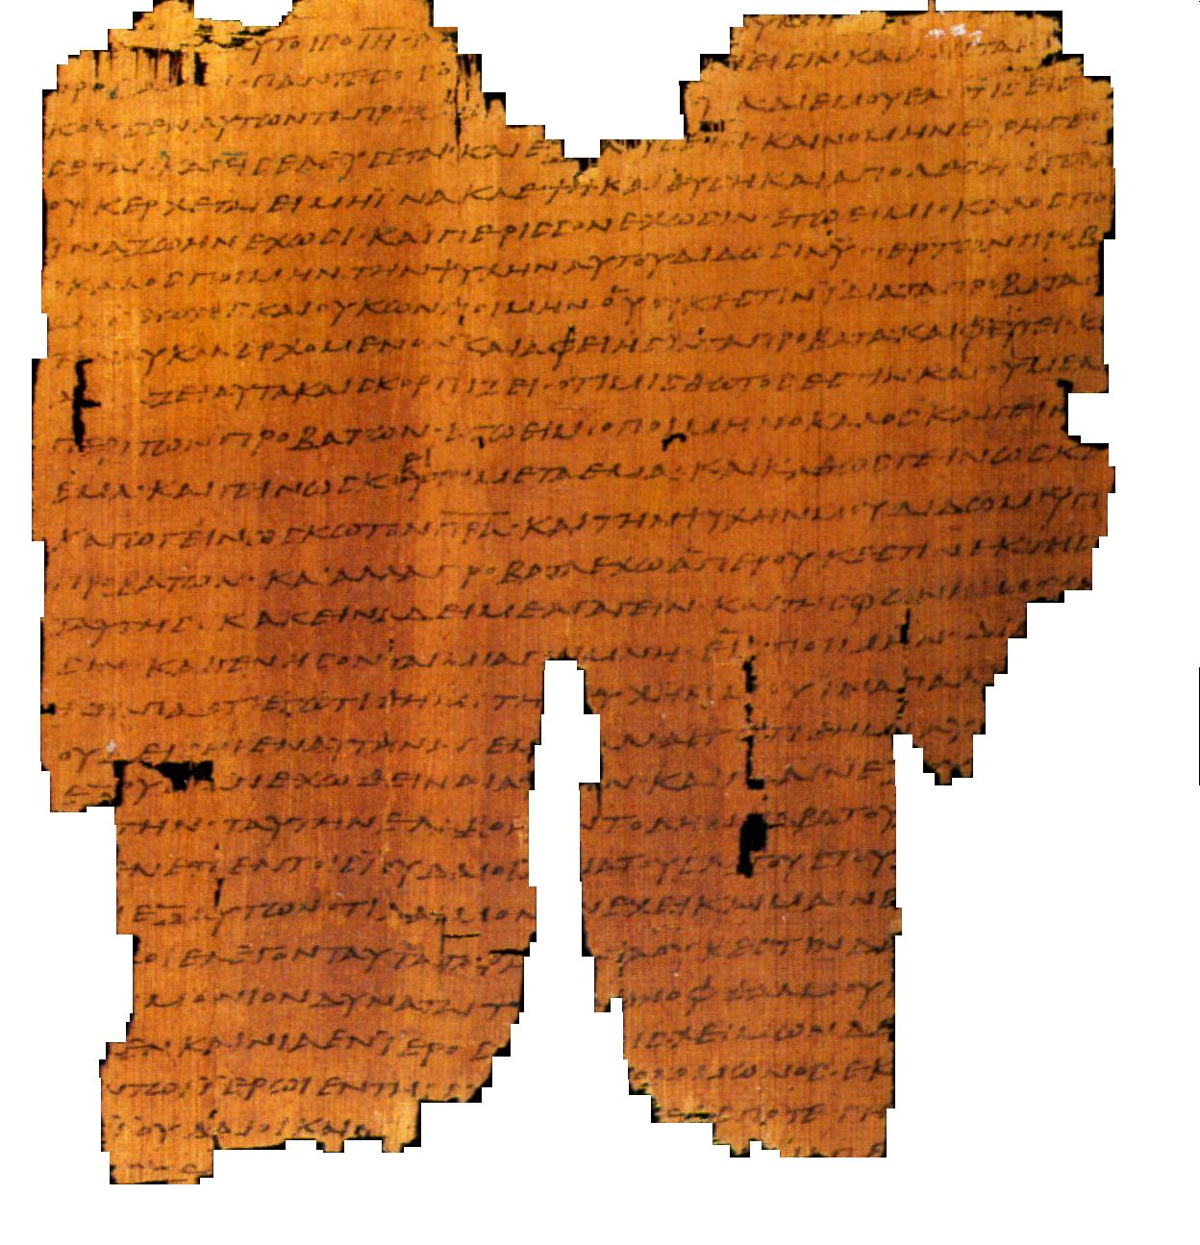
Early Manuscripts
This is one page of papyrus p⁴⁵, which contains all four canonical Gospels and the book of Acts.
It is dated from the 3rd century, so before AD 300 and before Constantine.

Slide 13
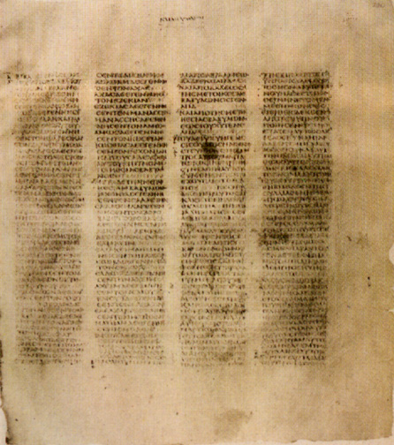
Post-Constantine Manuscripts
From the time of Constantine and onwards, we have the entire New Testament preserved on parchment, much more durable than papyrus.
This is Codex Sinaiticus, from the 4th century.
This was originally a complete Bible, though parts of the OT are now lacking.

Slide 14
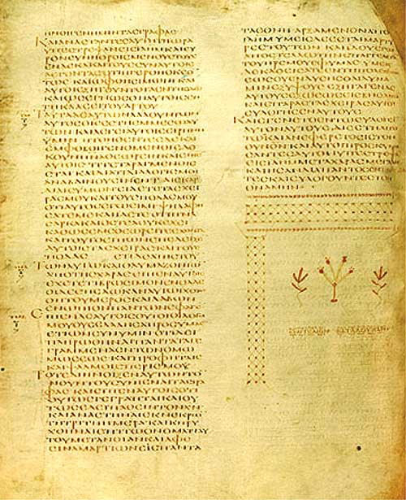
Post-Constantine Manuscripts
This is Codex Alexandrinus, from the 5th century.
It was originally a complete Bible, but now lacks most of Matthew & part of John.

Slide 15
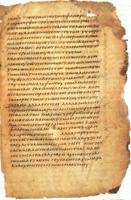
Post-Constantine Manuscripts
This is the Freer (or Washington) Codex, from the late 4th or 5th century.
It is a one-volume copy of the four Gospels.
Though its text is a mixture of the main text-types from antiquity, it shows no variations of the sort alleged in The Da Vinci Code.

Slide 16
Summary on Papyri
The graph at right lists the number of surviving manuscripts written on papyrus for the four Gospels.
Light blue indicates the number from before AD 300, thus before Constantine. There are 22 of these.

Slide 17
Summary on Papyri
The papyri, because of their age and the fragility of papyrus as a writing material, have only survived in fragmentary condition.
Still, before AD 300, we have 22 papyri, which together preserve the following chapters of each Gospel (partial, entire):
  Matthew: 1-3, 5, 11-12, 20-21, 23-26
  Mark: 4-12
  Luke: 1-10, 11-16, 17-18, 22, 23-24
  John: 1-5, 6, 7-13, 14-21

Slide 18
Summary on Papyri
Comparing their texts with post-Constantine texts, there is no evidence of tampering, i.e., they show us the same picture of Jesus.
Thus, the claim Constantine upgraded Jesus in the Gospel accounts is mistaken.
At most, he could only have selected the Gospels that already fit the program he was trying to advance.
Is there any evidence he did this?
Let's see.

Slide 19
Evidence from
Early Christian Leaders
Besides the evidence from manuscripts, we have the testimony of early Christian leaders regarding what gospels were in use in their churches.
This was, in fact, one of the criteria used to verify the authentic Gospels after persecution ended (at Constantine's time).

Slide 20
Apostolic Fathers
Several Christian leaders between AD 95-130 wrote letters and other writings that have survived.
Three of these explicitly quote NT passages as 'Scripture,' and one such passage quoted is from the Gospel of Matthew.
All of them make allusions to NT passages, including all four of the canonical Gospels and no others.

Slide 21
Marcion, ~140
The heretic Marcion gives us the earliest list of books he thinks belong in the New Testament.
He includes only one Gospel, Luke, and ten letters of Paul, all modified to remove any indication that the God Jesus and Paul spoke of was the God of the Old Testament.
Marcion is usually considered a Gnostic, since Gnostics typically rejected the Old Testament.

Slide 22
Allusions by Other Gnostics
Basilides (120-140) quotes from 1 Corinthians as Scripture. He alludes to Matthew, Luke and John as authoritative.
Valentinus (~140) authored The Gospel of Truth, now available in the Nag Hammadi papyri. He cites Ephesians as Scripture and alludes to Matthew, Luke and John.

Slide 23
Justin Martyr (130-160)
A student of the Greek philosophers, Justin was converted as an adult by talking to an elderly Christian. He spent the rest of his life as a Christian philosopher and was finally martyred.
In his two Apologies to the Roman emperor and in his Dialogue with the Jewish scholar Trypho, Justin speaks of the "Gospels" and calls them "memoirs of the apostles and those who followed them."
He uses our four Gospels and no others.

Slide 24
Irenaeus (~180)
Irenaeus was bishop of Lyons in southern France, but he grew up in Asia Minor, an early stronghold of Christianity.
He had studied under two students of the apostle John — Papias and Polycarp.
He wrote an extensive book Against Heresies, responding to the Gnostics, quoting from all the NT but a few of the shorter letters.

Slide 25
Irenaeus (~180)
Irenaeus takes our four Gospels for granted, and even seeks to give symbolic reasons for why there are exactly four of them.
He also says, "So firm is the ground upon which these Gospels rest, that the very heretics themselves bear witness to them, and starting from these documents, each one of them endeavors to establish his own peculiar doctrine."

Slide 26
The Muratorian Canon (~180)
This is the oldest canonical list preserved from the orthodox side.
It is anonymous, but was written from Italy in the late 2nd century by a Christian leader there.
Our only manuscript is broken at the beginning, but it starts with Luke as the 3rd Gospel, followed by John as the 4th.
It rejects the writings of the Gnostics and the Montanists.

Slide 27
Clement of Alexandria (~200)
Clement was head of the Christian school in Alexandria, which trained new converts and Christian leaders.
He uses some of the non-canonical Gospels…
But he distinguishes them from those "that have been handed down."

Slide 28
Origen (~230)
Successor to Clement as head of the Christian school in Alexandria, Origen later moves to Caesarea, where he develops the largest Christian library in antiquity.
Origen gives some insight into the status of the canon question in his time. He notes that two categories were commonly recognized by the orthodox:
  Books acknowledged by all Christians (21)
    4 Gospels, Acts, 13 Paul, 1 Peter, 1 John, Revelation
  Books disputed by some Christians (10)
    Hebrews, James, 2 Peter, 2-3 John, Jude,
    Ps-Barnabas, Hermas, Didache, Gospel of Hebrews

Slide 29
Eusebius (~325)
Writing at Constantine's time.
Four categories for canon discussion then:
  Acknowledged (21-22)
    Gospels, Acts, Paul & Hebrews, 1 Peter, 1 John, Revelation (?)
  Disputed but familiar to most (5)
    James, 2 Peter, 2-3 John, Jude
  Spurious but orthodox
    Acts of Paul, Hermas, Apoc of Peter, Ps-Barnabas
    Didache, Revelation (?), Gospel of Hebrews
  Heretical
    Gospels of Peter, Thomas, Matthaias, etc.
    Acts of Andrew, John, etc.

Slide 30
Summary on Canon
Thus the evidence is clear that Constantine did not suddenly set off in a new direction, putting together a "new Bible."
Rather, the four Gospels had been recognized by orthodox Christians as authoritative for at least 150 years.
Final decisions on the exact boundaries of the NT canon are made in the generation following Constantine, but this involves only one book that could be called a gospel, namely the Gospel of the Hebrews.

Slide 31
What about other Gospels?
Weren't there other gospels in competition with those four that were finally accepted?
  Yes, there were.
What do we know about these?
  Let's see.

Slide 32
The Testimony of Luke
The author of the third Gospel, Luke, a physician and associate of Paul, tells us a little on the status of writings about Jesus at the time he wrote (probably in the late 50s of the first century).
This is found in the first four verses of the Gospel of Luke.

Slide 33
The Testimony of Luke
"Many have undertaken to draw up an account of the things that have been fulfilled among us, just as they were handed down to us by those who from the first were eyewitnesses and servants of the word. Therefore, since I myself have carefully investigated everything from the beginning, it seemed good also to me to write an orderly account for you, most excellent Theophilus, so that you may know the certainty of the things you have been taught." – Luke 1:1-4

Slide 34
The Testimony of Luke
Of our canonical gospels, no more than two had been written when Luke wrote (Matthew and Mark), possibly only Matthew.
So there were apparently a number of other attempts in existence when Luke wrote.
He does not suggest these present a different Jesus, but rather that they, too, depend on the testimony of the eyewitnesses.
There is no evidence that any of these attempts survived to be the gospels mentioned in later centuries. They were probably displaced very early on by Matthew, Mark, Luke and John.

Slide 35
Other Early Gospels
From writings of the church fathers (that have been known for centuries), and from recently discovered manuscripts and fragments, we know something about 20-30 other gospels, orthodox or heretical, that circulated in the early centuries of church history, before Constantine.
Let's have a look at some of these.

Slide 36
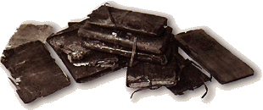
The Gospel of Thomas
Found in 1945 among the Nag Hammadi papyri, this Gospel has attracted the most attention.
The complete text is available only in Coptic, in a manuscript dating after Constantine.
We also have 3 Greek fragments, the earliest dating ~ AD 200.

Slide 37
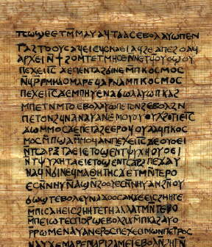
The Gospel of Thomas
The date is disputed:
  The common suggestion is AD 140.
  Some suggest as early as AD 50.
  There is now good evidence the Gospel depends on Tatian's Diatessaron, so dating after AD 175.
In any case, the picture of Jesus in Thomas does not match that in The DaVinci Code.

Slide 38
The Gospel of Thomas
"Simon Peter said to them: 'Let Mary go out from among us, because women are not worthy of the Life.'
Jesus said, 'See, I shall lead her, so that I will make her male, that she too may become a living spirit, resembling you males. For every woman who makes herself male will enter the Kingdom of Heaven.'" – saying 114

Slide 39
The Gospel of the Hebrews
This is the only non-canonical Gospel mentioned at all favorably in canon discussions (Origen and Eusebius).
It probably originated in Egypt, sometime between 100 and 150.
It seems to be Jewish-Christian, with a mixture from Gnosticism and other religions.

Slide 40
The Gospel of the Hebrews
This Gospel is known only from seven scattered quotations by the church fathers Clement of Alexandria, Origen, Cyril of Jerusalem, and Jerome.
Two of these quotations are especially strange!

Slide 41
The Gospel of the Hebrews
"When the Christ wished to come upon the earth to men, the good Father summoned a mighty power in heaven, which was called Michael, and entrusted Christ to the care thereof. And the power came into the world and it was called Mary, and Christ was in her womb seven months."
"Here the Savior says, 'Even so did my mother, the Holy Spirit, take me by one of my hairs and carry me away on to the great mountain Tabor.'"

Slide 42
The Gospel of the Hebrews
The Gospel clearly introduces ideas that are foreign to the Old Testament, but of the sort characteristic of Gnosticism.
In any case, it pictures Jesus having pre-existence as the Christ, which disagrees with the assessment in The Da Vinci Code that Jesus is merely human.

Slide 43
The Gospel of Philip
A Gnostic gospel, probably written in Syriac, 250-300, known to us in Coptic.
It rejects creation by God for creation by a lesser power.
It rejects Jesus being born of virgin for a strange reason, and similarly argues that Jesus had an earthly father.

Slide 44
The Gospel of Philip
"The world came about through a mistake. For he who created it wanted to create it imperishable and immortal. He fell short of attaining his desire. For the world never was imperishable, nor, for that matter, was he who made the world." – 75.2-9

Slide 45
The Gospel of Philip
"Some said, 'Mary conceived by the Holy Spirit.' They are in error. They do not know what they are saying. When did a woman ever conceive by a woman? Mary is the virgin whom no power defiled. She is a great anathema to the Hebrews, who are the apostles and the apostolic men.… And the Lord would not have said 'My Father who is in heaven' unless he had had another father, but he would have said simply 'my father.'" – 55.23-36

Slide 46
The Gospel of Philip
This Gospel demonstrates flimsy interpretation of the Bible:
  The Holy Spirit is feminine (because the Hebrew and Syriac words for 'spirit' are feminine).
  The apostles & their followers are mistaken.
  Jesus had an earthly father because he refers to God as his Father in heaven.
All these arguments depend upon using our Bible, and twisting it to make points the Bible does not.

Slide 47
The Gospel of Philip
The Gospel of Philip is one of the sources that Dan Brown, author of The Da Vinci Code, uses to support his reconstruction of Jesus and his emphasis on Mary Magdalene.
Some of it supports his view, some of it doesn't.
Another of his sources is the Gospel of Mary (Magdalene).

Slide 48
The Gospel of Mary
Slightly under ½ of this gospel survives in the Coptic language in the Berlin Codex from the 5th century, 8 of 18 pages.
The last two pages are also preserved in Greek from the early 3rd century.
The gospel thus dates from sometime before AD 200.

Slide 49
The Gospel of Mary
The first six pages are missing. On page seven we come in just at the end of a conversation of the risen Christ with his disciples. Then he blesses and leaves them.
The disciples are sad and fearful, given their commission and what happened to Jesus.
Mary Magdalene encourages them.

Slide 50
The Gospel of Mary
Peter asks Mary to tell them the revelations she received from Jesus, who loved her above all other women.
We begin to get a presentation of this when the text breaks off again (pp 11-14 are missing).
When the text resumes, she is describing how the soul passes through the planetary spheres, and how the soul is to speak with the hostile powers guarding each sphere — a standard Gnostic motif.

Slide 51
The Gospel of Mary
When she finishes, Andrew & Peter do not believe her.
Mary weeps, saying she is no liar.
Levi rebukes Peter, and the disciples go out to preach to the world.

Slide 52
Summary on Other Gospels
It is no evidence these other gospels go back to eyewitnesses of Jesus' ministry just because they claim to. Such claims (and claims to special revelation) are typical of false teachers.
They also typically make claims to secret knowledge, while the canonical texts claim that Jesus' works and words were essentially public.
The evidence that we do have suggests most of these came on the scene with Gnosticism, a mixture of paganism and Greek philosophy with Christianity.

Slide 53
Summary on Other Gospels
In any case, The Da Vinci Code makes selected and distorted use of the few gospels it does use.
It tries to make Mary Magdalene Jesus' wife, when its sources surely point to her being his mistress.
It tries to make a marriage between the royal house of David, and the royal house of Saul, when its sources are intensely anti-semitic and anti-Old Testament, and have no interest in anything of this sort.

Slide 54
Summary on Other Gospels
In fact, The Da Vinci Code uses just such details from the Gospels of Philip and Mary as the writer thinks his target audience might accept, and ignores those features which might incline them to think these texts are unbelievable.
It looks with suspicion on the orthodox Gospels, and with gullibility on the un-orthodox ones.
I would not trust The Da Vinci Code for reliable information about early Christianity.

Slide 55
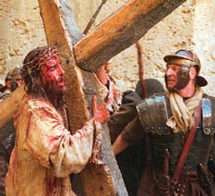
The Passion of the Christ
By Mel Gibson

Slide 56
The Passion of the Christ
The Passion of the Christ is a dramatic film presentation of the last hours leading up to Jesus' death, plus a glimpse of his resurrection.
As a drama, it goes beyond biblical statements here and there, and must make decisions on how to picture many things that the Gospels don't specify.

Slide 57
The Passion of the Christ
The film adheres quite strongly to the accuracy of the NT Gospels.
It clearly portrays the NT worldview, in which the world we can see is not all there is, but there is also an unseen supernatural world which contains both good and evil beyond the human scale.

Slide 58
Some Inaccuracies
There are some minor inaccuracies:
  Two languages are chosen for the film:
    Aramaic
    Latin
  But two other languages were probably just as common in Palestine at that time:
    Hebrew
    Greek

Slide 59
Some Supplements
The film fills in some scenes by picturing what Jesus or his mother might have been thinking.
These are based on other passages in the Gospels or the New Testament.
Some features are traditional ways in which the crucifixion has been pictured over the centuries.

Slide 60
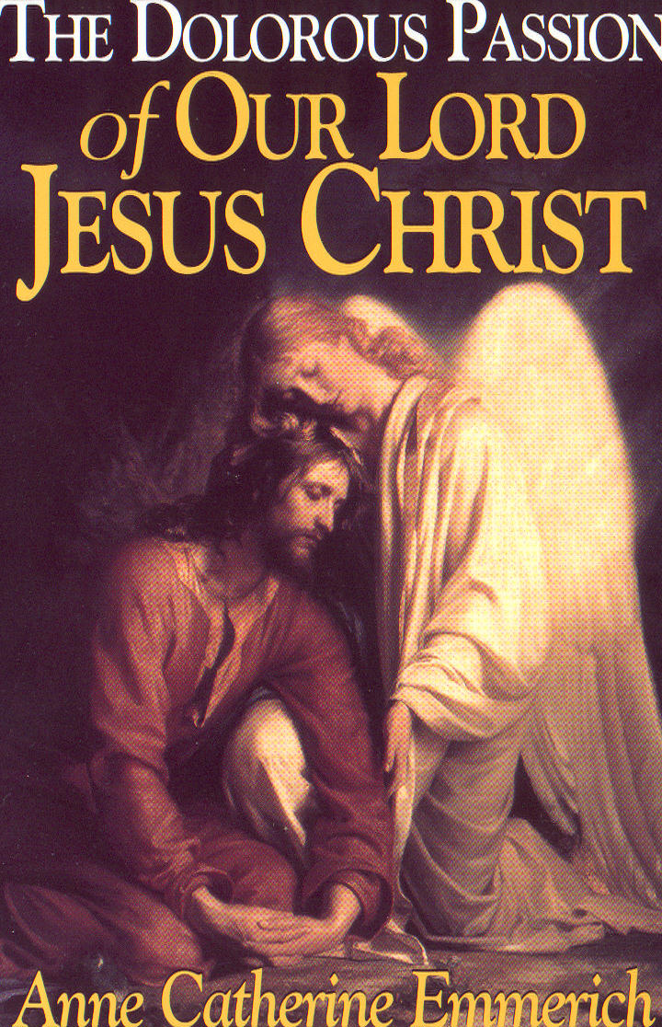
Some Supplements
Some features come from a vision that a German nun, Anne Catherine Emmerich, had about 1820.
These materials may be found in the book The Dolorous Passion of Our Lord Jesus Christ.

Slide 61
Some Objections
Some object that the film is anti-Semitic.
Others say that it is too violent.
Still others that it is historically inaccurate.
What can we say in response to such allegations?

Slide 62
Anti-Semitic?
It is no more anti-Semitic than the NT Gospels…
… which is to say that some Jews and the Jewish leadership rejected Jesus' claim to be the Messiah, the Son of God.
Other Jews believed and followed Jesus, or were uncertain how to respond.

Slide 63
Anti-Semitic?
The Romans are not depicted as better:
  Some of the soldiers are brutal & anti-Semitic.
  The governor Pilate is also anti-Semitic, and unwilling to risk his career.
  His wife, however, is portrayed favorably.
The film is not comfortable viewing for non-Christian Jews.
The film is not comfortable viewing for Christians, either!

Slide 64
Anti-Semitic?
The film makes clear that the crucifixion is:
  God's "fault"
  Satan's fault
  The fault of the Jewish leadership
  Pilate's fault
  Our fault as humans
Mel Gibson put himself into the film as the one who drives the nails into Jesus' hands.

Slide 65
Too Violent?
The film is by far the most violent depiction of the death of Christ filmed to date.
It probably diverges from historical accuracy in seeing Jesus as far more brutally treated than the two crucified beside him.
It accurately pictures the brutality of crucifixion.

Slide 66
Historically Inaccurate?
This has been the standard liberal response to the Gospels for about two centuries.
  A common objection from the Jesus Seminar.
We cannot go back to the past in time-machines to check this out.
But most liberals agree:
  Jesus was crucified about AD 30.
  His resurrection was believed immediately.
  Paul gives us an early understanding of what Jesus’ death meant.

Slide 67
Connections with OT
Astonishingly, these features all fit the predictions of the Old Testament!
  Isaiah 42 & 49 on the Messiah as a light to the nations
  Daniel 9 on the time of his execution
  Psalm 22 on the nature of his execution
  Isaiah 53 on the meaning of his execution
Let's see.

Slide 68
A Light to the Nations
I will appoint you as a covenant to the people [Israel], as a light to the nations, to open blind eyes, to bring out prisoners from the dungeon, and those who dwell in darkness from the prison.
Isaiah 42:6-7

Slide 69
A Light to the Nations
And now, says the LORD, who formed me from the womb to be His Servant, to bring Jacob back to Him, in order that Israel might be gathered to Him…. He says "It is too small a thing that you should be My Servant to raise up the tribes of Jacob, and to restore the preserved ones of Israel; I will also make you a light of the nations, so that My salvation may reach to the end of the earth."
Isaiah 49:5-6

Slide 70
A Light to the Nations
This fits Jesus!
Of the many claiming to be the Messiah, only he has started a world religion of Gentiles.
Before Jesus came, few non-Jews were believers in a single God, much less the God of the Bible.
Now nearly ½ the Gentiles in the world believe in the God of Abraham.

Slide 71
Daniel 9 on the
Time of His Execution
Know and understand this: From the issuing of the decree to restore and rebuild Jerusalem until the Anointed One [Messiah] comes, there will be seven 'sevens' and 62 'sevens.' It will be rebuilt with streets and a trench, but in times of trouble. After the 62 'sevens,' the Anointed One will be cut off and will have nothing.
Daniel 9:25-26

Slide 72
Messiah was to come after the 69th sabbath cycle.
The unit of time-measurement appears to be cycles of sabbatical years.
The starting point seems to be the command of King Artaxerxes 1 in his 20th year (445 BC).
The sabbatical cycle in which this starting point falls is 449-442 BC.
Using the usual inclusive method of counting, the 69th cycle is 28-35 AD.

Slide 73
Messiah was to come after the 69th sabbath cycle.
449 442 435 428 421 414 407 BC
⬇
1 2 3 4 5 6
… AD 7 14 21 28 35

65 66 67 68 69
⬇ Artaxerxes' decree, 445 BC
 Jesus' crucifixion, 30 AD

Slide 74
Text of Psalm 22
My God, my God, why have you forsaken me?… All who see me mock me, they hurl insults, shaking their heads…. You lay me in the dust of death…. Dogs have surrounded me, a band of evil men has encircled me, they have pierced my hands and my feet…. They divide my garments among them and cast lots for my clothing…. I will declare your name to my brothers; in the congregation I will praise you…. The poor will eat and be satisfied…. All the ends of the earth will remember and turn to the LORD…. Posterity will serve him; future generations will be told about the Lord. They will proclaim his righteousness to a people yet unborn – for he has done it.

Slide 75
Psalm 22 on the
Nature of His Execution
Why did Jesus cry out from the cross:
  "My God, my God, why have you abandoned me?"
He was quoting Psalm 22; it tells of one who is:
  Abandoned by God
  Surrounded by enemies
  Hands and feet pierced
  Clothes gambled away
  Thirsty
  Bones out of joint
  Laid in the dust of death
This fits crucifixion, especially that of Jesus!

Slide 76
Isaiah 53 on the
Meaning of His Execution
In Isaiah 53, we have a most famous prophecy of someone's death and resurrection.
God's servant:
  Rejected by humans
  Despised by Israel
  Dies for their sins
  Is raised to life again
  Is exalted by God
This fits what the NT says about Jesus, and in fact covers the major points of NT theology!

Slide 77
Conclusions
We have restricted our discussion of The Da Vinci Code to its allegations about Jesus and early Christianity.
It fares very poorly there.
Whatever the merits of its treatment of Leonardo da Vinci or the Priory of Sion, it is not good history for the first centuries of the Christian era.

Slide 78
Conclusions
We have restricted our discussion of The Passion of the Christ to its faithfulness to the Gospel accounts.
It fares very well there.
Whatever the merits of its extra-biblical features, its treatment of Jesus' death is consistent with the Gospels, and it is seen to be a fulfillment of Old Testament prophecy.

Slide 79
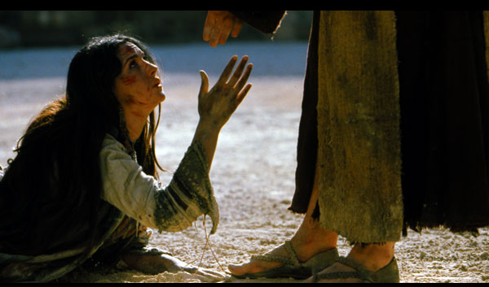
The End
May you, too, reach out to Jesus!

