Slide 1

The Miraculous:
4. Answering Objections
Robert C. Newman

Slide 2
Introduction
We will here respond to a number of the major arguments proposed against the occurrence of miracles.
For further discussion, see:
  Geisler, Miracles and the Modern Mind (1992)
  Brown, Miracles and the Critical Mind (1984)
  Geivett & Habermas, In Defense of Miracles (1997)

Slide 3
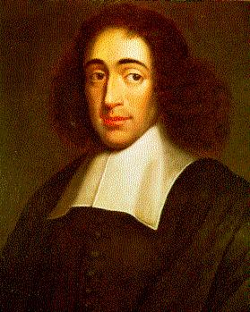
The Deductive Impossibility of Miracles (Spinoza)
Geisler's version of Spinoza:
1) Miracles are violations of natural law.
2) Natural laws are immutable.
3) It is impossible to violate immutable laws.
4) Therefore, miracles are impossible

Slide 4
Response to Spinoza
1) Miracles are violations of natural law.
  Probably some miracles are violations of natural law, though many of them may override natural law in some way or other, rather as we override gravity by picking up a pencil. So 1) is probably true in some cases, false in others.

Slide 5
Response to Spinoza
2) Natural laws are immutable.
  This depends on what we mean by natural law. If we define natural law to be immutable, it may be that there is no such thing as natural law. In any case, we do not know enough to be sure that the regularities we know about in nature are immutable. And immutable to whom? Obviously humans cannot change the constant of gravitation or suspend Newton's laws of motion, but it is not obvious that God cannot.

Slide 6
Response to Spinoza
3) It is impossible to violate immutable laws.
  Statement 3) is true so long as we qualify it by saying "It is impossible for someone to violate laws which are immutable to them."

Slide 7
Response to Spinoza
4) Therefore, miracles are impossible
  If 1) is not true in some cases, and 2) may be either an empty class or not immutable to God, it follows that Spinoza's argument is not sound.

Slide 8
Another Deductive Formulation
1) A miracle is a violation of natural law.
2) To violate a law is to be illegal, immoral, irrational or gauche.
3) God is not illegal, immoral, irrational or gauche.
4) Therefore, God (at least) cannot do miracles, though perhaps Satan could!

Slide 9
Response
1) A miracle is a violation of natural law.
  Same problems as Spinoza's 1).
2) To violate a law is to be illegal, immoral, irrational or gauche.
  Statement 2) assumes natural law can be fitted into one of the categories of civil law, moral law, logical law, or aesthetic law. But this does not follow. To violate a natural law is merely to be miraculous, which is how the God of the Bible is regularly pictured.

Slide 10
Response
3) God is not illegal, immoral, irrational or gauche.
  Granted.
4) Therefore, God (at least) cannot do miracles, though perhaps Satan could!
  The problems with 1) and especially 2) invalidate the argument.

Slide 11
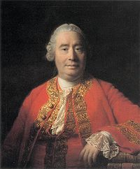
The Inductive Improbability of Miracles (Hume)
Newman's version of Hume:
1) Experience is our only guide to all decisions regarding matters of fact.
2) The laws of nature are established by a firm and unalterable experience.
3) Our belief in the reliability of witnesses is based on their reports usually agreeing with the facts.
4) Miracles are violations of natural law.
5) Thus miracles go against the very evidence by which we determine matters of fact.
6) One should not accept testimony regarding a miracle unless all the alternatives would be more miraculous than the miracle itself.

Slide 12
Response to Hume
1) Experience is our only guide to all decisions regarding matters of fact.
  This is a pure empiricist statement of how we know, and pure empiricism may not be satisfactory.
  Yet Hume is right to ask what warrant we can put forward for belief in miracles. It must be granted that even revelation needs to be tested in some way to avoid accepting false revelations. Cp the biblical injunctions to test everything (Gal 6:3-5; 1 Thess 5:19-21; 1 John 4:1; Deut 13:1-3; 18:18-22).

Slide 13
Bible re/ Testing
Gal 6:3 (NIV) If anyone thinks he is something when he is nothing, he deceives himself. 4 Each one should test his own actions. Then he can take pride in himself, without comparing himself to somebody else, 5 for each one should carry his own load.
1 Thess 5:19 (NIV) Do not put out the Spirit's fire; 20 do not treat prophecies with contempt. 21 Test everything. Hold on to the good.
1 John 4:1 (NIV) Dear friends, do not believe every spirit, but test the spirits to see whether they are from God, because many false prophets have gone out into the world.

Slide 14
Bible re/ Testing
Deut 13:1 (NIV) If a prophet, or one who foretells by dreams, appears among you and announces to you a miraculous sign or wonder, 2 and if the sign or wonder of which he has spoken takes place, and he says, "Let us follow other gods" (gods you have not known) "and let us worship them," 3 you must not listen to the words of that prophet or dreamer. The LORD your God is testing you to find out whether you love him with all your heart and with all your soul.

Slide 15
Bible re/ Testing
Deut 18:18 (NIV) I will raise up for them a prophet like you from among their brothers; I will put my words in his mouth, and he will tell them everything I command him. 19 If anyone does not listen to my words that the prophet speaks in my name, I myself will call him to account. 20 But a prophet who presumes to speak in my name anything I have not commanded him to say, or a prophet who speaks in the name of other gods, must be put to death. 21 You may say to yourselves, "How can we know when a message has not been spoken by the LORD?" 22 If what a prophet proclaims in the name of the LORD does not take place or come true, that is a message the LORD has not spoken. That prophet has spoken presumptuously. Do not be afraid of him.

Slide 16
Response to Hume
2) The laws of nature are established by a firm and unalterable experience.
  The laws of nature (defined empirically) are established by experience (observation and experiment), and must be pretty firm to be denoted "laws." Yet it is unclear in what sense the experience is "unalterable." Does Hume mean "no exceptions have ever been observed"? If so, he begs the question of the occurrence of the miraculous by secretly importing his answer into statement 2)!

Slide 17
Response to Hume
3) Our belief in the reliability of witnesses is based on their reports usually agreeing with the facts.
  Our belief in the reliability of a particular witness is somewhat more complicated than this. If he only usually tells the truth or makes sound judgments, we probably won't put much stock in his reports. Some combination of number of witnesses, their known character, and what they might have to gain from lying will usually figure here.

Slide 18
Response to Hume
4) Miracles are violations of natural law.
  Strangely enough, 4) is true in an empirical sense, but it is not when used by Spinoza in his 1). Miracles clearly go against what we normally experience.

Slide 19
Response to Hume
5) Thus miracles go against the very evidence by which we determine matters of fact.
  Hume is mistaken here, once we adjust 3) as above. But he is correct in that we tend to be more skeptical in proportion to the peculiarity of the event reported (Cp report of recently seeing a close friend, George Bush, Ben Franklin, or God).

Slide 20
Response to Hume
6) One should not accept testimony regarding a miracle unless all the alternatives would be more miraculous than the miracle itself.
  Hume here guarantees that we will never accept the report of a miracle, nor probably even if we saw one ourselves, since witnesses can lie and senses can deceive. Here is the rub: Hume would have us explain away miracles even if they occur! One can set the level of certainty so high that one will never admit a miracle. A dangerous tactic!

Slide 21
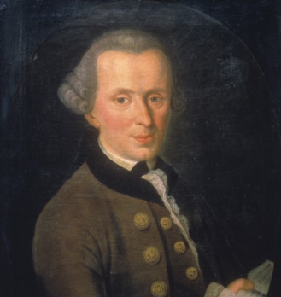
The Practical Irrelevance of Miracles (Kant)
Newman/Geisler/Brown version of Kant's Argument:
  1) We cannot know things as they really are, but only as they appear to us.
  2) Therefore, any claimed knowledge of God and transcendent reality is just unwarranted speculation.
  3) Nevertheless, in order to function practically in this world, we postulate God, freedom, and immortality as a basis for morality and duty.
  4) Miracles either happen daily, seldom or never.
    If daily, not miracle but natural law;
    If seldom, no basis for knowing them.
    So probably never.
  5) True religion, consisting of fulfilling all duties as though they were divine commands, needs no miracle to do what is right. Miracles, rather, tend to corrupt one's motives.
  6) Therefore, miracles are irrelevant to everyday life and true religion.

Slide 22
Response to Kant
1) We cannot know things as they really are, but only as they appear to us.
  We cannot know that "we cannot know things as they really are" unless we know how they really are! Statement 1) is self-defeating.

Slide 23
Response to Kant
2) Therefore, any claimed knowledge of God and transcendent reality is just unwarranted speculation.
  God, who knows things as they really are, can reveal to us what we need to know along these lines, having created our capacities and knowing our limitations. Of course, not every claim to revelation is valid.

Slide 24
Response to Kant
3) Nevertheless, in order to function practically in this world, we postulate God, freedom, and immortality as a basis for morality and duty.
  God, freedom and immortality are indeed a basis for morality and duty, but those with Kant's epistemology have no strength to stand against the forces of skepticism which deny these. See Lewis, Pilgrim's Regress.

Slide 25
Response to Kant
4) Miracles either happen daily, seldom or never.
  If daily, not miracle but natural law;
  If seldom, no basis for knowing them.
  So probably never.
Jesus probably worked miracles daily during his ministry on earth, and they have probably occurred very rarely at some other times in human history (1 Sam 3:1). We are not suggesting that we would fully understand a miracle or be absolutely certain whether an event was miraculous or not, but certain miracles exhaust the available probabilities. See Judg 6:36-40; 1 Sam 6:1-9.

Slide 26
Miracles Rare
1Sam 3:1 (NIV) The boy Samuel ministered before the LORD under Eli. In those days the word of the LORD was rare; there were not many visions.
Judg 6:12 (NIV) When the angel of the LORD appeared to Gideon, he said, "The LORD is with you, mighty warrior." 13 "But sir," Gideon replied, "if the LORD is with us, why has all this happened to us? Where are all his wonders that our fathers told us about when they said, 'Did not the LORD bring us up out of Egypt?' But now the LORD has abandoned us and put us into the hand of Midian."

Slide 27
Exhaust Probabilities
Judg 6:36 (NIV) Gideon said to God, "If you will save Israel by my hand as you have promisedn 37 look, I will place a wool fleece on the threshing floor. If there is dew only on the fleece and all the ground is dry, then I will know that you will save Israel by my hand, as you said." 38 And that is what happened. Gideon rose early the next day; he squeezed the fleece and wrung out the dewna bowlful of water. 39 Then Gideon said to God, "Do not be angry with me. Let me make just one more request. Allow me one more test with the fleece. This time make the fleece dry and the ground covered with dew." 40 That night God did so. Only the fleece was dry; all the ground was covered with dew.

Slide 28
Exhaust Probabilities
1Sam 6:1 (NIV) When the ark of the LORD had been in Philistine territory seven months, 2 the Philistines called for the priests and the diviners and said, "What shall we do with the ark of the LORD? Tell us how we should send it back to its place." … 6 "Why do you harden your hearts as the Egyptians and Pharaoh did? When he [God] treated them harshly, did they not send the Israelites out so they could go on their way? 7 Now then, get a new cart ready, with two cows that have calved and have never been yoked. Hitch the cows to the cart, but take their calves away and pen them up. 8 Take the ark of the LORD and put it on the cart, and in a chest beside it put the gold objects you are sending back to him as a guilt offering. Send it on its way, 9 but keep watching it. If it goes up to its own territory, toward Beth Shemesh, then the LORD has brought this great disaster on us. But if it does not, then we will know that it was not his hand that struck us and that it happened to us by chance."

Slide 29
Response to Kant
5) True religion, consisting of fulfilling all duties as though they were divine commands, needs no miracle to do what is right. Miracles, rather, tend to corrupt one's motives.
  True, but man is no longer capable of doing what is right, and needs a redemptive miracle of atonement and regeneration to solve this. The miracles of Scripture point to the Redeemer God who is able and willing to intervene for our salvation.

Slide 30
Response to Kant
6) Therefore, miracles are irrelevant to everyday life and true religion.
  Miracles are only irrelevant to non-redemptive religions like Deism and theological liberalism, neither of which will save at the last judgment.

Slide 31
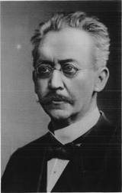
Ancient Ignorance and
Miracles (Harnack)
Newman's version of Harnack's Argument:
  1) People in antiquity thought that miracles occurred every day. So it is not surprising that miracles are reported in the ministry of Jesus, the apostles, and the prophets.
  2) People in antiquity did not understand nature and its laws. Therefore they regularly mistook natural events for miracles.

Slide 32
Response to Harnack
1) People in antiquity thought that miracles occurred every day. So it is not surprising that miracles are reported in the ministry of Jesus, the apostles, and the prophets.
  There are people both in antiquity and today who believe miracles occur every day; there are others both then and now who deny miracles altogether (Epicureans, Sadducees). Probably there are more skeptics today than back then, but probably both the skeptics and the everyday miracle people are wrong. In any case, it was widely realized that John the Baptist didn't do miracles (Jn 10:41), so they didn't have to be reported of famous prophets. And the Sadducees realized that it was impossible for them to deny that Jesus had done miracles (Jn 9:18; 11:47; 12:10; cp Acts 4:16).

Slide 33
Response to Harnack
2) People in antiquity did not understand nature and its laws. Therefore they regularly mistook natural events for miracles.
  This is absurd! None of the miracles of Jesus can easily be converted into misunderstood natural events, at least not taken as a group (3 cases of misdiagnosed death that just happen to revive when Jesus shows up? Jesus walking on shore/sandbar instead of water?) Give us a break!

Slide 34
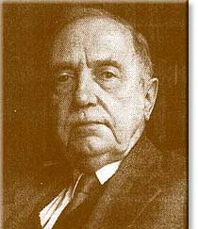
Miracles in a Closed
Universe (Bultmann)
Newman's version of Bultmann's Argument:
  1) Modern science and history operate on the assumption that our universe is a closed system of cause and effect, so that they can describe, explain and predict what is happening. Even Fundamen-talists practically operate this way when they use electricity, modern medicine, and modern technology.
  2) The old mythical view of nature was that God, angels, demons, etc., were the direct causes of lightning, sickness, earthquakes, storms. Today we know better.

Slide 35
Response to Bultmann
1) Modern science and history operate on the assumption that our universe is a closed system of cause and effect.
  Neither modern science nor history knows enough to know that the universe is a closed system. It appears to be a system in the sense that similar causes are operating at great distances as nearby, but we do not know how to explain its origin, nor the origin of life, nor the striking examples of apparent design in nature apart from a mind behind the universe. We certainly have no full explanations of what history is all about, nor a proof that it is meaningless. The discoveries of electricity, modern medicine and modern technology are not inconsistent with Xn theism, and many Xns were involved in their discovery.

Slide 36
Response to Bultmann
2) The old mythical view of nature was that God, angels, demons, etc., were the direct causes of lightning, sickness, earthquakes, storms. Today we know better.
  Xns (and others) have sometimes imagined they knew a great deal more about what God, Satan, angels, and demons were doing than they really did, but the Bible nowhere says that God runs nature without mediation, or that Satan and demons are the sole causes of disease, etc. We certainly do not know enough about either medicine or the weather today to say that there is never any supernatural intervention in either (much less providence).

Slide 37
Are Miracles Real?
There is good evidence for Divine intervention in creation.
  Discussed in some detail in our Apologetics course:
  Origin of universe
  Design in universe
  Correlation between Genesis 1 & origin of earth
  Origin of life
  Origin of major body plans in life
  Origin of mankind

Slide 38
Are Miracles Real?
There is good evidence for Divine intervention in history.
  Discussed in some detail also in our Biblical Foundations and Synoptic Gospels courses:
  Origin of Israel
  Fulfilled prophecy
  Origin of Christianity
  Phenomena of Jesus' ministry, including his claims, miracle accounts, esp. resurrection

Slide 39
Are Miracles Real?
There is good evidence for Divine intervention in the present.
  Christians disagree on the frequency of miracle in modern times.
  The phenomena of conversion, both on the individual and societal level, are striking.

Slide 40
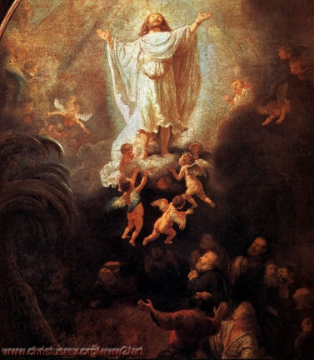
The End

